Slide 1
Summary of Breakout Session 1.2 GEO Societal Benefit Areas (Chair: Antonio Bombelli) Coordinator of the GEO Task CL-02 “Global Carbon Observations and Analysis” Rapporteur: Mark Bourassa

Slide 2
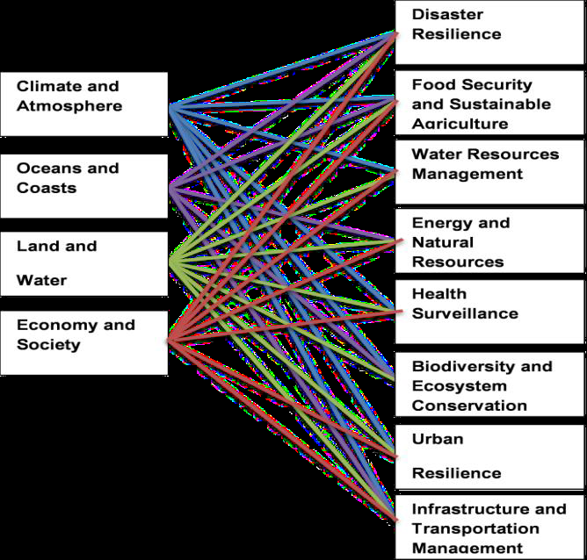
CLIMATE
New possible GEO SBAs (2016-2025)
and their links with the
Earth Observation Domains
Notes:
While linking Evs to GEO SBA we should start thinking about the new possible GEO SBA for 2016-2025

Slide 3
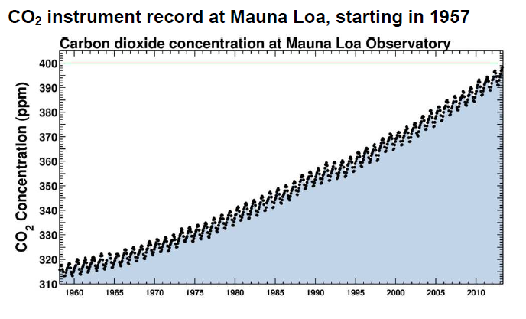
Is Status and Trend Sufficient?
CO₂ concentration increase at Mauna Loa Observatory
since 1958
No – we also need to know impacts are variability

Slide 4
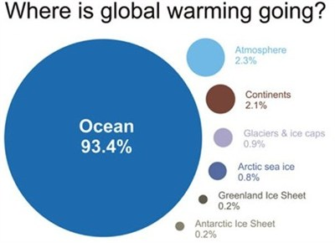
The role of the oceans in the climate system

Slide 5
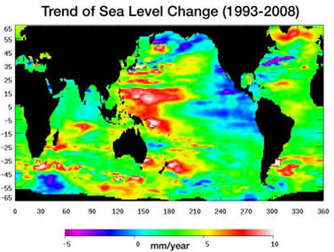
Regional Changes
Regional and seasonal to interannual changes can be very large compared to a 30 year global averaged change
Societal impacts of these scales are very important, particularly when the change is predictable (even as probabilities of conditions)

Slide 6
New GEO SBAs | Relevant indicator We could divide indicators into policy relevant / and science relevant
Disaster Resilience | Depends on the disaster-type and on the preparedness of affected area Size of the event / losses Epidemic after the event Population dynamics Atmospheric, ocean and ground fluxes Availability of insurance
Food Security and Sustainable Agriculture | Water resources/availability (Drought) (and Models showing their fluctuations) Soil characteristics Crop yield and type / nutrition properties Land cover and land use Winds, Temperature, … Population dynamics Pests … Ocean productivity / fishery
Water Resources Management | Water resources/availability Rainfall Ref. indicators by UN-Water
Energy and Natural Resources Management | Water resources, T-stresses, heating Biomass consumption, Transportation, manufacture, carbon management
Health Surveillance | Disease spread and frequency
Biodiversity and Ecosystem Conservation | Land cover change (-> habitat losses and fragmentation) Species richness, shift and distribution (population dynamics) Vegetation (productivity) indexes (LAI, NDVI, FAPAR, etc.) Carbon stocks and fluxes Ocean acidification and temperature, color
Urban Resilience | Urban-relevant infrastructure Reserves and availability (of resources – energy, food, water, …) Air quality Water quality Ref. to disaster and infrastructure
Infrastructure and Transportation Management | Natural disasters (extremes) Population dynamics Availability of resources( fuel, energy, Weather dynamics Age of infrastructure Carbon emissions

Slide 7
New GEO SBAs | Relevant indicator We could divide indicators into policy relevant / and science relevant
Water Resources Management | Water resources/availability Rainfall Ref. indicators by UN-Water
Energy and Natural Resources Management | Water resources, T-stresses, heating Biomass consumption, Transportation, manufacture, carbon management
Health Surveillance | Disease spread and frequency
Biodiversity and Ecosystem Conservation | Land cover change (-> habitat losses and fragmentation) Species richness, shift and distribution (population dynamics) Vegetation (productivity) indexes (LAI, NDVI, FAPAR, etc.) Carbon stocks and fluxes Ocean acidification and temperature, color
Urban Resilience | Urban-relevant infrastructure Reserves and availability (of resources – energy, food, water, …) Air quality Water quality Ref. to disaster and infrastructure
Infrastructure and Transportation Management | Natural disasters (extremes) Population dynamics Availability of resources( fuel, energy, Weather dynamics Age of infrastructure Carbon emissions

Slide 8
Summary of Comments
Difficult task because the scope is large (tipping points or GEO SBAs or other?).
Is was like pealing an onion – always more layers
SBA’s, Impacts, Science issues and Variables are separate
Related, but where to start?
GEO SDGs
Strategy to engage stakeholders and other groups already invest in these topics?
Different indicators are needed for political applications vs. science
and different requirements for understanding applications.
Indicators of warnings (i.e., increased risk) could come from production, logistics, population dynamics as well as environmental variables

Slide 9
Summary of Comments
Models are needed for forecasts, and data are needed for input and to develop models
Forecasts and understand require observations with much better temporal and spatial resolution than needed to identify changes in the climate system
Short-term fluctuations and extreme are important
The science metric (quantitative) must be linked to risk and SBAs.
e.g., indicator example: number of magnitude of earthquakes to loss of lives (risk)
modulated by the local preparations.
We want to link the quantitative indicator to risk
Disasters in one location are linked to changes in demand in other areas
Need to link SBA to science goals to observations

Slide 10
Summary of Comments
Types of indicators:
measurement of physical change
measurement of progress on science objectives
Measurement of impact (use as well as real impact)
GEO should act as a forum to bring together groups with a vested interest in the topic
For communications purposes, we must link the need for observations and modeling to the SBAs
SBA -> science and operational issues
science and operational issues -> observational needs

