Slide 1
Research Data Alliance
Dr. Kathleen Fontaine
Managing Director, RDA/US
GEOSS S&T Workshop
March 2015
Norfolk, VA
Notes:
Thank you very much for being here
Very excited to have the first RDA/US Science Meeting following in the footsteps of the RDA/EU science meeting

Slide 2
Topics
A Bit of Background
Governance
The Importance of the User
RDA/US Work Funded by
Notes:
Today and tomorrow we’ll be letting you do the talking, but first I wanted to give you an idea of what RDA is, what RDA/US is, what we do, and how your inputs here will fold into RDA efforts down the line

Slide 3
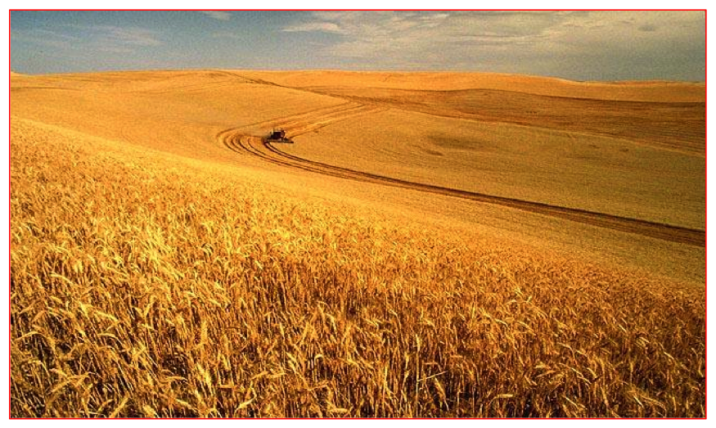
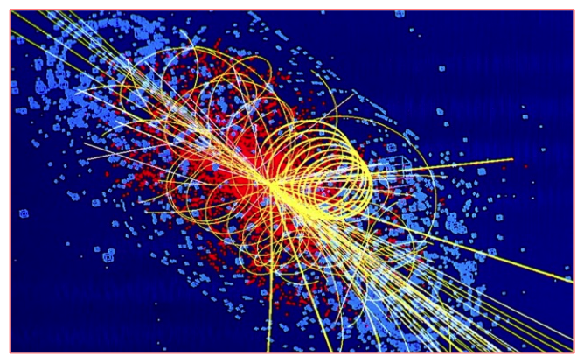
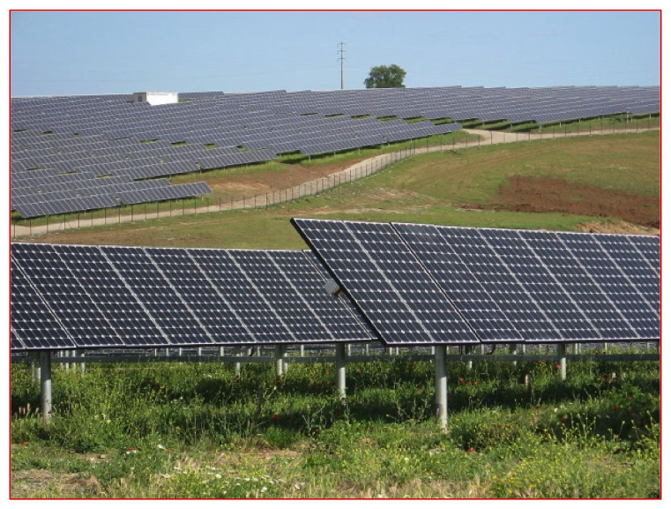
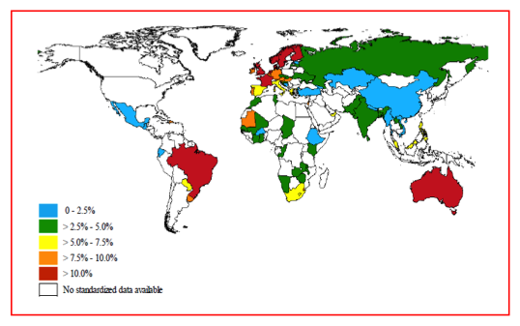
Research Data Driving Solutions to Complex Scientific and Societal Challenges
How can we best address energy needs and sustain the environment?
How do we address these challenges?
How can we increase wheat yields?
Image: Lucas Taylor
How accurate is the Standard Model of Physics?
Who is most at risk to contract asthma?
Image: Ceinturion, Wikipedia
RDA/US Work Funded by
Notes:
http://cms.web.cern.ch/news/about-higgs-boson
We all know that there are questions to be answered that have varying degrees of direct impact on our civilization – so how do we answer those questions? Partly, and I might argue, of necessity, we use the scientific method.

Slide 4
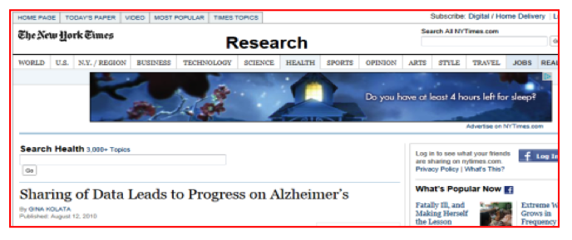
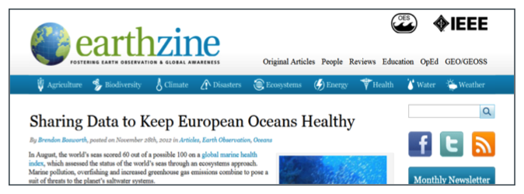
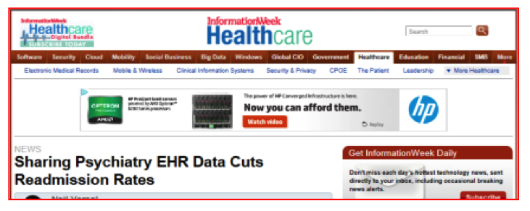
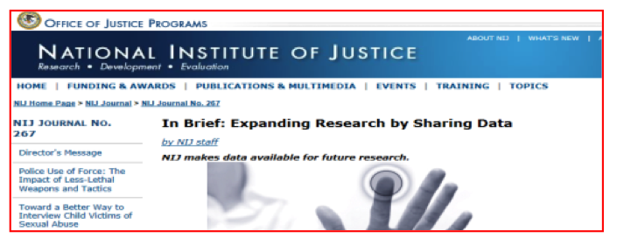
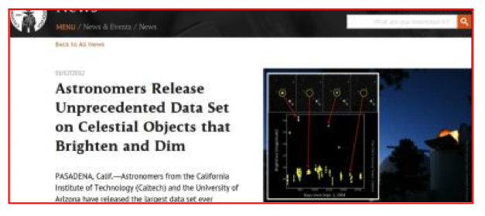
Data-Sharing Driving Innovation Across Sectors and Communities
So - simply share data, right?
…….not quite
RDA/US Work Funded by
Notes:
We look at the problem, we create a repeatable experiment, we collect that data, we analyze the data, we draw conclusions, and we publish. But we’re still in the necessary but not sufficient realm.

Slide 5
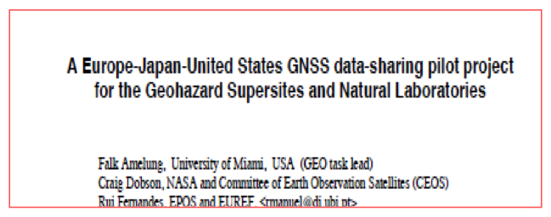
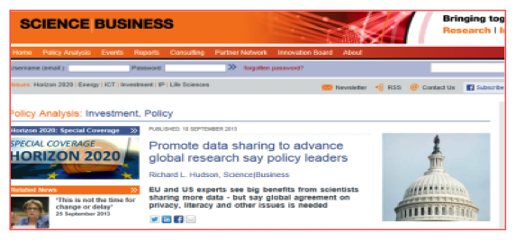
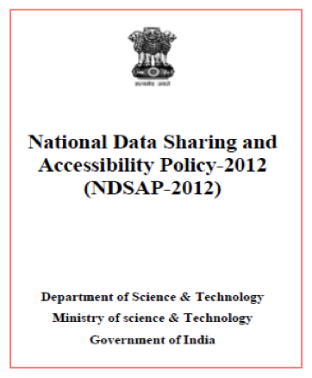
World-wide Efforts on Infrastructure to Support Research Data Sharing, Access, Use
Science, Humanities, Arts Communities
Libraries, Archives, Repositories, Museums
E-Infrastructure professionals, data analysts, data center staff, …
Data Scientists
RDA/US Work Funded by
Notes:
In order to really make a difference, data must be shared. We know now that discoveries in one area of science, in one area of the world, can impact many others – so sharing is vital. But what’s involved in sharing?

Slide 6
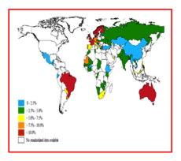
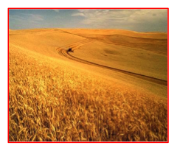
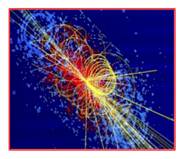
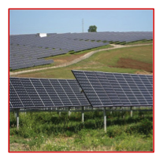
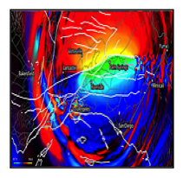
Many Infrastructure Building Blocks Needed to Accelerate Progress
Data Access and Distribution Policy
Institutional Data Sharing Practice
Data Discovery Tools
Digital Object
Identifiers
Common Metadata Standards
Data Citation Standards
Data Preservation Practice
Data Analytics Algorithms
Data Scientists and Expert Support
Curation Practice and Policy
Auditing, Certification and Reporting Practice
Sustainable Economic Models
RDA/US Work Funded by
Notes:
Sharing is more than just giving the data to someone. It’s the infrastructures required for those data to be found, understood, used, and applied to a new problem, and then the resultant data put back into circulation. Infrastructures can be physical, policy, software, etc. – whatever enables the broadest, most effective sharing.
Building blocks must be sturdy and substantial for this to happen

Slide 7
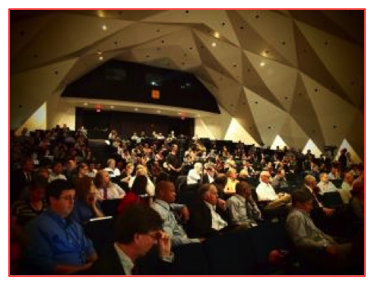
Research Data Alliance
Created to accelerate the development of research data sharing infrastructure worldwide
build social, organizational and technical infrastructure
reduce barriers to data sharing and exchange
accelerate the development of coordinated global data infrastructure
broad range of infrastructure pieces developed based on need
RDA/US Work Funded by
Notes:
Here is where RDA comes in, both globally and regionally (or in our case, nationally)
All countries need data infrastructure to tackle the big problems
They need international collaboration across disciplines
Data volume, variety and velocity is increasing
More value from reuse of data
So countries need to share the cost of research data infrastructure
Need to future proof investments
RDA is a good way of lowering the cost and increasing the interoperability of research data infrastructure

Slide 8
RDA Governance
Features Openness, Transparency, and Consensus
through high-level governance bodies
through community-based groups
through individual contributions
through emphasis on real outputs that solve real barriers to research data sharing
RDA/US Work Funded by
Notes:
Here is where RDA comes in, both globally and regionally (or in our case, nationally)
All countries need data infrastructure to tackle the big problems
They need international collaboration across disciplines
Data volume, variety and velocity is increasing
More value from reuse of data
So countries need to share the cost of research data infrastructure
Need to future proof investments
RDA is a good way of lowering the cost and increasing the interoperability of research data infrastructure

Slide 9
RDA Organizational Structure
*
RDA Council Responsible for overarching mission, vision, impact of RDA
*
*
Secretary-General and Secretariat
Responsible for administration and operations
Organizational Advisory Board and Organizational Assembly
Responsible for organizational and strategic advice
Technical Advisory Board
Responsible for Technical roadmap and interactions
RDA Membership
*
Working Groups Responsible for impactful, outcome-oriented efforts
*
Interest Groups Responsible for defining and refining common issues
* heavy user involvement
*
RDA Colloquium (Research Funders) Operational and community sponsorship
RDA/US Work Funded by

Slide 10
RDA/US Work Funded by

Slide 11
RDA/US Work Funded by

Slide 12
RDA/US Work Funded by

Slide 13
Technical Advisory Board
Current membership
Beth Plale, Director Data to Insight Center, Professor of Computer Science, Indiana University Bloomington - TAB Co-chair
Andrew Treloar Director of Technology, Australian National Data Service - TAB Co-chair
Bridget Almas, Senior Software Developer and Architect, Perseus Digital Library, Tufts University
Simon J D Cox, Senior Principal Research Scientist, CSIRO Australia
Peter Fox, Tetherless World Constellation Chair, Professor of Earth and Environmental Science and Computer Science, Director of the Information Technology and Web Science Program at Rensselaer Polytechnic Institute
Françoise Genova, Director, Strasbourg Astronomical Data Centre CDS
Chuang Liu, Professor, Institute of Geographical Sciences and Natural Resources, Chinese Academy of Sciences (IGSNRR/CAS)
Carole Palmer, Professor, Information School at the University of Washington
Susanna-Assunta Sansone, Associate Director and Principal Investigator, University of Oxford e-Research Centre, Consultant for the Nature Publishing Group (NPG)
Jamie Shiers, Information Technology Department, CERN & Manager of the Data Preservation for Long-Term Analysis in High Energy Physics (DPHEP)
Rainer Stotzka, Leader of “Software Methods” department and software development group “Big Data”, Institute for Data Processing and Electronics, Karlsruhe Institute of Technology (KIT)
Peter Wittenburg, The Language Archive, Max Planck Institute for Psycholinguistics
RDA/US Work Funded by

Slide 14
Create -> Adopt -> Use
Birds-of-a-Feather – groups meeting at Plenaries to gauge broader interest in a topic
Interest Groups – longer-lived discussion forums that spawn Working Groups as specific pieces of needed infrastructure are identified.
Working Groups – 12-18 month efforts to build, adopt, and use specific pieces of infrastructure
Code, policy, infrastructure, standards, or best practices that are adopted and used by communities to enable data sharing
“Harvestable” efforts for which 12-18 months of work can eliminate a roadblock
Efforts that have substantive applicability to groups within the data community, but may not apply to everyone
Efforts for which working scientists and researchers can start today
RDA/US Work Funded by
Notes:
Many ways to participate; many types of infrastructure
Point is all are real, and have not only an initial user, but an adopter for the next step or two to create the “buzz” around the widget

Slide 15
RDA Working Groups
Brokering Governance
Data Citation
Data Description Registry Interoperability
Data Foundation and Terminology
Data Type Registries
Metadata Standards Directory
PID Information Types
Practical Policy
RDA/CODATA Summer Schools in Data Science and Cloud Computing in the Developing World
RDA/WDS Publishing Data Bibliometrics
RDA/WDS Publishing Data Services
RDA/WDS Publishing Data Workflows
Repository Audit and Certification DSA–WDS Partnership
The BioSharing Registry: connecting data policies, standards & databases in life sciences*
Wheat Data Interoperability WG
* in review
RDA/US Work Funded by

Slide 16
RDA Interest Groups
Agricultural Data Interoperability
Active Data Management Plans*
Big Data Analytics
Biodiversity Data Integration
Brokering
Community Capability Model
Data Fabric
Data for Development
Data Foundations and Terminology*
Data in Context
Data Rescue*
Defining Urban Data Exchange for Science IG*
Development of cloud computing capacity and education in developing world research
Digital Practices in History and Ethnography
Domain Repositories Interest Group
Education and Training on handling of research data
ELIXIR Bridging Force
Engagement
Ethics and Social Aspects of Data*
Federated Identity Management
Geospatial*
Libraries for Research Data
Long tail of research data
Marine Data Harmonization
Metabolomics
Metadata
National Data Services*
PID
Preservation e-Infrastructure
Quality of Urban Life
RDA/CODATA Legal Interoperability
RDA/CODATA Materials Data, Infrastructure & Interoperability
RDA/WDS Certification of Digital Repositories
RDA/WDS Publishing Data Cost Recovery for Data Centres
RDA/WDS Publishing Data
Repository Platforms for Research*
Reproducibility
Research data needs of the Photon and Neutron Science community
Research Data Provenance
Service Management
Structural Biology
Toxicogenomics Interoperability
Vocabulary Services*
* in review
RDA/US Work Funded by

Slide 17
RDA/US Work Funded by

Slide 18
RDA/US Work Funded by

Slide 19
RDA/US Work Funded by

Slide 20
Role of the User - Deliverables and Adoption
Data Foundations and Terminology
Deliverables: Common vocabulary for data terms, formal definitions and open registry for data terms
Initial Adopters and Users: EUDAT, DKRZ, Deep Carbon Observatory, CLARIN, EPOS
Practical Policy
Deliverables: Survey of policies in production use, test bed of machine actionable policies, deployment of 5 policy sets, policy starter kits
Initial Adopters and Users: RENCI, DataNet Federation Consortium, CESNET, Odum Institute, EUDAT
Persistent Identifier Information Types
Deliverables: Minimal set of PID types, API
Initial Adopters and Users: Data Conservancy, DKRZ
Data Type Registries
Deliverables: System of data type registries, formal model for describing types, working model of a registry.
Initial Adopters and Users: CNRI, International DOI Foundation, Deep Carbon Observatory
RDA/US Work Funded by
Notes:
By Focus as of June 2014 – not going into these in detail, but general points on each box

Slide 21
Users Contribute and Collaborate Globally and Locally
Individual Members
National and Regional Offices
Coordinate national goals with RDA goals
Provide national focus
Act as a conduit
Focal points for funding
Current offices in Europe, Australia, Canada, Japan, and US
Coming soon to Germany, France, Brazil, China.......
RDA/US Work Funded by
Notes:
Order locally to globally
Help NSF Directorate for Computer and Information Science and Engineering achieve its goals with respect to ‘big data’ R&D using research coordination networks

Slide 22
RDA/US Work Funded by

Slide 23
RDA/US Work Funded by

Slide 24
RDA/US
RDA/US Goals:
Leverage and implement RDA deliverables in the US to amplify impact
Build the RDA community within the US
Collaborate closely with other RDA “regions” on key programs and initiatives
Contribute to RDA “international” efforts and leadership
RDA/US Work Funded by
Notes:
Order locally to globally
Help NSF Directorate for Computer and Information Science and Engineering achieve its goals with respect to ‘big data’ R&D using research coordination networks

Slide 25
Pilot Activities - US Focus
Outreach
Over three dozen presentations and articles done for various groups
Panels, sessions, and conferences around special topics
Deliverables Amplification
Five Working Groups presented their deliverables at Plenary 4
Path from output to adoption between now and March
Continual cycles of output and adoption as WGs mature
Student/Early Career Engagement
First round of Fellowships and Internships awarded this summer
Awardees go to Plenary to present their work
RDA/US Work Funded by

Slide 26
Work Methodologies
Plenaries every six months, in September and March
Sept 2015 (P6) - Paris
March 2016 (P7) - Japan
Sept 2016 (P8) - Canada or US, joint day with SciDataCon
Working Group Chair meetings, every six months in June and November
Remote participation the norm
RDA/US Work Funded by

Slide 27
Governance Main Points
Openness and Transparency
Consensus
Mix of individual and organizational members
Mix of monetary and in-kind contribution
Flexible, distributed funding mechanisms
Balance of bottom-up and top-down approaches [aka, light-touch structure]
FOCUS on OUTPUT that is RELEVANT to the USER by REQUIRING users to be included FROM THE BEGINNING!!!
Own as little as possible
RDA/US Work Funded by

Slide 28
Thank You and Questions
fontak@rpi.edu
enquiries@rd-alliance.org
rd-alliance.org
RDA/US Work Funded by

