Slide 1
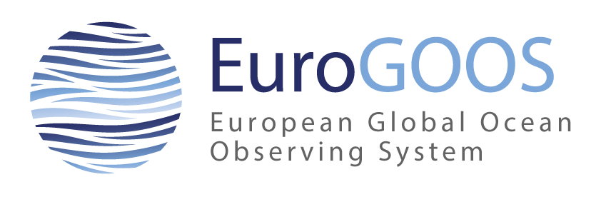

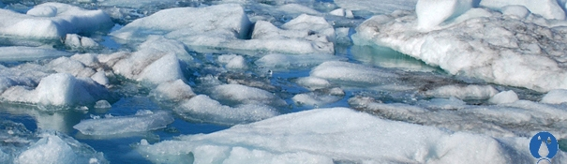
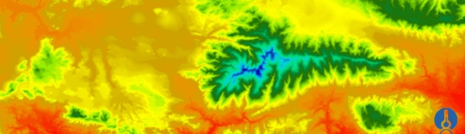
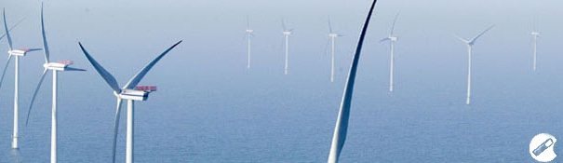
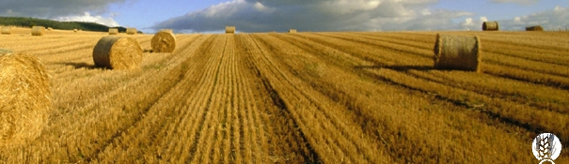
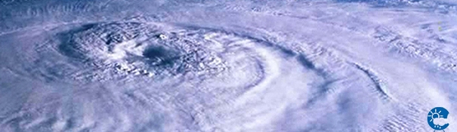
EuroGOOS/EuroGOOS Task Team on Tide Gauges
Begoña Pérez Gómez (on behalf of Dr. Erik Buch), Glenn Nolan, Patrick Gorringe
bego@puertos.es, glenn.nolan@eurogoos.eu, patrick.gorringe@smhi.es, eurogoos@eurogoos.eu

Slide 2
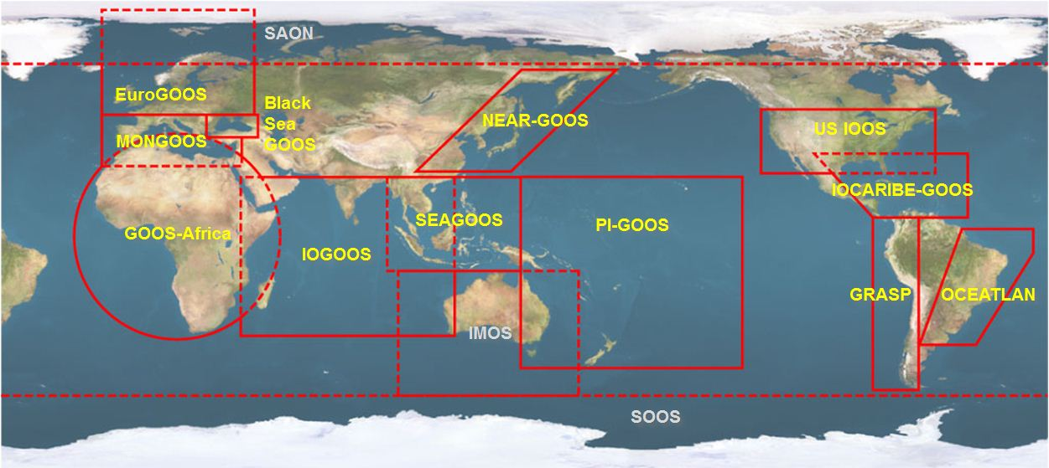

1. About your network
  1.2 What are the main objectives of the network?
  EuroGOOS: International Non-Profit Association with the main objective of promoting and implementing operational oceanography in Europe; funded in 1994, operates in the framework of GOOS (UNESCO/IOC), being one of 13 regional alliances of GOOS (GRAs),

Slide 3
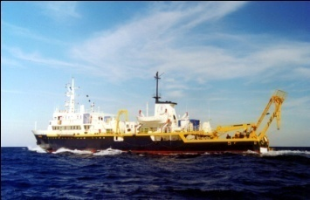
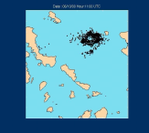
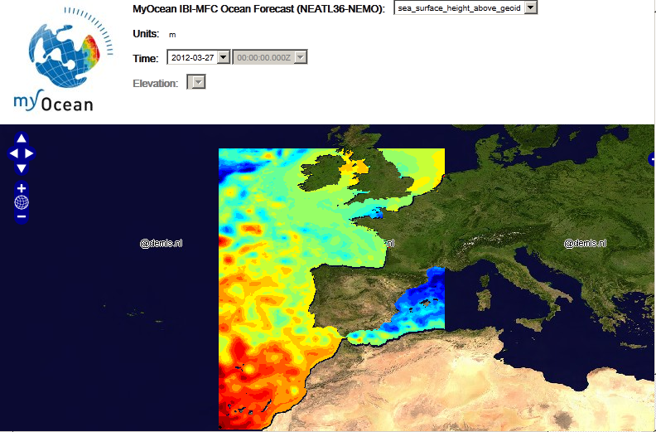
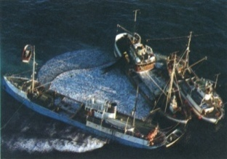
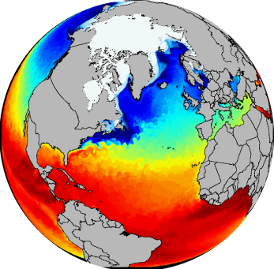
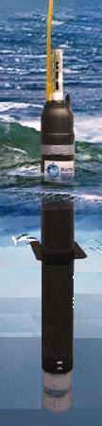
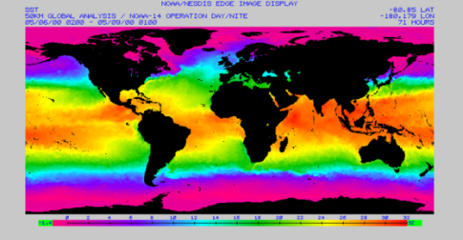
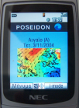
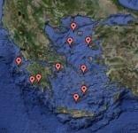
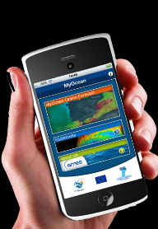
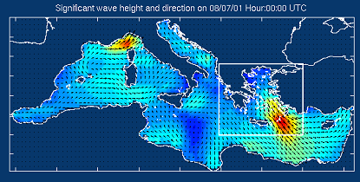
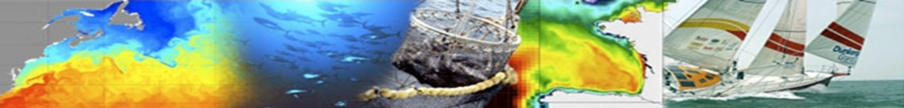
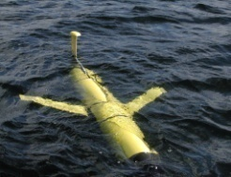
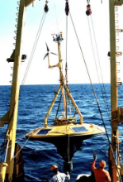
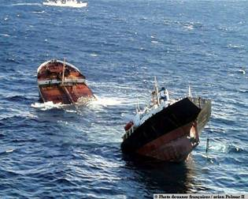
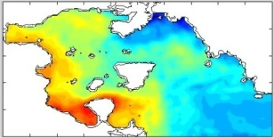
Operational Oceanography
Observations
Processing & Modeling
Services
End Users

Slide 4
  EuroGOOS objectives
  Strategy: identify priorities for operational oceanography
  Promotion: of O.O. and the necessary research and technology
  Co-operation: at global and regional scales (ROOS)
  Co-production: of data and model based services
  Coordination: of European contribution to sustained observing systems
  Representation: of members to third parties (EU, Int. organizations etc)

Slide 5
About your network
  1.3 Who are the main contributors to your network?
  39 national agencies, institutes and research organizations in Europe in 19 countries, about 50 additional partners through the regional ROOS’s

Slide 6
COUNTRY | AGENCY |  | COUNTRY | AGENCY
BELGIUM | Agentschap voor Martieme Dienstverlening en Kust (MDK) |  | NETHERLANDS | Deltares
BELGIUM | Operational Directorate Natural Environment (O.D. Nature) |  | NETHERLANDS | Koninklijk Nederlands Meteorolologisch Instituut (KNMI)
CYPRUS | Oceanography Centre, University of Cyprus (OCY-UCY) |  | NETHERLANDS | Rijkswaterstaat Waterdienst
DENMARK | Danish Meteorological Institute (DMI) |  | NORWAY | Institute of Marine Research (IMR)
DENMARK | Defense Center for Operational Oceanography (FCOO) |  | NORWAY | Nansen Environmental and Remote Sensing Center (NERSC)
ESTONIA | TTU Marine Systems Institute |  | NORWAY | Norwegian Meteorological Institute (MET NORWAY)
FINLAND | Finnish Meteorological Institute (FMI) |  | POLAND | Institute of Meteorology and Water Management (IMWM),Maritime Branch
FRANCE | IFREMER |  | POLAND | Institute of Oceanology, Polish Academy of Sciences
FRANCE | Mercator Océan |  | POLAND | Maritime Institute Gdansk (MIG)
GERMANY | Bundesamt für Seeschifffahrt und Hydrographie (BSH) |  | PORTUGAL | Instituto Hidrográfico
GERMANY | Helmholtz-Zentrum Geesthacht Zentrum für Material und Küstenforschung GmbH (HZG) |  | PORTUGAL | Portuguese Institute for Ocean and Atmosphere (IPMA)
GREECE | Hellenic Centre for Marine Research of Greece (HCMR) |  | SLOVENIA | National Institute of Biology (NIB)
IRELAND | Irish Marine Institute (IMI) |  | SPAIN | Instituto Español de Oceanografia (IEO)
ITALY | Centro Euro-Mediterraneo sui Cambiamenti Climatici (CMCC) |  | SPAIN | Puertos del Estado, Spain
ITALY | Consiglio Nazionale delle Ricerche (CNR) |  | SWEDEN | Swedish Meteorological & Hydrological Institute (SMHI)
ITALY | Italian National Agency for new technologies, energy and sustainable economic development (ENEA) |  | UK | Met Office
ITALY | Istituto Nazionale di Geofisica e Vulcanologia (INGV) |  | UK | Natural Environment Research Council (NERC)
ITALY | Istituto Superiore per la Protezione e la Ricerca Ambientale (ISPRA)
ITALY | Istituto Nazionale di Oceanografia e di Geofisica Sperimentale (OGS)

Slide 7
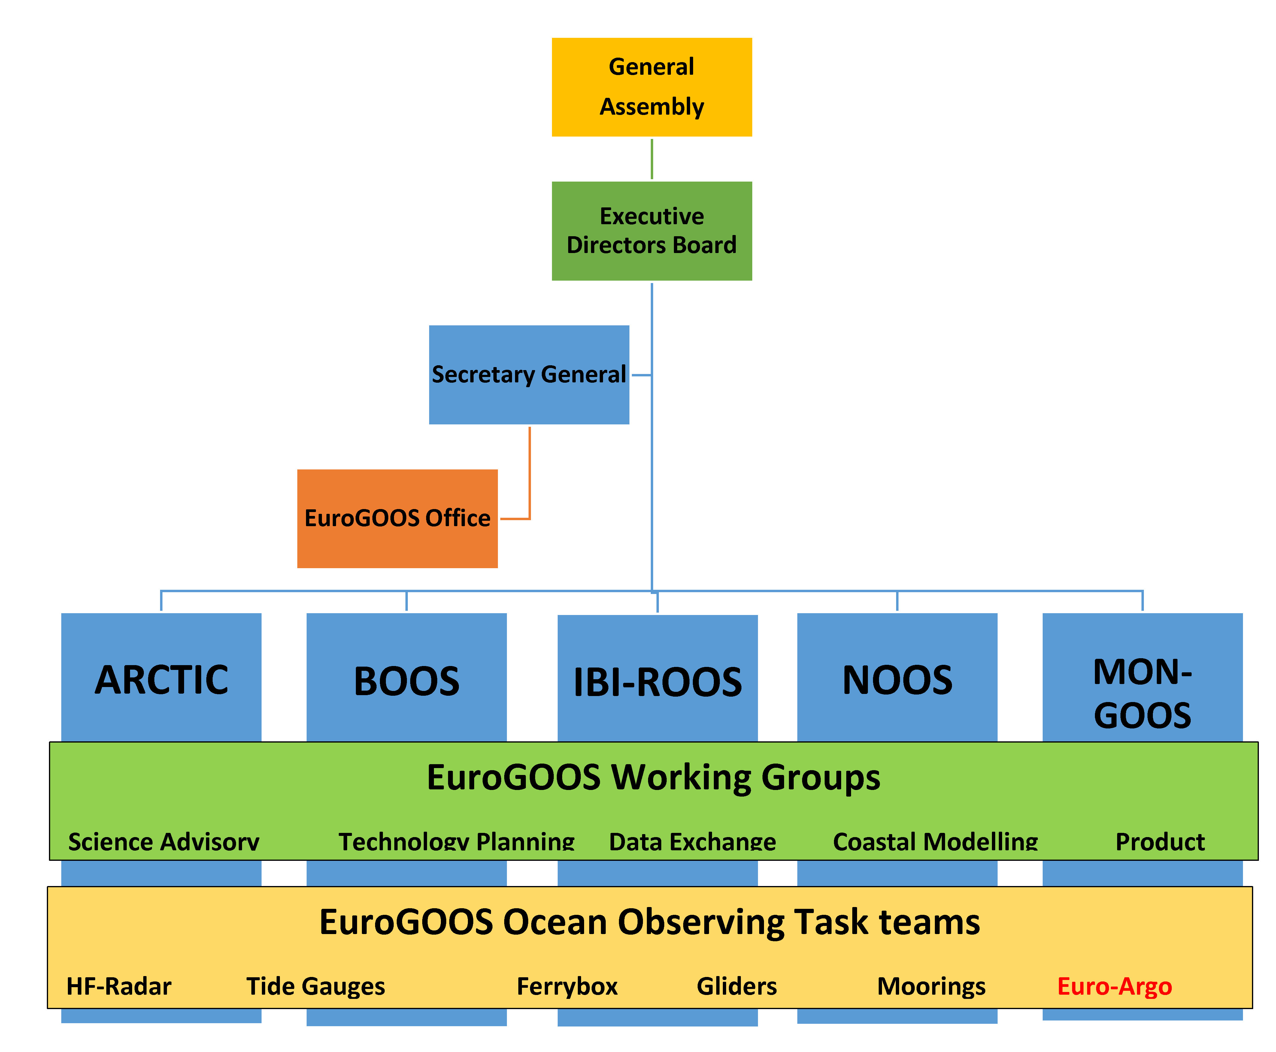
EuroGOOS Structure:
Strategies and actions are decided by an General Assembly and the Executive Directors
Actions are carried out by the EuroGOOS Office, the Board, the Chair and the members/partners.
Development of O.O. systems is carried out by the Regional Systems
Working groups produce strategies, priorities and standards for O.O.
Ocean Observing Task Teams organizes and develops the individual observation communities and foster cooperation

Slide 8
About your network
  1.4 What form of commitment do you have for the maintainance of your network?
  Commitment of maintenaince assumed by the different national agencies

Slide 9
About your network
  1.5 How large is your user base and who are your users?
  Hundreds: scientists, emergency agencies, private companies, etc

Slide 10
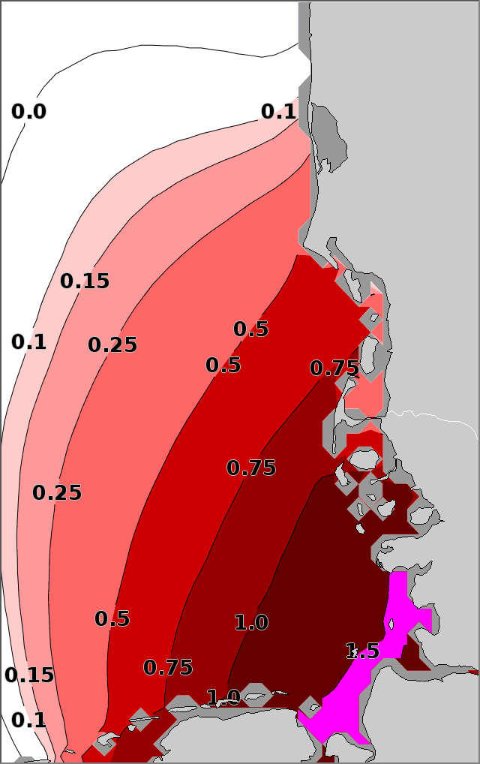
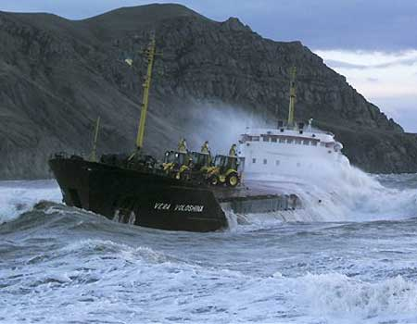
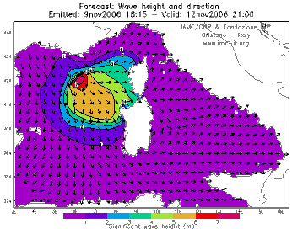
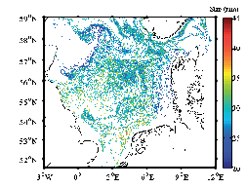
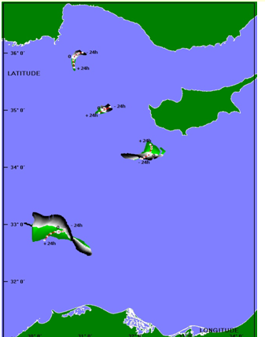
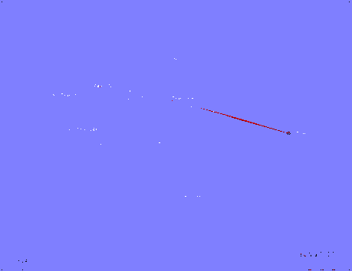
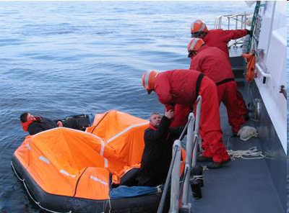
Operational end-user Services
Storm-surge warnings
Sea-Ice service
Ship routing - Marine operations
Oil spill Service
Fish larvae distribution
Search and Rescue

Slide 11
About your network
  1.6 Do you maintain a database of user needs and observational requirements?
  Yes, this is in fact one of the roles of the different observational task teams established by EuroGOOS: HF-radar, FerryBox, Tide Gauges, Gliders, Moorings and Euro-Argo, as well as of the different working groups: Science, Technology, Data Exchange, Products and Coastal

Slide 12
About your network
  1.7 What are the costs and efforts of maintaining the network?
  EEA conducted a study in 2010, out of date now, will be repeated next year. Difficult to give an exact figure: several 10’s of millions per year..

Slide 13
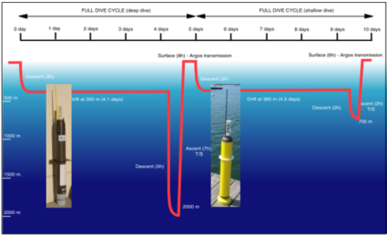
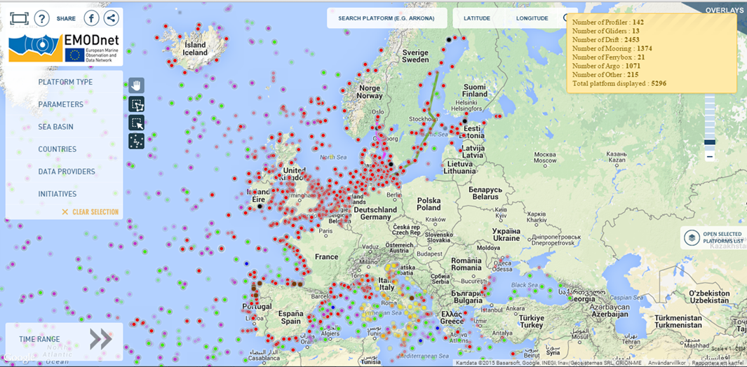
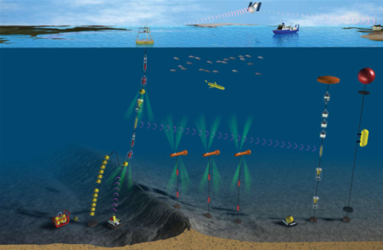
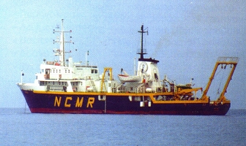
Technologically complex and high cost infrastructures. Variety of platforms/technologies (more than 5000!)
  Remote sensing (satellite and coastal radars)
  Drifting-profiling floats
  Fixed moorings (time-series stations)
  Ships of opportunity
  Gliders
  Research vessels
  Coastal networks
Multi – platform, multi-parametric, observatory approach
Diversity of operators (national,
local, research, …..) & funding
mechanisms

Slide 14
About your network
  1.8 What are your main funding sources?
  Member States through the national agencies that operate and maintain the observational network
  European Commission through funded projects for data exchange, modelling and services distribution: MyOcean, JERICO, Copernicus, SeaDataNet, EMODnet, AtlantOS…

Slide 15
About your network
  1.9 What are the key issues for sustainability of your network running?
  Economic crisis during recent years implies the risk of stopping the maintainance funding of the networks in several countries

Slide 16
2. About data
  2.1 What observations does your network collect and what products are produced?
  Physical oceano-meteorological parameters and related products: sea level, wind waves, atmospheric pressure, wind, sea temperature, sea salinity, sea currents, light attenuation, ice coverage…

Slide 17
2. About data
  2.2 What are the spatial and temporal characteristics and limits of your network?
  European coastal and open ocean waters, focus on real and near-real time data, aiming to deal also with delayed-mode and historical data nowadays
  Time-sampling and latency dependent on type of data and the application

Slide 18
2. About data
  2.3 How is the data archived and made accesible to users?
  Through the Regional Operational Oceanographic Systems (ROOS’s) established regionally as the operational arms of EuroGOOS, which archive and distribute the data through their data portals

Slide 19
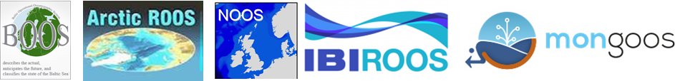
The ROOSs - Regional Operational Oceanographic Systems are the operational arm(s) of EuroGOOS
About 60 additional partners in ROOSs
The ROOSs cooperation focus on improved national and regional services and products
ROOSs coordinate the observations and the data transfer for internal use and to other users
Regional data portals in every ROOS simplifying the data transfer and enable interoperability
Data free and open via regional data portals and pan-European scale via EMODnet Physics

Slide 20
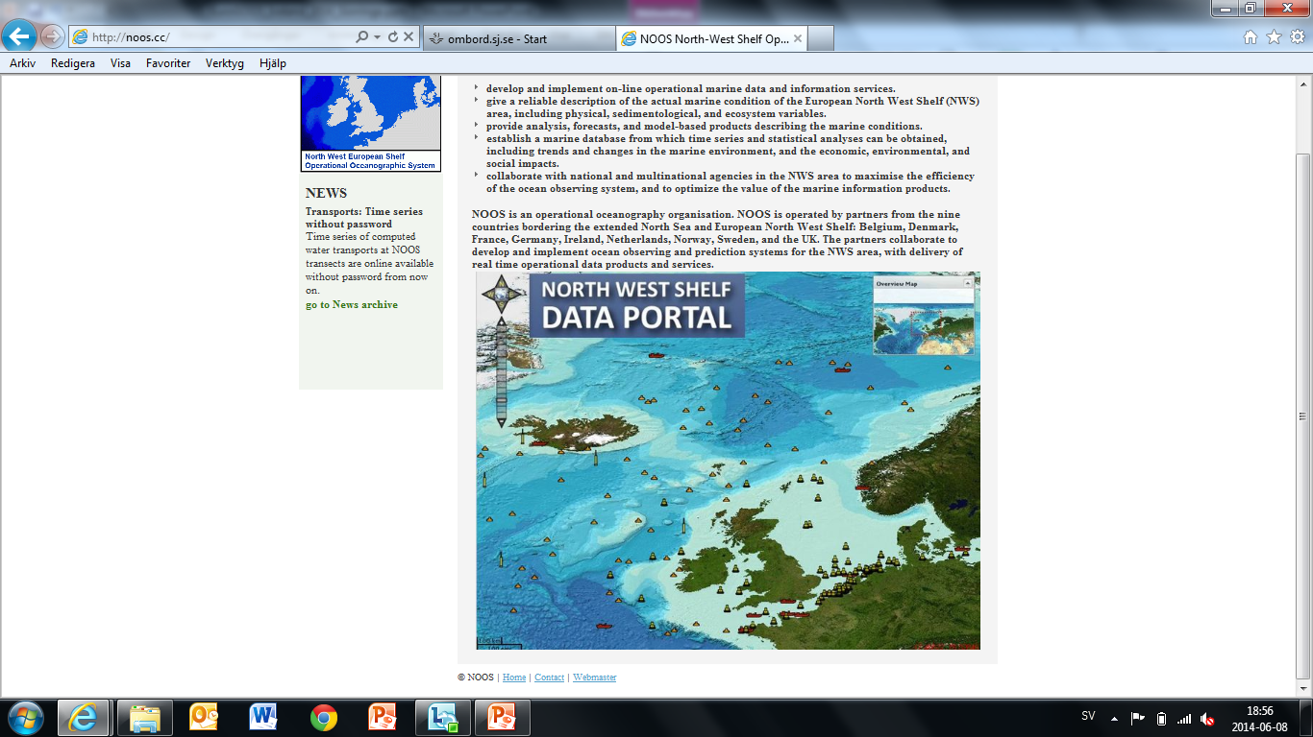
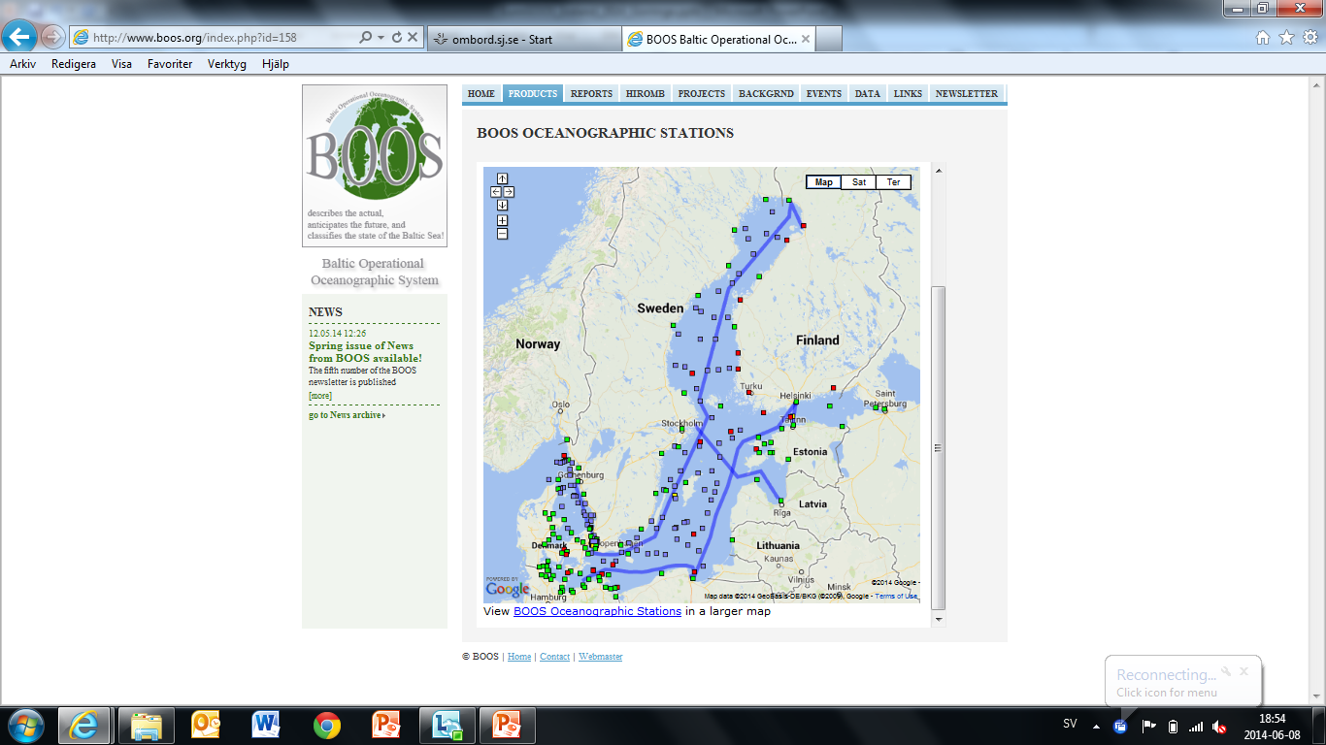
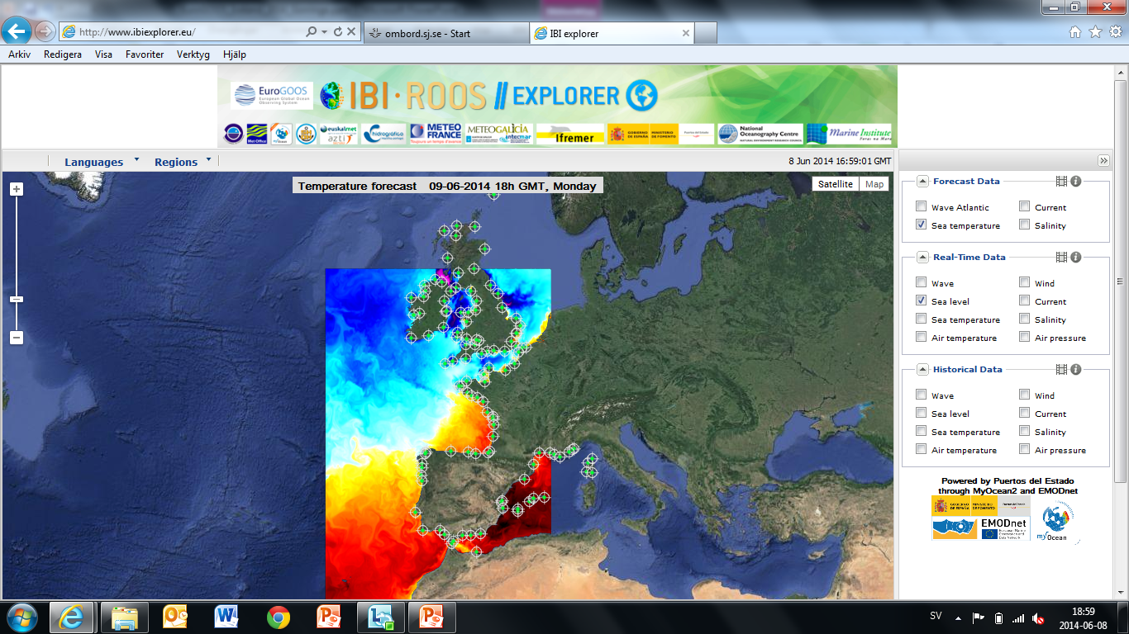
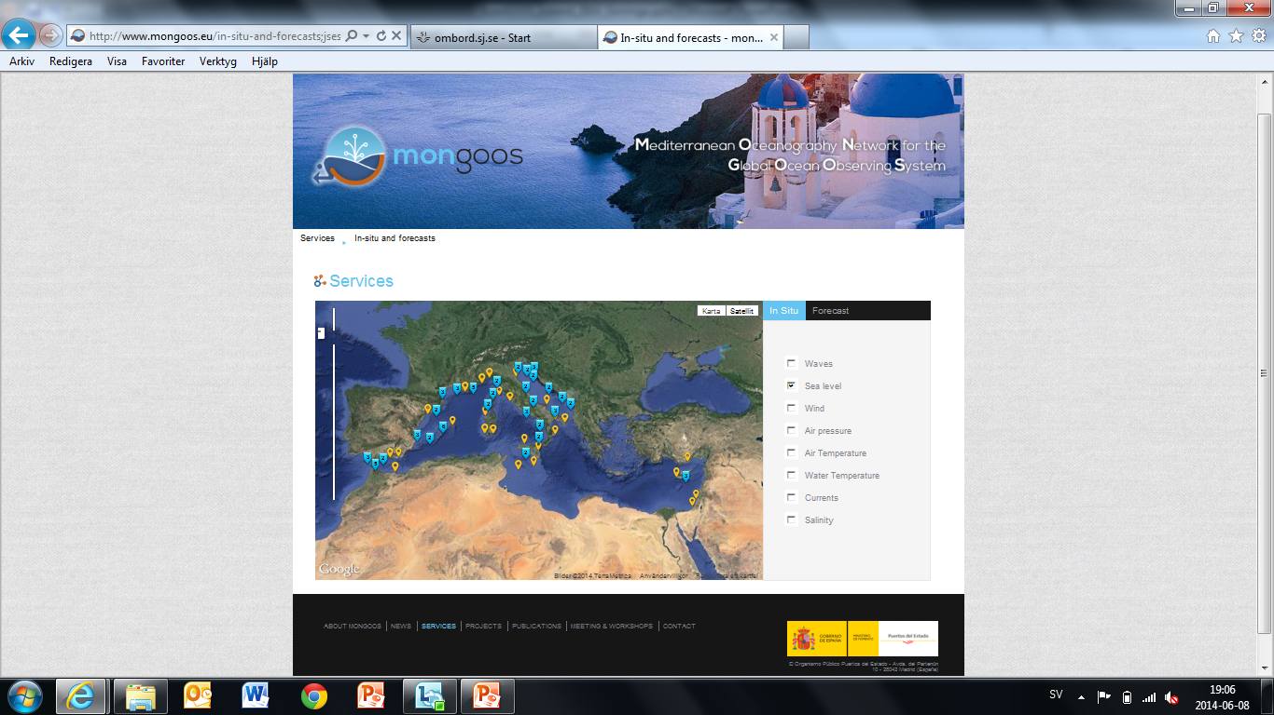

Slide 21
2. About data
  2.4 Do you address data quality in some way?
  Yes, different portals but same formats, QC and standards – coordinated by the EuroGOOS DATAMEQ WG (Data Management, Exchange and Quality Working Group ).
  Considerable work has been done on data and metadata standards supported by EC funded projects: Seadatanet, MyOcean, EMODnet..

Slide 22
2. About data
  2.5 Are there risk for data continuity and how are data preservation and network continuity addressed?
  One of main concerns: observational Task teams (new initiative) recently established with the purpose to organise the various ocean observation communities to further develop and generate the necessary funding

Slide 23
2. About data
  2.6 What are the conditions (licenses) for sharing your data and products with users?
  Data free and open via regional data portals and pan-European scale via EMODnet Physics

Slide 24
2. About data
  2.9 Are there observations that are needed but not captured by your network or by other networks that you have access to or products that are not generated?
  Biogeochemical data (both surface and profiles) remains a key gap in the ocean observing system. This is where the effort will be over the coming years), to increase the skill of BGC forecasts and ecosystem related products
  Deep sea is under-sampled, spatial gaps also
  Geodetic measurements (correction of sea level data)
  More complete time series

Slide 25
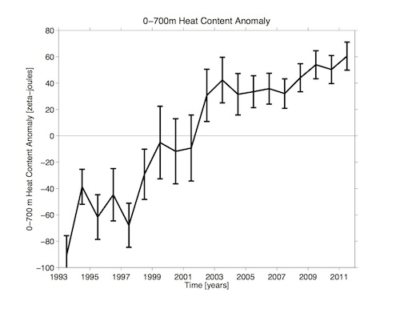
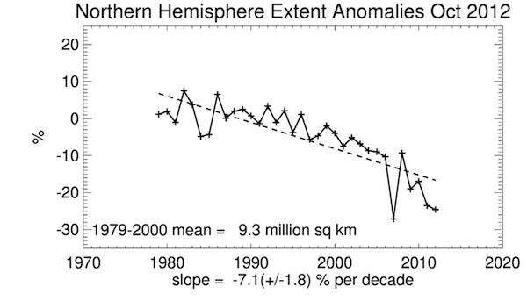
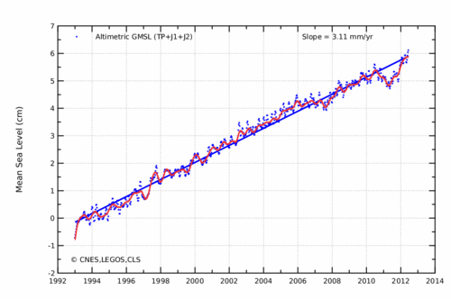
Future of EuroGOOS: Changing ocean environment
Heat content
anomaly
Arctic summer sea ice
Global sea level

Slide 26
Future of EuroGOOS: EOOS a major priority
Europe Need to develop an integrated “European Ocean Observing System – EOOS”
To bring together National, European, Private infrastructures and new investment and maximize efficiency and benefits following a “integrated system approach”:
  National Systems (EuroGOOS)
  European Strategy Forum on Research Infrastructures - ESFRI (EuroARGO, EMSO,..)
  IA – Infrastructure networks: JERICO, FixO3, GROOM, EuroFLEET, ..)
To properly interface with key EU infrastructures: EMODNET, Copernicus
To respond to major EU policies: Integrated Maritime Policy, Marine Strategy Framework Directive (MSFD), Blue Growth
Mechanisms to establish a key role of Europe in Ocean Observing (under GEO, GOOS, GCOS).

Slide 27
3. About a network of networks
  3.1 What coordination and collaboration interfaces do you have with other networks?
  EuroGOOS coordinates with the 15 GOOS Regional Alliances to share best practice and governance between GOOS entities.
  Many other bi-lateral agreements and links with other ocean observing organizations: EEA, IOC, Copernicus.
  Overarching AISBL agreement between EuroGOOS and its 39 members

Slide 28
3. About a network of networks
  3.2 Is your network contributing to GEO(SS) and if so, what is this contribution? Could ConnectinGEO help to enhance your contribution to GEOSS?
  EuroGOOS is an observer in the GEO High Level Working Group at EC level. ConnectinGEO could help enhance the GEO link

Slide 29
3. About a network of networks
  3.3 Are there additional interfaces that would be desired and what would be the main benefits of these interfaces?
  Stronger interfaces with the policy formulation and implementation instruments of the EC would be useful

Slide 30
3. About a network of networks
  3.4 Do you think that your network could benefit from the existence of an ENEON or a similar network?
  EuroGOOS is developing the European Ocean Observing System (EOOS) concept with European Marine Board and other stakeholders. EOSS will provide a forum for the in-situ marine observing system in Europe. A collaboration with ENEON could be helpful in promoting a sustained system.

Slide 31
EMODnet Physics
EMODnet Physics objectives:
  Provide a single point of access to marine near real time and achieved data
  on physical conditions as monitored by:
    Fixed Stations¹, Ferrybox¹, Argo², Gliders², HF Radars² ,……..
  Parameters:
    Sea Temperature¹, Sea Level¹, Sea Salinity¹, Winds¹, Waves¹, Sea Currents¹, Light Attenuation¹, Ice Coverage², Sea Level trends²
  Build up on existing infrastructures i.e. EuroGOOS ROOSs by adding value – not complexity
  Ensure data access to any user
  Facilitate integration and interoperability with further systems
    (INSPIRE compliant, WMS, WFS, etc.)
  Bring together the main European Marine Observation and Data Communities – and linking to global
  (EuroGOOS ROOSs, INSTAC, SeaDataNet, etc)
  Attract new data and new data providers
  Attract new users and stakeholders

Slide 32
Example: Tide gauges network:
Sea level assumptions:
old and well-known technology
adequate number of stations already in Europe
no need of new developments in data processing
Real facts:
increasing demand of sea level data and stations
multi-disciplinar variable → new requirements for the last 10 years
last EU funded project for sea level measurements: ESEAS-RI (ended 2005, more than 10 years ago!)
Why did ESEAS finally fail? Where is the european sea level community?
Creation of the EuroGOOS Task Team on Tide Gauges in 2015, Terms of
Reference approved April 2015.

Slide 33
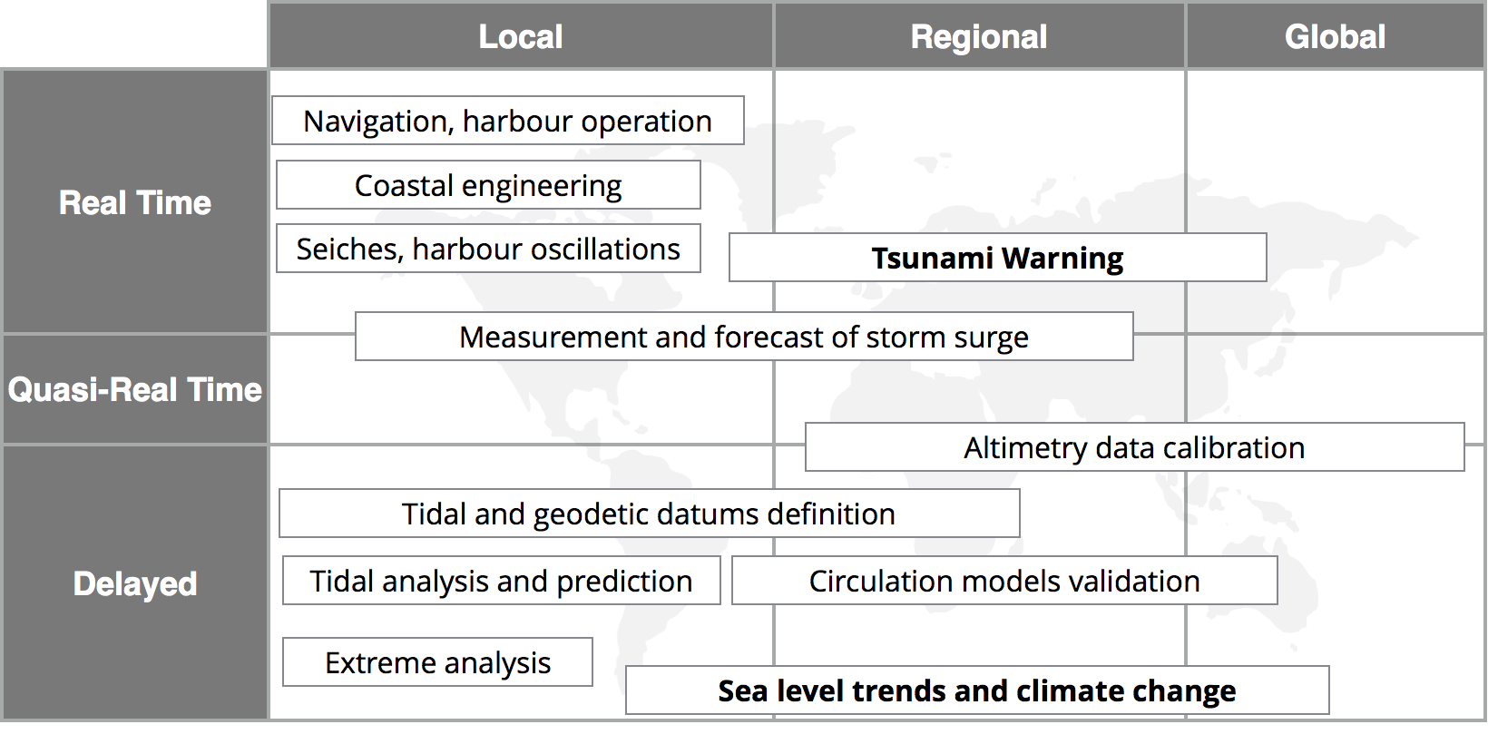
Example: Tide gauges network:
Applications of tide gauges:
Sea level related hazards becoming more important. Changes in the network

Slide 34
Sea level data portals: several data portals allow today access to sea level data from TG’s. Focused on different applications and users.
PSMSL
TG msl
Global:
SONEL
IOC SLSMF
TG monitoring
ROOS’S: MONGOOS
European:
EuroGOOS: General: opera.
oceanography
EMODnet
… apart from national centers, National and Regional Tsunami Warning Centers (NEAMTWS) etc….

Slide 35
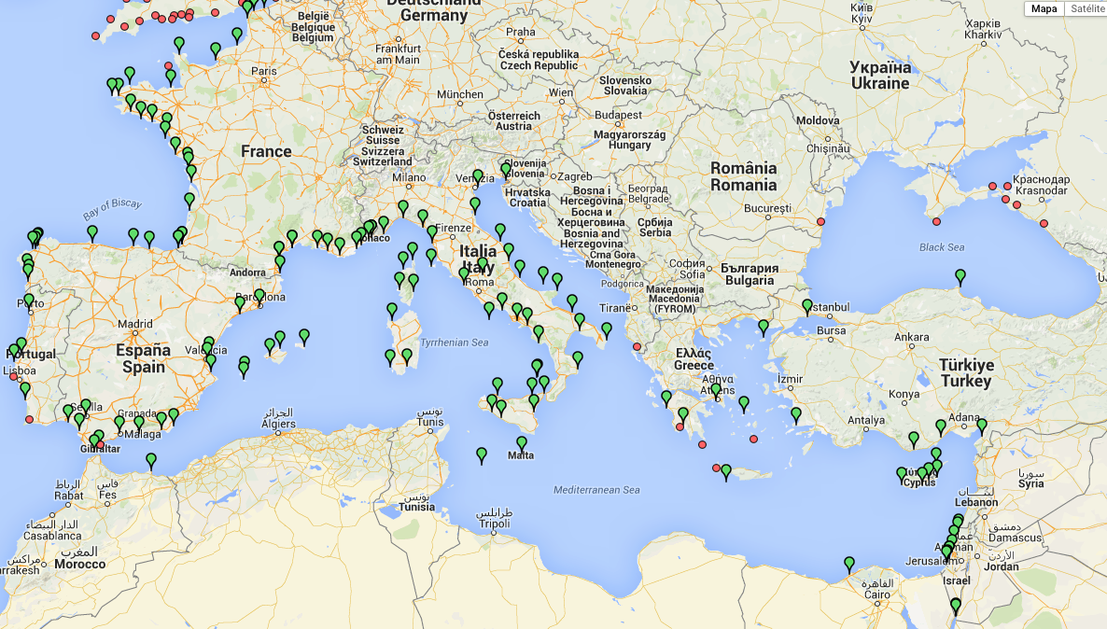
NEAMTWS inventory (WG3): ≤1’ sampling (and latency?) around 103 tg’s in the Med
More stations being installed by the NTWC’s. New technologies (radar)
Main gap of the sea level network:
North of Africa

Slide 36
Example: Tide gauges network:
Task Team on Tide Gauges will address:
Duplication and/or gaps of existing sea level data portals in Europe
Relevant products required by sea level data users
Review of metadata inventories (NEAMTWS WG3, GLOSS, MyOcean, etc) and
adequacy of stations for the different applications: mean sea level, warning, etc
Identify gaps on the sea level network (geographical coverage)
New technologies: e.g. GNSS buoys
Additional instrumentation: ocean bottom pressure sensors (cable observatories),
land movement monitoring, redundant tsunami sensors
New requirements on data processing and quality control
Communications and use of GTS (Global Telecommunications System)
Basic requirements for operational oceanography
Analysis of the funding and structure used in the different states
Interest of historical data recovery
Connection with the altimetry community
Working now on creating and providing a metadata map on the actual maintenance status of
existing stations and future sustainability of the systems.

Slide 37
Thank you for your attention…

