Slide 1

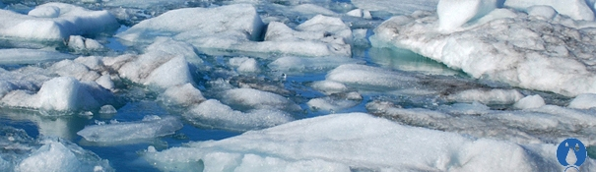
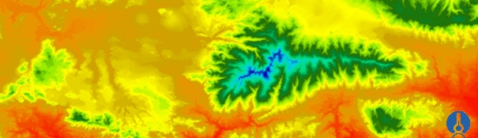


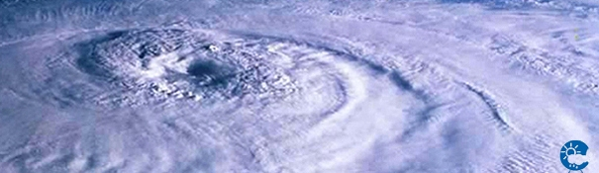
ENEON first workshop
Observing Europe: Networking the Earth Observation Networks in Europe
21-22 September, Paris
Copernicus cross-cutting in situ component
Jan Hendrik Voet (voet@irceline.be)

Slide 2
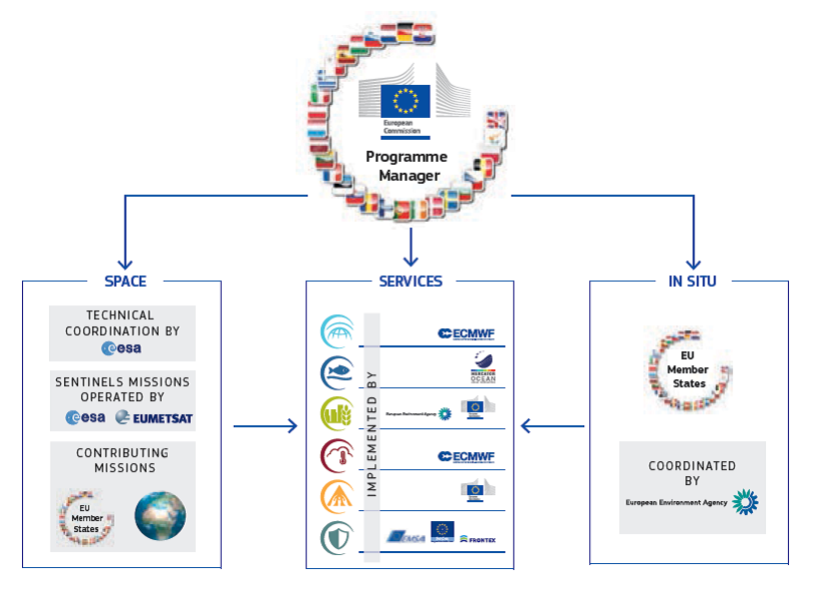
Copernicus
Source: http://www.copernicus.eu/main/Brochure

Slide 4
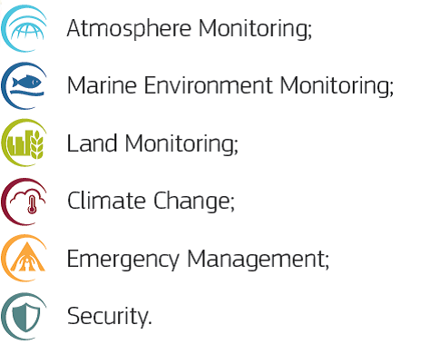

Copernicus Services
*
*
*
*
* Operational & Delegation Agreement

Slide 5


Copernicus in situ data = puzzle !
a lot of pieces
too many pieces
missing pieces
do not know what the result looks like

Slide 6
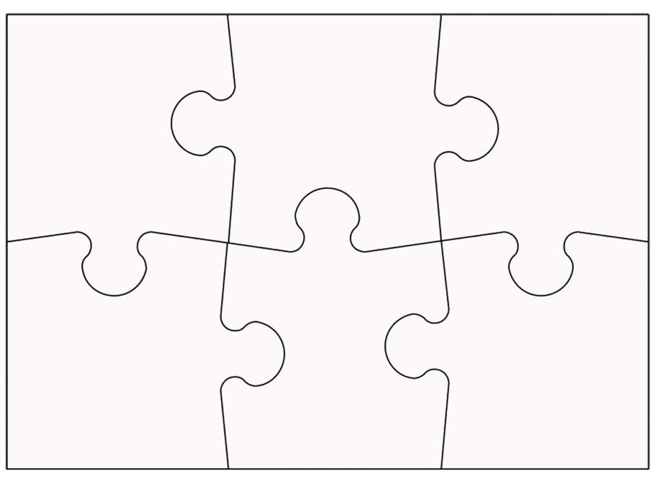






Copernicus In Situ Component: distributed approach
in situ data managed by services individually
cross cutting aspects coordinated by European Environment Agency
cross
Cross cutting

Slide 7
European Environment Agency & Environment Information and Observation Network (Eionet)
established by founding regulation (COUNCIL REGULATION (EEC) No. 1210/90* of 7 May 1990)
provide objective, reliable and comparable information at European level to support the European and member state policy makers, assess the results of measures and inform the public; all with the aim to protect the environment
Eionet is a network of institutions (ministries, agencies, institutes) at country level that can provide (environmental) information or can support this provision (=> session 5)
*Codified Regulation (EC): No 401/2009 of 23 April 2009

Slide 8

Activities Copernicus cross cutting in situ component
Delegation agreement EU - European Environment Agency (EEA)
  Pan-european and local land component (global => JRC)
  Cross cutting in situ component
Copernicus Work Programmes 2014-2015-2016
GISC (GMES In Situ Component) project (2010-2013)
EEA supported by Eionet Copernicus In Situ Task Force and …
1 dedicated EEA staff member + 3-5 TF members
Jan Hendrik Voet
Roadmap ‘2016’ (Nov ´15 – Dec ´16)
Draft version ready – Final 15th Oct ´15
…

Slide 9
1) Elaborate a comprehensive overview of in situ data requirements (services)
  database with meta-information (not the data)
  update (GISC) for Atmosphere, Marine, Emergency, Land
  include Climate Change & Security (‘new’)
  contain information about already available and used data and their characteristics (gaps, accessibility, quality, fit for purpose)
  information about products of services (portfolio)
  information provided by services (cooperation)
Analysis of the database focusing on gaps, accessibility, quality, fit for purpose of the in situ data

Slide 10

2) Operational provision of cross cutting in situ data to Copernicus services (1)
  overall system CORDA (COpernicus Reference Data Access) improving access 24/7 targeted towards Copernicus services Fit for purpose services. Quid other users?
  to geospatial reference data sets
  some thematic data sets
  to some specific ‘European’ databases

Slide 11

2) Operational provision of cross cutting in situ data to Copernicus services(2)
  reference data sets like Ortho-photos, Transport networks, Elevation, Buildings, Land cover/use also related to Inspire (annexes) 15 or more
  thematic Eionet (EEA) data flows
  like NRT Air Quality data
  Other Eionet data sets suitable?
  LUCAS (Land Use and Cover Area frame Survey– ESTAT)
  LPIS (Land Parcel Identification System – EU CAP)
  EU-Hydro (Hydrology – EEA)
  Other?

Slide 12

3) Manage partnerships with data providers to improve access and use conditions of in situ data for Copernicus services
  Connect to established networks (Eionet, Statistical System, Inspire, thematic, global, …) with country participation
  Partnerships with in situ data providers at European and global level (EuroGeographics – EuroGeoSurveys – EuroGOOS - Eumetnet)
  Quid data policy? Free and open?

Slide 13

4) Support EC and Copernicus Services to find solutions for in situ issues
  GEO/GEOSS and global issues in general
  Enhance communication and visibility of Copernicus In Situ Component (CISC)
    public website and information platform
    participation in and organisation of events
  Cooperation between services (incl. EC)
    data quality
    future R&D needs
    sustained LT data provision
  Practical cooperation between services (incl. EC)
  Ad hoc support to EC

Slide 14

Quid connection with ENEON?
To be continued … Session 5
Tuesday, September 22, 2015: 1025 – 1045
EIONET: European Environment Information and Observation Network
Thank you
Jan Hendrik Voet (voet@irceline.be)

