Slide 1




Workshop on Gap Analysis and Prioritization
Providing Earth Observation Support to the Monitoring and Implementation of the Sustainable Development Goals: Gaps and Priorities
The ConnectinGEO Approach to Gap Analysis
Joan Masó
10 - 11 October 2016
IIASA. Schlossplatz 1 - A-2361 Laxenburg, Austria

Slide 2
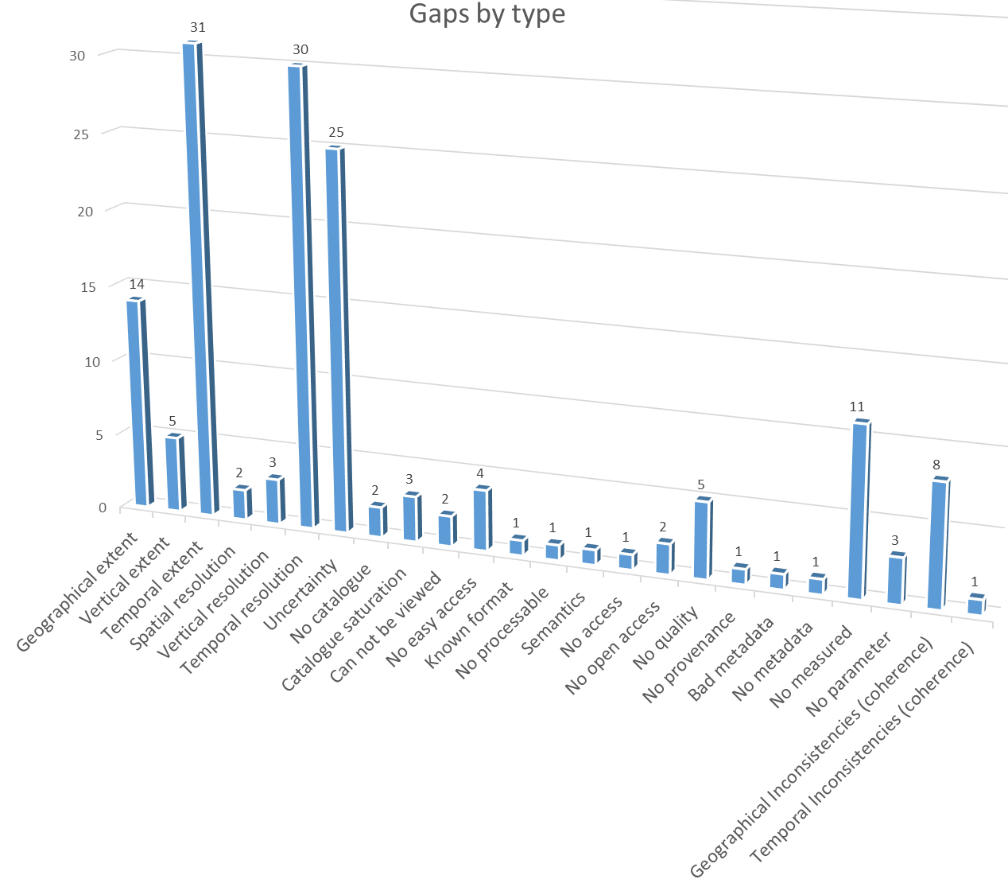
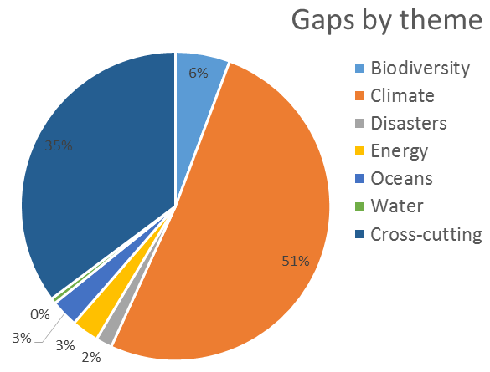
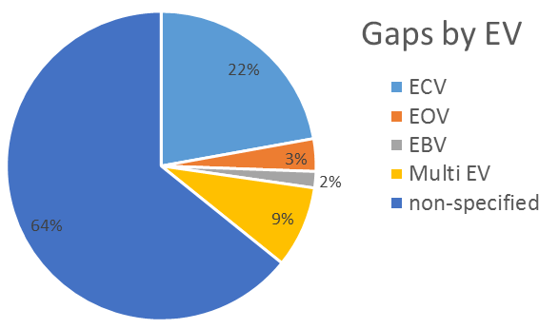
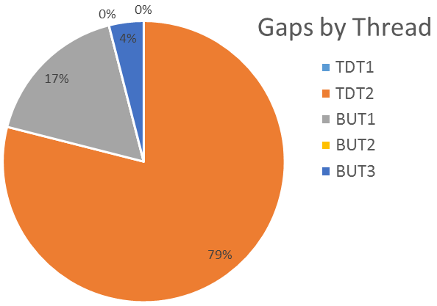
We have some results
176 gaps identified
What methodology do we use?

Slide 3
ConnetinGEO methodology for the gap analysis five threads
Top-Down thread 1: Identification of a collection of observation requirements and specifications from generic goals for sustainability of the global civilization as expressed in the GEOSS Strategic Targets, the SDGs, and the adherence to the planetary boundaries.
Top-Down thread 2: Incorporation of material from international programs such as Future Earth, Belmont Forum, the Research Data Alliance and community assessments of socio-economic benefits of Earth observations
Bottom-up thread 1: A consultation process in the current EO networks, consisting of collaboration platforms, surveys and discussions at workshops and even involvement of citizen science.
Bottom-up thread 2: A careful analysis of the observations and measurements that are currently in GEOSS Discovery and Access Broker complemented by other means (e.g. scientific literature)
Bottom-up thread 3: The realization of a series of real industry-driven challenges to assess the problems and gaps emerging during the creation of business opportunities

Slide 4

Goal → Indicators → EV → Observations: Gaps
First translate knowledge needs (e.g. SDG) into indicators and
then these indicators into essential variables (EV) required for the quantification of the indicators;
Ultimately, these EV are used to refine observation requirements.
In ConnectinGEO, requirements will be related to information on available observations to identify key gaps.
Society
Policy and Planning
Industry Challenge
Decisions
Impact
Knowledge base
Observation
priorities
Forecast
and
projections
Top-Down
Goals
Strategic Targets
Sustainable Development
Goals
Sustainability Indicators
Essential Variables
Remote & In-Situ Observations
Bottom-up
Observation
Observing Systems/Networks
Climate
Water
Agriculture.
Natural Res.
Carbon
Ecosystems
Energy.
Raw materiasls
Scientific Community

Slide 5

1 Top-Down thread 1:
Observation requirements identification
Determine a set of targets that the NoN has. These targets can be e.g strategic, scientific, organizational, etc. e.g. GEOSS Strategic Targets, the UN SDGs, the planetary boundaries, etc.
Substeps:
  Identifying the strategic goals we want to achieve
  Identifying the variables that can be used to measure the achievement of the goals
  Identifying the metrics used to achieve the goals
  Express them in a format that makes them compatible with the observation needs

Slide 6

E.g.: SDG-3 Ensure healthy lives and promote well-being for all at all ages
Target 3.9 By 2030, substantially reduce the number of deaths and illnesses from hazardous chemicals and air, water and soil pollution and contamination
  Current indicators focus on consequences
    3.9.1 Mortality rate attributed to household and ambient air pollution
    3.9.2 Mortality rate attributed to unsafe water, unsafe sanitation and lack of hygiene (exposure to unsafe WASH services)
  Focus more on the cause (e.g. environmental pollution)

Slide 7
Discussion on requirements
  Mortality is not a good indicator because:
    There is an accumulative effect that generates a huge delay
      A decrease in mortality can happen even if pollution is increasing in the short term.
SDG indicators do not recognize the relation between pollution and mortality. EC directives in place do recognize it.
Measuring pollution status
  Satellite do not see the lower levels in tropospheric O³
  In-situ is coverage is good in populated areas only
  Satellite+in-situ gives better result for near real time prediction.

Slide 8

2 Top-Down thread 2:
International research programs
International Research Programs conducted their own gap analysis before and they already defined their priorities.
  Roadmaps where some gaps an priorities are identified.
  The calls themselves (including ERA-NETs)
  Careful examination of the documentation released by research programs can hep in detecting gaps in EO
Substeps:
  Examine the documentation of EO related topics released by the funding agencies
  Attend workshops organised by the funding agencies or the international instruments of collaboration and collecting minutes
  Identify the current directions of the funded research that uses or contributes to EO
  Consult the funding agencies responsible and make them review the produced list of current priorities and explore possible continuation
  Explain the results of the other threads to them and adjust them considering their expert opinion.
  Express them in a format that makes them compatible with the observation needs

Slide 9

E.g. ESA call for RS-EBVs
Development of Remotely-Sensed Essential Biodiversity Variables (RS-EBVs) for terrestrial ecosystems.
The primary objective of the activity shall be to perform all necessary engineering activities for the definition, specification, benchmarking, prototyping, validation, scaling up and utility demonstration of at least three High Resolution (HR) Remotely-Sensed Essential Biodiversity Variables (RS-EBVs) on the structure and function of terrestrial ecosystems.
GlobDiversity shall bring a significant contribution towards the integration of satellite observations in the development of Essential Biodiversity Variables.
It will address the engineering of remotely sensed EBVs, which prioritization and specification are still an on-going process within the GEO BON Community of Practitioners.

Slide 10


E.g. ESA call for RS-EBVs
There is a gap in:
  High Resolution (HR: 30 meter resolution) Remotely-Sensed Essential Biodiversity Variables on the structure and function of terrestrial ecosystems.
    That can be extracted from Sentinel 2 and Landsat data
  The Integration of satellite observations in the development of Essential Biodiversity Variables.
  In the prioritization and specification of EBVs that is still an on-going process within the GEO BON Community of Practitioners.
Notes:
http://data.geobon.org/EBVclasses/img/ecosystem%20structure.png
http://data.geobon.org/EBVclasses/img/ecosystem%20function.png

Slide 11
3 Bottom-up thread 1: Consultation process
A consultation process in the experts in Earth observations
  Separate them in two collectives: producers and users.
  Collaboration platforms, surveys and discussions at workshops and even involvement of citizen science.
Substeps:
  Elaborate a list of networks of Earth observation for all relevant topics considering satellite, airborne and in-situ segments (SME and private sectors and Citizens Observatories)
  Elaborate a list of EO stakeholders and consumers
  Structure the two lists into two networks to give it some stability
    Communicate the needs and the benefits of the networks to them
    Set up virtual environments where the networks can have their communication and debate mechanisms to keep the concept alive continuously.
  Elaborate a list of requirements, gaps and priorities based on the results of the questionnaires and workshops
  Communicate to the results of the consultation process and make them review and validate it.

Slide 12
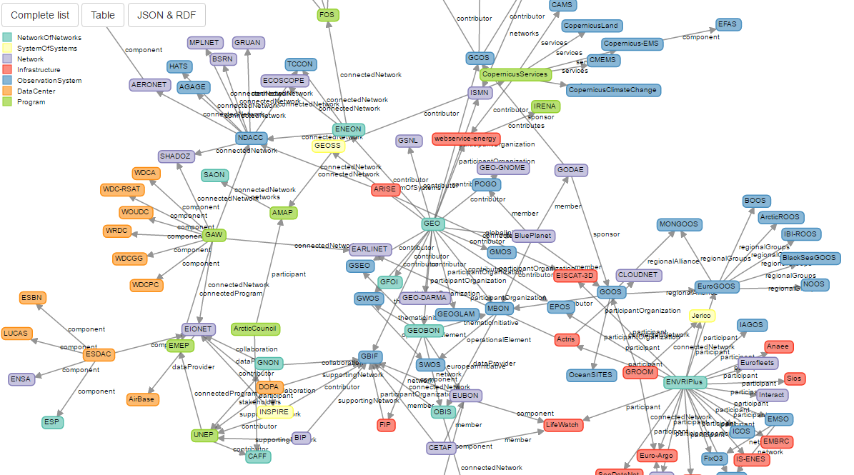
Map of the EO networks
This is the list on Networks
We have a group of ambassadors in ConnectinGEO

Slide 13
E.g.: A gap coming for the Ocean community
Sea Surface Salinity
Insufficient spatial coverage by design. Argo does not measure salinity close to the surface (< 5 m) to avoid biofouling. Around 1% of data within 1 m.
Ballabrera, 2015 (avalaible at http://www.euro-argo.eu/content/download/91862/1123452/version/1/file/E-AIMS_D4.443-V2.pdf)
SSS is essential for climate and water cycle changes derived from E-P fluxes over the ocean from basin to global scales. It is relevant to determine the surface density, freshwater transport and coastal ocean dynamics (river discharges). Further, in situ SSS measurement essential for cal/val satellite signals and sensor drift .

Slide 14


4 Bottom-up thread 2:
Systematic analysis of the observations
A systematic analysis of DAB records can revile important information about gaps in current EO products.
  These gaps can be spatial, temporal or thematic.
A further validation (expert review or scientific literature) of these results will be needed
Substeps:
  Determine the parameters we want to search for
  Determine the structure of database storing the relevant parameters of the records in the catalogue
  Populate the database. This can be done in two modes
    Harvest the whole catalogue
    Make a set of well defined queries to the database and accumulate the results in a database filtering repetitions (this is the only possible way if the catalogue does not allow harvesting).
  Complement the database with other sources of information such as links to scientific papers and other documentation describing the data.
  Analyze the database and create aggregated results
  Validate analysis results with experts reviews and remove the gaps that has been detected due to missing or wrong metadata.

Slide 15
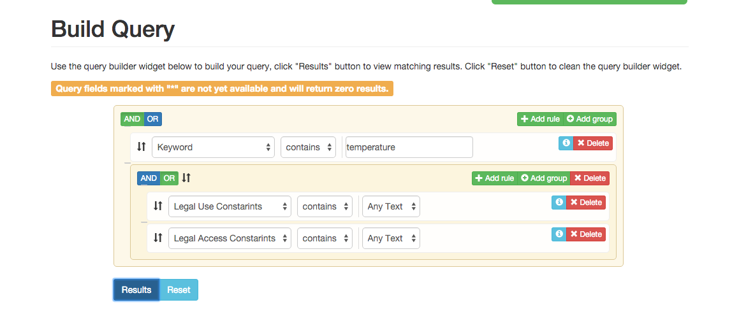
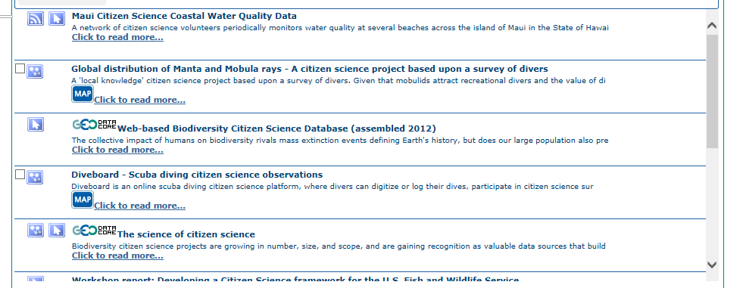
E.g. Are Gap Citizen Science datasets under-resented in GEOSS?

Slide 16
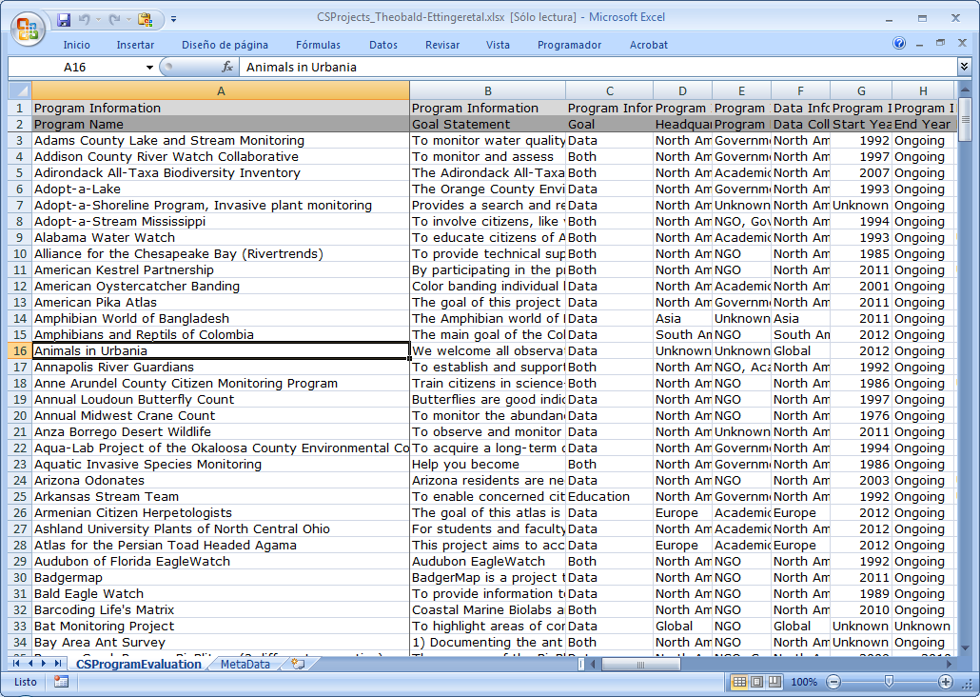
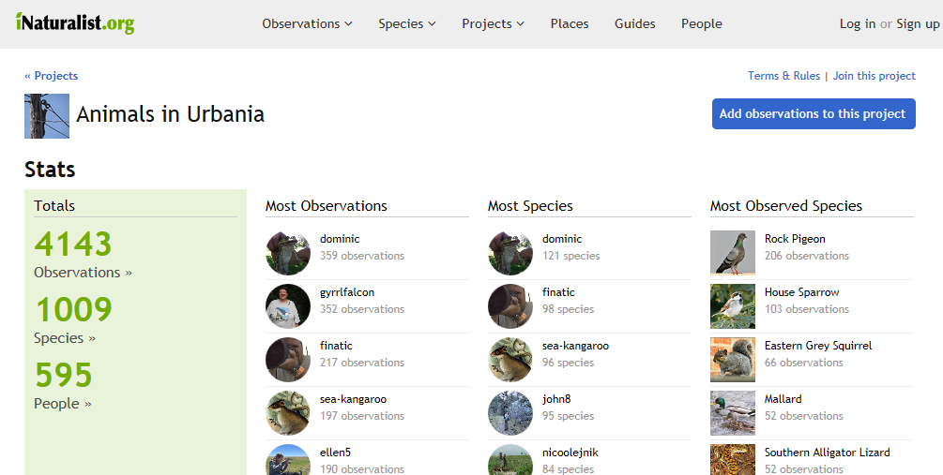
Even if some CS projects emerged, not all CS FP7 project datasets are included in GEOSS

Slide 17
5 Bottom-up thread 3:
Hands on activities
Activities are conducted by experts in the field with contacts to the right people, the results of this activities have a high degree of confidence.
However, the scope of these activities is quite limited and only can be done partially in a project like ConnectinGEO.
Substeps:
  Define a set of data intensive challenges that have not been tried before
    Involve RS but also in-situ if possible
  Complementarily, involve other parties by offering prices to participants that contribute their own challenges and their own evaluation.
  Use the geospatial catalogues to try to find the information
  When the information has not been found contact expert to continue looking for the data
    If the data is found, determine if is it possible to register this data so other will be able to find it easily.
  Try to extrapolate the results to other topics or spatial or temporal extent.

Slide 18
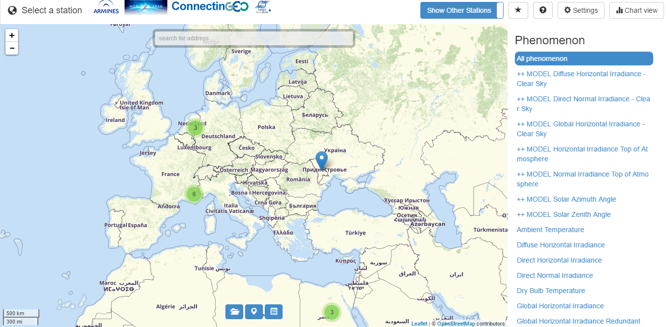
E.g. A WebGIS Client providing access to in-situ measurements
http://insitu.webservice-energy.org/jsClient-0.2.0/#map
Gap: Technical difficulties on integrating sensor observations in GEOSS
  OGC SOS (Sensor Observation Service) standard

Slide 19
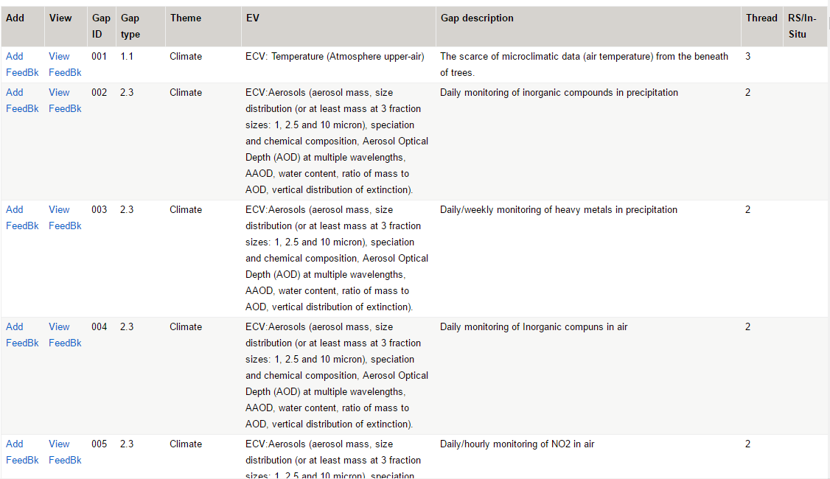
Main results – EO gaps analysis
176 gaps identified coming from a collaborative table:
  http://twiki.connectingeo.net/foswiki/bin/view/ConnectinGEOIntranet/GapAnalysisTable
User feedback system integrated

Slide 20
A single data model for all theads.

Slide 21
Future work: Setting priorities for the gaps
Impact
A combination of
  Impact,
  Feasibility and
  Cost
will determine the priorities of the gaps found
We need to target
  impact high with feasibility high and cost low
  impact high with feasibility medium and cost medium
1st target
2nd target
Feasibility
Costs

Slide 22
Thanks
Joan.Maso@uab.cat

