Slide 1
Summary of Bottom-Up Thread 2
ConnectinGEO Workshop on Gap Analysis and Prioritization
October 10-11, 2016, Laxenburg, Austria
Stefano Nativi and Mattia Santoro

Slide 2
Objectives
Analyse the resources contributed to GEOSS through the GCI and the GEO Discovery and Access Broker (DAB)
Identify possible gaps between users’ needs and present information in the metadata concentrated in the DAB

Slide 3
The Process

Slide 4
User Needs
Parameter
River Discharge
Water use
Groundwater
Lakes
Snow Cover
Glaciers
Ice sheets
Permafrost
Albedo
Land cover
FAPAR
LAI
Above ground biomass
Soil carbon
fire disturbance
Soil moisture
Desired Spatial Resolution
1km
1km
1km
1km
1km
1km
1km
1km
1km
1km
1km
1km
1km
1km
1km
1km
Desired Temporal Resolution
Daily
Monthly
Monthly
Annual
Annual
Annual
Annual
Annual
Monthly
Annual
Monthly
Monthly
Annual
Annual
Daily
Monthly

Slide 5
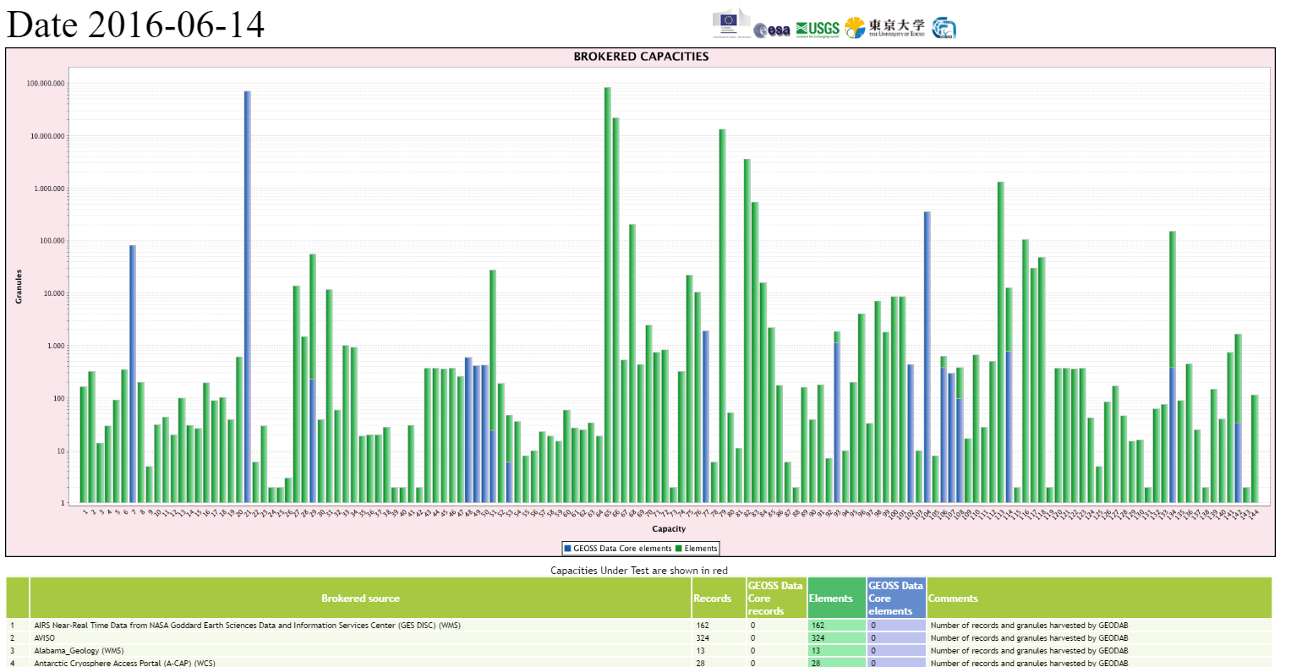
GEOSS Resources
More than 150 Brokered Systems
About 190 M granules





Slide 6
Possible Gaps
Number of Discoverable Resources
Number of Accessible Resources
Trends

Slide 7
Matching User Needs
 | Strict | Relaxed
Text | Match in Title or Keyword | Match in Title or Keyword or Abstract
Spatial Resolution | <= Required Spatial Resolution | Any
Temporal Resolution | <= Required Temporal Resolution | Any

Slide 8
Results Text Match

Slide 9
Results Text Match + Desired Spatial Resolution

Slide 10
Results Text Match + Desired Spatial Resolution

Slide 11
Results Text Match + Desired Spatial + Temporal Resolution

Slide 12
Trends
Text -> Sp. Res. -> Sp. + Temp. Res.
Text -> Temp. Res. -> Sp. + Temp. Res.

Slide 13
Relaxing Constraints
Parameter Name in Metadata Abstract
Any Spatial resolution
Any temporal Resolution

Slide 14
Text -> Sp. Res. -> Sp. + Temp. Res.
Text -> Temp. Res. -> Sp. + Temp. Res.
Bold = Relaxed
Text -> Sp. Res. -> Sp. + Temp. Res.
Text -> Temp. Res. -> Sp. + Temp. Res.

Slide 15
Conclusions
Found about 1.5M entries matching user needs for the considered essential variables
Most of the other resources are discoverable if the relaxed approach is applied because they are instrumental for generating the EVs
Most of the resources are not “directly” accessible
The use of spatio-temporal constraints mainly impacts the number of discoverable resources, not the number of accessible ones
Resources fully described are commonly “directly” accessible
Commonly spatio-temporal resolutions are not provided as Metadata fields. The ConnectinGEO Metadata enricher addresses this issue

Slide 16
Thank you

Slide 17
Backup

Slide 18
Trends (Text -> Sp. Res. -> Sp. + Temp. Res.)

Slide 19
Trends (Text -> Temp. Res. -> Sp. + Temp. Res.)

Slide 20
Trends (with relaxed text constraint)

Slide 21
Trends (with relaxed text constraint)

Slide 22
Trends (with relaxed text and spatio-temporal constraints)

Slide 23
Trends (with relaxed text and spatio-temporal constraints)

Slide 24
Results Text Match

Slide 25
Match Parameter Name in Text Match Desired Spatial Resolution

Slide 26
Match Parameter Name in Text Match Desired Temporal Resolution

Slide 27
Match Parameter Name in Text Match Desired Spatial AND Temporal Resolution

Slide 28
Trends

Slide 29
Trends

Slide 30
Trends (with relaxed text constraint)

Slide 31
Trends (with relaxed text and spatio-temporal constraints)

Slide 32
Trends

Slide 33
Trends

Slide 34
Possible Gaps
 | Strinct | Relaxed
Text | Match in Title or Keyword | Match in Title or Keyword or Abstract
Spatial Resolution | <= Required Spatial Resolution | Any
Temporal Resolution | <= Required Temporal Resolution | Any
Parameter
Spatial Resolution
Temporal Resolution
Query

Slide 35
Possible Gaps
Combine
Number of Resources
User Needs
Parameter
Spatial Resolution
Temporal Resolution
Text
Text AND Spatial
Text AND Temporal
Text AND Spatial AND Temporal
Discoverable
Accessible

Slide 36
Rationale and Objectives [source: DoW]
TODO
Monitoring the current observations contributing to GEOSS through the GCI and the DAB
Analysing the created inventory as a systematic approach to recognize the different observed properties and their types
Connect the observation inventory database to the SEE IN Knowledge Base
Using results from Task 2.3 and the SEE IN Knowledge Base content to elaborate a list of essential variables and indicators
Create the observation inventory database, and populate it using the current information in the metadata concentrated in the DAB and the GCI

Slide 37
The Process
Tasks 4.2, 2.3
GEOSS
Observation Inventory DB
GEOSS Content DB
1. Access GEOSS full Metadata Content
2. Extract/Infer Extra Semantics*
3. Generate an enriched GEOSS Metadata Content
GEOSS content
Metadata
Extended/
Advanced evaluation and
Discoverability
URR
* including: coverage aspects, accuracy/quality/fit-for-purpose, accessibility, policy/licensing, versioning
Knowledge
Body
Ontology
Documents
(Publications)

Slide 38
1. Access GEOSS Metadata Content
GEOSS Content DB
GEO DAB makes use of the native no-SQL APIs to read the full metadata content of each GEOSS harvested resources
1. Access GEOSS full Metadata Content
GEOSS content
Metadata
Full metadata content
No-SQL DB

Slide 39
2. Extract/Infer Extra Semantics*
Rules
Enriched Metadata content
Full Metadata
content
2. Extract/Infer Extra Semantics*
Enricher*
Discovery & Access
*Applying the Enricher pattern
Information
from external
systems (e.g. URR)

Slide 40
Enricher types and GEO DAB actions
Web Resource Enricher
Harvest
Accessibility Check
Add Tags
Record
Enricher
Data Enricher
… .
Document Enricher
… .

Slide 41
Enrichers combinations
GEOSS content
Metadata
GEOSS Observation Inventory DB
Web Resource Enricher
Record
Enricher
Data Enricher

Slide 42
3. Generate an enriched GEOSS Metadata Content
GEO DAB makes use of the native no-SQL APIs to generate the GEOSS Observation Inventory DB
3. Generate an enriched GEOSS Metadata Content
Enriched Metadata content
No-SQL DB
GEOSS
Observation Inventory DB

Slide 43
WP4 Architecture
GEOSS
content
Metadata
GEOSS
Observation Inventory DB
GEOSS Supply Systems
Rules
Harvest
Analyzer
Knowledge
systems (e.g. URR)

