Slide 1
EO for Impact
Technologies for observing and monitoring plastics
in the oceans
November 26-27 2018/ Brest, France

Slide 2
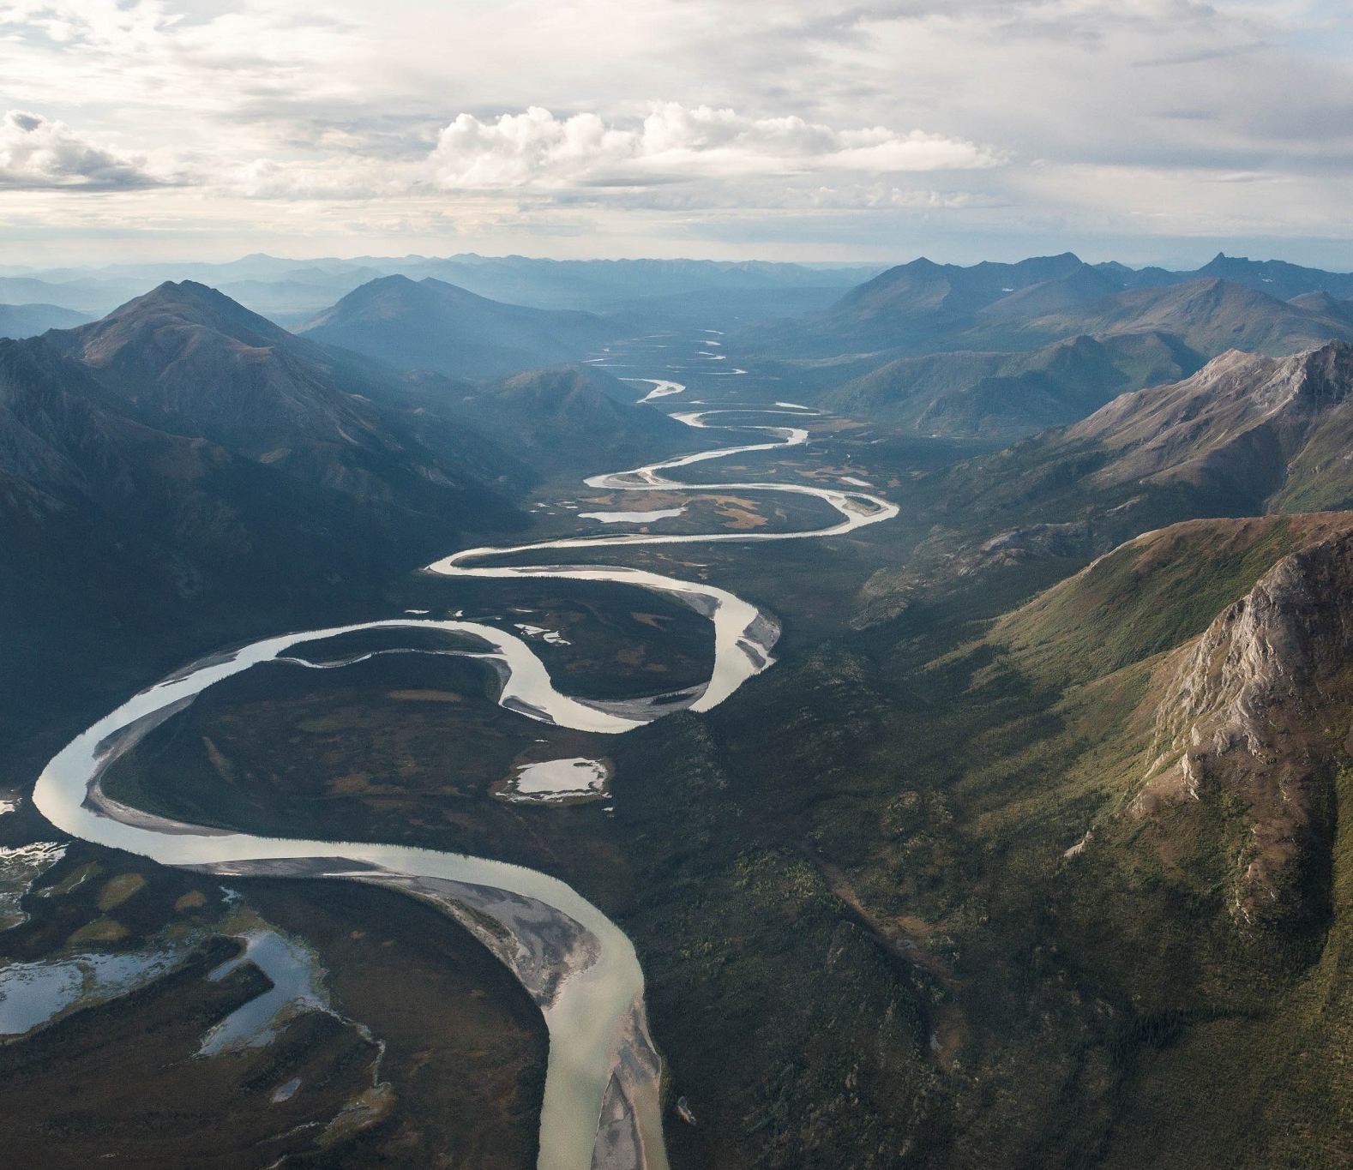
Earth observations
In, on and around the Earth
What is Earth observation?
Earth observation is the gathering of information about physical, chemical and biological systems in, on and around the Earth.

Slide 3
Group on Earth Observations
Intergovernmental partnership
What is GEO?
GEO works to improve the availability, access, understanding and use of Earth observations for the benefit of society.

Slide 4
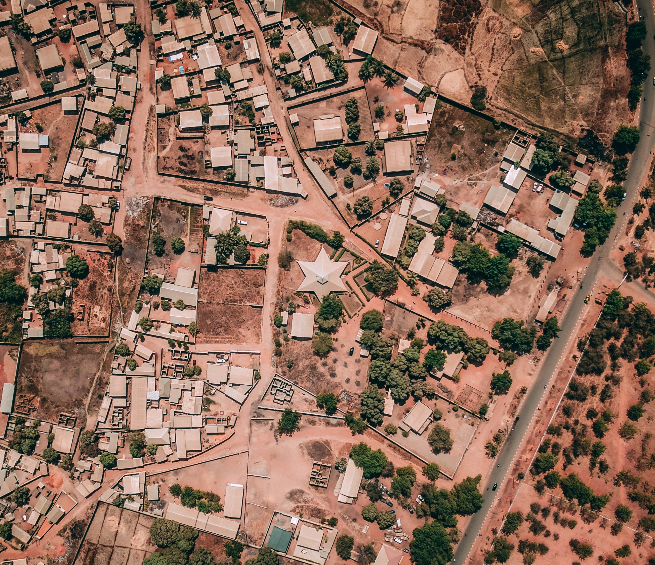
Group on Earth Observations
Research, policy and decision making
What does GEO do?
GEO’s member governments and participating organizations work together to develop and implement Earth observations projects and initiatives that address global environmental challenges.

Slide 5
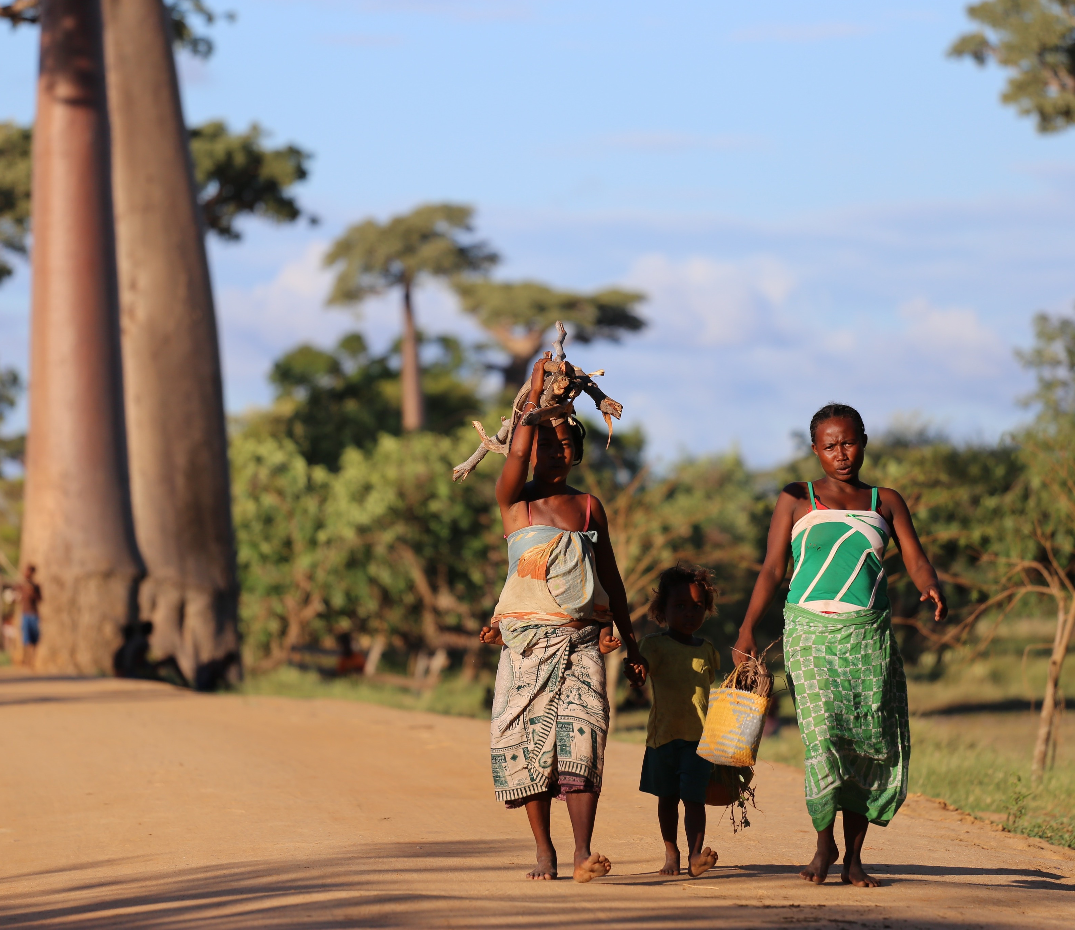
Group on Earth Observations
Open Earth observations data and information
What does GEO have to offer?
In addition to 70+ Work Programme activities, the GEO community is building the Global Earth Observation System of Systems (GEOSS), and has already made over 400 million open data and information resources available via www.geoportal.org

Slide 6
Group on Earth Observations
Our focus areas
GEO’s global engagement priorities include supporting the UN 2030 Agenda for Sustainable Development, the Paris Agreement on Climate and the Sendai Framework for Disaster Risk Reduction. In particular, the intersection, overlap and shared monitoring and reporting requirements to achieve the respective goals and objectives.

Slide 7
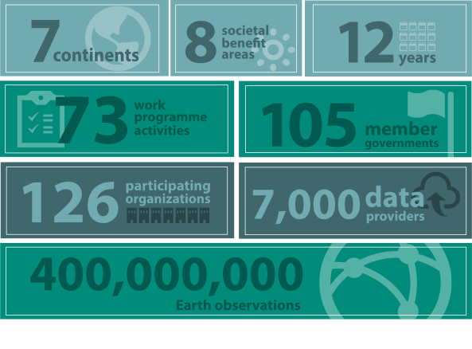
GEO in Numbers
GEO in Numbers

Slide 8
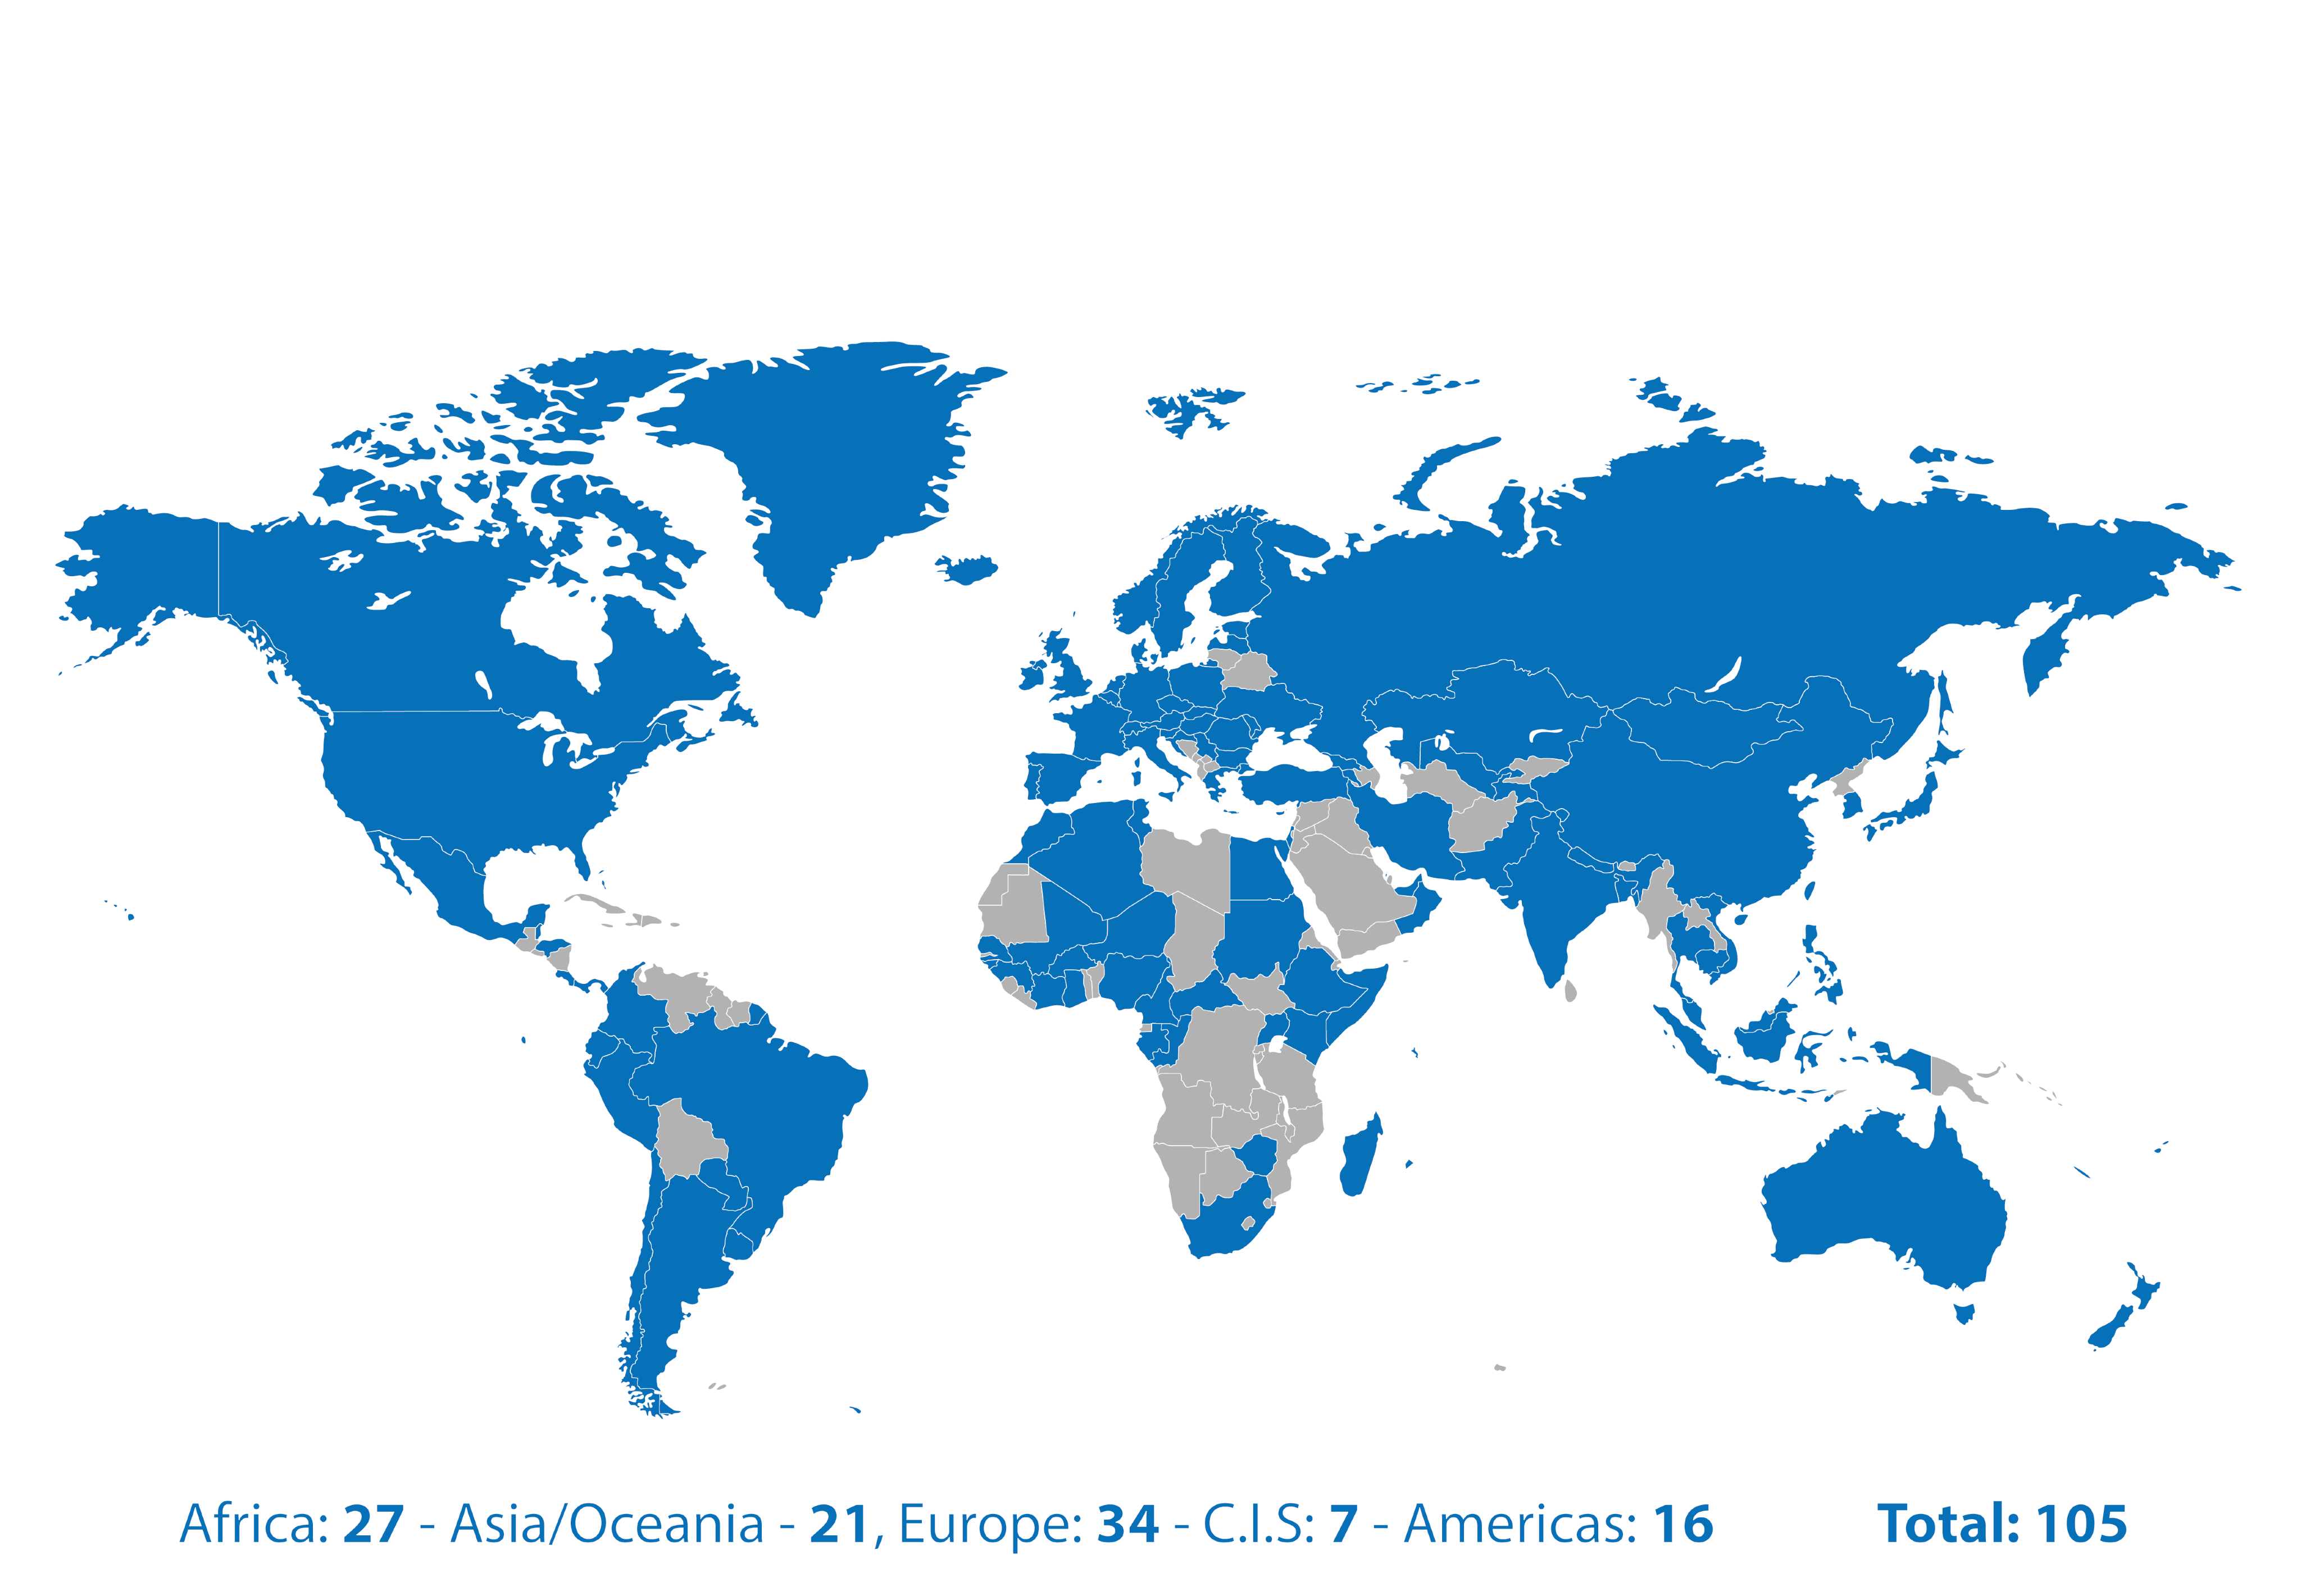
Group on Earth Observations
105 Member Countries

Slide 9
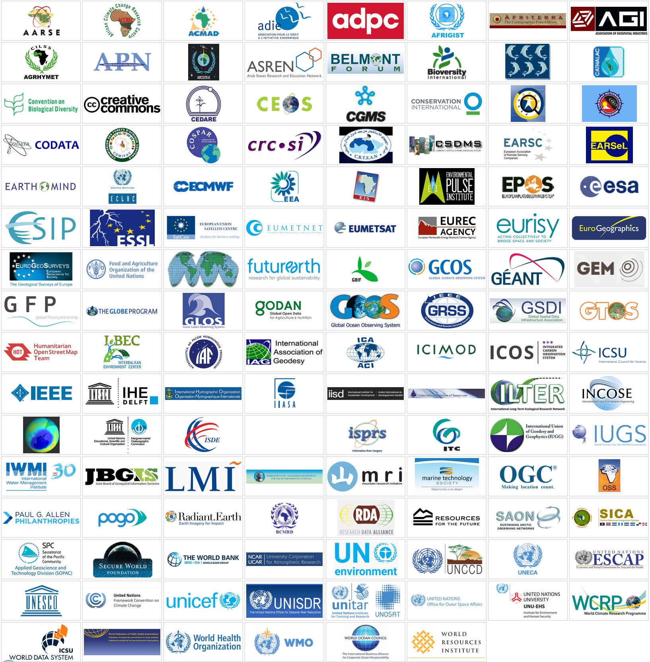
Group on Earth Observations
127 Participating Organizations

Slide 10
Earth Observations for Temporal Monitoring
Time-series data for dynamic observations
Urbanization
Urban expansion in New Delhi, India, March 14, 1991 - March 2, 2016
Source: NASA Images of Change

Slide 11
Earth Observations for Temporal Monitoring
Time-series data for dynamic observations
Climate impact monitoring
Older, thicker Arctic sea ice declines, September 1984 - September 2016
Source: NASA Images of Change

Slide 12
Earth Observations for Temporal Monitoring
Time-series data for dynamic observations
Flood monitoring
Storms swell Ceder River, Iowa, July 8 2016 - September 26, 2016
Source: NASA Images of Change

Slide 13
Earth Observations for Temporal Monitoring
Time-series data for dynamic observations
Drought and water resources management
Drying Lake Poopó, Bolivia, April 12, 2013 - January 15, 2016
Source: NASA Images of Change

Slide 14
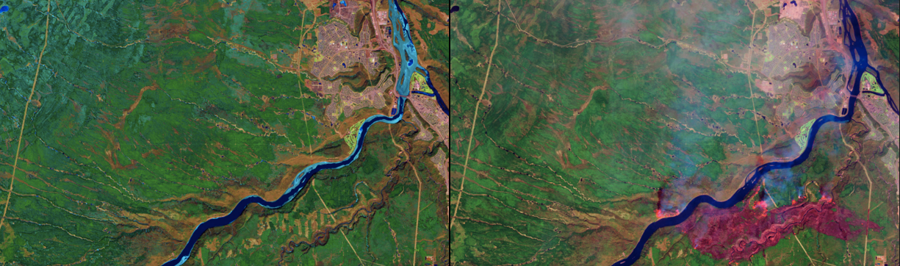
Earth Observations for Temporal Monitoring
Time-series data for dynamic observations
Wildfire monitoring
Wildfires near Fort McMurray in Alberta, Canada, April 17, 2016 - May 3, 2016
Source: NASA Images of Change

Slide 15
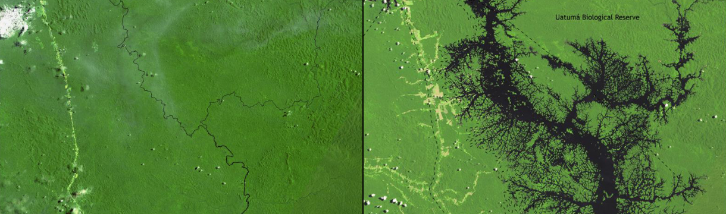
Earth Observations for Temporal Monitoring
Time-series data for dynamic observations
Water, ecosystem and infrastructure resource management
Balbina Dam impact, Brazil, 1985 - 2007
Source: NASA Images of Change

Slide 16
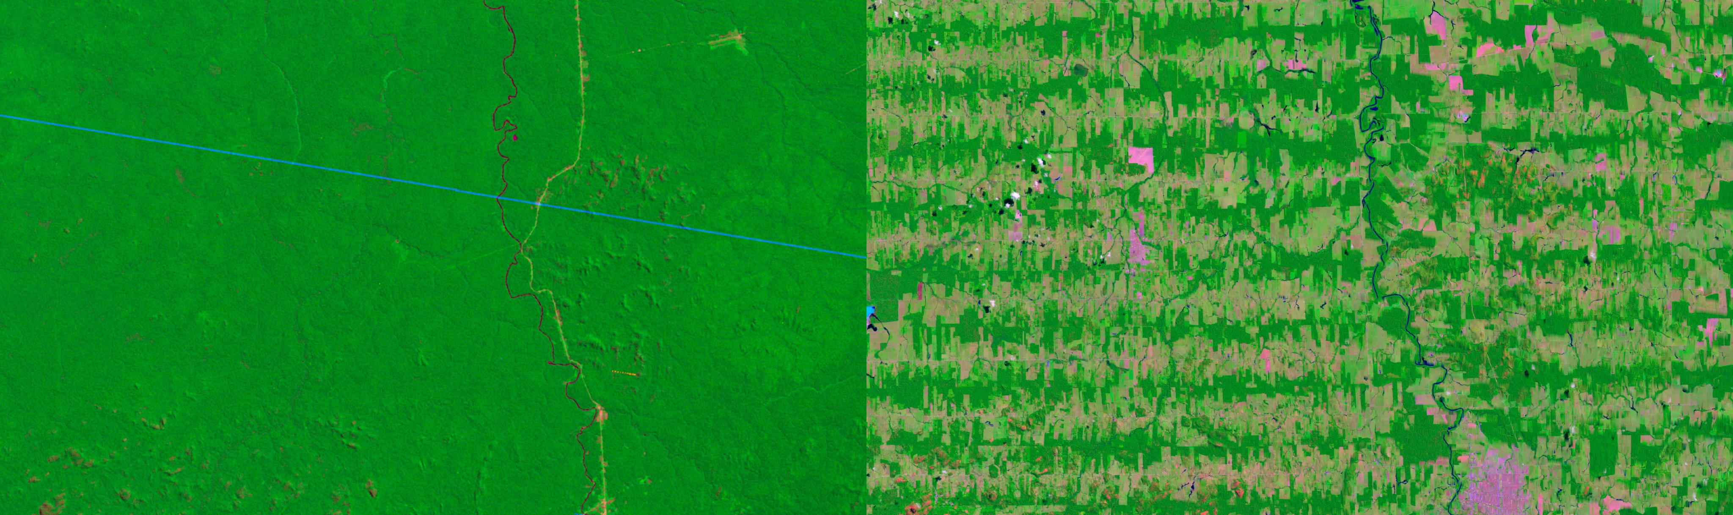
Earth Observations for Temporal Monitoring
Time-series data for dynamic observations
Deforestation in Amazonia
Rondonia, Brazil, 1975 - 2012
Source: NASA Images of Change

Slide 17
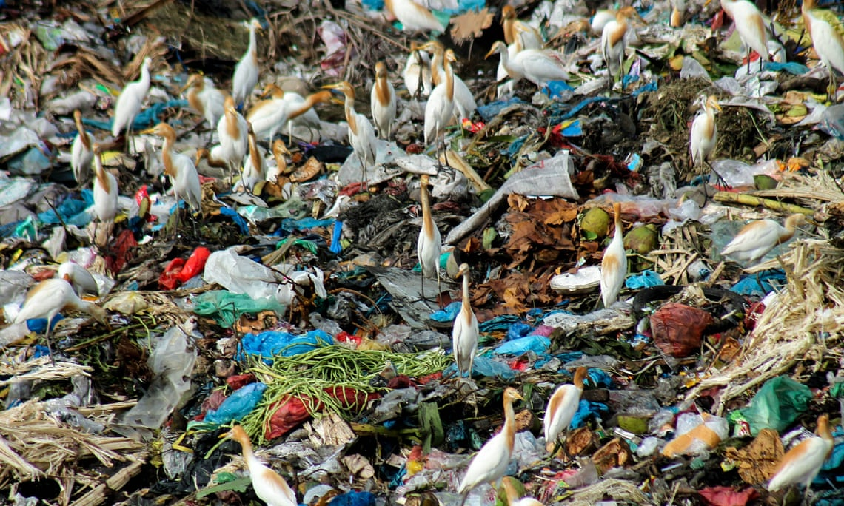
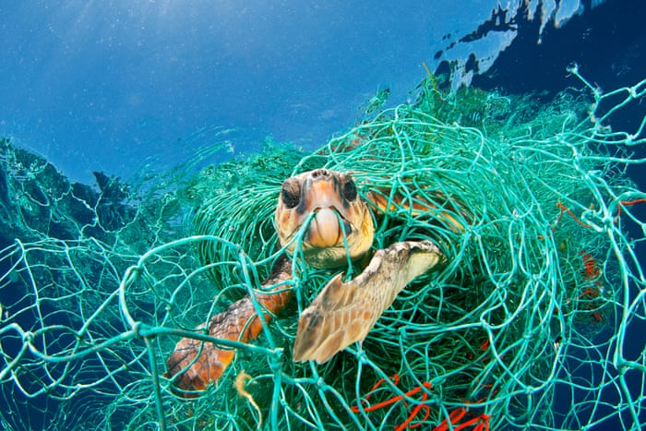
Earth Observations for Plastic Monitoring
Monitoring of marine debris
A plastic world
Scavengers seen collecting garbage at a landfill for recycling in Aceh, Indonesia
A plastic world
A loggerhead turtle trapped in a drifting abandoned net, Mediterranean Sea
Source: Fachrul Reza / Barcroft Images
Jordi Chias/NPL/WWF

Slide 18
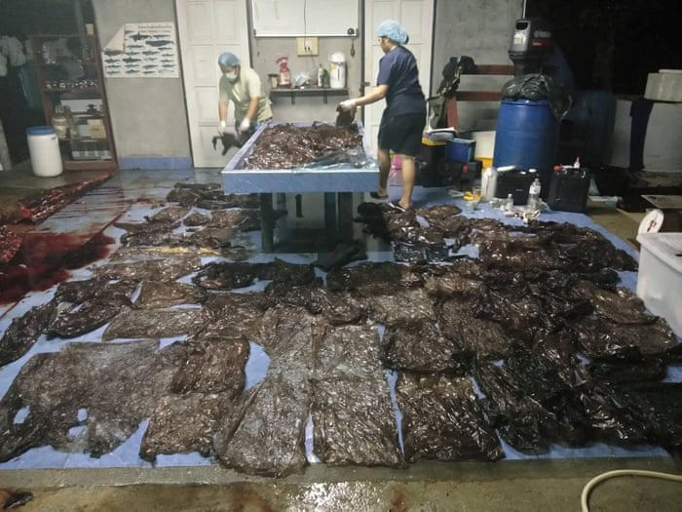
This whale’s tasty plastic feast ended in disaster when it swallowed up to 80 plastic bags and died.
Department of Marine and Coastal Resources/Reuters

