Slide 1
Capacity Development for Water and Food Security
Breakout Session B4: Food and Water Security
Dr. Jens Liebe
UN-Water Decade Programme on Capacity Development (UNW-DPC)
GEOSS S+T Stakeholder Workshop
30 August 2012 ∙ Bonn, Germany
1

Slide 2
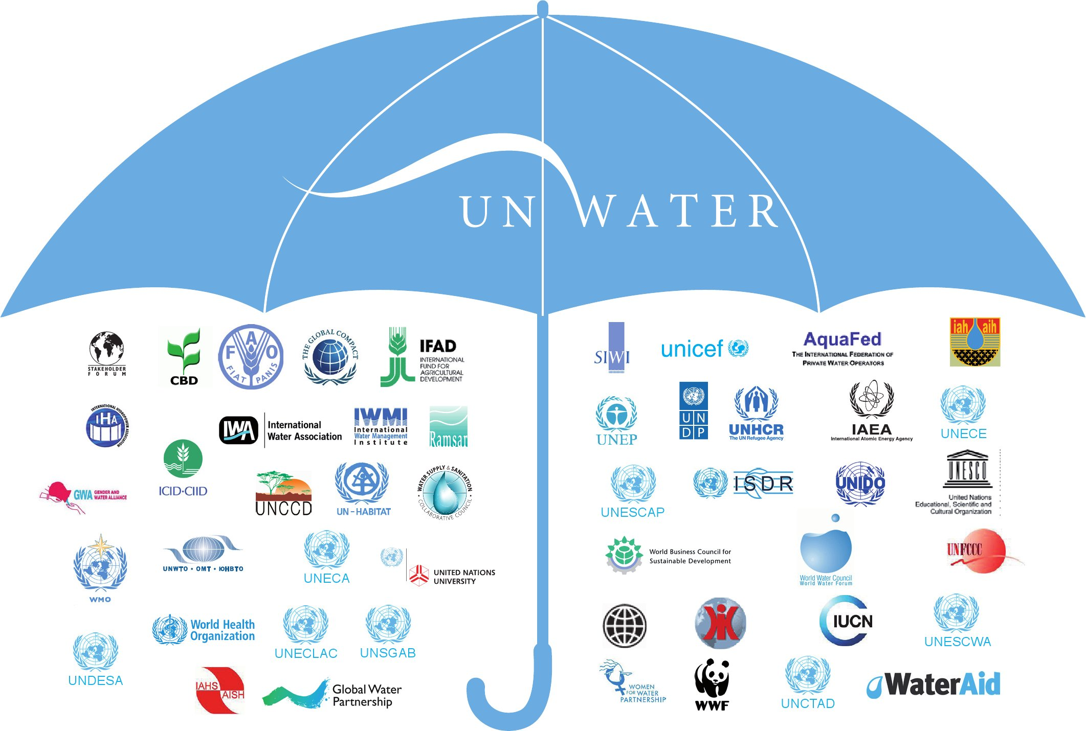
WWAP
UNW-DPC
UNW-DPAC
JMP
UN-Water Members
UN-Water Partners

Slide 3
UNW-DPC’s Mission
“to enhance the coherence, credibility and integrated effectiveness
of UN-Water
by strengthening its capacity development programmes, particularly in developing countries and economies in transition.”

Slide 4
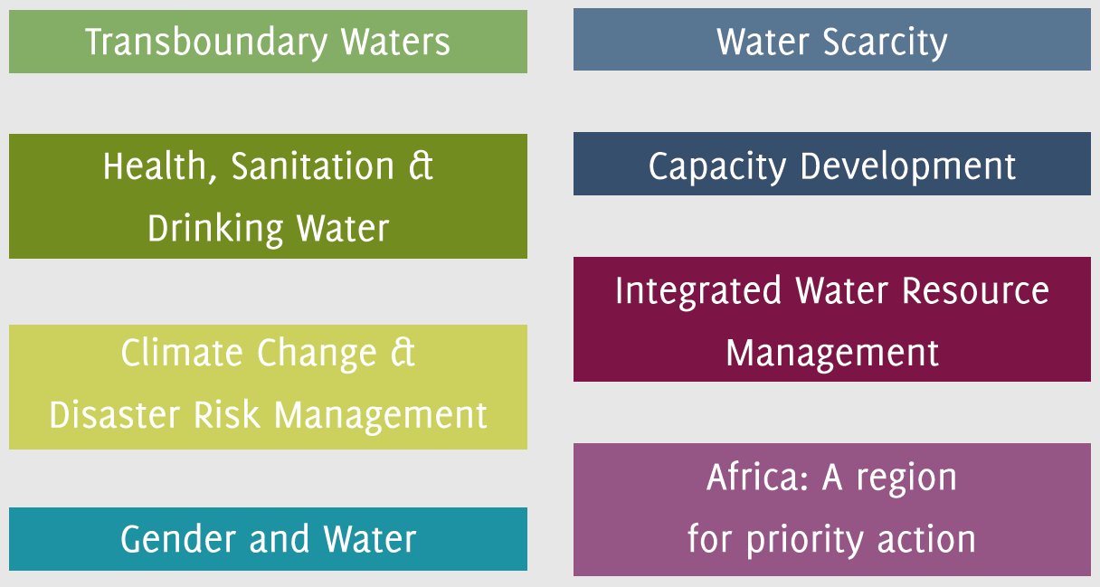
UNW-DPC Areas of Activity
all areas of priority to UN-Water:

Slide 5
Global Water and Food Challenges
About 1 billion people have no secure food supply and only limited access to clean water, sanitation or modern sources of energy
Population growth, urbanization, industrial expansion and climate change (by 2025 ~ 3 billion people water stressed)
Urgent need for action to enhance sustainable development and to achieve water, energy and food security for the world’s population

Slide 6
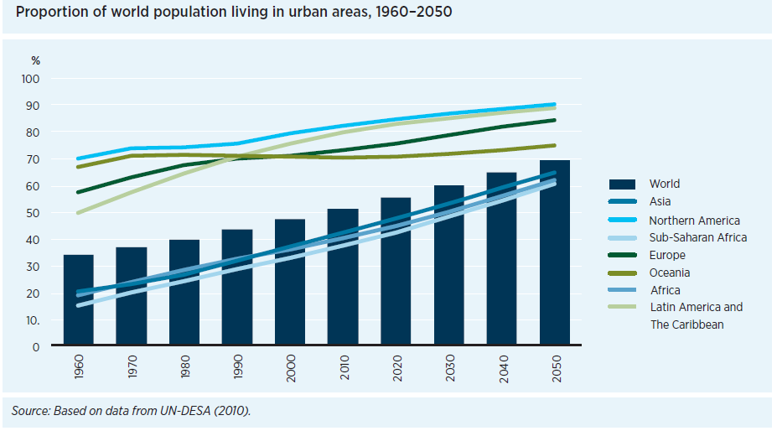
Urbanization
WWDR 4

Slide 7
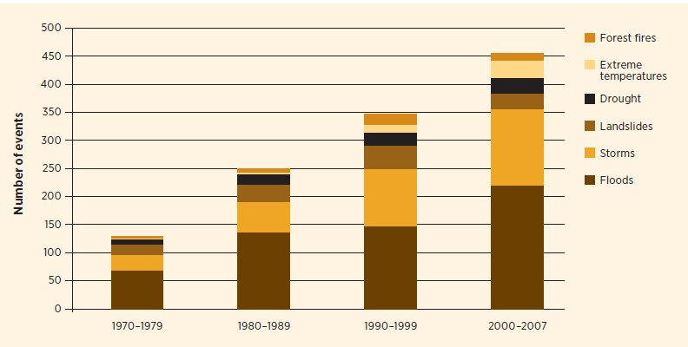
Frequency of hydromet. events 1970-2007
“The frequency, duration and intensity of extreme weather events are expected to rise with climate change, increasing the need for risk management.”
WWDR 4

Slide 8
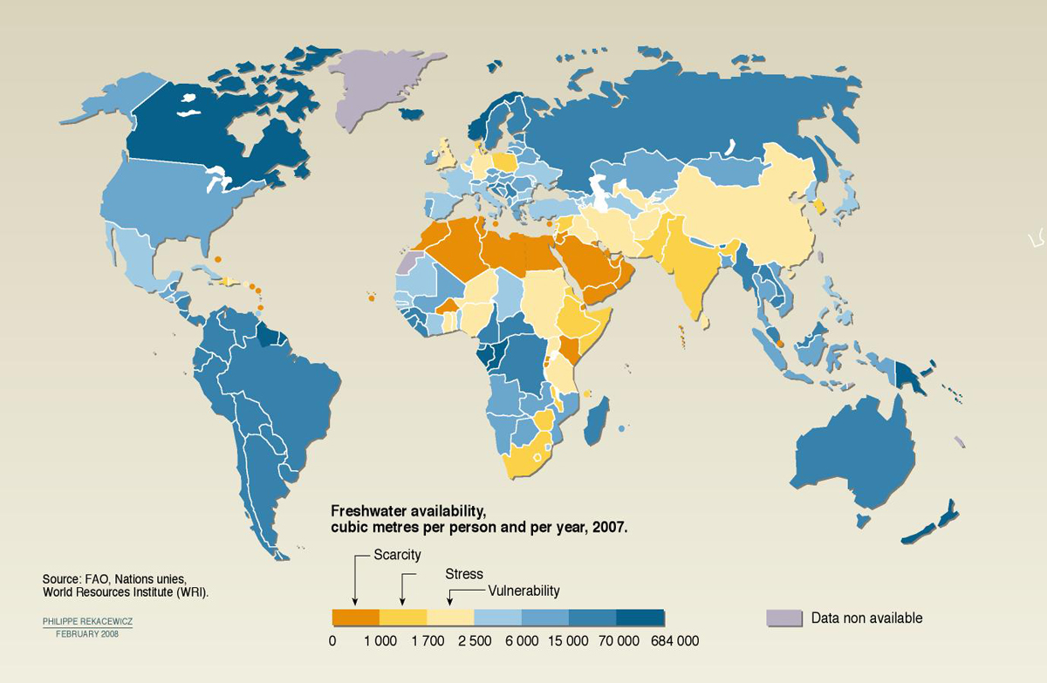
Freshwater Scarcity

Slide 9
The Water, Energy and Food Security Nexus
Source: Bonn Nexus Conference 2011

Slide 10
The Water, Energy and Food Security Nexus
In many regions and sectors, resources are not used in an efficient and sustainable way and there is a large potential to increase overall resource use efficiency and benefits in production and consumption
The Nexus perspective considers the inter-dependencies across the water, energy and food sectors and policies such as climate and biodiversity
The Nexus approach aims to increase efficiency, reduce trade-offs, build synergies and improve governance across sectors

Slide 11
In the Nexus context, Capacity Development is crucial
...to identify interconnections between sectors and actors
...to promote learning and knowledge sharing across sectors and regions
...to narrow the gap between the availability of solutions and skills and means to use them (e.g. technology)
...to support decision-makers to develop appropriate policies, strategies and investments, to explore and exploit synergies, and to identify and mitigate trade-offs

Slide 12
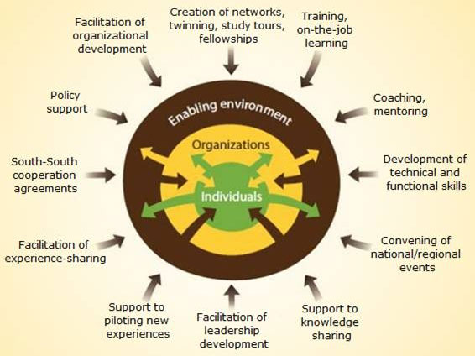
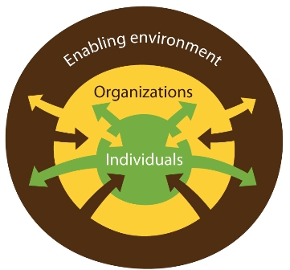
Dimensions of Capacity Development
FAO

Slide 13
Example 1: Water Scenarios
How can we meet the global water demand?
On a global scale, data base of stocks and flows are rather poor
At the same time, nations thin out their measuring and monitoring programmes
Gap can be closed, and significant advances can be made by Earth Observation

Slide 14
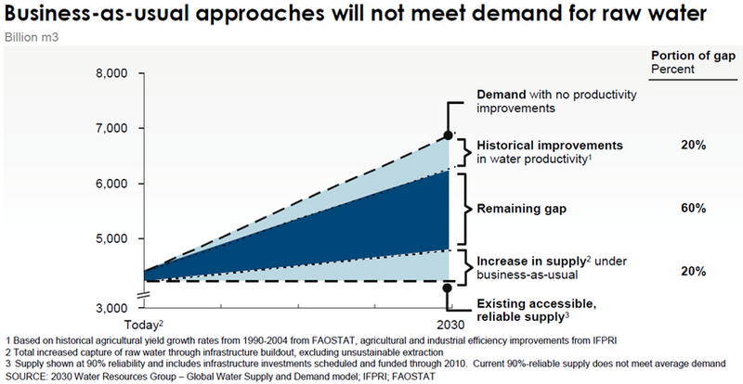
Example 1: Water Scenarios

Slide 15
Some key aspects
Scenarios are important for decision makers
The underlying physical data is largely poor
“You can’t manage [well] what you can’t measure [well]”
Yet: Decisions have to be made today

Slide 16
Challenges
Spatial and temporal distribution of water (ideally stocks and flows)
Monitoring of water quality
Keeping data up-to date
Climate change models need to improve to lead to better adaption
National strategies require political decisions on water allocation
Fostering cross-disciplinary decision making (acknowledging the nexus)

Slide 17
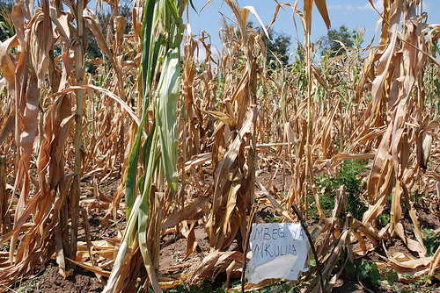
Example 2: Drought Management
Currently: push to move away from crisis-driven approach and to promote development of integrated risk-based national drought policies.
Source: CIMMYT

Slide 18
Drought Management
Many advances in RS of the water cycle components (P, ET, soil moisture, storage)
Several drought monitoring products
But in many nations:
Lack of capacity to utilize such drought products
Skills of individuals
drought management policy

Slide 19
Challenges
Define and Implement NDMP with elements of
Drought monitoring and Early warning
Vulnerability Assessment and Impacts
Emergency Relief and Response
Risk based management requires sound underpinning data
(Sivakumar et al. 2011)

Slide 20
Conclusion
Mismatch between availability of solutions and skills and means to use and benefit from them
Capacity Development is essential to assist nations in managing their resources and achieving water and food security
Overcoming silos for improved management essential
EO can play an important role in providing data and developing tools: Underpin sound resource management

Slide 21
Concrete steps/Current planning
Formation of a TF on Water and Food Security
“National Drought Management Policy” Initiative
Many other capacity development initiatives, e.g.:
Drinking water loss reduction
Aquacrop Training
Safe Use of Wastewater in Agriculture
Climate- smart agriculture

Slide 22
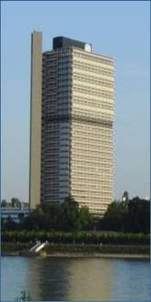
Thank you!
UN-Water Decade Programme on Capacity Development (UNW-DPC)
UNITED NATIONS UNIVERSITY
UN Campus
Hermann-Ehlers-Str. 10
D-53113 Bonn, Germany
Phone: + 49 (0) 228 815-0652
Fax: + 49 (0) 228 815-0655
E-Mail: info@unwater.unu.edu
www.unwater.unu.edu

