Slide 1
The Role of GEOSS Strategic Targets as Metric for the Success of GEOSS and
The challenges to meet targets with a bottom-up approach
2nd GEOSS Science&Technology Workshp
Bonn, Germany
August 29, 2012
Lars Ingolf Eide,
Co-Chair
Third Evaluation Team

Slide 2
Contents
Review of the Targets structure
  Role in logic model, targets vs. output, outcome and impact
Review of how the targets work – learnings from the evaluations
Challenges to meet targets with a bottom-up approach
Summing-up & conclusions

Slide 3
What is SUCCESS of GEOSS?
A definition of success for GEOSS could be
  Achievement of a set of targets for which the users feel ownership
Success will require
  Clear targets
  Common understanding of targets
  Strong organizations with will and ability to reach targets
  Users must be involved in setting targets
  Users involved in evaluation of achievements

Slide 4
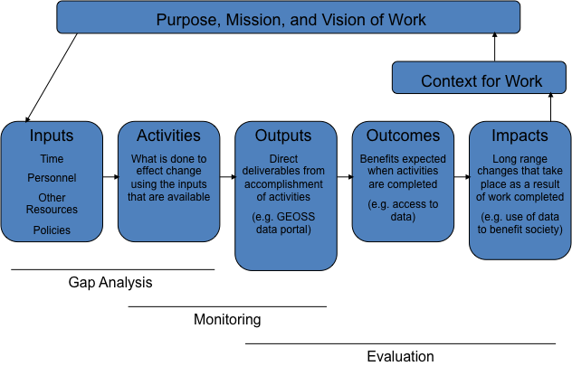
The role of targets in a generic logic model
Help identify needs
Enable proper monitoring and evaluation
From Midterm Evaluation Report

Slide 5
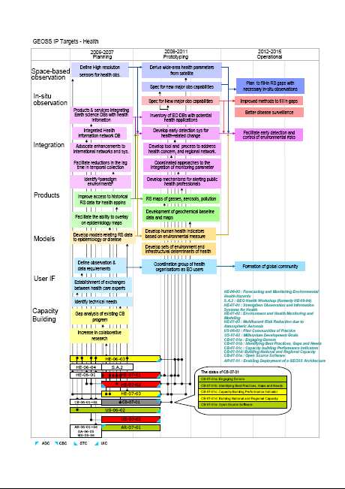
GEOSS logic model
Targets
Inputs
Activities
Outputs
Outcomes
Contributions from Members and Participating Organizations
Outcome Performance Indicators
Workplan
GEOSS Roadmap
Reporting
Reporting and Monitoring
Evaluation
Task sheets
From Document 11, GEO-V

Slide 6
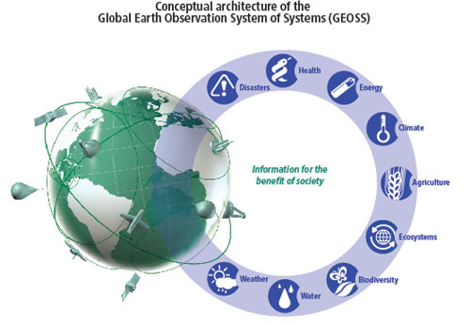
GEOSS target structure
Before 2015, GEO aims to:
Achieve/Improve/Enhance/Ensure/Provide/Establish/Enable/Close
critical gaps/Substantially expand/Produce comprehensive/
This will be achieved through:
Mmmm
nnnnnn
This will be demonstrated by:
Mmmm
nnnnnn

Slide 7
Why this structure?
M&E WG saw that
  Strategic Targets are too broadly stated and too open to interpretation to be of much use in supporting monitoring and evaluation.
  The Strategic Targets are more like goals than targets
    As such, they require further specification to make them measurable.
Note: Some targets need a “baseline” (enhance, improve, expand, close gaps). This does not exist.

Slide 8
Three tiers
The” outcomes" would be stated with sufficient detail to support measurement
Indicators would be developed for many, if not all, of these outcomes
Quantified and time-bound objectives (real "targets") would be established for each of these indicators.
This approach would follow general good practices in monitoring
and evaluation.
The indicators developed would collectively enable GEO to track
progress toward the Strategic Targets.

Slide 9
Difficulty in finding Performance indicators, Example: User Engagement
Outcome: | Rating | Possible indicators | Observations
Establishment of an agreed core set of essential environmental, geophysical, geological, and socio-economic variables needed to provide data, metadata and products in support of all GEOSS Societal Benefit Areas | Likely measurable | Number of SBAs for which critical earth observation priorities have been identified and agreed to by user communities. | More elaboration needed between UIC and M&E. M&E should make sure if the said core data sets, if they refer to task US-09-01a, is what exactly the M&E wants. (This study so far is based on *publicly available documented* observation needs and there are certain limitations to this approach)
Involvement of users in: reviewing and assessing requirements for Earth observation data, products and services; creating appropriate mechanisms for coordinating user requirements; utilizing data/information delivery systems; and capturing user feedback on an ongoing basis across Societal Benefit Areas | Likely measurable | Number of active communities of practice Number of individual participants in GEO communities of practice Number of user institutions participating in GEO tasks Number of inputs to User Requirements Registry | Definition of 'user institutions' will have to be clarified
Increased use of geo-spatial data in all Societal Benefit Areas and in particular in developing countries | Possibly measurable |  | Focus on adoption of GIS by developing countries.
Memo from M&E WG 22 December 2010

Slide 10
Difficulty in finding Performance indicators, Example: Energy
(Text in red is presenter´s comments)
Outcome: Significant increase in use of Earth observations by all sectors for improved: | Rating | Possible indicators | Observations
Environmental, economic and societal impact assessments of energy exploration, extraction, conversion, transportation and consumption | Not measurable but examples may be identified | One could do one or more test cases with and without GEOSS data. Perhps something for ENERGEO, i.e. Task EN-07-02 | Success here is closely linked to outcomes of other areas, as 2.1.4, 2.2.1, 2.5.3 and 2.5.4
Prediction of potential hazards to the energy infrastructure | Not measurable but examples may be identified | Try to track examples or increased use within national authorities and/or energy providers | Success here is closely linked to outcomes of other areas, as 2.4.2, 2.9.2 and 2.9.3
Prediction of the production of intermittent sources of energy | Not measurable but examples may be identified | As 2.6.2 | Success here is closely linked to outcomes of other areas, as 2.9.2 and 2.9.3
Mapping of renewable energy potential | Not measurable but examples may be identified | As 2.6.2 | Success here is closely linked to outcomes of other areas, as 2.1.1, 2.3.2, 2.3.4 and 2.9.3

Slide 11
Potential Measurability of GEOSS Outcomes
(M&E WG preliminary analysis)
 | Likely measurable | Possibly measureable | Not measurable | Sum
GEOSS Building Blocks | 6 | 8 | 5 | 19
GEOSS Societal Benefit Areas (SBA) | 3 | 25 | 13 | 41
Sum | 9 | 33 | 18 | 60
Not measurable may also mean that examples may be identified
or that outcomes may be determinable but not measurable

Slide 12

Example of answers from ABE Evaluation
Which of the AG/BI/EC Targets and Outcomes to you think will be achieved by 2015?
  Outcomes are rather vague or more like vision statements and ambitions.
  Most outcomes are likely to be reached simply because others are already doing or have done this.

Slide 13
Example of answers from ABE Evaluation (cont´d)
To what extent do you feel the Outcomes of AG/BI/EC are aligned with stakeholder priorities?
  Who are the stakeholders and what are their priorities? As a very big initiative, it is very difficult to establish what the focus is and the measurable outcomes to be achieved in the near future.
  We have no clear understanding of who the stakeholders are. That’s one of the problems with GEOSS. It is quite unclear who the owner is, who requested the program, and who participates under which mandate.

Slide 14
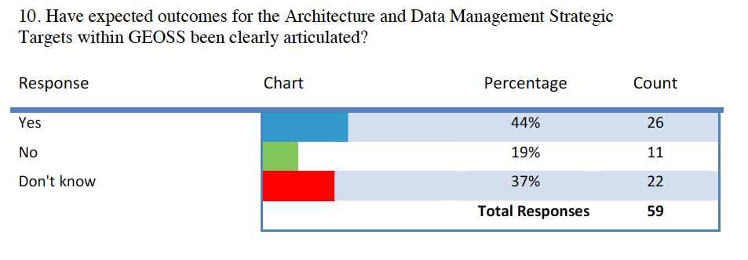
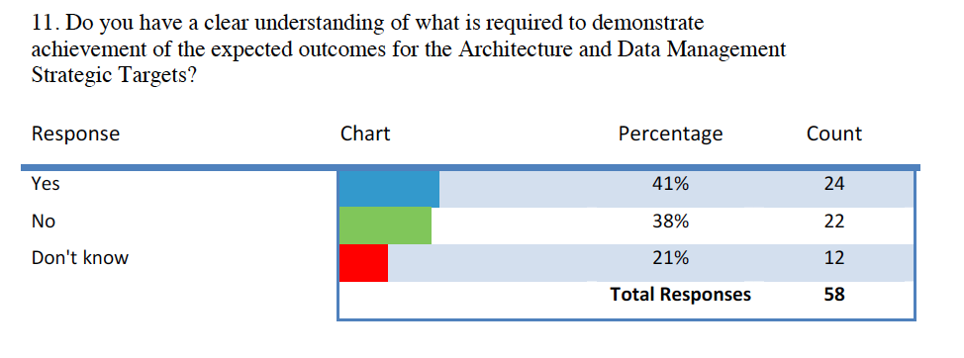
Example from ADM Evaluation

Slide 15
Impacts of insufficiently defined targets
Gaps and needs become unclear and difficult to identify
Proper monitoring and evaluation difficult to perform
From Midterm Evaluation Report

Slide 16
Requirements to indicators
(Memo from M&E WG 22 December 2010)
Relevance to GEO
Clear definitions
Verifiability
Cost-effectiveness
Quantitative metrics that supplement qualitative reporting
Data to produce indicators must be easily available, preferably as multiple data points
Indicators kept to a reasonable number
Need not address all aspects of GEOSS

Slide 17
Challenges to meet targets with a bottom-up approach

Slide 18
Definitions
(inspired by Wikipedia)
Bottom-up approach is the piecing together of systems to give rise to grander systems, thus making the original systems sub-systems of the emergent system
  In a bottom-up approach the individual base elements of the system are first specified in great detail. These elements are then linked together to form larger subsystems, which then in turn are linked, sometimes in many levels, until a complete top-level system is formed.
Top-down approach formulates an overview of the system, specifying but not detailing any first-level subsystems.

Slide 19
From contributors bottom-up requires
Common perception and understanding of common targets
Will and ability to work towards common goals
Common understanding of what is needed (gap analysis)
A set of targets and performance indicators for own activity (must tie into overall targets)
Willingness to report in a larger context in light of common targets

Slide 20
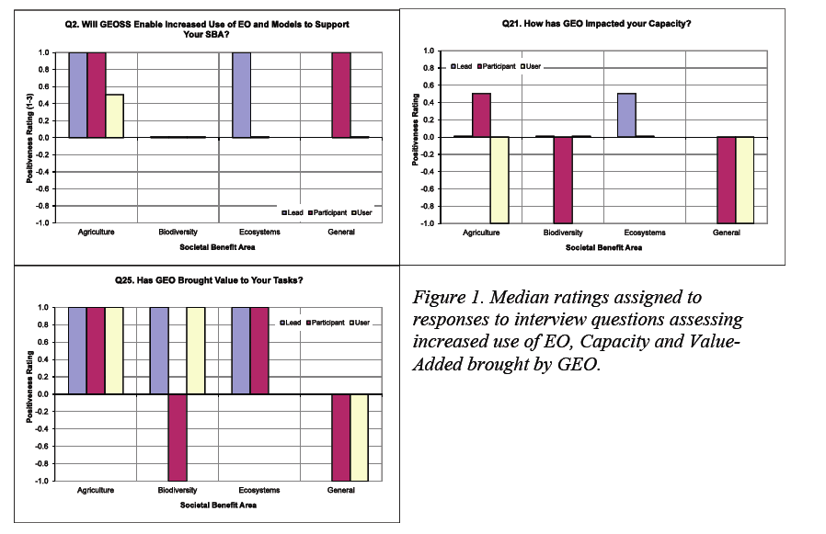
… and …
Will and ability to work for added value beyond own organization (benefit beyond co-operation)
From 3rd evaluation:
  Key informants expressed the view that GEO and GEOSS are adding value to the work within the involved organizations and members, mainly through collaborative initiatives and less likely to add value through contributing to increased use of Earth Observations and institutional capacity building.

Slide 21
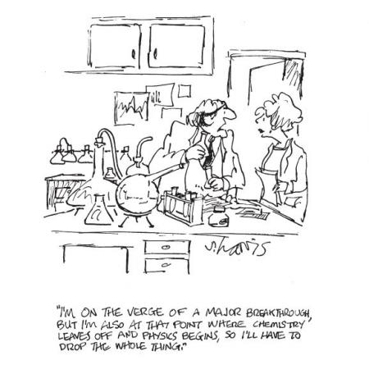
…and…
Willingness to learn across initiatives
  Cooperation between components, cross-cutting as well as SBAs
Acknowledgement of work of others (no co-opting)

Slide 22
Bottom-up also requires
Coordination of base element activities
  Understanding of what is needed (Gap analysis is critical to ensure that Targets and Outcomes can be achieved)
  Clear targets and performance indicators
  Ability to set requirements
  Ability to prioritize
  Common progress reporting towards targets, not only of activities
  Ability to leverage funding for necessary activities

Slide 23
…and…
Engagement of and communication to users (Activities must not primarily focus on establishing collaboration and developing data products, but also involve users.)
Some assurance that activity has potential to achieve target (e.g. feasibility study and secured resources)
Milestones and/or Decision Gates

Slide 24
Summary
Targets have a role for success but
Present formulation and/or presentation of the GEOSS Strategic Targets may not be sufficient to demonstrate success
  Targets and outcomes appear insufficient, they are perceived as vague and lacking objective criteria.
  Vagueness around ownership of Targets and Outcome encumbers their use as metric.
  This leads to lack of clear understanding of how to demonstrate achievement of outcomes.
  A bottom-up approach requires clear targets and a common understanding of how they work and how to achieve them.

Slide 25
Recommendation
The targets and outcomes should be revisited with an aim to establish more measurable and potentially achievable ones in a post 2015 GEO plan, e.g. using the three tiers.
  Added value better emphasized?
Align targets/outcomes and Work Plan
  Procedures or guidelines for gap identification should be developed and implemented that allow task leads to identify gaps and outline potential solutions.
  A reporting structure should be established that explicitly links activities and progress to GEO Targets and Outcomes and contains quantitative measure of progress.

Slide 26
Thank you for your attention!

