Slide 1

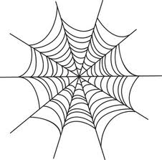












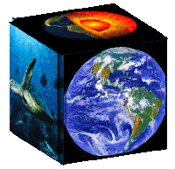


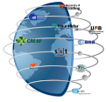


The Model Web approach: a push-pull component for the science-policy interface?
Stefano nativi, paolo mazzetti, gary geller
CNR-IIA ESSI-lab, NASA JPL
August 2012
stefano.nativi@cnr.it

Slide 2
What if…
?
How will CC affect infection rate
of dengue fever in Vietnam?
?
Socioeconomic
Fossil Fuel Use Model
Data
Global Climate
Model
Regional
Climate Model
Observational Data
(environment &
vector distribution)
Data
Data
Data
Deforestation/
Disturbance Model
Vector Niche
Model
Infection
Rate Model
Data
Human Population Density
and Distribution Model
Infection Rates

Slide 3
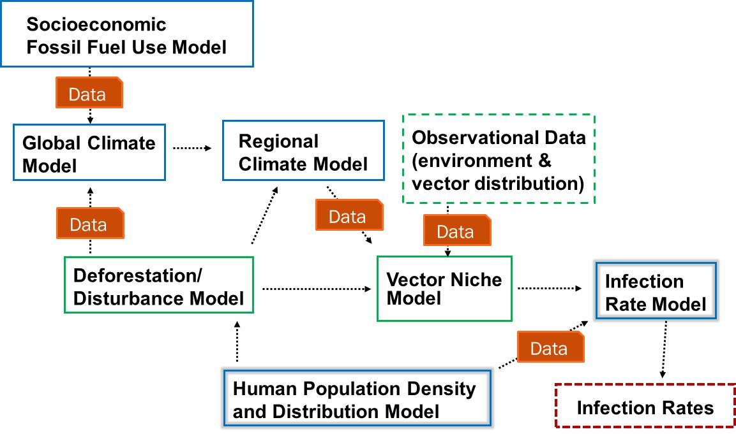
Elements …
?
How will CC affect infection rate
of dengue fever in Vietnam?
?
Business Process
Data
Model
Link/Interface

Slide 4




General Use Case
Define and run a Business Process to answer to “What if..”
A
B
C
D
  Create or Edit an abstract BP
  Compile the abstract BP
  Execute the BP
  Return the output to the User
USER
BP editor
BP
Brokers
WF engine
Middleware

Slide 5

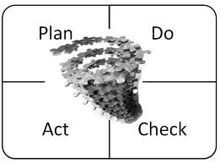
Elements …
?
How will CC affect infection rate
of dengue fever in Vietnam?
?
Business Process
Data
Model
Link/Interface
Vocabularies
Knowledge Base

Slide 6
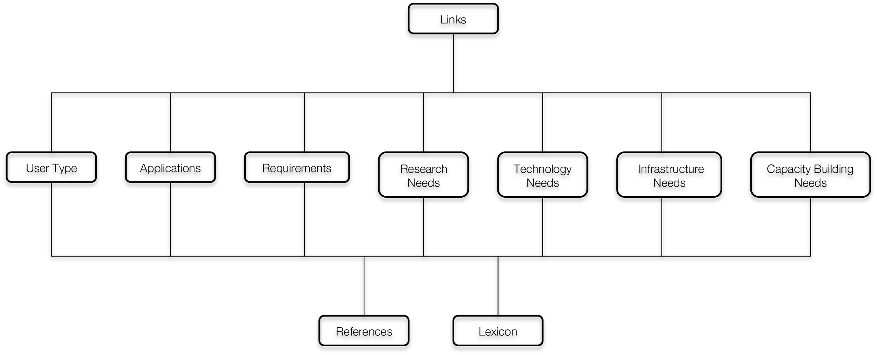

Knowledge bases
URR is a knowledge base
    Application = BP (with User’s feedbacks)
    Lexicon = Vocabulary

Slide 7



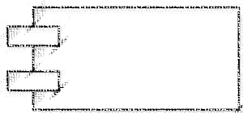




UncertWeb Bp Broker
URR
BP Editor
BP library
BP Broker
Resources
Brokering
framework
Component library
Controller
Preprocessor
WF engine

Slide 8
ConclusioNs
The Model Web aims to support the science of tomorrow building an ecosystem of interacting models and facing the related challenges (i.e. multidisciplinarity, scalability, etc.).
In the Model Web users focus on high-level representations (i.e. abstract Business Processes); lower level details are in charge of the middleware.
Building meaningful multidisciplinary BPs requires knowledge bases supporting the interaction with and between Science and Policy components
The GEO URR can provide the knowledge (applications/BPs, lexicon/vocabularies) required to implement the GEO Model Web vision.

