Slide 1
GEOSS S&T Workshop, Aug. 2012
International Geosphere-Biosphere Programme (IGBP)
Earth System Science for Global Sustainability: Observations
Sybil P. Seitzinger
Executive Director, IGBP
Stockholm, Sweden

Slide 2
IGBP Strategic Vision
To provide essential scientific leadership and knowledge of the Earth system to help guide society onto a sustainable pathway during rapid global change
Notes:
2

Slide 3
IGBP Strategic Vision
Fundamentals of the Earth system
Impacts of environmental disturbances
Bio-geophysical and social diversity
Resource management
Mitigation and adaptation
Notes:
3

Slide 4
Integrated Earth-System Approach
Atmosphere
Notes:
In the atmosphere

Slide 5
Integrated Earth-System Approach
Land
Notes:
processes on land

Slide 6
Integrated Earth-System Approach
Ocean
Notes:
the oceans

Slide 7
Integrated Earth-System Approach
Land-
Atmosphere
Notes:
We have a large focus on the links between these systems: land-atmosphere,

Slide 8
Integrated Earth-System Approach
Land-Ocean
Notes:
land-ocean

Slide 9
Integrated Earth-System Approach
Ocean-
Atmosphere
Notes:
and ocean-atmosphere.

Slide 10
Integrated Earth-System Approach
Integration-
Synthesis
Notes:
We are looking at the Earth system as a whole.
Two overall integrating projects look at past global changes and another at current and future changes.

Slide 11
Integrated Earth-System Approach
Notes:
And of course, each core project has an acronym – shown here.
The message here is that we take an integrated approach to studyng the major systems of the Earth system
And very importantly, people are key components of each system

Slide 12
IGBP Strategic Vision
Fundamentals of the Earth system
Impacts of environmental disturbances
Bio-geophysical and social diversity
Resource management
Mitigation and adaptation
Notes:
12

Slide 13
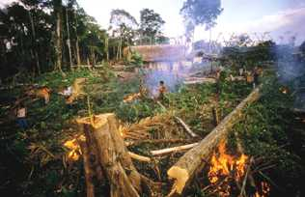
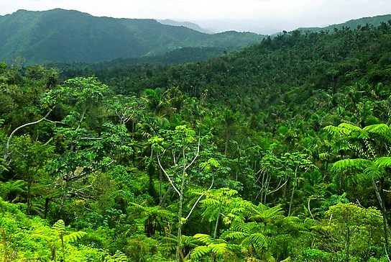
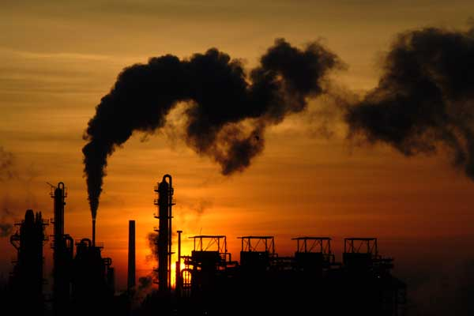
Fate of anthropogenic CO₂ emissions
Atmosphere
45%
+
Land
30%
Oceans
25%
This is a great service, now worth >half a trillion US$
(25€ per ton CO2-equivalents)
Canadell et al. 2007, PNAS

Slide 14
Primary production trends
Global NPP decrease
S.Hemisphere decrease – drought
Implications terrestrial C sink
Space-based and in situ observations
Terrestrial NPP trends
(2000 – 2009)
M. Zhao et al., 2010 Science
Notes:
Long-term space based observations, combined with in situ data and modeling are critical to illucidate trends, globally and regionally.
Between 2000 and 2009 global plant growth on land – net primary productivity (NPP) – fell slightly. However, most of the decrease was in the Southern Hemisphere (red areas in figure), including large parts of South America, Africa and Australia. Where severe regional droughts have become more frequent. Contrasts with large areas northern hemisphere which saw a rise in primary production….in part attributed to warming which lengthens the growing season in higher latitudes promoting plant growth, and nitrogen deposition and fertilizer use which also stimulated a rise in NPP in the northern hemisphere. The results of these trends have implications for changes in the terrestrial carbon sink, and for regional and global climate model development.

Slide 15
Sustainability in urbanizing planet
Urbanization and Built Environments
If 3.2 billion additional people by 2100
Mostly in cities of 1 million
Require 3200 cities of 1 million over 89 years
89 years = 32485 days
3200 cities over 32485 days
~ 1 new city of 1 million every 10 days
Karen Seto 2011

Slide 16
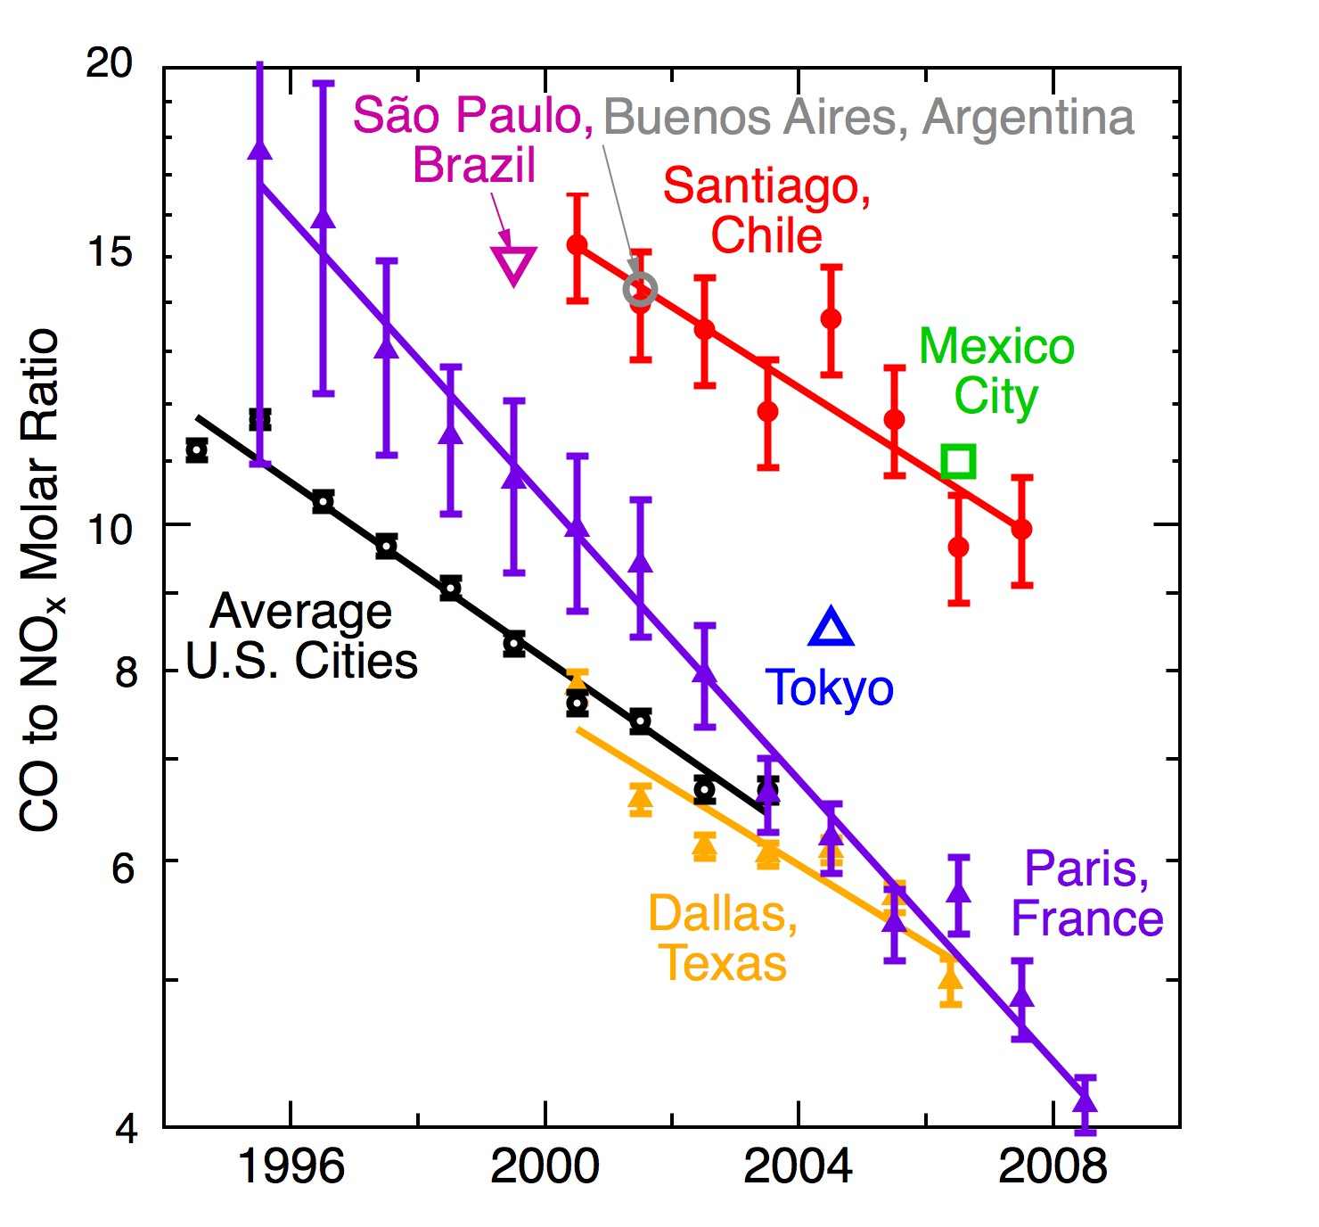
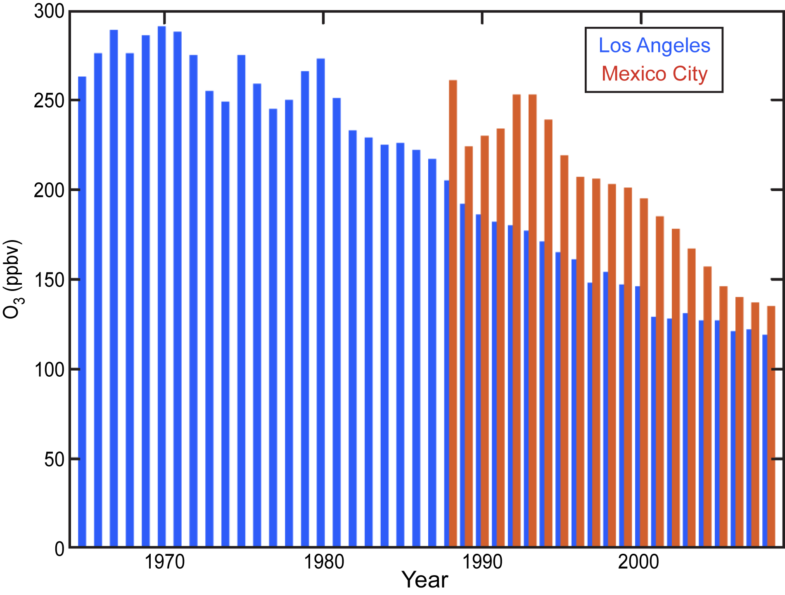
Impacts of cities on air pollution and climate
The Impacts of Megacities on Air Pollution and Climate
Ozone conc. vs time

Slide 17
Quantifying anthropogenic and natural emissions of trace gases and aerosols, and facilitating use by research, assessment, and policy communities
Quantifying anthropogenic emissions and natural exchanges of trace gases and aerosols, and facilitating the use of this information by the research, assessment, and policy communities
Surface NOx emissions
Anthro. CH4 emissions
Notes:
GEIA through ECCAD--Emissions of atmospheric Compounds & Compilation of Ancillary Data -- is creating online access to emission data sets and providing tools for quick analysis of these data sets. CIERA is creating an online community of scientists and policy makers to enhance communication between these two communities and improve emission inventories across the board. The figures here so surface NOx emissions comparison between two different data sets. the evolution of anthropogenic methane emissions – location Brazil (bottom right).

Slide 18
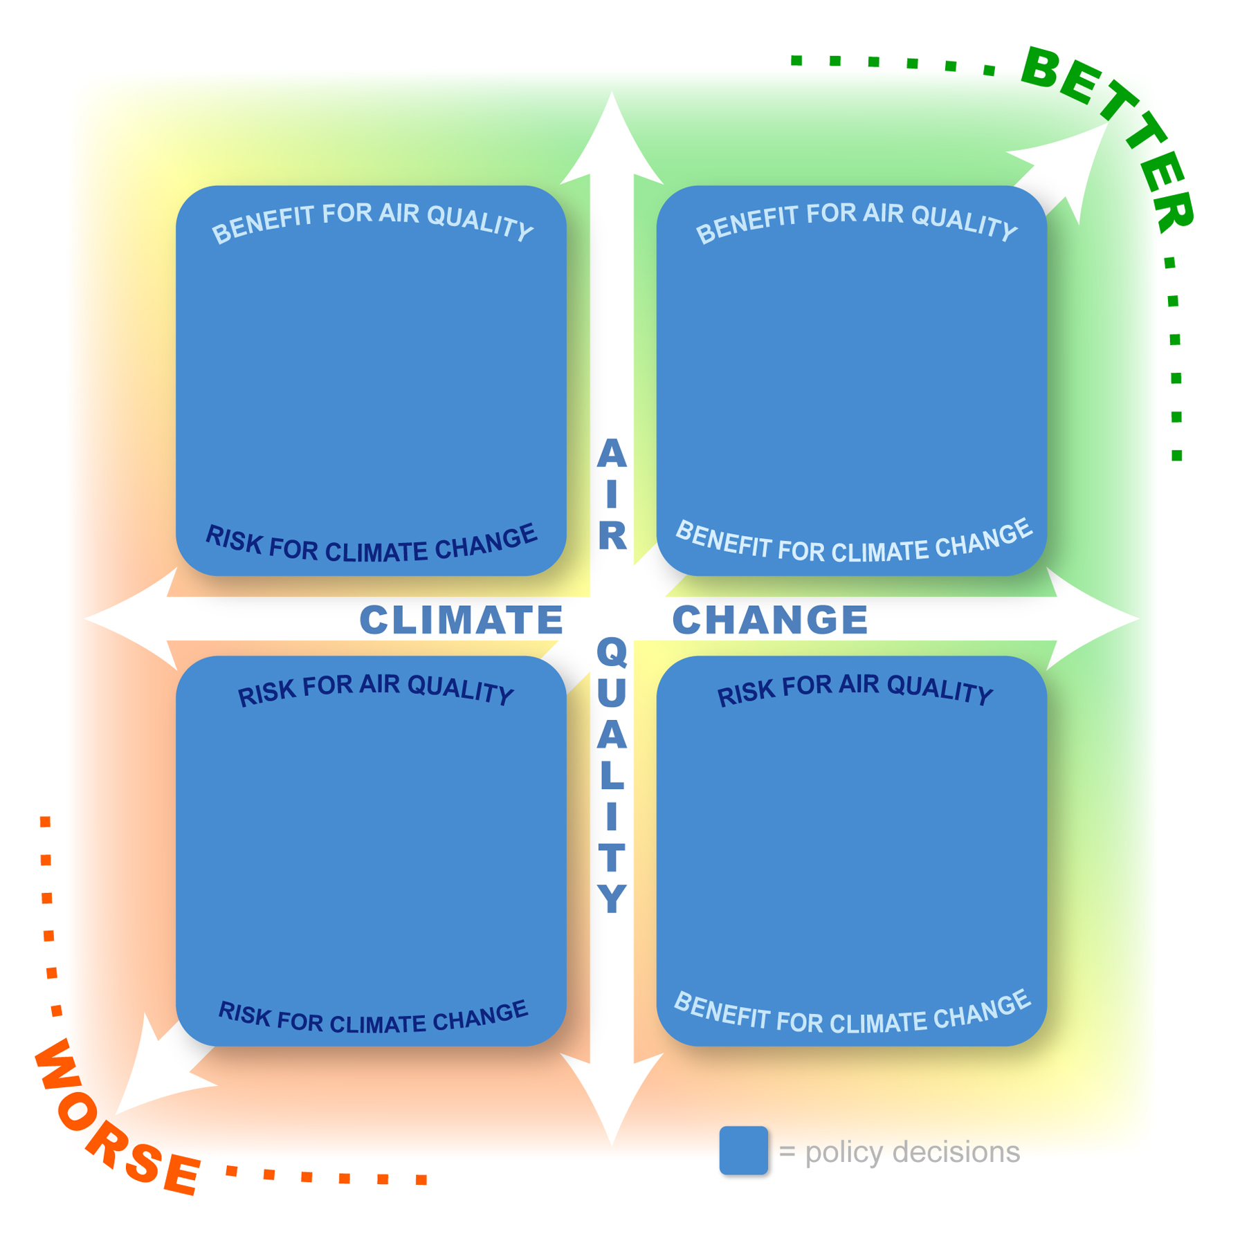
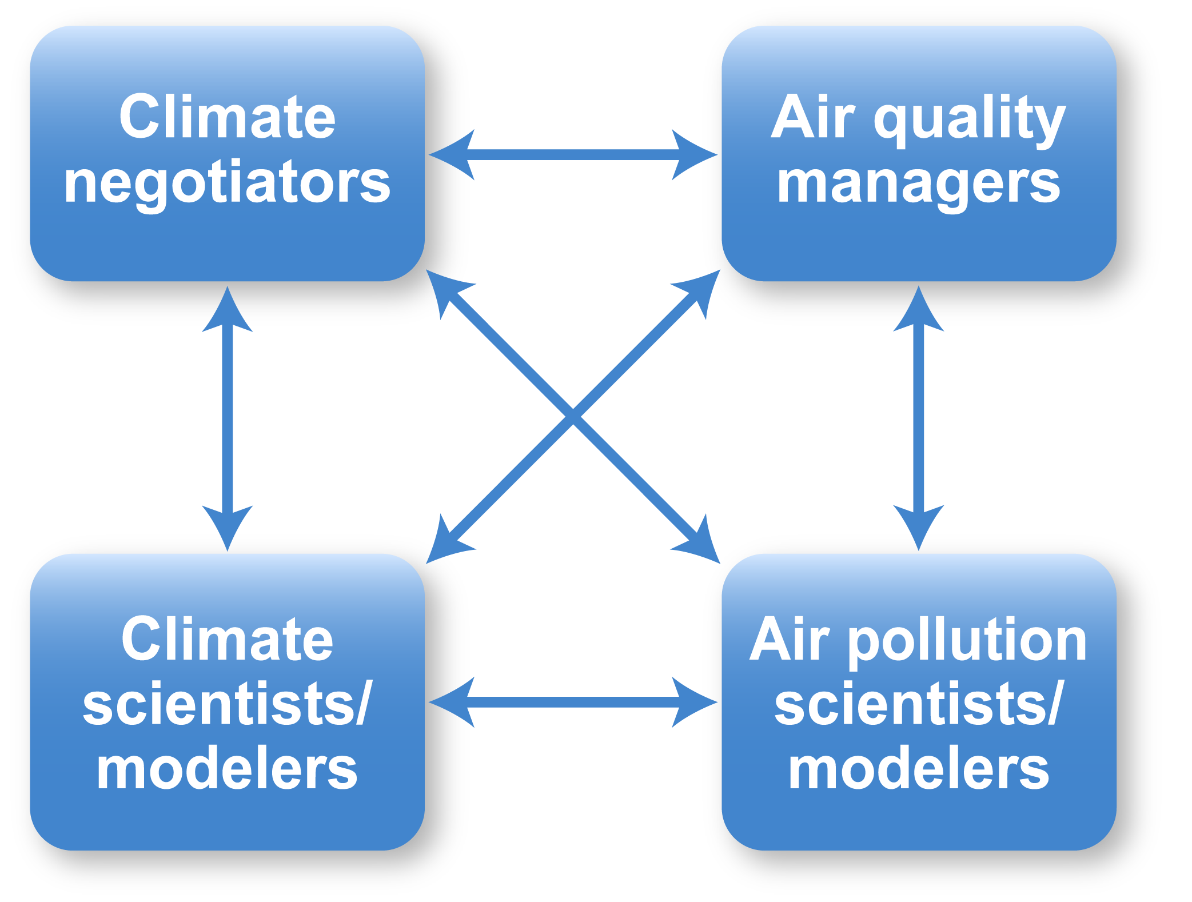
Air Pollution & Climate: mitigation options and policy discussions
Notes:
This feeds into one of our IGBP synthesis topics on Air Pollution and Climate which aims to
engage a range of stakeholders (scientists, economists, policy makers, etc.) to assess the status of knowledge with regard to current understanding about air pollution and climate and their interactions in particular with relation to current and proposed mitigation options and policy discussions.

Slide 19
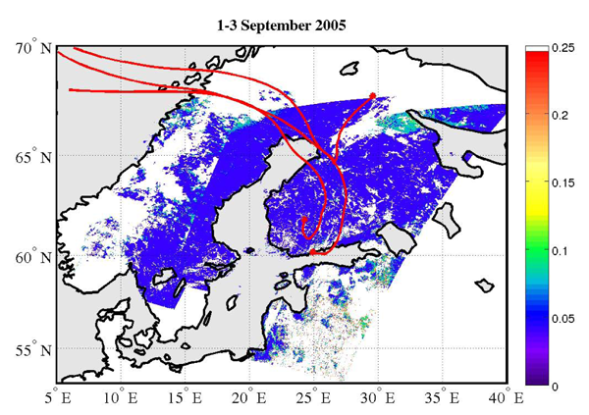
Aerosol sources – satellite and in situ observations
AOD (550 nm – AATSR obs.)
de Leeuw et al. 2011 BGD
Notes:
Fig. 2. AOD (550 nm) over Northern Europe retrieved from AATSR observations on 1, 2 and 3
September 2005. The figure is a composite of three tracks, with the most western track on 1
September, the middle one on 2 September and the most eastern one on 3 September. The
AOD values are given on the colour scale on the rhs of the map. White areas indicate that no
aerosol properties could be retrieved due to the presence of clouds or over the mountains near
the Norwegian coast. North of 67 N the solar zenith angle was too small for aerosol retrieval.
The red lines are the 96-hour back trajectories for air masses arriving in Helsinki, Hyyti ¨ al ¨a and
V¨ arri ¨o on 2 September at 12:00 GMT.

Slide 20
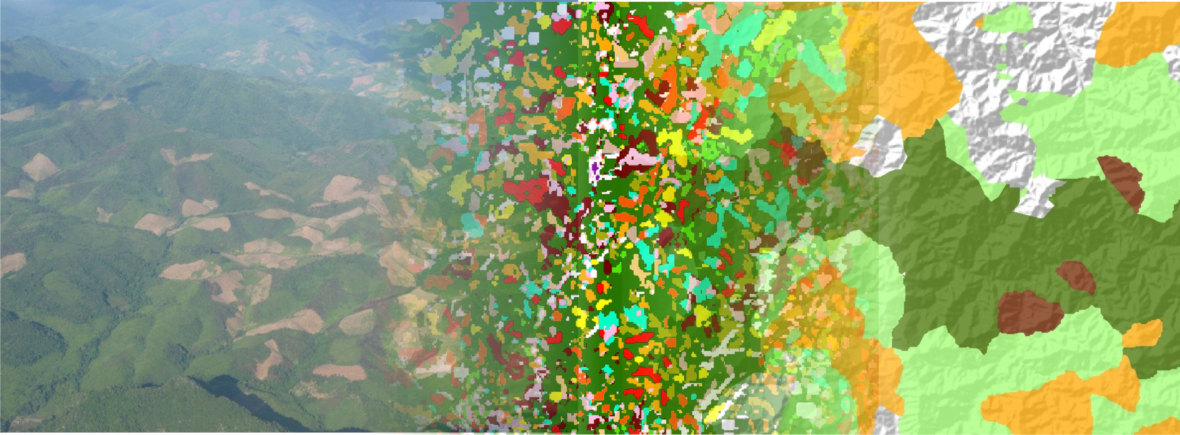
Observing land change in support of the MDG’s
Linking local and global observations of land use and ecosystem services
From large scale land cover changes to subtle modifications of land use

Slide 21
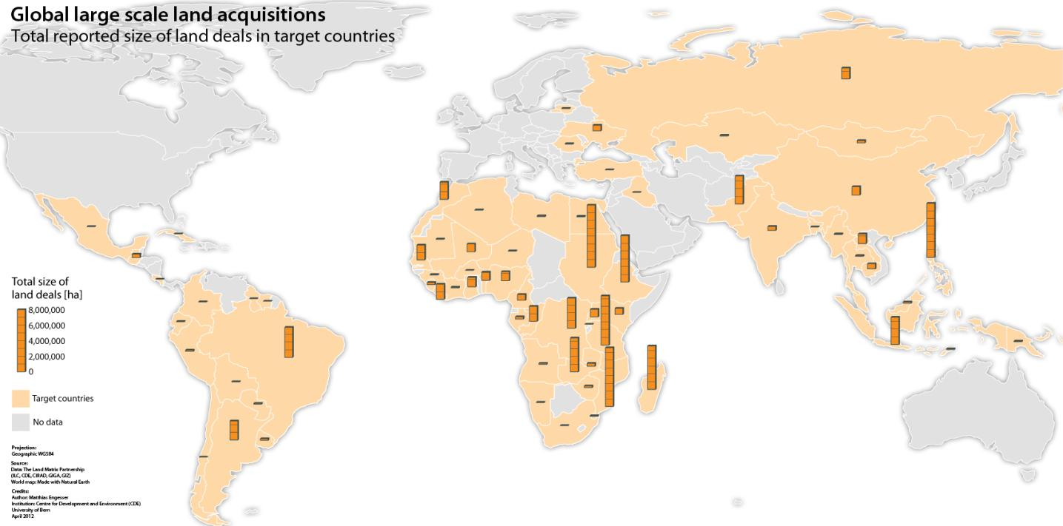
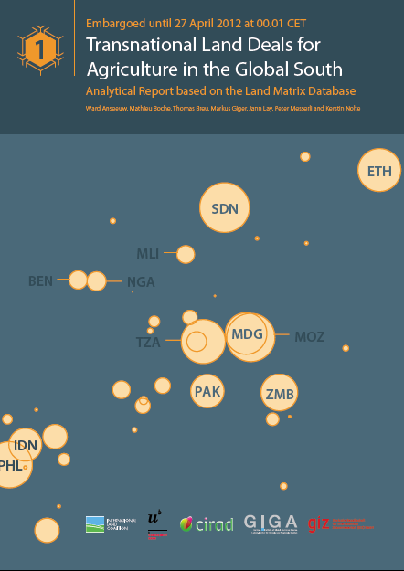
Large-scale Land Acquisitions (LSLAs) in the Global South The Land Matrix Database on www.landportal.info/landmatrix
Global Overviews and emerging patterns of concessions and investors
Global Land Cover | Share of deals
Cropland mosaics | 43%
Forest land | 24%
Shrub- and grassland | 28%
Marginal and other land | 5%
Analytical report
Analysis of geo-referenced concessions

Slide 22
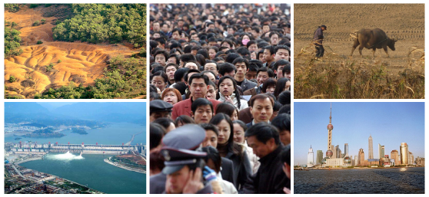
Integrating social and ecological changes
Dearing et al. 2012 PNAS

Slide 23
Integrating social and ecological changes Lower Yangtze basin – ES 1930-2006
Water quality
Soil stability
Sediment quality
Dearing et al. 2012 PNAS

Slide 24
GEOSS S&T Workshop, Aug. 2012
International Geosphere-Biosphere Programme (IGBP)
Earth System Science for Global Sustainability: Observations
Sybil P. Seitzinger
Executive Director, IGBP
Stockholm, Sweden
www.IGBP.net

