Slide 1
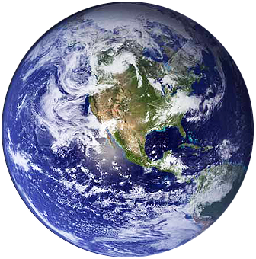
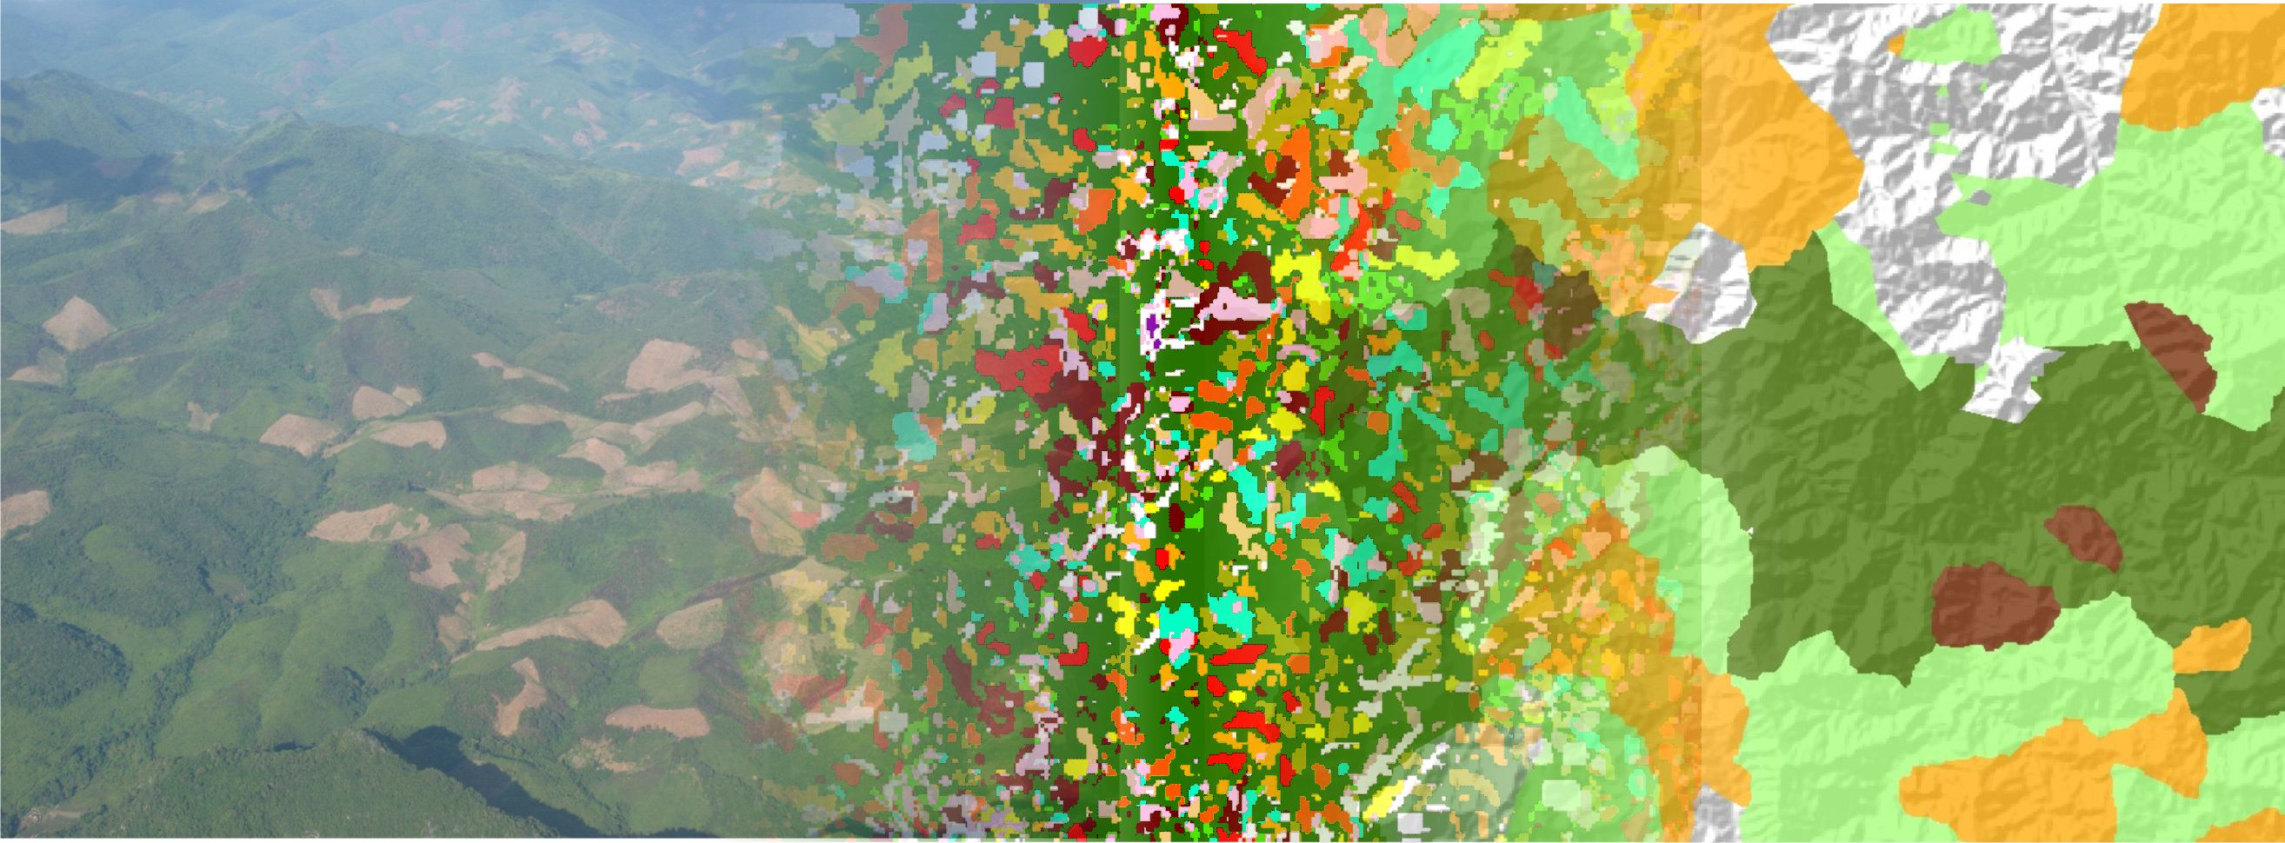
Observing land change in support of the MDGs
Peter Verburg with contributions of Andreas Heinimann, Peter Messerli and others

Slide 2
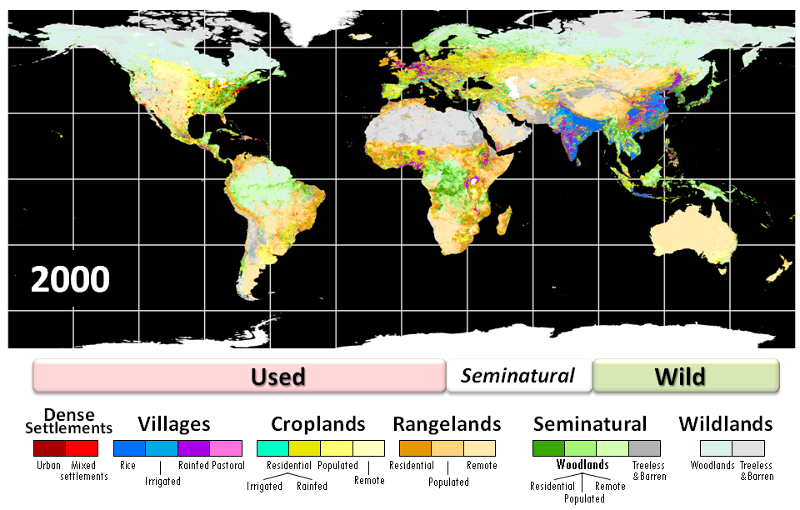
Human influence on the environment (Ellis et al., 2010)

Slide 3
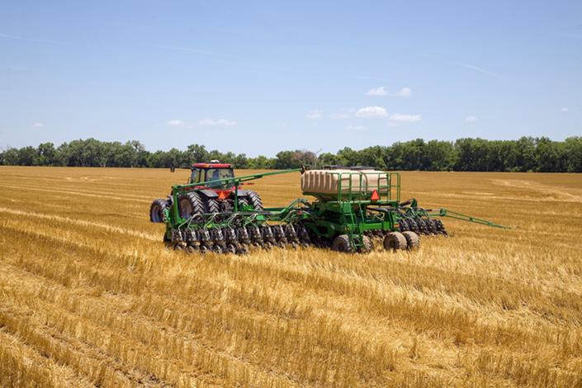
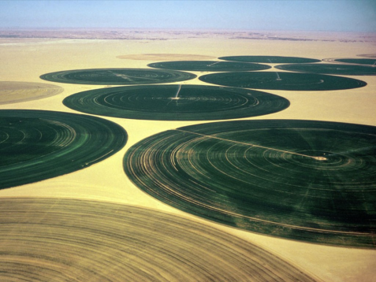
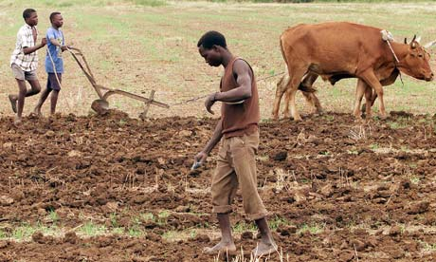
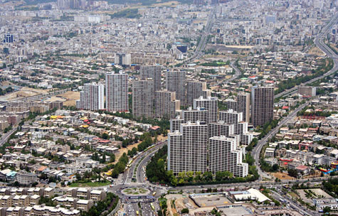
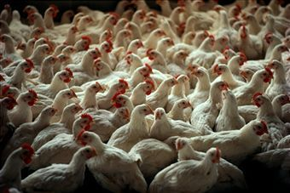
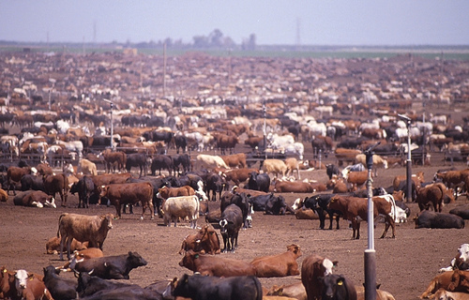
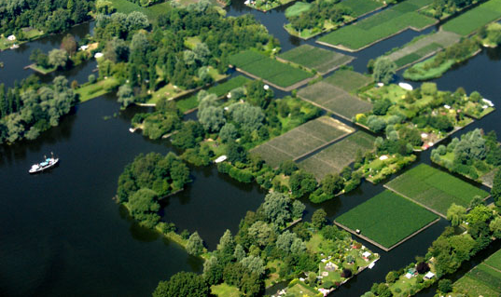
Managed ecosystems
Notes:
Around the world, there are different ways of how people use the land: it may be intensively managed or used, or extensively

Slide 4
Key messages
Land change happens at the interface of the human and physical earth system
Land is a critical (limited) resource for development and sustainability
Land science can act as a platform integrating research efforts, connecting different perspectives across scales
Land systems architecture provides ways to adapt to and mitigate global environmental change, but requires land system observations beyond land cover

Slide 5
Millenium Development Goals
1. Eradicate extreme poverty and hunger
2. Achieve universal primary education
3. Promote gender equality and empower women
4. Reduce child mortality
5. Improve maternal health
6. Combat HIV/AIDS, malaria and other diseases
7. Ensure environmental sustainability
8. Develop a global partnership for development
Food production, access to resources
7.1 Proportion of land area covered by forest
7.5 Proportion of total water resources used
7.6 Proportion of terrestrial and marine areas protected
7.7 Proportion of species threatened with extinction
7.8 Proportion of population using an improved drinking water source
7.10 Proportion of urban population living in slumbs

Slide 6
Food security
Expansion of agricultural area
Intensification of land use systems
Food/Feed/Fibre/Energy
demand
Import from other areas
Change in consumption pattern

Slide 7
Agricultural intensity (cropland areas)
Based on Neumann et al. (2010), Agricultural Systems 103, 316-326.

Slide 8
Food security
Expansion of agricultural area
Intensification of land use systems
Food/Feed/Fibre/Energy
demand
Import from other areas
Change in consumption pattern

Slide 9
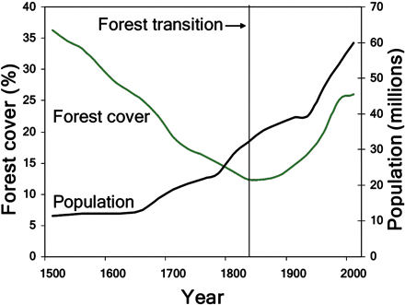
Forest transition: changing forest/population relations
Kauppi et al., 2006

Slide 10
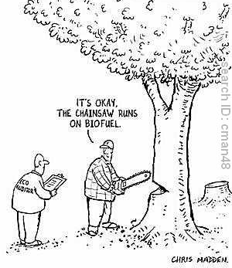
Feedbacks important to land change:
Displacement/leakage effects
Rebound effects
Cascade effects
Lambin & Meyfroid, 2011

Slide 11
Spatial trade-offs: a scenario study 2000-2030
Agricultural area
Verburg et al., 2008 Annals of Regional Science
Banse et al., 2010 Biomass and Bioenergy

Slide 12
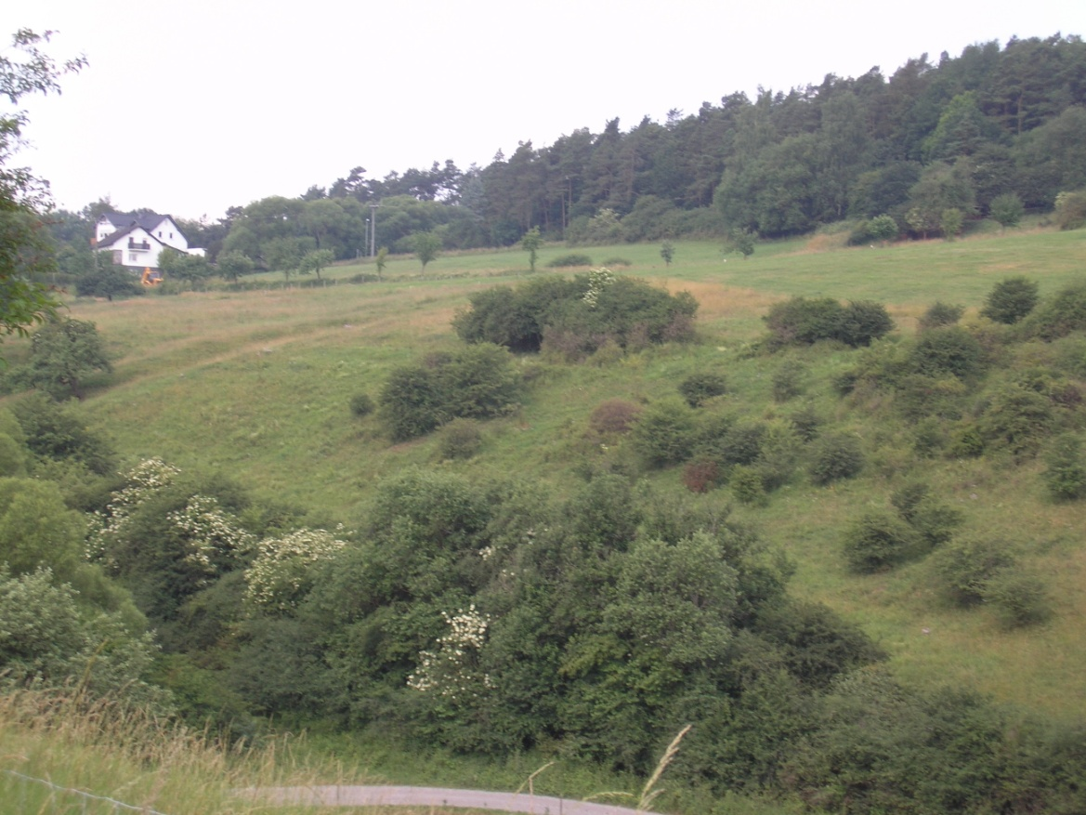
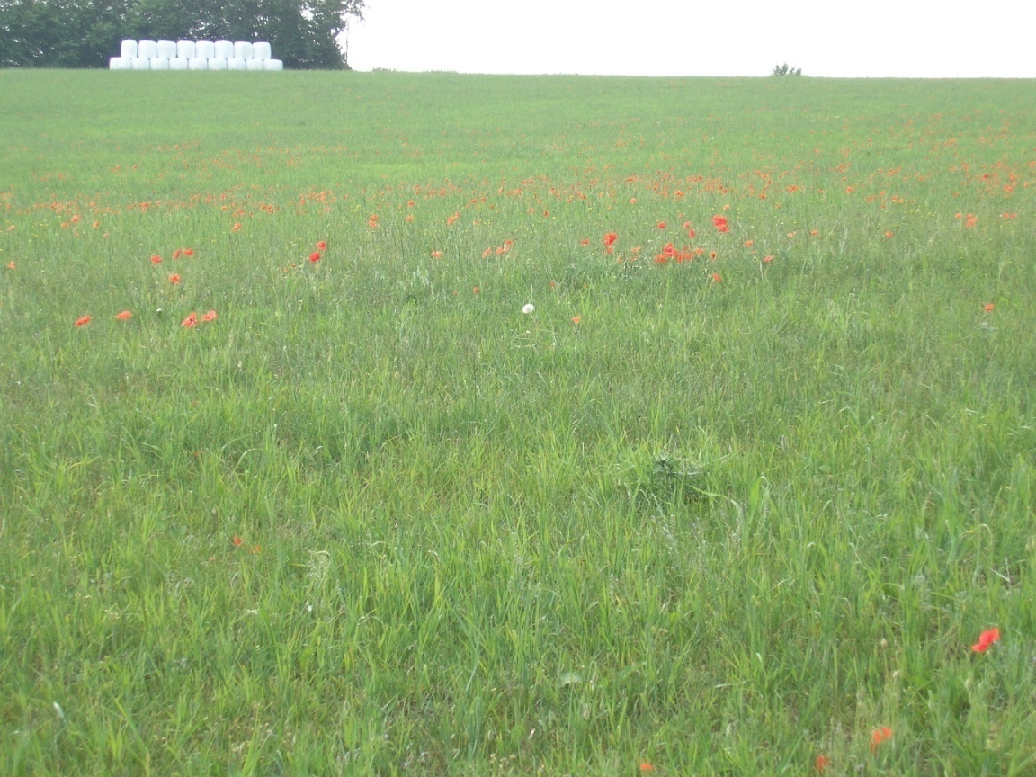
Spatial trade-offs
Global scale
Landscape scale
Increased competitiveness of agriculture
Marginal areas:
Abandonment
Prime agricultural areas:
Intensification/scale enlargement

Slide 13
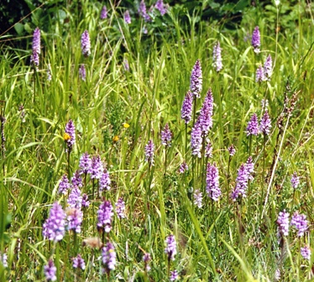
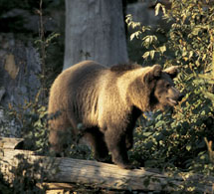
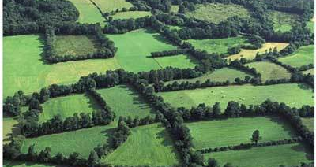
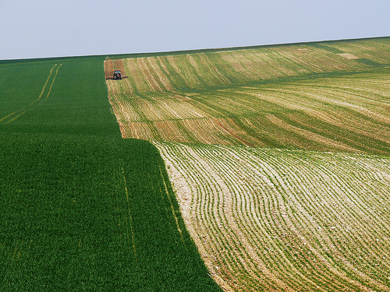
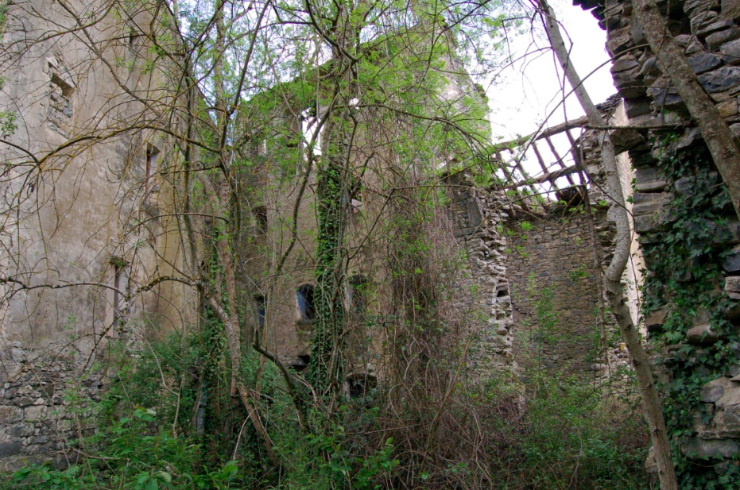
Land sparing
vs.
Land sharing
Agricultural biodiversity
Wilderness
Intensification
Abandonment

Slide 14
Land Sparing vs. Land Sharing
Land sparing: human activities very intensive on ‘restricted’ area.
High impact on ecosystem services in affected area
Low impact on ecosystems in remaining area
Spatial/temporal spill-over / re-bound effects
Not all ecosystem services can be ‘transported’
Land sharing: multi-functional land use
Based on synergies in ecosystem service provision
Extensive land uses, requiring large areas
☹ Large land requirements, no ‘wilderness’

Slide 15
Observing land change to support MDG/SDG’s

Slide 16
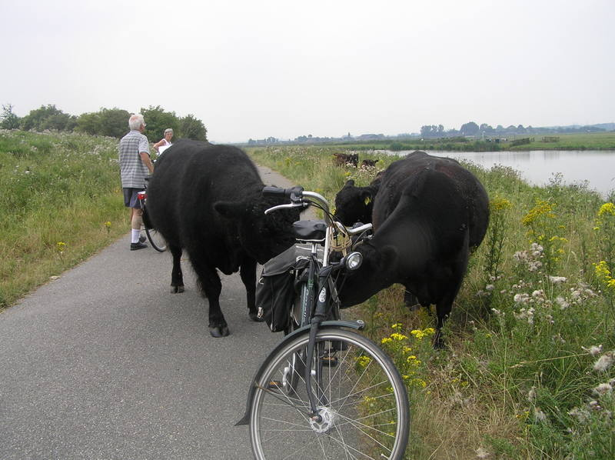
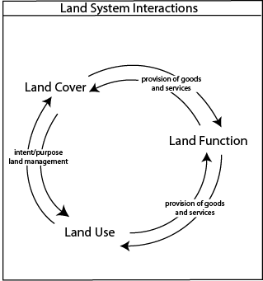
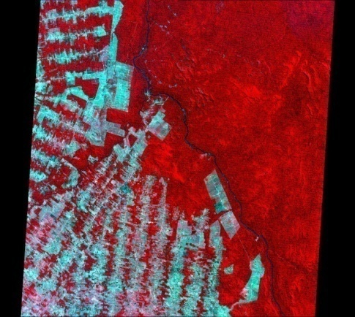
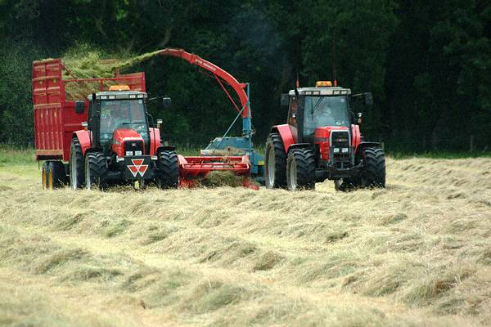
From land cover to land use to land function
“Land cover can be a cause, constraint or consequence of land use”
(Cihlar and Jansen, 2001)
-intended
-unintended
Verburg et al., 2009 Journal of Environmental Management
Land functions:
the capacity of the land to provide goods and services

Slide 17
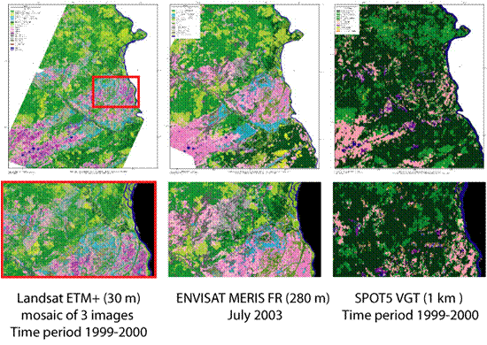
Land cover observation

Slide 18
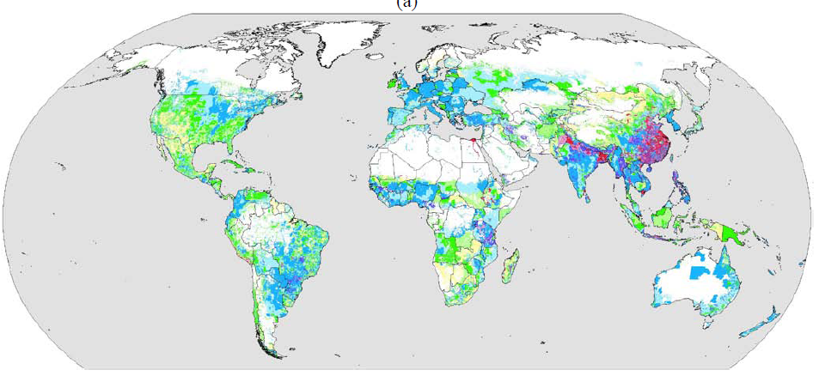
Cropping intensity
Siebert et al., 2010

Slide 19
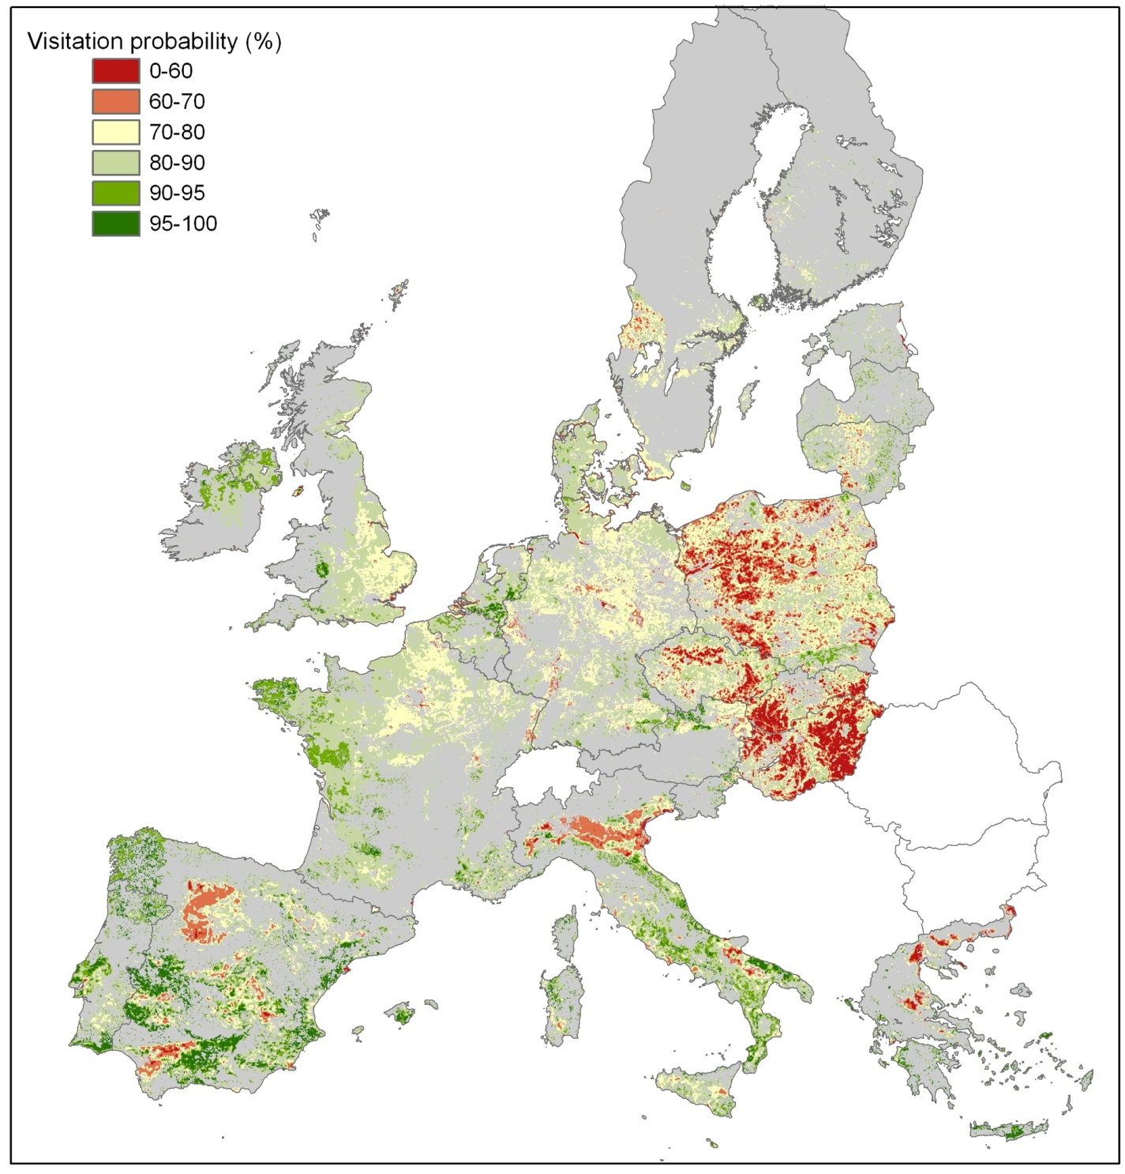
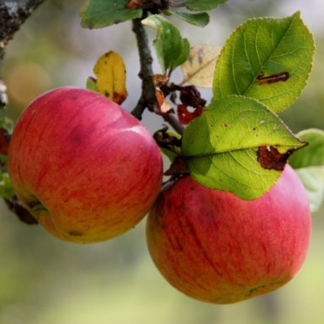
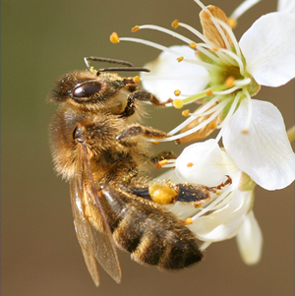
Pollination service supply (Visitation probability)

Slide 20
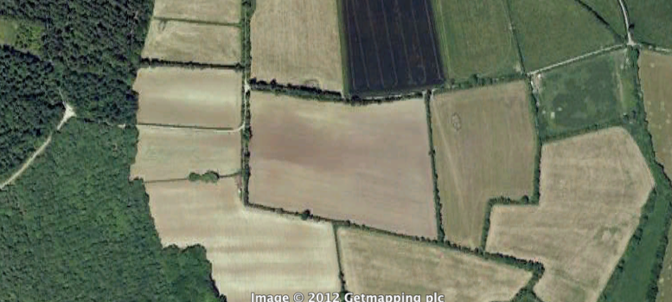
Pollination service supply Forest edges and landscape elements

Slide 21
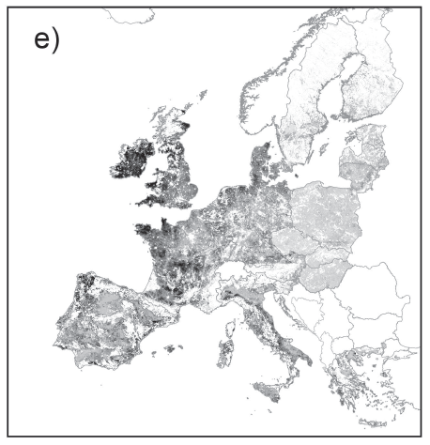
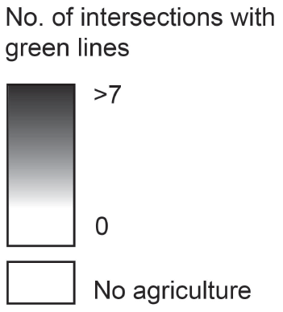
Observing green linear landscape elements
Van Zanden et al. (in review)

Slide 22
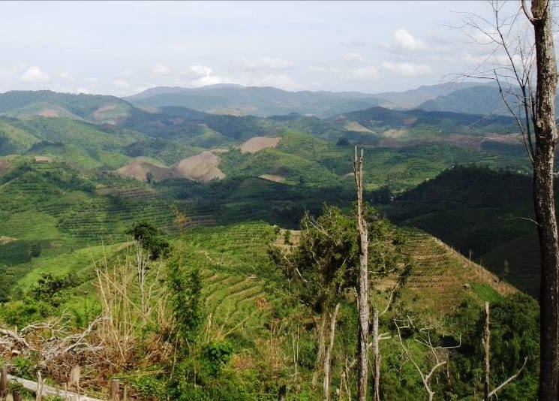
Temporal dynamics of land systems

Slide 23
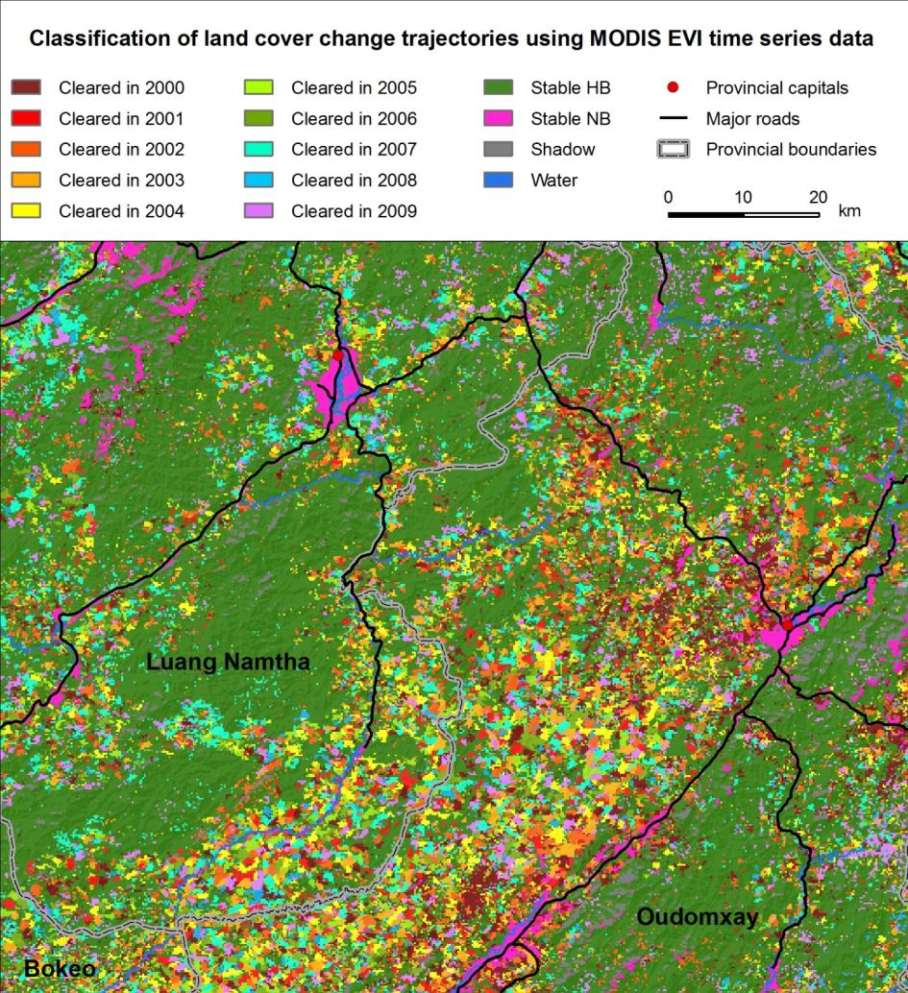
K. Hurni , et al. 2012 (fc)

Slide 24
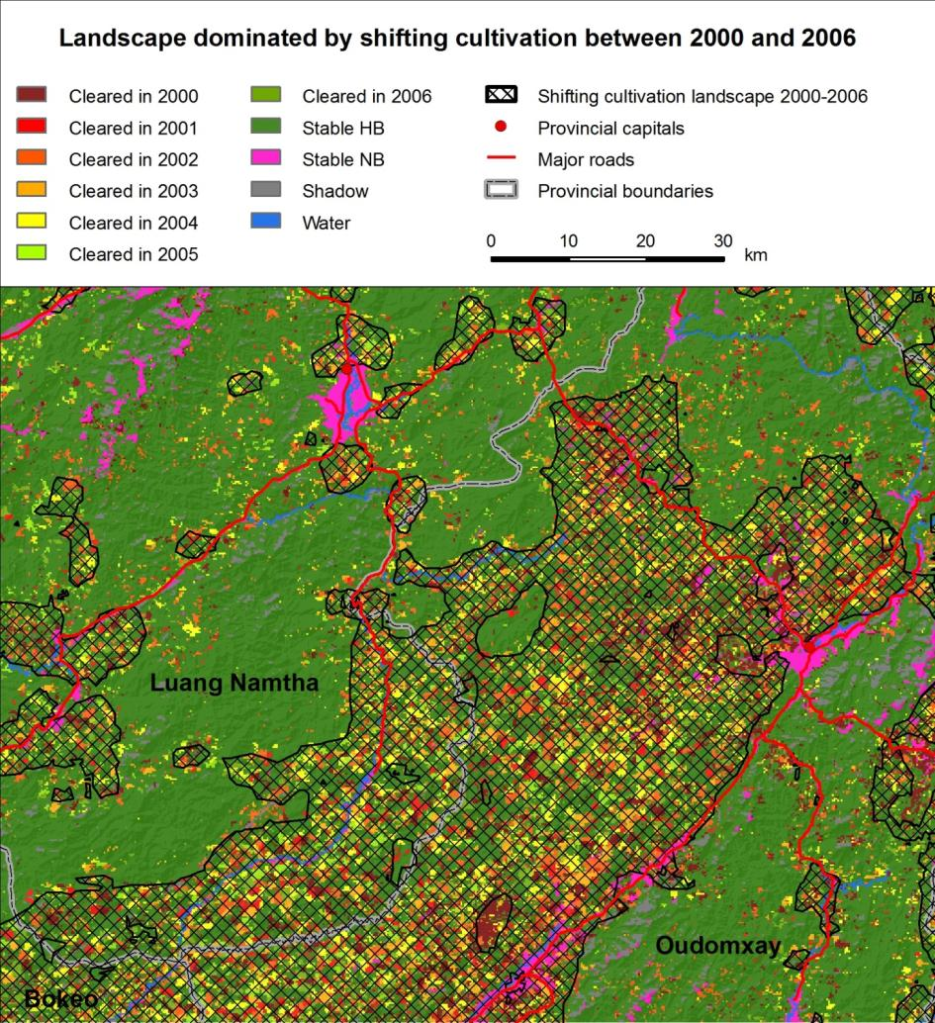
K. Hurni , et al. 2012 (fc)
K. Hurni , et al, in prep

Slide 25
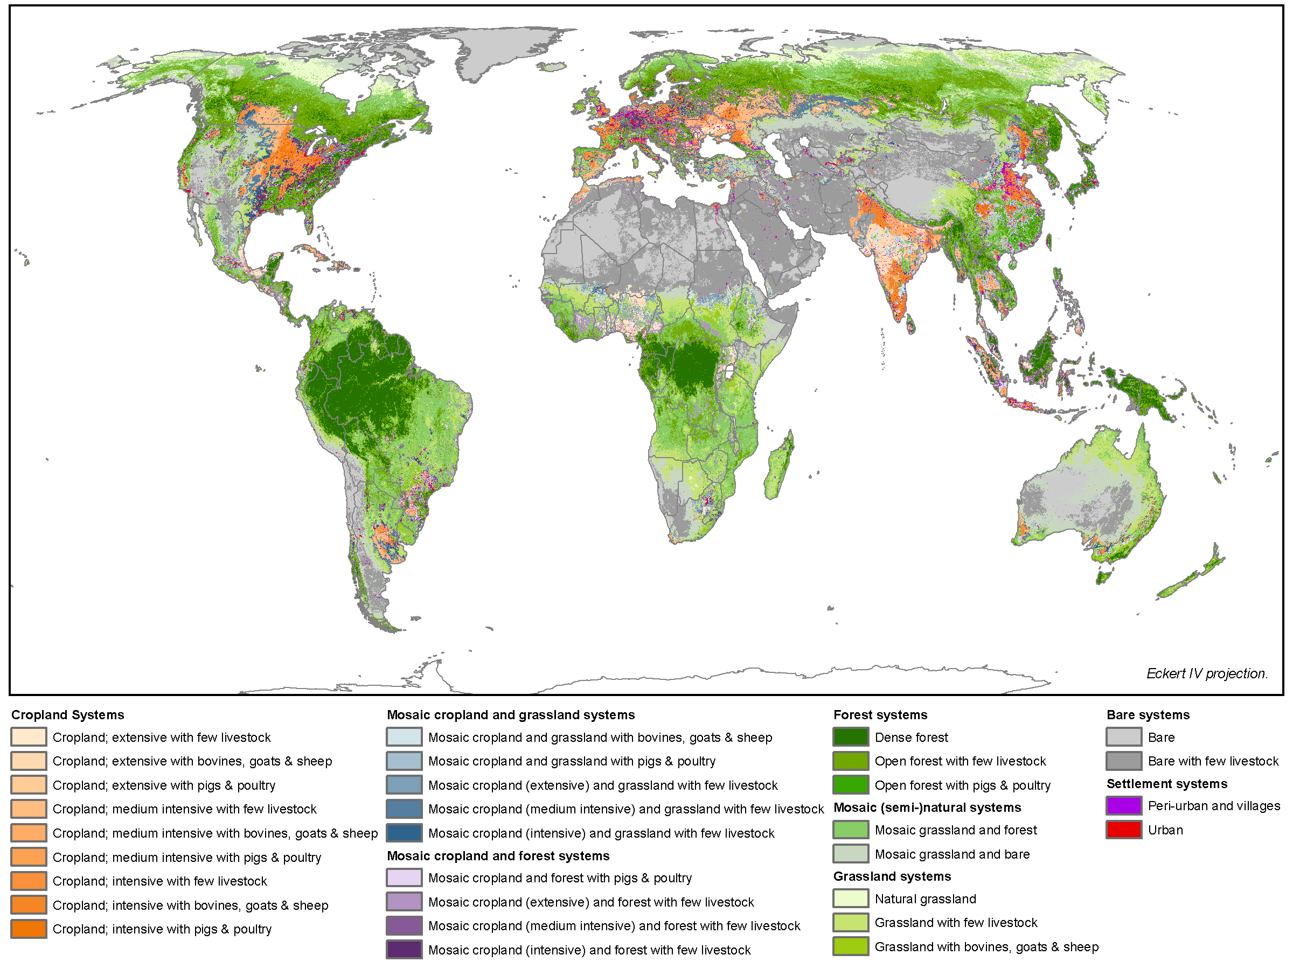
Asselen & Verburg, 2012 GCB

Slide 26
Millenium Development Goals
1. Eradicate extreme poverty and hunger
2. Achieve universal primary education
3. Promote gender equality and empower women
4. Reduce child mortality
5. Improve maternal health
6. Combat HIV/AIDS, malaria and other diseases
7. Ensure environmental sustainability
8. Develop a global partnership for development

Slide 27
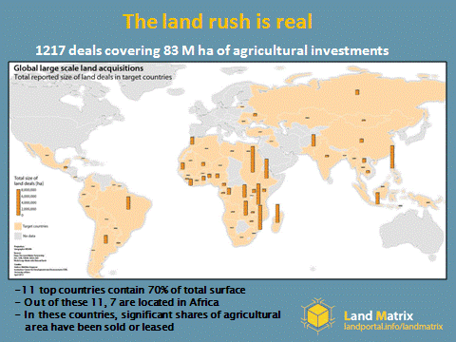

Slide 28
landportal.info/landmatrix

Slide 29
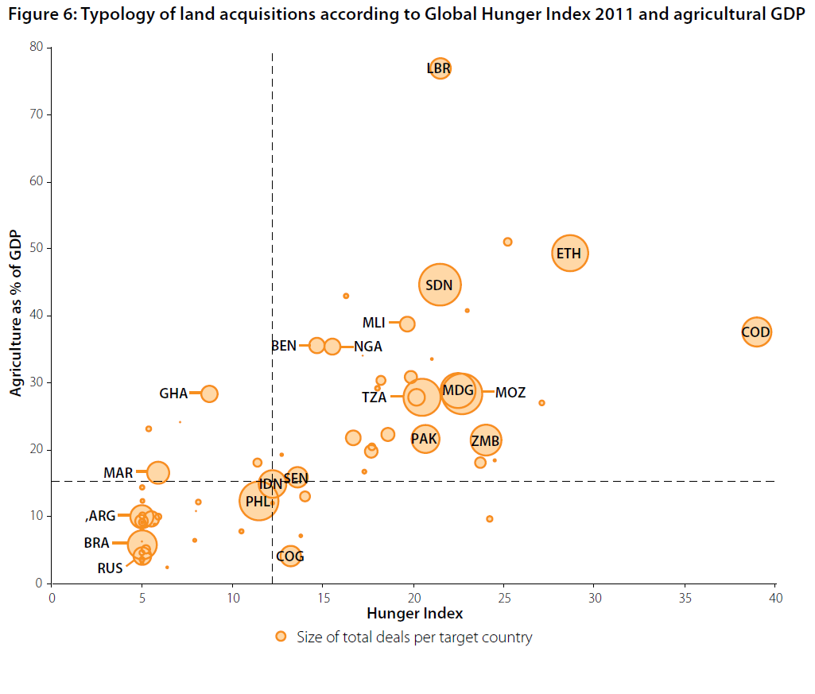
Global Land Cover | Share of deals
Cropland mosaics | 43%
Forest land | 24%
Shrub- and grassland | 28%
Marginal and other land | 5%
landportal.info/landmatrix

Slide 30
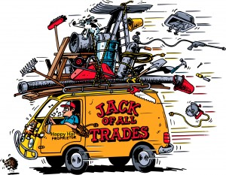
Land change and sustainable development
Land change is a CONSEQUENCE of global change
Land change is a major CAUSE of global change
Land change is a possible SOLUTION to global change
Land governance
Land system architecture

Slide 31
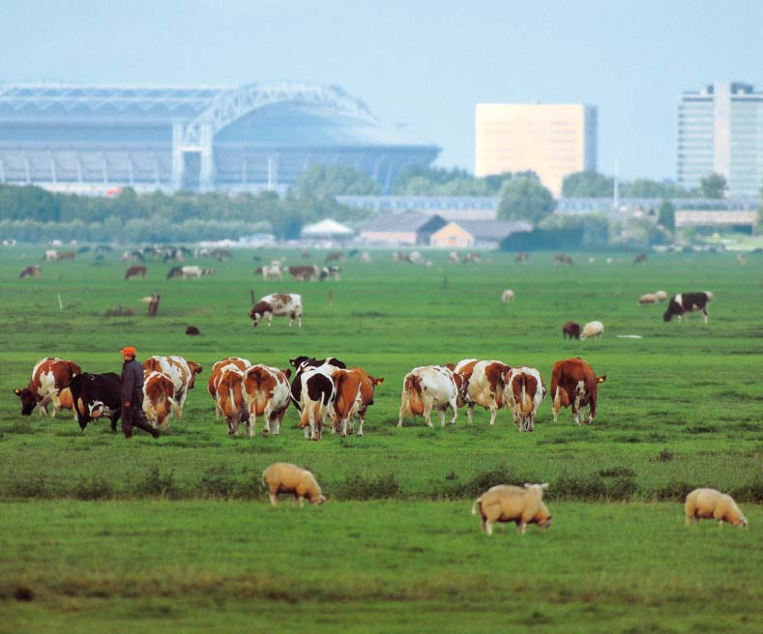
Thank you!
Peter.Verburg@vu.nl
Institute for Environmental Studies
VU University Amsterdam
http://www.ivm.vu.nl

Slide 32
OPEN SCIENCE MEETING
LAND TRANSFORMATIONS:
BETWEEN GLOBAL CHALLENGES AND LOCAL REALITIES
19-21 March 2014, Berlin (Germany)
Call for Session proposals opens 1st October 2012
www.globallandproject.org

