Slide 1




Towards a sustainability process for
GEOSS Essential Variables
11-12 June 2015, Bari-Italy
Objectives of the Workshop and final document
Antonio Bombelli
CMCC - Euro-Mediterranean Center on Climate Change
Coordinating an Observation Network of Networks EnCompassing saTellite and IN-situ to fill the Gaps in European Observations
YOUR LOGO

Slide 2
Objectives of the Workshop
ConnectinGEO - WP2: Strategic goals, metrics and indicators
  Task 2.2 Essential Variables
  Identify EVs
  Assess their status in different communities
  Determine how to make progress
  Generate scientific literature about the EVs
  EV are required to:
  - quantify the metrics for GEO SBAs
  - prioritize EO networks
  - populate the "SEE IN Knowledge Base"
  Task 2.3 Observation specifications and requirements
  Develop observation specifications for all EVs that would meet the requirements to quantify the indicators defined in Task 2.1
  Develop a measure to use the EVs and their relevance to the indicators for prioritization.
  Define how the EVs can be extracted from observations and measurement information.

Slide 3
Objectives of the Workshop
ConnectinGEO - WP2: Strategic goals, metrics and indicators
  Milestone MS8: Collocated EV workshop
  D2.2: EVs current status in different communities and way to move forward.
  Report on the Essential Variables current status in the scientific community and the strategy to push them forward and make progress.
  D2.3: Proposal of EVs for selected themes
  It will include description and justification of inclusion. It will collect drafts of SBA-specific EVs for Carbon, Health and Pollution, Ecosystems, Biodiversity, Energy, Disasters and Oceans. It will also include a report on the Co-located Essential Variables Workshop.

Slide 4
Objectives of the Workshop
Assess the status of existing EVs in the different GEO SBAs
Review the different processes (criteria, methods, etc.) to define and identify EVs
Find common points (distinguish between the specificities that have to be addressed internally by each community and the common processes/issues - definition, criteria, methods, priorities, gaps, etc. - that crosscut and integrate all EVs). Identify “super-EVs”.

Slide 5
Objectives of the Workshop
Clarify to what extent EVs are validated (e.g. are them endorsed by international independent bodies, etc.?) and used (assess the usefulness and applicability of the EVs concept)
Understand what are the operational networks currently measuring EVs
Assess EV observational needs and readiness (in terms of temporal frequency, spatial resolution, accuracy, other specifications)
Asses the current Gaps, priorities and requirements for improving the use of EVs

Slide 6
Outcomes from the Workshop
Produce a peer reviewed document on the EV status and definition process and requirements
This document shall address the workshop objectives and provide recommendations and way forward in the frame of GEO/GEOSS
It should become a scientific publication
You are welcomed to participate

Slide 7
Why do we need Essential Variables?
Understand natural and anthropogenic processes
Monitor state and trends in the Earth system
Detect and attribute changes
Assess the impacts of these changes
Identify tolerable limits of these changes (sustainable development)
Some criteria to select EVs:
Useful to a wide range of users, particularly decision makers
Cross-cutting several GEO SBAs
Credibility, Feasibility, Cost-effectiveness (GCOS criteria)
Others

Slide 8
Further questions:
EVs should be observable and useful at the same time. The usefulness of a variable potentially “essential” can be limited by uncertainty, resolution and accuracy. Therefore, in addition to their “essentiality” in describing states and trends the EVs have to meet in practice the users’ needs.
Could different EVs be used in different contexts according to different users’ categories, or should we focus mainly on “universal” EVs, cross-cutting different users and SBAs?
Who are our main target users: policy makers?
What are the current gaps and main requirements to set up an operational monitoring network?

Slide 9

New SBA
(preliminary list,
not confirmed)
Societal challenges
Urban resilience
Water security
Energy and resource development
Food security
Resilience to natural hazards
Environmental security
Developing sustainable economy
Climate: cross-cutting challenge
ConncetinGEO
Energy
Carbon
Oceans
Disasters
Biodiversity
Ecosystems
Health-Pollution

Slide 10
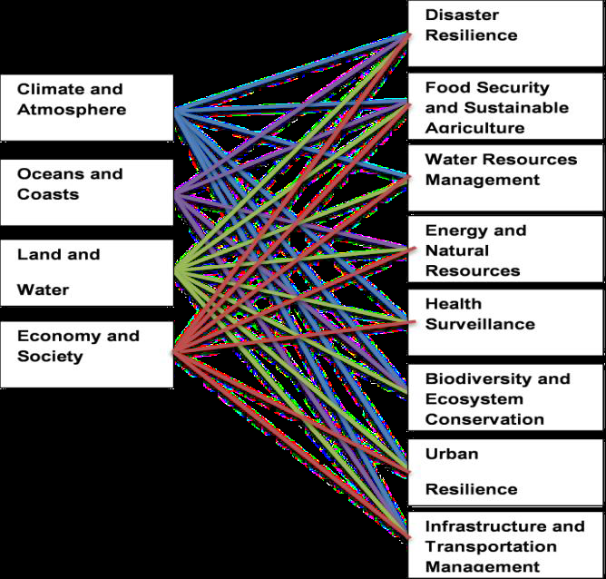
CLIMATE
New possible GEO SBAs (2016-2025)
and their links with the
Earth Observation Domains
Notes:
While linking Evs to GEO SBA we should start thinking about the new possible GEO SBA for 2016-2025

Slide 11
THANKS!
Let’s have a fruitful Workshop!
antonio.bombelli@cmcc.it

