Slide 1
Introduction to Breakout Session 2.2
Essential Variables for GEO SBAs
(Chair: Antonio Bombelli)
Coordinator of the GEO Task CL-02
“Global Carbon Observations and Analysis”
antonio.bombelli@cmcc.it

Slide 2
Plenary Session 2: Assessment of the Metrics
Breakout Sessions Block 2: Quantifying the Metrics
Breakout Session 2.2: Essential Variables for GEO Societal Benefit Areas
Workshop Objective - Relevant to Session 1.2
Link societal goals to the essential variables needed to measure progress towards these goals (top-down approach) .
Identify a refined set of change and sustainability indicators and the essential variables required to quantify these indicators.
Assess the capability of current and future Earth observation systems to measure these essential variable with sufficient spatial and temporal resolution, accuracy, and latency.
Breakout Session 2.2: Essential Variables for GEO SBAs

Slide 3
Breakout Session 2.2: Essential Variables for GEO Societal Benefit Areas
Tacking stock of the previous sessions we have to:
Analyze the sets of essential variables (EVs) identified for the different GEO SBA.
Assess their completeness, applicability and usefulness in decision support.
Address the issues that can limit their use: uncertainty, resolution, accuracy, cost-effectiveness and inadequacy of the current observing systems.
Consider existing initiatives to identify EVs for different GEO SBAs.
Questions to be addressed:
To ensure that the indicators can be quantified, essential variables need to be identified and observed. What process and criteria could be used to identify EVs and link indicators to them?
Is a top-down approach available and used to link indicators to EVs in your area of societal goals?
Breakout Session 2.2: Essential Variables for GEO SBAs

Slide 4
Why do we need Essential Variables?
Understand natural and anthropogenic processes
Monitor state and trends in the Earth system
Detect and attribute changes
Assess the impacts of these changes
Identify tolerable limits of these changes (sustainable development)
Breakout Session 2.2: Essential Variables for GEO SBAs

Slide 5
Criteria to select EVs:
Useful to a wide range of users, particularly decision makers
Cross-cutting several GEO SBAs
Credibility, Feasibility, Cost-effectiveness (GCOS criteria)
Others?
Further questions:
EVs should be observable and useful at the same time. The usefulness of a variable potentially “essential” can be limited by uncertainty, resolution and accuracy. Therefore, in addition to their “essentiality” in describing states and trends the EVs have to meet in practice the users’ needs.
Could different EVs be used in different contexts according to different users’ categories, or should we focus mainly on “universal” EVs, cross-cutting different users and SBAs?
Who are our main target users: policy makers?
What are the current gaps and main requirements to set up an operational monitoring network?
Breakout Session 2.2: Essential Variables for GEO SBAs

Slide 6
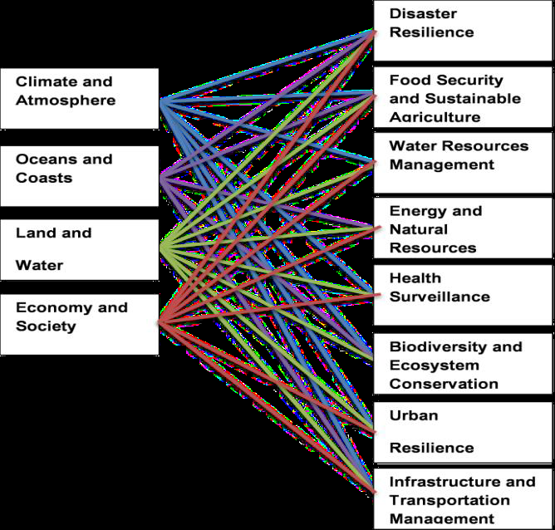
CLIMATE
New possible GEO SBAs (2016-2025)
and their links with the
Earth Observation Domains
Notes:
While linking Evs to GEO SBA we should start thinking about the new possible GEO SBA for 2016-2025

Slide 7
Relevant effort: the GCOS ECVs
The Essential Climate Variables of the Global Climate Observing System
GCOS criteria:
Credibility (consensus by the scientific community and users)
Feasibility (technically measurable)
Cost-effectiveness
Domain | GCOS Essential Climate Variables
Atmospheric (over land, sea and ice) | Surface: Air temperature, Wind speed and direction, Water vapour, Pressure, Precipitation, Surface radiation budget. Upper-air: Temperature, Wind speed and direction, Water vapour, Cloud properties, Earth radiation budget (including solar irradiance). Composition: Carbon dioxide, Methane, and other long-lived greenhouse gases, Ozone and Aerosol, supported by their precursors.
Oceanic | Surface: Sea-surface temperature, Sea-surface salinity, Sea level, Sea state, Sea ice, Surface current, Ocean colour, Carbon dioxide partial pressure, Ocean acidity, Phytoplankton. Sub-surface: Temperature, Salinity, Current, Nutrients, Carbon dioxide partial pressure, Ocean acidity, Oxygen, Tracers.
Terrestrial | River discharge, Water use, Groundwater, Lakes, Snow cover, Glaciers and ice caps, Ice sheets, Permafrost, Albedo, Land cover (including vegetation type), Fraction of absorbed photosynthetically active radiation (FAPAR), Leaf area index (LAI), Above-ground biomass, Soil carbon, Fire disturbance, Soil moisture.

Slide 8
Atmospheric ECVs
Surface:
Air temperature
Wind speed and direction
Water vapour
Pressure
Precipitation
Surface radiation budget.
Upper-air:
Temperature
Wind speed and direction
Water vapour
Cloud properties
Earth radiation budget
Composition:
Carbon dioxide
Methane
other long-lived greenhouse gases
Ozone and Aerosol
ECVs cross-cut
many SBAs
(not only climate)

Slide 9
Oceanic ECVs
Surface:
Temperature / Salinity
Sea level
Sea state
Sea ice
Surface current
Ocean colour
pCO2
Ocean acidity
Phytoplankton.
Sub-surface:
Temperature / Salinity
Current
Nutrients
pCO2
Ocean acidity
Oxygen
Tracers
ECVs cross-cut
many SBAs
(not only climate)

Slide 10
Terrestrial ECVs
River discharge
Water use
Groundwater
Lakes
Snow cover
Glaciers and ice caps
Ice sheets
Permafrost
Albedo
Land cover
FAPAR
LAI
Above-ground biomass
Soil carbon
Fire disturbance
Soil moisture
ECVs cross-cut
many SBAs
(not only climate)

Slide 11
New GEO SBAs | Relevant EVs (including GCOS ECVs)
Disaster Resilience
Food Security and Sustainable Agriculture
Water Resources Management
Energy and Natural Resources Management
Health Surveillance
Biodiversity and Ecosystem Conservation
Urban Resilience
Infrastructure and Transportation Management

Slide 12
Follow up: “Co-located EV workshop”
Bari (Italy), 11-12 June 2015
To further elaborate and integrate contributions from different communities/domains concerning the definition and operationalization of EV.
The objectives of the Workshop are:
Reviewing extensively the status of existing essential variables in different Societal Benefits Areas (SBA) of the Group on Earth Observations (GEO);
Assessing their observational needs and readiness (in terms of temporal frequency, spatial resolution, accuracy, etc.);
Describing the monitoring networks currently operational,
Capturing gaps and requirements for EV operational definition (mainly in terms of integration of all types of Earth observations);
Identifying the process underlying EV definition in support to less mature domains and the elaboration of new variables.
At the end of the workshop a document on the EV status, definition process, gaps and requirements for operationalization shall be produced.
Organized by CNR and CMCC (Italy) in the frame of the EU H2020 project ConnectinGEO.

