Slide 1
GEO Strategic Plan 2016-2025: Implementing GEOSS
implementation Plan Working Group
GEOSS Science & technology stakeholders Workshop
23-26 March 2015
Norfolk, virginia

Slide 2
Progress since Plenary
IPWG-4
Private Sector engagement (World Bank)
Commercial Sector (ESRI World Conference)
UN engagement
IPWG-5
February
1st draft
M&E WG
January
Ministerial WG
December
Also consulted…
Implementation Boards
Data Sharing WG
Data Management WG

Slide 3
What’s new?
Unique value defined
Strategic Objecives refined
GEOSS better described
Core Functions refined; Targets & Indicators added
Implementing Mechanisms consolidated
SBAs revised
Work Programme developed further;
Governance Programme Board added Legal status analyzed
Resources indicative scale;
Specific contributions

Slide 4
Unique Value
GEO value proposition has not been clear enough
Deliver observational foundations for major global initiatives, notably SDGs
Unique upstream coordination position
Flexible, agile forum to forge partnerships
GEO does more than build GEOSS
Uniqueness of GEO is in its community

Slide 5
Strategic objectives
Need to talk policy-makers
Three Strategic Objectives in the Areas of Action – Advocate, Engage, Deliver
Encompass major GEO achievements and success
Data Sharing Principles / Data Management Principles
Flagship Initiatives
Communities
High level message on what GEO strives for
Evolution, not revolution

Slide 6
GEO Strategic Plan 2016-2025: Implementing GEOSS
What´s new:
Three Action Areas with Strategic Objectives
Advocate
Strategic Objective:
GEO will ADVOCATE the value of Earth observations as a vital means of achieving national and international objectives for a resilient society, and sustainably growing economies and a healthy environment worldwide.
Notes:
GEO „envisions a future wherein decisions and actions for the benefit of humankind are informed by coordinated, comprehensive and sustained Earth observations”
Strategic objectives are “political messages”
Strategic Objective 1:
GEO will ADVOCATE the value of Earth observations as a vital means of achieving national and international objectives for a resilient society, and sustainably growing economies and a healthy environment worldwide.
Strategic Objective 2:
GEO will ENGAGE with stakeholder communities to address global and regional challenges by deepening the understanding of Earth system processes and improving the links between scientific understanding and policy-making.
Strategic Objective 3:
GEO will DELIVER data, information and knowledge enabling stakeholders to: improve their decision-making processes; promote the exchange of best practices; enable the uptake of new technologies; and create new economic opportunities, while reducing costs to public sector budgets through innovation and collaboration.

Slide 7
GEO Strategic Plan 2016-2025: Implementing GEOSS
What´s new:
Three Action Areas with Strategic Objectives
Advocate
Engage
Strategic Objective:
GEO will ENGAGE with stakeholder communities to address global and regional challenges by deepening the understanding of Earth system processes and improving the links between scientific understanding and policy-making.
Notes:
GEO „envisions a future wherein decisions and actions for the benefit of humankind are informed by coordinated, comprehensive and sustained Earth observations”
Strategic objectives are “political messages”
Strategic Objective 1:
GEO will ADVOCATE the value of Earth observations as a vital means of achieving national and international objectives for a resilient society, and sustainably growing economies and a healthy environment worldwide.
Strategic Objective 2:
GEO will ENGAGE with stakeholder communities to address global and regional challenges by deepening the understanding of Earth system processes and improving the links between scientific understanding and policy-making.
Strategic Objective 3:
GEO will DELIVER data, information and knowledge enabling stakeholders to: improve their decision-making processes; promote the exchange of best practices; enable the uptake of new technologies; and create new economic opportunities, while reducing costs to public sector budgets through innovation and collaboration.

Slide 8
GEO Strategic Plan 2016-2025: Implementing GEOSS
What´s new:
Three Action Areas with Strategic Objectives
Advocate
Engage
Deliver
Strategic Objective:
GEO will DELIVER data, information and knowledge enabling stakeholders to: improve their decision-making processes; promote the exchange of best practices; enable the uptake of new technologies; and create new economic opportunities, while reducing costs to public sector budgets through innovation and collaboration.
Notes:
GEO „envisions a future wherein decisions and actions for the benefit of humankind are informed by coordinated, comprehensive and sustained Earth observations”
Strategic objectives are “political messages”
Strategic Objective 1:
GEO will ADVOCATE the value of Earth observations as a vital means of achieving national and international objectives for a resilient society, and sustainably growing economies and a healthy environment worldwide.
Strategic Objective 2:
GEO will ENGAGE with stakeholder communities to address global and regional challenges by deepening the understanding of Earth system processes and improving the links between scientific understanding and policy-making.
Strategic Objective 3:
GEO will DELIVER data, information and knowledge enabling stakeholders to: improve their decision-making processes; promote the exchange of best practices; enable the uptake of new technologies; and create new economic opportunities, while reducing costs to public sector budgets through innovation and collaboration.

Slide 9
GEOSS
Need to clarify what GEOSS is and what GEO‘s role is
Observation and Information Systems
GEO implements central components, based on clear high-level principles
Name principles for central GEOSS components: openness, effectiveness, flexibility, adaptability, sustainability, reliability
One simple description of GEOSS
GEO’s role is enabling GEOSS

Slide 10
Core Functions
What does GEO do – and what does it not do?
Evolved Core Functions
Developed SMART targets (Annex) and Indicators
Comprehensive list of high-level actions for GEO
Targets and indicator support M&E
Specific scoping helps cooperation with others

Slide 11
Implementation Mechanisms
Need for appropriate processes and simple structures for effective and efficient implementation
Defined four Implementation Mechanisms
GEO Flagships
GEO Initiatives
GEO Community Activities
GEO Foundational Tasks
Clear understanding of how GEO implements its actions
Expectations and process clarified
Handle diversity of actions effectively

Slide 12
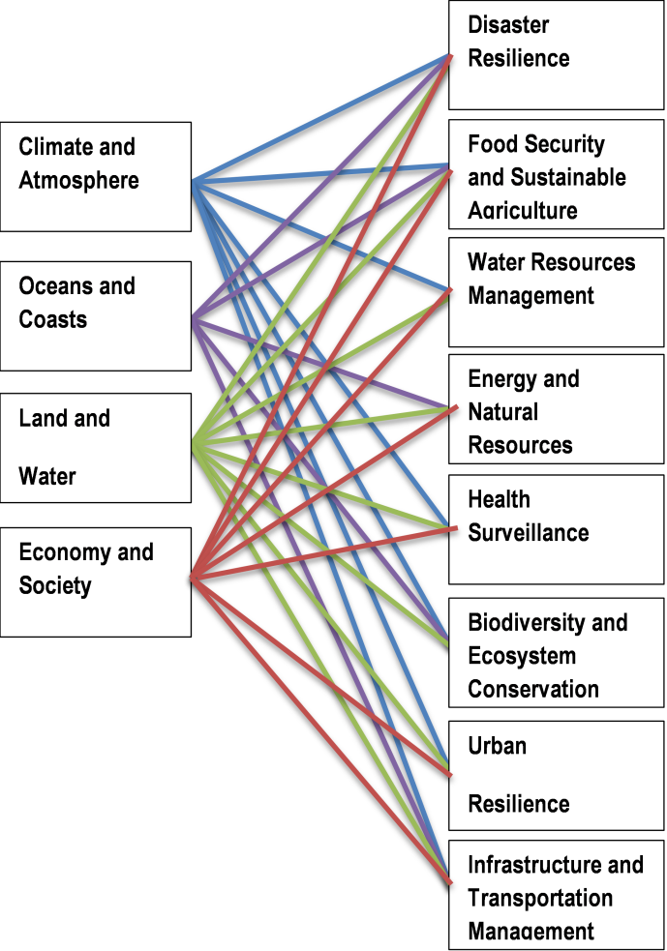
Revised SBA
Current SBA did not fully enable coordination and user-engagement
Application-oriented SBA proposed – to be discussed further

Slide 13
Work Programme
Need to prioritze actions and match ambition to resources
3-year Work Programmes, transitional Work Programme for 2016
Include all GEO actions, decide on priorities
Discuss and agree on GEO Programme Board
Include indicative resource planning
Work Programme concept developed further
Community engagement begun
Notes:
Explain difference between Foundational Tasks and rest

Slide 14
Governance
Governance needs to clearly support implementation needs
Evolve ExCom for more equitable participation
Expand to 15 seats plus 3 PO observers
Enable rotation of Co-Chairs
GEO Programme Board to discuss implementation
Include PO and Members
Nominate PO observers in ExCom
Establish GEO as independent legal persona
Form follows function
Details in Rules of Procedure
Legal Status options analyzed
Notes:
Mention Advisory Boards

Slide 15
Resourcing
Address lack of resources at all levels, but remain voluntary
Commitments maintained as voluntary
Support for use of an indicative scale of contributions, ideally multi-year
Commitments to be specified for Flagships and Initiatives
Resource allocations specified in Work Programme
Mechanisms suggested to strengthen reliability of resourcing in voluntary context of GEO

Slide 16
Document Suite
Ministerial Summary (2 pg)
Strategic Plan (~10 pg, framework document)
Annexes:
Targets and Indicators
Rules of Procedure
Description of Implementation Mechanisms
Architectural elements
M&E framework
Transitional Work Programme
Notes:
Further docs will come from MinWG

Slide 17
Next Steps
Consult Plenary (inter-session)
ExCom-33 and GEO Principals
March 27 deadline
Further develop Strategic Plan and Annexes
IPWG-6 (May, Tokyo), IPWG-7 (tbd)
Next version for ExCom-34 (July)
Prepare draft Work Programm
Work Programme Symposium (May 5-8)
Draft finalized by September
Continued Engagement
Alongside IPWG-6 (Tokyo)
Exchanges with GEO Community
Notes:
Need ExCom input to Work Programme!

Slide 18
Summary
Unique value – defined
Strategic Objectives – refined
GEOSS – better described
Core Functions – refined and Targets/Indicators added
Implementation Mechanims – consolidated
SBAs – revision proposed
Work Programme – concept developed further
Governance – ExCom evolution, Programme Board proposed
Resources – indicative scale and improved resourcing mechanims

Slide 19
BackUp

Slide 20
Caucuses | Members | 2016-2025 membership | Previous Membership
Asia-Oceania Caucus | 17 | 4 | 4
Americas Caucus | 15 | 3 | 3
CIS Caucus | 7 | 2 | 1
African Caucus | 24 | 3 | 2
European Caucus | 37 | 3 | 3
Total | 15 | 15 | 13
Notes:
Membership:
Asia: 18%
Americas 15%
CIS: 7%
Africa: 25%
Europe: 38%

Slide 21
Legal Status
Lack of legal status has hampered GEO‘s ability to partner and cooperate
Analyzed different options for attaining legal status
Treaty-based organization
Foundation/association under national law
Status quo
IPWG recommends that GEO seeks legal status
Suggest that ExCom decides on option and way forward
Notes:
Mention Advisory Boards

