Slide 1

What We Know and Don’t Know
About Sea Level
Ben Hamlington
Center for Coastal Physical Oceanography
Old Dominion University

Slide 2
Overview
Why do we care about sea level?
  Sea Level as an Essential Climate Variable/Indicator
  Sea Level Impacts
Global vs. Regional Sea Level
Observing Sea Level
  Historical Sea Level Measurements
  Modern Observing System
Projecting Future Sea Level Rise
  Global vs. Regional Projections
  What do we know?
  What don’t we know?
  Priorities for the future
Summary

Slide 3
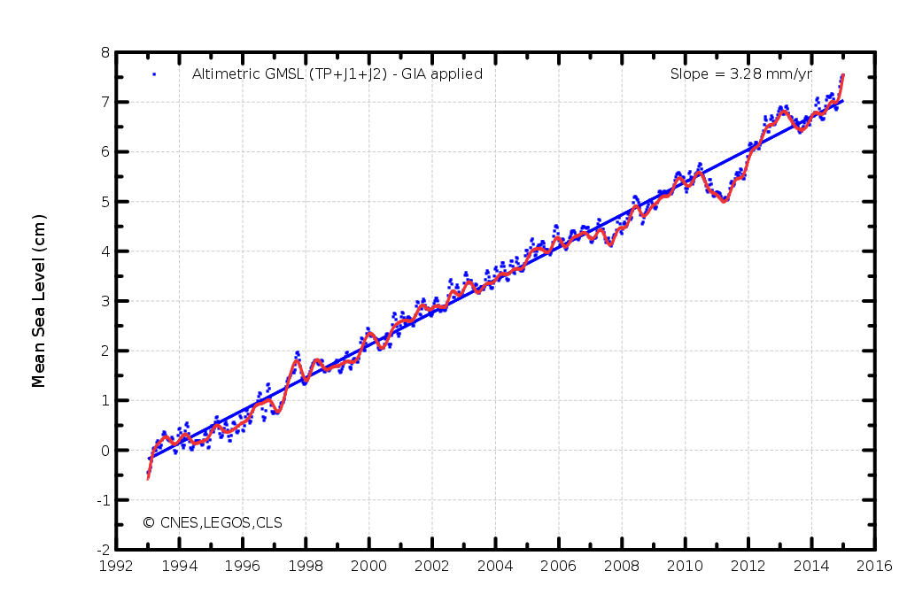
Why do we care about sea level?
Sea Level provides an important “lens” into the state of the climate.
  Sea level rise encompasses both thermal expansion from rising ocean temperatures, as well as mass change due to increased run-off from ice sheet and glacier melt.
  Reflects current state of the climate that spans both the oceans and the cryosphere.
  Provides an easy way to communicate changes in our climate on a broader scale.

Slide 4
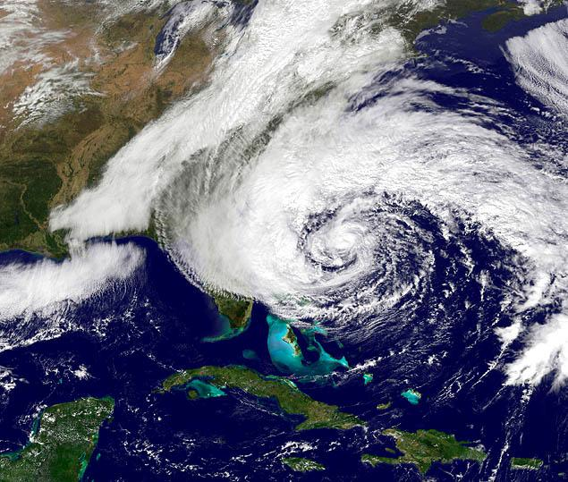
Why do we care about sea level?
Rising sea levels along the world’s coastlines threaten to permanently impact infrastructure and ecosystems.
Increased risk and impact of storms moving over higher sea levels [Cooper et al., 2008; Kirshen et al., 2008].
  Higher sea levels affect not only the potential of coastal flooding from such storms, but also the recurrence time of extreme events [Tebaldi et al., 2012].
  Events like super-storm Sandy will occur more frequently.
A growing concern in this region, “Nuisance Flooding” will continue to increase.
  As defined by NOAA, flooding that causes public inconvenience and leads to road closures and damage to infrastructure over long periods of time.

Slide 5
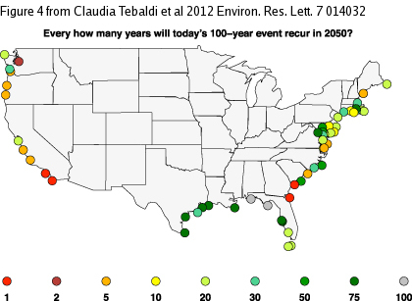
Impact of Rising Sea Level

Slide 6
Nuisance Flooding
Sweet et al. (2014)

Slide 7
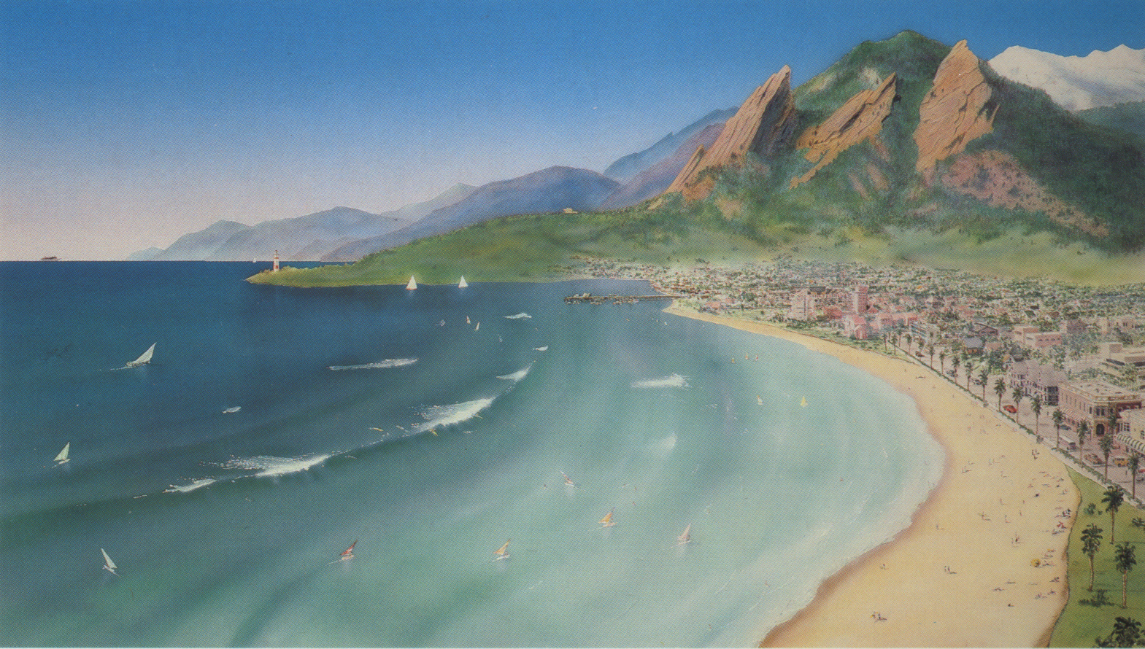
Impact of Rising Sea Level
Sea Level Rise in Boulder, CO…

Slide 8
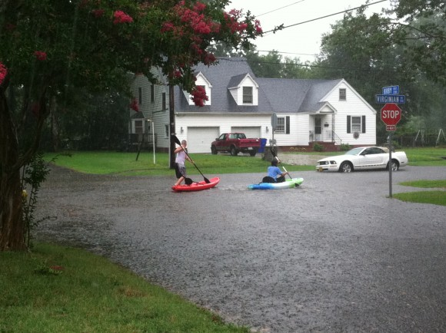
Impact of Rising Sea Level
Sea Level Rise in Norfolk, VA…

Slide 9
Global vs. Regional Sea Level
Rate of global mean sea level (GMSL) rise since 1993 ~ 3.2 mm/yr.
Rate of GMSL since 1900 ~1.8 mm/yr.
There are a three fundamental ways global sea level can be raised:
  Changing volume of existing ocean water (thermal expansion).
  Adding water mass (melting land ice, land water storage).
  Changing the depth of the ocean basins by movement of Earth’s crust (Glacial Isostatic Adjustment ~ 0.3 mm/yr).
Regional trends can be up to 4x the trend in GMSL (depending on the timescale) → GMSL alone is not adequate for planning and decision making purposes on the regional level.

Slide 10
Global vs. Regional Sea Level

Slide 11
Regional Sea Level Change
Land Water Storage Changes
Vertical Land Motion
Ocean Heat Content Changes
Ice Load
Grows/Melts
Crustal Deformation
Ocean Dynamics/Circulation
Gravity Changes
Relative Sea Level Change
Steric Changes: Thermal Expansion

Slide 12
Regional Sea Level Change

Slide 13
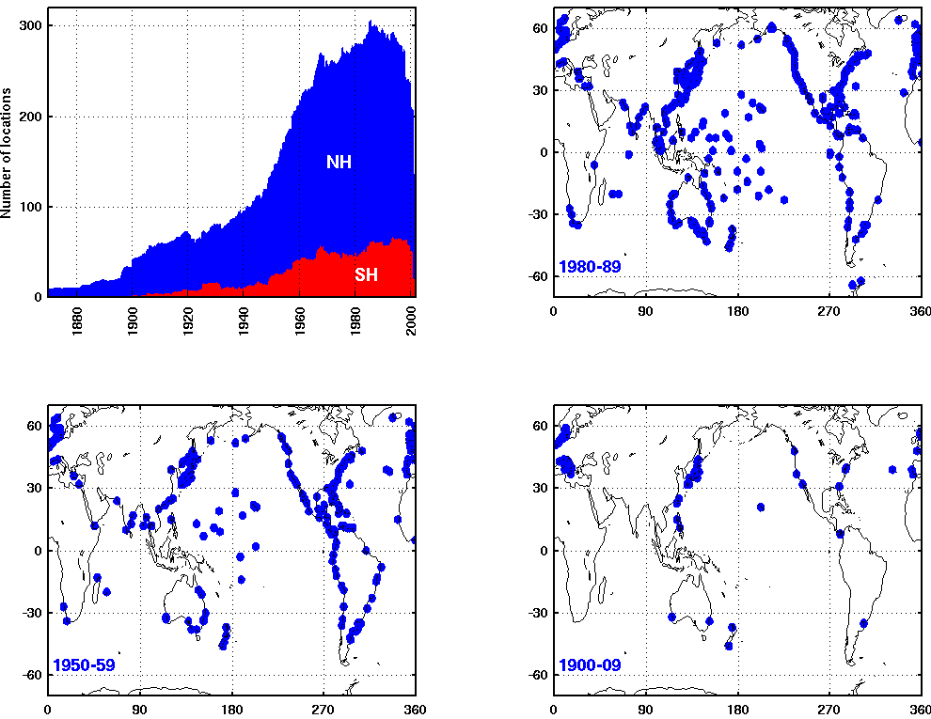
Observing Sea Level – Tide Gauges
Tide gauge record – long record (1700s-), but poor spatial coverage.

Slide 14
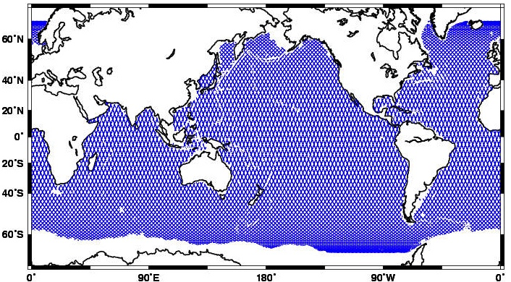
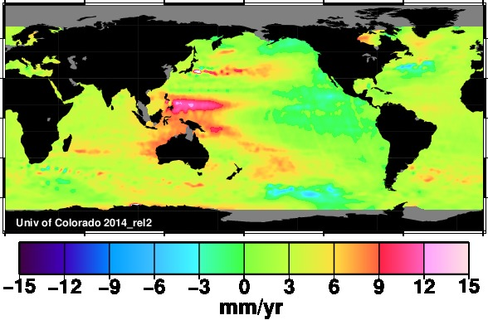
Observing Sea Level – Satellite Altimetry
Satellite altimetry record – near-global coverage, but short record length (1993-)
Cooperative Institute for Research in Environmental Sciences (CIRES)
Notes:
Near-global coverage of satellite altimeters has improved our understanding of how sea level is changing on regional and global scales.
Led to first definitive estimates of global mean sea level (GMSL) rise.
Provided measurements of how trends in sea level vary from the global mean on regional scales.
The satellite altimetry record, however, spans only two decades.
Difficult to separate the secular trend (long-period, non-periodic) from natural climate variability on decadal and longer timescales

Slide 15

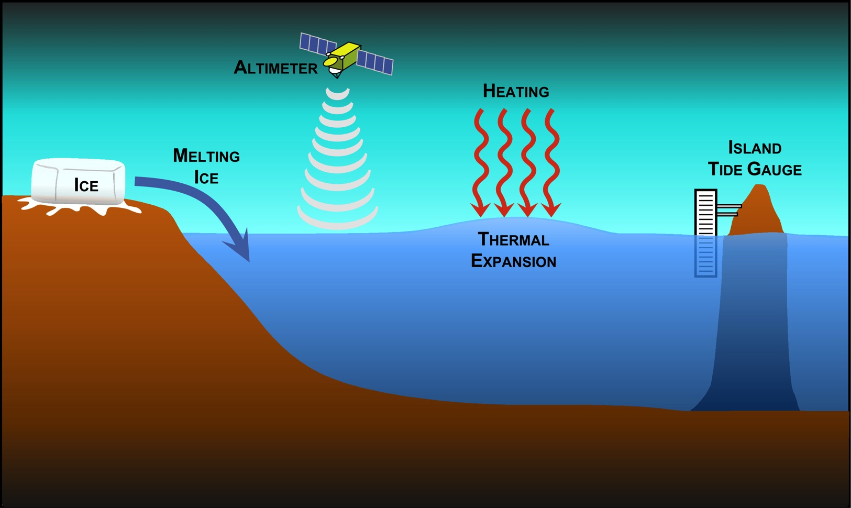
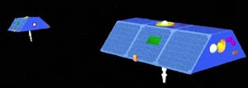
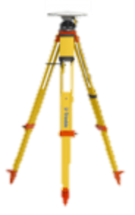
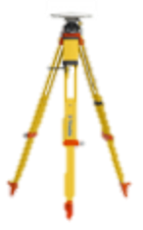

Modern Observing System
GRAVITY
GNSS
CRUSTAL
MOTION
Argo
Cooperative Institute for Research in Environmental Sciences (CIRES)
Notes:
Near-global coverage of satellite altimeters has improved our understanding of how sea level is changing on regional and global scales.
Led to first definitive estimates of global mean sea level (GMSL) rise.
Provided measurements of how trends in sea level vary from the global mean on regional scales.
The satellite altimetry record, however, spans only two decades.
Difficult to separate the secular trend (long-period, non-periodic) from natural climate variability on decadal and longer timescales

Slide 16
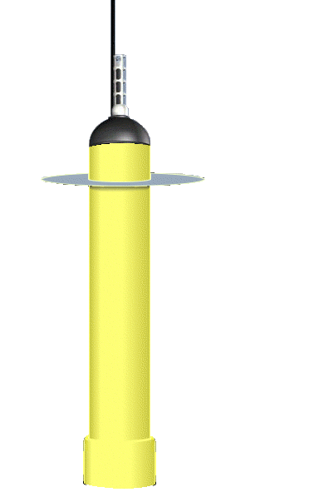
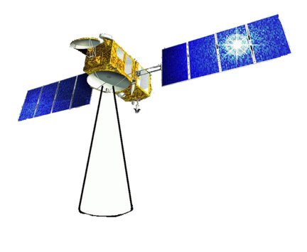
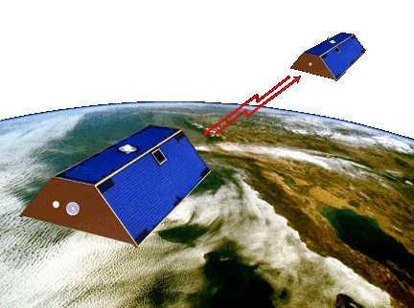
Closing the Sea Level Budget
Addition of Heat
Addition of Freshwater
Total Sea Level Rise
+
=
(roughly)
Argo
GRACE
Jason
Cooperative Institute for Research in Environmental Sciences (CIRES)
Notes:
Near-global coverage of satellite altimeters has improved our understanding of how sea level is changing on regional and global scales.
Led to first definitive estimates of global mean sea level (GMSL) rise.
Provided measurements of how trends in sea level vary from the global mean on regional scales.
The satellite altimetry record, however, spans only two decades.
Difficult to separate the secular trend (long-period, non-periodic) from natural climate variability on decadal and longer timescales

Slide 17
Closing the Sea Level Budget
Addition of Heat
Addition of Freshwater
Total Sea Level Rise
+
=
(roughly)
Argo
GRACE
Jason
Cooperative Institute for Research in Environmental Sciences (CIRES)
Notes:
Near-global coverage of satellite altimeters has improved our understanding of how sea level is changing on regional and global scales.
Led to first definitive estimates of global mean sea level (GMSL) rise.
Provided measurements of how trends in sea level vary from the global mean on regional scales.
The satellite altimetry record, however, spans only two decades.
Difficult to separate the secular trend (long-period, non-periodic) from natural climate variability on decadal and longer timescales

Slide 18
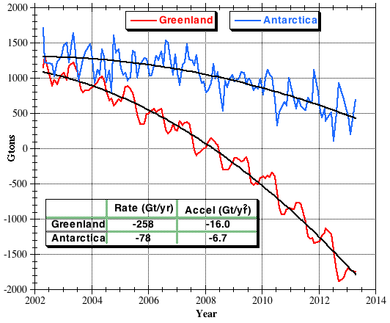
Ice Mass Loss from GRACE
Cooperative Institute for Research in Environmental Sciences (CIRES)
Notes:
Near-global coverage of satellite altimeters has improved our understanding of how sea level is changing on regional and global scales.
Led to first definitive estimates of global mean sea level (GMSL) rise.
Provided measurements of how trends in sea level vary from the global mean on regional scales.
The satellite altimetry record, however, spans only two decades.
Difficult to separate the secular trend (long-period, non-periodic) from natural climate variability on decadal and longer timescales

Slide 19
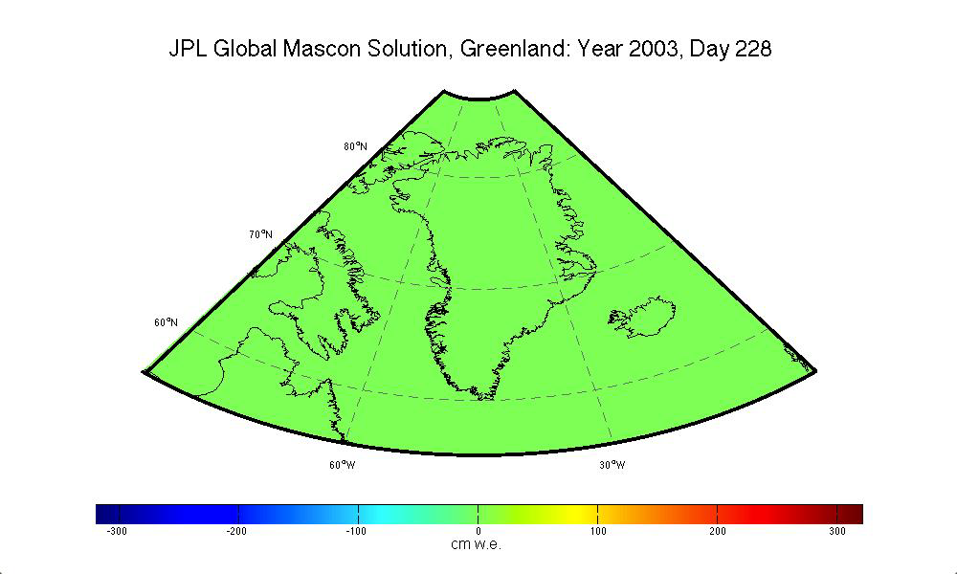
Greenland Ice Mass Changes from GRACE
Cooperative Institute for Research in Environmental Sciences (CIRES)
Notes:
Near-global coverage of satellite altimeters has improved our understanding of how sea level is changing on regional and global scales.
Led to first definitive estimates of global mean sea level (GMSL) rise.
Provided measurements of how trends in sea level vary from the global mean on regional scales.
The satellite altimetry record, however, spans only two decades.
Difficult to separate the secular trend (long-period, non-periodic) from natural climate variability on decadal and longer timescales

Slide 20
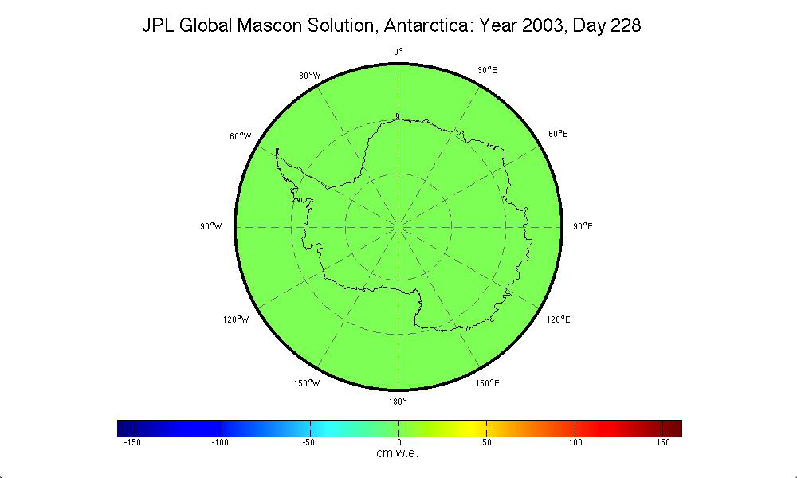
Antarctica Ice Mass Changes from GRACE
Cooperative Institute for Research in Environmental Sciences (CIRES)
Notes:
Near-global coverage of satellite altimeters has improved our understanding of how sea level is changing on regional and global scales.
Led to first definitive estimates of global mean sea level (GMSL) rise.
Provided measurements of how trends in sea level vary from the global mean on regional scales.
The satellite altimetry record, however, spans only two decades.
Difficult to separate the secular trend (long-period, non-periodic) from natural climate variability on decadal and longer timescales

Slide 21
Closing the Sea Level Budget
Addition of Heat
Addition of Freshwater
Total Sea Level Rise
+
=
(roughly)
Argo
GRACE
Jason
Cooperative Institute for Research in Environmental Sciences (CIRES)
Notes:
Near-global coverage of satellite altimeters has improved our understanding of how sea level is changing on regional and global scales.
Led to first definitive estimates of global mean sea level (GMSL) rise.
Provided measurements of how trends in sea level vary from the global mean on regional scales.
The satellite altimetry record, however, spans only two decades.
Difficult to separate the secular trend (long-period, non-periodic) from natural climate variability on decadal and longer timescales

Slide 22
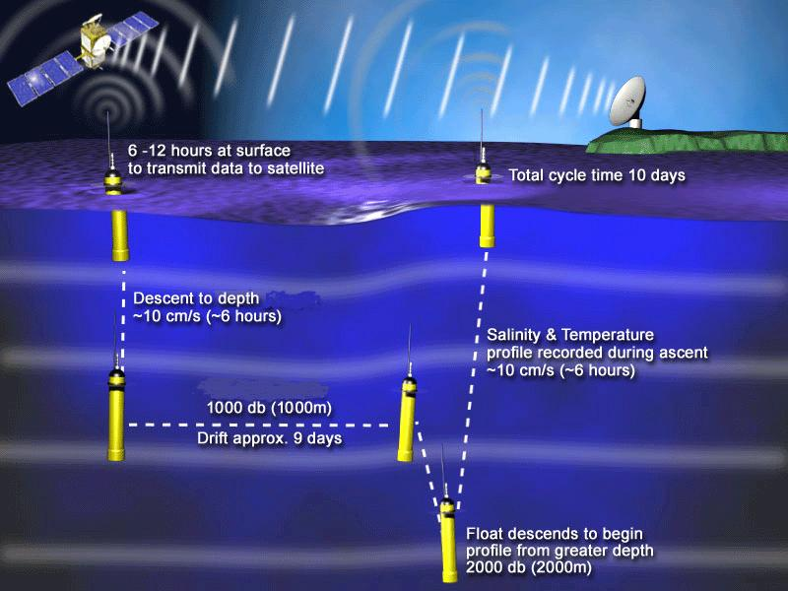
Thermosteric Sea Level Change – Argo Floats
Cooperative Institute for Research in Environmental Sciences (CIRES)
Notes:
Near-global coverage of satellite altimeters has improved our understanding of how sea level is changing on regional and global scales.
Led to first definitive estimates of global mean sea level (GMSL) rise.
Provided measurements of how trends in sea level vary from the global mean on regional scales.
The satellite altimetry record, however, spans only two decades.
Difficult to separate the secular trend (long-period, non-periodic) from natural climate variability on decadal and longer timescales

Slide 23
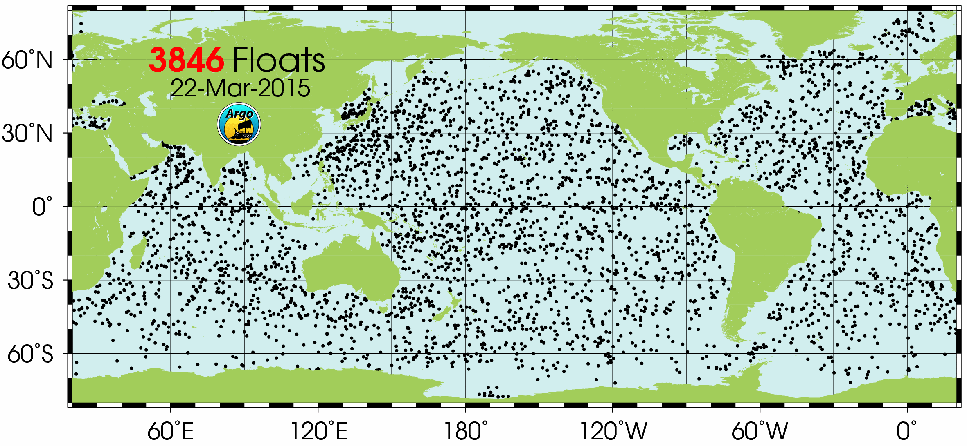
Thermosteric Sea Level Change – Argo Floats
Cooperative Institute for Research in Environmental Sciences (CIRES)
Notes:
Near-global coverage of satellite altimeters has improved our understanding of how sea level is changing on regional and global scales.
Led to first definitive estimates of global mean sea level (GMSL) rise.
Provided measurements of how trends in sea level vary from the global mean on regional scales.
The satellite altimetry record, however, spans only two decades.
Difficult to separate the secular trend (long-period, non-periodic) from natural climate variability on decadal and longer timescales

Slide 24
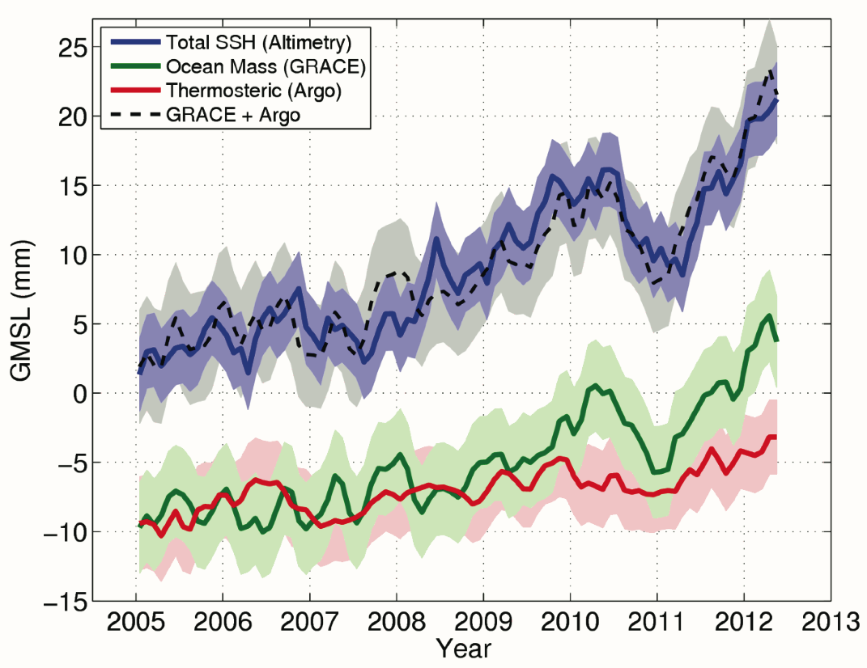
Closing the Sea Level Budget
Cooperative Institute for Research in Environmental Sciences (CIRES)
Notes:
Near-global coverage of satellite altimeters has improved our understanding of how sea level is changing on regional and global scales.
Led to first definitive estimates of global mean sea level (GMSL) rise.
Provided measurements of how trends in sea level vary from the global mean on regional scales.
The satellite altimetry record, however, spans only two decades.
Difficult to separate the secular trend (long-period, non-periodic) from natural climate variability on decadal and longer timescales

Slide 25
Closing the Sea Level Budget (altimeter era)
Thermal Expansion: ~ 1.1 mm/year
+
Mountain Glaciers: ~ 1.2 mm/year
+
Greenland Ice Melt: ~ 0.7 mm/year
+
Antarctic Ice Melt: ~ 0.2 mm/year
+
Land Water Storage: ?
=
Total: ~ 3.2 mm/year
Cooperative Institute for Research in Environmental Sciences (CIRES)
Notes:
Near-global coverage of satellite altimeters has improved our understanding of how sea level is changing on regional and global scales.
Led to first definitive estimates of global mean sea level (GMSL) rise.
Provided measurements of how trends in sea level vary from the global mean on regional scales.
The satellite altimetry record, however, spans only two decades.
Difficult to separate the secular trend (long-period, non-periodic) from natural climate variability on decadal and longer timescales

Slide 26
Sea Level Budget
IPCC (2014)
Cooperative Institute for Research in Environmental Sciences (CIRES)
Notes:
Near-global coverage of satellite altimeters has improved our understanding of how sea level is changing on regional and global scales.
Led to first definitive estimates of global mean sea level (GMSL) rise.
Provided measurements of how trends in sea level vary from the global mean on regional scales.
The satellite altimetry record, however, spans only two decades.
Difficult to separate the secular trend (long-period, non-periodic) from natural climate variability on decadal and longer timescales

Slide 27
Projecting Sea Level Rise: Global vs. Regional
Two main approaches for projecting sea level: process-based models vs. semi-empirical methods
Semi-empirical methods have been developed for projecting sea level rise on global scales [Vermeer and Rahmstorf, 2009; Rahmstorf, 2012].
  Rely on relationship between sea level and surface temperature in the past, then use model predictions of temperature to extend relationship in to the future.
  Recent IPCC AR5 report had “low confidence” in semi-empirical models.
Currently, there are no comprehensive climate models that project all the different components of regional sea level change.
Semi-empirical methods are not appropriate for projecting regional sea level rise.
  Different factors contribute to regional sea level rise that can’t be accounted for in semi-empirical approach.
  Quality long-term sea level records are more difficult to reconstruct than GMSL.
  Over a long enough time period, the regional sea level trends will approach the trend in GMSL.

Slide 28
Semi-Empirical Projections
RCP2.6
RCP4.5
RCP6.0
RCP8.5
IPCC (2014)
Notes:
: Range (5–95%) for projections of global-mean sea level rise (m) in 2081–2100 relative to 1986–2005 by semi-empirical models for (a) RCP2.6, (b) RCP4.5, (c) RCP6.0, and (d) RCP8.5. Blue bars are results from the models using RCP temperature projections, red bars are using RCP radiative forcing. The numbers on the horizontal axis refer to the literature source of the projection and the sea level reconstruction used for calibration (for studies using RCP temperature projections) or reconstruction of radiative forcing (for studies using RCP radiative forcing). (1) Rahmstorf et al. (2012a), with Kemp et al. (2011); (2) Schaeffer et al. (2012); (3) Rahmstorf et al. (2012a), with Church and White (2006); (4) Rahmstorf et al. (2012a), with Church and White (2011); (5) Rahmstorf et al. (2012a), with Jevrejeva et al. (2008); (6) Grinsted et al. (2010), with Moberg et al. (2005); (7) Jevrejeva et al. (2012a), with Goosse et al. (2005); (8) Jevrejeva et al. (2012a), with Crowley et al. (2003); (9) Jevrejeva et al. (2012a) with Tett et al. (2007). Also shown for comparison is the median (thick black line) and likely range (horizontal gray bar) (as defined in Section 13.5.1) from the process-based projections (Table 13.5), which are assessed as having medium confidence, in contrast to SEMs, which are assessed as having low confidence (Section 13.5.3)

Slide 29
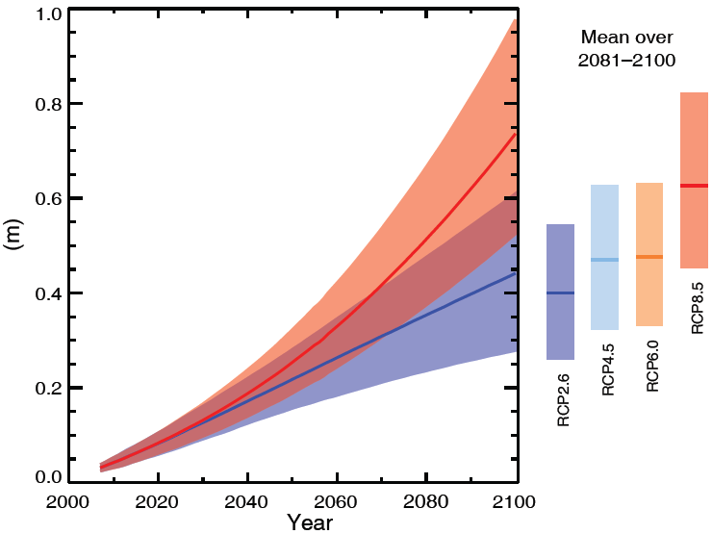
Process-Based Model Projections of 21st-century GMSL
According to IPCC: Medium confidence in likely ranges. Very likely that the 21st-century mean rate of GMSLR will exceed that of 1971-2010 under all RCPs.
IPCC (2014)

Slide 30
Regional Projections from Process-Based Models
IPCC (2014)

Slide 31
What We Know About Sea Level
Quick Summary of what has been covered so far:
Since 1993, we have near-global measurements of sea level from satellite altimeters.
Since early-mid 2000s, we have near-global measurements of the mass (GRACE) and steric (Argo) contributions to sea level.
During the satellite altimeter era, we are able to (roughly) close the sea level budget.
Process-based model projections of GMSL estimate a likely range of ~0.2 m to ~0.9 m of sea level rise in 2100, depending on the RCP.
Process-based model projections of regional sea level point towards higher sea level in 2100 for the vast majority of the globe.
Let’s take a broader view regarding what we know and what we don’t know (condensed and simplified in the interest of time)…

Slide 32
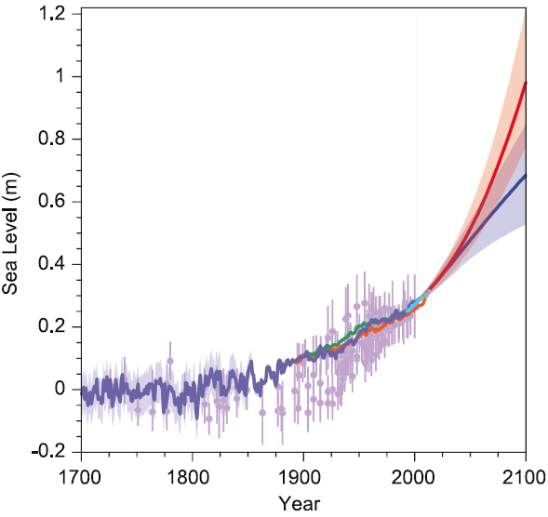
What We Know About Sea Level
Global sea level is rising.
Past and future sea-level rise. For the past, proxy data are shown in light purple and tide gauge data in blue. For the future, the IPCC projections for very high emissions (red, RCP8.5 scenario) and very low emissions (blue, RCP2.6 scenario) are shown. Source: IPCC AR5 Fig. 13.27.

Slide 33
What We Know About Sea Level
Global sea level is rising.
The rise has accelerated since pre-industrial times.
Past and future sea-level rise. For the past, proxy data are shown in light purple and tide gauge data in blue. For the future, the IPCC projections for very high emissions (red, RCP8.5 scenario) and very low emissions (blue, RCP2.6 scenario) are shown. Source: IPCC AR5 Fig. 13.27.

Slide 34
What We Know About Sea Level
Global sea level is rising.
The rise has accelerated since pre-industrial times.
It will accelerate further in this century.
Past and future sea-level rise. For the past, proxy data are shown in light purple and tide gauge data in blue. For the future, the IPCC projections for very high emissions (red, RCP8.5 scenario) and very low emissions (blue, RCP2.6 scenario) are shown. Source: IPCC AR5 Fig. 13.27.

Slide 35
What We Know About Sea Level
Global sea level is rising.
The rise has accelerated since pre-industrial times.
It will accelerate further in this century.
Regional sea level will be higher in 2100 (relative to today) for the majority of the world.
Past and future sea-level rise. For the past, proxy data are shown in light purple and tide gauge data in blue. For the future, the IPCC projections for very high emissions (red, RCP8.5 scenario) and very low emissions (blue, RCP2.6 scenario) are shown. Source: IPCC AR5 Fig. 13.27.

Slide 36
What Don’t We Know About Sea Level
Perhaps of greater importance at this point is to consider what we don’t know (or at least don’t know very well) about sea level...

Slide 37
What Don’t We Know About Sea Level
How is sea level change different now than it has been in the past?

Slide 38
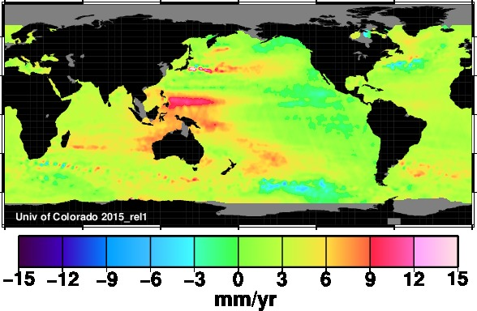
What Don’t We Know About Sea Level
What will regional sea level be 5, 10, or 20 years from now? What is the impact of natural climate variability?

Slide 39
What Don’t We Know About Sea Level
What will regional sea level be in 2050? 2100?

Slide 40
What Don’t We Know About Sea Level
What is the upper limit on sea level in 2050? 2100?
  A plausible upper limit is essential for planning purposes.
  Coastal infrastructure needs to survive in the worst case scenario, similar to how it needs to survive in the “likely” scenario.
  A dike that is only “likely” good enough is not really the safety level engineers and planners want to provide.
The top end of the IPCC “likely” range is 98 cm.
  Based on the IPCC definitions, this means that there is a 17% chance of exceeding 98 cm.
  The IPCC does not provide an upper-limit of sea level rise.
The collapse of marine-based sectors of the Antarctic ice sheet, if initiated, could cause GMSL to rise substantially above the likely range during the 21st century.
  This additional contribution could approach (exceed?) several tenths of a meter.
  Current evidence and understanding do not allow a quantification of either the timing of its onset or of the magnitude of its multi-century contribution.
Are there other factors that we don’t understand well-enough that could increase this upper limit?

Slide 41
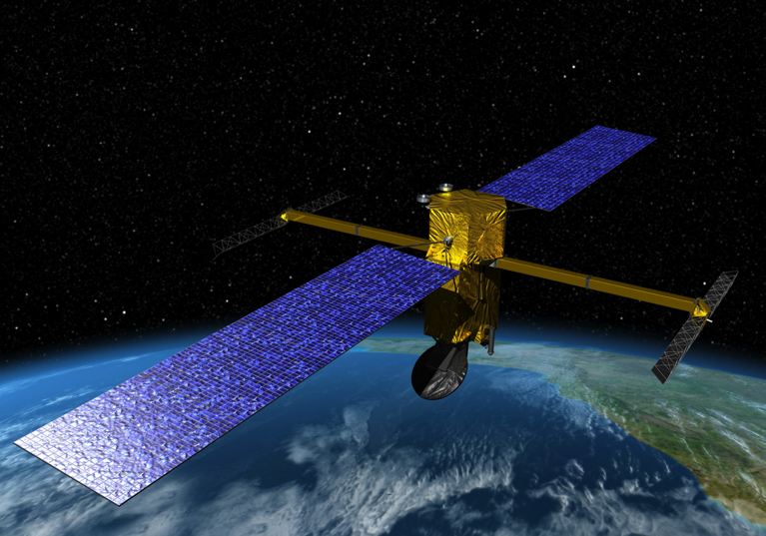
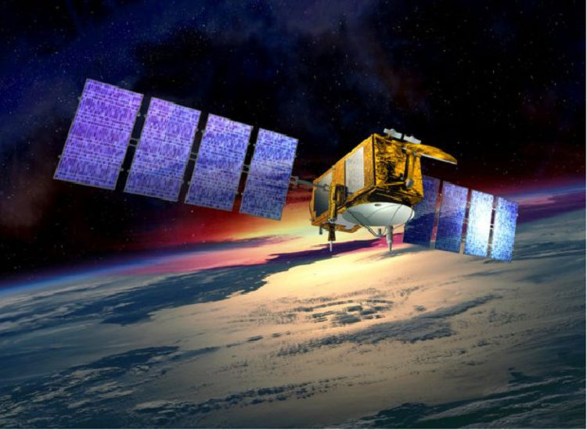
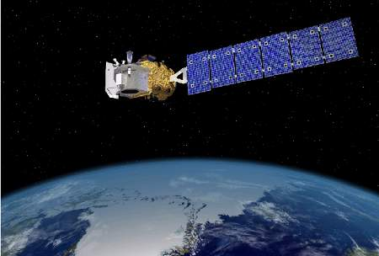
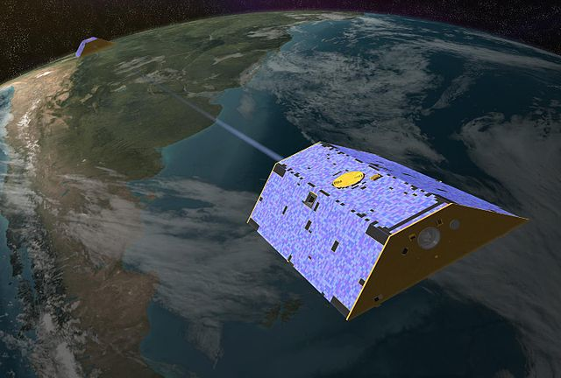
Priorities for the Future
Maintain (and improve) the current observing system.
SWOT – Surface Water Ocean Topography Mission (2020)
Jason-3 (2015)
ICESat-2 (2016)
GRACE Follow-on (2017)
GRACE Follow On Mission (2017)

Slide 42
Priorities for the Future
Improve regional sea level projections on a variety of timescales.
  Requires an interdisciplinary approach, bringing together scientists from different fields to contribute to improve our understanding of regional sea level.
A.15 NASA Sea Level Rise
This solicitation calls for proposals to support the following:
Interdisciplinary research required to improve the accuracy and spatial resolution of current and future sea level change estimates;
Development of a web portal to serve as a central hub for the effort, including communicating results in a simplified manner to the scientific community and general public; and
Establishment of the NASA Sea Level Change Team (N-SLCT) to foster this work.

Slide 43
Priorities for the Future
Effectively communicate information about sea level change to decision makers and stakeholders.
  Debate among scientists over what approach to take when discussing sea level: IPCC?
  Important to use what we don’t know to inform the guidance scientists give.
  Although we may not think upper limit is likely, it is essential for planners to understand what the upper limit may be so that it can be accounted for.
  There is risk associated with choosing a certain scenario or range to plan for – this risk must be communicated as clearly as possible.

Slide 44
Summary
Sea level is an essential climate variable that provides important insight into the state of the climate.
  Changes in sea level reflect both thermal expansion from rising ocean temperatures as well as well as mass-change due to increased run-off from ice sheet and glacier melt.
  Changes in sea level also pose a direct and serious societal and economic risk.
In the past two decades, satellite measurements have improved our understanding of sea level.
  Have led to closure of the sea level budget.
  Need to continue the satellite-measured sea level record into the future.
Still many questions to be answered with regards to future sea level.
  Need to communicate uncertainties clearly – it is possible that the “likely” range is an underestimate of future sea level.

Slide 45
Thank you for your time!

