Slide 1
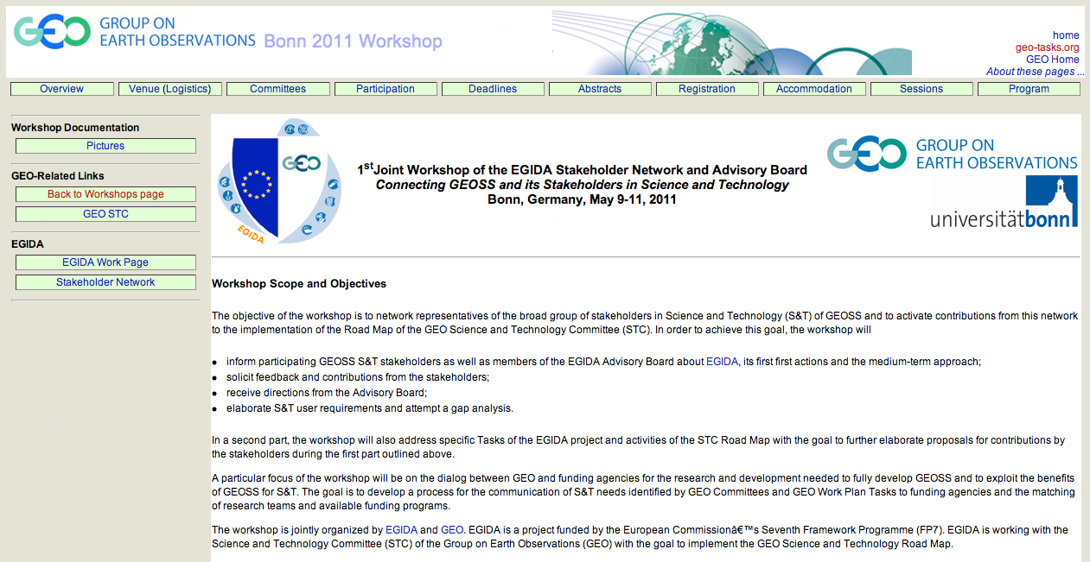
3rd and 4th GEOSS Science and Technology Stakeholder Workshops
Welcome
Connecting GEOSS and its Stakeholders in Science and Technology
Bonn, Germany, May 9-11, 2011

Slide 2
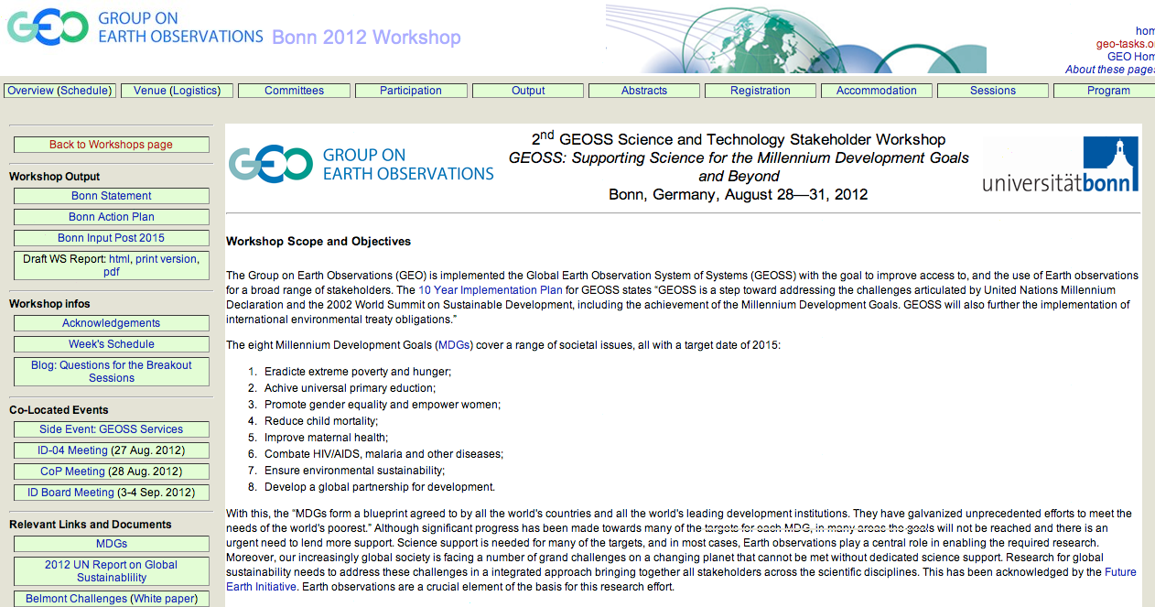
3rd and 4th GEOSS Science and Technology Stakeholder Workshops
GEOSS: Supporting Science for the Millennium Development Goals and Beyond
Bonn, Germany, August 28—31, 2012
Bonn Statement
Bonn Action Plan
Bonn Input Post 2015

Slide 3
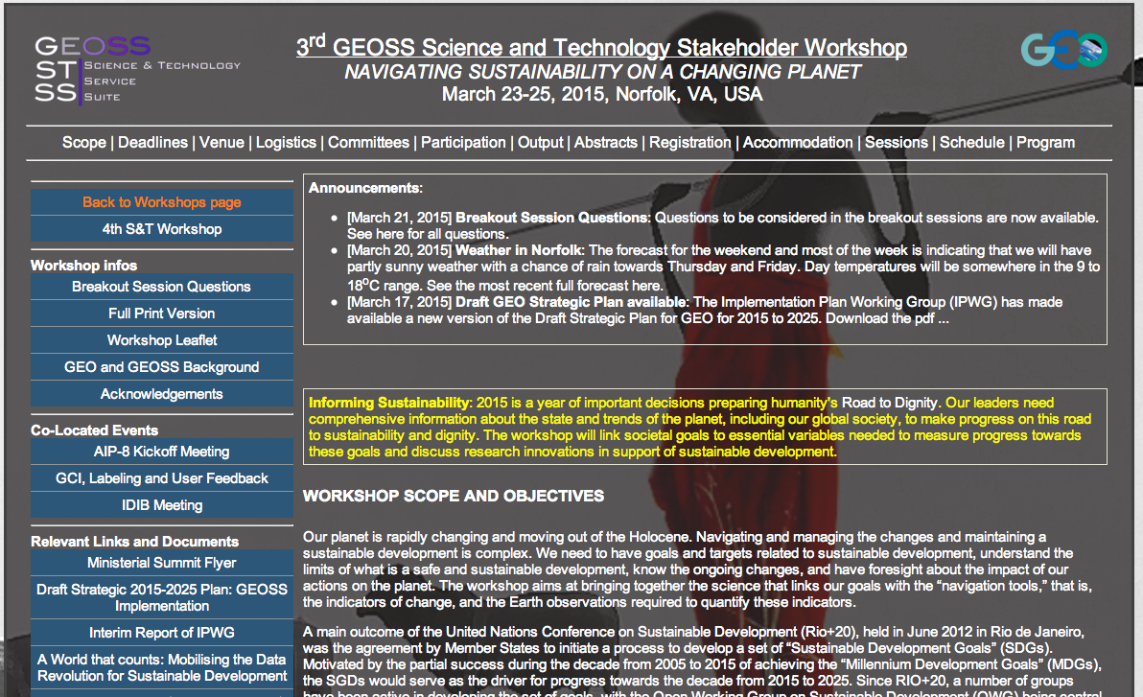
3rd and 4th GEOSS Science and Technology Stakeholder Workshops
Linking societal goals and targets to metrics and essential variables
3rd Workshop
Breakout Session Block 1 “Designing the Metrics”
In developing a top-down approach for the identification of essential variables starting at societal goals and targets (such as the SDGs and associated targets, or the GEO Strategic Targets), what process and criteria could be used to develop indicators that can serve as a management tool to support planning and a report tool to support assessments of progress? Note: An example of such a process could be the Result-Based Managment (RBM) approach; see http://www.unep.org/geo/pdfs/geo5/GEO5_report_C17.pdf for a recommendation to apply RBM of MDGs to sustainability MDG 7 (pp 470 UNEP GEO-5).
How developed are indicators in your area of societal goals?
Breakout Session, Block 2: “Quantifying the Metrics”
To ensure that the indicators can be quantified, essential variables need to be identified and observed. What process and criteria could be used to link indicators to essential variables?
Is a top-down approach available and used to link indicators to essential variables in your area of societal goals?
Joint Sessions
Joint Breakout Sessions: “Creating the practice-relevant knowledge to cope with global change”
For societal goals such as the emerging SDGs and the GEO Targets, are we making the best use of the “data super nova” to generate the knowledge needed to achieve these goals?
Is there a need to increase the usability and userfriendliness of the data and information provided by GEOSS and how could that be achieved?
Is there a need for a higher level of integration of earth observation and socie-economic data and how could progress made toward this integration?
Considering the speed of change and the potential for emerging risks, are we providing the science and observations to respond rapidly to emerging knowledge needs?
Are we sufficiently focused on societal challenges arising from societal goals expressed through, for example, the SDGs, the new framework for disaster risk reduction, or the GEO Strategic Targets?
Navigating Sustainability on a Changing Planet
Sustainable Development Goals
Global Boundaries

Slide 4
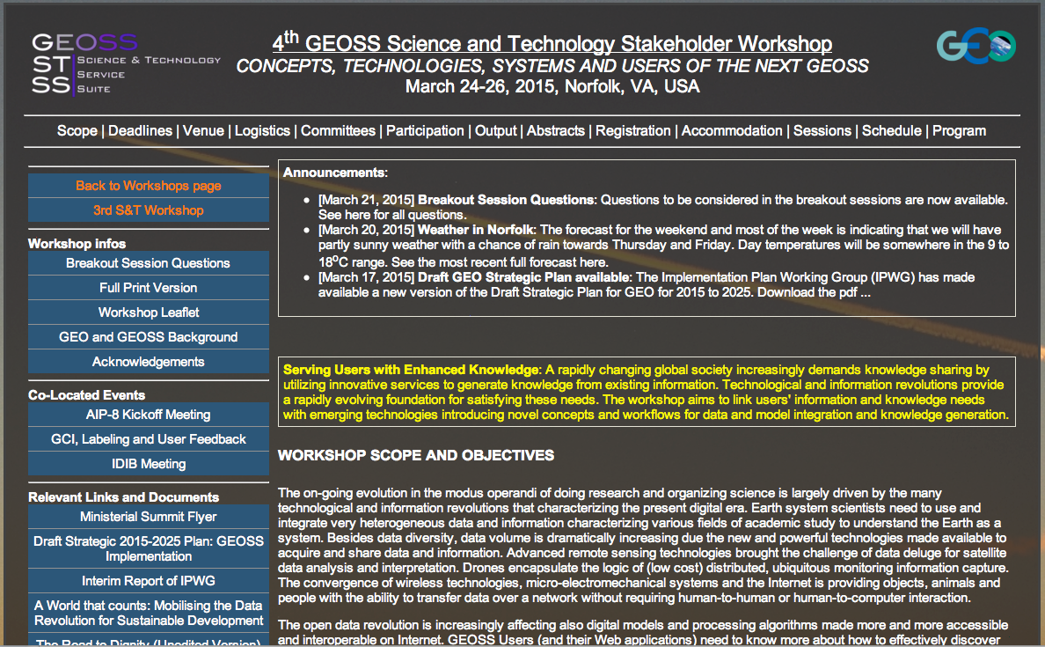
3rd and 4th GEOSS Science and Technology Stakeholder Workshops
Linking users’ information and knowledge needs with emerging technologies and novel concepts
4th Workshop
Breakout Session Block 1: “Emerging revolutions: challenges and opportunities”
How should the data super nova generated by the IoT, the Internet of Everything, and the Internet of People by utilized for the next GEOSS?
How can the big data approach support and be integrated into the next GEOSS?
What e-infrastructure is needed to facilitate the full exploitation of societal benefits of the next GEOSS?
Breakout Session Block 2: “Sustaining GEOSS in a Changing World”
How important are public-private partnerships for the next GEOSS and who should be involved?
Are there new approach to a sustainable business model for the next GEOSS?
How should a network of network be governed to ensure sustained observation and processing infrastructure for the next GEOSS?
What can be done to align the next GEOSS better to the needs of the developing world and sustaining capacity in developing economies?
What should the information system of the next GEOSS provide to users and how can we ensure that the system supports those users who are solution-oriented?
Concepts, Technologies, Systems and Users of the Next GEOSS
Servicing users with enhanced (practice-relevant) knowledge

