Slide 1

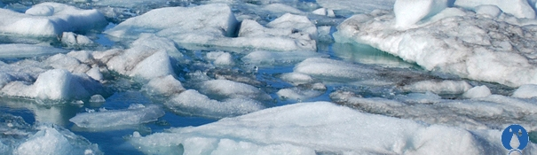
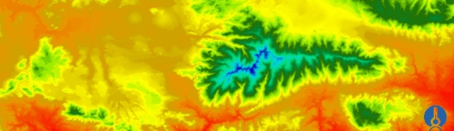

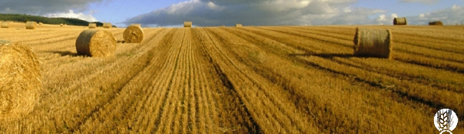
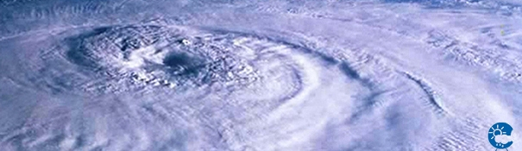
The ConnectinGEO project
ENEON first workshop
Observing Europe: Networking the Earth Observation Networks in Europe
21-22 September, Paris
CREAF
Joan Masó / Joan.Maso@uab.cat

Slide 2
ConnectinGEO in brief
H2020 funded project that will last 2 years (641538)
Coordinate and Support Action (CSA)
Formed by 15 partners
A contribution of the EU to GEOSS
A gap analysis of GEOSS
Will propose priorities
Proposes a European Network of Earth Observation (ENEON).

Slide 3















Partnership
Good balance:
Some technical people
Some thematic experts
Some networking experts

Slide 4

Summary
ConnectinGEO links existing coordinated Earth observation networks with science and technology (S&T) communities, the industry sector and the GEOSS and Copernicus stakeholders.
The emerging UN Sustainable Development Goals (SDGs) are a motivation.
Outcome:
prioritized list of critical gaps within the European Union in observations and the models that translate observations into practice-relevant knowledge.
It will include the research activities required to address these gaps.
Increase coherency of European observation networks, increase the use of Earth observations and inform the planning for future observation systems.

Slide 5





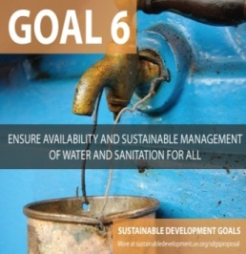


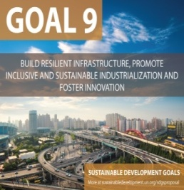

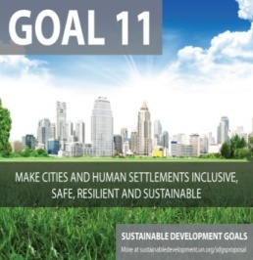
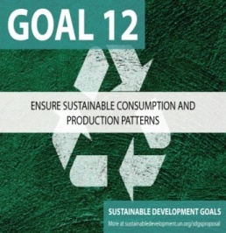
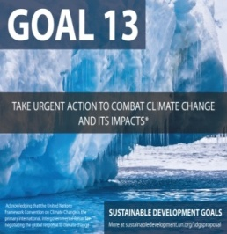
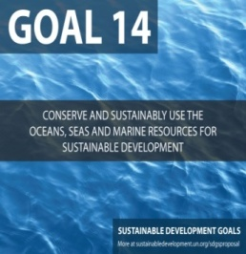
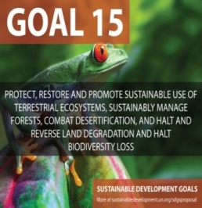

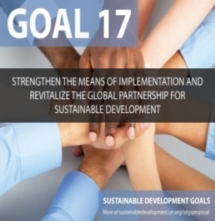
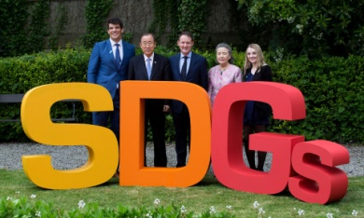
Sustainable Development Goals are our motivation

Slide 6
Sustainable Development Goals monitored by RS

Slide 7
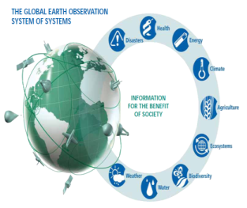
Sustainable Development Goals monitored by RS
Goal 2: End hunger, achieve food security and improved nutrition and promote sustainable agriculture
Goal 3: Ensure healthy lives and promote wellbeing for all at all ages
Goal 6: Ensure availability and sustainable management of water and sanitation for all
Goal 7: Ensure access to affordable, reliable, sustainable and modern energy for all,
Goal 11: Make cities and human settlements inclusive, safe, resilient and sustainable
Goal 13: Take urgent action to combat climate change and its impacts
Goal 14: Conserve and sustainably use the oceans, seas and marine resources for sustainable development
Goal 15: Protect, restore and promote sustainable use of terrestrial ecosystems, sustainably manage forests, combat desertification, and halt and reverse land degradation and halt biodiversity loss

Slide 8




Indicators: Technical report by the Bureau of the United Nations Statistical Commission (UNSC)
Indicator 2.3.1
Value of agricultural production per hectare (measured in constant USD/hectare, disaggregated for the two lowest quintiles of countries’ farm size distribution, as well as for female-headed smallholder producer households)
Indicator 2.4.1
Emissions of greenhouse gases in agriculture (per hectare of land and per unit of output, separately for crop and livestock sectors).
Indicator 2.4.2
Absolute levels of emissions in relevant sectors and sub-sectors.
Indicator 3.9.1
Population in urban areas exposed to outdoor air pollution levels above WHO guideline values
Indicator 6.4.1
Water Stress
Indicator 6.6.1
Change in wetlands extent over time (% change over time)

Slide 9

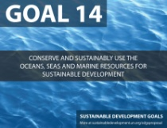

Indicators: Technical report by the Bureau of the United Nations Statistical Commission (UNSC)
Indicator 11.3.1
Ratio of land consumption rate to population growth rate at comparable scale
Indicator 11.b.2
Population density measured over continuous urban footprint
Indicator 14.2.2
Ocean Health Index
Indicator 14.3.1
Average marine acidity (pH) measured at agreed suite of representative sampling stations
Indicator 14.5.2 & Indicator 15.4.1
Coverage of protected areas
Indicator 15.1.1
Coverage of protected areas broken down by ecosystem type, including total area of forests in protected areas (thousands of hectares)
Indicator 15.1.2
Forest area as a percentage of total land area
Indicator 15.3.1
Trends in land degradation

Slide 10

Define a methodology
First translate knowledge needs (e.g. SDG) into indicators and
Indicators as mapped into essential variables (EV) required for the quantification;
Ultimately, these EV are used to refine observation requirements.
Society
Policy and Planning
Industry Challenge
Decisions
Impact
Knowledge base
Observation priorities
Forecast and projections
Goals
Top-Down
Strategic Targets
Sustainable Development
Goals
Sustainability Indicators
Essential Variables
Remote & In-Situ Observations
Bottom-up
Observation
Observing Systems/Networks
Climate
Water
Agriculture.
Natural Res.
Obj. 2
Carbon
Ecosystems
Energy.
Raw materiasls
Scientific Community

Slide 11
ConnetinGEO methodology for the gap analysis five threads
Top-Down thread 1: Identification of a collection of observation requirements and specifications from generic goals for sustainability of the global civilization as expressed in the GEOSS Strategic Targets, the SDGs, and the adherence to the planetary boundaries.
Top-Down thread 2: Incorporation of material from international programs such as Future Earth, Belmont Forum, the Research Data Alliance and community assessments of socio-economic benefits of Earth observations
Bottom-up thread 1: A consultation process in the current EO networks, consisting of collaboration platforms, surveys and discussions at workshops and even involvement of citizen science.
Bottom-up thread 2: A careful analysis of the observations and measurements that are currently in GEOSS Discovery and Access Broker complemented by other means (e.g. scientific literature)
Bottom-up thread 3: The realization of a series of real industry-driven challenges to assess the problems and gaps emerging during the creation of business opportunities

Slide 12
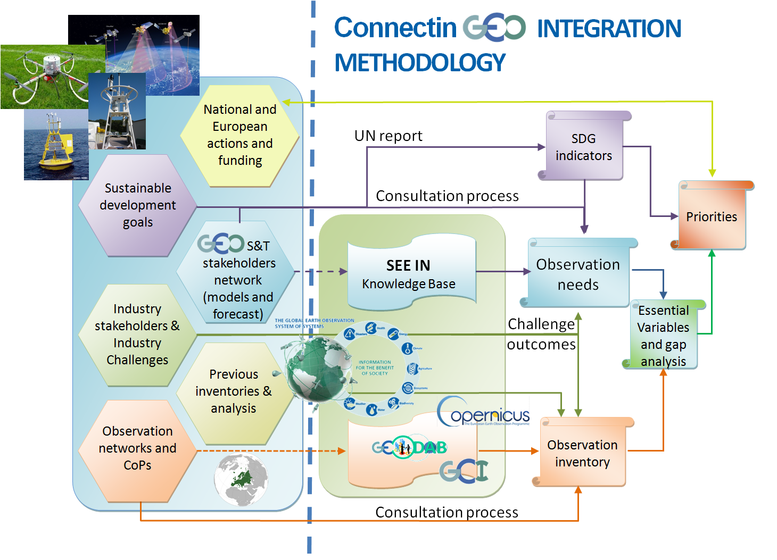

The methodology

Slide 13





European Network of Earth Observation Networks (ENEON) INPUTS
National and regional actions and funding
SDG
Observation inventory
Gap analysis
Priorities
Outcomes
Observation needs
Apply the methodology
SBAs & CoPs
Multiple loops
Industry stakeholders & challenges
National, regional actions & S&T feedback
Obj.3

Slide 14
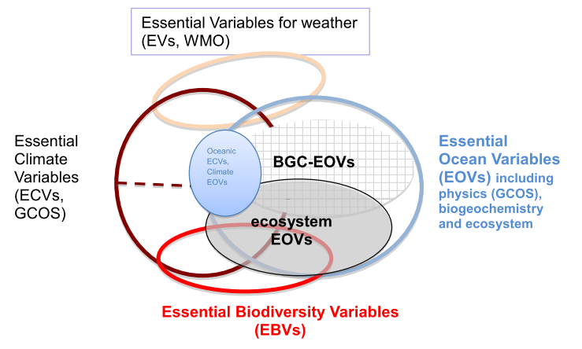
Essential Variables
The Essential Variables concept is the bases to reinforce the EO knowledge base
Climate– Global Climate Observing System;
Biodiversity– GEO BON;
Ocean – UNESCO and Southern Ocean Observing System.
Water
ConnectinGEO new communities are starting to propose new sets:
Carbon
Agriculture
Health and Pollution
Ecosystems
Renewable Energy
Disasters
Also spotting dependences and priorities

Slide 15
European Network of EO Networks ENEON
The thematic partners (that represent thematic observation networks),
The GEOSS S&T Stakeholder Network and GEOSS CoPs,
Copernicus services, Sentinel missions and in-situ support data representatives,
European networks representatives for space-based, airborne and in-situ observations (e.g. EPOS, EMSO and GROOM, etc)
Representatives of the SMEs and industry sector.
European and national funding agencies and in particular the ones participating in the ERA-PLANET
Obj.1

Slide 16















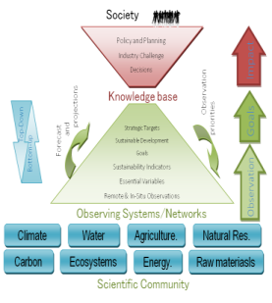





European network of EO Networks
Expert opinions will be considered in the methodology
LTER
SIOS
E.g. Offering to the European Networks of EO a common space in a booth to ensure their presence in the GEO week in Mexico.

Slide 17
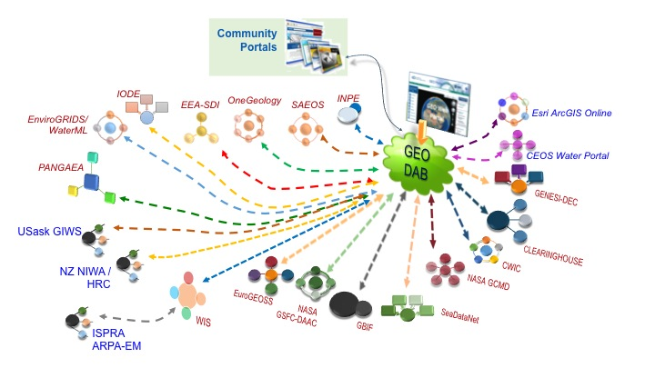


The DAB analysis for the GAP analysis

Slide 18


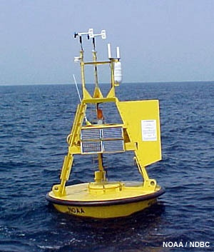
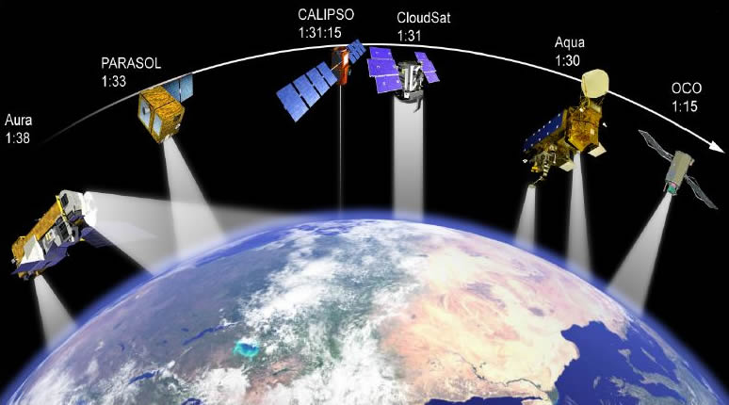
The hands-on challenges
Renewable energy challenge
In-situ and Remote Sensing challenge
In-situ integration in the GeoDAB
RS industry challenge
Network integration challenge

Slide 19
Interdisciplinary cooperation on global change challenge
ConnectinGEO we will select an interdisciplinary topic and will discuss about the possibilities for cooperation.
The exact topic will be driven by stakeholders:
E.g. relations and links between Global Change, Climate Change, Carbon, Land use and Biodiversity and its links to the planetary boundaries is a promising topic.
It will conduct the following activities:
Use the observation inventory analysis and the gap analysis in general, to identify potential stakeholders who can benefit from collaboration between themes. Develop a compelling argument to prioritize across domain target based on results from the work packages.
Determine stakeholders, develop plans for further research and investigate regional, national and international funding opportunities to cover this gap.
Analyze cost saving potential through collaboration across previously unrelated domains

Slide 20

Exploit the results of the project:
By providing a list of gaps with priorities:
European Commission
National and regional funding agencies,
Needs for GEOSS
Opportunities for Private Sector and Citizen Observatories
A solid foundation for an ENEON
A published ConnectinGEO methodology
A collection of best practices for observation networks and data exchange.
H2020 - SC5
Obj.4

Slide 21


Activelly workshoping
EV

Slide 22
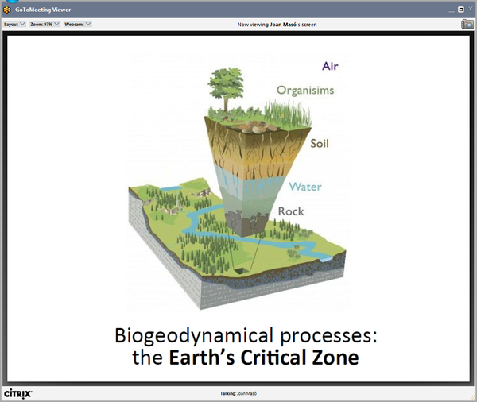
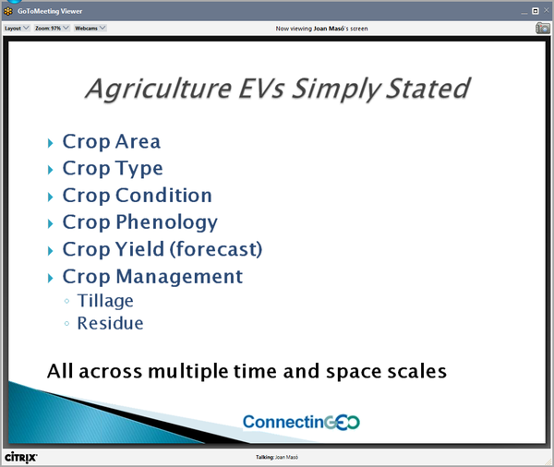
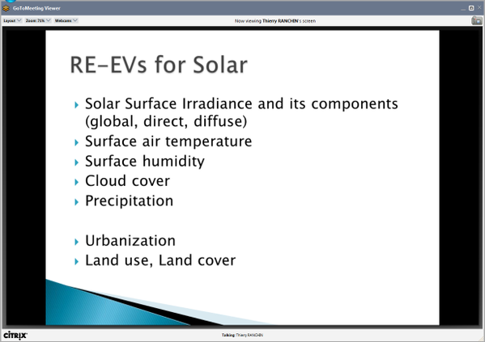
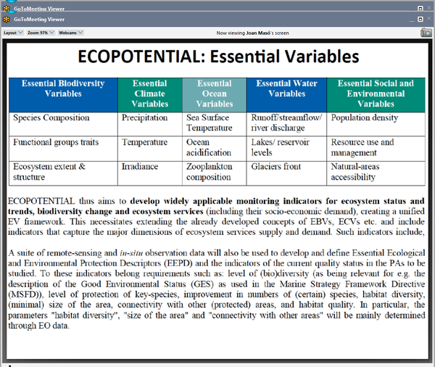
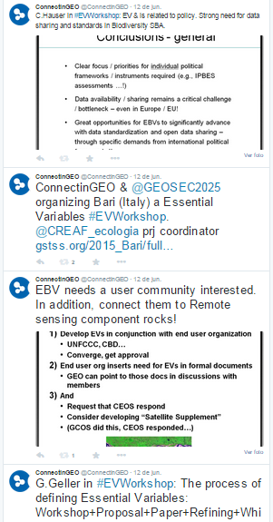
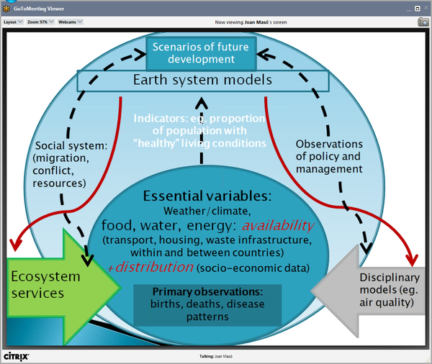
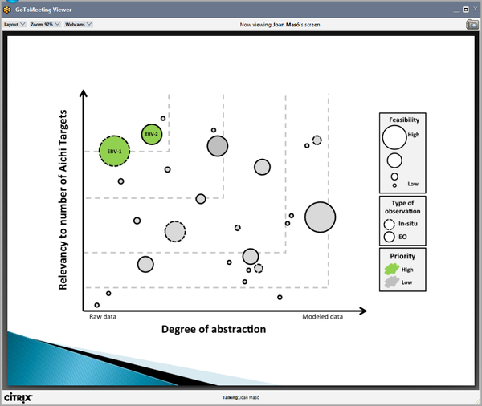
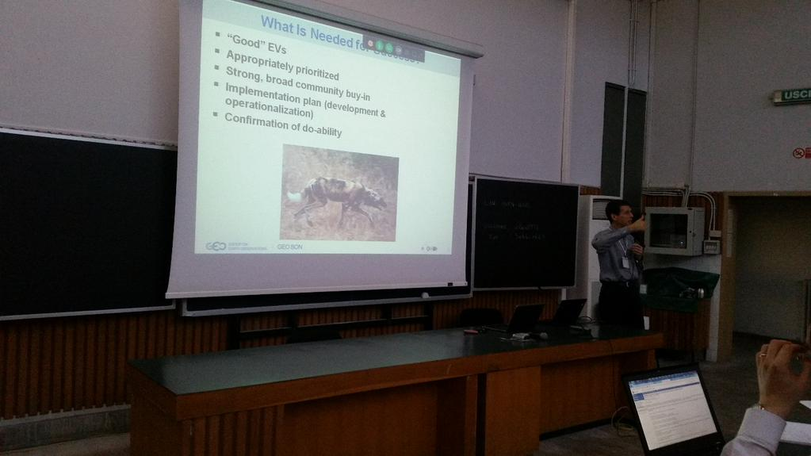
Joint ConnectinGEO and GEO Workshop in Bari

Slide 23
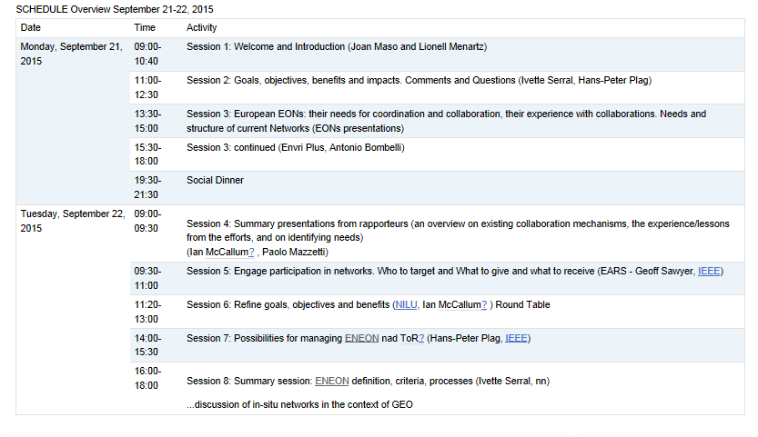
ENEON workshop
Objectives
Know more about the main current Earth Observation networks in Europe.
Review previous umbrella initiatives.
Clearly define the goals and benefits of the ENEON.
Develop a strategy to setup the network of networks.
Consider the legal status

Slide 24
Thanks!.
ENEON first workshop
Observing Europe: Networking the Earth Observation Networks in Europe
21-22 September, Paris
CREAF
Joan Masó / Joan.Maso@uab.cat

