Slide 1

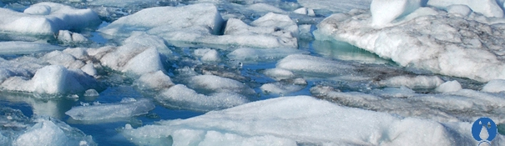
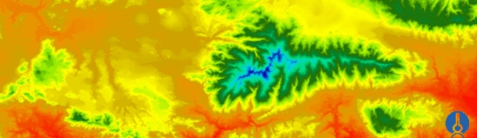
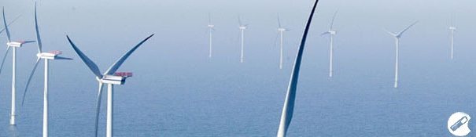
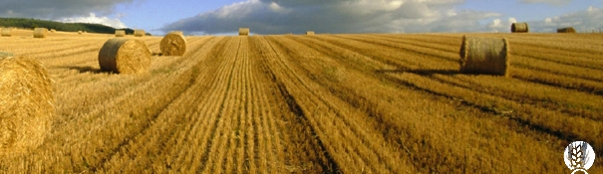
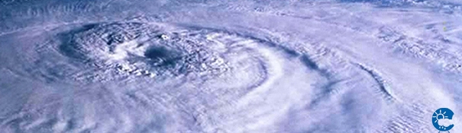
ENEON first workshop
Observing Europe: Networking the Earth Observation Networks in Europe
21-22 September, Paris
ECSA – European Citizen Science Association
Arne.J.Berre@sintef.no

Slide 2

ECSA Headquarters
Museum für Naturkunde Berlin
Leibniz Institute for Evolution and Biodiversity Research
September 2015

Slide 3
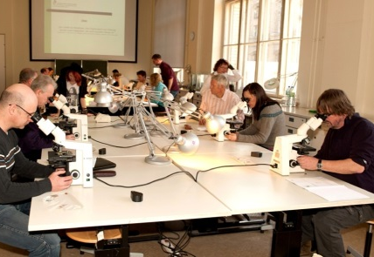

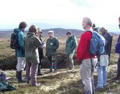
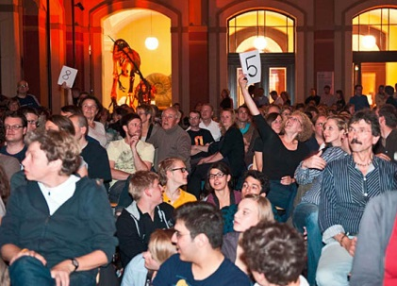
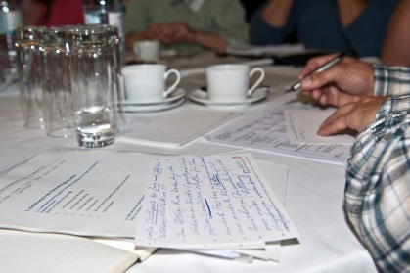
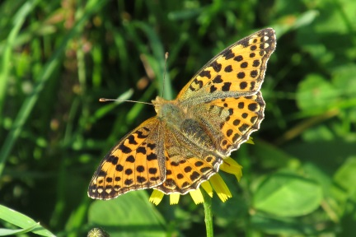

Our Mission:
Connecting citizens and science
through fostering active participation
Our Vision:
In 2020, citizens in Europe are valued and empowered
as key actors in advancing knowledge and innovation and thus supporting a sustainable development of our world.

Slide 4
Definition of Citizen Science
Oxford English Dictionary in June 2014:
‘scientific work undertaken by members of the general public, often in collaboration with or under the direction of professional scientists and scientific institutions’

Slide 5
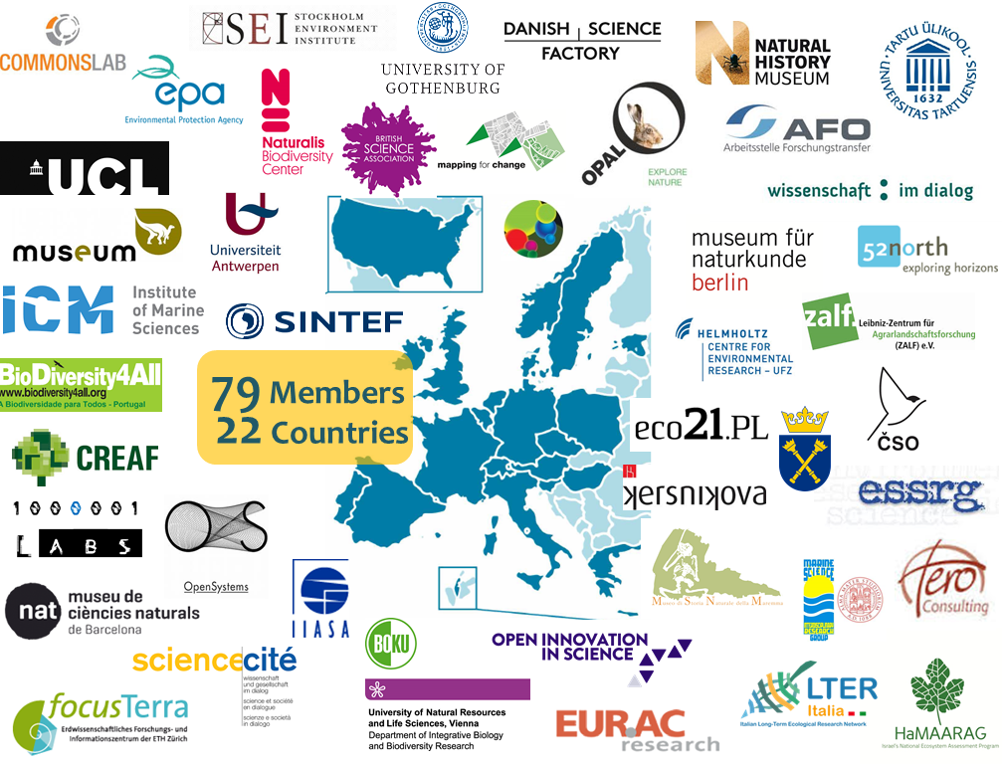

Slide 6
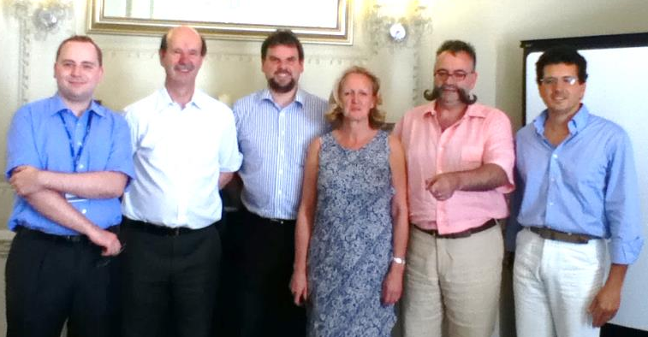
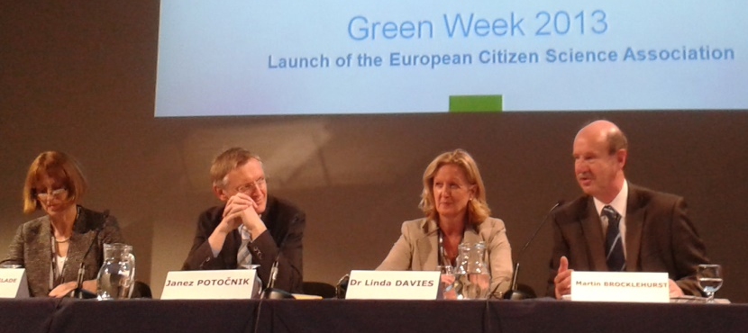
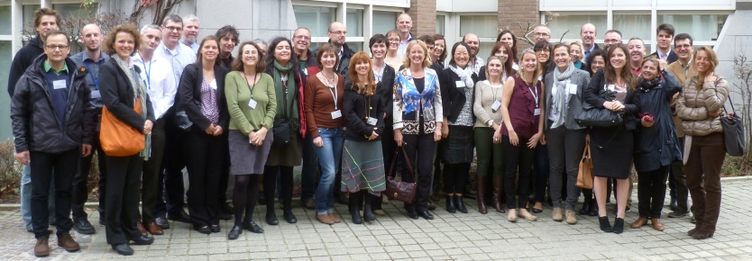
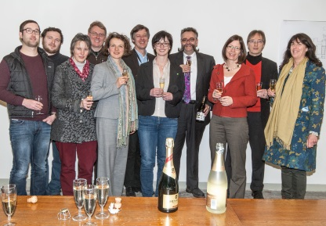

July 2012
October 2013
November 2012
June 2013
April 2014
November 2014
January 2014
Brief history
EEA Copenhagen
Meeting on the Development of European Citizen Science Network
First Meeting in London
ECSA Launch in Brussels
ECSA Meeting in Brussels
ECSA 1st General Assembly (Copenhagen)
ECSA 2nd General Assembly (Berlin)
ECSA Registration in Berlin

Slide 7

ECSA Strategy
Promoting Sustainability through CS
  Implementing EU-wide CS programmes
  Linking CS to politics
Building a Think Tank for Citizen Science
  Sharing knowledge & skills
  Providing expertise & fostering excellence
  Linking to international CS community
Developing Participatory Methods for Cooperation, Empowerment and Impact
  Carrying out synthesis & research on CS

Slide 8
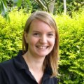
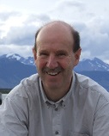



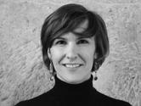

ECSA Working Groups
Standards, Principles,
Best Practice
& Capacity Building
Policy, Strategy,
Governance
& Partnerships
> Fundraising & Marketing
> Communication & Events
> International Conference
Projects, Data,
Tools
& Technology

Slide 9
The road ahead…
Networking & Capacity Building
  International Conference, Workshops, Papers, etc.
EU-wide CS Programmes
  E.g. Tree Health, Lichens
CS-Policy Interface
  CS supporting EU Environment & Climate Policy, RRI, Open Science
CS Data Infrastructure
  Synthesis of available tools, metadata standards, service provision

Slide 10
Some CS example references
University of Antwerp - Lab of environmental and urban ecology - e.g. measuring urban air quality with strawberry plants at city scal
https://www.uantwerpen.be/en/rg/endemic/research/research-topics/lab-of-environmental/
University College London, extreme citizen science group - various CS projects, usually community driven, on environmental and social issues
https://www.ucl.ac.uk/excites
- one spin-of is the mapping for change project http://mappingforchange.org.uk/
Natural History Museum of the Maremma, Italy - Bioblitz activities that contribute to several regional and national biodiversity surveys
http://www.museonaturalemaremma.it/
Ludwig Boltzmann Society, Austria, Open Innovation in Science - gathering citizens' input to formulate future research questions in the public health sector
http://www.openinnovationinscience.at/home.html

Slide 11
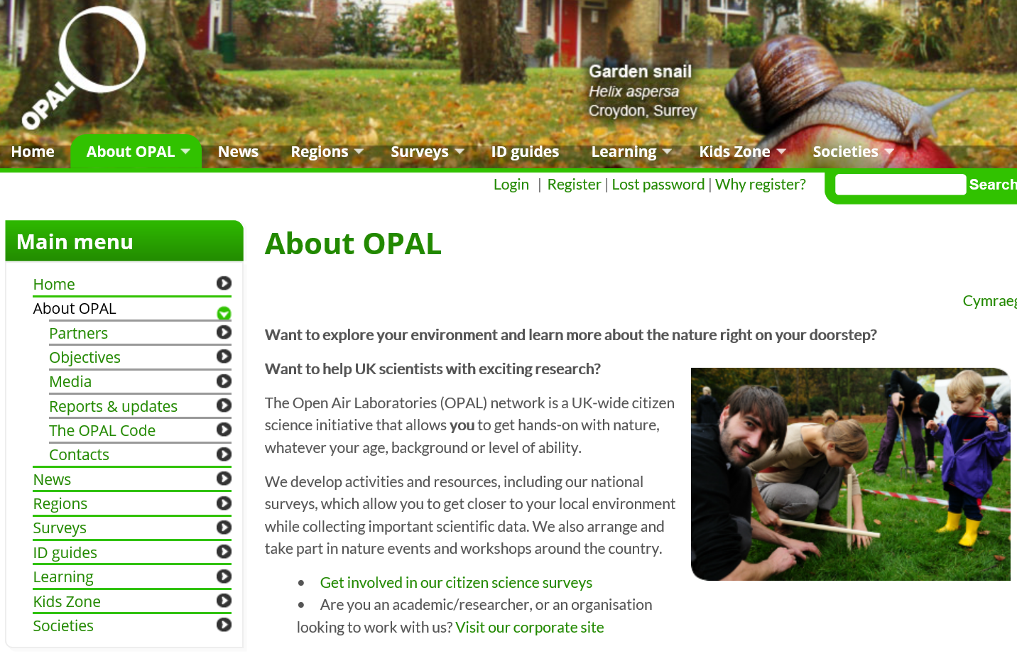

Slide 12
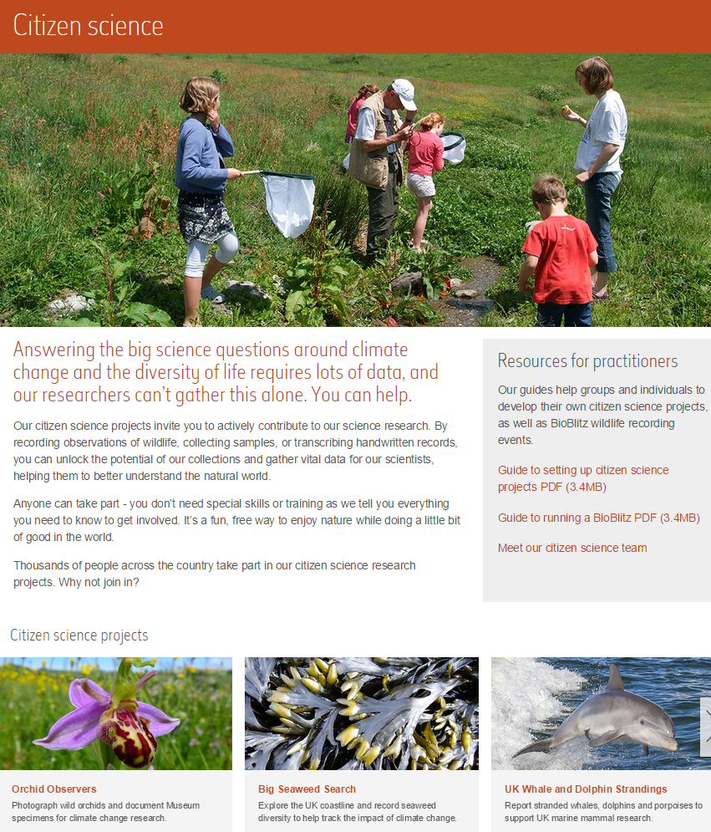
Natural History Museum, London

Slide 13
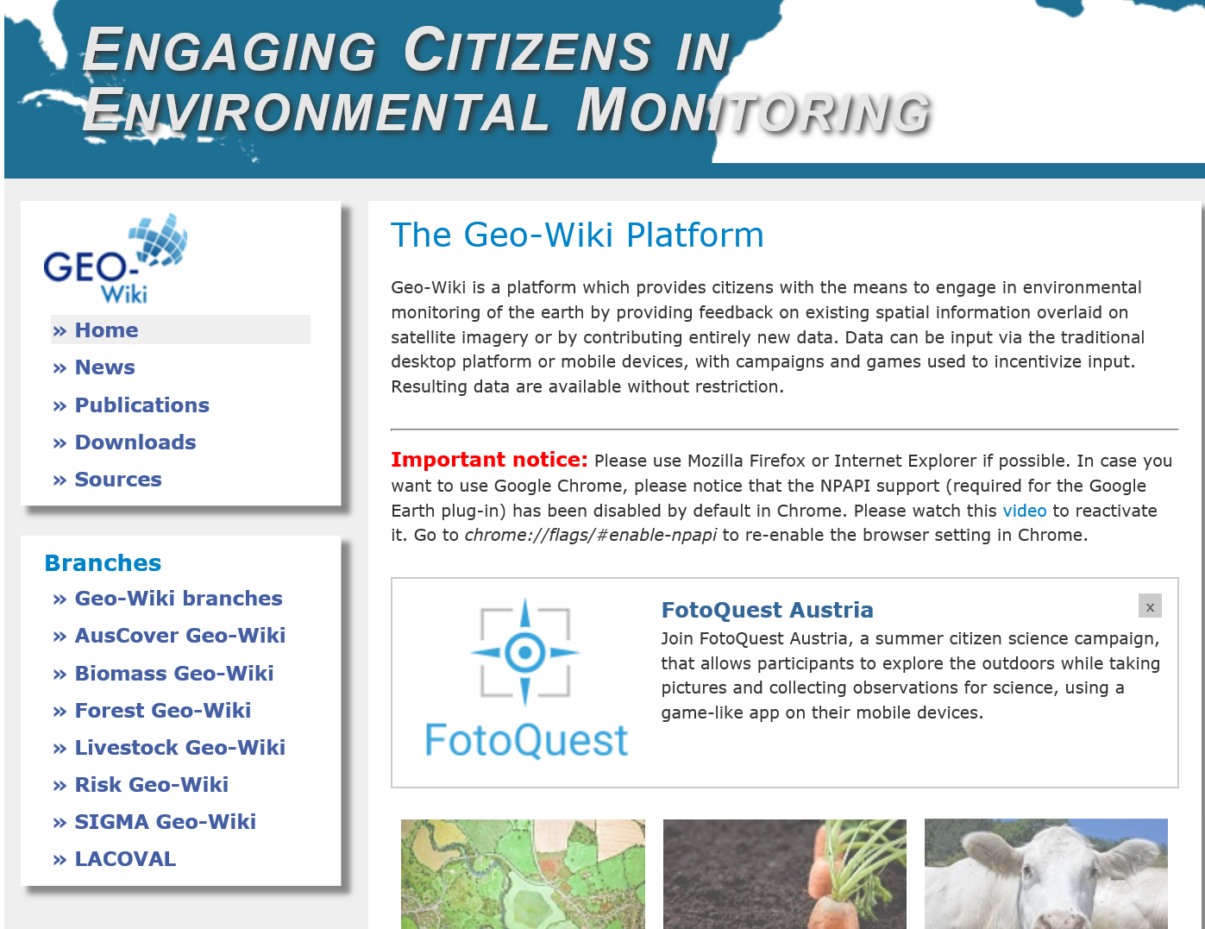

Slide 14
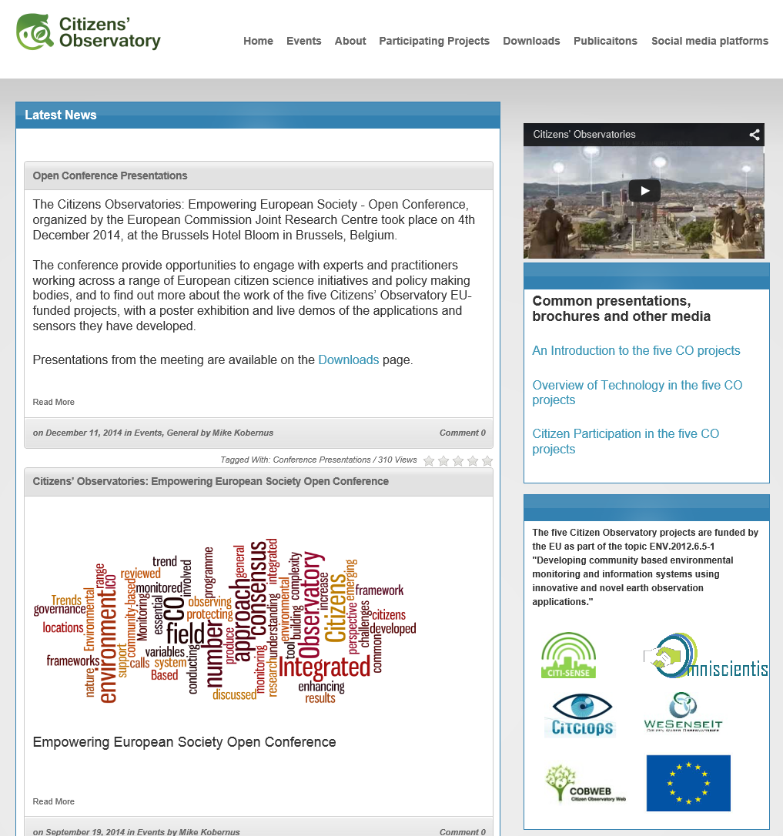
5 Citizen
Observatory
projects

Slide 15
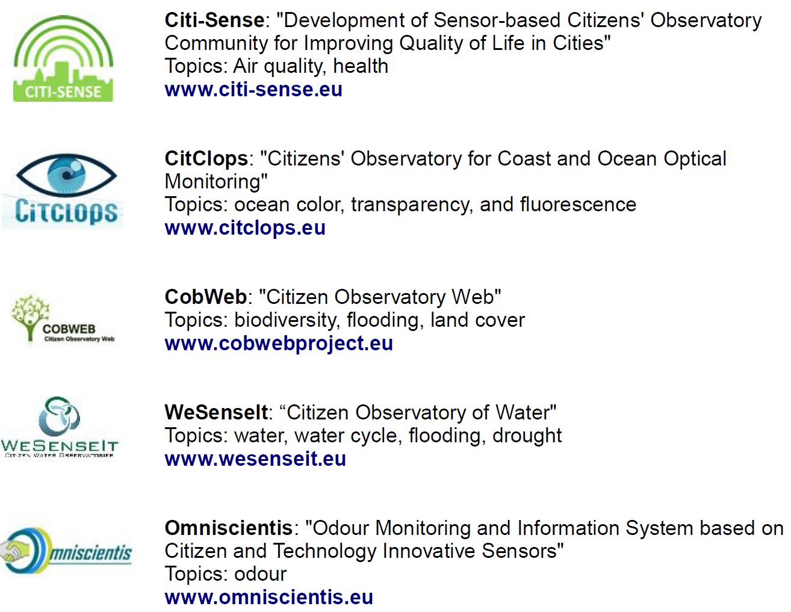
5 EU
Citizen
Observatories
(2012-2016)

Slide 16
Definition of Citizen Observatory
CITI-SENSE: the ‘citizens’ own observations and understanding of environmentally related problems and in particular as reporting and commenting on them within a dedicated ICT platform
WE-SENSE-IT: a method, an environment and an infrastructure supporting an information ecosystem for communities and citizens, as well as emergency operators and policymakers, for discussion, monitoring and intervention on situations, places and events
vs. Citizen Science ….

Slide 17
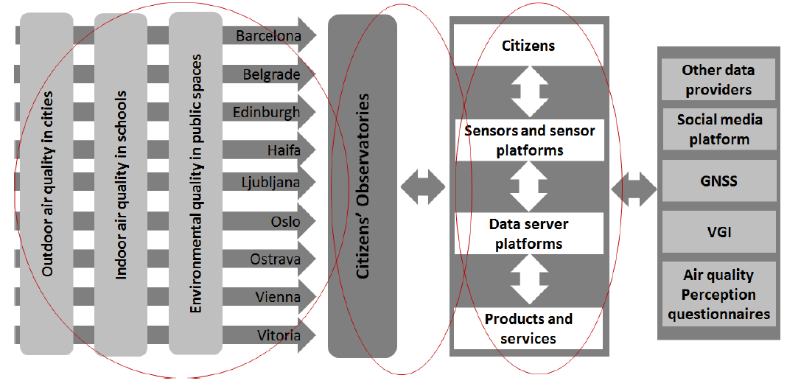
CITI-SENSE City locations

Slide 18
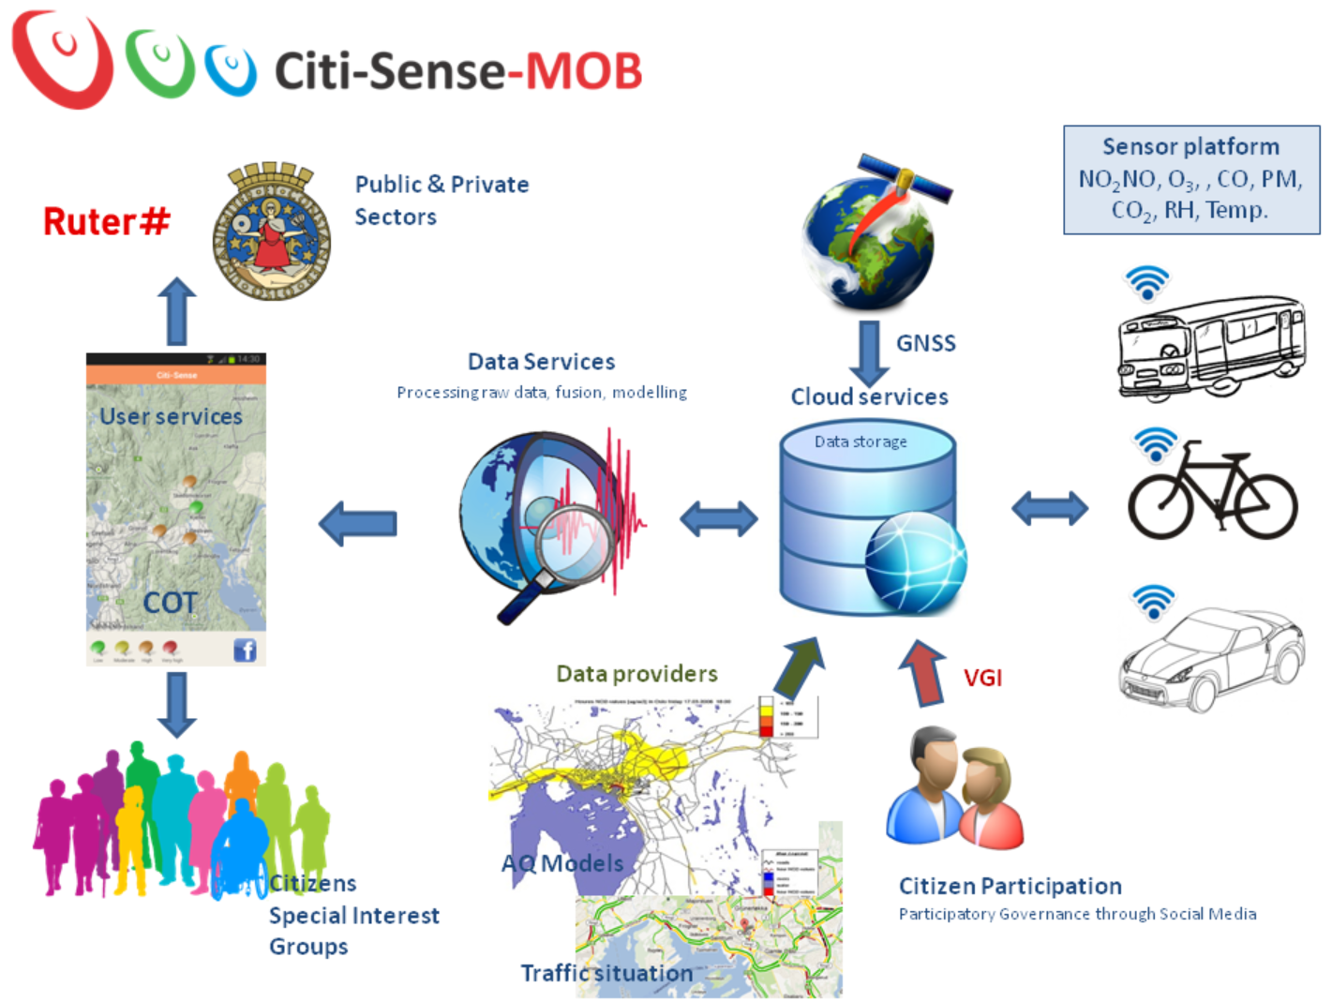

Slide 19
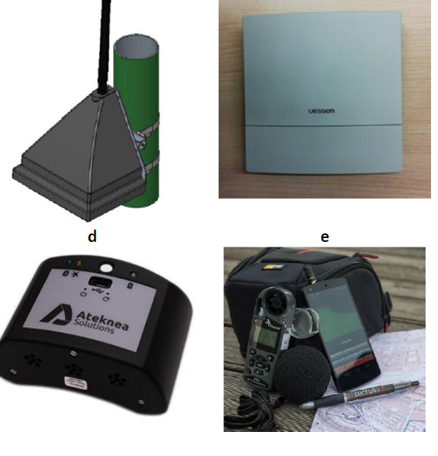
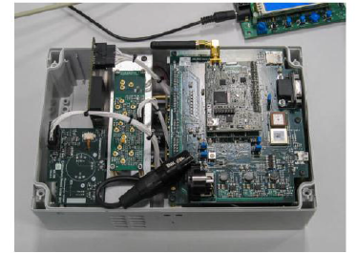
CITI-SENSE low(er) cost sensor units

Slide 20
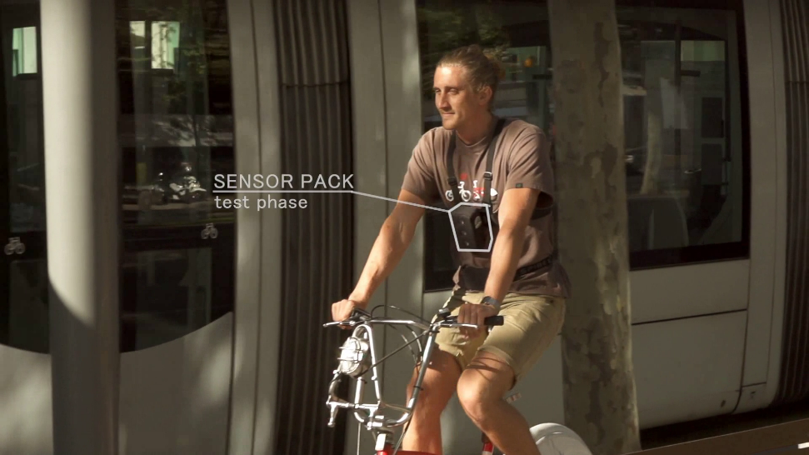
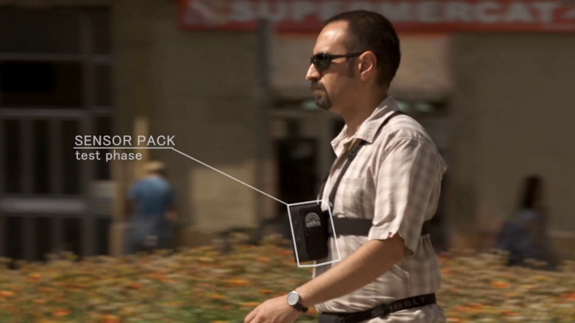
Personal Sensor Pack (PSP)
The Personal Sensor Pack developed by Ateknea is equipped with the following sensors:
NO, NO₂, O₃, CO (ppb)
Temperature (°C)
Relative Humidity (%)
USB connectivity
Bluetooth 2.0
New version released May 2015
Notes:
Sensor Spec

Slide 21
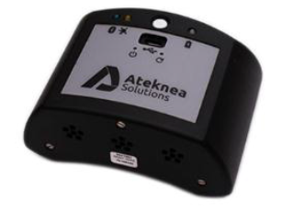
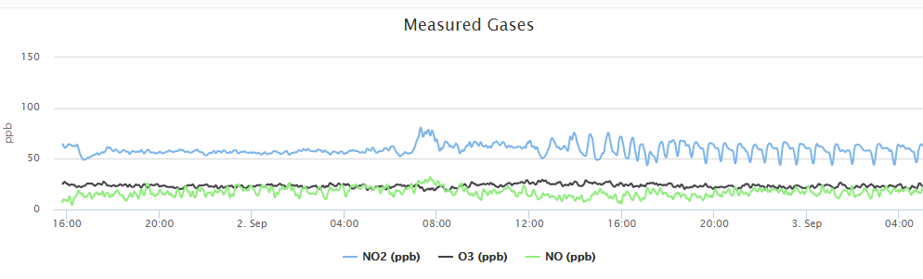
Portable Air Quality Sensor Package

Slide 22
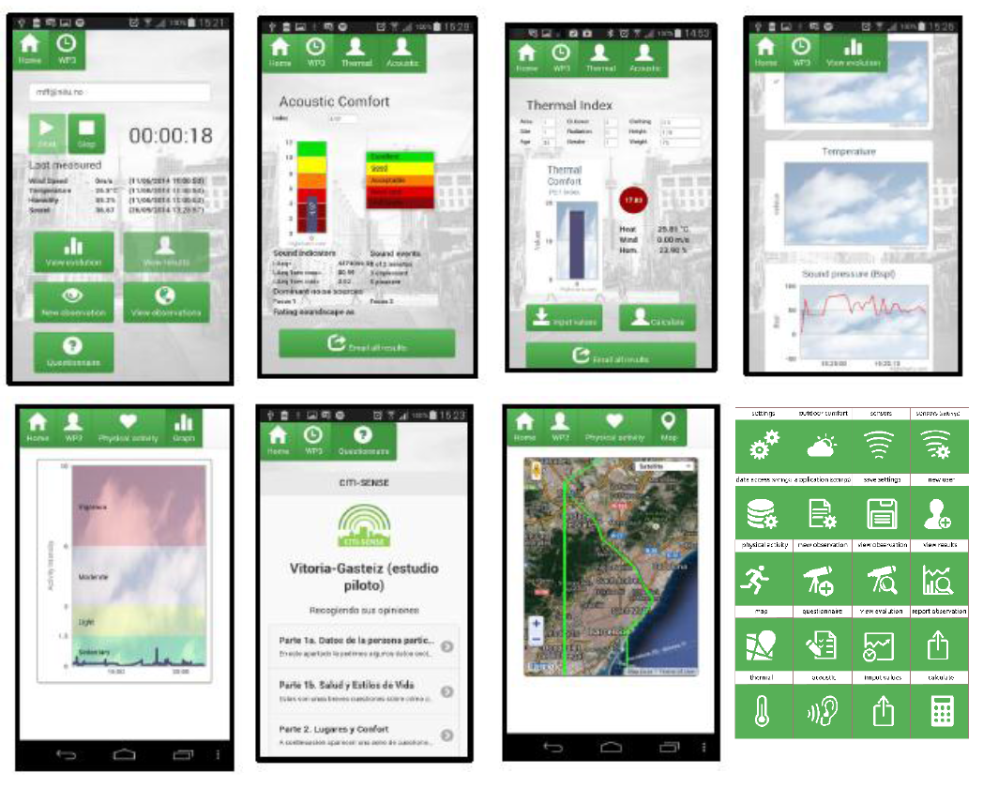
Sense-it-Now App

Slide 23
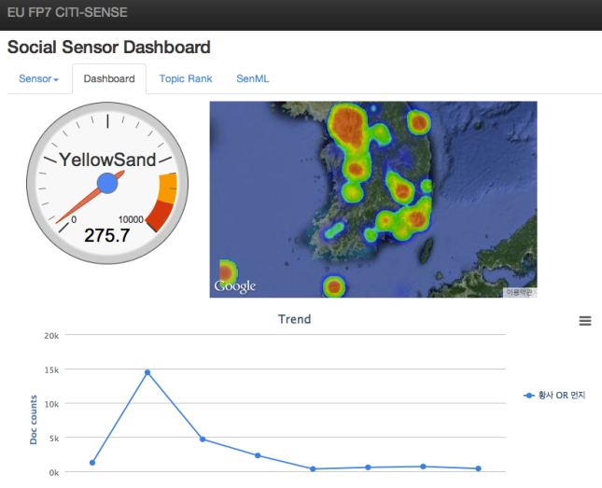
Social Sensor – CITI-SENSE Experiment & Pilot
From tags/words
in twitter
Social media
analysis

Slide 24
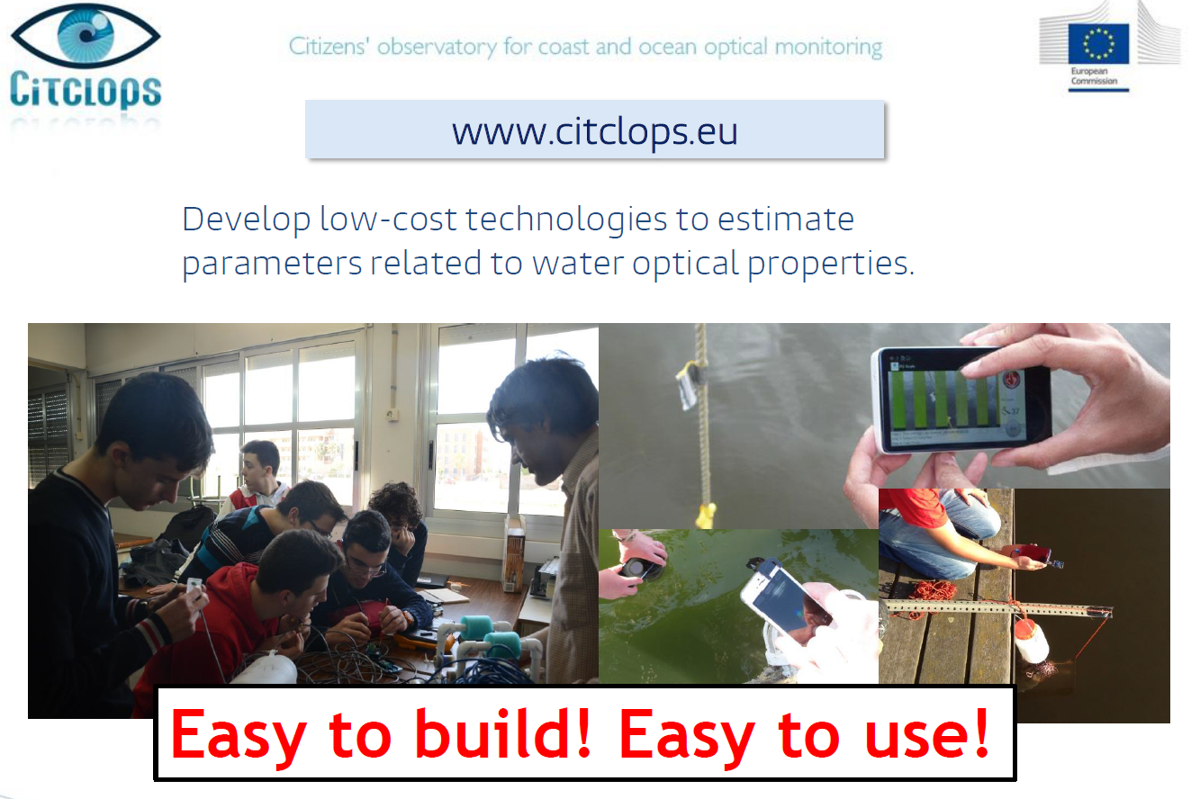

Slide 25
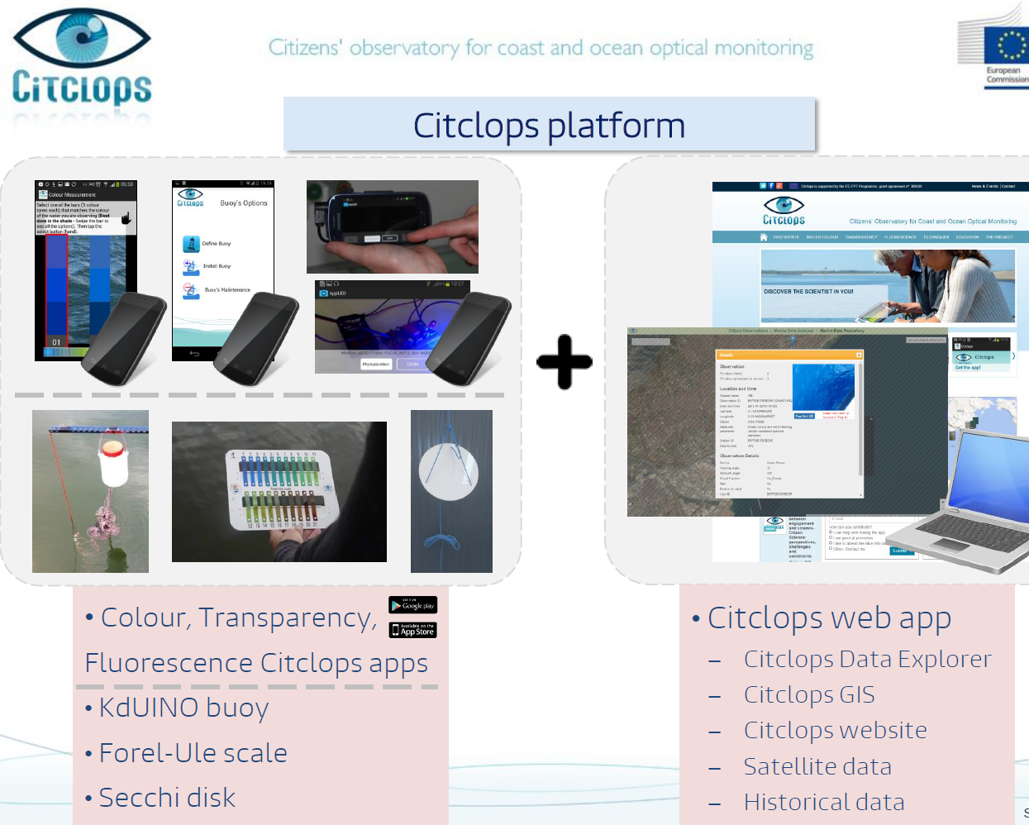

Slide 26

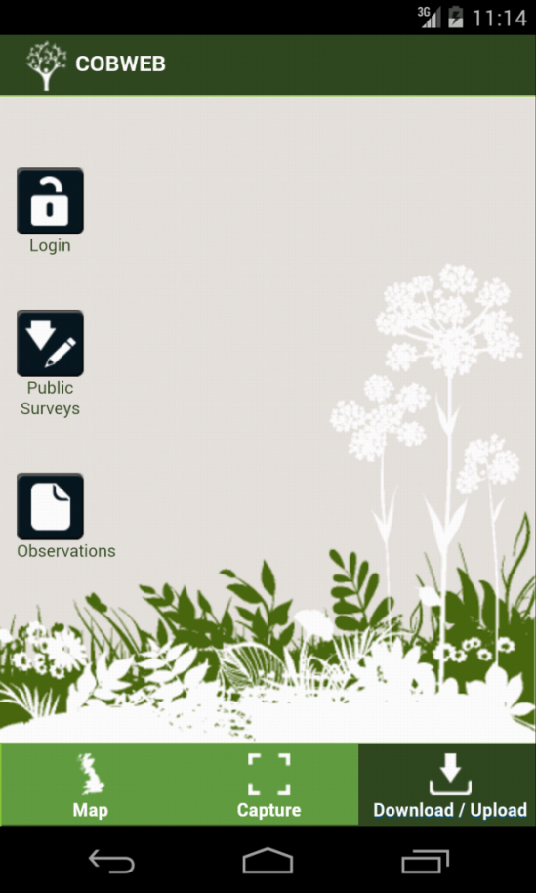
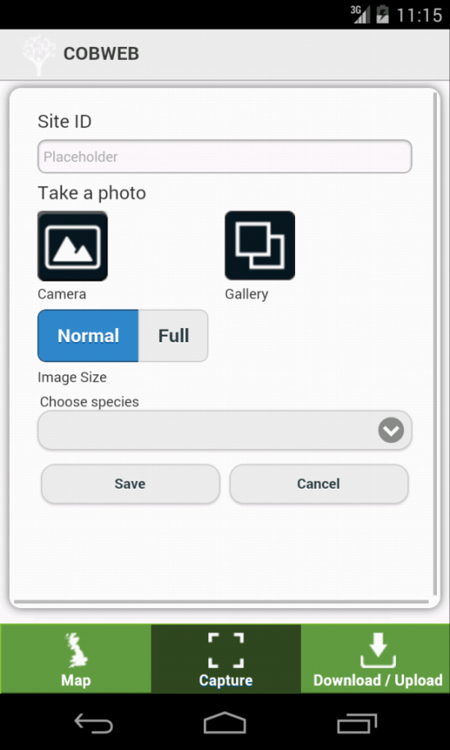
Citizen captures data on their phone

Slide 27
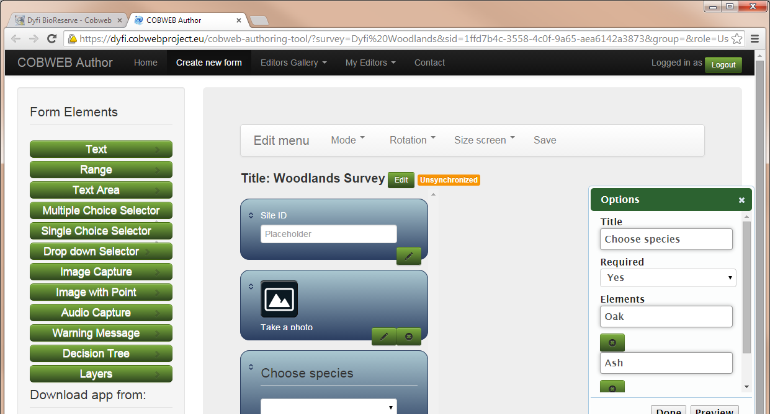
Customise your own app for your survey
Notes:
You are now in the authoring tool.
This is where you can create the app that your volunteers will use, to record the information you require for your survey.
This tool allows you to drag and drop different types of information collection methods, to produce you app for download.
My project is going to be about tree species found in the local woodland. So I need some information like tree species, estimated height, and take a photo.

Slide 28
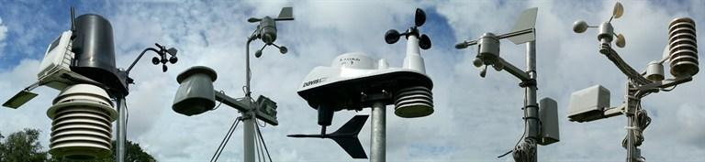
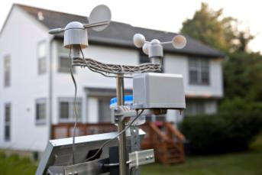

Personal Weather Stations (PWSs)

Slide 29






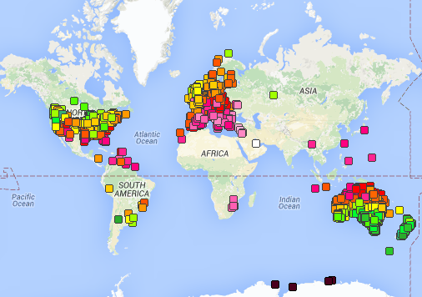
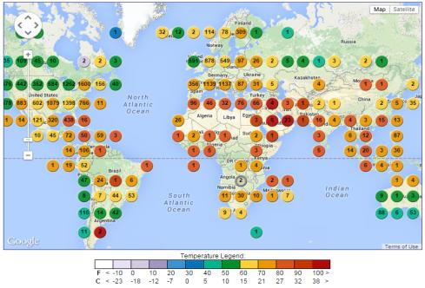
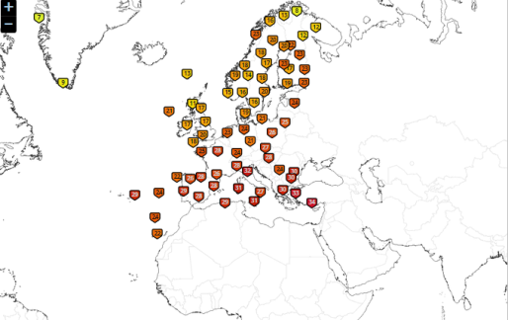
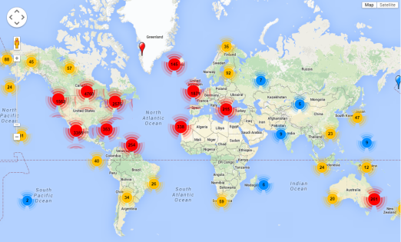
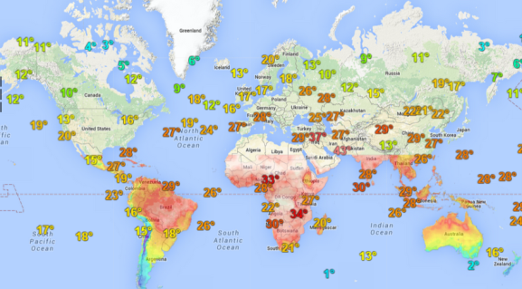
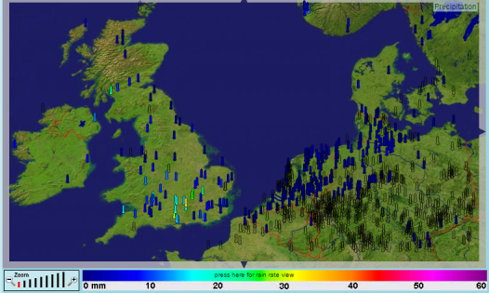
Amateur Weather Networks
Motivation, possibilities and issues ….
Private
Member stations: 100000+
Public Private Partnership
Member stations: 19000+
Citizen Weather Observer Program (CWOP)
Weather Observation Website (WOW), MetOffice
Weather Underground
Davis WeatherLink Network
AWEKAS
European Weather Network (EWN)
….
National Weather Service
Member stations: 6000+
Private
Member stations: 7000+
Private
Member stations: 19000+
Private
Member stations: 800+
http://wow.metoffice.gov.uk/
http://www.wunderground.com/wundermap/
http://www.kanonbra.com/maps/cwop/all_stations_in_map.html
http://www.weatherlink.com/map.php
http://www.awekas.at/en/
http://www.europeanweathernetwork.eu/

Slide 30
Citizen Science Profile for OGC SWE/SOS with
ISO/OGC Observations & Measurements
Capturing and preserving the observations … ?

Slide 31
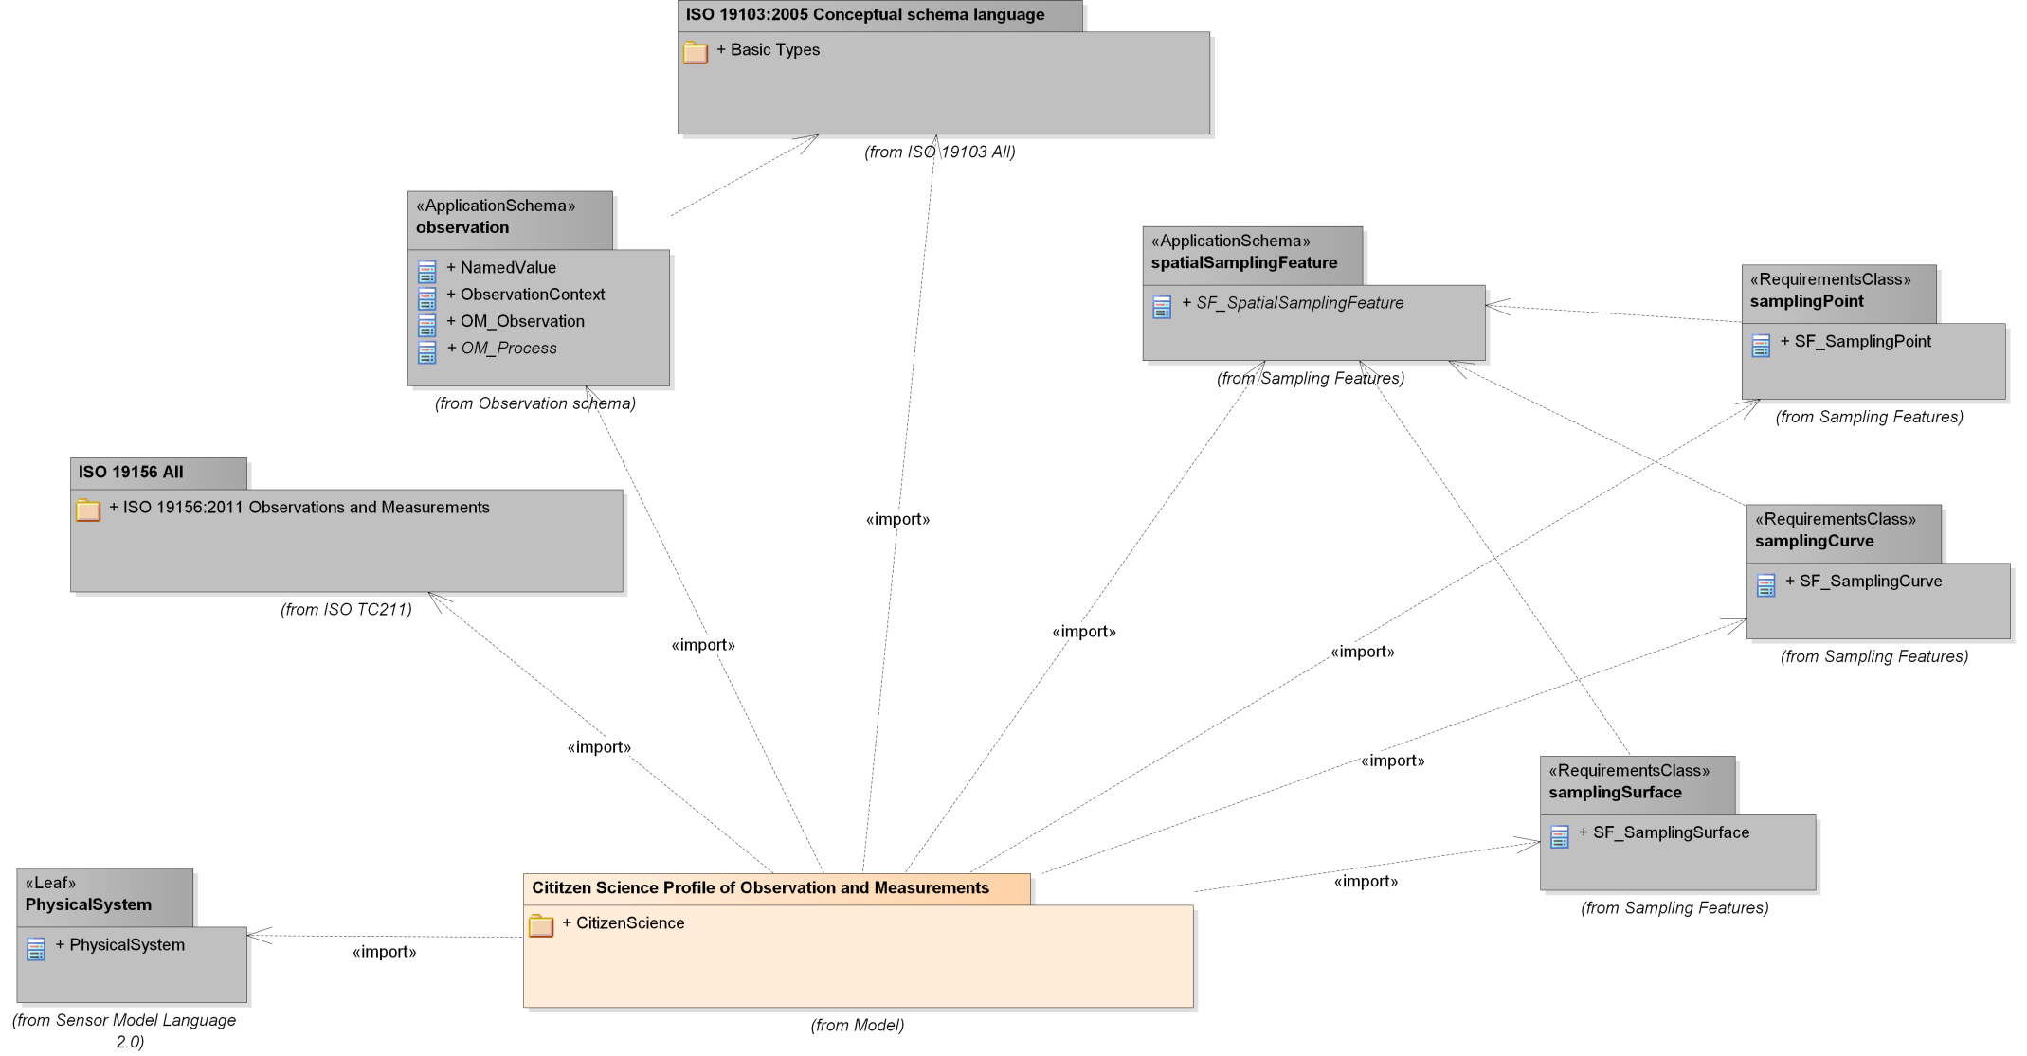
UML PackageDependencies

Slide 32
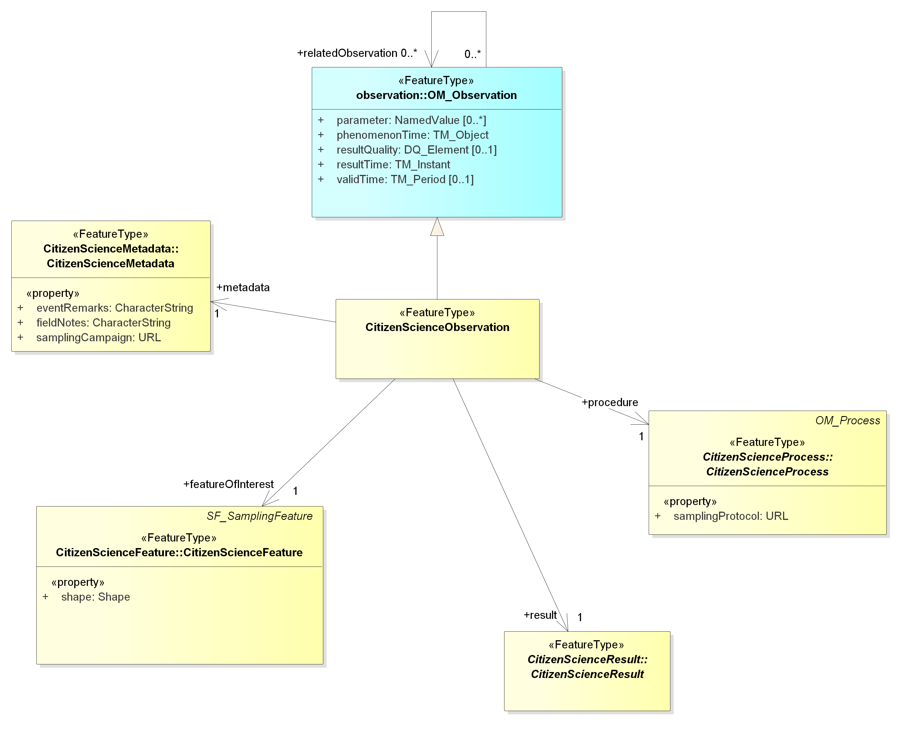
CitizenScienceObservation

Slide 33
GEOSS and Community portals
Citizens
Observatory
Portals

Slide 34
Conclusion
Consider Citizen Science and Citizen Observatories as one complementary component for your network
Interact with ECSA for a link to ongoing and future CS/CO networks.
Challenge – How to relate to a large amount of low cost/lower quality sensor units and citizens involvement?
Join ECSA for the upcoming General Assembly in Barcelona on October 28-29, 2015, and the first International Conference in Berlin in May/June 2016

Slide 35
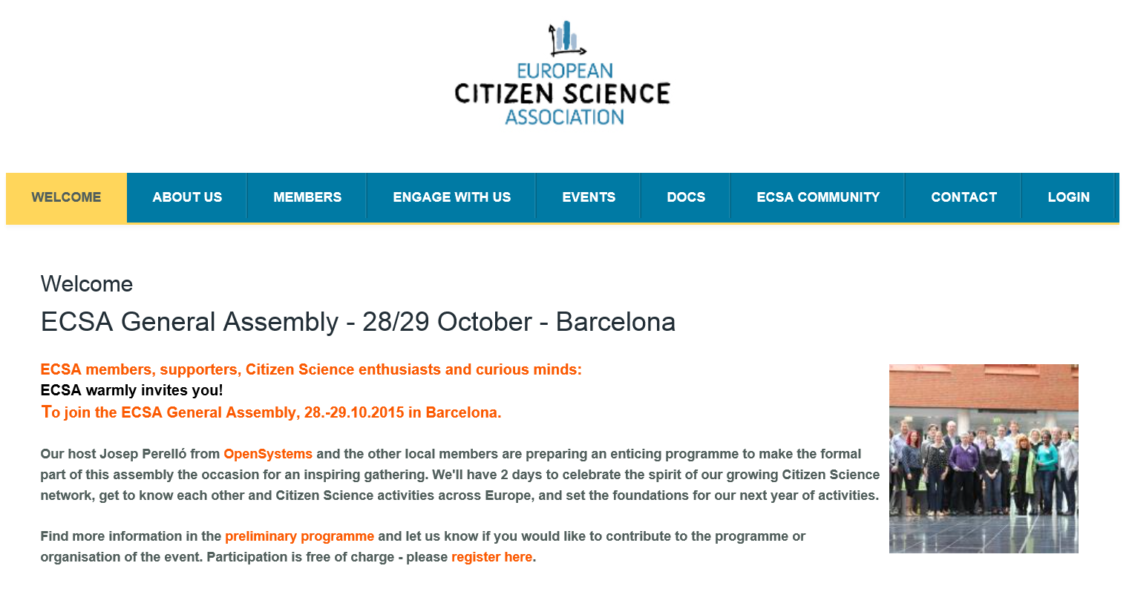
http://www.ecsa.citizen-science.net/

