Slide 1


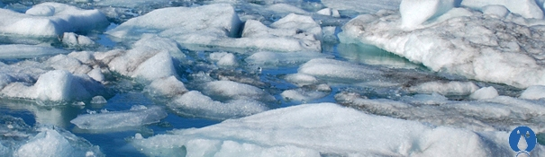
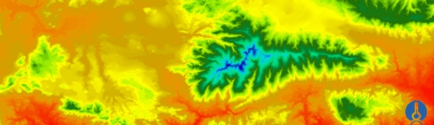


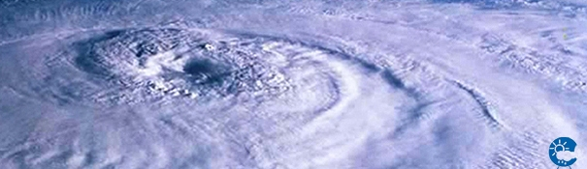
ENEON first workshop
Observing Europe: Networking the Earth Observation Networks in Europe
21-22 September, Paris
EUREF Permanent GNSS Network
Carine Bruyninx/C.Bruyninx@oma.be
Royal Observatory of Belgium

Slide 2
  1. About your network
  1.1 Brief introduction about you and the network you are representing and the topic
Central Bureau of EUREF Permanent Network (EPN)
  Daily EPN network management
  Information system: htpp://www.epncb.oma.be/
EUREF Permanent Network
  GNSS* ground stations tracking network (core network / densification network)
  Data Analysis Centers & Coordinators
  Data Centers : GNSS data and products
  Central Bureau
* GNSS= Global Navigation Satellite Systems (GPS, GLONASS, Galileo,…)

Slide 3

International Association of Geodesy
IAG Commission 1
Reference Frames
Sub-commission 1.3
Regional Reference Frames
Sub-commissions 1.3f
Sub-commissions 1.3e
Sub-commission 1.3b
South America (SIRGAS)
Sub-commission 1.3d
Africa (AFREF)
Sub-commission 1.3a
Europe (EUREF)
Sub-commission 1.3c
North America (NAREF)

Slide 4
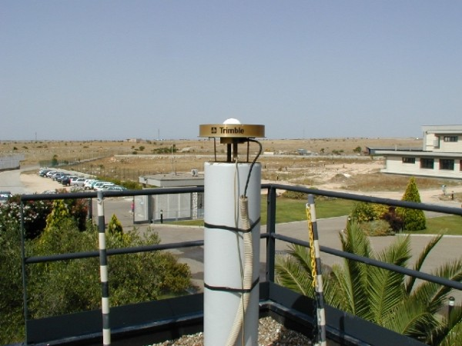
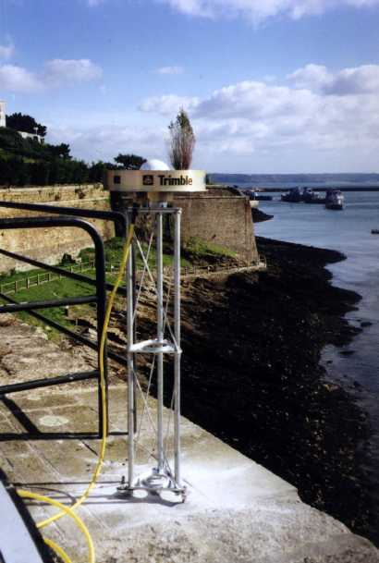
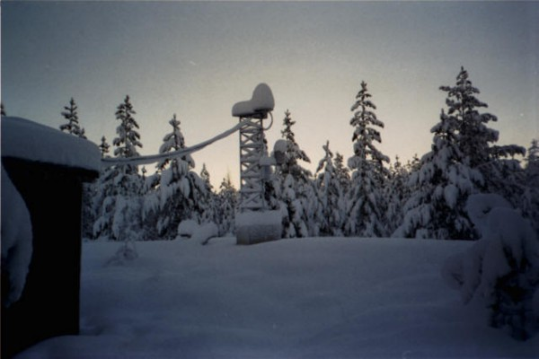
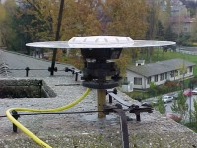
Matera, Italy
Brest, France
Sajarevo,
Bosnia/Hercegovina
Vaasa, Finland

Slide 5
EUREF distributes GNSS observation data, meta-data and derived products to
  Maintain and provide access to the European Terrestrial Reference System (ETRS89) = INSPIRE datum for three-dimensional and two-dimensional coordinate reference systems
  Support multi-disciplinary applications, such as
    Ground deformation monitoring
    Numerical weather prediction
    Space weather applications (ionospheric monitoring)

Slide 6
1. About your network
  1.2 How large is your user base?
National Mapping Agencies & surveyors
  Access to European reference frame
Researchers
  Geophysicists (ground deformation monitoring)
  Meteorologists (nowcasting & numerical weather prediction) & climatologists
  Space weather (ionospheric monitoring)
Contributors

Slide 7
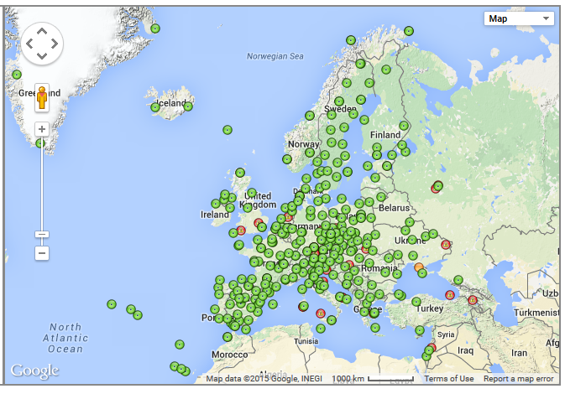
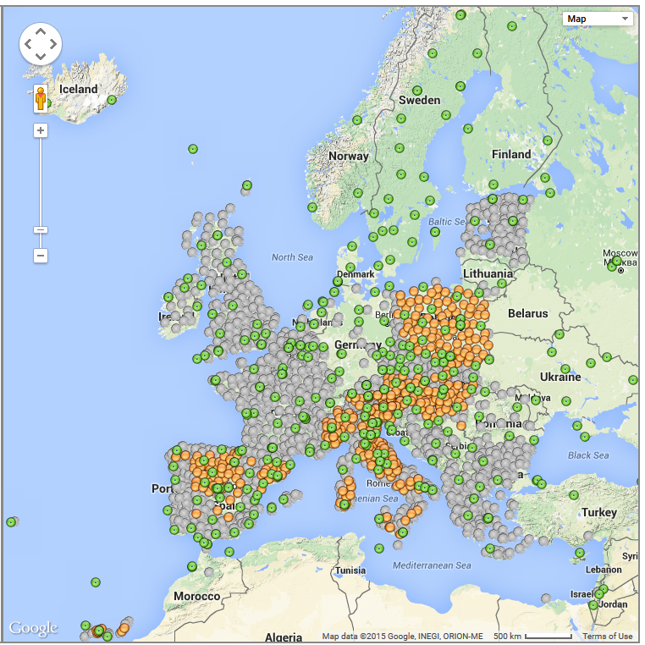
EPN Core network
EPN Densification network
CORE = 270+ GNSS stations, ~20 analysis centers, ~10 data centers,
100+ agencies: universities, research agencies, National Mapping and Carthographic Agencies, Private Compagnies
2500+ GNSS stations

Slide 8
Access statistics
Data (core network), meta-data and products made available through distributed data centers: no access statistics available
EPN Central Bureau:
  Web site: 200.000 hits/month from 4000+ unique visitors
  FTP site: 1 - 2.5 milj. hits/month (300 - 1200Gb/month)

Slide 9
1. About your network
  1.3 What form of commitment do you have?
Voluntary partnership
Commitment letter signed by Agency
How does it work?
  Reliability through redundancy (avoiding single point of failure)
  Quality above quantity
    Extensive guidelines (operating standards, data flow, …)
    Quality requirements → contributing is a synonym of quality

Slide 10
1. About your network
  1.4 How is the cost of maintaining the networks (just to give an idea of the magnitude to be weighed against the benefits). Who are your funding sources?
EUREF Financial Plan (2014) :
Stations & maintenance | 2000k€ /yr
Data distribution & Products | 1200k€ /yr
Quality Control, Management, Central Bureau | 120k€ /yr
TOTAL | 3320k€ / yr
Each agency assures its own funding

Slide 11
1. About your network
  1.5 Do you have problems keeping your network running?
Not up to now, but long-term maintenance critical in some countries due to budgetary restrictions.
Most stations funded for surveying
Scientific (other societal) value is often neglected at national level
Strong point: Quality above quantity
(contributions are sometimes refused)
→ Contribution to the network is considered as a quality stamp

Slide 12
2. About data
  2.1 What data your network produces?
Standards & Guidelines
Observational Data
Meta-Data
Products

Slide 13
2. About data
  2.1 What data your network produces?
GNSS Data
(observations)
Meta-Data
Daily/hourly/15-min
RINEX format
Real-time
RTCM format
GNSS station description
GNSS Data Quality
Distributed Broadcasters
Equipment, environment, calibration, ownership
Generated at Central Bureau
Distributed Data Centers
Data/Analysis Centers Info

Slide 14
Products

Slide 15
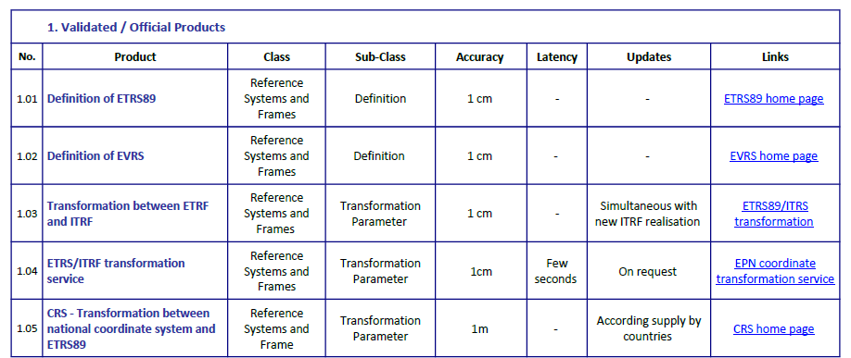
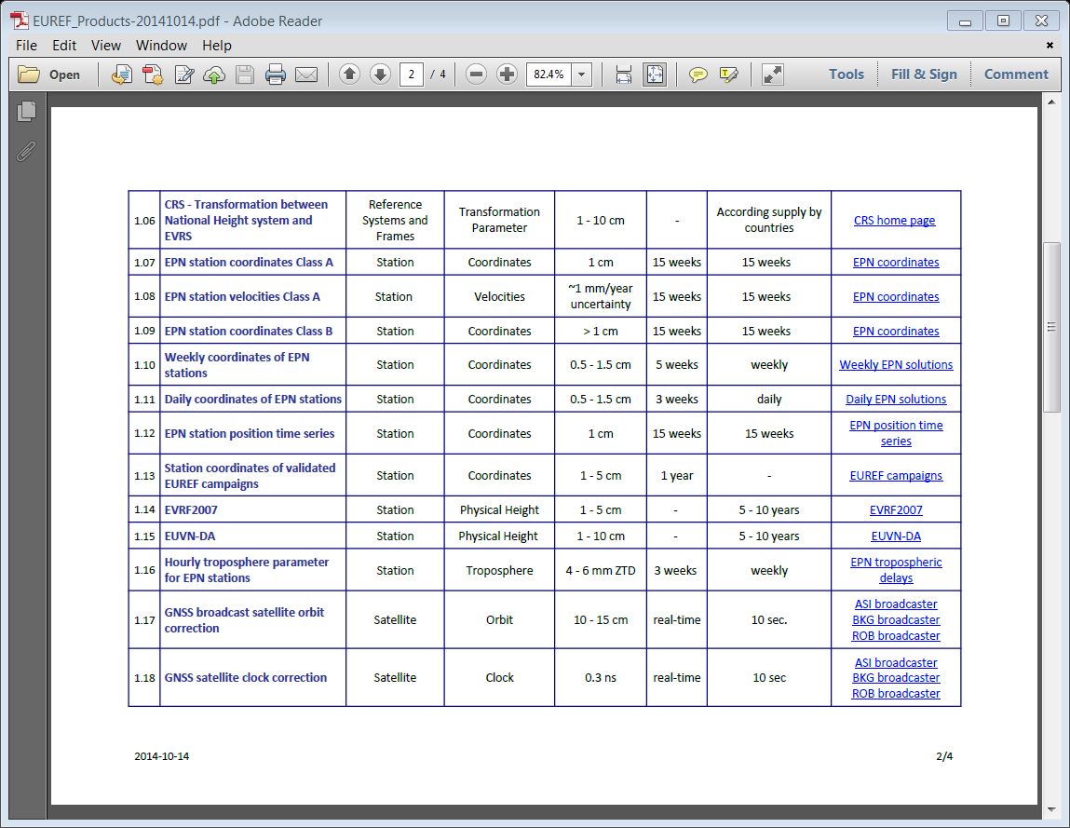
Products focussing on reference frame

Slide 16
Products derived from observations

Slide 17
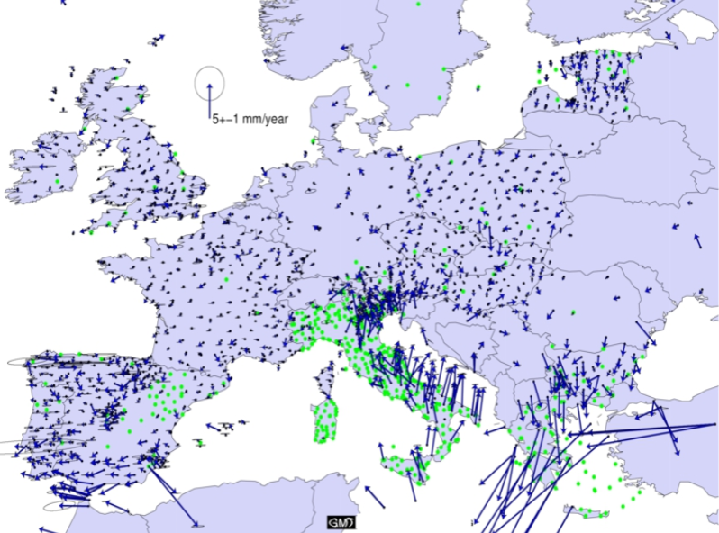
Horizontal ground motion
Kenyeres et al, 2015

Slide 18
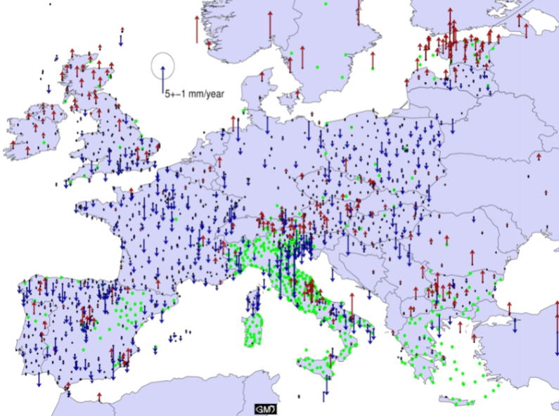
Vertical ground motion
Kenyeres et al, 2015

Slide 19
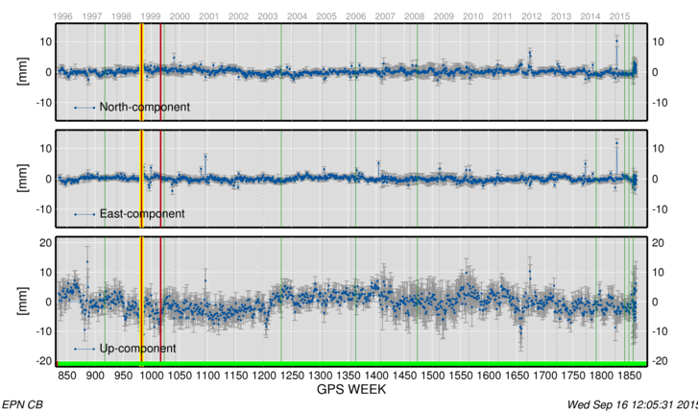
Non-linear ground deformations

Slide 20
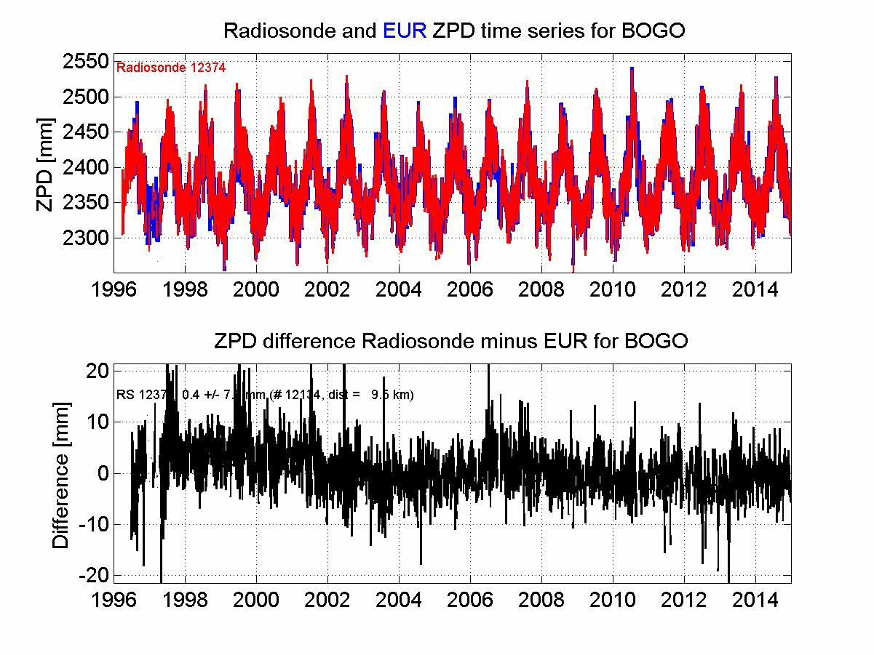
Tropospheric delays
Used by EUMETNET E-GVAP programme as reference solution for comparison with (near) real-time tropospheric delays generated by E-GVAP analysis centers (based on GNSS data) and submitted to meteorological agencies
→ Numerical weather prediction (operational) & nowcasting (pilot)

Slide 21
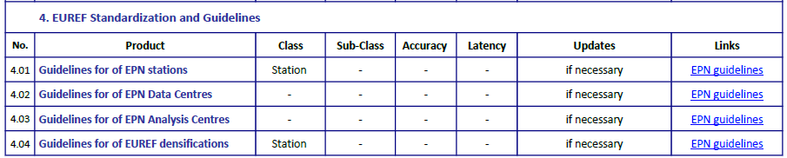
Standards & guidelines

Slide 22
2. About data
  2.2 What are the limits of your network (spatio temporal)?
Geographical zone: Europe

Slide 23
2. About data
  2.2 What are the limits of your network (spatio temporal)?
1-sec & 30-sec GNSS observations
Daily, hourly and real-time data provision
Daily, weekly & multi-year station positions
Hourly tropospheric delays
Real time satellite orbit & clock corrections

Slide 24
2. About data
  2.3 Is the data shared? To whom? In what conditions/license?
Open data access, no registration required
For all data (core), meta-data and derived products

Slide 25
2. About data
  2.4 Do you address data quality in some way?
Yes!
One of the core tasks of the EPN Central Bureau!
Daily quality checks of data and meta-data.
Stations operators are notified in case of degraded data.
Essential activity guaranteeing the success of the EPN.

Slide 26
2. About data
  2.5 Which data you know that is needed but is not captured by your network or by other networks that you have access to?
  Needed … none

Slide 27
2. About data
  2.6 What key interface standards do you use?
  Data exchange is done using international standard formats
  Observations → RINEX: Receiver Independent Exchange format (or RTCM)
  Meta-data → IGS Site Log
  Solutions → SINEX: Software Independent Exchange Format
  Data exchange primarily done using ftp.

Slide 28
2. About data
  2.7 Is there risk of data continuity lost (Data preservation and data acquisition continuity)?
Data & Products (including historical) are stored at different (redundant) locations.
Data acquisition can be interrupted at one GNSS station or stations of one brand (firmware issue), but not all stations simultaneously, unless general GPS, GLONASS AND Galileo outage.
Products depend on availability of satellite orbits and clocks from the International GNSS Service. No problems for final products (2-3 week delay).

Slide 29
3. About a network of networks
  3.1 What interfaces do you have with other networks?
IAG (International Association of Geodesy) – IUGG (International Association of Geodesy (IAG) or and Geophysics) -> Sub-commission EUREF
IGS (International GNSS Service): European densification, use of IGS products, upload of solutions to IGS
EPOS (European Plate Observatory System) : building block of GNSS component, MoU planned, Interfaces will be defined and implemented during EPOS-IP project
EUMETNET : MoU (data exchange)
EuroGeographics (umbrella organization of the European National Mapping and Cartographic Agencies): MoU
CEGRN (Central European GPS Geodynamic Reference Network): MoU
Participating to some UN WG/Committees
  ICG (International Committee on GNSS)
  UN-GGIM WG on GGRF

Slide 30
3. About a network of networks
  3.2 Are there additional interfaces that would be desired?
EUREF is
European network
No legal entity (sub-commission from IAG)
→ No representation in global initiatives
More formal recognition would be welcome (national funding)

Slide 31
3. About a network of networks
  3.3 Do you think that your network can benefit from the existence of an ENEON or a similar network
    Improve visibility of added-value of GNSS observation networks
    Provide some clarity in the jungle of organizations
    Potential role of organization that coordinates activities in different countries
  3.4 From you point of view how this network of network should be managed?

Slide 32
3. About a network of networks
  3.5 Is your network contributing to GEO(SS) and how ConnectinGEO can help you in better participating?
Implicit through IAG and IUGG (and EPOS)
But information about GEO(SS) is not flowing to our organization.
More direct link with European part of GEO(SS) would be welcome to better acknowledge added-value of GNSS observation network (EPN) maintained by EUREF.

Slide 33
More information
EUREF Permanent Network Central Bureau
Royal Observatory of Belgium
http://www.epncb.oma.be
epncb@oma.be or C.Bruyninx@oma.be
http://www.euref.eu/

