Slide 1


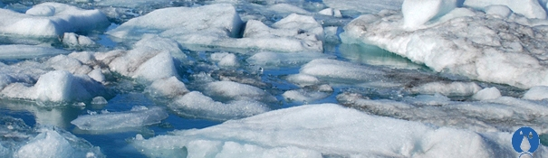
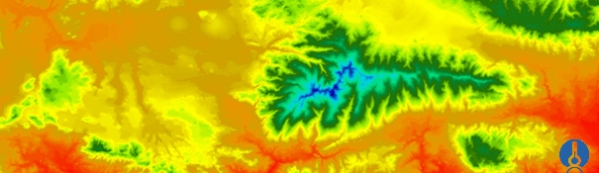


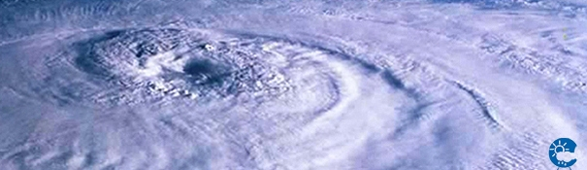
ENEON first workshop
Observing Europe: Networking the Earth Observation Networks in Europe
21-22 September, Paris
Belgian Institute for Space Aeronomy
Martine De Mazière; martine.demaziere@aeronomie.be

Slide 2
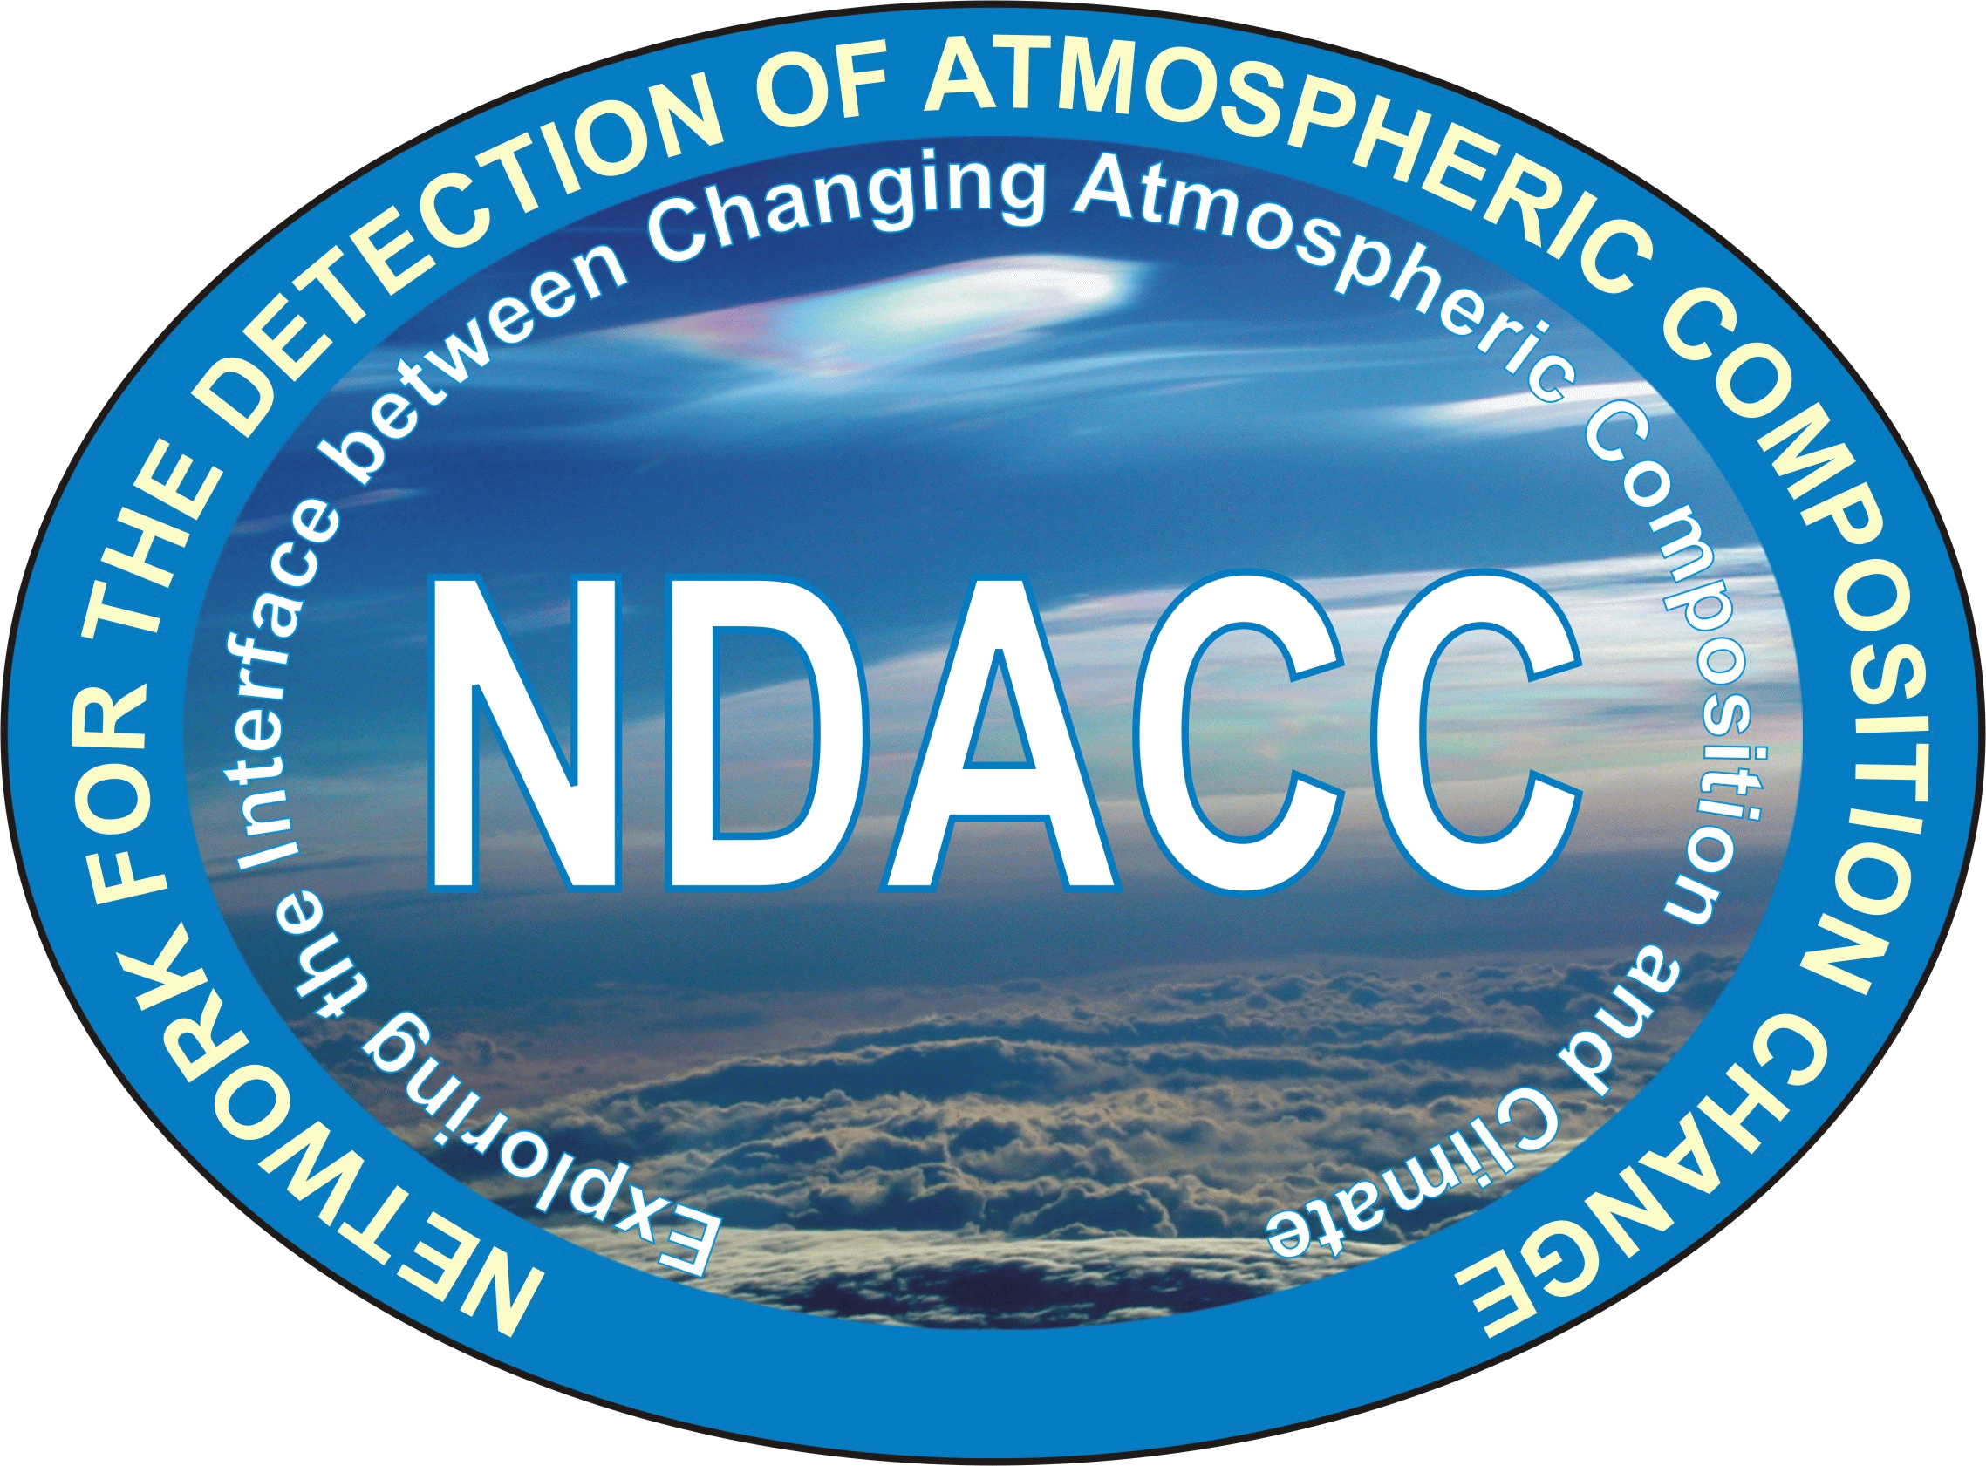
The Network for the Detection of Atmospheric Composition Change (NDACC)

Slide 3
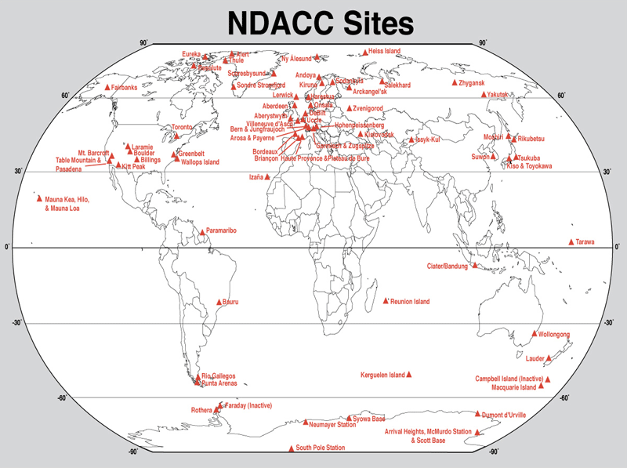
Worldwide
Ground-based remote sensing of the atmospheric composition
6 techniques
  Microwave
  Lidar
  FTIR
  DOAS
  Dobson/Brewer
  sondes
& spectral UV
> 80 stations
Research oriented
Started in 1991
www.ndacc.org

Slide 4
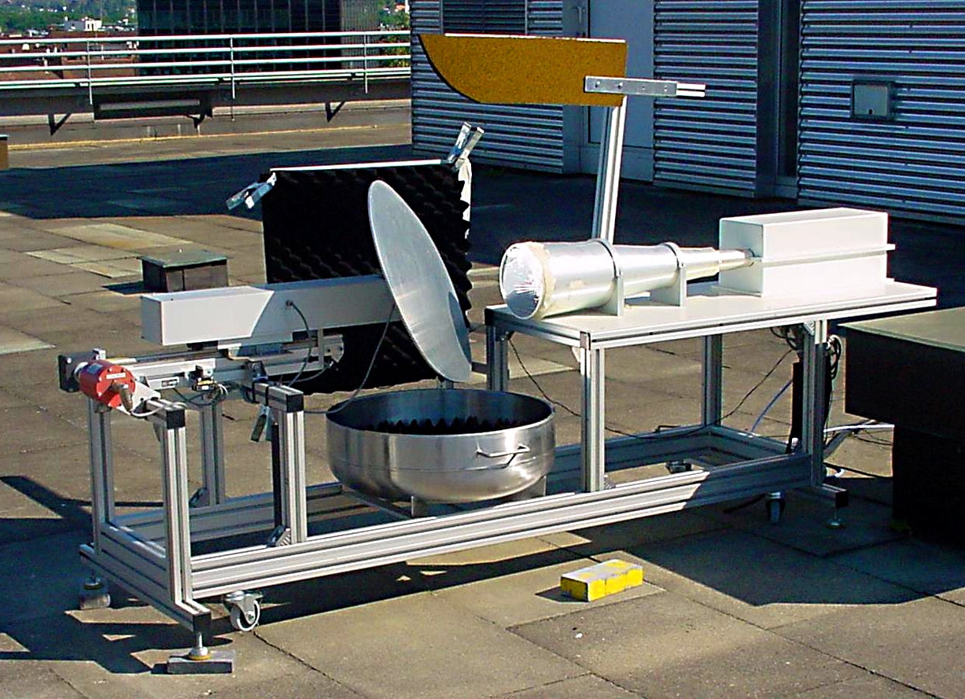
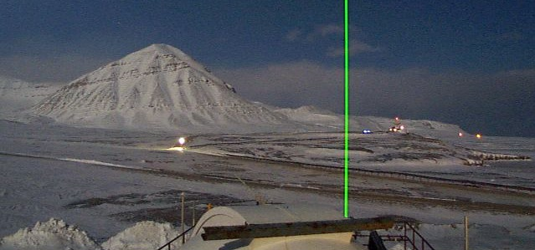
μwave spectrometer
LIDAR

Slide 5
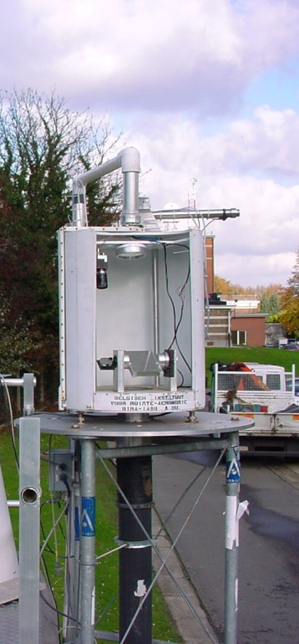
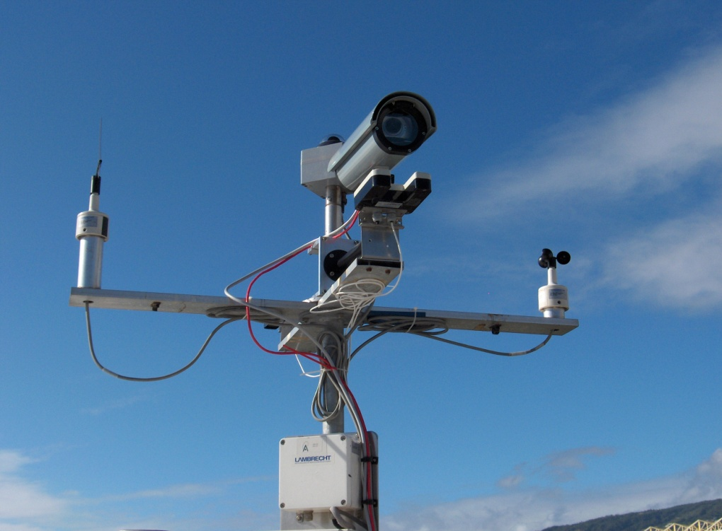
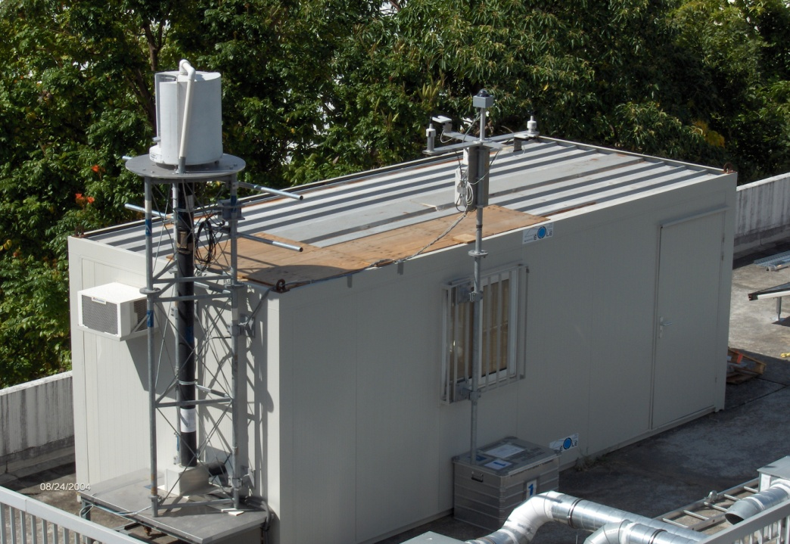
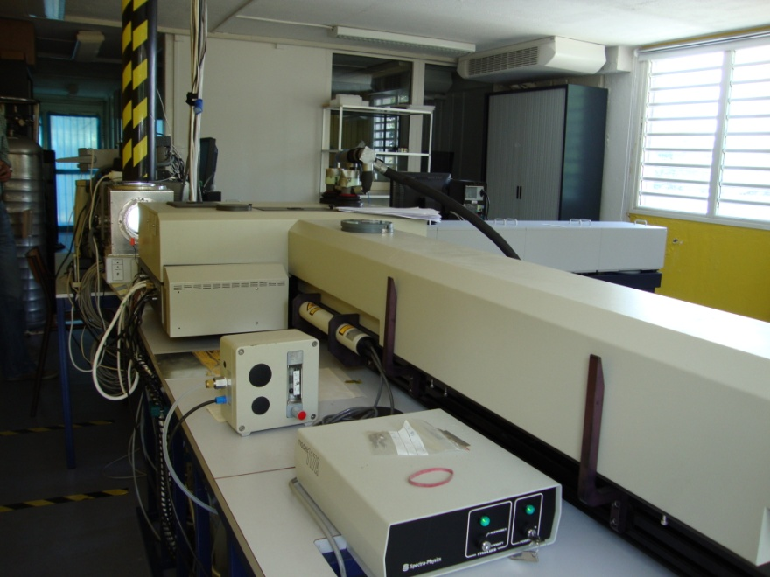
Fourier-transform
infrared spectrometer
Meteo mast

Slide 6
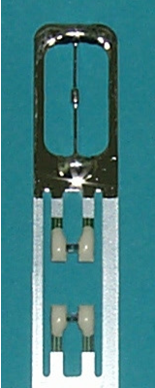
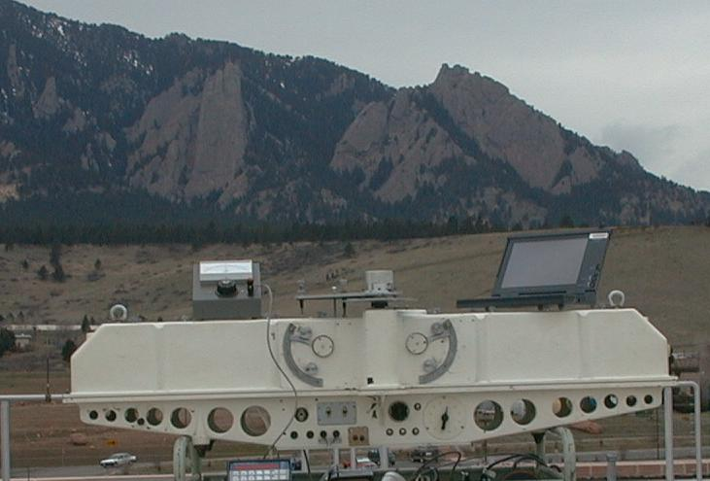
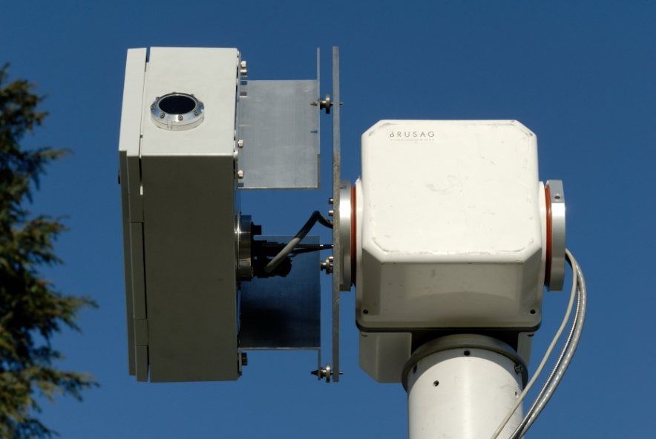
RS 90 O₃ sonde
Dobson spectrometer
UV-Vis Maxdoas spectrometer

Slide 7
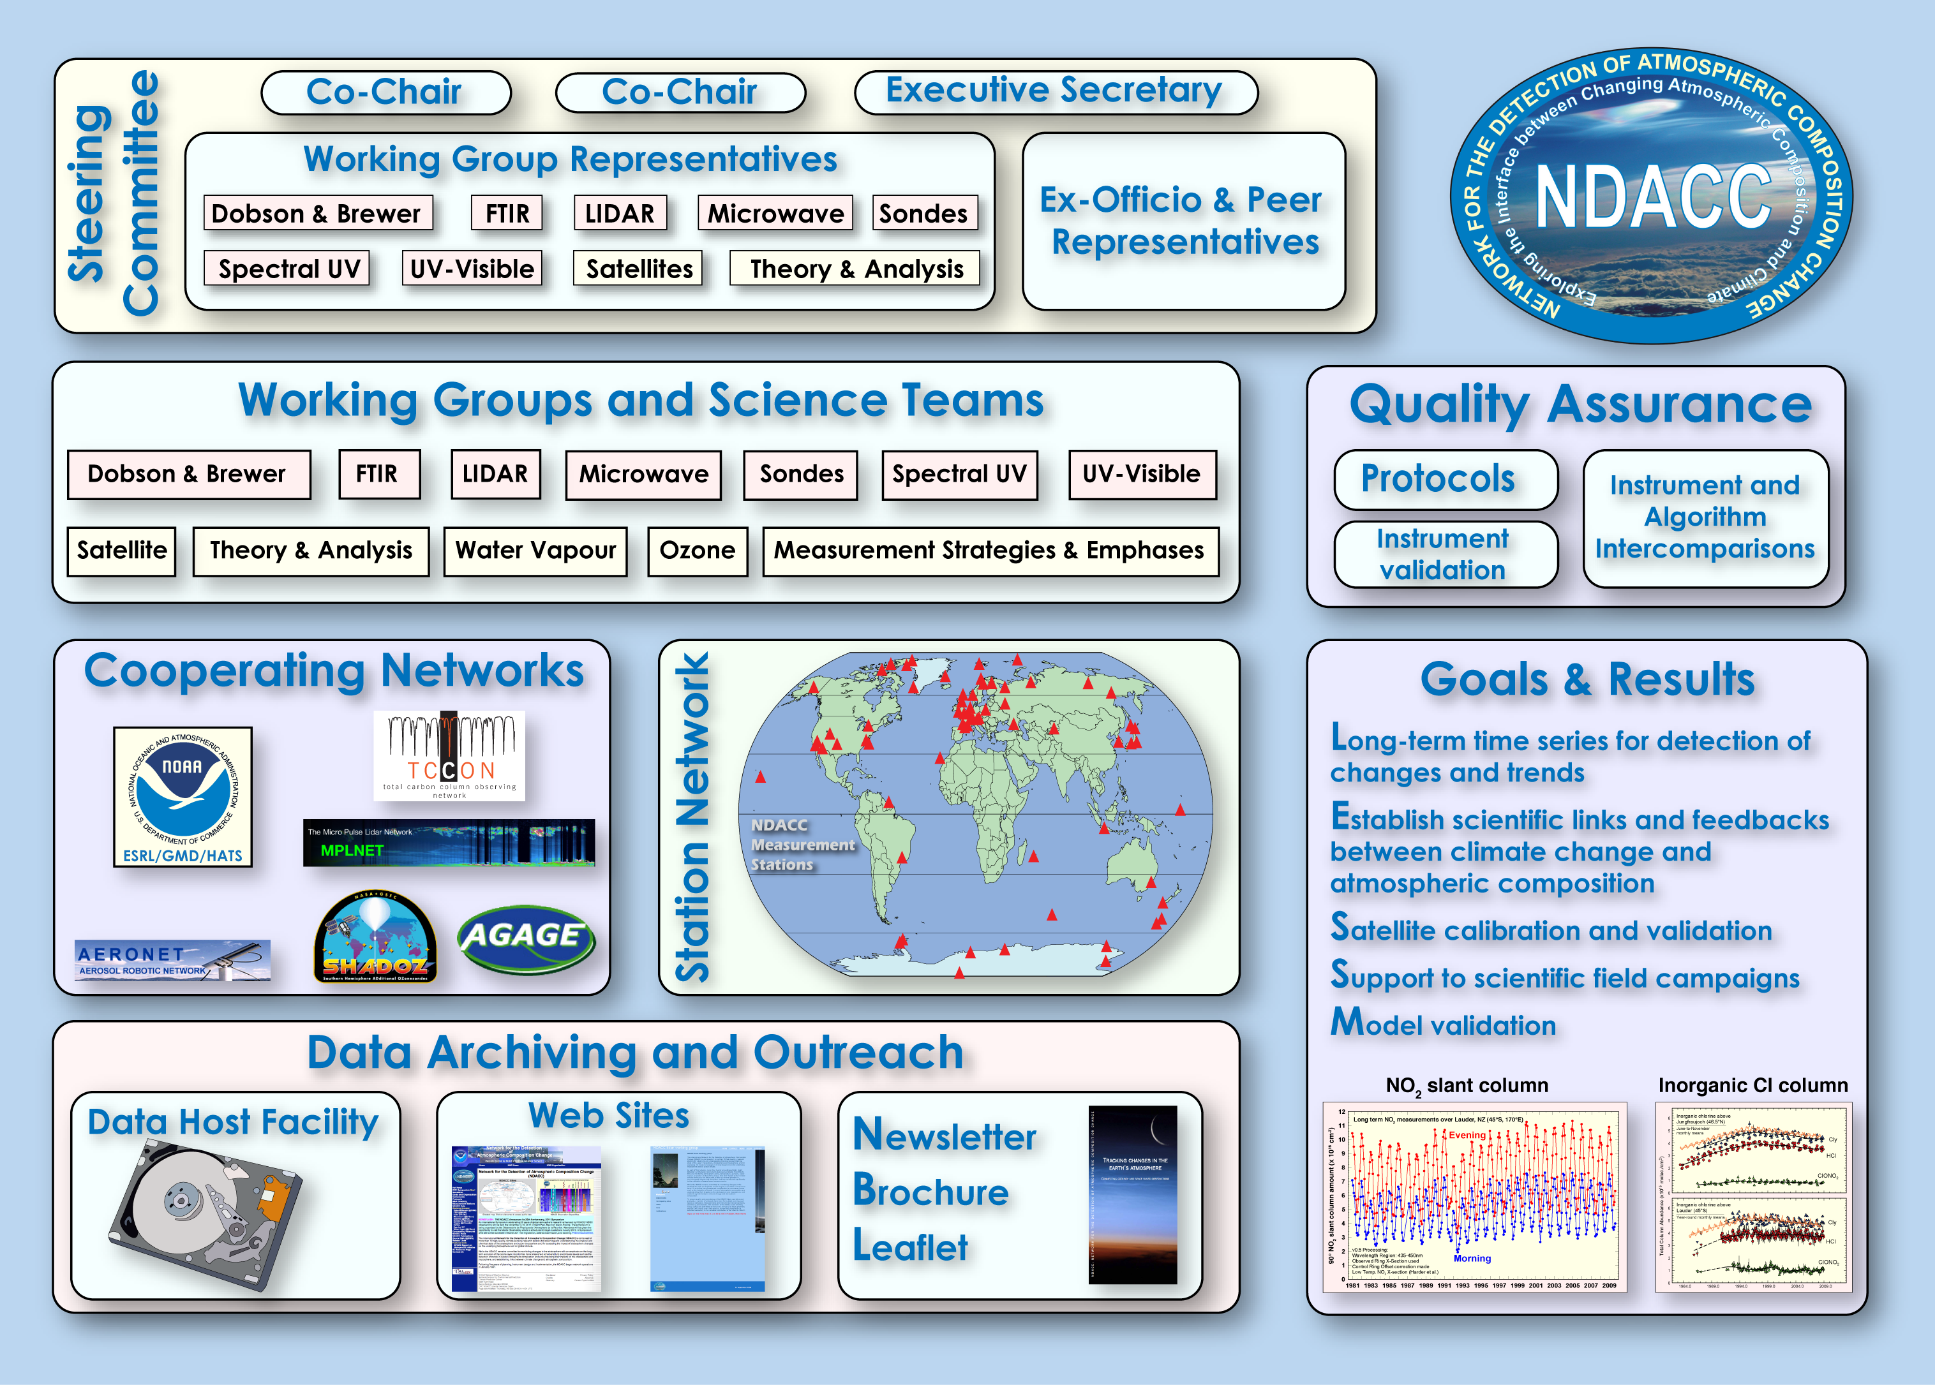
M. De Mazière
M. Van Roozendael
JC. Lambert

Slide 8
1.2 Main objectives of NDACC
Long-term monitoring of atmospheric variables for detection and quantification of variabilities and trends
Establishment of scientific links and feedbacks between climate change and atmospheric composition
Support to scientific field campaigns
Support to satellite calibration and validation
Support to model validation

Slide 9
Example: Contribution to SI2N
(SPARC/IOC/IGACO-O3/NDACC) Initiative
What happened to vertical distribution of stratospheric ozone globally and in different regions, over the last 40+ years?
Evidence of ‘recovery’?

Slide 10
1.3-1.6 Main contributors, commitment, users
NDACC is an association of research institutes whole over the world
endorsed by national and international scientific agencies, including UNEP and the International Ozone Commission of IAMAS; NDACC (formerly NDSC) is a major contributor to GAW of WMO.
Contributors commit themselves to comply with instrument and data quality protocols and to submit data to the central database on a regular basis, provided availability of resources.
NDACC data are used by the atmospheric science community, including modelers and the climate community, as well as EO satellite teams and Space Agencies. Example: The Copernicus Atmospheric Composition Service (CAMS) is a user of NDACC data for validation of their products
NDACC evolution follows user needs, e.g., more rapid delivery for CAMS, tropospheric measurements for supporting nadir satellite sounders, etc…
Notes:
IAMAS = International Association of Meteorology and Atmospheric Sciences
GAW = Global Atmosphere Watch

Slide 11
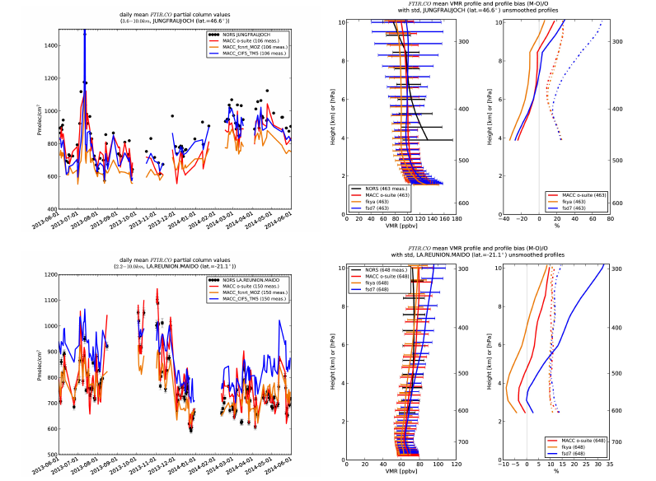
Example: CAMS products validation
Daily mean relative
Differences of Tropospheric CO columns
(till 10km) by MACC_osuite (red),
MACC_fcnrt_MOZ (orange), MACC_CIFS_TM5 (blue,
Full line) compared To NDACC FTIR data at Jungfraujoch (46.6°N,
7.98°E, left) (top) and
La Reunion Maido
(21.1 °S, 55.4°E, right)
(bottom) for the period
June 2013--‐June 2014.
The number of measurement days
And yearly bias is
Indicated in the
legend.

Slide 12
1.7-1.9 Funding & sustainability
NDACC as an organisation does NOT provide funding; each contributor must find its own funding
Network maintenance is costly
e.g.,
- instrument cost of order 10 kEuro to several 100 k€ ;
- data quality verification is manpower intensive
Evolution towards more automatisation to reduce cost !
Development of more compact, less expensive instruments
Sustainability is an issue cf. fund raising for long-term activities is a problem
Space Agencies provide some support; research projects provide only short-term science-dedicated funding.
national funding authorities are considered to have the responsibility to support the ‘in situ’ networks, but are also reluctant towards long-term commitment

Slide 13
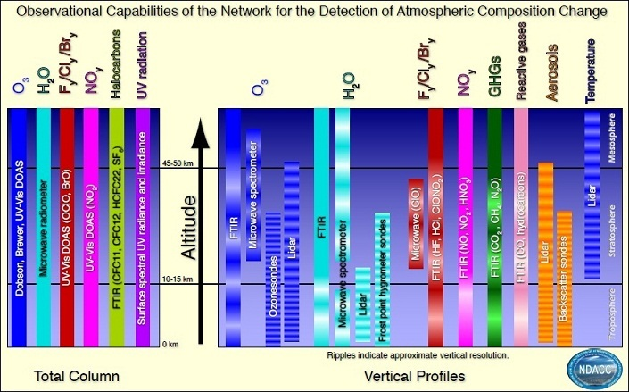

Slide 14
2.1-2.3 Data access
Data at ftp.cpc.ncep.noaa.gov/ndacc or via a clickable map that guides you to the station directory
Data protocol @ www.ndacc.org:
  Public data: > 2 years old
    All NDACC data more than two years old are public data. Additionally some PIs have authorized their data for early release. These data are available as soon as they are cataloged in the database.
  Proprietary data: < 2 years old
    Accessible via collaborative agreements with PI
  Rapid delivery data: within 1 month after acquisition or from non-certified NDACC sites
    Quality not yet consolidated, but publicly available for use

Slide 15
2.4-2.9 Data quality, continuity, additional needs.
Two data formats are co-existing in database: NASA Ames (Ascii) and HDF4. PIs must comply with one of both formats. The actual tendency is towards HDF4 GEOMS guidelines. Actually there are no resources to convert all data to HDF4.
Each PI must comply with quality protocol established and verified by Working Group and Steering Committee
Working Groups organise data acceptance exercise, algorithm comparisons and instruments/observations comparison campaigns
Work on network consistency and characterisation of uncertainties is ongoing

Slide 16
2.4-2.9 Data quality, continuity, additional needs (cont’d).
Data continuity is a potential problem associated with instrument failure and resources (cf. funding)
Auxiliary data like meteorological data sometimes available at the observatory, otherwise taken from NCEP or ECMWF.
Complementary data: in-situ surface, airborne, satellite data
Latest initiative: build an ACTRIS ESFRI including (part of) European NDACC activities, to ensure long-term commitment of EU Member States and better integration with complementary data
(similar to initiative to associate European TCCON activities to ICOS ESFRI)

Slide 17
3. Network of networks
NDACC has signed agreements with “cooperating networks” for facilitating data exchange, like
    AGAGE, AERONET/MPLNET, NOAA HATS, TCCON, BSRN, GRUAN, SHADOZ, GAW…
NDACC can contribute to GEOSS (cf. it is mentioned in GEO 2012-2015 WORK PLAN) but there are no formal links yet
⇒ an argument for partnership in ConnectinGEO.

Slide 18
3. Thoughts about ENEON
GEOSS calls for Essential Variables for societal benefits ⇒ could ENEON produce derived data sets based on the contributing networks data that are fit-for-purpose for benefiting society ? E.g., from NDACC: ECV and climate, aerosol and health, UV and energy, .. ?
NDACC has contributed to progress in Data Centre Inter-Operability (DCIO); can ENEON facilitate such progress ? Be an advanced demonstration case ?
Ambitions, objectives, components, implementation of ENEON are not yet clear …. So diffcult to say more at this stage

Slide 19
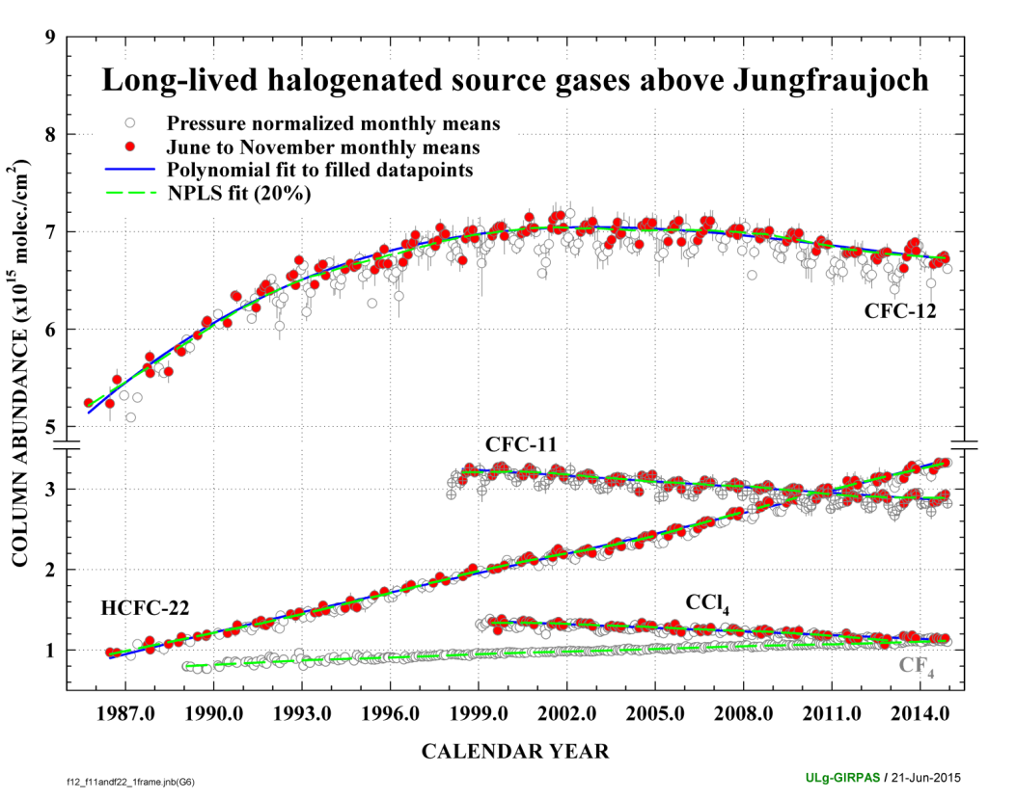
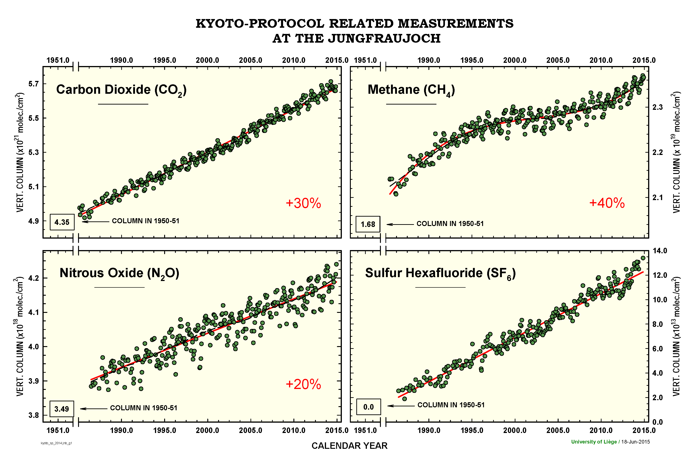
Example: Support to Montreal and Kyoto Protocols
Jungfraujoch
Courtesy: E. Mahieu et al., Univ. Liège, Belgium

Slide 20
Conclusions
NDACC is a mature network, evolving from a pure research network to a more operational status
It’s focus is on atmospheric composition: processes and long-term changes
Points of attention: data quality and characterisation, network consistency, database maintenance.
NDACC data are widely used by the scientific community and policy makers (through contributions to environmental assessments)
Maintenance of the network is a concern because of lack of long-term funding commitments

