Slide 1

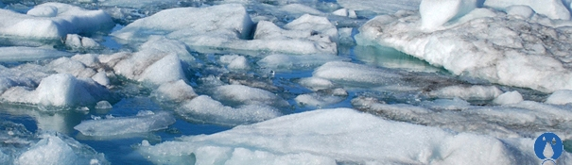
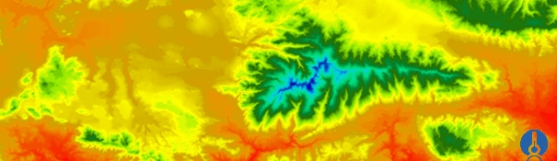
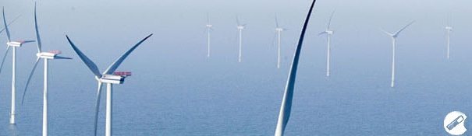
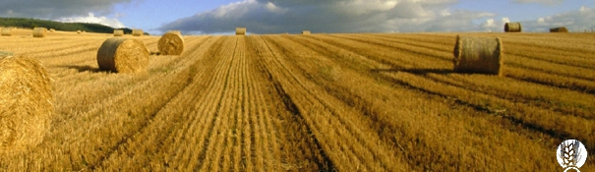
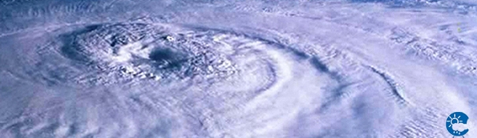
ENEON first workshop
Observing Europe: Networking the Earth Observation Networks in Europe
21-22 September, Paris
Eionet: Environment Information and Observation Network
Jan Hendrik Voet (voet@irceline.be)

Slide 2
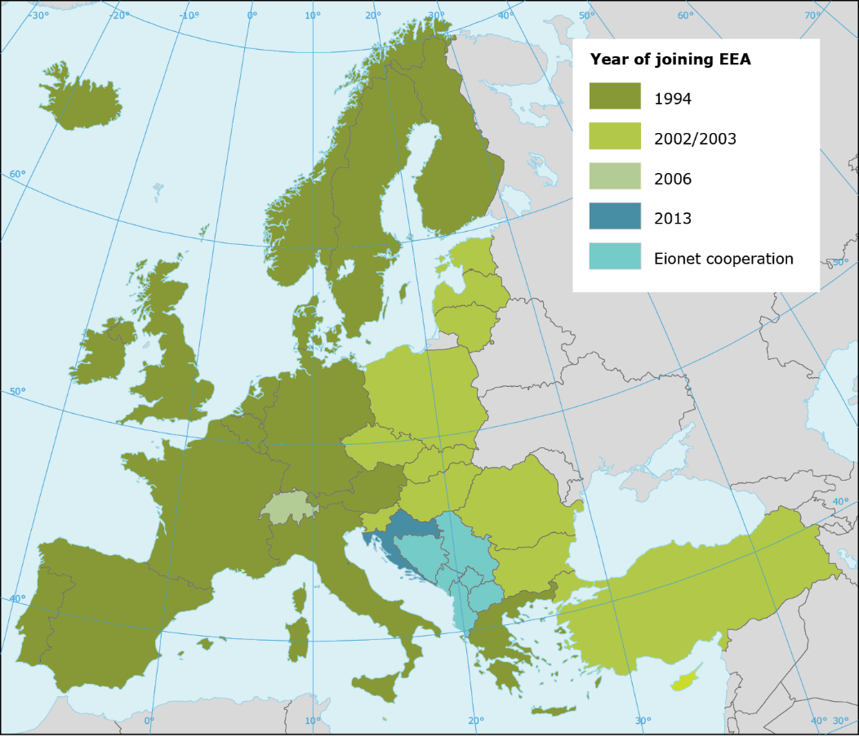
EEA Regulation and geographical coverage
European Environment Agency (EEA) and the European Environment information and Observation Network (Eionet) was initially established by founding regulation (COUNCIL REGULATION (EEC) No. 1210/90* of 7 May 1990)
33 Member countries (EU28+5) and
6 Cooperating countries (West Balkan)
*Codified Regulation (EC): No 401/2009 of 23 April 2009
Notes:
2
Eionet is a partnership network of the EEA and its 39 countries.
Eionet aims to provide data, information and expertise for assessing the state of Environment in Europe.
Last version from 2009 including changes overtime (=codified) can be found via link. Fundamentals did not change.
Amended/revised
Non-EU: Norway, Lichtenstein, Switzerland, Iceland and Turkey.

Slide 3
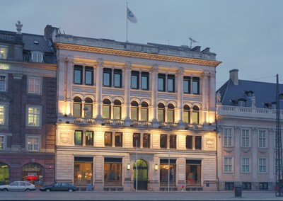
European Environment Agency (EEA) &
Environment Information and Observation Network (Eionet)
provide objective, reliable and comparable information at European level to support the European and member state policy makers, assess the results of measures and inform the public; all with the aim to protect the environment
Eionet is a network of institutions (ministries, agencies, institutes) at country level that can provide (environmental) information or can support this provision
Copenhagen
Between Research/Science and Policy

Slide 4

EEA/Eionet – Governance
7th Environmental Action Programme :
‘Living well, within the limits of our planet’ (incl. Knowledge Base in Priority objective no.5)
Management
Board - MB
Bureau - BU
Scientific Committee - SC
Executive Director - ED
EEA Legislation/Programmes
EEA/Eionet Regulation
MAWP 2014-2018
Annual Work Programme 2015
Notes:
4

Slide 5
Role of Eionet
Eionet and EEA
Supporting implementation of the EEA Multi-Annual and Annual Work Programme(s) (MAWP - AWP) by:
Coordinating national data and information flows;
Providing country-level expertise and advice;
Linking EEA to country sources;
and vice versa
Promoting EEA activities and outputs at national level.
Eionet and international institutions
Connecting countries with other international/European institutions and networks (EC DGs, JRC, ESTAT, OECD, UN, Copernicus, …)
Eionet and countries
Connecting national environmental institutions and networks among EEA countries
Notes:
5
The concept of Eionet contains the following elements: Cooperation, Content and Infrastructure.
Let‘s start with Cooperation. To better understand relationships between Eionet and other stakeholders, we need to understand what the Eionet role is. Eionet role has two dimensions – vertical and horizontal. On the vertical level, the main role of Eionet is the cooperation of the countries towards European level. Eionet supports EEA’s implementation of the Multi-Annual and Annual Work Programme(s) (MAWP - AWP) by for example:
Coordinating national data and information flows;
Providing country-level expertise
The other role of Eionet at vertical level is to connect countries with other international/European institutions and networks.
On the horizontal level, Eionet helps to connect national environmental institutions and networks among EEA countries (e.g. East with West).
EC DGs: some institutions (=organisations) are part of Eionet and EC working groups
JRC: NRC Soil, forest data
ESTAT: Dimesa ( Directors meeting on environmental statistics and accounts); data for waste and natural resources and products
UN: UNEP, UNECE
UNEP: United Nations Environment Programme
UNECE: United Nations Economic Commission for Europe

Slide 6
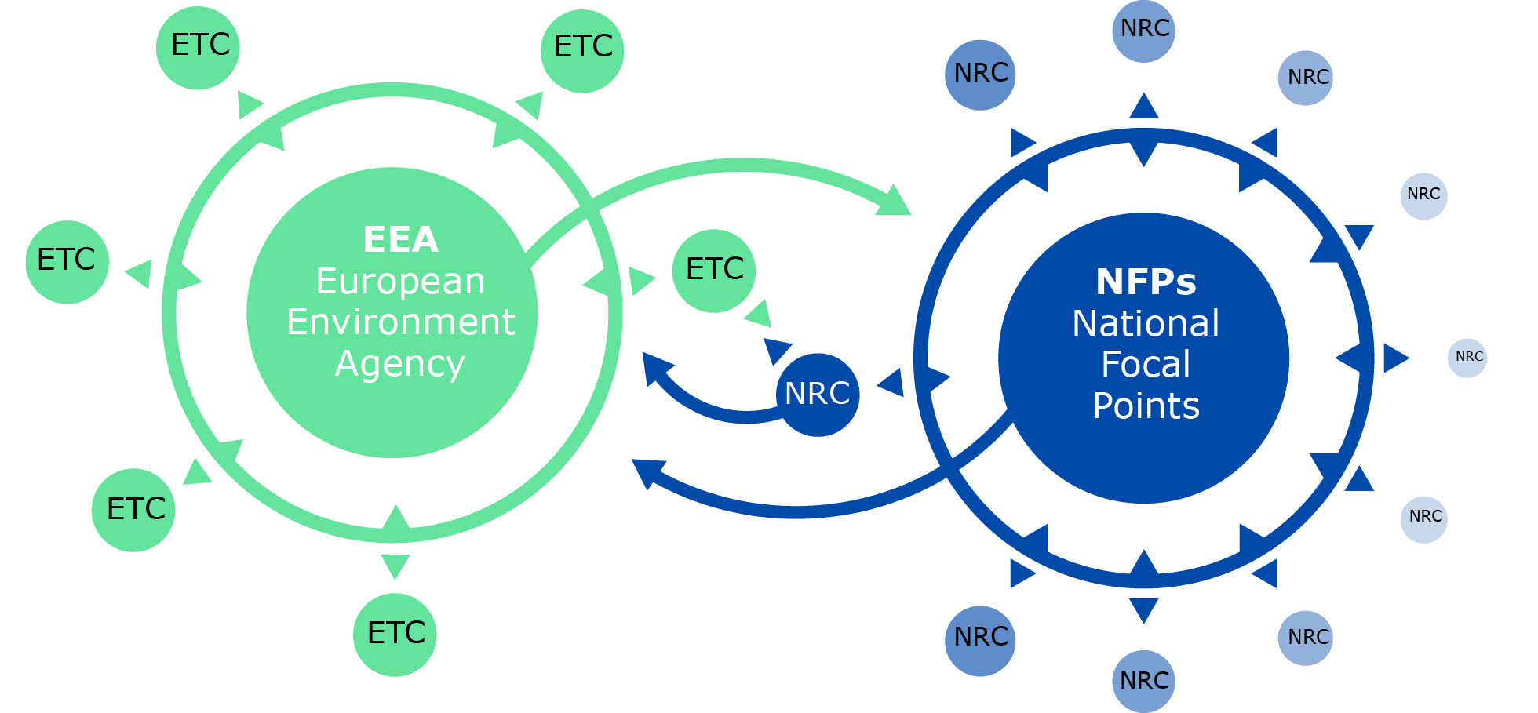
Cooperation - Network components
EEA - European Environment Agency
ETCs - European Topic Centres (6)
NFPs - National Focal Points (33+6)
NRCs - National Reference Centres (24 topics)
Network of more than ‘350’ institutions from 39 countries represented by around ‘1000’ experts
Notes:
6
Eionet consist of the EEA, number of ETCs and network of experts designated as NFPs and NRCs.
NFP – overall coordination
NRC – thematic contact points

Slide 8
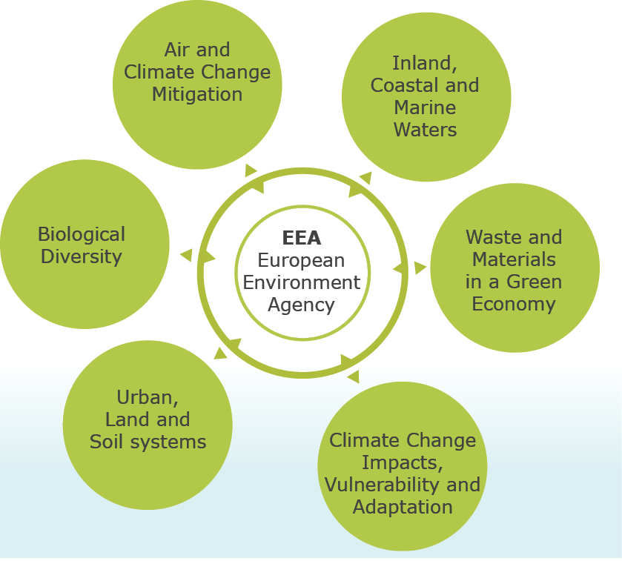
European Topic Centre (ETC)
Defined in EEA Regulation
Centres of thematic expertise
Contracted by EEA via grant agreements to perform specific tasks identified in MAWP and AWP
(ACM)
(ICM)
(BD)
Consortium of organisations from EEA member countries: leader and partners
Selection based on competition
Potential activities: data – indicators – reports – meetings –services – policy evaluation
(WMGE)
(ULS)
(CCA)
Notes:
8
ETC – part of the thematic work is given to ETCs based on contract; call for tender must be agreed by MB; consortia (leader and partners) make a bid
e.g. ACM - Air and climate change mitigation
Data: provision of data; collect data (example: PDF)
Indicators: calculate or develop/propose indicators
Reports: deliver reports; collaborate with EEA on reports
Meetings: co-organise meetings
Services: deliver services; collaborate with EEA to develop Services e.g. Application tool for web
Policy evaluation: policy evaluation is becoming more important part of the ETC tasks
RIVM – The Netherlands institute for Public health and the Environment (leader of AET/ACM consortium – Paul R.)

Slide 9
National Focal Point (NFP)
Defined in EEA Regulation
One institution per country represented by one or more persons
Main contact point for EEA in countries
Co-operation with EEA, ETCs, and coordination at national level with NRCs and other institutions
Working methods in countries are different
Support to national Management Board (MB) member
Meetings
  physical (tri-annual plenary; ad hoc working groups)
  virtual (ad hoc webinars)
Notes:
9
Working methods reflect diverse nature of teh national Environment systems; agencies x ministries; centralised administration x decentralised administration (e.g. Federal states)
Simple structure: CZ, SK
Complex structure: BE, DE, UK

Slide 10
National Reference Centre (NRC)
Not mentioned in EEA Regulation (referred to Article 4 on ‘Main Component elements’)
One or more institution(s) per theme per country with a specific role and represented by experts
Thematic expertise on environmental (or related) issues
Different types of expertise:
  Monitoring – Data – Indicators – Assessments –Knowledge (MDIAK information chain)
  Policy measures and support (IT, Communication)
24 NRC roles - structure reviewed to be in line with MAWP 2014-2018
NRC role profile
Notes:
10
NRCs were suggested to be established by MB; they are not mentioned directly in EEA regulation but belong to the Article 4
Monitoring: NRC water, air quality (experts using technical infrastructure for working on measurements, e.g. Taking samples and analyse them
Data: experts take care of database of monitored phenomenons (substances, componentes, particles)
Indicators: experts calculate indicators and propose their update
Assessments: expert analyse indicators and policy measures
Knowledge:

Slide 11
National References Centres for MAWP 2014-2018 (24)
SA 1.1 | Air quality | SA 1.5 | Water quality and ecological status | SA 1.8 | Land use and spatial planning
SA 1.1 | Environment and transport | SA 1.5 | Water emissions | SA 1.9 | Waste
SA 1.1 | Noise | SA 1.6 | Marine, coastal and maritime | SA 2.1 | Resource-efficient economy and the environment
SA 1.2 | Industrial pollution | SA 1.7 | Biodiversity data and information | SA 2.2 | Environment and health
SA 1.3 / 1.1 | Mitigation of air pollution and climate change | SA 1.7 | Biodiversity and ecosystems indicators and assessments | SA 2.3 | Forward looking information and services
SA 1.3 | Environment and energy | SA 1.7 | Environment and agriculture | SA 2.4 | State of environment
SA 1.4 | Climate change impacts, vulnerability and adaptation | SA 1.8 | Soil | SA 3.2 / 3.3 | Environmental information systems
SA 1.5 | Water quantity | SA 1.8 | Land cover | SA 3.4 | Communication
Notes:
11

Slide 12
Information chain: MDIAK
M
D
I
A
K
Member countries/
Eionet
KNOWLEDGE
BASE
SA1
DATA
SA2
Member States/
Eurostat
Horizon 2020,
JRC
SA1
INDICATORS
SA2
Remote sensing
Copernicus
SA1
ASSESSMENTS
SA2
Citizens, civil society,
business
SA1 Informing policy implementation
SA2 Assessing systemic challenges
SA3 Knowledge co-creation, sharing and use
Notes:
The strategic areas and EEA/Eionet core processes
The figure illustrates more explicitly how SA1-3 fit within the overall business model of the EEA/Eionet.
Across the top of the figure is the overall process from Monitoring (in the broadest sense) through Data, Indicators and Assessments to Knowledge. This value-adding chain is at the heart of the work of the EEA and Eionet.
As an enabler for the other two strategic areas, it is important to note that SA3’s support function stretches along the entirety of the MDIAK chain and across the whole policy cycle. The most obvious example of this is the Eionet, which shares the entire business model together with the EEA, but is also in essence based on networking, information systems, content-sharing and communications as these elements play a role in all links in the chain.

Slide 13
Reporting ‘Obligations’ (in situ data collection)
‘Voluntary’ like WISE SOE water quality – water quality – water emissions – TCM
Legally binding based on the ‘EU environmental acquis’ = collection of all environmental laws (directives, regulations, …)
Technical arrangement (2005) between EEA, Eurostat, JRC, DG ENV resulted in a kind of thematic division (coordination task via Data Centres)
  JRC: Soil, Forests
  Eurostat: Waste, Natural Resources, Integrated Product Policy
  EEA: Air, Water, Biodiversity, Climate Change, Land Use
Operational collection of around 78 country data flows via ‘Reportnet’
Notes:
The strategic areas and EEA/Eionet core processes
The figure illustrates more explicitly how SA1-3 fit within the overall business model of the EEA/Eionet.
Across the top of the figure is the overall process from Monitoring (in the broadest sense) through Data, Indicators and Assessments to Knowledge. This value-adding chain is at the heart of the work of the EEA and Eionet.
As an enabler for the other two strategic areas, it is important to note that SA3’s support function stretches along the entirety of the MDIAK chain and across the whole policy cycle. The most obvious example of this is the Eionet, which shares the entire business model together with the EEA, but is also in essence based on networking, information systems, content-sharing and communications as these elements play a role in all links in the chain.

Slide 14
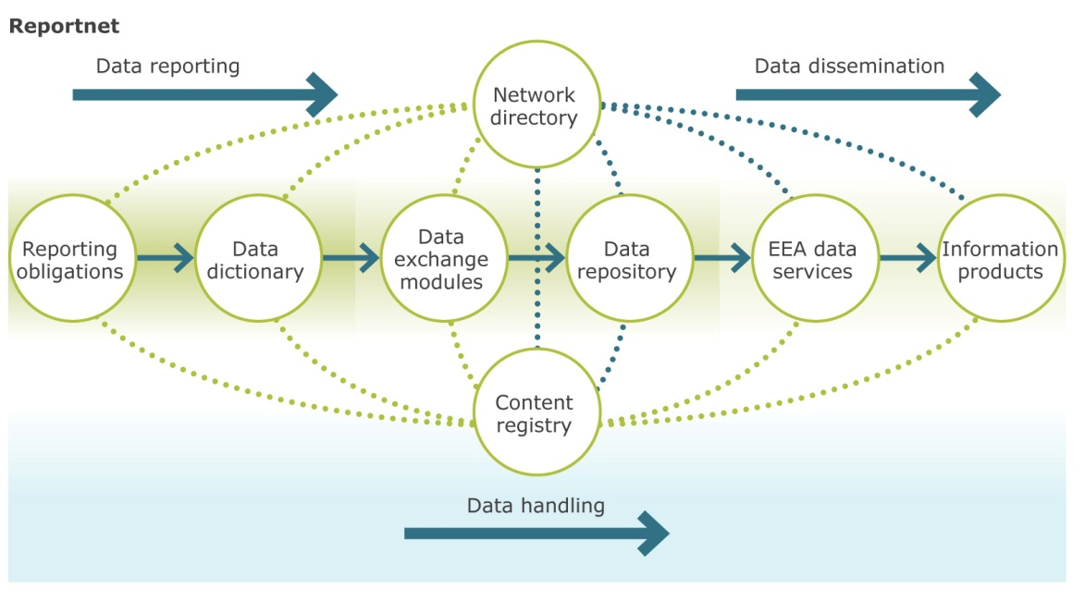
Reportnet (reporting platform)
Reporting Obligations Database (ROD)
Central Data Repository (CDR)
Notes:
14

Slide 15
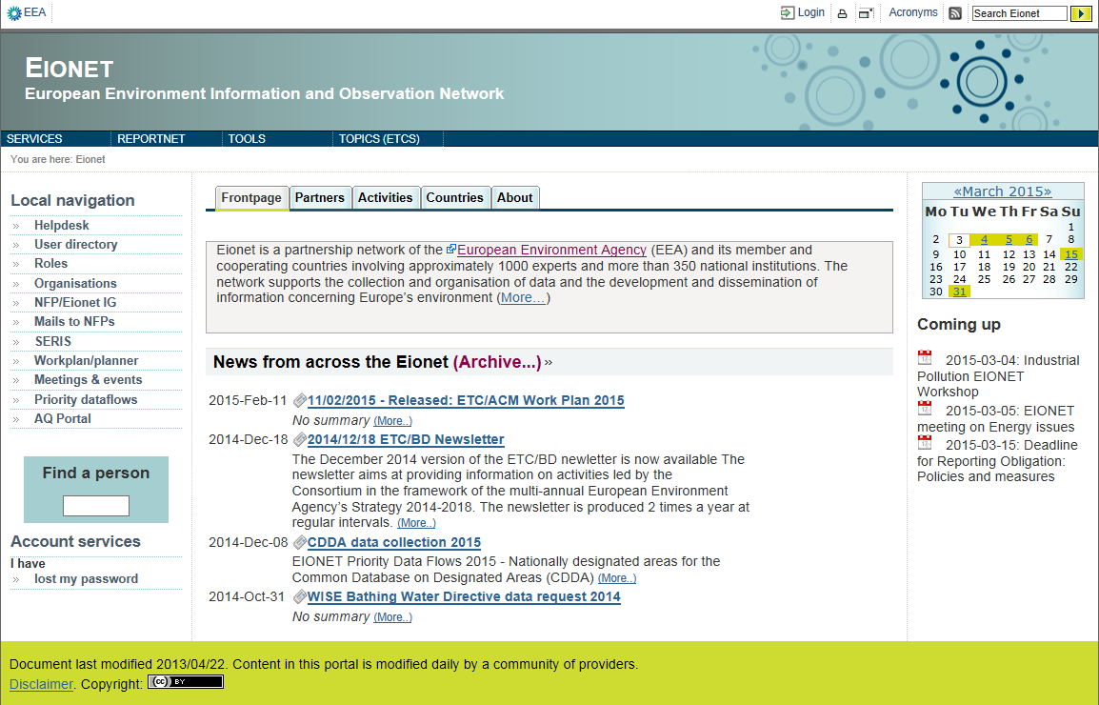
Eionet Portal: www.eionet.europa.eu/
Notes:
15

Slide 16
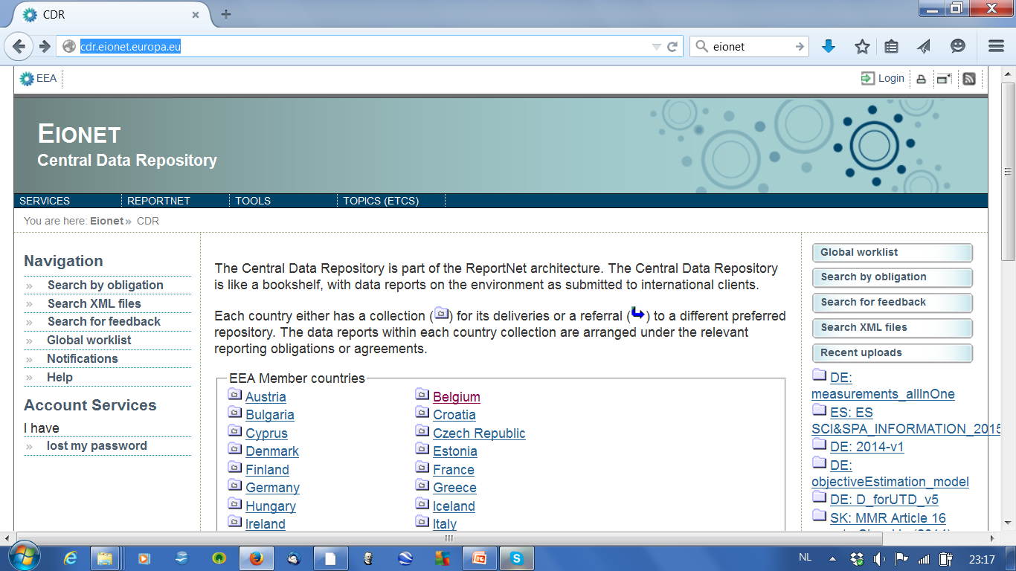
Notes:
16

Slide 17
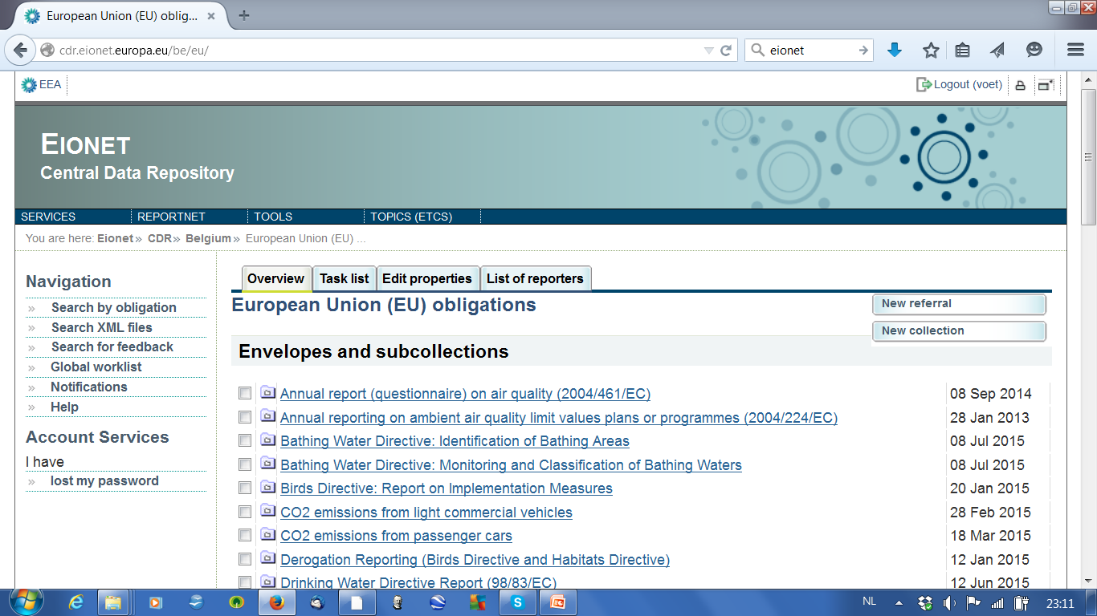
Notes:
17

Slide 18
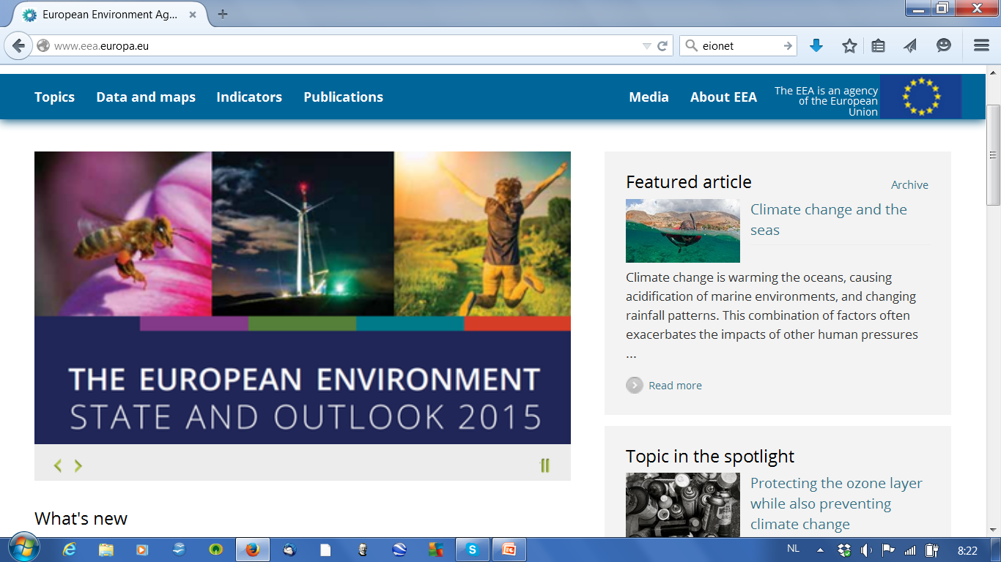
http://www.eea.europa.eu/
Notes:
18

Slide 19
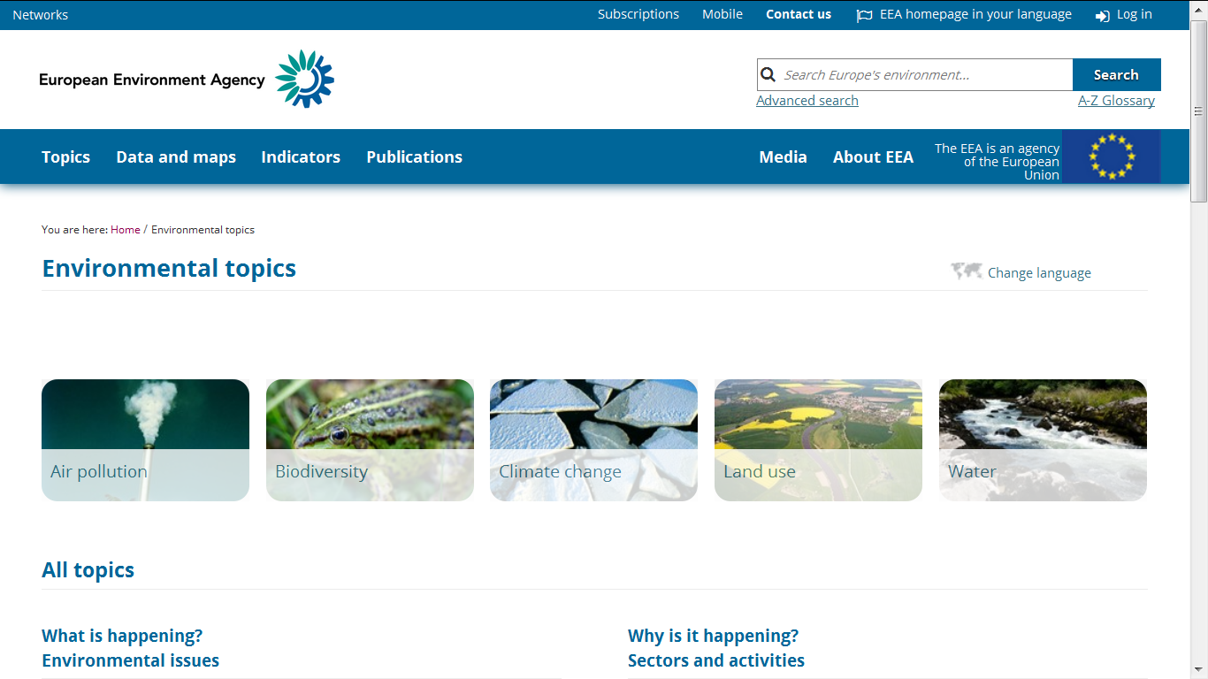
http://www.eea.europa.eu/
Notes:
19

Slide 20
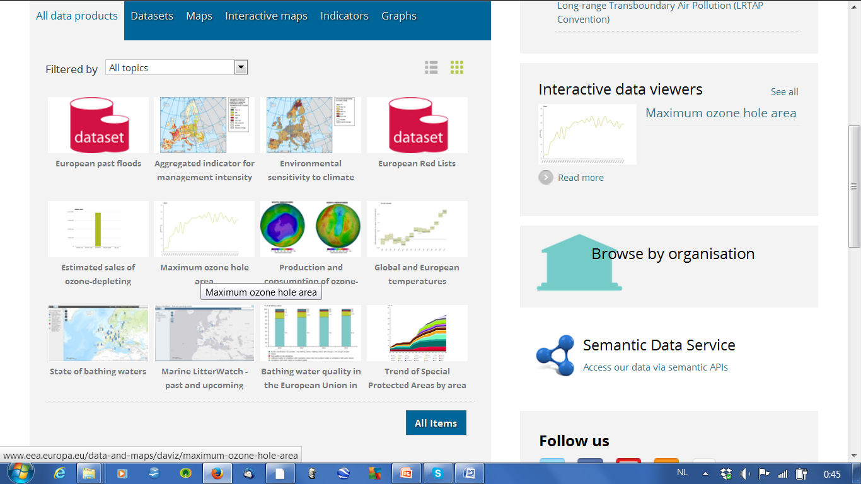
http://www.eea.europa.eu/
Notes:
20

Slide 21
Almost the END … some additional answers
QA/QC data flows - databases - reports
Step by step more or less Inspire compliant
EEA involved in Copernicus/GEOSS – Eionet as a whole a bit less
Financial information : EEA 43 Meuro (EU+) – Eionet ?
Free and open data policy aggregated information
New horizons for European and Global land monitoring, Copenhagen 19-20 October
http://land.copernicus.eu/event
Notes:
21
The concept of Eionet contains the following elements: Cooperation, Content and Infrastructure.
Let‘s start with Cooperation. To better understand relationships between Eionet and other stakeholders, we need to understand what the Eionet role is. Eionet role has two dimensions – vertical and horizontal. On the vertical level, the main role of Eionet is the cooperation of the countries towards European level. Eionet supports EEA’s implementation of the Multi-Annual and Annual Work Programme(s) (MAWP - AWP) by for example:
Coordinating national data and information flows;
Providing country-level expertise
The other role of Eionet at vertical level is to connect countries with other international/European institutions and networks.
On the horizontal level, Eionet helps to connect national environmental institutions and networks among EEA countries (e.g. East with West).
EC DGs: some institutions (=organisations) are part of Eionet and EC working groups
JRC: NRC Soil, forest data
ESTAT: Dimesa ( Directors meeting on environmental statistics and accounts); data for waste and natural resources and products
UN: UNEP, UNECE
UNEP: United Nations Environment Programme
UNECE: United Nations Economic Commission for Europe

Slide 22
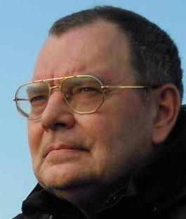
… this is the END
Thank you
Jan Hendrik Voet (voet@irceline.be)

