Slide 1
Monitoring progress towards Sustainable Development Goals
The role of land monitoring
Brice Mora, Martin Herold, Erika Romijn,
Transforming our
world:
The 2030 agenda
for sustainable
development
5th GEOSS Science and Technology Stakeholder Workshop - Linking the Sustainable Development Goals to Earth Observations, Models and Capacity Building. 9-10 December, 2016, Berkeley, CA
Notes:
Within the scope of GOFC-GOLD activities

Slide 2
Monitoring of SDGs analysis
Objectives of analysis: (Within the scope of GOFC-GOLD land monitoring activities)
Identify which goals, targets and indicators land use, land cover, land cover change, biomass and fire data can support
Identify gaps and needs, in terms of data, and indicators
Ultimate aim of land monitoring: Assess progress towards goals

Slide 3
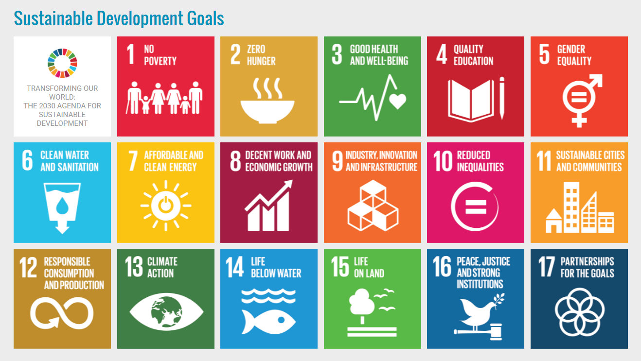
Sustainable Development Goals
17 goals, 169 targets, 230 indicators
Land (use/cover) datasets essential
Land (use/cover) datasets complementary
https://sustainabledevelopment.un.org/sdgs
supports the SDGs
Notes:
Green circle: direct contribution of land monitoring: use land use/land cover datasets as essential datasets
Blue circle: additional contribution of land monitoring: use of land use/land cover datasets as complementary datasets

Slide 4
Spatial data requirements
Thematic categories
Land use data subcategories
# The numbers in the pie charts refer to the number of indicators for which the spatial data requirements apply.
Notes:
# The numbers in the pie charts refer to the number of indicators for which this type of data is needed.

Slide 5
Spatial data requirements
Land cover data subcategories
Aggregated Land cover classes:
Tree cover | Tree cover
 | Tree cover, regularly flooded
Herbaceous & Grassland | Herbaceous cover (natural)
 | Grassland (pasture)
Agricultural crops | Herbaceous crops (agriculture)
 | Tree crops (agriculture)
Other | Bare areas
 | Snow and ice
Land cover change data subcategories
# The numbers in the pie charts refer to the number of indicators for which the spatial data requirements apply.

Slide 6
Data for monitoring SDGs
SDGs |  | Land Use data | Land Cover data | Land Cover Change data | Biomass data (AGB) | Fire data (Active fires, burnt areas)
 | Zero hunger
 | Clean water
 | Industry
 | Cities
 | Consumption & production
 | Climate action
 | Life below water
 | Life on land
Importance of data for indicators in place to monitor targets/goals:
Essential | some essential / some comple-mentary | Complementary | Not relevant

Slide 7
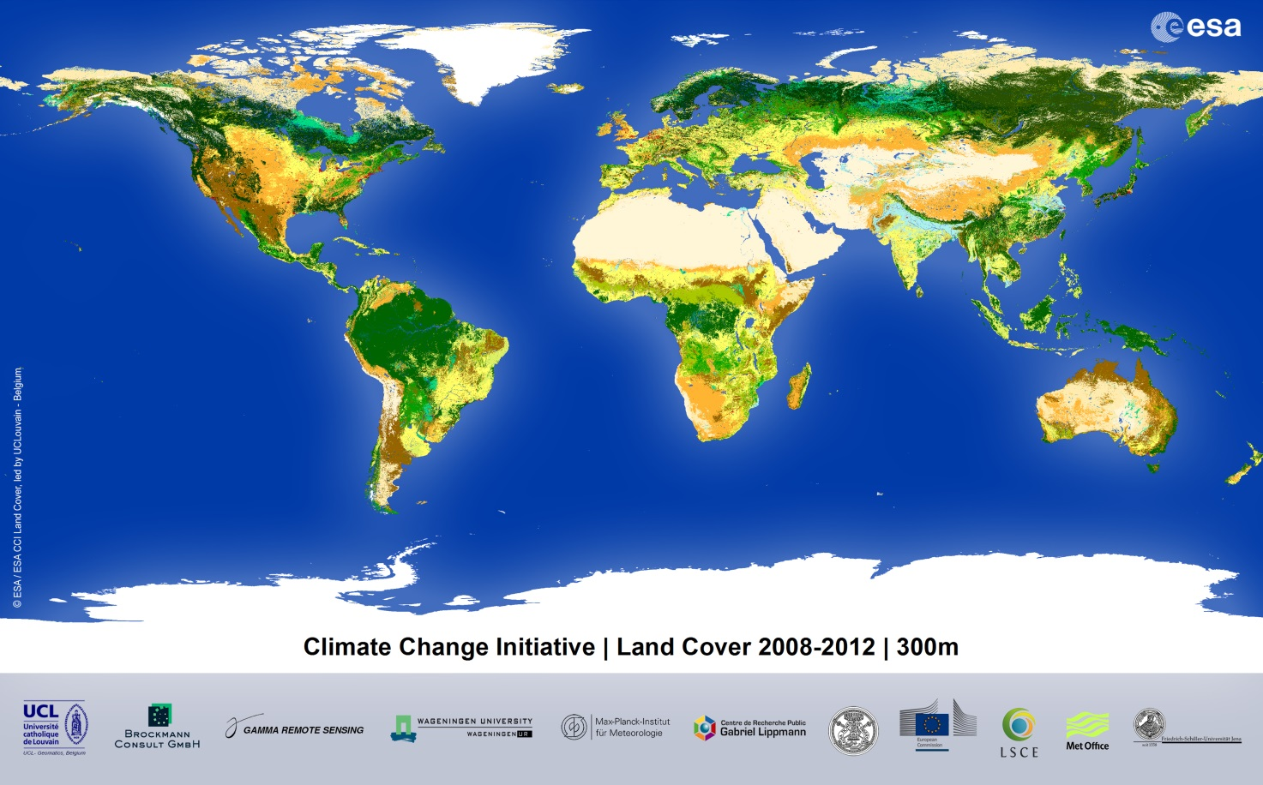
Goal 15: Life on land
Target 15.1 By 2020, ensure the conservation, restoration and sustainable use of terrestrial and inland freshwater ecosystems and their services, in particular forests, wetlands, mountains and drylands, in line with obligations under international agreements
Indicator 15.1.1 Forest area as a percentage of total land area

Slide 8
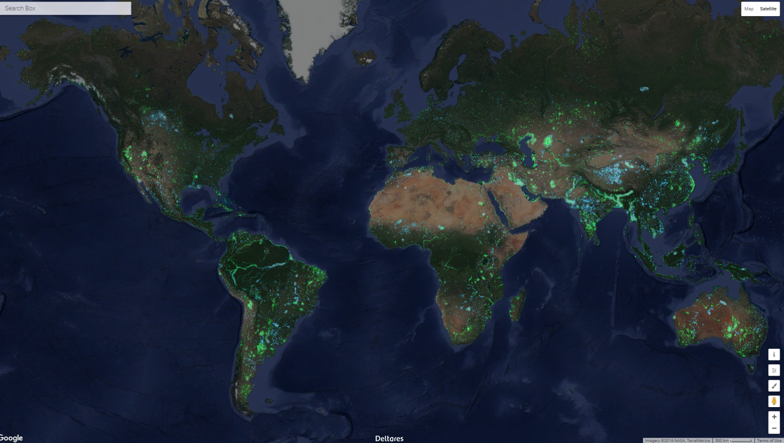
Goal 6: Clean water
Target 6.6 By 2020, protect and restore water-related ecosystems, including mountains, forests, wetlands, rivers, aquifers and lakes
Indicator 6.6.1 Percentage of change in the extent of water-related ecosystems over time
Source: Aquamonitor by Deltares; Donchyts et.al, 2016, Nature Climate Change

Slide 9
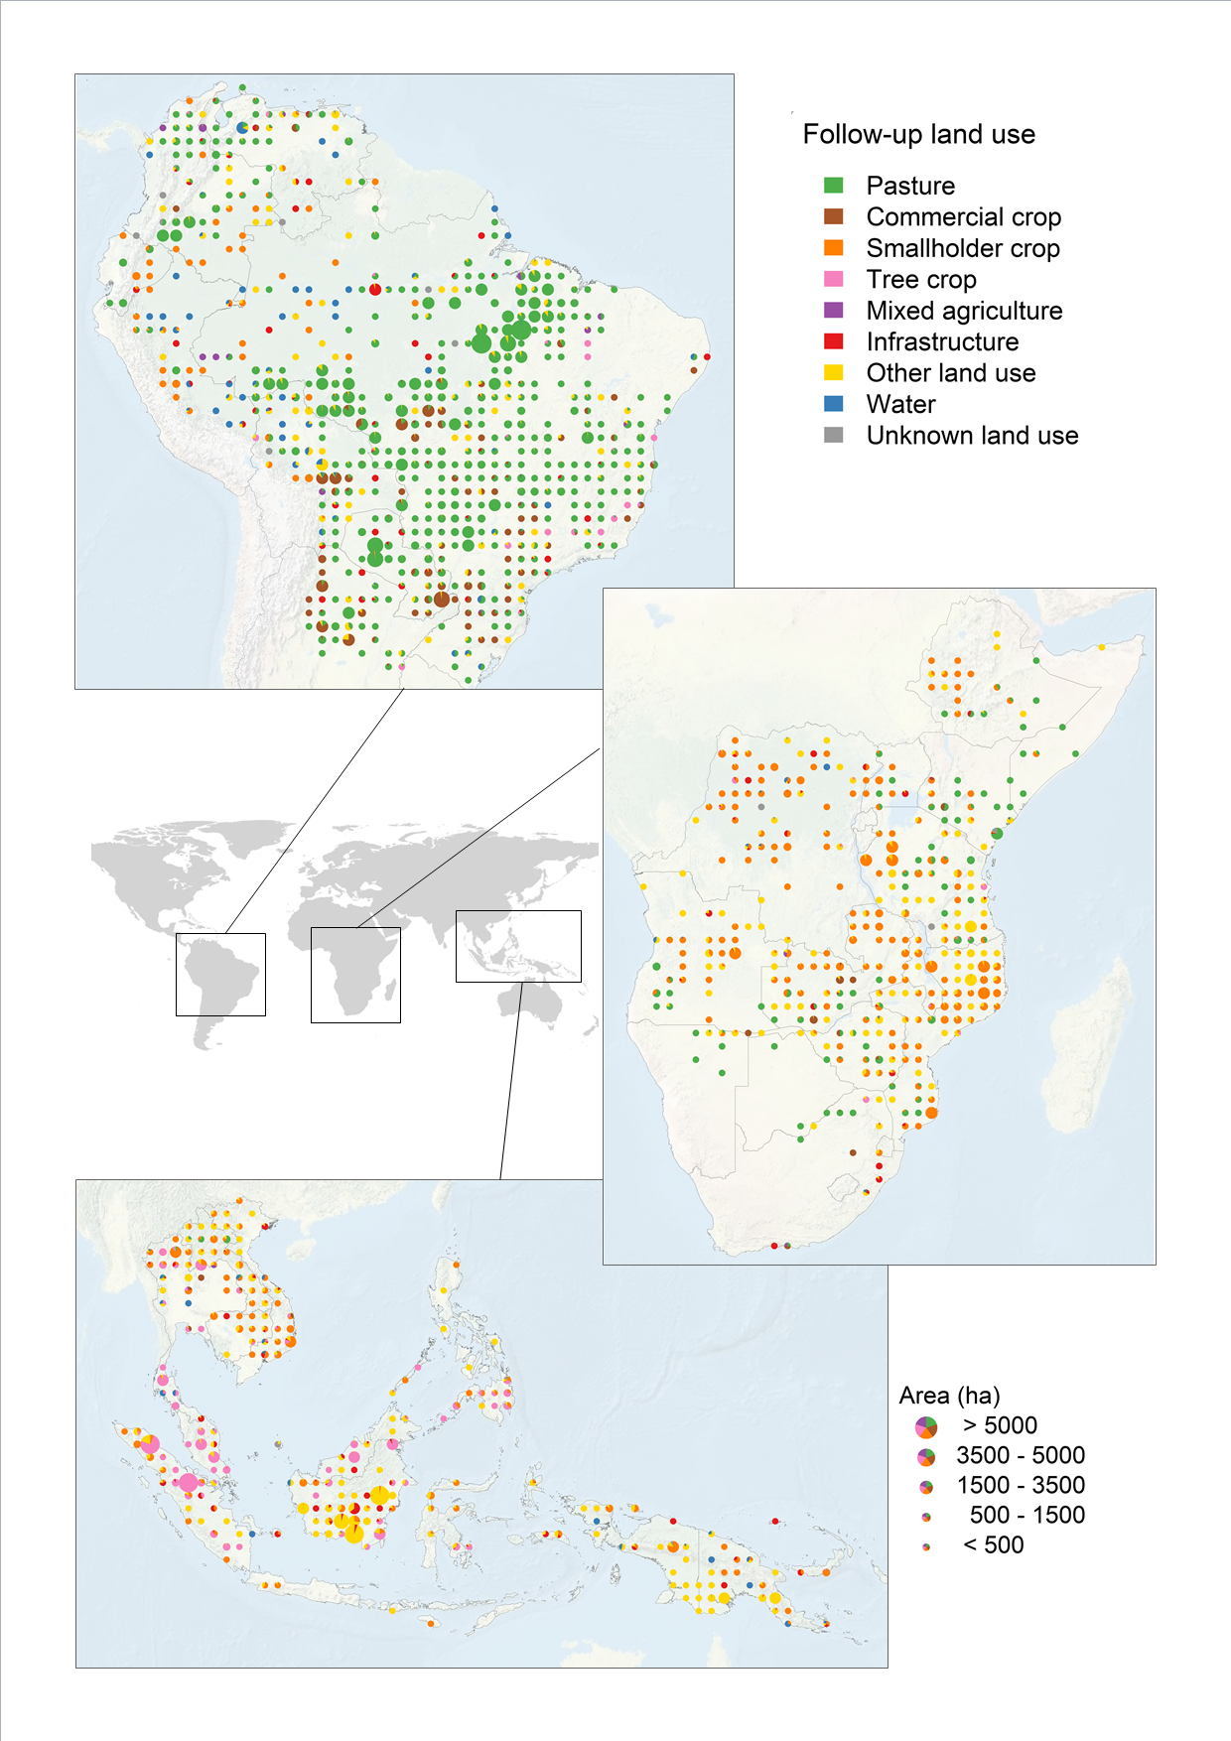
Goal 13: Climate action
FAO remote sensing survey data 1990-2005
Land use following deforestation 1990-2005
 | Area (1000 ha) | %
Smallholder crop | 12123 | 18.8
Commercial crop | 4326 | 6.7
Tree crop | 5584 | 8.7
Pasture | 27305 | 42.3
Mixed agriculture | 404 | 0.6
Total Agricult. | 49781 | 77.1
Infrastructure | 2210 | 3.4
Other land use | 11230 | 17.4
Water | 1073 | 1.7
Unknown | 200 | 0.3
Total other | 14748 | 22.9
Total | 64529 | 100.0
De Sy et al., 2015, ERL

Slide 10
Goal 13: Climate action
www.fao.org/publications/sofo/2016/
Forests and agriculture: land-use challenges and opportunities
De Sy et al., 2015, ERL

Slide 11
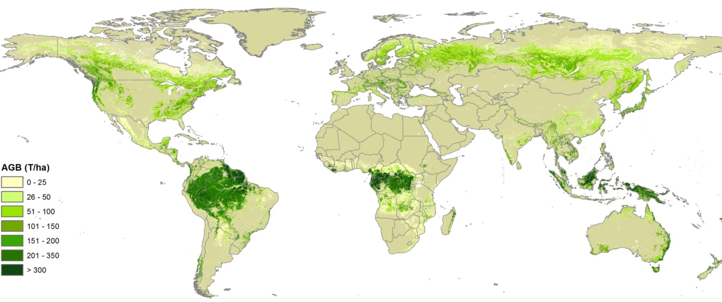
Goal 13: Climate action
Global
Forest
Biomass
GEO CARBON
Avitabile et al., 2016, GCB
www.wageningenur.nl/grsbiomass

Slide 12
Data for monitoring SDGs
SDGs |  | Land Use data | Land Cover data | Land Cover Change data | Biomass data (AGB) | Fire data (Active fires, burnt areas)
 | Zero hunger
 | Clean water
 | Industry
 | Cities
 | Consumption & production
 | Climate action | X | X | X | X | X
 | Life below water
 | Life on land | X | X | X | X | X
Gaps for indicators:
X Data essential to monitor targets and goals, however, indicator insufficient or no relevant indicator listed

Slide 13
Indicator gaps – Goal 13 Climate action
Goal 13. Take urgent action to combat climate change and its impacts
Target 13.2 Integrate climate change measures into national policies, strategies and planning
Indicator 13.2.1 Number of countries that have communicated the establishment or operationalization of an integrated policy/strategy/plan which increases their ability to adapt to the adverse impacts of climate change, and foster climate resilience and low greenhouse gas emissions development in a manner that does not threaten food production (including a national adaptation plan, nationally determined contribution, national communication, biennial update report or other)
Land use data; Land cover data; Land cover change data; Biomass data; and Fire data can inform this goal and target. However, indicator does not reflect this need.

Slide 14
Indicator gaps – Goal 15 Life on land
Goal 15. Protect, restore and promote sustainable use of terrestrial ecosystems, sustainably manage forests, combat desertification, and half and reverse land degradation and halt biodiversity loss
Target 15.2 By 2020, promote the implementation of sustainable management of all types of forests, halt deforestation, restore degraded forests and substantially increase afforestation and reforestation globally
Indicator 15.2.1 Progress towards sustainable forest management
This target is related to UNFCCC REDD+ and UNCBD initiatives. Additional indicators are needed to reflect the policy and monitoring needs for this target.

Slide 15
Preliminary Conclusions

Slide 16
How can Land data support monitoring of goals, targets and indicators?
Land monitoring contributes to many goals/targets, for some goals it is essential, and for some goals complementary
Important categories: Wetlands/water bodies, Forest land, Grassland, Cropland (agriculture), Urban areas
SDGs require operational programs to assess trends for reporting performance (2015-2030)
Emphasis on monitoring land use / land cover, however link to societal and economic issues is essential for goals/ targets/ indicators
Required spatial detail for data: <30 m or 30-100 m

Slide 17
What are the gaps and needs, in terms of data and indicators, to support monitoring of SDGs?
While some targets can be served already, some indicators are not sufficient to be monitored and require specific attention
Still goals/targets can benefit from already working/ anticipated programs (i.e. goal 13 Climate action & goal 15 Life on land)
Need for further dialogue between SDGs indicator developers and scientific community to assess gaps and further development of indicators
Need reporting principles to comply with:
e.g. similar to 5 principles from IPCC (Transparency, Accuracy, Consistency, Comparability, Completeness)
Role for Independent monitoring?

Slide 18
Which existing and future datasets / monitoring programs are important for monitoring SDGs?
Key examples of existing, useful datasets for SDG targets
Assessment for key ESA projects (CCI) and key ESA missions (Fluoresence, Globbiomass)
 | Datasets | Coverage of years | Temporal resolution | Spatial resolution
1 | ESA Land Cover CCI (22 classes) | 2000, 2005, 2010, 2015 | Every 5 years; Annual from 2017 onwards | 300 m
2 | Globeland30 (10 classes) | 2000, 2010 | 10 years | 30 m
3 | Hansen et al., 2013. High-Resolution Global Maps of 21st-Century Forest Cover Change. | 2000 – present | Annual | 30 m
4 | Copernicus European Earth monitoring program - Global Land Service (GIO-GL) | 2015 onwards | Annual | 1 km & 300 m
5 | ESA Globbiomass | 2000-2015 | Reference year = 2010 | 150-500 m
6 | Pekel et al., A Global 30m Water Occurrence Dataset | 1985-2015 (expected) | Monthly | 30 m
Notes:
http://www.esa-landcover-cci.org/?q=node/164
http://www.un-spider.org/links-and-resources/data-sources/land-cover-map-globeland-30-ngcc
http://www.sciencemag.org/content/342/6160/850
http://land.copernicus.eu/global/products/
http://globbiomass.org

