Slide 1

Earth Energy Monitoring System (E²MS)
A Strategic News Service TM
Project

Slide 2
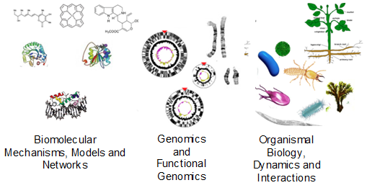
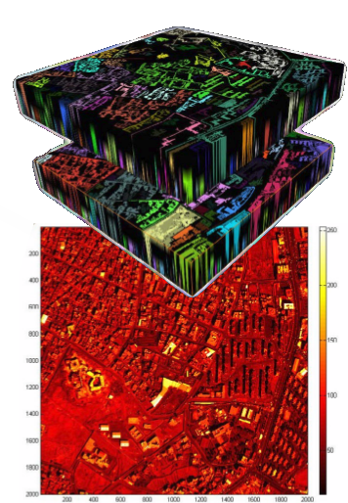
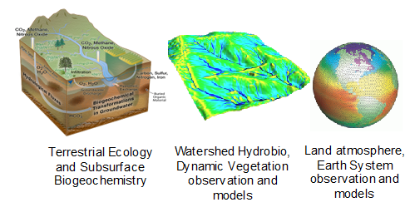
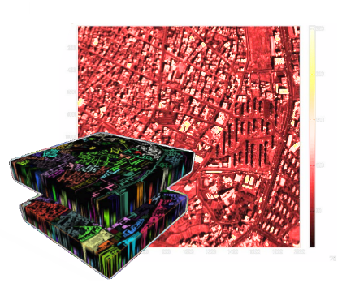






Understanding Earth Energy
leverage the HUGE body of work done to date
The earth system has emergent properties. Exploring this requires access to layers of flows* of data and their interactions coupled across at least 18 orders of magnitude in scale
Human earth-system interactions
Femtoseconds (10⁻¹⁵)
Angstroms
Years (10³)
Kilometers
Earth Energy Monitoring requires the capacity to know which spatiotemporal scales are relevant in an evolving, non-stationary system
Notes:
Interactions: Flows – coupled across at least 18 orders of magnitude The earth system is an emergent property of layers of flows and interactions at many levels
City photo credit:
http://earthobservations.org/documents.php?smid=200
http://dcitynetwork.net/manifesto/?page=88

Slide 3
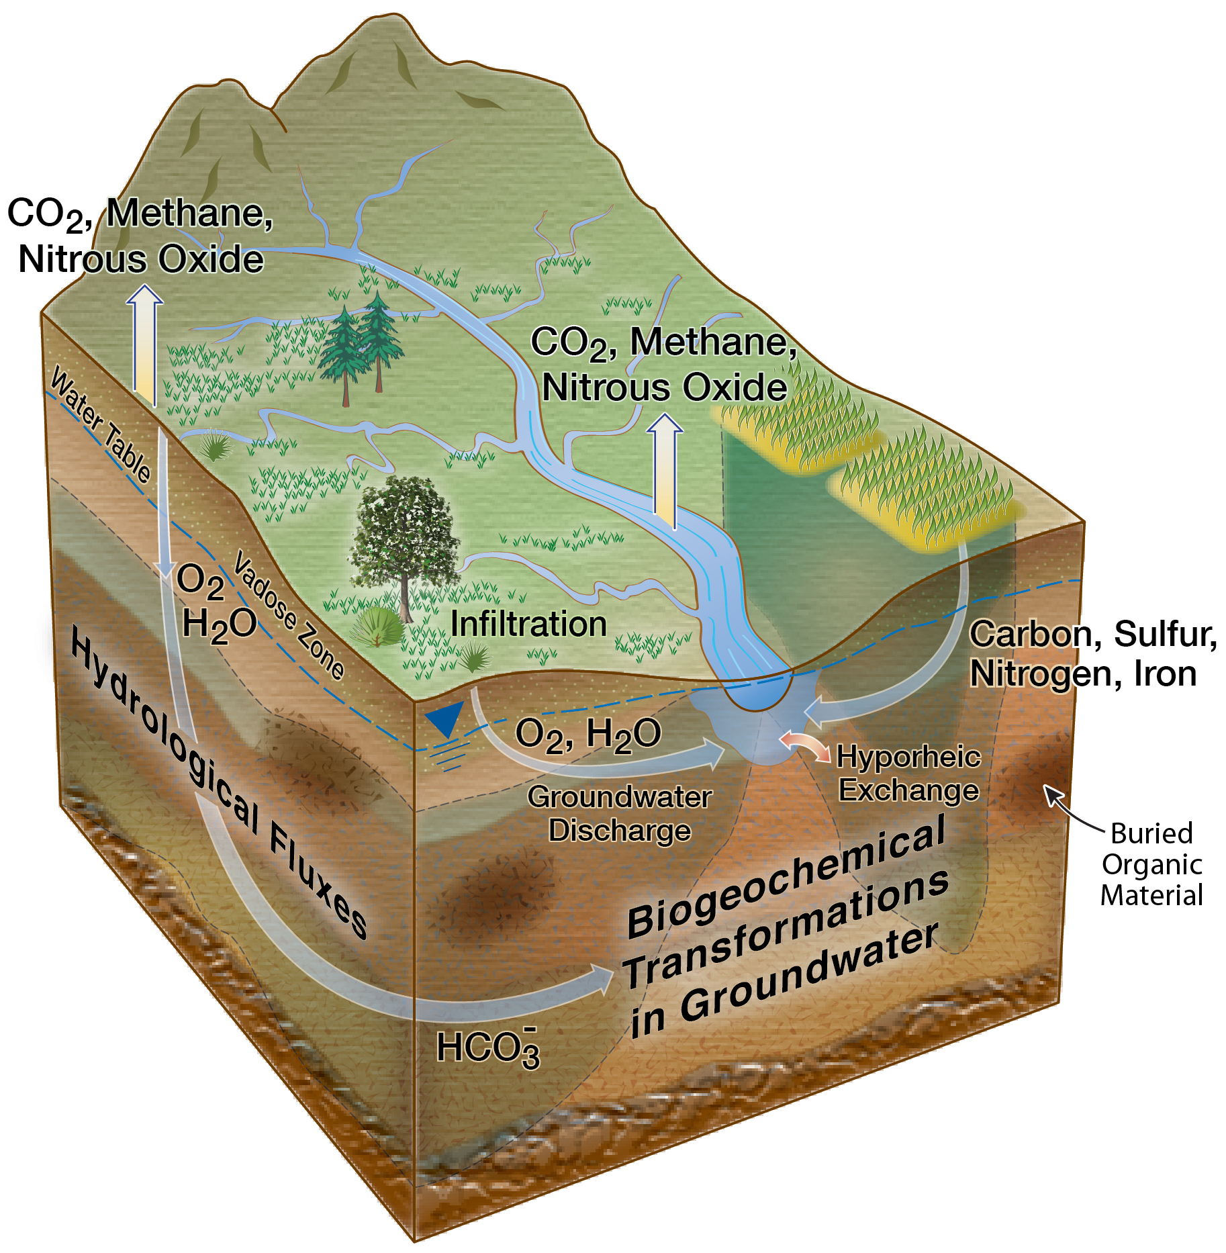
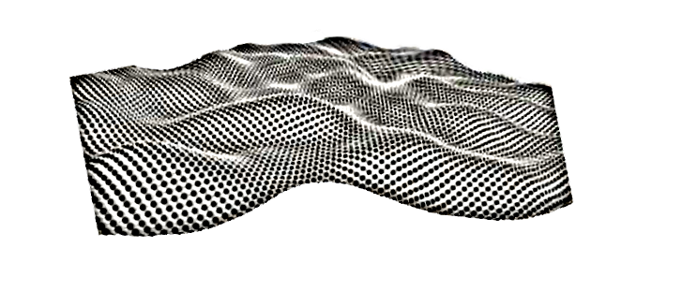
Solution to Monitoring Earth Energy Now Possible: observe unprecedented velocity and volumes of data through networks of distributed multi-modal sensors to achieve adaptive and asynchronous observations at the most relevant scales
The Flow & Interaction system
E²MS Use Case
Water
Waste
Food
Thermal
Air
Sensors report more data than can be recorded.
asynchronous observations
Intelligent reporting of those observations
Machine Learning
Observation of Flows
Pattern recognition from them
Package data for consumption
Interpretive visualization
Disseminate products to end user
Notes:
The message is: Yep, now big deal. We got together and it can be done. ()

Slide 4
System Context
It is now realistic to collect and analyze
data across all relevant scales
Energy Sensors
Existing or to be deployed
Earth Energy Monitoring System (E²MS)
General Flow & Interaction System
Monitor / Measurer / Model
User Interface
Access to Historical Data
Interpret / report / visualize
Policy Makers and Staff
Provide Facts, knowledge, understanding to inform policy decisions.

Slide 5
The Flow & Interaction System Capabilities:
General purpose system
Extensible
Loosely couple sensor(s) integration
Support existing or future
Decompose and Distribute Functionality
Configurability
Embedded Security
Support varied actor and data policies
Scaling
Multi-scale
Multi-tier
Multi-modal/temporal
Massively unknown coupling
Massive Data
Flow
Data Flows are Visualized
Patterns identified from Flows

Slide 6
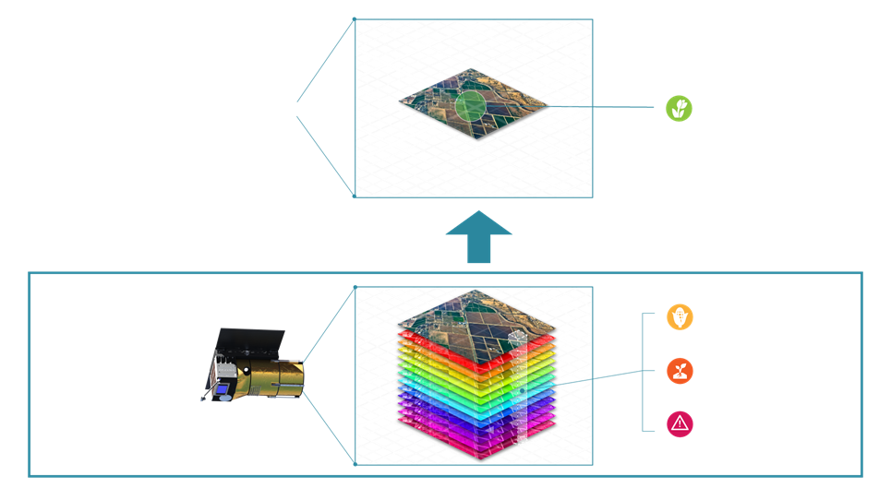
Actionable Data Data fusion, etc
E²MS Implementation
Components of the Designed System
Interface to existing sensor(s)
Collect energy Flows
Data aggregation
Provide views of Energy Flows
Current
Historical
Identify Patterns in Energy Flows
Provide Views of Flow Interactions
Fusion of flows
System Membership
World wide community Awareness
Policy Makers
Environment care industry
Scientific community
Controllers: The builder of the aggregators and sensor

Slide 7

Who is the Strategic News Service, LLC
A 21 year old Technology Collective
Initiatives
INVNT/IP
Consortium to impact Intellectual Property Theft
The Carbon Trifecta
Utilize CO² ‘waste’ to produce Graphene - CO₂ + 2Mg = Cgraphene + 2 MgO
Orca Relief
“Committed to the Full Recovery of the Endangered Southern Resident Killer Whales”
Project Inkwell
A Reference Architecture for K-12 Education Computer to assist K-12 digital conversion
Future In Review (FIRe) Conference
“The best technology conference in the world” – The Economist
FIRe Films
Screen and fund world changing documentaries
The Pattern Computer
Notes:
FIRe Films
Ivory Trade
Alternative Alzheimers “Treatment” Alive Inside
Animal Rights

Slide 8
E²MS Creators
Mark Anderson – Founder and CEO, Strategic News Service, LLC
Larr Smarr – Director of Calit2
Ty Carlson – CTO - Coventry Computer
Brad Holtz – Chief Nexus Officer - Coventry Computer
Ben Brown – Dept Head Molecular Ecosystems Biology, Lawrence Berkeley National Laboratory
Lee Hall – Large Scale Systems of Systems Architect, Clew Group, LLC
Nathaneal Miller – Science Mission Developer Mechatronics and Satellites, NASA Langley
Steve Coy – Founder, TimeLike Systems
Franklin Williams – Principal, Live Earth Imaging Inc.
David Zuniga – Commercial Innovation Manager, Center for the Advancement of Science in Space
Paul Higgins – CEO, NanoXplore, Inc
Ilkay Altinas – Chief Dara Science Officer UCSD Supercomputer Center
Talbot Jeager – Founder & CTO NovaWurks, Inc
Robert Anderson – CEO, Hybrid Electric Vehicle Technologies
Bei Wang Phillips – Assistant Professor, School of Computing SCI Institute University of Utah
James Urquhart – SVP of Performance Analytics SOASTA, Inc
Kevin Montgomery – Founder, Collaborate.org; Sr Researcher, Stanford University

Slide 9
Backup

Slide 10
*Flows (processes as they change over time)
Dynamic evolving process
Defined in a set of fields over time, where time is increasing

Slide 11
Different Types of Flows
A “flow” is movement of some kind of stuff from one place to another.
1D vs 2D vs 3D flows
1D: stuff moving along a line
2D: stuff moving across a surface
3D: stuff moving within or across a volume
1D & 2D are really just special cases of 3D.
Continuous vs discrete flows
The moving stuff may consist of discrete chunks, e.g. cars, or it may be continuous, e.g. fluids or current.
Discrete flows can be treated special cases of continuous flows.
In general, all flows can be treated as being both 3D and continuous.

Slide 12
Existing Water, Air, Thermal Energy, Food, and Waste Sensor Network
An Earth Energy Model
Energy (heating and cooling) driving potable water: a basic building blocks of life thing
Energy (heating and cooling) driving soil conditions, and plant efficiency via transpiration and evaporation: a food problem
Energy (heating and cooling) driving atmospheric composition: a breathing problem
Energy (heating and cooling) driving atmospheric convection: a climate problem
Thermal Energy (heating and cooling) driving a habitable environment: a quality of life problem

