Slide 1
A Food-Energy-Water Calculator for Western Kansas
Mary C Hill (KU), Groundwater and uncertainty
Ruth Douglas Miller (KSU), Electrical energy
Danny Rogers (KSU), Agriculture
Joshua Roundy (KU), Climate, surface water, and drought indices

Slide 2
What is a Food-Energy-Water Calculator?
Like a mortgage calculator but more complicated
Provides analysis of farm income tradeoffs
Income increase from wind energy possible with changes to Kansas regulations
Would allow more locally advantageous wind power development
Income decrease because farmers would need to relinquish some water rights to get permission to develop wind energy in the more locally advantageous ways.
The trade for water makes the change to Kansas regulations politically possible
Goals:
Conserve and extend usable life of the Ogallala
Maintain as much crop production into the future as possible
Keep farmer revenues and local economies healthy by also harvesting wind energy

Slide 3
The depleted aquifer region has some of the best wind in the country
KGS

Slide 4
Turning to turbines: By Cole Epley / World-Herald staff writer (Omaho, NB)
Terry Brockhaus: “… land-lease payments of about $32,000 …”
$5,000 to $7,000 per year per turbine
But later in the article…
Ed Woolsey: “One turbine has changed my life”
What is happening here??
Part is the Production Tax Credit (PTC). What else?
http://www.omaha.com/money/turning-to-turbines-as-commodity-prices-remain-low-wind-energy/article_2814e2cf-83a3-547d-a09e-f039e935f399.html
http://farmenergy.org/success-stories/wind-energy/new-crosswind-energy-project

Slide 5
Kansas changes needed to support more locally profitable wind development
Special treatment of land owners/collectives who agree to water cutbacks for power sale rights.
Sell electricity to coops without KCC “utility” label
No generator size limit
Coops can sign PPAs* with landowners
Collectives are allowed.
Multiple meters under one contract.
Grid capacity:
Need lines and substations for MW-sized generators at landowner sites. Cost-share rules to pay for enhancements
Coop role bigger?
*PPA, Power Purchase Agreement: agreed sale price, typically for 20 yrs
Necessary
Useful

Slide 6
The calculator – initial design ideas
Users: define circumstances and preferences
Equations, numbers, web links, web searches, judgement. User modification supported.
Notes:
The range of $70,000 annual income from wind power seems reasonable, and is consistent with the quote at the beginning of the talk about one turbine changing a farmer’s life.

Slide 7
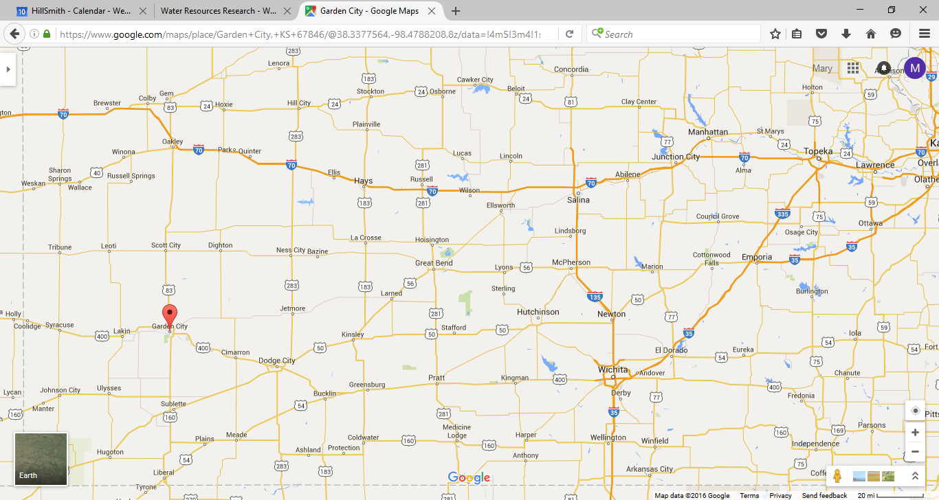
FAQs
Is local pumping enough to deplete the groundwater? Click here
What federal and state incentives are there for wind power development? Click here
Results: Graph end year: 2072
1. Select your location and area
558 acres
Plot Annual Average
Add Variability Add Uncertainty
2. Define Framework
3. Make Choices
Key knowledge
Select, then click here for defaults
Consequences
Calculate
Agri-culture
3A
2A
Wind and Solar Energy
2B
3B
Water
2C
3C
Climate
Select to change. Select and click here to return to default

Slide 8
FAQs
Is local pumping enough to deplete the groundwater? Click here
What federal and state incentives are there for wind power development? Click here
Results: Graph end year: 2072
1. Select your location and area
558 acres
Plot Annual Average
Add Variability Add Uncertainty
2. Define Framework
3. Make Choices
Key knowledge
Select, then click here for defaults
Consequences
Calculate
Field Crops Ranching
.
Agri-culture
Use county defaults for crops, water, fertilize, prices, etc.
Choose via Crop Water Allocation CWA
from KSU
3A
OR
Wind and Solar Energy
Wind turbines Solar panels
Buy Lease Land Lease
Electric generation potential:
Wind speed map is HERE
Solar map is HERE
3B
Irrigation: Fresh Groundwater
Water
HPA map from KGS is HERE
Stories from your region are HERE
3C
Climate
Select to change. Select and click here to return to default

Slide 9
FAQs
Is local pumping enough to deplete the groundwater? Click here
What federal and state incentives are there for wind power development? Click here
Results: Graph end year: 2072
1. Select your location and area
558 acres
Plot Annual Average
Add Variability Add Uncertainty
2. Define Framework
3. Make Choices
Key knowledge
Select, then click here for defaults
Consequences
Calculate
Field Crops Ranching
.
Subsidies, insurance Options
Phase in period for irrigation change: 5 years
First year: 2017
Average past annual farm income: $32,000
Agri-culture
Use county defaults for crops, water, fertilize, prices, etc.
Choose via Crop Water Allocation CWA
from KSU
OR
Wind and Solar Energy
Wind turbines Solar panels
Buy Lease Land Lease
Electric generation potential:
Wind speed map is HERE
Solar map is HERE
Wind turbines 2 2 MW
Loan: 20 years APR 4%
Grid connection needed
Irrigation: Fresh Groundwater
Reduce irrigation by 25% of 5 year average.
Years to no or little irrigation?
Calculate
Soil condition? Poor
Water
HPA map from KGS is HERE
Stories from your region are HERE
Climate
Select to change. Select and click here to return to default

Slide 10
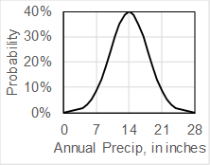
FAQs
Is local pumping enough to deplete the groundwater? Click here
What federal and state incentives are there for wind power development? Click here
Results: Graph end year: 2072
1. Select your location and area
558 acres
Plot Annual Average
Add Variability Add Uncertainty
2. Define Framework
3. Make Choices
Key knowledge
Select, then click here for defaults
Consequences
Calculate
Field Crops Ranching
.
Subsidies, insurance Options
Phase in period for irrigation change: 5 years
First year: 2017
Average past annual farm income: $32,000
Agri-culture
Use county defaults for crops, water, fertilize, prices, etc.
Choose via Crop Water Allocation CWA
from KSU
OR
Wind and Solar Energy
Wind turbines Solar panels
Buy Lease Land Lease
Electric generation potential:
Wind speed map is HERE
Solar map is HERE
Wind turbines 2 2 MW
Loan: 20 years APR 4%
Grid connection needed
$3M/turbine = $6M Life 20 yrs
Grid connection: $400,000/turbine
O&M: $31,000/yr/MW=$124,000/yr Electric price: $.038/kwh.
Factors: Grid 100% Production 45%
Irrigation: Fresh Groundwater
Reduce irrigation by 25% of 5 year average.
Years to no or little irrigation?
Calculate
Soil condition? Poor
Precipitation 14” per year
At present pumping rates, dryland farming dominates in 2054. Map
Years added per area-wide 25% pumpage reduction: 5-10
Water
HPA map from KGS is HERE
Stories from your region are HERE
Assume: average change temp +2º F , precip +0% to 2050. Precipitation probability scenario (DPS) A.
If temperature increases, precipitation must increase for the same drought probabilities to occur.
Climate
Select to change. Select and click here to return to default

Slide 11
FAQs
Is local pumping enough to deplete the groundwater? Click here
What federal and state incentives are there for wind power development? Click here
Results: Graph end year: 2072
1. Select your location and area
558 acres
Plot Annual Average
Add Variability Add Uncertainty
2. Define Framework
3. Make Choices
Key knowledge
Select, then click here for defaults
Consequences
Calculate
Field Crops Ranching
.
Subsidies, insurance Options
Phase in period for irrigation change: 5 years
First year: 2017
Average past annual farm income: $32,000
Average annual income reduction after water use change implemented: 20%
(0%=no change), to $200,000.
Agri-culture
Use county defaults for crops, water, fertilize, prices, etc.
Choose via Crop Water Allocation CWA
from KSU
OR
Wind and Solar Energy
Wind turbines Solar panels
Buy Lease Land Lease
Electric generation potential:
Wind speed map is HERE
Solar map is HERE
$3M/turbine = $6M Life 20 yrs
Grid connection: $400,000/turbine
O&M: $31,000/yr/MW=$124,000/yr Electric price: $.038/kwh.
Factors: Grid 100% Production 45%
Added annual income= $67,184
Income: 4MW x 365 x 24 hours/year x 45% x $.038/kwh x 1000kw/Mw = $599,184.
Expenses: O&M $124,000 +
loan payment $408,000 = $532,000
Wind turbines 2 2 MW
Loan: 20 years APR 4%
Grid connection needed
Irrigation: Fresh Groundwater
Reduce irrigation by 25% of 5 year average.
Years to no or little irrigation?
Calculate
Soil condition? Poor
Precipitation 14” per year
At present pumping rates, dryland farming dominates in 2054. Map
Years added per area-wide 25% pumpage reduction: 5-10
Dryland farming delayed by 5-10 years. Use 7 years. Approximate year to start dryland farming is 2061
Water
HPA map from KGS is HERE
Stories from your region are HERE
Assume: average change temp +2º F , precip +0% to 2050. Precipitation probability scenario (DPS) A.
If temperature increases, precipitation must increase for the same drought probabilities to occur.
Climate
Select to change. Select and click here to return to default

Slide 12
Intended uses of the Food-Energy-Water Calculator
Provides Kansas- and site-specific information to consider choices
Approximates future income
Interested in considering turbine ownership??
Work with legislators, electric coops, IOUs, vendors and banks to figure out how to realize the opportunities.
To get started, see Windustry, or
http://windlibrary.org/exhibits/show/business-models/introduction OR http://farmenergy.org/success-stories/wind-energy/new-crosswind-energy-project

Slide 13
This is the first step
We are interested in your thoughts.
We hope for a continuing conversation.
We hope to develop workflows and software that can be used to address other issues elsewhere, such as
Quantify pollutant budgets like nitrates, and other things like food
Include stakeholder contributions – a FaceBook-like extension based on a shared issue of interest

Slide 14
Kansas: Feeding the World.
Powering the Nation?
Questions?

Slide 15
The following are slides for anticipated questions

Slide 16
Sales from owned turbines - Illustrated
A Net metering
B Parallel Generation
C Commercial scale
Retail
Wholesale
Notes:
100kW in KS; up to 500kW elsewhere.
1 month in KS; up to a year elsewhere (much more advantageous).
Net metering. Buy=sell price. Limit capacity and trading time
100kW in KS
1 month in KS
Parallel generation. Sell price = 150% of wholesale, figured instantly. Limit capacity. In KS:
25 kW for residential customers, 200 kW for commercial customers
Not more than 4% of utility peak demand
Community Wind (Windustry.org) Buy retail. Sell wholesale.
No limits on capacity
May allow aggregation of different energy capacity sources

Slide 17
Sales from owned turbines - Illustrated
A Net metering
B Parallel Generation
C Commercial scale
Retail
X
Wholesale
Notes:
100kW in KS; up to 500kW elsewhere.
1 month in KS; up to a year elsewhere (much more advantageous).
Net metering. Buy=sell price. Limit capacity and trading time
100kW in KS
1 month in KS
Parallel generation. Sell price = 150% of wholesale, figured instantly. Limit capacity. In KS:
25 kW for residential customers, 200 kW for commercial customers
Not more than 4% of utility peak demand
Community Wind (Windustry.org) Buy retail. Sell wholesale.
No limits on capacity
May allow aggregation of different energy capacity sources

Slide 18
Sales from owned turbines - Illustrated
A Net metering
B Parallel Generation
C Commercial scale
Retail
X
Wholesale
0.45
Production Factor
X
=
Explains “One turbine has changed my life”
Notes:
100kW in KS; up to 500kW elsewhere.
1 month in KS; up to a year elsewhere (much more advantageous).
Net metering. Buy=sell price. Limit capacity and trading time
100kW in KS
1 month in KS
Parallel generation. Sell price = 150% of wholesale, figured instantly. Limit capacity. In KS:
25 kW for residential customers, 200 kW for commercial customers
Not more than 4% of utility peak demand
Community Wind (Windustry.org) Buy retail. Sell wholesale.
No limits on capacity
May allow aggregation of different energy capacity sources

Slide 19
Sales from owned turbines - Illustrated
A Net metering
B Parallel Generation
C Commercial scale
IOUs only in Kansas
IOU: Investor Operated Utility, like Westar. KCC defines what is an IOU and thus who can own large wind generators in Kansas
Retail
X
Always limited, but very limited in Kansas
Wholesale
0.45
Production Factor
There are also restrictions relating to timing and percent of utility peak demand.
X
=
Notes:
100kW in KS; up to 500kW elsewhere.
1 month in KS; up to a year elsewhere (much more advantageous).
Net metering. Buy=sell price. Limit capacity and trading time
100kW in KS
1 month in KS
Parallel generation. Sell price = 150% of wholesale, figured instantly. Limit capacity. In KS:
25 kW for residential customers, 200 kW for commercial customers
Not more than 4% of utility peak demand
Community Wind (Windustry.org) Buy retail. Sell wholesale.
No limits on capacity
May allow aggregation of different energy capacity sources

Slide 20
Sales from owned turbines - Illustrated
A Net metering
B Parallel Generation
C Commercial scale
IOUs only in Kansas
IOU: Investor Operated Utility, like Westar. KCC defines what is an IOU and thus who can own large wind generators in Kansas
Retail
X
Always limited, but very limited in Kansas
Wholesale
0.45
Production Factor
Additional factors: Restrictions relating to timing and percent of utility peak demand.
X
=
In all cases, Kansas restrictions mean less money for private land owners than in many other states.
Notes:
100kW in KS; up to 500kW elsewhere.
1 month in KS; up to a year elsewhere (much more advantageous).
Net metering. Buy=sell price. Limit capacity and trading time
100kW in KS
1 month in KS
Parallel generation. Sell price = 150% of wholesale, figured instantly. Limit capacity. In KS:
25 kW for residential customers, 200 kW for commercial customers
Not more than 4% of utility peak demand
Community Wind (Windustry.org) Buy retail. Sell wholesale.
No limits on capacity
May allow aggregation of different energy capacity sources

Slide 21
**Approximate relative values
Farm Net Income Cartoon
Farm net income = 5**
From agriculture
Agricultural production
Electric use
Electric meter
Water well
Notes:
From Ruth on v0:
SPP does not generate or sell electricity. It is a regulatory agency, it only controls who may sell to whom (among utilities; nothing to do with retail) at what price in real time, and a lot of the time it doesn't do much. Change the slides to this:
replace "SPP" with "Electricity Generation: IOU or Coop" (IOU = Investor-owned utility--in KS = Westar. Generation Coop in KS = Sunflower Electric)
Adding wind turbine &/or solar panel symbols to the circles in 6-8 would also help explain the idea.
Title page looks fine for my part. If you want to clarify things a bit more you might say "Electricity" or "Electric energy" instead of just "energy"; lots of people in KS think oil/gas when you say "energy.“
Via web: 126 acres per center pivot irrigation. 124 acres per wind turbine for turbines in an array

Slide 22
Farm Net Income Cartoon
Farm net income = 3
From agriculture
Agricultural production
Still important to keep this land producing agricultural goods for the country.
Electric use
Electric meter
Water well

Slide 23

Farm Net Income Cartoon
Wind Energy Land lease agreement
No investment by the land owner
Farm net income = 3 + 0.5
From agriculture and land lease
Agricultural production
Electric use
Electricity production
Electric meter
Water well
2 MW wind turbine
Notes:
IOU, like

Slide 24
Farm Net Income Cartoon
Wind Energy Ownership
Investment by the land owner
Farm net income = 3 + ???
From agriculture and turbine
Agricultural production
Electric use
Electricity production
Electric meter
Water well
2 MW wind turbine
Notes:
VA limit is 500kw

Slide 25
Farm Net Income Cartoon
Wind Energy Ownership
More complicated arrangement
Farm net income = 3 + 6
From agriculture and turbine
Agricultural production
Electric use
Electricity production
Electric meter
Water well
2 MW wind turbine
Notes:
VA limit is 500kw

Slide 26
Kansas changes needed to support more locally profitable wind development
Special treatment of land owners/collectives who agree to water cutbacks for power sale rights.
Sell electricity to coops without KCC “utility” label
No generator size limit
Coops can sign PPAs* with landowners
Collectives are allowed.
Multiple meters under one contract.
Grid capacity:
Need lines and substations for MW-sized generators at landowner sites. Cost-share rules to pay for enhancements
Coop role bigger?
*PPA, Power Purchase Agreement: agreed sale price, typically for 20 yrs
Necessary
Useful

Slide 27
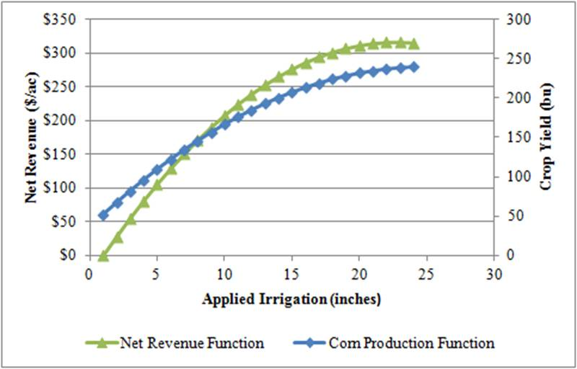
Relate irrigation to ag production and income
Calculate income from electrical generation
2 2MW wind turbines
Added annual income= $67,184
vs ~$12,000 for land lease
Income:
4MW x 365x24 hours/year x
45% x Production factor
$.038/kwh x Price for electricity
1000kw/Mw =
$599,184 Total
Expenses:
O&M $124,000 +
loan payment $408,000 Total
For long forecasts include aquifer projections from KGS groundwater models

Slide 28
2. Define Framework
3. Make Choices
Key knowledge
Select, then click here for defaults
Consequences
Agri-culture
Wind and Solar Energy
Water
Climate
Graph end year: 2050
Click for default
1. Select your location and area
FAQs

Slide 29
2. Define Framework
3. Make Choices
Key knowledge
Select, then click here for defaults
Consequences
Field Crops
Ranching
Use county defaults for crops, water, fertilize, prices, etc.
Choose via Crop Water Allocation from KSU CWA
Agri-culture
OR
Wind and Solar Energy
Wind turbines Solar panels
Buy Lease Rent land
Electric generation potential:
Wind speed map is HERE
Solar map is HERE
Irrigation: Fresh Groundwater
Water
HPA map from KGS is HERE
Stories from your region are HERE
Climate
Graph end year: 2050
Click for default
1. Select your location and area
FAQs
Is it local pumping that is depleting the groundwater? Click here
How does weather variability affect agricultural income? Click here
558 acres

Slide 30
2. Define Framework
3. Make Choices
Key knowledge
Select, then click here for defaults
Consequences
Field Crops
Ranching
Use county defaults for crops, water, fertilize, prices, etc.
Choose via Crop Water Allocation from KSU CWA
Subsidies, insurance Options
Phase in period for irrigation change: 5 years
First year: 2017
Average past annual farm income: $32,000
Agri-culture
OR
Wind and Solar Energy
Wind turbines Solar panels
Buy Lease Rent land
Electric generation potential:
Wind speed map is HERE
Solar map is HERE
Wind turbines 2 2 MW @.
Loan: 20 years APR 4%
Grid connection needed
Irrigation: Fresh Groundwater
Reduce irrigation by 25% of 5 year average.
Years to unable to irrigate?
Calculate
Soil condition? Poor
Water
HPA map from KGS is HERE
Stories from your region are HERE
Climate
Graph end year: 2050
Click for default
1. Select your location and area
FAQs
Is it local pumping that is depleting the groundwater? Click here
How does weather variability affect agricultural income? Click here
558 acres

Slide 31
2. Define Framework
3. Make Choices
Key knowledge
Select, then click here for defaults
Consequences
Field Crops
Ranching
Use county defaults for crops, water, fertilize, prices, etc.
Subsidies, insurance Options
Phase in period for irrigation change: 5 years
First year: 2017
Average past annual farm income: $32,000
Reduced crop production caused by reduced irrigation (0%=no change)
Year: Average Drought
Crops 10% 90%
Livestock 15% 95%
Probability 50% 5%
Agri-culture
Choose via Crop Water Allocation from KSU CWA
OR
Based on location and DPS from climate
Wind and Solar Energy
Wind turbines Solar panels
Buy Lease Rent land
Electric generation potential:
Wind speed map is HERE
Solar map is HERE
Wind turbines 2 2 MW @.
Loan: 20 years APR 4%
Grid connection needed
$3M/turbine = $6M Life 20 yrs
Grid connection: $400,000/turbine
O&M: $31,000/yr/MW=$124,000 Electric price: $.038/KWH.
Factors: Grid 100% Production 45%
Irrigation: Fresh Groundwater
Reduce irrigation by 25% of 5 year average.
Years to unable to irrigate?
Calculate
Soil condition? Poor
Precipitation 14” per year
Time to dry farming at historic pumping rates: 2054. See map
Years added per area-wide 25% pumpage reduction: 5-10
Water
HPA map from KGS is HERE
Stories from your region are HERE
Climate
Assume: average change temp +2º F , precip +0% to 2080. Drought probability scenario (DPS) A. If temperature increases, precipitation must increase to see the same drought probabilities.
Graph end year: 2050
Click for default
1. Select your location and area
FAQs
Is it local pumping that is depleting the groundwater? Click here
How does weather variability affect agricultural income? Click here
558 acres

Slide 32
2. Define Framework
3. Make Choices
Key knowledge
Select, then click here for defaults
Consequences
Field Crops
Ranching
Use county defaults for crops, water, fertilize, prices, etc.
Subsidies, insurance Options
Phase in period for irrigation change: 5 years
First year: 2017
Average past annual farm income: $32,000
Reduced crop production caused by reduced irrigation (0%=no change)
Year: Average Drought
Crops 10% 90%
Livestock 15% 95%
Probability 50% 5%
Average annual income reduction after water use change implemented: 25%
(0%=no change), to $24,000.
Agri-culture
Choose via Crop Water Allocation from KSU CWA
OR
Based on location and DPS from climate
Wind turbines Solar panels
Buy Lease Rent land
Electric generation potential:
Wind speed map is HERE
Solar map is HERE
Wind turbines 2 2 MW @.
Loan: 20 years APR 4%
Grid connection needed
$3M/turbine = $6M Life 20 yrs
Grid connection: $400,000/turbine
O&M: $31,000/yr/MW=$124,000 Electric price: $.038/KWH.
Factors: Grid 100% Production 45%
Added annual income= $67,184
Income: 4MW x 365x24 hours/year x 45% x $.038/kwh x 1000kw/Mw = $599,184.
Expenses: O&M $124,000 +
loan payment $408,000
Wind and Solar Energy
Irrigation: Fresh Groundwater
Reduce irrigation by 25% of 5 year average.
Years to unable to irrigate?
Calculate
Soil condition? Poor
Precipitation 14” per year
Time to dry farming at historic pumping rates: 2054. See map
Years added per area-wide 25% pumpage reduction: 5-10
Dryland farming delayed by 5-10 years. Use 7 years. Approximate year to start non-irrigated farming is 2061
Water
HPA map from KGS is HERE
Stories from your region are HERE
Climate
Assume: average change temp +2º F , precip +0% to 2080. Drought probability scenario (DPS) A. If temperature increases, precipitation must increase to see the same drought probabilities.
Graph end year: 2050
Click for default
1. Select your location and area
FAQs
Is it local pumping that is depleting the groundwater? Click here
How does weather variability affect agricultural income? Click here
558 acres

Slide 33
Farm Net Income Cartoon
Wind Energy Land lease agreement
No investment by the land owner
Electricity
Investor Owned Utilities (IOUs, like Westar)
and Coops (like Sunflower)
Farm net income = 3 + 0.5
From agriculture and land lease
Agricultural production
Trans-mission
Distribution
IOU or Coop
Electricity production
Electric meter
Water well
2 MW wind turbine
Notes:
IOU, like

