Slide 1
Introduction to SDG 2 Discussions
Rick Lawford
Berkeley, CA
December 9, 2016

Slide 2
Principles that guided the decisions regarding the SDGs
(from ICSU and ISSC. 2015. Review of targets for the sustainable development goals: the science perspective.)

Slide 3
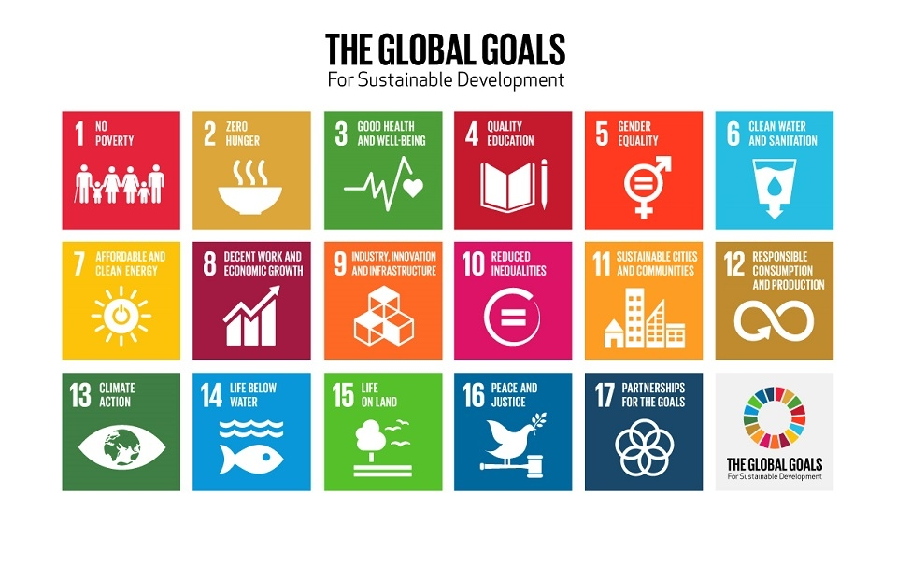
http://www.un.org/en/index.html

Slide 4
Links among SDG’s
GSDR 2015

Slide 5










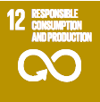
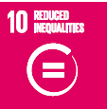

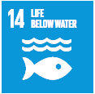
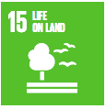
WEF Nexus and interlinkages between SDG 6
and other SDGs
Dedicated Water Goal
Directly Related
Indirectly Related

Slide 6
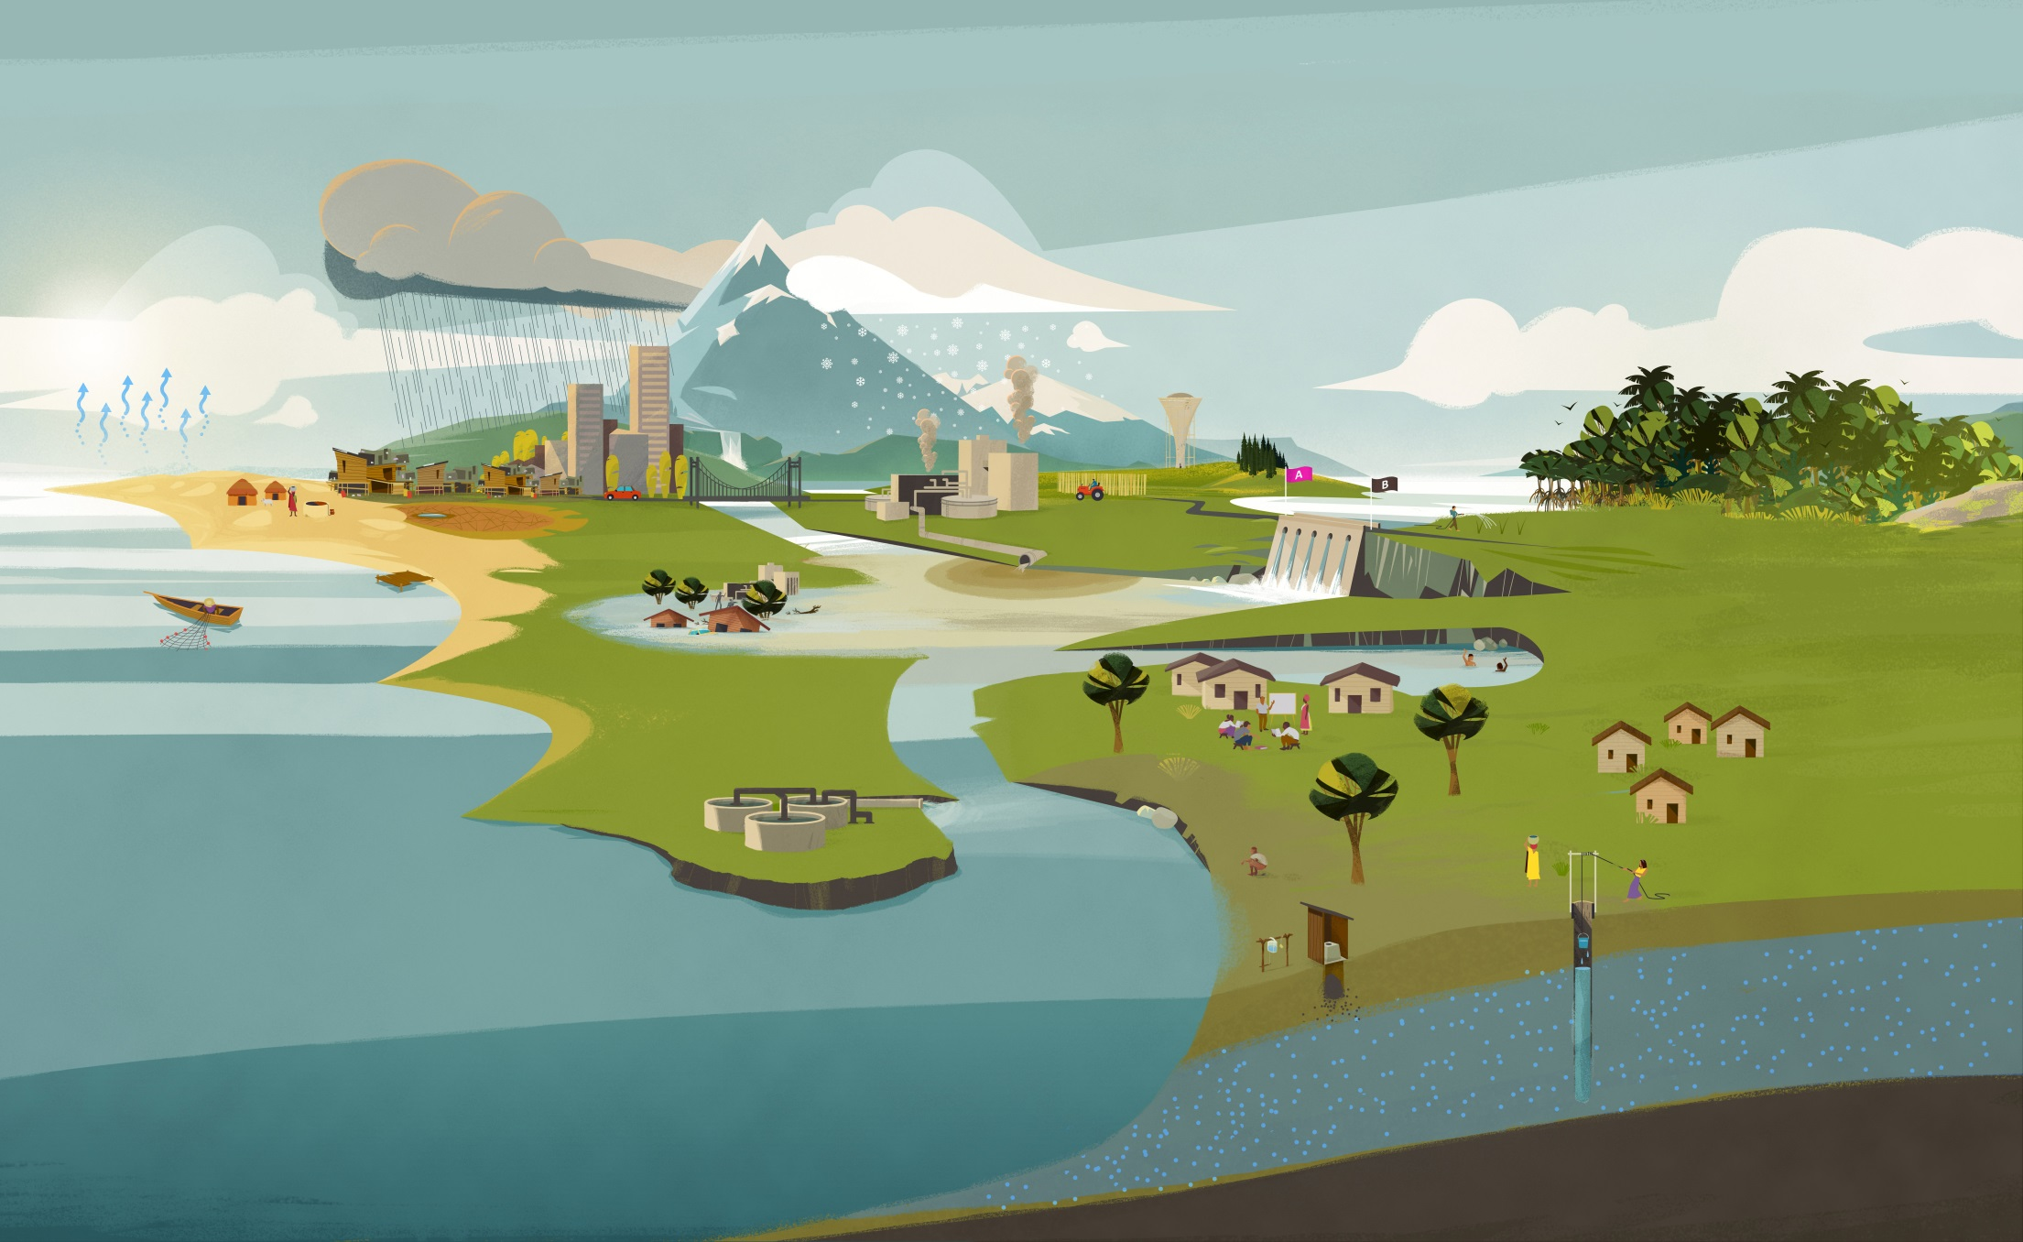
Integrated management – across sectors and regions – balancing competing needs
Industry – Food – Energy
Climate change
Scarcity – Flooding
Pollution
Recycling
Reuse
Ecosystems - Resilience
Risks related to famine, epidemics, migration, inequalities,
political instability
Human health and well-being
(source: GEMI 2016)
Notes:
Drinking water, sanitation and hygiene - pillars of human health and well-being
Water for food, energy and industrial production - potentially conflicting use - integrated management
Wastewater - water pollution - recycling and reuse
Water for healthy ecosystems - improved resilience
Climate change - shifts in water availability - water scarcity, flooding
Risks related to famine, epidemics, migration, inequalities, political instability

Slide 7
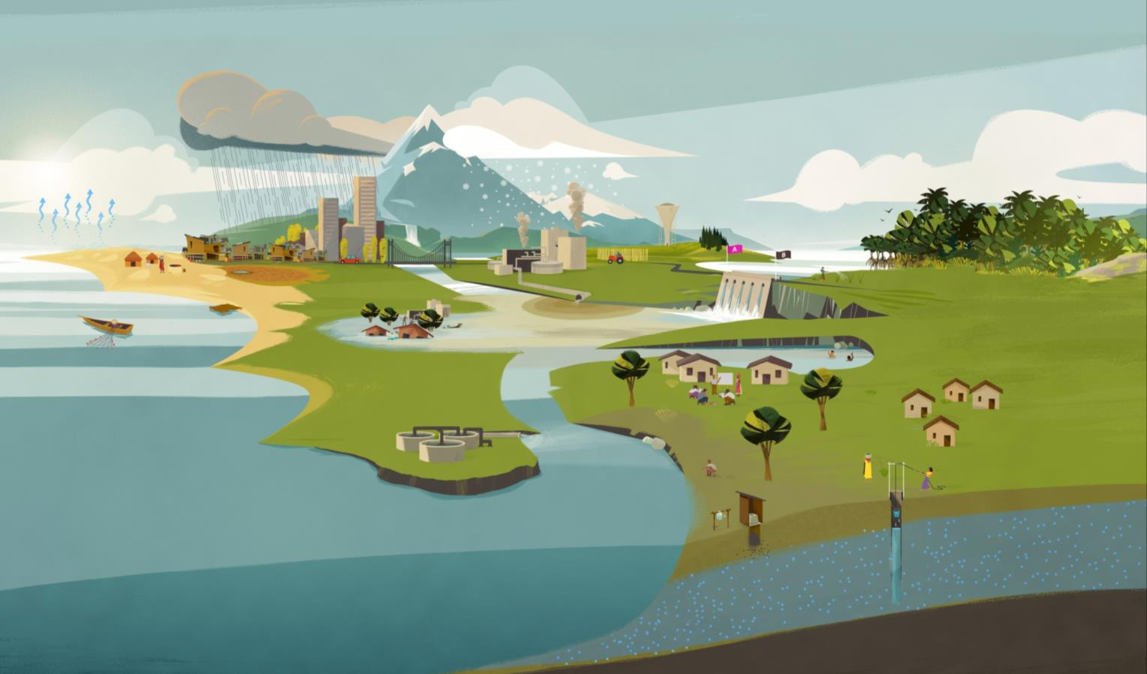
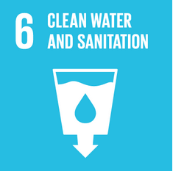
SDG 6
“Ensure availability and sustainable management of water and sanitation for all”
6.5
Water manage-ment
6.4
Water use and scarcity
6.6
Eco-systems
Integrated management – across sectors and regions – balancing competing needs
11.5
Disasters
6.a and 6.b
Cooperation and participation
6.3
Waste-water and water quality
6.1
Drinking water
6.2
Sanitation and hygiene
(source: GEMI 2016)

Slide 8
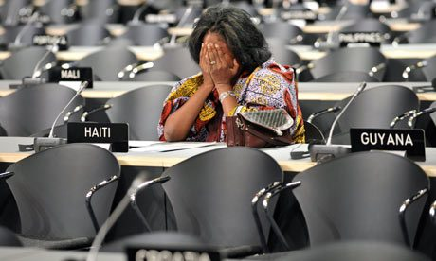
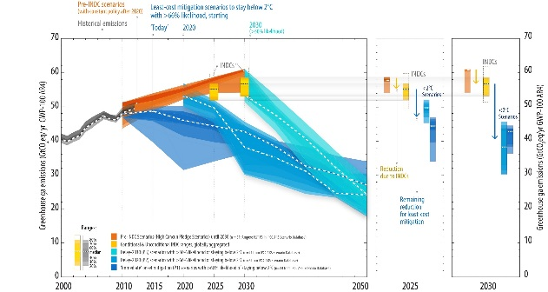
Governance through Goals
Conceptualizing a New Governance Strategy for Sustainable Development
International Regimes and MEAs
⇒ Governance through rules
Pledge what is achievable/possible
Insufficient actions
Lack of Ambitions (the level of ambitions too high)
Raise ambition
Integrated approach
Highlight non-MEA agenda （ex. SCP）
SDGs: Start with aspiration and set goals
NO implementation set forth (when goals are set)
NO legal obligations
But, monitoring and reviews
Kanie and Biermann eds (forthcoming) Governing through Goals (MIT Press)

Slide 9
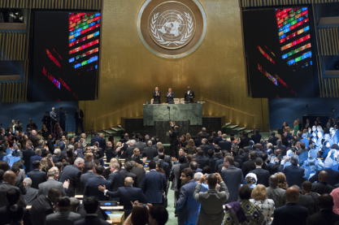
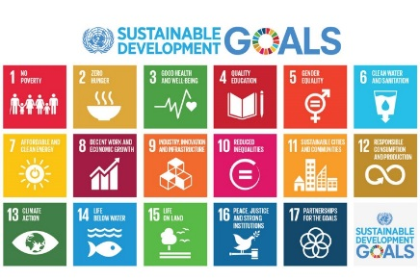
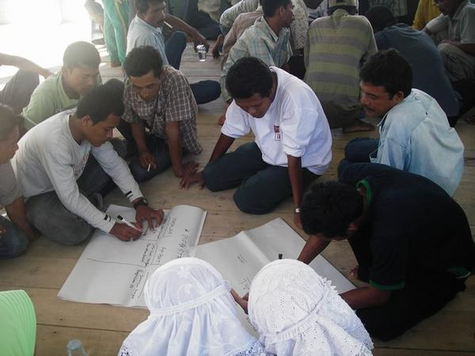
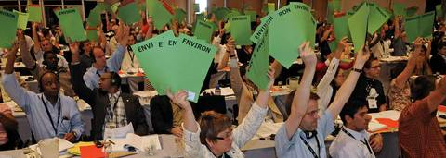
Challenges Ahead
The SDGs need to be addressed at multiple levels of governance (D.Ojima)
After the decision at the UN in September 2015, SDGs will enter into regional, national and local level making, implementation, and follow-up and review.
Implementation of the SDGs at he UN level
What will implementation mechanism of the SDGs?
What is the mechanisms to link global and national/local levels?
Regional and National level SDGs
How to make national-level SDGs?
How to make implementation mechanisms of the SDGs?
How to establish the process to get stakeholder engagement?
How to materialize integration of social, economic, and environmental sustainability?

Slide 10
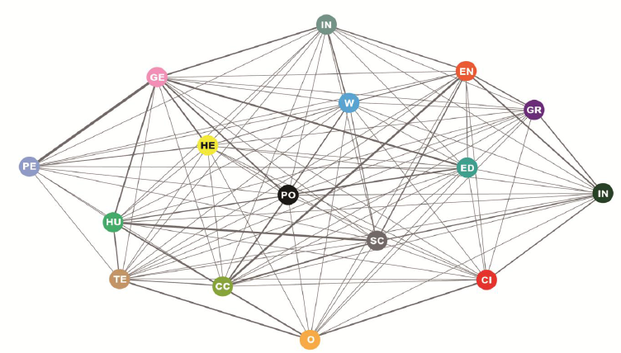
Potential of the SDGs as a national policy tool
A tool to reconsider existing (national) policies in terms of global and long-term perspectives (global standards)
Policy agenda is linked with many SDGs (i.e. nexus – food waste is about Goal 1, 2, 6, 7, 10, 12, 17, etc). Therefore, securing inter-linkages is important ⇒ SDGs function as a check-list to consider inter-linkages
Potential to be utilized for “exporting” [good] policy practices to other countries through the Multi-stakeholder Forum on Science Technology and Innovation for the SDGs and/or HLPF
都市
不平等
気候変動
インフラと産業
教育
海洋
エネルギー
平和的でインクルーシブな社会
ジェンダー
貧困
成長と雇用
持続可能な消費と生産
健康
陸域生態系
飢餓
水

Slide 11
Future Earth Knowledge Action Networks
Knowledge-Action Networks are collaborative frameworks that facilitate highly integrative sustainability research with the aim to generate the multifaceted knowledge required to inform solutions for complex societal issues

Slide 12
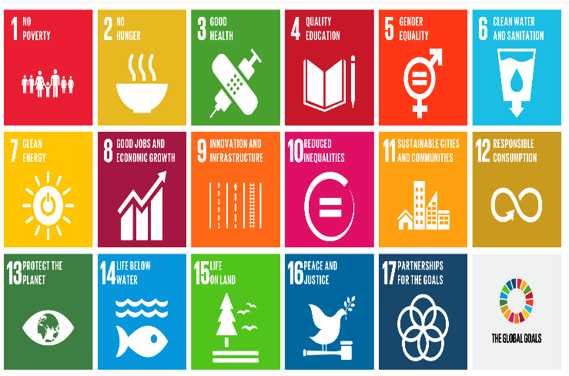
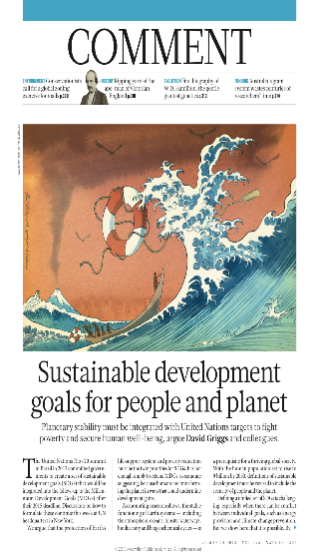
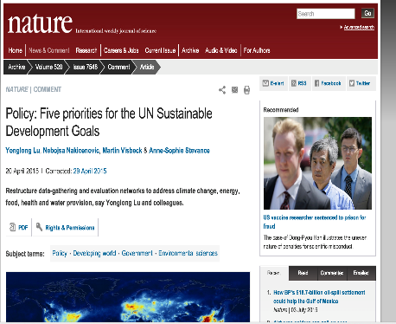
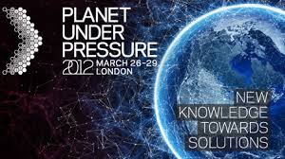
FE Collaborative Science for SDGs
Systemic Understanding
Reviewing Targets
Developing indicators
High Level Political Forum
Global SD Report
Foresighting + science policy architecture
SDG Monitoring & Governance
2015
2012

Slide 13










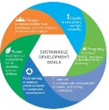
Knowledge-Action Network initial set
Themes Challenges | Dynamic Planet | Sustainable Development | Transformations to Sustainability
1. Water, food, energy for all
2. Decarbonise socioeconomic systems & adapt
3. Safeguard natural assets
4. Build healthy, resilient cities
5. Sustainable rural futures
6. Improve human health under GEC
7. Sustainable consumption and prod’n
8. Social resilience to future threats
Food-Energy-Water Nexus
Transfor-
mations
Future Oceans
Natural assets
Future cities
Future health
Finance and economic systems
$
SDGs

Slide 14

Global Sustainable Development Report
- A mechanisms for enhanced science-policy interface -
GSDR: official mandate by the 2030 Agenda
  GSDR to inform reviews of the new agenda / SDGs
Assessment of assessment approach
  Not prescriptive
  Policy relevant
An window of opportunity for science engagement in the HLPF and sustainable development policies in the UN

Slide 15
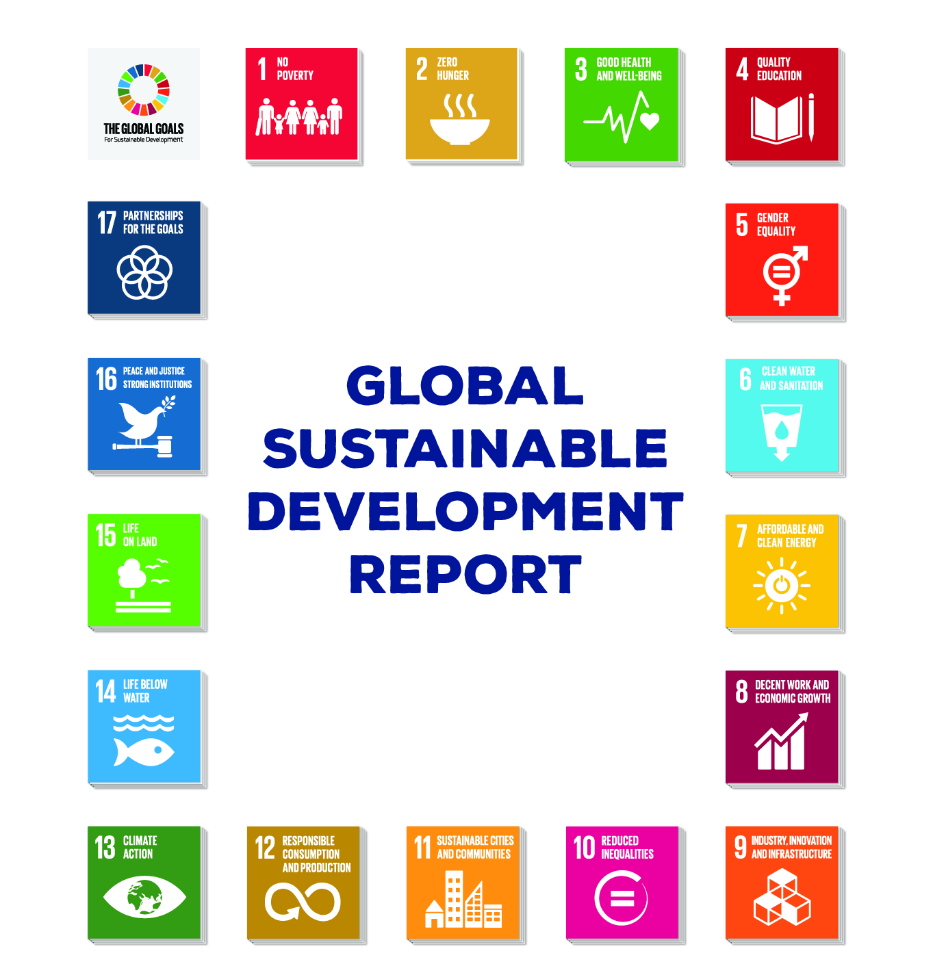
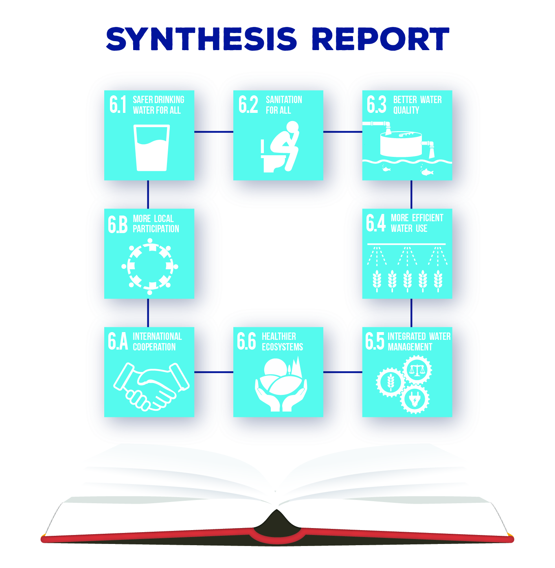
Synthesis Report
(first edition will be published in May 2018)

Slide 16
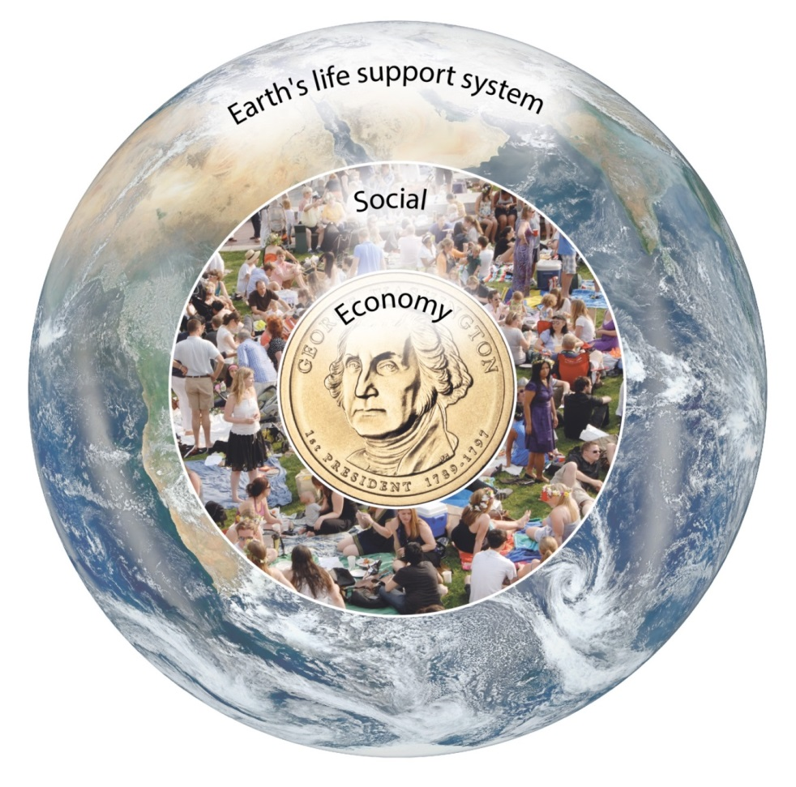
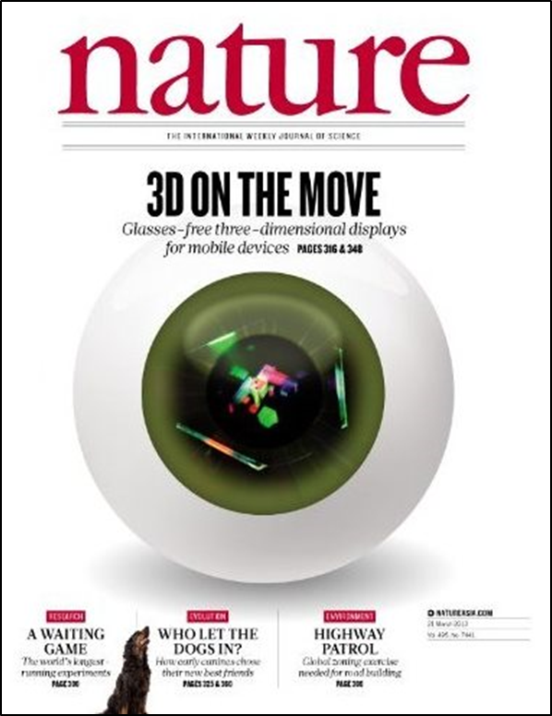
Integration is a key for “Sustainable Development” in the 21st Century
SD
Sustainable development is development that meets the needs of the present without compromising the ability of future generations to meet their own needs. （Brundtland Report, 1987)
ENV
SOC
ECON
Changing relations between human and the Earth
→ re-definition of Sustainable Development (from pillars to nested)
Anthropocene
Development that meets the needs of the present while safeguarding Earth’s life-support system, on which the welfare of current and future generations depends
David Griggs, Mark Stafford-Smith, Owen Gaffney, Johan Rockstrom, Marcus C Ohman, Priay Shyamsundar, Will Steffen, Gisbert Glaser, Norichika Kanie and Ian Noble, ‘Sustainable Development Goals for People and Planet.’ Nature (Vol 495, 21 March 2013).

Slide 17
International Science-Policy Interface
Integrated framework (SDG’s)
  Goals, Targets, Indicators
Observations and Data (GEO)
Analytics and Information (SDSN: World 2050)
Assessments (e.g., IPCC, IPBES, GEA)
Bottom line: 1) Visioning and facilitating integration should be a top priority for the science community. What is the best way to proceed with this challenge.
2) While metrics and monitoring to assess progress are good, science has much more to offer to achieving SDGs, including providing evidence to show people how to live sustainably today.

