Slide 1
Possible directions for integration: The WEF Nexus and SDGs
(From a Draft Discussion Paper)
Richard Lawford Berkeley CA
December 9, 2016

Slide 2
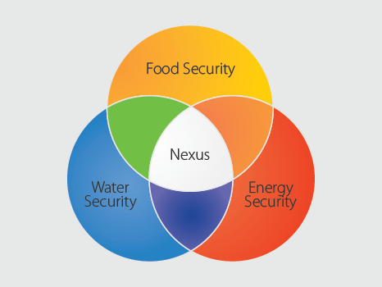
What do we mean by the Nexus?
There are many Nexus combinations.
Why choose the WEF combination?
Name recognition in policy circles (World Economic Forum has identified it as one of the 3 greatest risks to the world economy),
It has strong links to the SDGs (three fundamental targets that permeate the SDGs.)
It has a clientele at both national and international levels.
70% of the consumed
water
33% of
the global
energy

Slide 3
The Water-Energy-Food (WEF) Nexus is a transformational approach to addressing the planning and management of the three sectors in a way that maximizes their efficiencies and benefits and at the same time minimizes the effects of the Nexus on health, ecosystem services and the economy.
In 2015, Future Earth and the Sustainable Water Future Programme (SWFP) launched a study to explore the use of integrated information and improved governance for enhancing the sustainability of the Water-Energy-Food (W-E-F) Nexus. Four regional workshops have been held and a synthesis report is being developed.

Slide 5
Goal: (Overall objective)
Target: (individual outcomes that represent the objective by the goal for the sector)
Indicator: something measurable that can be used to examine if the country is approaching the target or getting further from it.
(3 Tiers):
1. Ready to monitor
2. Information exists but it is not accessible
3. Information does not exist

Slide 6
2. End hunger
.2.4. By 2030, ensure sustainable food production systems and implement resilient agricultural practices that increase productivity and production, that help maintain ecosystems, that strengthen capacity for adaptation to climate change, extreme weather, drought, flooding and other disasters and that progressively improve land and soil quality
2.4.1 Proportion of agricultural area under productive and sustainable agriculture

Slide 7
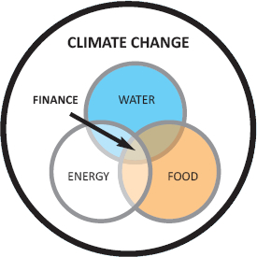
Food
Food
for all
NEXUS
Water
Energy
Water
for all
Energy
for all
A
B
C

Slide 8
Information gaps exist in the W-E-F Nexus
Table 1. Interactions of water with the food and energy sectors.
Water | Potential Data Sources
Source water for irrigation | FAO (AQUASTAT) Water withdrawals for agriculture
Source water for fracking | No data sources
Water used for biofuel production and processing | Does not appear to be monitored
Wastewater reclamation | FAO (AQUASTAT)
Water for food processing | FAO (AQUASTAT)
Decreased lake water quality from fertilizers and pesticides | No data source
Thermally polluted water from power plants and industry | No data source
Urban water demand | No data source
Similar gaps exist for food, energy and land

Slide 9
Climate Change Effects on the W-E-F Nexus and the SDGs
Direct effect of carbon dioxide: Increasing atmospheric carbon dioxide may reduce the water need and increase the productivity of plants
Indirect effects: Increased atmospheric carbon dioxide changes the Earth’s radiation balance and the atmospheric circulation affecting evaporation and evapotranspiration rates, precipitation patterns, extreme events, including drought events, rates of crop growth and productivity, water availability, and water and energy use.
Responses to targets for reduced carbon emissions: Commitment by governments to keep CO₂ at levels that will not allow a warming of more than 2ºC above historic averages will lead to reducing carbon emissions will impact the energy sector as well as food production and processing. These decisions will have on the WEF Nexus and on the water, energy, and food targets.
The Challenge: To implement Climate Change adaptation in a way that benefits the WEF Nexus and the F, W, E SDGs. How can we best achieve this goal?

Slide 10
Opportunities for Integrated Monitoring
The Global Environmental Monitoring Initiative (GEMI) has been launched to monitor the Water SDG targets. FAO will serve as a clearing house for information related to water use (using national data submitted voluntarily to AQUASTAT)
Big data and citizen data provide opportunities to bring more information to both the WEF Nexus and to SDG monitoring. We need a strategy for exploiting these opportunities.
More independent monitoring capabilities are needed at regional and global levels to support the WEF Nexus and the SDGs. A central WEF information/knowledge platform could address multiple needs including the SDGs.

Slide 11
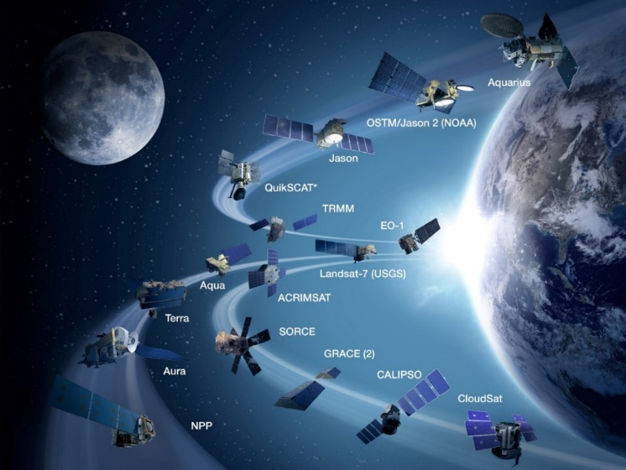
SDGs need information aggregated to the national and global scale and accumulated over several years. The WEF Nexus requires disaggregated data. Can we bring the two types of data together?
Earth Observations are most likely to play a role in monitoring water indicators 6.3.2, 6.4.1, 6.4.2, 6.5.1, and 6.6.1; energy indicators 7.2.1 and 7.2.1; and food indicators 2.3.1 and 2.4.1. How can we best exploit these opportunities in a coordinated way?
Data alone are insufficient – we need to supplement them with modelling capabilities. Actions are needed to determine the observation-modeling systems best suited to the needs of the WEF Nexus and the SDGs.

Slide 12
Mobilizing Action through Multi-level Governance.
Good governance principles imply that water governance should be participatory, accountable, transparent, responsive, consensus-orientated, effective, efficient, equitable, and inclusive, and should respect the rule of law (UN ESCAP, 2003).
To date, no existing policy frameworks explicitly address coordination of the W-E-F Nexus.
The process of SDG implementation can be instrumental in supporting transformative change at different levels. Local communities and stakeholder groups need to be involved in the implementation, in the processes of developing meaningful indicators, and in monitoring progress

Slide 13
Capacity Development and Co-leveraging the Development Agenda
Possible means for improving capacity:
- increase the nexus’ water storage capability.
- develop better infrastructure for moving produce to consumers.
- establish alternative energy systems to produce and use electricity.
- Joint planning between the W-E-F Nexus implementation plan and approaches to monitoring the relevant SDG indicators.
- Capacity building and training in technical and organizational skills to develop the human resource base.
OECD will monitor international investment in IWRM. Can OECD expand this monitoring to track aid investment in the W-E-F Nexus implementation?

Slide 14
Insights for Implementation
SDGs provide indicators with final results but limited information on how to achieve result.
The W-E-F Nexus can provide guidance and options on how to achieve the end result. How can we provide information that will influence the governments with the results that the SDGs are seeking. (We need to create a enabling policy environment to make this happen).

Slide 15
Scenario #3: EO Contributions

Slide 16
Recommendations:
- The W-E-F Nexus community should develop indicators that could illustrate progress made during the implementation process and complement the SDGs by improving the coherence of the targets with respect to the goals.
- Some of the assessments carried out by and interventions initiated through the W-E-F Nexus project could be directed at SDGs. Priority could be given to those strategies that benefit both the W-E-F Nexus and the three SDGs.
- An analysis of the Nexus elements should be undertaken to assess inequalities among sectors in different countries.
- An inventory of tools that can be used in Nexus assessments should be developed and made available to efforts involved in the SDGs.
- Modify appropriate data and information systems, governance instruments and diagnostic toolboxes being developed for the Nexus for use by the SDGs.
- The W-E-F Nexus community should build liaisons with international organisations and activities such as UN-Water and its High-level Panel on Water, GEO, and space agencies.

