Slide 1
Evidence-Based Policy Options for Implementing Goals: Knowledge Needs and Gaps

Slide 2
GEO - Define an Architecture Integrated Solutions
Earth System Models
Oceans
Ice
Land
Atmosphere
Solid Earth
Biosphere
Predictions
Earth Science Models
Oceans
Ice
Land
Atmosphere
Solid Earth
Biosphere
Earth Science Models
Oceans
Ice
Land
Atmosphere
Solid Earth
Biosphere
Societal Benefits
High Performance Computing, Communication, & Visualization Standards & Interoperability
Decision Support
Assessments Decision Support Systems
Policy Decisions
Decision Support Tools
Assessments Decision Support Systems
Decision Support Tools
Assessments Decision Support Systems
DATA
Management Decisions
Earth Observation Systems
Remotely-sensed
In situ
Monitoring & Measurements
remotely-sensed
in situ
Monitoring & Measurements
remotely-sensed
in situ
Observations
On-going feedback to optimize value and reduce gaps

Slide 6
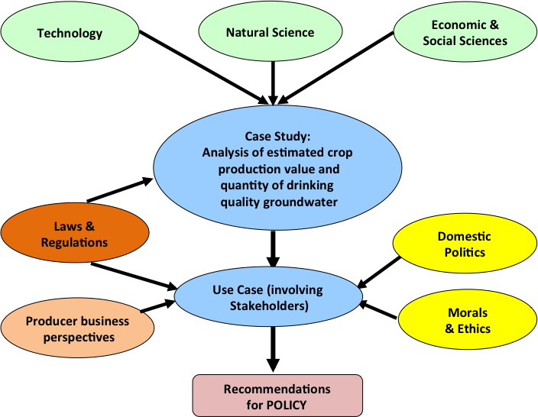

Slide 8
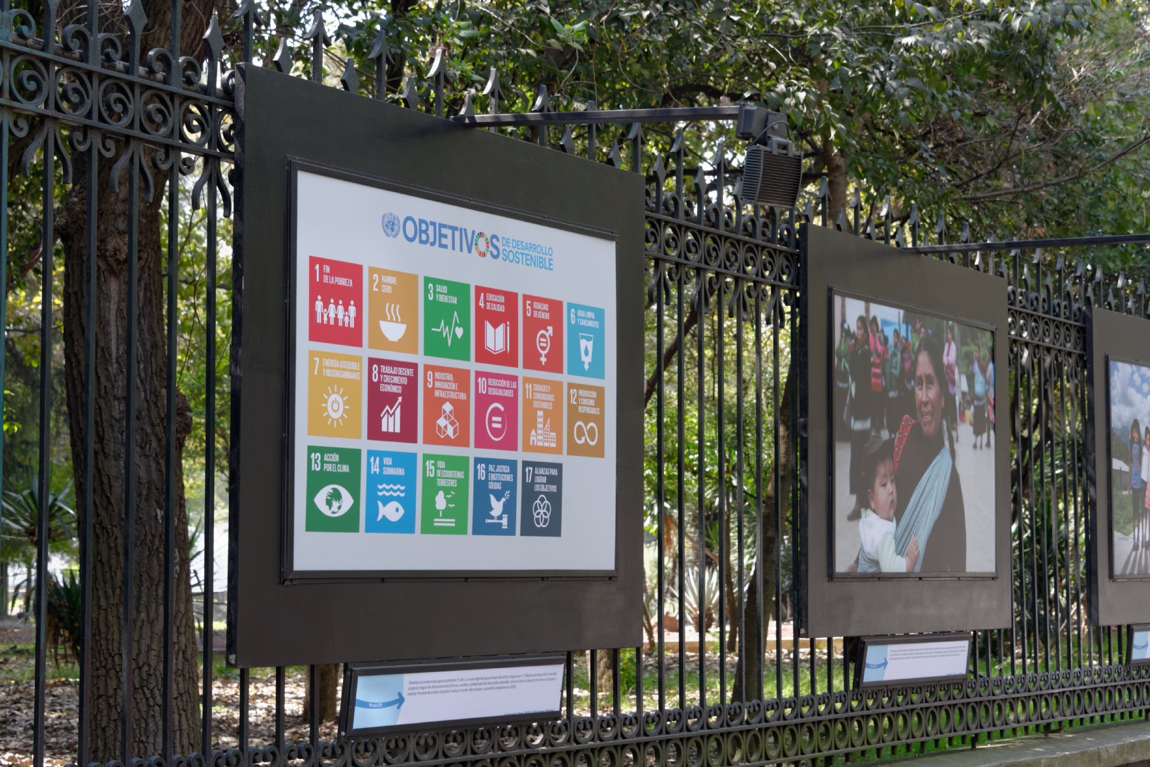
What are pathways to the creation of transformation knowledge? What are the Knowledge Needs and Gaps?

Slide 9
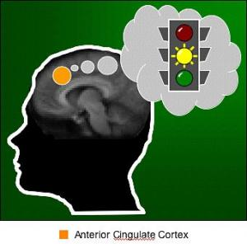
What is an
Integrated Information System?
……..Informs early warning to early action across time scales
The systematic development, analysis, and communication of relevant information about and coming from areas of impending risk to:
a) anticipate risk and opportunities and their evolution
b) inform development of strategic responses
c) communicate options to critical actors for the purposes of decision-making and response
Notes:
The whole notion of an Integrated Information System—in this case for health, is to provide a framework for sustained engagement and partnerships that support the systematic development, analysis, and communication of relevant information about and coming from areas of impending risk to:
a) anticipate risk and opportunities and their evolution
b) inform development of strategic responses
c) communicate options to critical actors for the purposes of decision-making and response
There are many early warning systems for heat, vector-borne diseases such as malaria, and air quality. An IIS provides a common integrated framework that fosters the sustained engagements needed across sectors and disciplines to accurately characterize demand, vulnerability and risk; identify information needed (including forecast, predictions and early warning but not limited to the climate and weather warnings alone) to inform decisions across time scales; effectively develop and communicate that information; evaluate effectiveness; and in turn refine the research/product/observations and surveillance needs.

Slide 10
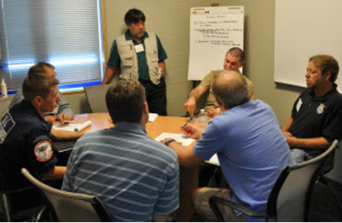
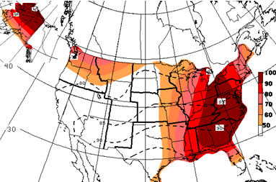
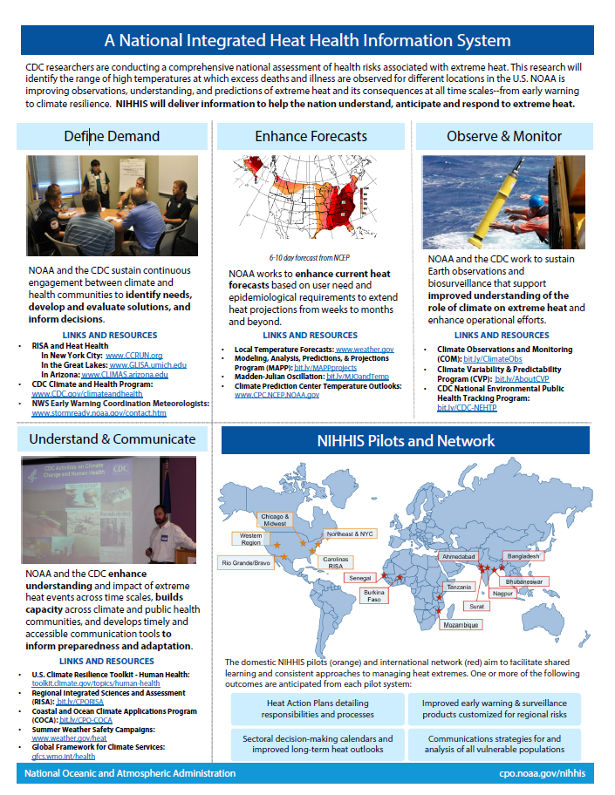
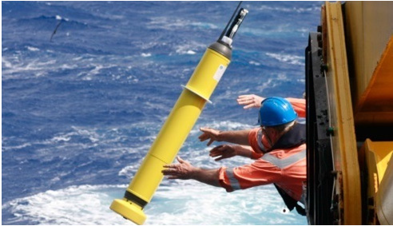
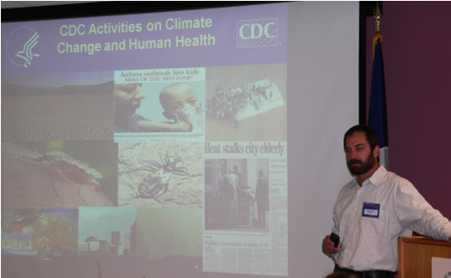
Building Integrated Information Systems: for Health
Develop and coordinate partnerships: networks of practitioners: map decision-making arrangements
Define Demand
Enhance Forecasts
Advance regionally-linked earth system observations and prediction capabilities
Construct risk profiles: the role of rates of change in trends, frequency, and magnitude of extremes at different scales
Integrated Information
Capacity and Coordination: Integrate Research, Observations, and Assessments into integrated information on critical transitions and capacity for response
Observe & Monitor
Understand & Communicate
Overcoming impediments
- Do this for a long time
10
Notes:
This is the basic structure of any Integrated Information System for Health
NIHHIS and GHHIN focus on heat health because there will be more extreme events in the future based on climate change, and this is an integrated approach to the co-production of knowledge and provision of useful information to enhance resilience to heat at multiple timescales and for multiple vulnerable populations.
Also, the science of predicting temperature extremes allows longer lead times (now 2, 3, 4 week in experimental mode in US)
And the health impacts are significant and direct as well as indirect (changes in habitat for mosquitoes, etc)
An Integrated Information System for Water-related diseases is also possible. We do have the science for predicting vibrios (of which cholera is one), for predicting extreme rainfall events and related runoff depending on data availability.
At NOAA we are operationalizing forecasts for vibrios (the species that affect shellfish and cause human illness if consumed) in coastal waters—these and related modeling efforts globally form the basis for a capacity to build an IIS for water-related illness.
10

