Slide 1
Expectations to the Workshop
9-10 December 2016
Berkeley, CA USA
Giovanni Rum
GEO Secretariat
5th GEOSS S&T Stakeholders Workshop
Developing a Collaborative Platform in Support of the Implementation and Monitoring of the Sustainable Development Goals with Earth Observation and Model-Based Knowledge

Slide 2
Background – why this theme to the Workshop ?
Contribute responding to the new challenges associated with the implementation of the 2030 Agenda
“We have an abundance of knowledge, not a shortage. Our true challenge is to better understand the needs of those implementing the 2030 Agenda so that we can more effectively match supply and demand.
We need creative mechanisms for simplifying and translating knowledge into forms that are relevant, timely and actionable.
A transformative agenda requires a new mindset, business as usual will not do. We must change the way we think and work to achieve the SDGs.
This new mindset must include a massive boost in experimentation, innovation, and capacity building at all levels – multilateral, national and local.
The 2030 Agenda requires working at an unprecedented pace. We should consider how we can improve our own organizations' ability to be responsive and agile in this fast-paced implementation period. ”

Slide 3
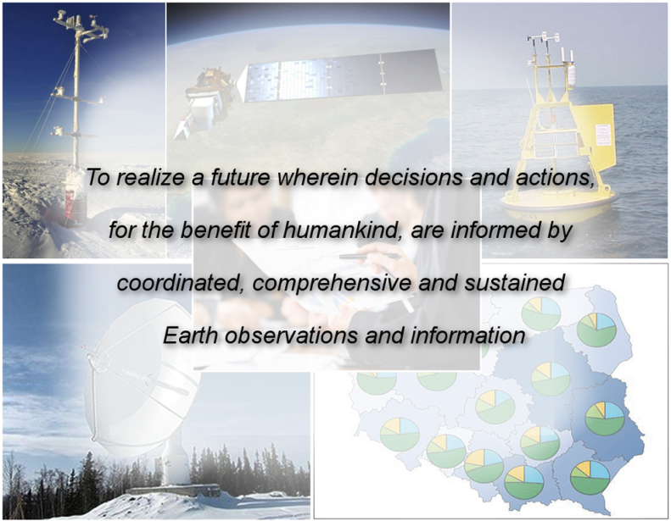
GEO Vision

Slide 4
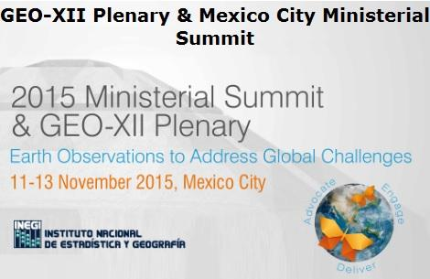
Background – why this theme to the Workshop ?
The Mexico City Ministerial Declaration (Nov 2015) calls on GEO:
to strengthen engagement with Users & Stakeholders,
with a focus on UN Institutions, Multilateral Environmental Agreements (MEAs), Development Banks, Private Sector
to launch an Initiative to leverage EO in support of 2030 Agenda
The GEO-XIII Plenary (Nov 2016) identified three priorities for engagement in :
Agenda 2030 for sustainable development
Paris Agreement on Climate Change – Greenhouse Gas Monitoring
Disaster Risk Reduction

Slide 5

GEO supports the implementation of the 2030 Agenda
Access to Data, information, Knowledge
User needs, observational gaps and associated knowledge base
Capacity Building Strategy based on the three I’s: Individual, Infrastructural, Institutional
Regional coordination to improve data infrastructure (observation, archiving, processing, dissemination) in developing countries
Advocacy for continuity & sustainability of Earth Observations
57 activities (from R&D to prototype, end-to-end products & services) addressing the role of EO in policy- and decision-making in 8 Societal Benefit Areas (SBAs)
One dedicated Initiative to support SDGs achievement: EARTH OBSERVATIONS IN SERVICE OF THE 2030 AGENDA FOR SUSTAINABLE DEVELOPMENT
GEO as a platform for cooperation
Linking providers, users, scientific and technical actors

Slide 6
Workshop Expectations
Revisit and improve our approach to meet the challenges of the 2030 Agenda
Identify the overall functions, “deliverables” and linkages (as well as target “users”) of a collaborative Platform that would allow interaction of the Science and Earth observations community with the “whole society” to develop together and implement integrated solutions to achieve the 2030 Agenda.
Identify the key actors/institutions that would need to work together
Identify what role GEO could play in the development and subsequent “operation” of this collaborative platform.

Slide 7
Thank you !
grum@geosec.org
dcripe@geosec.org
GEO Website
http://www.earthobservations.org/index.php

