Slide 1
GEO's contribution in support of SDG monitoring 9-10 December 2016 Berkeley, CA USA Giovanni Rum GEO Secretariat
5th GEOSS S&T Stakeholders Workshop Developing a Collaborative Platform in Support of the Implementation and Monitoring of the Sustainable Development Goals with Earth Observation and Model-Based Knowledge

Slide 2
Sustainable Development Goals
17 Goals
169 Targets
231 Indicators

Slide 7
What global initiatives in support of 2030 Agenda?
The key actors are the countries
UN formal process mainly focused on the indicators
Each indicator has a “custodian agency” in charge of assessing methodologies for its calculation and the data (environmental and socio-economic) necessary as an input
Several international organizations and partnerships are supporting countries in implementing SDGs from different perspectives, such as
GEO has a clear opportunity to support in different areas
Sustainable Development Solutions Network
Global Partnership for Sustainable Development Data
UN Committee of Experts on Global Geospatial Information Management
International Institute for Sustainable Development

Slide 8
What are GEO overall objectives ?
Promote the value of Earth Observations in support of the 2030 Agenda
Ensure that EO-related data and associated methods and solutions are available for all countries to use
Support countries and stakeholders to actually access and use them and build capacity
Make available its cooperation framework (through a collaborative platform) and its Community to address the new challenges facing countries in the achievement of the 20130 agenda.
Notes:
8

Slide 9
How GEO can support
GEO is member of the Working Group on Geospatial Information
Consistent with its mandate and strategic directions, GEO supports the measuring, monitoring and achievement of the SDGs
Direct measures of some Indicators, contribution to others. Integration with other data
Contribute to progress on the Targets, which will show up in the Indicators.
Consistent with the planned revision process of the Indicators’ framework, propose new indicators (mainly EO-based) to improve monitoring of Targets’ achievement
Notes:
9

Slide 10
Alignment of Earth Obs. and GEO to the Goals, Targets, and Indicators
SDGs with most opportunities:
Tier III
Notes:
Tier III Indicators included in the table we are showing in the slides (based on the Work Plans for Tier III Indicators, as of Sep 20, 2016) : 1.4.2 ; 2.4.1 ; 5.a.1; 6.3.2, 6.6.1; 9.1.1; 13.1.1; 14.3.1, 15.2.1, 15.3.1).

Slide 11
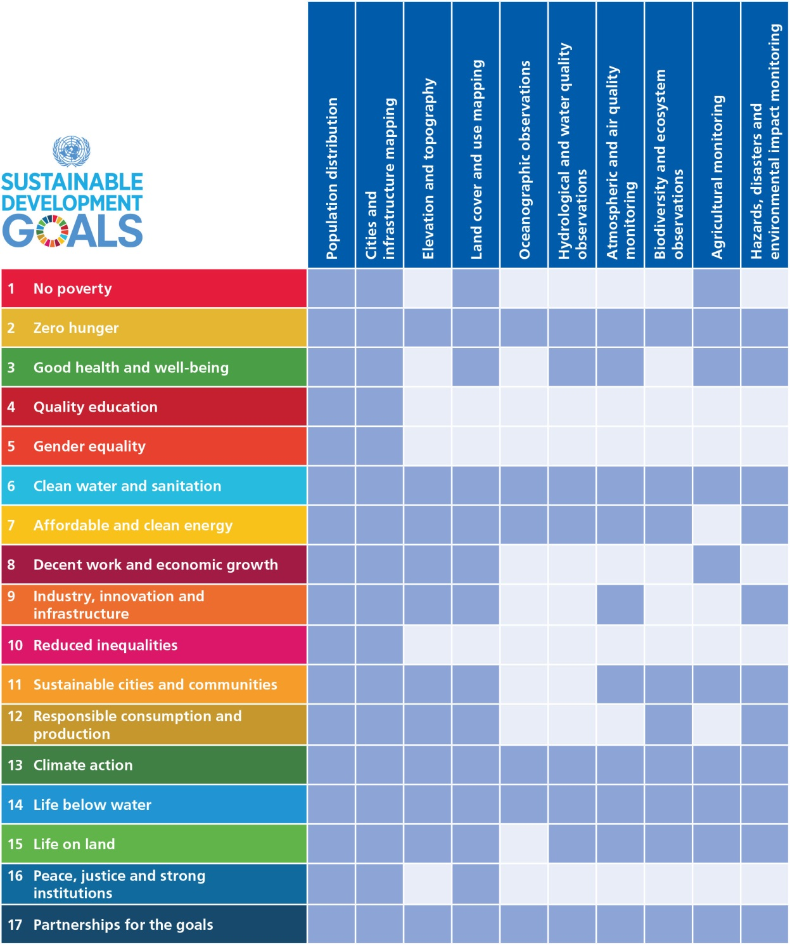
EO linkages with SDGs Goals, Targets, and Indicators
Alignments of the Goals with specific types of Earth observation and geospatial info “products”.
Notes:
Projects:
Federated approach: Other GEO tasks also relate to SDGs. GI-18 serves a coordination function - guidance, consistent approaches, quality standards
A series of pilot projects apply and test uses of Earth observations to support the assessment and tracking of the SDGs, including integration with national statistical accounts for the indicators.
Projects: Include efforts to support qualitative and quantitative evaluation on the benefits of Earth observations to enable societal benefits.
Some pilot project activities may focus on one country and address several SDG indicators; others may focus on a particular SDG indicator and apply it to several countries.
particular attention to the ability to scale a method to multiple nations or stakeholders on a regional or global scale
share smart practices and provide guidance, encouraging consistent approaches and quality standards
Capacity Building
draw on and contribute to GEO’s established capacity building activities and expertise
includes virtual and physical activities, such as trainings, webinars, joint projects, applied research, and workshops, among many other successful capacity building practices
Data and Information Products:
support GEO’s efforts to promote and encourage open data policies
Outreach:
creation and maintenance of a portfolio of materials, such as examples, stories, articles, and web features. For instance, a series of thematic examples can articulate how Earth observations relate to specific SDGs and can be integrated with traditional statistical approaches;

Slide 12
Thank you !
grum@geosec.org
dcripe@geosec.org
GEO Website
http://www.earthobservations.org/index.php

