Slide 1
European
Network of
Earth Observation
Networks
Plenary Workshop
Building a collaborative ENEON to inform policies and actions to address complex societal challenges
[Meta network in solar energy: A contribution to ENEON]
[Lionel MENARD – ARMINES/MINES ParisTech]
12 - 13 October 2016
IIASA. Schlossplatz 1 - A-2361 Laxenburg, Austria

Slide 2
Outline
Surface Solar Irradiance (SSI)
Need for SSI in-situ measurements (Focus private sector)
Bottlenecks / Opportunities to access in-situ measurements
ConnectinGEO
Platform development to support data providers
Meta-Network concept
Relevance in ENEON
Wrap up and perspectives

Slide 3
Surface Solar Irradiance
Definition: SSI is a measure of solar radiation at the surface of the Earth
Essential climate variable by the GCOS (Global Climate Observing System)
High interest in various domains:
Health (UV - Skin cancer…)
Architecture (Daylighting in building)
Agriculture (Crop monitoring)
Forestry (Biomass monitoring)
Solar Energy (PV and CSP domains)
Solar Energy Users: Policy Makers, SMEs, Industries, Research, Gov. Ag., NGO
Needs: Solar resource assessment, planning, bank loan, commissioning, monitoring, O&M, forecast

Slide 4
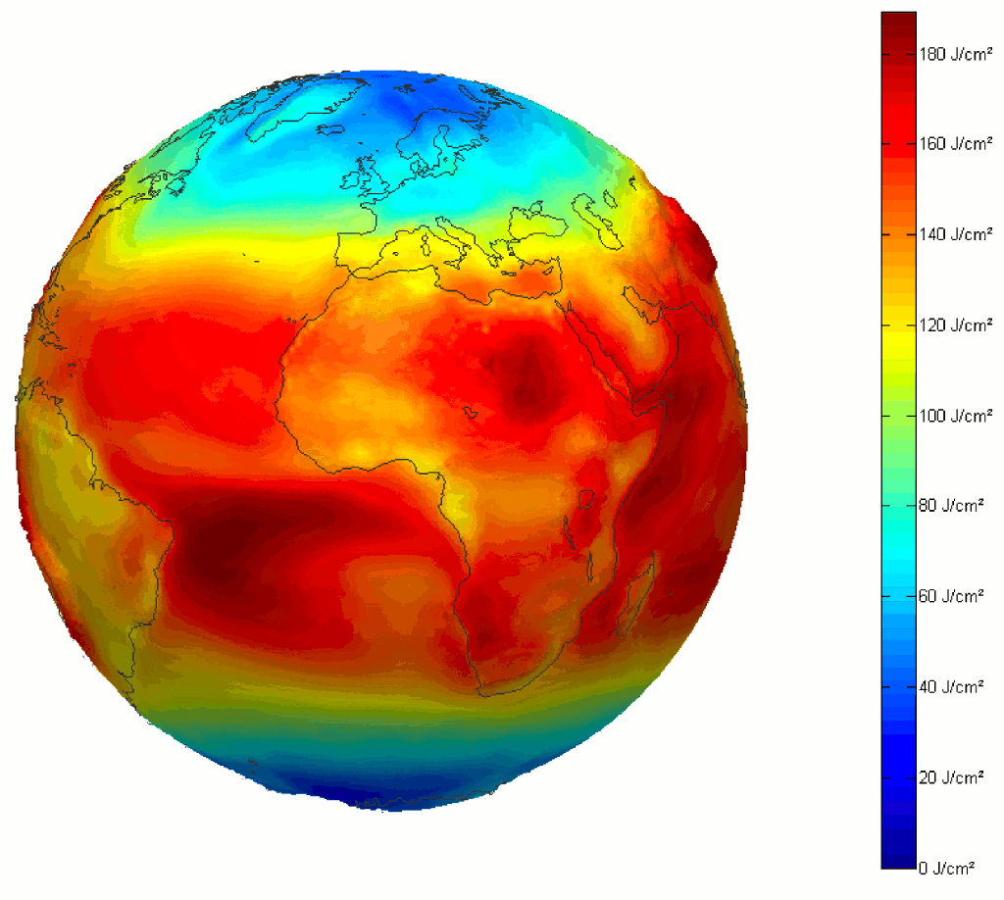
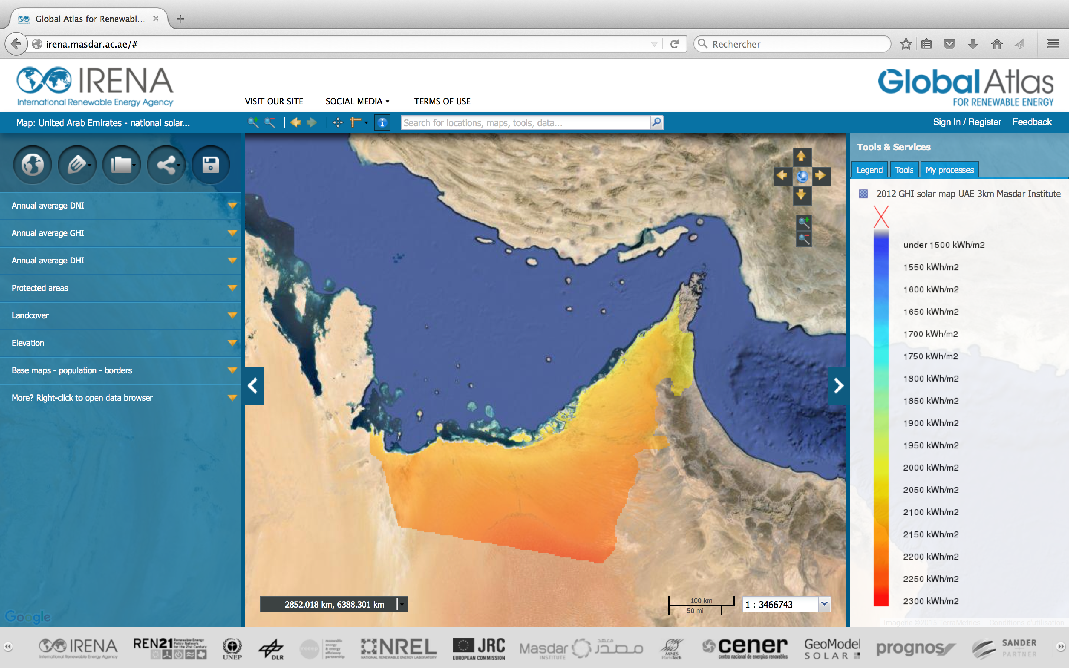
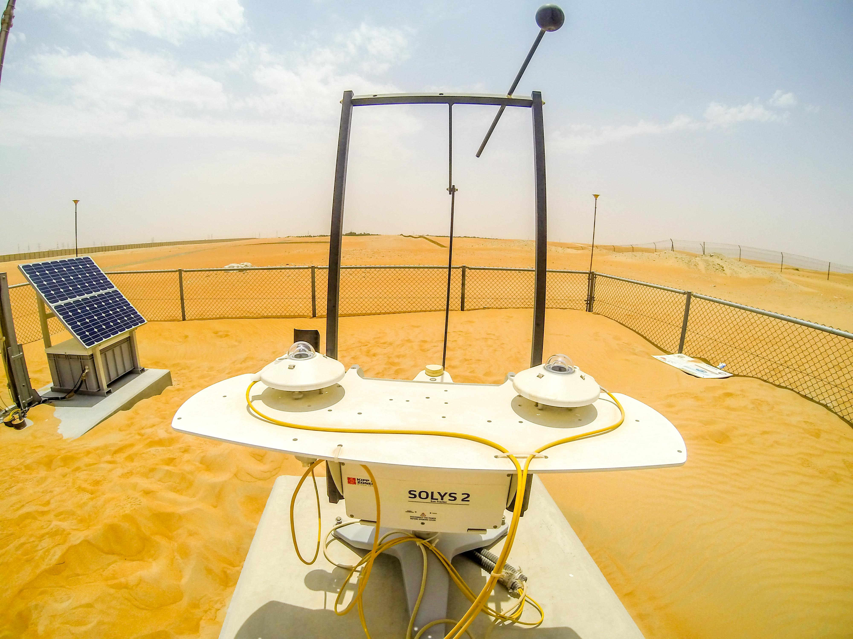
How to estimate SSI ?
Various Earth Observation (EO) components provide estimations of the SSI:
Numerical weather models (NWM), such as ECMWF-IFS or ERA-INT
Processing of meteorological satellites, such as the Copernicus Atmosphere Monitoring Service, or Eumetsat-SAFs
In-situ pyranometric sensors

Slide 5
Need for in-situ measurements
NWM and satellite data are necessary but not enough to convince investors:
For the commissioning of large-scale solar power plants
For monitoring and forecast production of these plants
In-situ pyranometric sensors provide the best possible assessment of the SSI:
They serve as a reference to assess the quality of the two other components
Project assumption from Third Step
Ground-mounted PV plant, 100 MWp (~equiv. 110 M€ cost)
Around 1100 kWh/kWp, typically North of France (Capacity factor ~12.5 %)
A 3 % error on the yearly SSI estimation -> 8% deviation on cash flow (25 y)
-> 8 M€ default on cash flow cumulated over 25 years !
In-situ measurements are crucial
for policy-makers and business development

Slide 6
Access to in-situ measurements
Bottlenecks
No major in-situ network dedicated to SSI.
Users need to contact several providers (Meteorological networks)
The spatial density of existing network is heterogeneous across the world
Lack of datasets spanning several years (Missing data)
No harmonization between providers for accessing data
Internet access to direct human-to-human phone-calls
Intellectual Property Rights
Opportunities (“Low hanging fruits”)
Investors or developers install and operate in-situ pyranometric stations
In EU several hundreds of private ground stations associated with power plants
Need to increase the number of data providers
Provide interoperable and standard access to data

Slide 7
ConnectinGEO Platform
Platform : http://insitu.webservice-energy.org
Open Source 52°North platform - OGC / SWE
Operational part of webservice-energy SDI
Web app. (easy to use) - Script based (Curl or Wget) - QGIS plugin (Under dev.)
Metadata included (import & export) – Connection to GEO/DAB
Providers
Universities, Institutions, World Bank, IRENA
Start to integrate SMEs time series (THIRD STEP, Solaïs)
8 network providers - 15 stations - 276 time-series - 1 up to 11 years – 1h to 1min
Quality Check procedures are applied to time-series (Feedback to providers)
Additional variables from models (7): Top of atmosphere, radiation under a cloud-free sky, solar zenith and azimuth angles
Platform integrates “Other Stations” (Request from stakeholders workshops)

Slide 8
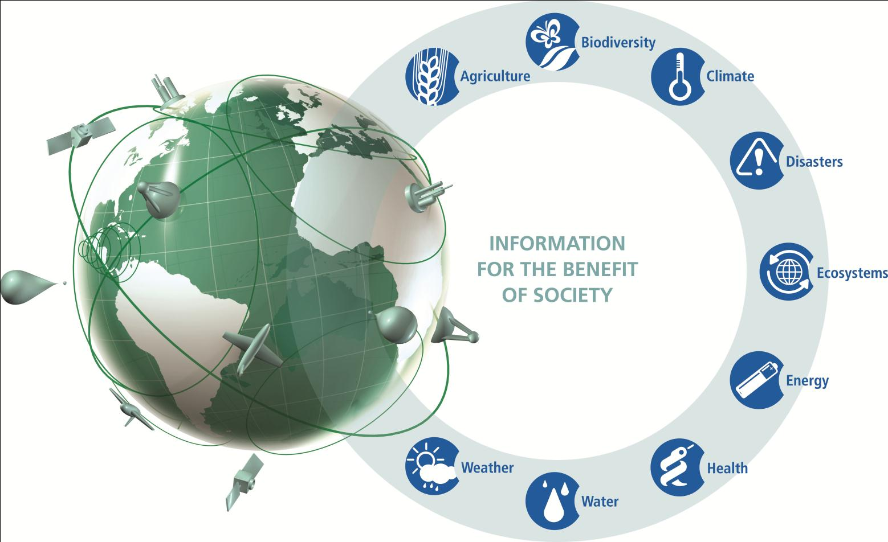
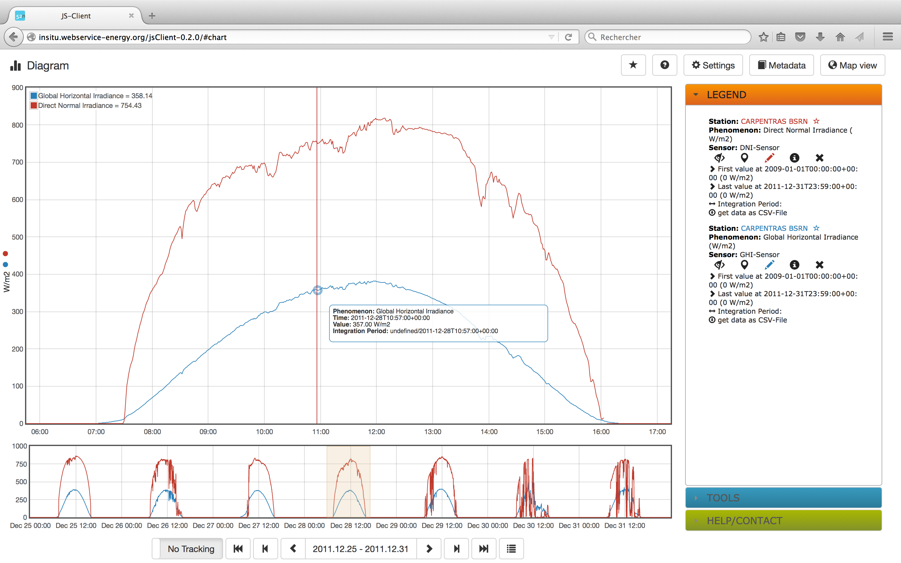
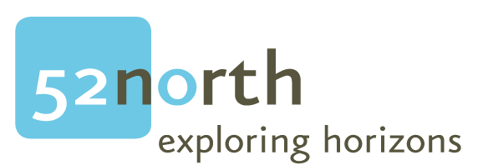
Spatial Data Infrastructure
Discovery &
Access Broker (DAB)
GCI
Geo Web Portal
Webservice-energy SDI:
Sensor Web Enablement Architecture
Open Geospatial Consortium Catalog
Connected to the GEOSS (GCI)
Weekly harvested by the DAB
Sensor Web JavaScript Client

Slide 9
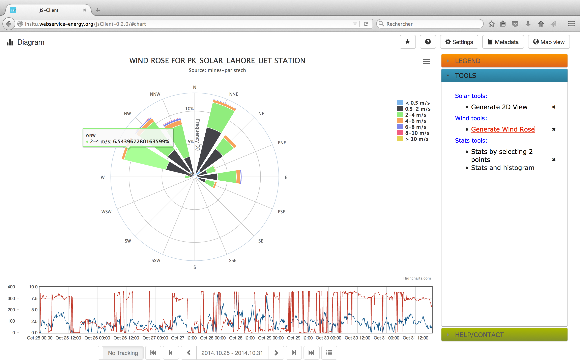
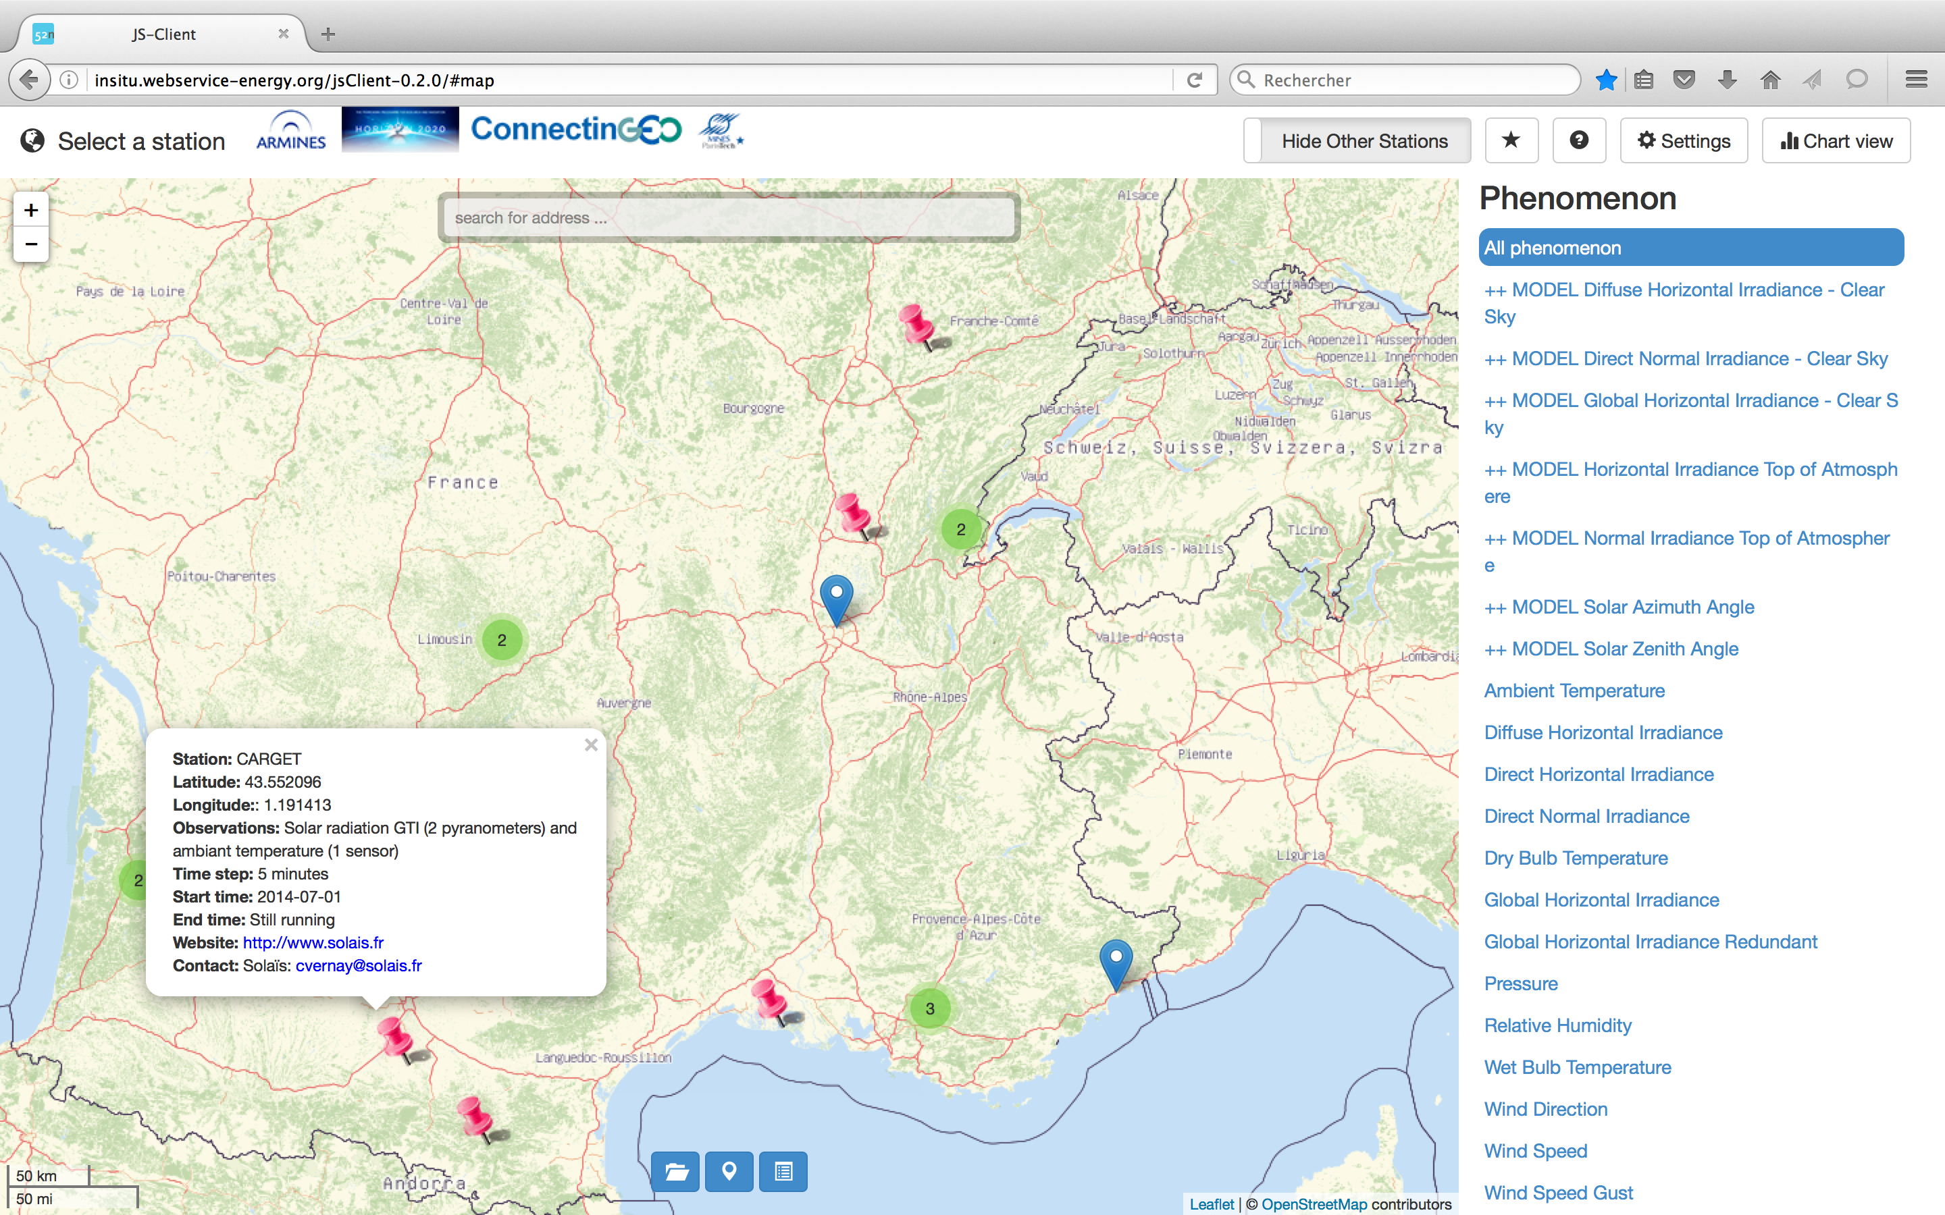
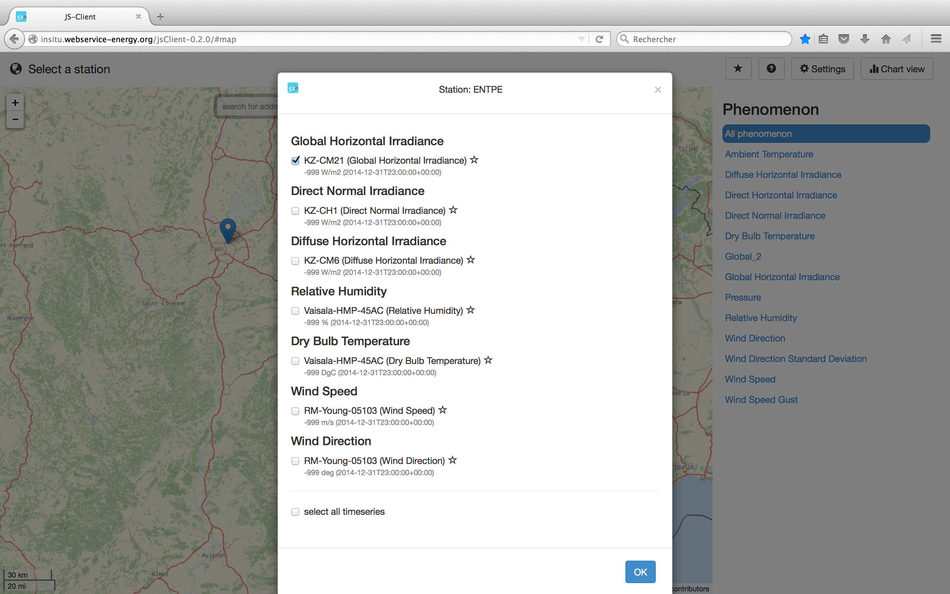
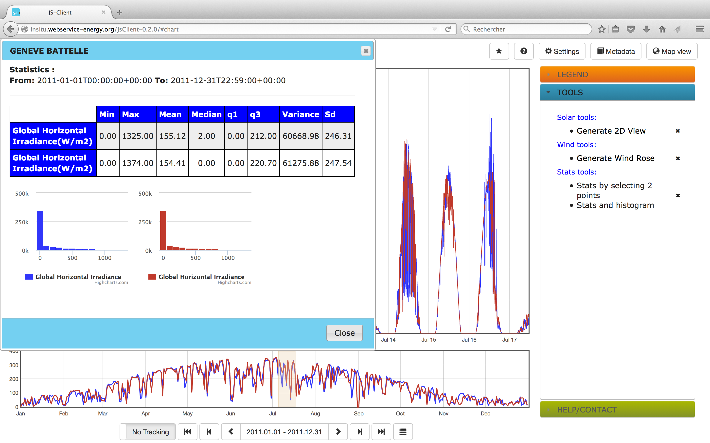
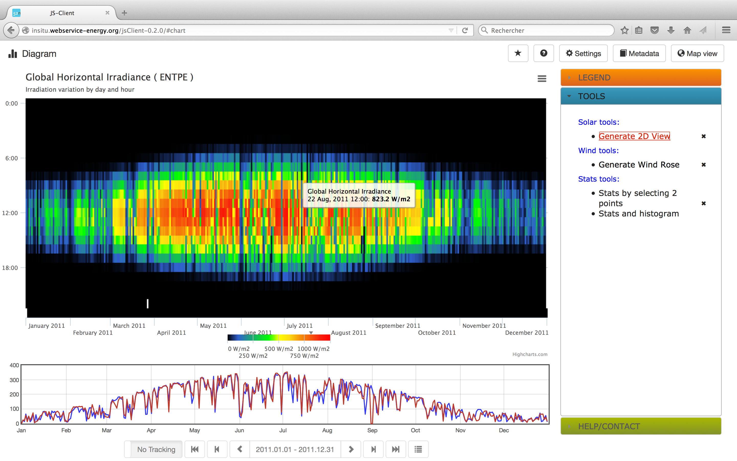
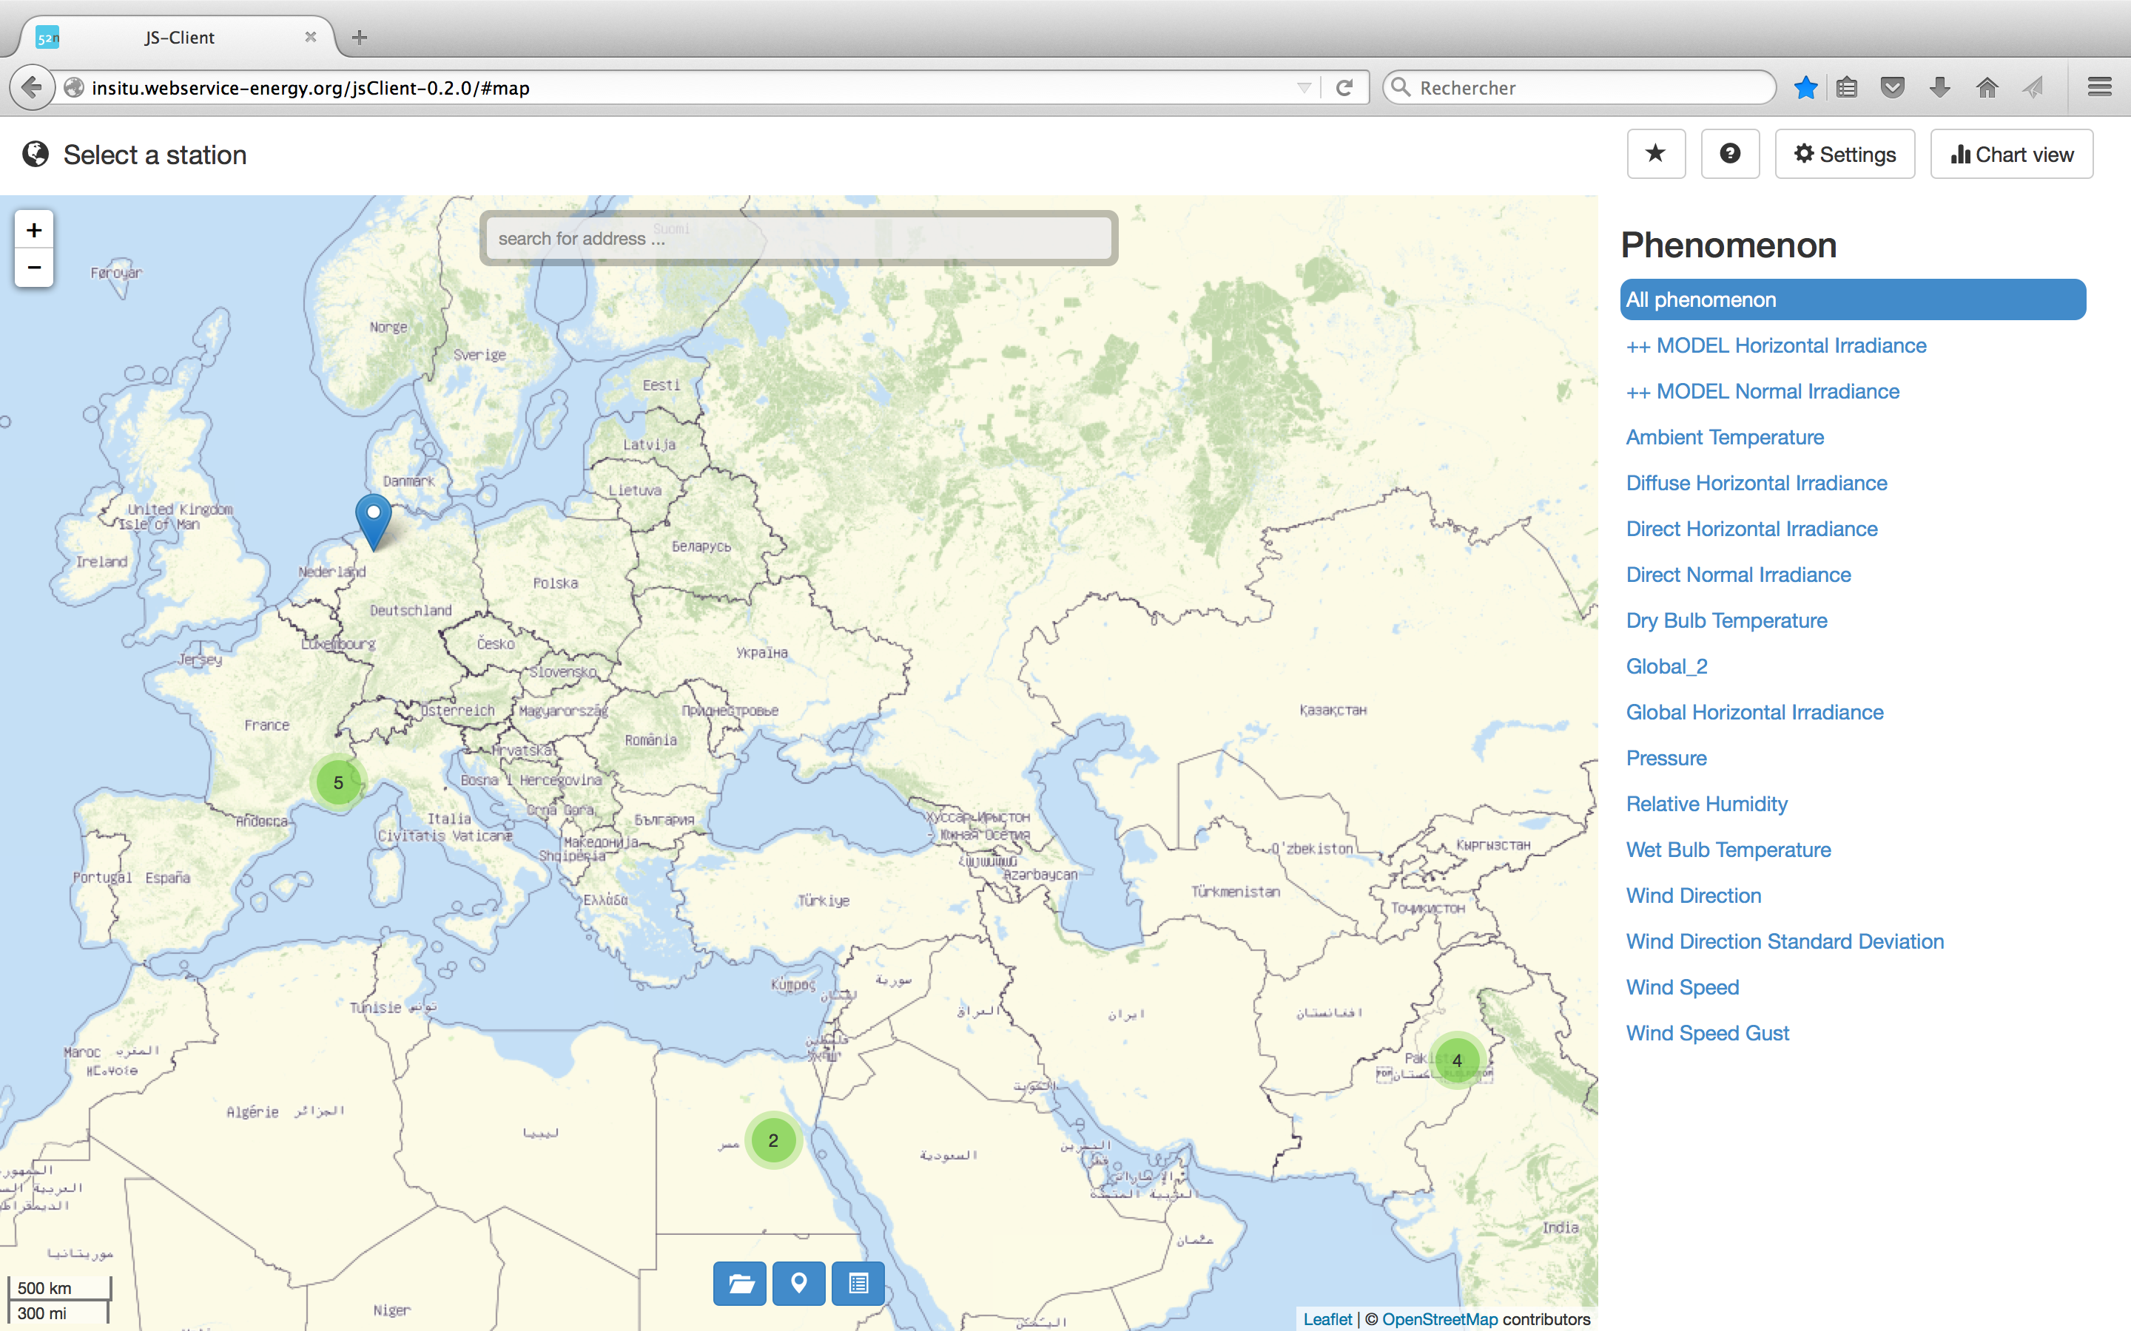
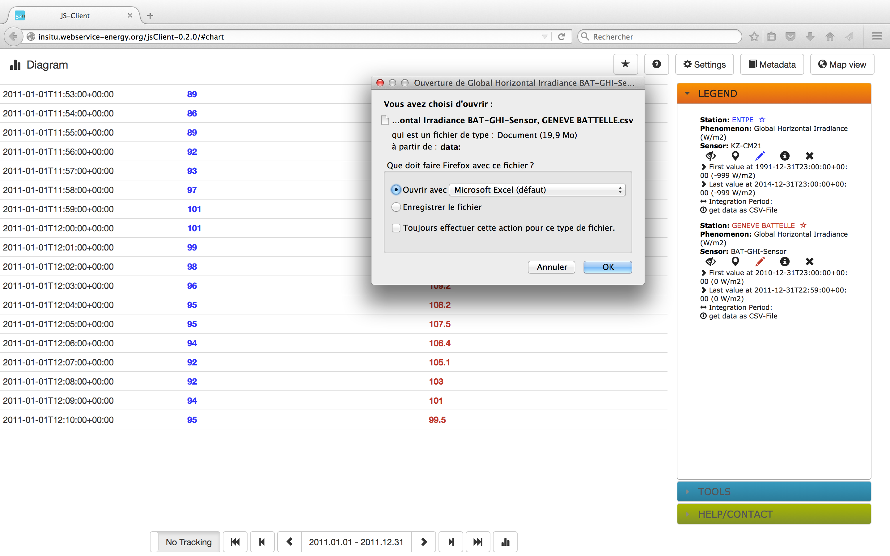
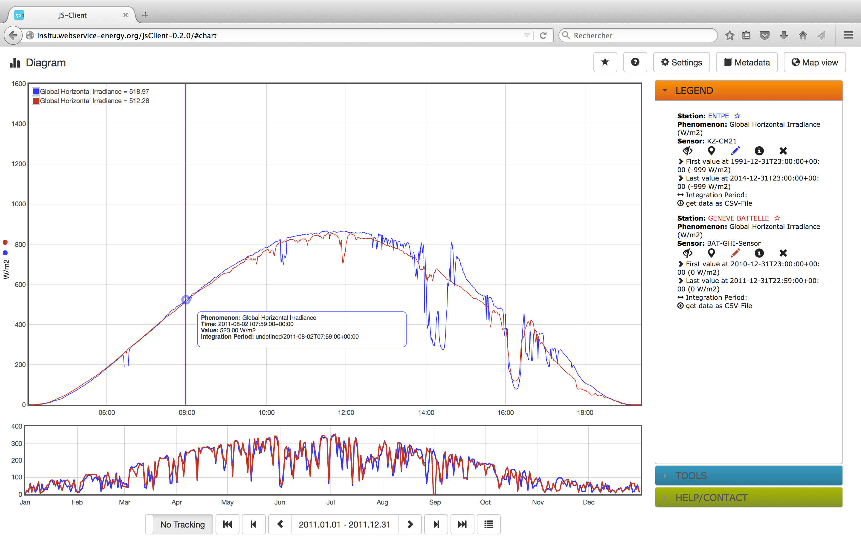
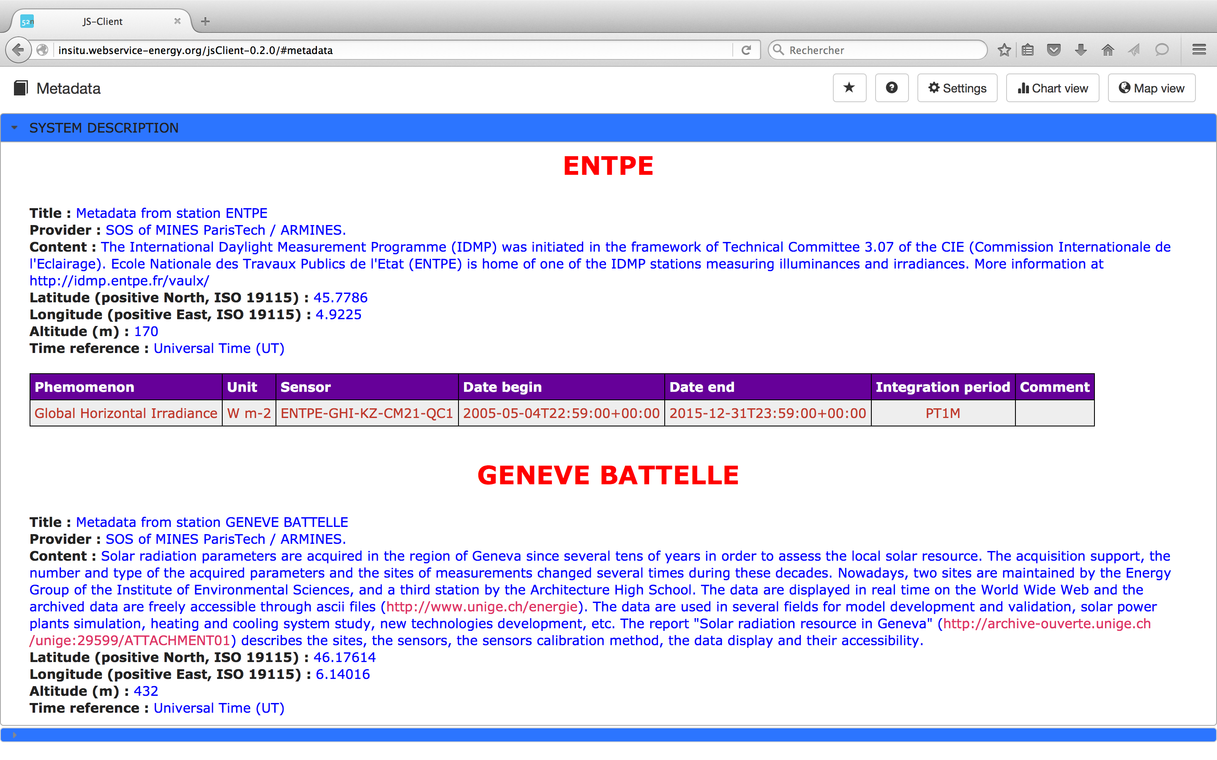
http://insitu.webservice-energy.org

Slide 10
Major lessons learned
Huge potential of in-situ data from several hundreds of private ground stations in EU
No need of extra money to deploy such sensors (“Low hanging fruits”)
Existing private ground stations already located in favorable areas
SMEs are not reluctant to share their in-situ measurements
SMEs interested in having access-to or locate such data for their business
SMEs very interested in known and recognized Quality Check (QC) procedures
Other untapped networks (Universities, Weather Bureaus, Gov. Agencies, NGO’s)
ENEON for a step forward

Slide 11
Meta-Network – Solar Energy
Global Network
WRDC
BSRN
GAW
….
Micro Network
Investors PV Plants
University, research institutes, NGO
META-Network
ENEON
Actions
Gaps Measurements
Gaps Data Model
Gaps Collaboration
Platform

Slide 12
Relevance to ENEON Roadmap
Renewable Energy Ambassador: ARMINES
Purposes
Spatial harmonization of EO in-situ data
Spatio-temporal continuity of the observations
Harmonization among standards (sensorML, etc)
Open to
The GEOSS S&T Stakeholder Network and Communities or Practice
Copernicus in‐situ segment
Representatives of the SME's the private sector
Outputs
Reemphasizing the political strategic targets
Create opportunities for SMEs to develop products based on the current networks

Slide 13
Wrap up and perspectives
Outcomes
Positive feedback from SMEs and institutions toward an operational system
Tackling gaps in ConnectinGEO
Increase number of providers
Improvements in platform and data model
ENEON as the institutional umbrella to engage public and private sectors
Steps forwards
Need for coordination between providers, users and system operators -> ENEON
-> Define a sustainable development model
-> Support long-term B2B economic activities

Slide 14
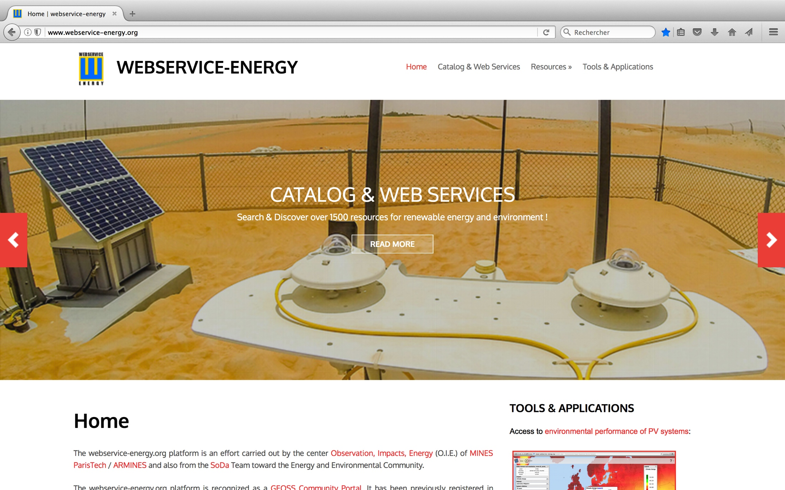
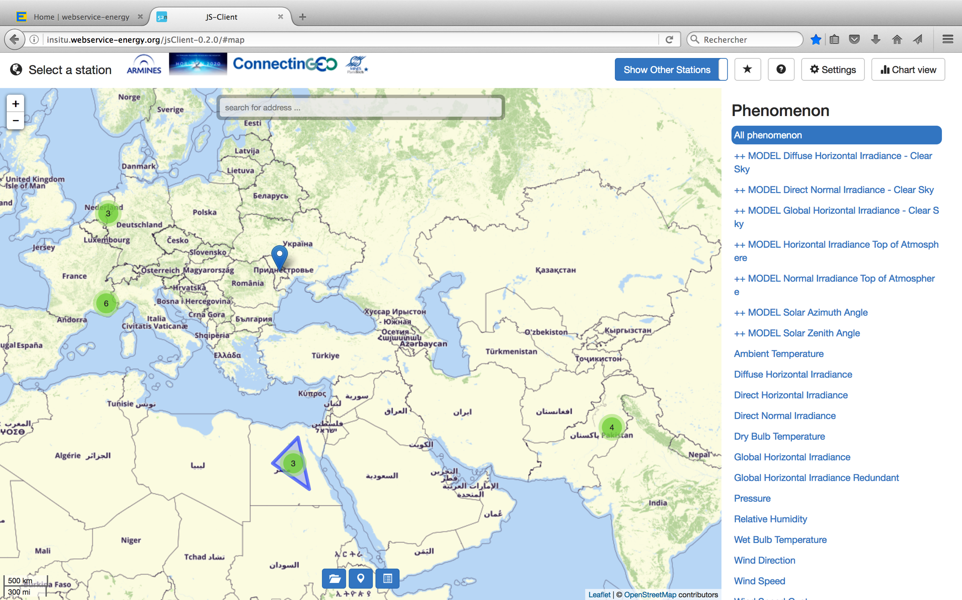
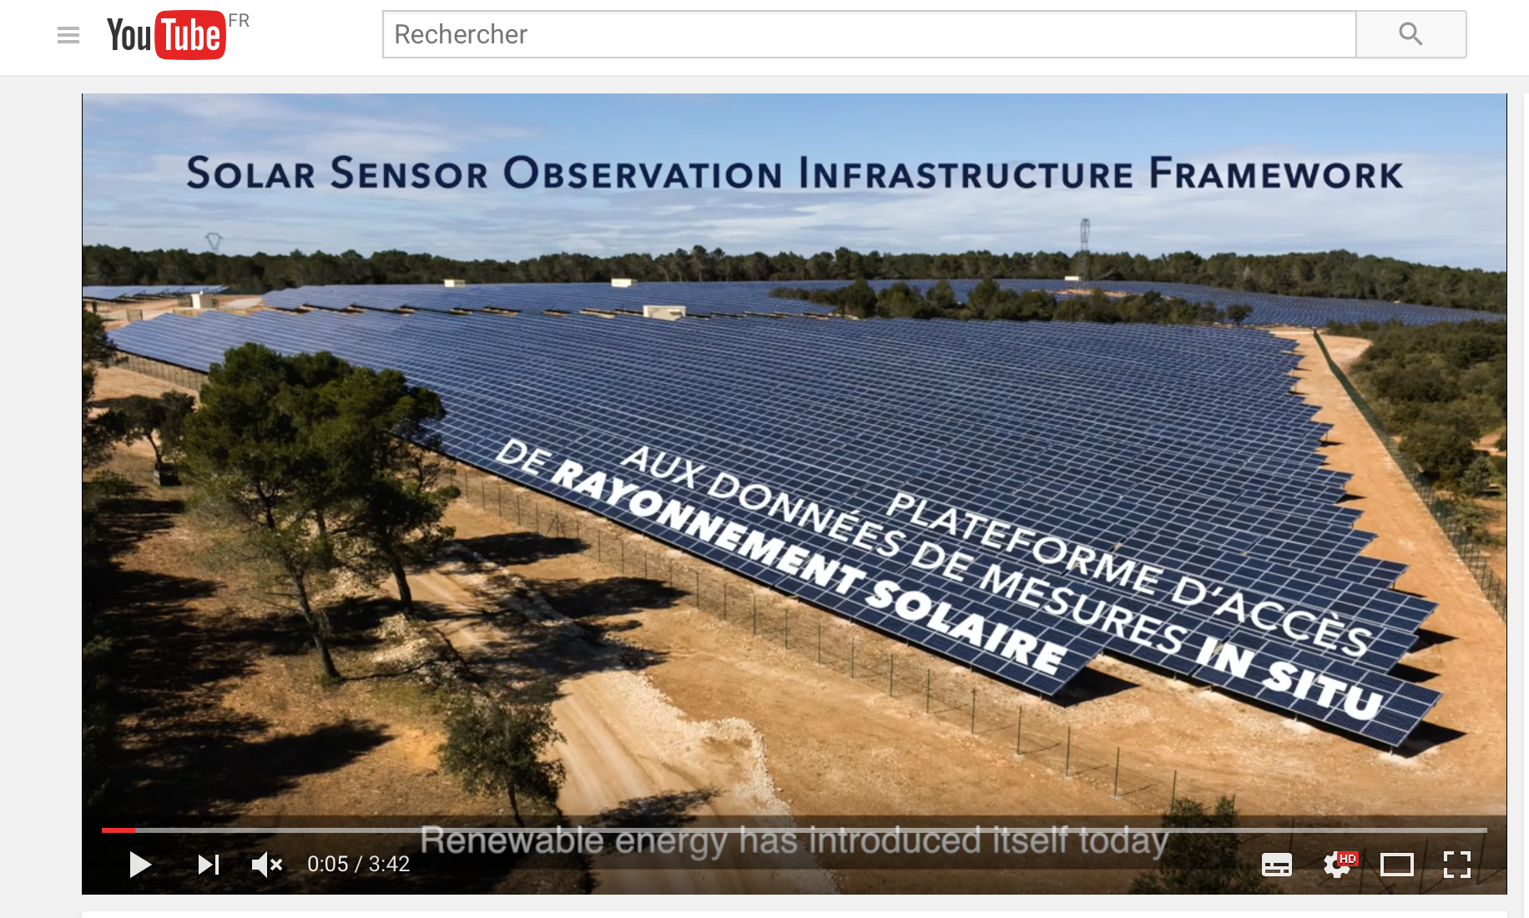
Extra
Links
Webservice-energy SDI:
http://www.webservice-energy.org
In-situ platform:
http://insitu.webservice-energy.org
Video
In-situ data for SMEs
https://youtu.be/WpC5C6qnYkg

Slide 16
Project assumption:
- Ground-mounted PV plant, 100 MWp
- around 1100 kWh/kWp, typically North of France
Let's consider a 3 % error on the yearly GHI and then assume that the error is the same on the yield (kWh).
On the investors' side, the Return On Equity (ROE) turns down from 11.3 % (108 M€ of cash flow cumulated over 25 years) to 10.2 % (100 M€). The deviation of ROE is not so important, but the CF is (8 M€).
On the debt side, this is much more interesting when considering the Debt Service Cover Ratio (DSCR) whose target is usually 1.25. This ratio means that each year, if the developer has to pay back 100 to the bank, he must necessarily have 125 of CF available. In the case of a 3 % error on the irradiation, the DSCR for that project turns down from 1.26 to 1.23 which means that:
- during the development phase, the project wouldn't have been financed;
- during the exploitation, a payment default would likely occur with important consequences.

