Slide 1
European
Network of
Earth Observation
Networks
Plenary Workshop
Building a collaborative ENEON to inform policies and actions to address complex societal challenges
ENEON Overview
Ian McCallum
12 - 13 October 2016
IIASA. Schlossplatz 1 - A-2361 Laxenburg, Austria

Slide 2
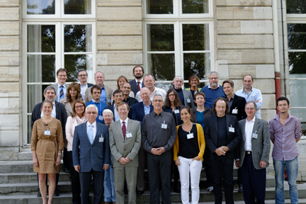
Overview
Agenda Overview
ENEON Defined
Goals for Workshop and Program
The Need for ENEON
History of ENEON
Achievements
Possible Futures

Slide 3
ENEON
ENEON shall coordinate European EO in-situ Networks providing coherent, continuous, timely and accurate information in support of GEOSS and Copernicus

Slide 4
Goals for Workshop
Bring together a selection of EO network representatives in Europe, together with the EC, GEO, EEA, EARSC and others;
Assess the extent to which ENEON can be embedded in the European EO landscape;
Continue the development of an ENEON strategy from an organizational and content standpoint;
Explore options for ENEON contributions to the GEO Work Programme;
ENEON funding opportunities, sustainability, future.

Slide 5
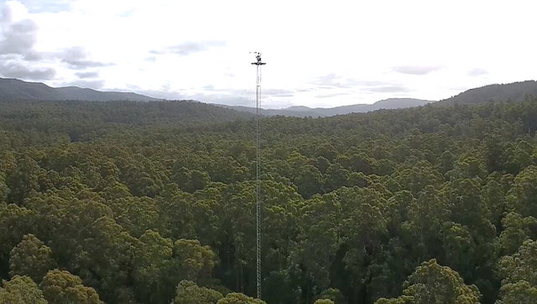
Need for ENEON

Slide 6
CEOS

Slide 7
Need for an ENEON
No global coordination group exists for the insitu observation community
The number of in situ networks is vast
The networks are very heterogeneous

Slide 8
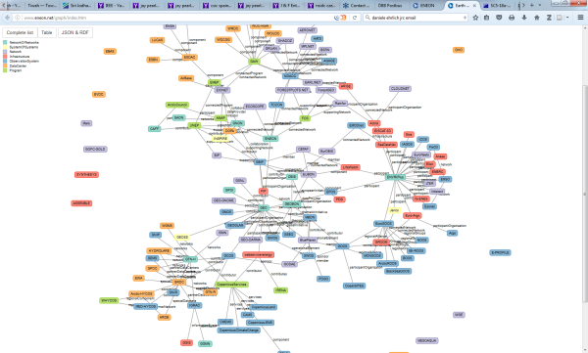
Need for an ENEON
Internationally: UN organizations - WMO, the UN Economic Commission for Europe, UNEP, the Arctic Council and others
European: national or service-based efforts supported by the European Commission (EC) and particularly the European Environment Agency (EEA) and the Copernicus Services
New data streams are presenting themselves, e.g. citizen science, with networks and associations ECSA
Hence an ENEON might be beneficial…

Slide 9
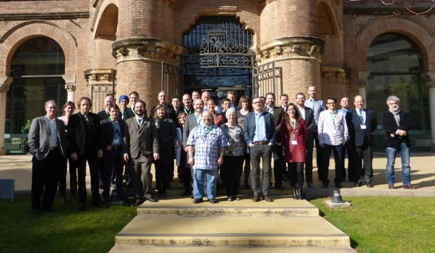
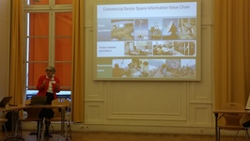
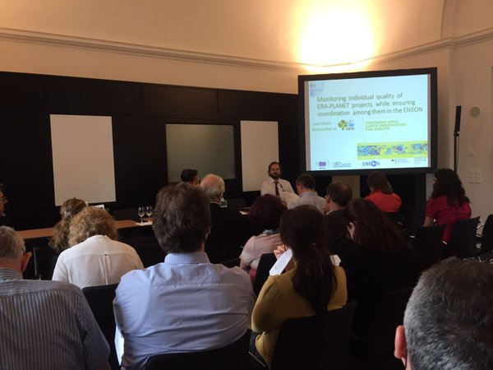
History of ENEON
Paris – Sept 2015
Eneon.net
Mexico – Dec 2015
Brussels – April 2016
EGU – April 2016
ECSA – May 2016
Berlin – June2016

Slide 10
Paris Recap
NoN needed across complex EU landscape
ENEON as a voice for the networks to the higher level forums, concerning issues of funding, sustainability, etc.
Help networks collect user needs
Identify transdisciplinary gaps
Create new products and services
Link business and research – expose this data to business creating new job opportunities

Slide 11
Brussels Recap
ENEON must consider the political domain
Focus on Europe: ERA-PLANET could be a good way
You need to identify critical in-situ systems and this way identify the political domain. Don’t just focus on the gaps!

Slide 12
Achievements
Network Mapping Solar in-situ
CREAF
ARMINES/52N

Slide 13
Possible Futures – ENEON as a Virtual Marketplace
ENEON might benefit from being restructured along the lines of a virtual marketplace (“commons”) – essentially a space where EO in-situ suppliers and consumers could meet and interact
Such a commons could have at its core a facilitator component (e.g. EC, GEOSS, EARSC, others).
This platform could eventually offer services and facilities helping the in-situ community
Source: CLOUDEO

Slide 14
Sustainability
Migrating ENEON Social Network/virtual marketplace
Relations to other initiatives
Sustainability of ENEON - Considerations of a Pilot ENEON, inclusion into GEO as a NoN
Funding Possibility: ERA-PLANET, NextGEOSS, COST Action, ERIC

Slide 15
Thankyou!

Slide 16
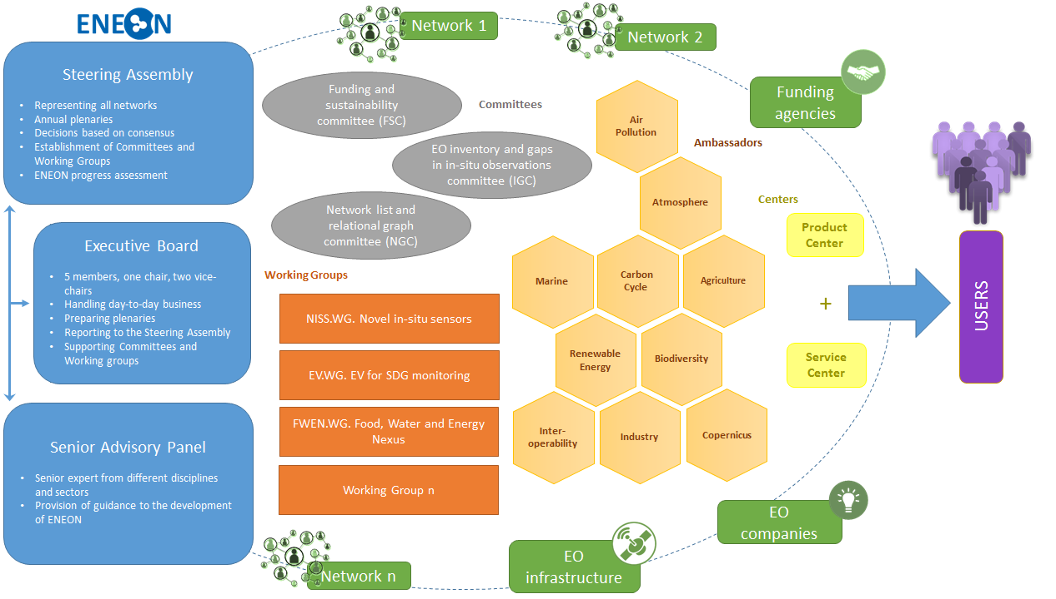
ENEON

Slide 18
Market Facilitator
SEE-IN KB

