Slide 1
GEOSS and in-situ data
Michael Obersteiner
IIASA
12th Oct, 2016

Slide 2
Forest: GEO - SS

Slide 3
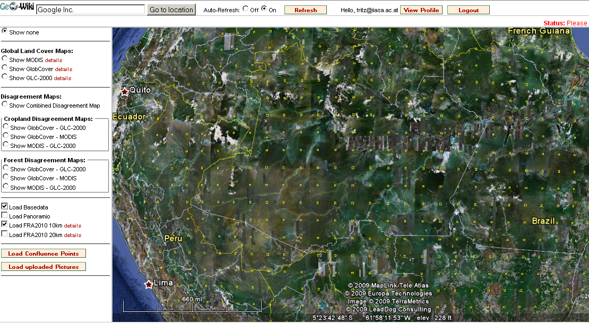
FRA2010 Density

Slide 4
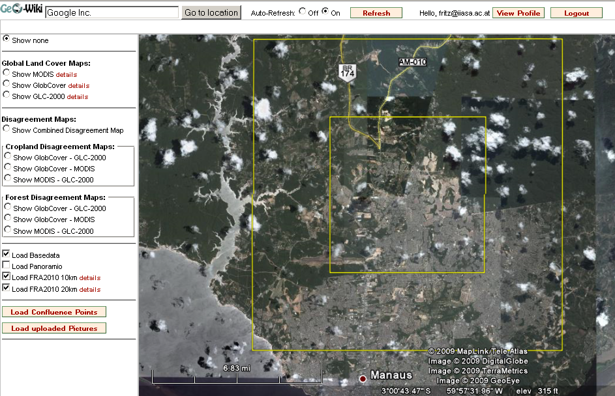
FRA2010 how much at each point

Slide 5
Forest: GEO - SS

Slide 6
Forest fire Management

Slide 7

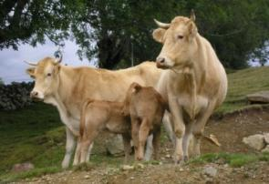
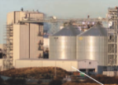

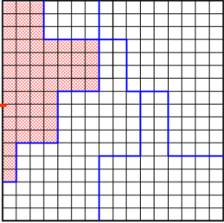
Demand
Population, GDP, preferences
Food
Fibers
Energy
Industry
Markets
ECONOMIC MARKET + Spatial equilibrium trade → PRICES
Production
RUMINANT
Digestibility model
Feed intake
Animal production
GHG emissions
BIOENERGY
Processing
MJ biofuel
MJ bioelectric
Coproducts
G4M
Global Forest model
Harvestable wood
Harvesting costs
18 crops (FAO + SPAM)
Wheat, Rice, Maize, Soybean, Barley, Sorghum, Millet, Cotton, Dry beans, Rapeseed, Groundnut, Sugarcane, Potatoes, Cassava, Sunflower, Chickpeas, Palm Fruit, Sweet potatoes
3 different systems
7 animals (FAO + Gridded livestock)
Cattle & Buffalo
Sheep & Goat
Pig
Poultry
8 different systems
Land suitable for Poplar
Pillow
Eucalyptus
Productivity from literature
Downscaled FAO FRA at grid level
Area
Carbon stock
Age
Tree size
Species
Rotation time
Thinning
Land use
Land cover
Cropland
Grassland
Short rotation plantations
Managed forest
Natural
forest
Other natural land
Global Land Cover 2000

Slide 8
Duration of fire

Slide 9
Minimization of burned area:
Number of weather stations

Slide 10
Conclusion
GEO - SS
Purpose driven e.g. MRV vs. Management
Cost Benefit of the EO system component for a good enough outcome

