Slide 1




European
Network of
Earth
Observation
Networks
Plenary Workshop
Building a collaborative ENEON to inform policies and actions to address complex societal challenges
Mapping the Network Landscape
Ivette Serral
12 - 13 October 2016
IIASA. Schlossplatz 1 - A-2361 Laxenburg, Austria

Slide 2

Introduction
One of the main objectives from ConnectinGEO:
  Enable a European Network of Earth Observation Networks:
    A forum to discuss joint strategies and harmonize across the observation networks
    Facilitate access and to share the information from EU observing systems
First, we needed to map
all in-situ networks working
in EO in Europe, know its relations
and dependencies
www.eneon.net

Slide 3
European in-situ Networks
Mapping the in-situ networks at the European level has lead to the discovery of a large, complex and incomplete system.
There’s coordination within each topic, but less interaction and knowledge across them.
Different semantics using the name “Network”.
  We have identified:
    ObservationSystem is a network that is building some sensor network and collecting data with them
    SystemOfSystems is a network that has the objective of integrating “ObservationSystems” in a bigger structure.
    Infrastructure is an “informatics” system that connects data, services and sensors to facilitate access to or processing of data.
...

Slide 4
    DataCenter is a data repository that is not really a network but needs a network to exist. It generally does not own the data but aggregates it in a single repository (in opposition to a system of systems that has a federated structure). Actually it could be argued that this category is out of scope of the ENEON but there are cases where if not included the complete picture is not understood (e.g. the WMO thematic data centers).
    Program is a network created/financed directly by the decision makers that is neither an observing system nor an infrastructure but e.g. a coordination effort.
    Network is anything that cannot be classified in the previous categories.
    NetworkOfNetworks is a network connected to other networks with the intention to aggregate them.

Slide 5
Mapping the networks
Before creating our graph data model, previous initiatives using metadata model to describe networks were analyzed, mainly:
  the Network Metadata Model (NMM), responding to the ILTER and LTER Europe requirements. Collect basic information on the network itself as well as the associated information provided within DEIMS (Drupal Ecological Information Management System). Includes the links to associated people as well as research sites and datasets. For Networks, Research sites can be managed and the status of affiliation. The content type applies to ILTER/LTER networks especially.
  The NMM misses the relations between networks
We have adopted the NMM
  adding the necessary relations between networks
  the financing projects
  the link with SBA and GEOSS

Slide 6
Each individual network is defined by a reduced set of properties.
It also includes links to other networks
  specifies the role of the relation.
UML model for the networks database elaborated in ENEON

Slide 7
Implementation
It is closer to the modern web technologies
  JSON+RDF
The network database in maintained in a JSON file that encodes the model.
  It has been encoded in JSON-LD that can be dynamically converted into RDF and connected to the linked data
  The JSON is validated using a JSON schema.
The graph representation is based on an open source code available at GitHub called d3-process-map that uses the d3.js graphical library
  The PHP server side has been removed: javascript contains all the intelligence
  Relational role representation has been added
  Conversion to RDF has been added (using a JSON-LD github lib.)

Slide 8
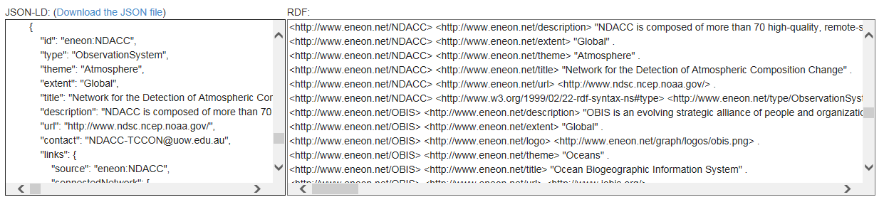
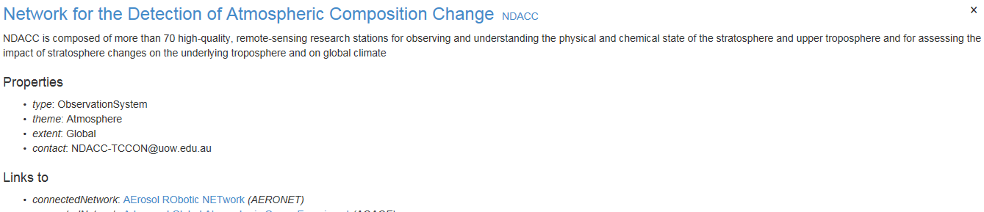
HTML representation of a network and export
Full text description of each network in the graph
Export to RDF representation for exploitation in the linked data

Slide 9
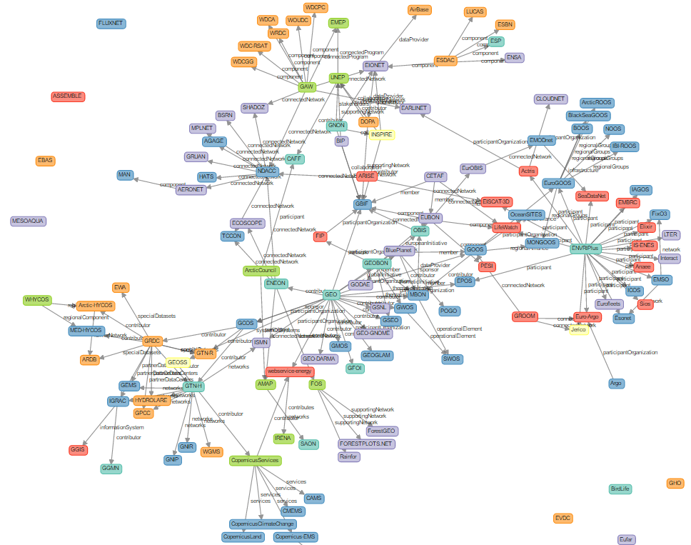
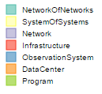
The result of this implementation has led to the establishment of an initial graph of European in-situ networks.
www.eneon.net/graph

Slide 10
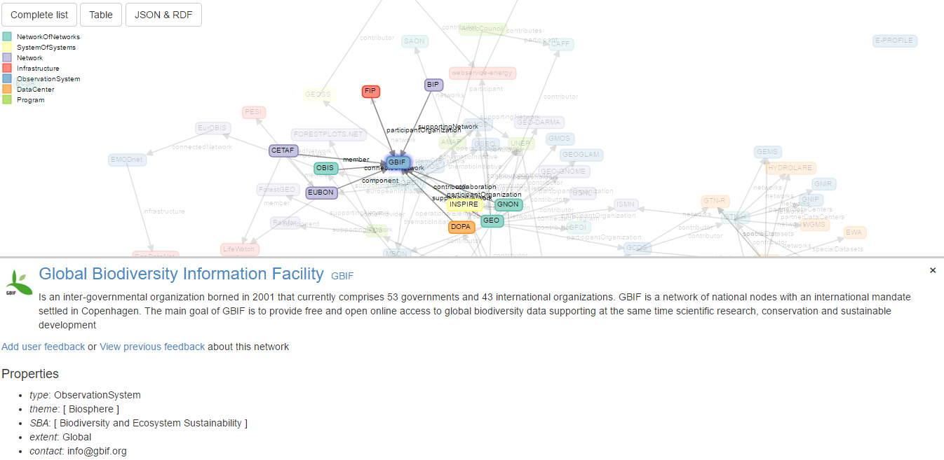
User feedback
If you see something wrong or missing, please provide feedback!!

Slide 11
Conclusions
Shows a large, complex and incomplete system
Helps in discovering gaps/redundancies and missing links
We need help in perfecting and updating. Give us feedback
It will be included in the project sustainability plan
Could be generalized to Global scope in GEOSS
Easy to move/transfer/extended to other servers (no server side technology)

Slide 12
Thanks!
ivette@creaf.uab.cat

