Slide 1
GAIA-CLIM
Online Catalogue of Gaps
and
Gaps Assessment and Impacts Document (GAID)
Michiel van Weele, Richard Davy, Corinne Voces,
Martine de Maziere, Peter Thorne
and project team
ConnectinGEO workshop, Laxenburg, October 11th 2016

Slide 2
Talk outline
GAIA-CLIM gap identification
SMART formulation of gaps
The on-line catalogue
The GAID living document
Future plans

Slide 3
Gap identification
Bottom-up process:
Internal to all GAIA-CLIM project members through workpackage leads
External input through 3 dedicated user workshops* and scientific advisory committee
Feedback using deliverables providing formal input to the living document (GAID)
Use of a template to harmonize input
Categorization into generic gap types
Direct interaction with gap owners
Next GAIA-CLIM workshop still open for registration and participation. Brussels at BIRA/IASB, 21-24 November 2016;

Slide 4
Gap identification template

Slide 5
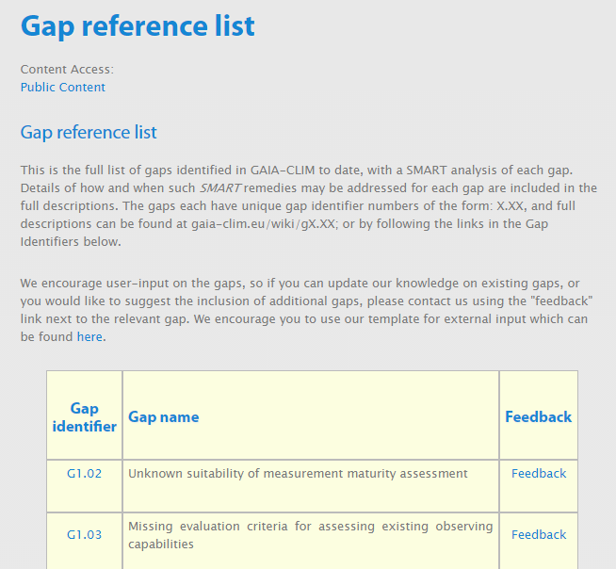
The GAIA-CLIM on-line catalogue
Feedback on individual gap content / additional gaps encouraged
Form for expert input available online

Slide 6
SMART gap formulation
Specific Specific proposed action to remedy
Measurable Outcome for success of the remedy
Achievable Indicative cost estimate
Relevance User impact if not remedied
Time bounded Action on short-, mid- or long-term
Risks Risk register for non-resolution (+impact, +probability)

Slide 7
Anatomy of our current gaps

Slide 8
1. Gap detailed description
G6.01 Dispersed governance of high-quality measurement assets leading to gaps and redundancies in capabilities and methodological distinctions.
Gap detailed description
Non-satellite data sources identified as reference and baseline quality within GAIA-CLIM have greatly dispersed governance. This dispersed governance leads to decisions which, although sensible on a network basis, are sub-optimal on a more holisitic basis. This fractured governance also results from but also augments a diversity in funding support and observational priorities as discussed in G6.02 and G6.03. Different networks take different approaches to data processing and serving which reduces comparability of the resulting data.

Slide 9
2. Activities within project
Activities within GAIA-CLIM related to this gap
This gap is indirectly addressed within GAIA-CLIM to the extent that it brings together actors from many of the high-quality networks. However, there is no single activity which specifically addresses this point.

Slide 10
3. Gap remedies foreseen
Gap remedy(s)
Two remedies are foreseen.
In the short term efforts should be made to strengthen cross-network governance representation to improve coordination. In the longer term it may be advisable to seek to merge networks where possible and where aims overlap sufficiently so that non-satellite high-quality measurement systems have a stronger and more unified voice globally.

Slide 11
Remedy #1 (not showing remedy 2 for brevity)
Specific remedy proposed
Strengthen existing efforts to ensure meaningful collaboration through cross-governance group representation, network memoranda of understanding and involvement in joint research and infrastructure activities.
Measurable outcome of success
Demonstrable increase in collaboration between networks through joint projects, publications, and participation in network meetings.

Slide 12
Achievable outcomes
Technological viability: High
Indicative cost estimate: Low (<1 million)
Relevance
The remedy would improve visibility of all high quality networks and their relevance.
Timebound
Within the GAIA-CLIM project timeframe.

Slide 13
4. Gap risks to non-resolution
Identified future risk / impact | Probability of occurrence if gap not remedied | Downstream impacts on ability to deliver high quality services to science / industry / society
Continued fractured governance leading to sub-optimal management and development of high-quality measurement networks | High | Reduced utility of observational data assets through fractured decision-making
Reduction in funding opportunities for high-quality measurements owing to fractured and competing demands | Medium | Reduced value of observations

Slide 14
The GAIA-CLIM on-line catalogue
Example: A no regret low cost, mid-term gap in governance
Currently in catalogue: 88 gaps

Slide 15
The GAIA-CLIM on-line catalogue
Further examples: Gaps related to measurement comparisons
G3.01 Incomplete knowledge of atmospheric variability during a measurement
G3.02 Missing standards for co-location criteria in validation
G3.03 Limited quantification of the impact of different criteria on the comparison result
G3.04 Limited characterization of the smoothing and sampling properties of atmospheric remote sensing systems, and of the resulting uncertainties
G3.05 Representativeness uncertainty assessment missing after averaging of individual measurements

Slide 16
GAIA-CLIM generic gap types
Seven types of gaps
Gaps in spatiotemporal coverage of the observations
Gaps in the vertical domain (resolution, altitude domain)
Measurement Uncertainty
Comparator measures (one type of obs vs. another type of obs)
Parameter gaps (missing auxiliary information)
Technical gaps
Governance gaps (‘non-observational’)
GAIA-CLIM Essential Climate Variables (full analysis)
Temperature, Water Vapor, Greenhouse gases, Ozone, Aerosols

Slide 17
Selected GAIA-CLIM governance gaps

Slide 18
The GAID living document
The purpose of the GAID is to
To provide the latest status of the on-line catalogue
To provide an analysis of the latest list of gaps by taking different cross sections through the full catalogue
Outreach
Current cross sections
Per ECV
Per instrument/observational technique

Slide 19
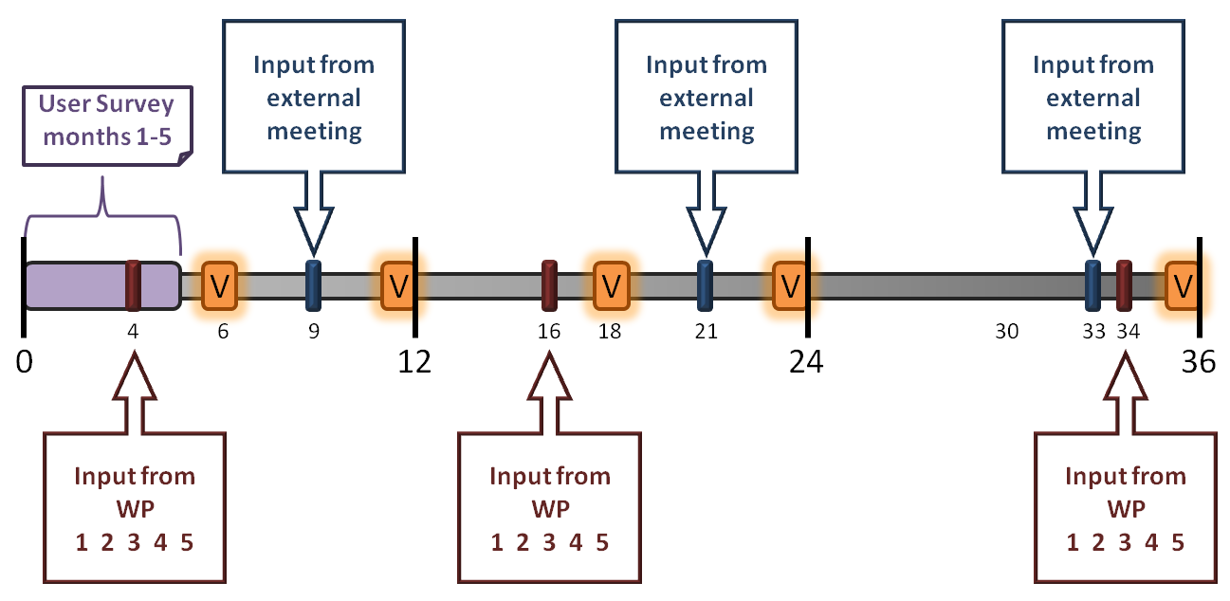
The GAID living document
We are here

Slide 20
Future plans
21-24 November 2016 the second workshop in Brussels at BIRA/IASB. Open for registration and active participation
Updated on-line catalogue
Interactive tools (e.g. search by multiple fields, user-generated cross-sections)
GAID version 4 (Feb 2017)
Cross sections on impact, costs, and time horizon
Further support to gap prioritization and the production of the overall project recommendations
Incorporate further internal and external input

Slide 21
Contributions to ECV gaps? Please visit
http://www.gaia-clim.eu/page/gap-reference-list

