Slide 1
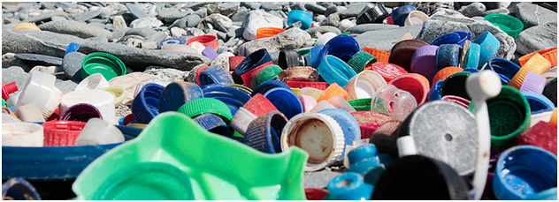

MARINE LITTER WITHIN MSFD
F Galgani, IFREMER

Slide 2
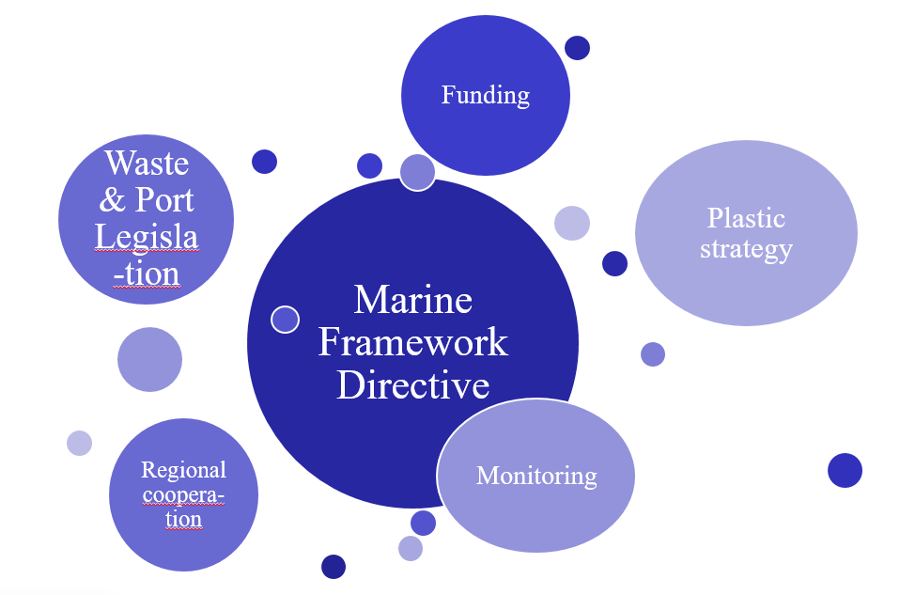
WHAT IS DOING EUROPEAN COMMISSION?
A new directive

Slide 3
THE MARINE STRATEGY FRAMEWORK DIRECTIVE
Objective: Achieving Good Environmental Status by 2020
- 11 descriptors (D10 on marine litter)
- GES / Harmonized monitoring/ Programs of Measures
MONITORING: COM DEC (EU) 2017/848 (2017), and 2010/477/EU on Criteria
(criteria elements, and methodological standards for monitoring and assessment)
- 10DC 1: Litter on beaches, at sea and on the sea floor
- 10DC2: Microplastics (beaches/sediments/floating)
- 10 DC 3: Ingested litter
- 10 DC4: Entanglement

Slide 4
Technical Group Marine Litter
(100 experts)
A collaboration platform To support implementation of monitoring
first pan-European beach litter dataset (417 beaches),
Harmonized dataset /templates on seafloor (IBTS/MEDITS/BITS) and microplastics
collaboration with EMODNET ( data management/ european scale)
Providing input to DG ENV Plastics Strategy and Impact Assessment
Define baselines , thresholds , targets (started in 2018)
Updating monitoring guidance (2019)
Growing interest in quantitative data on riverine litter input

Slide 5


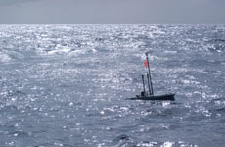
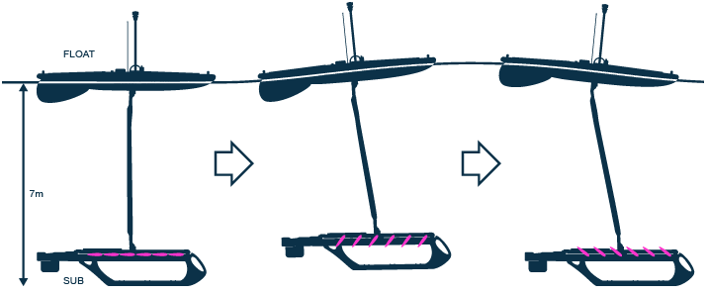
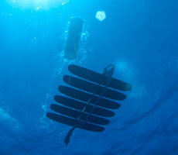

WAVEGLIDING FOR MARINE LITTER
WAVE GLIDERS (Liquid Robotics):
Long term surveys ( 6 months)
KNOWN APPLICATIONS
Acoustics Surveys, Monitoring (Oil, isotopes,
noise, temperature, salinity, fluorescence, etc.)
Meteorology & Oceanography (ADCP, etc.)

Slide 6

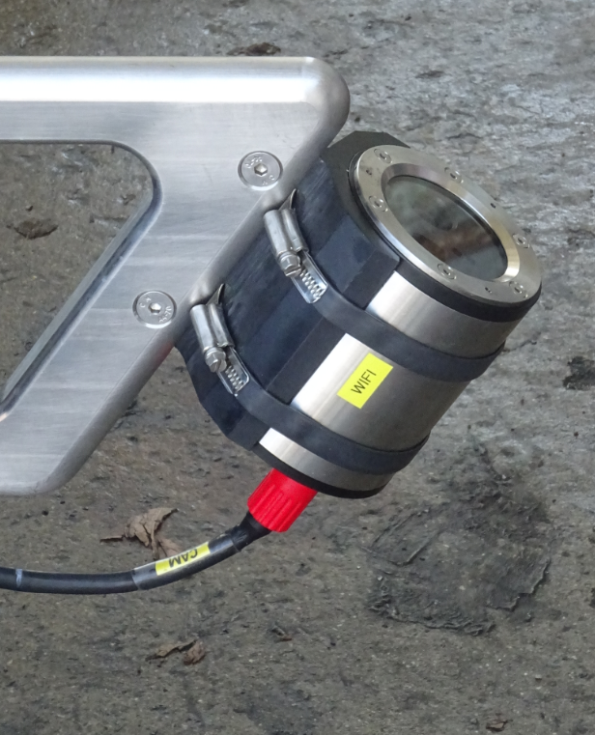
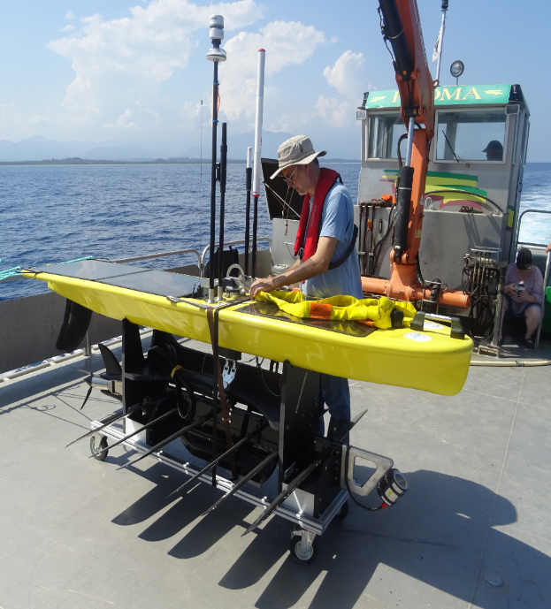

LONG TERM APPLICATION OF CAMERA TO MONITOR SURFACE/SUBSURFACE MARINE LITTER AT SEA.
Programmed camera ( Gopro) - Mounted on ballast of a Wave Glider (in resistant 60cm tube) - Front side and sea surface oriented , 45° angle,
Line transect evaluation of 12.5 m width at ther suface

Slide 7
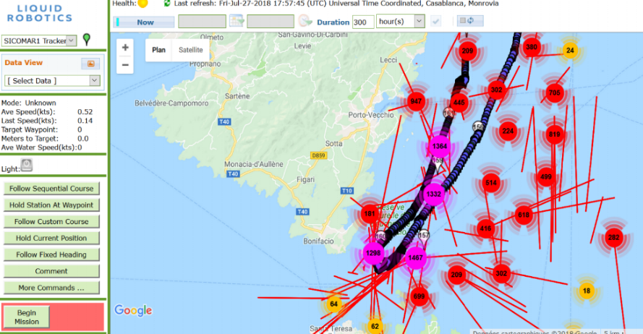
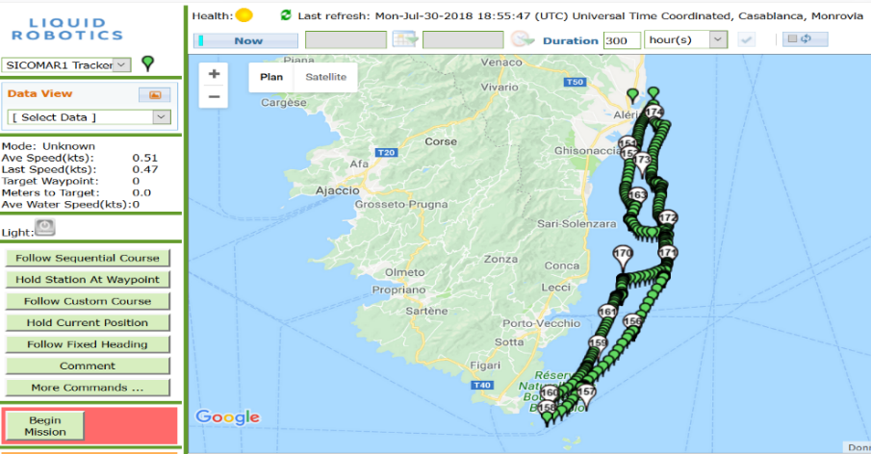
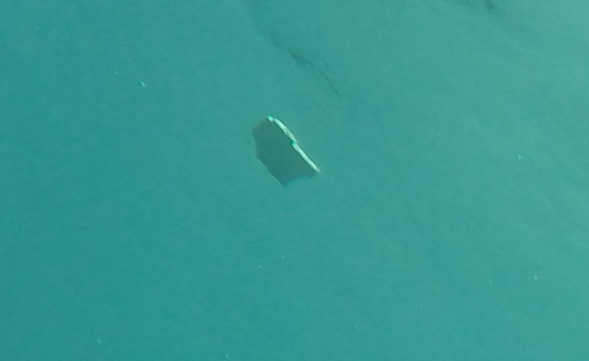
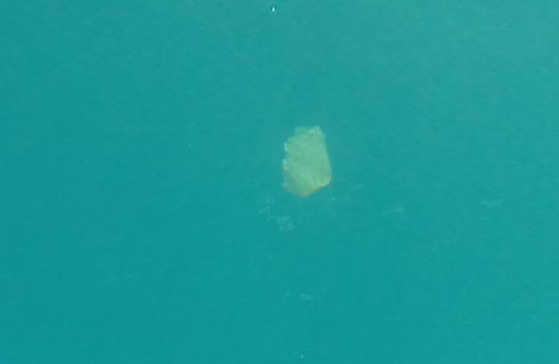
- 13 days, 4,5 days for Marine litter, 1.5 Knots: No movements, No cavitation
Consistent data and stable images (Video and photo)
- Adequate for monitoring surface ( 0-4.5m) debris, Densities at # 6 items/km2

