Slide 1
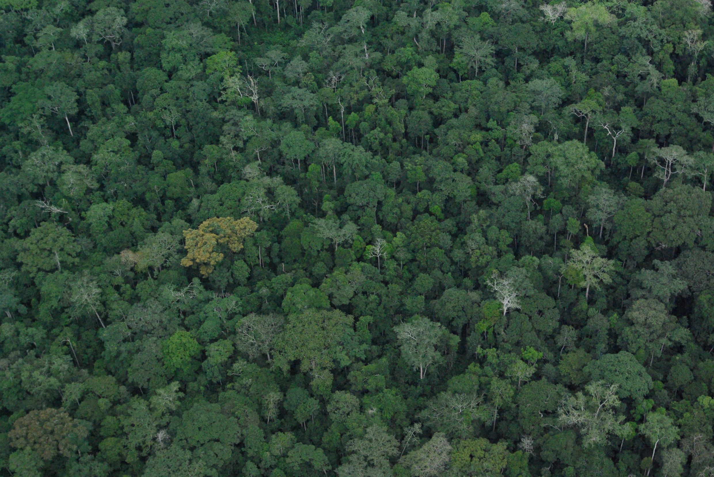




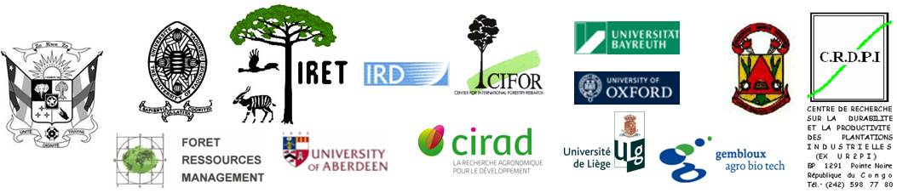






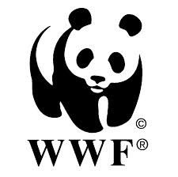


Claude Garcia and Laurene Feintrenie – Paris 2018

Slide 2
Coupling social and ecological drivers to explore alternative futures for the forests of the Congo Basin

Slide 3

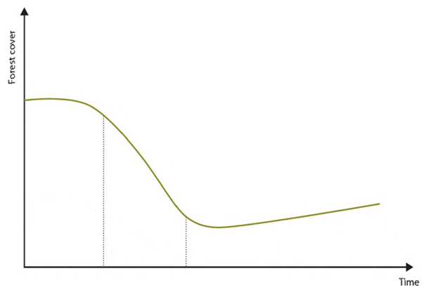
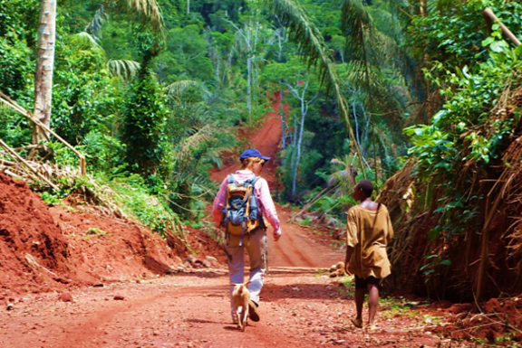
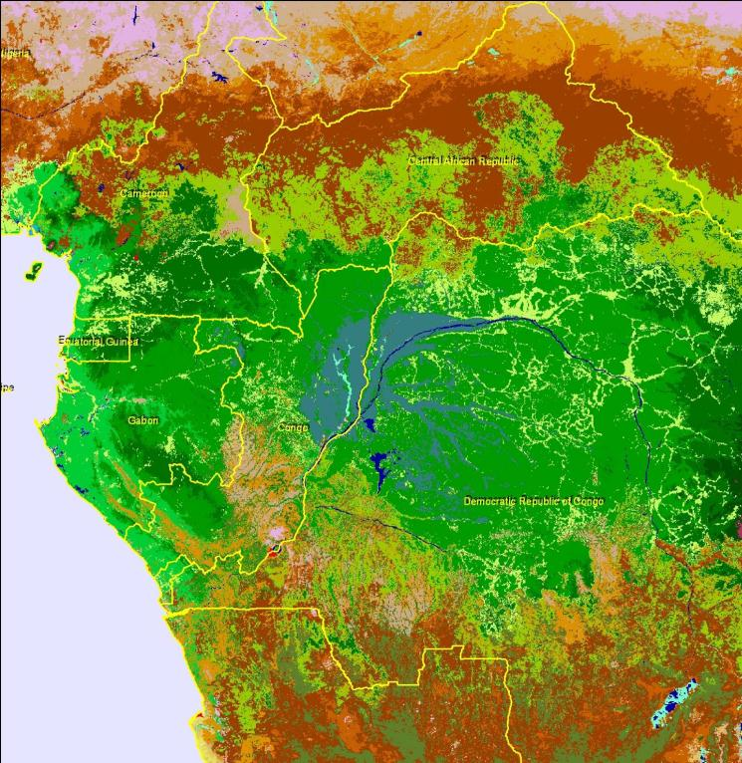
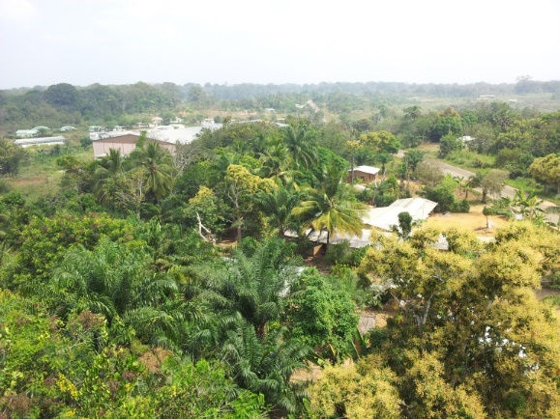
Selected sites along a gradient illustrating the forest transition
Makokou
(Gabon)
Mindourou,
(Cameroun)
Guefigue
(Cameroun)
Notes:
Premier résultat: choix des sites. Expliquer les critères de sélection:
Sur la courbe de transition
Terrains où nous avons du recul: 1 et 2 sont des terrains de Gembloux et en plein dans la zone de Coforchange. 3 est en marge de la zone de coforchange, mais terrain d’étude ancien du CIRAD sur les activités agricoles.
IRAD et IRET seront de fait les partenaires africains les plus actifs dans le projet, il est prévu que des chercheurs juniors de ces instituts accompagnent les étudiants sur le terrain et soient formés aux différents outils utilisés ou développés dans le projet.

Slide 4

Team Science

Slide 5
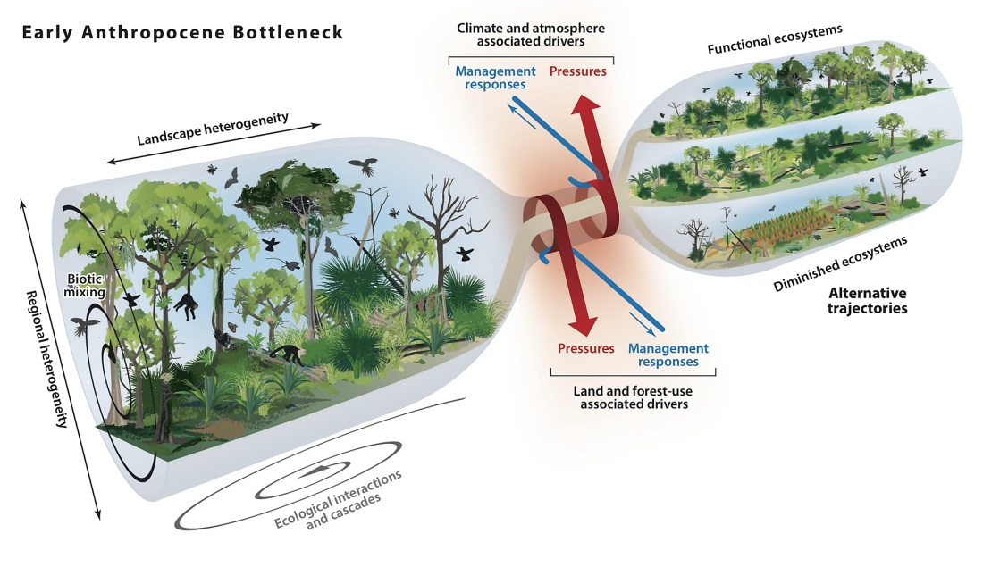
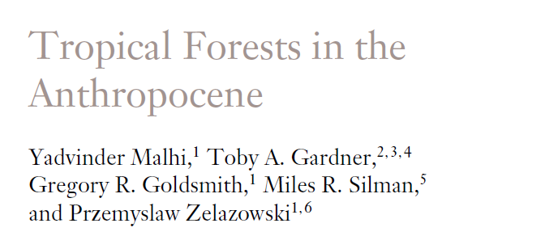

Slide 7
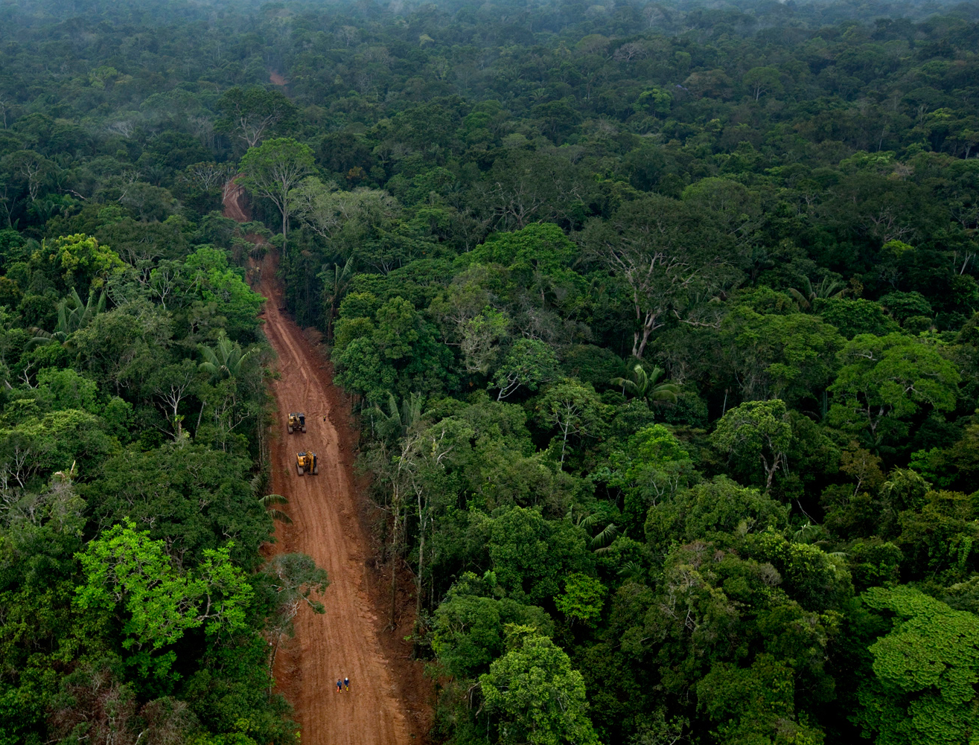
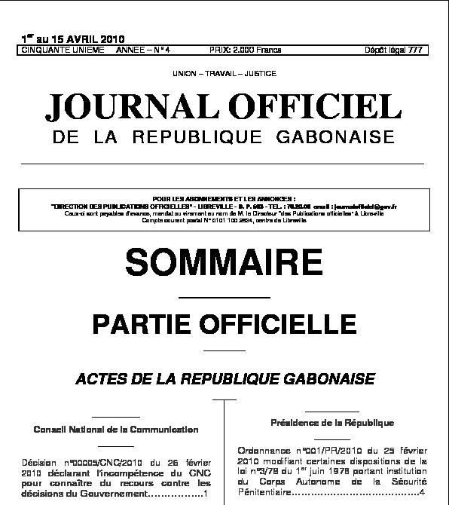
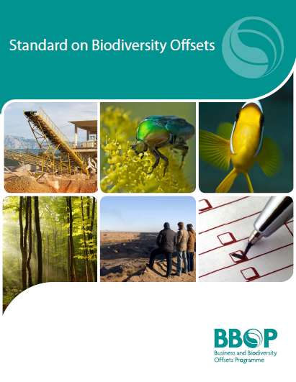
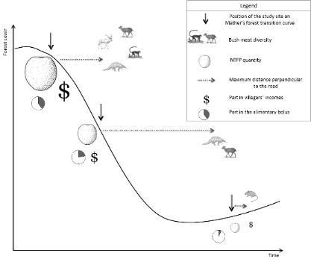
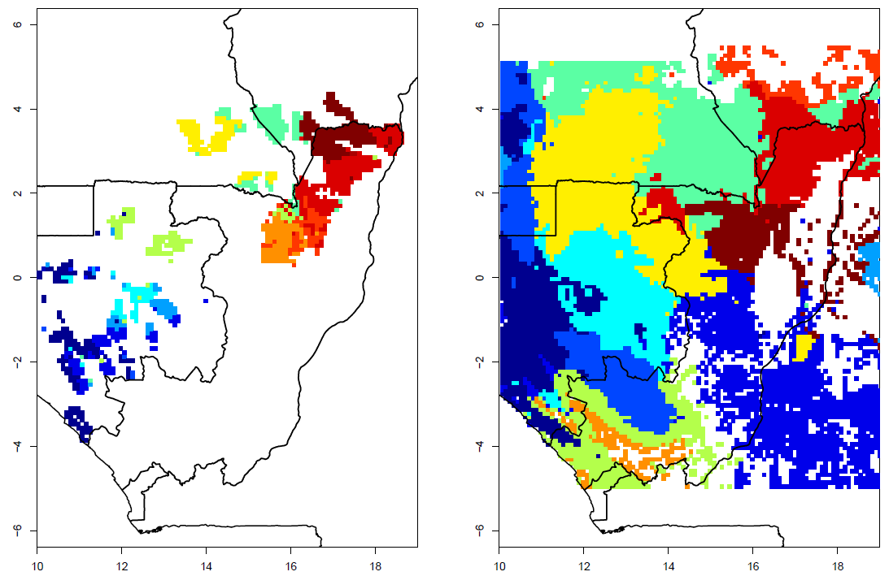
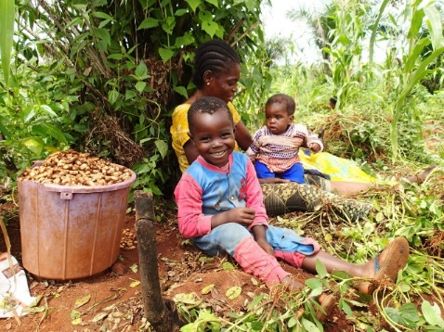
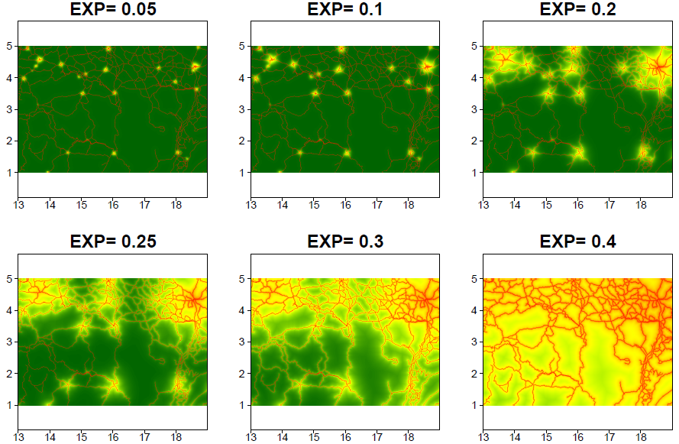
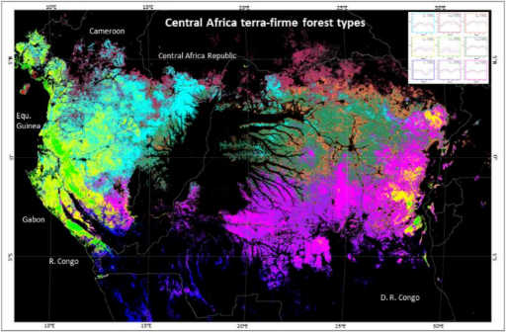
Norms and institutions
What people should or shouldn’t do
Permissions
N
Ecosystems and their processes
Biophysical constraints and natural capital
S
E
People and their strategies
Knowledge, desires, beliefs, intentions, capacities.
Capacities
Constraints
© C. A. Garcia et al. (2017)

Slide 9
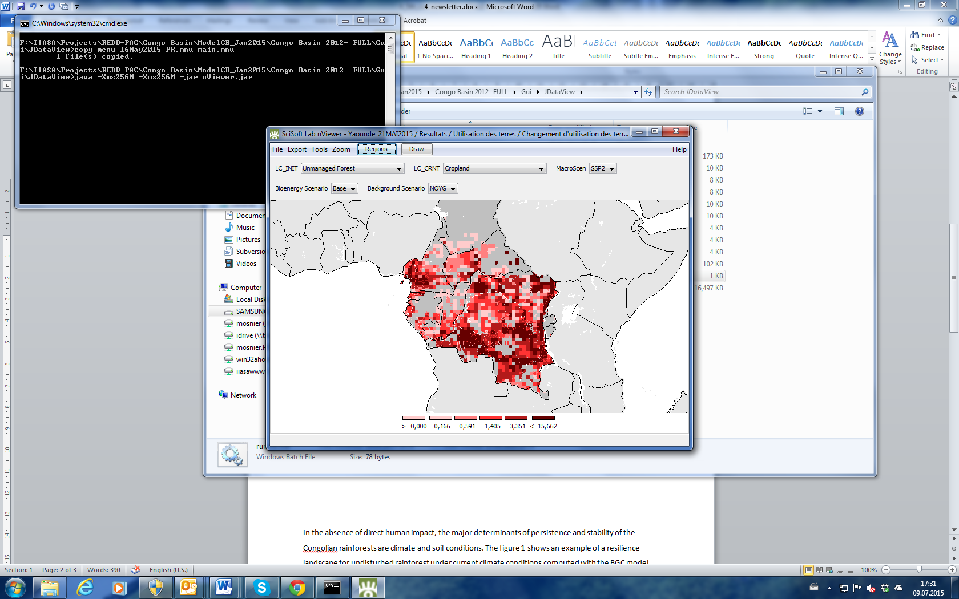
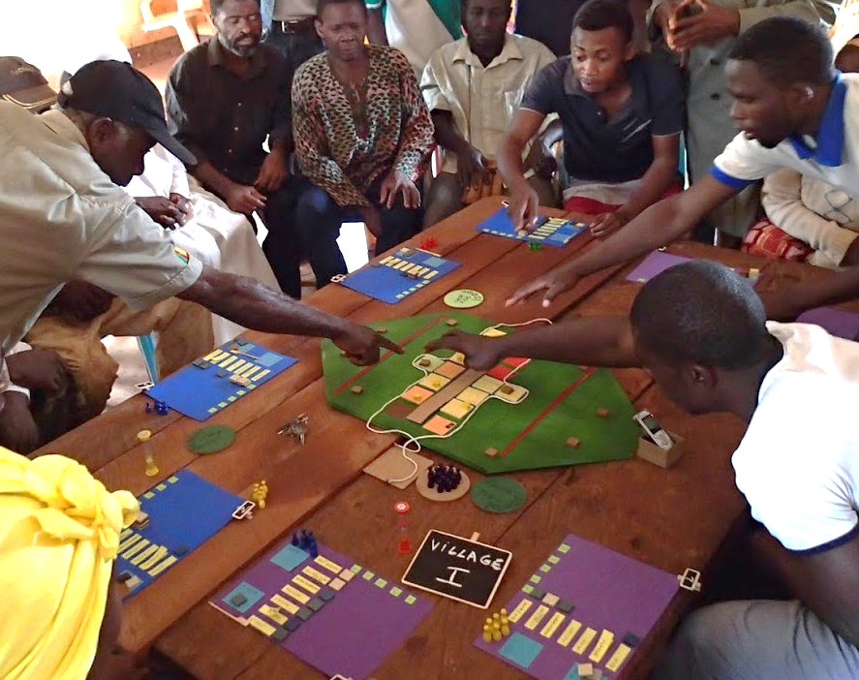
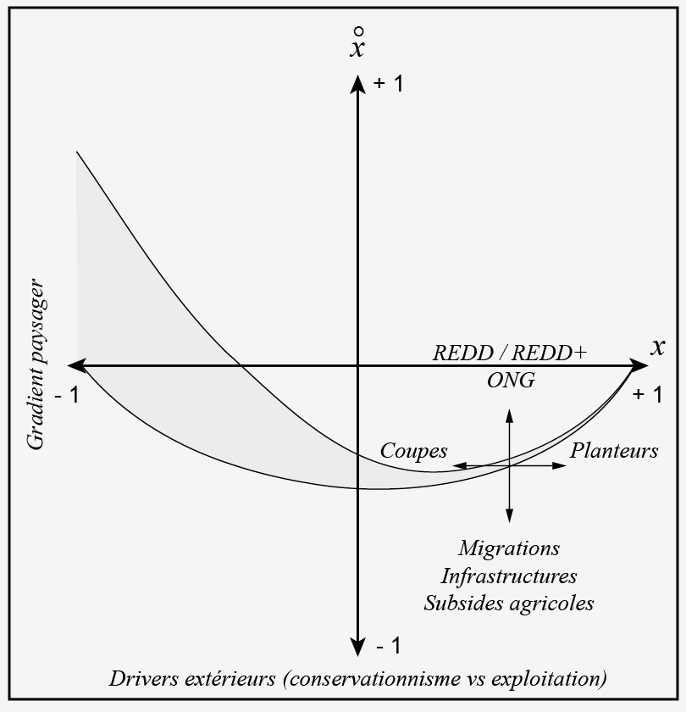
Why?
R
P
G
What?
How?

Slide 10
Notes:
Figure 2: Projection of population density by 0.5 degree grid between 2000 and 2050 in the Congo Basin (source: IIASA/POP)

Slide 12
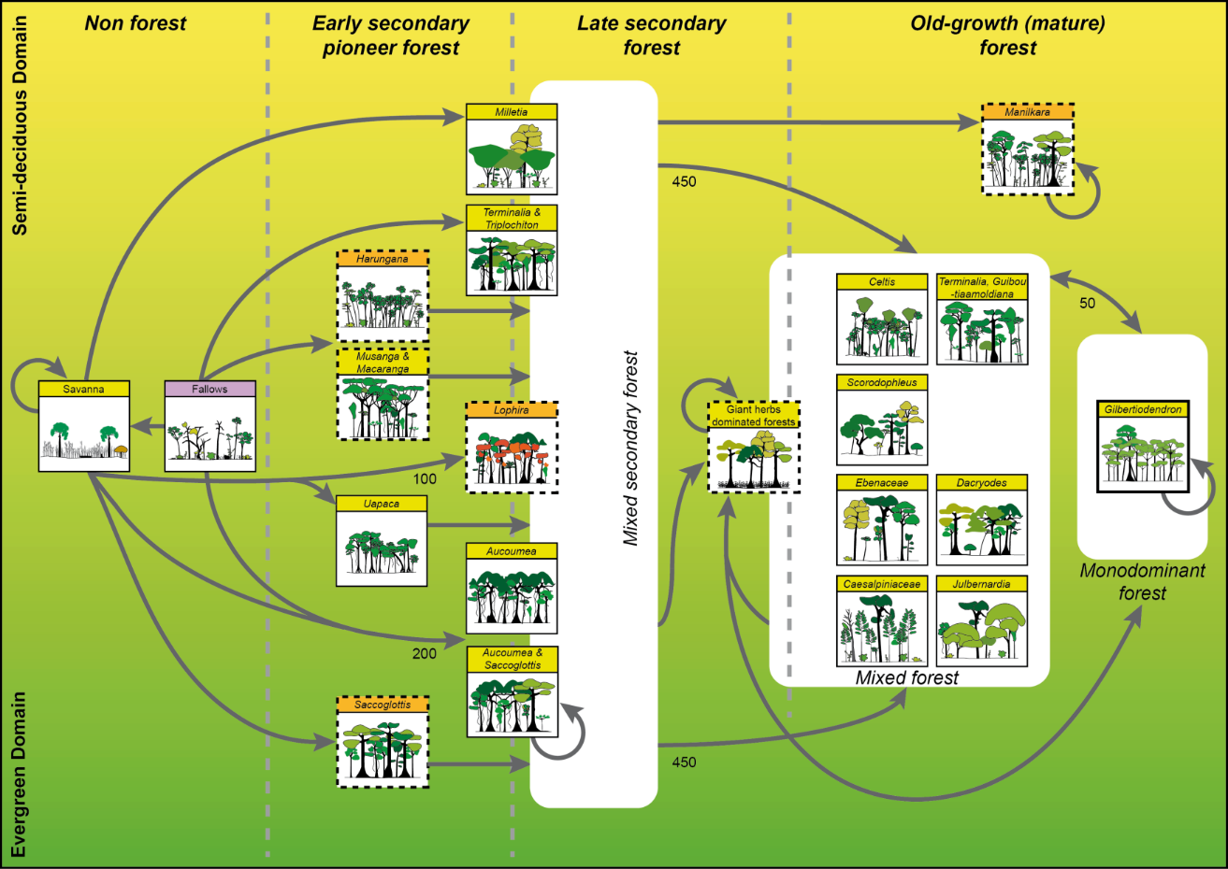
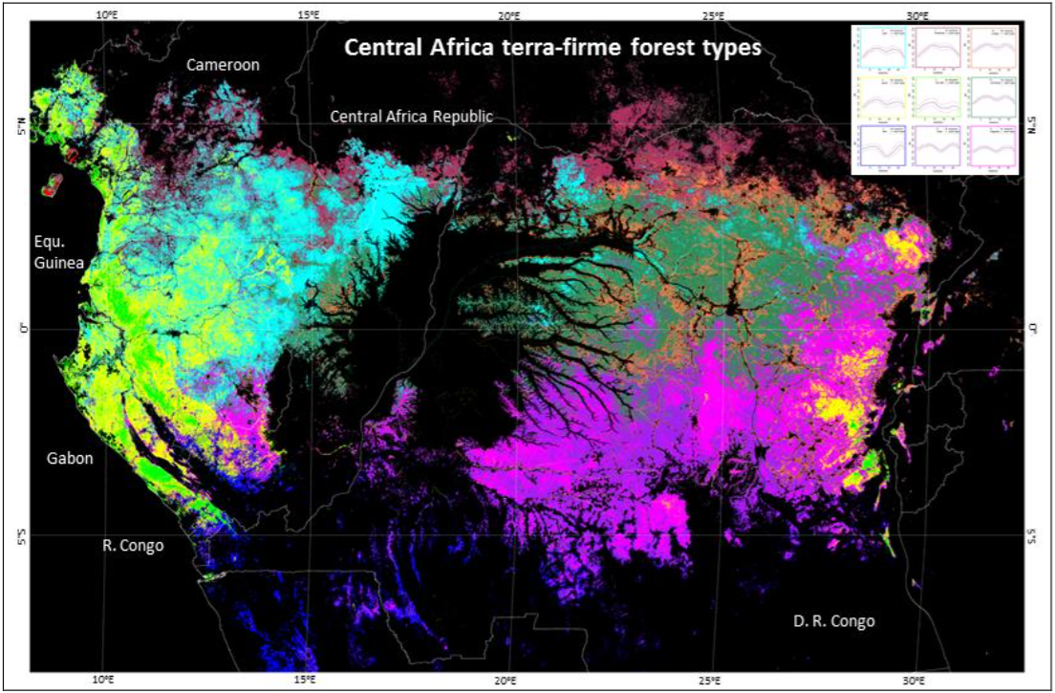
Notes:
A regional map of forest types has been produced based on a classification of the seasonal profiles of photosynthetic activity (measured by EVI, Enhanced Vegetation Index) as derived from a 13-y time series (2000-2012) of MODIS (Moderate Resolution Imaging Spectro-radiometer) satellite data. Ten terra firme forest classes were identified and interpreted in terms of deciduousness and structure based on 37,898 0.5-ha ground truth plots gathered from 19 forest companies. Radar and Lidar data were also used to discriminate the swamp forests.

Slide 14
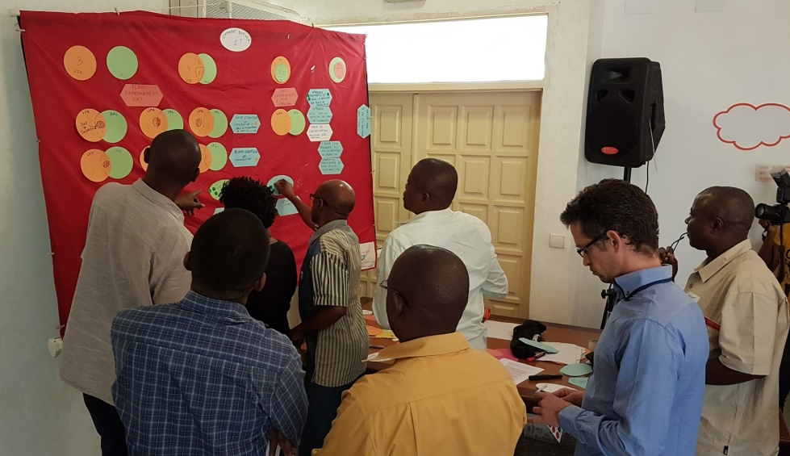
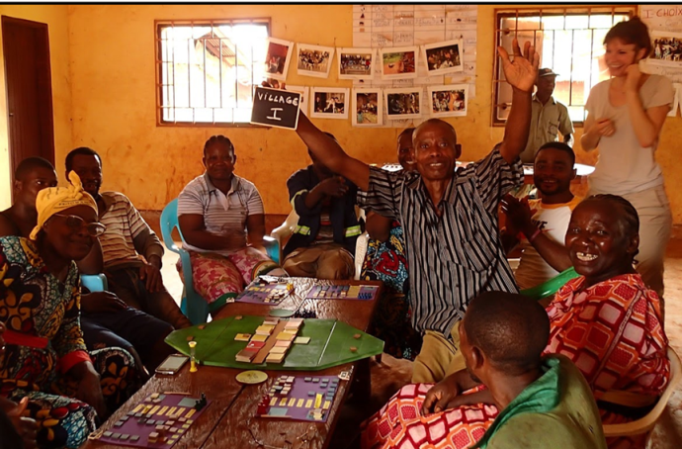
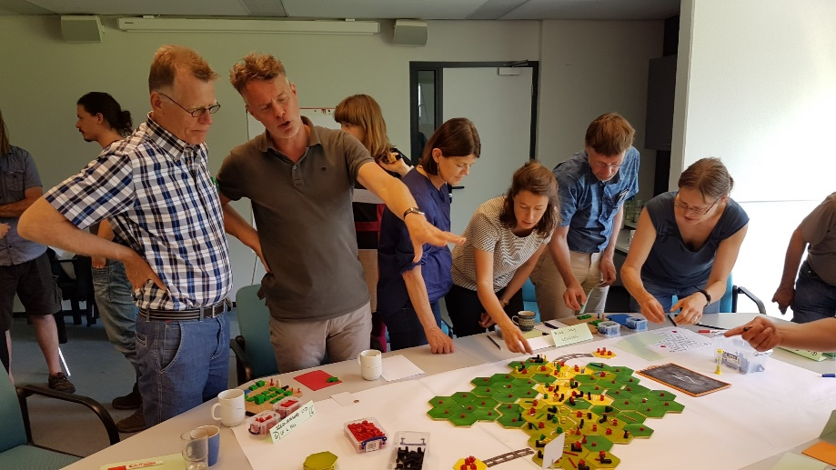
R
S
A

Slide 15
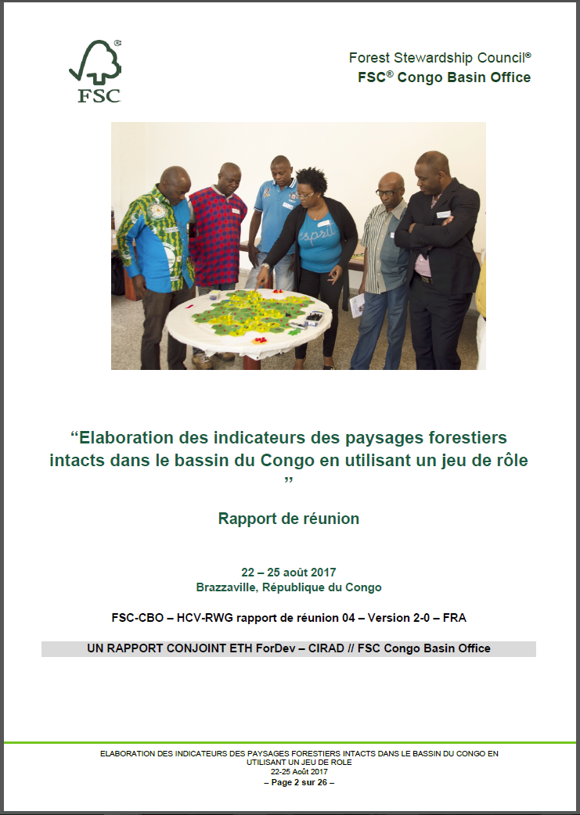
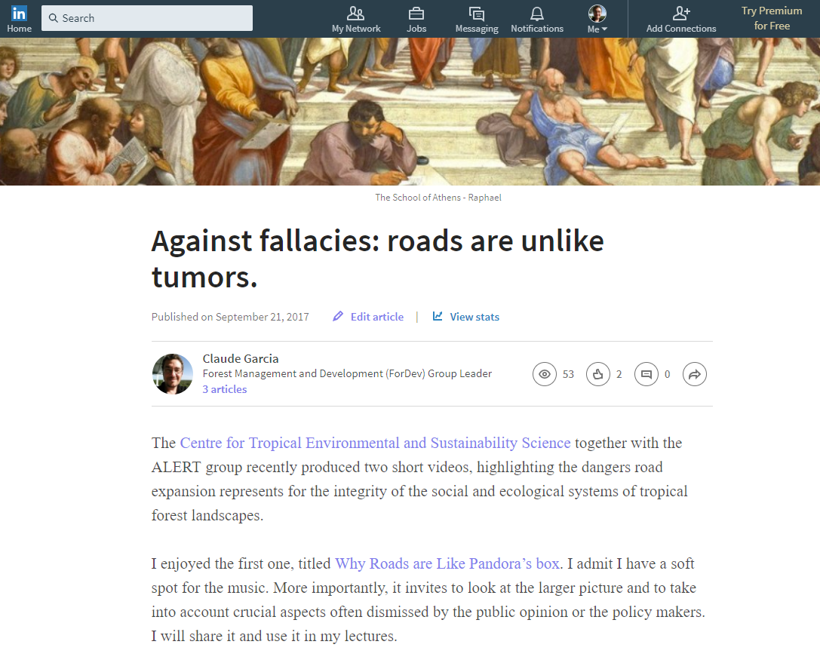

Slide 16
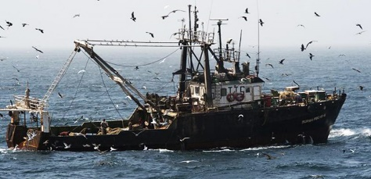
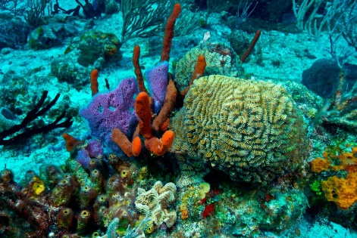

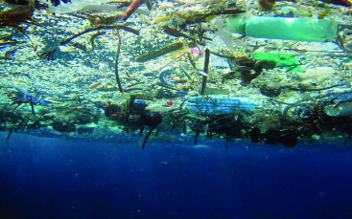
Oceans

