Slide 1
Technologies for observing and monitoring plastics in the oceans
René GARELLO
Fellow IEEE
Professor IMT
ExCom member GEO

Slide 2
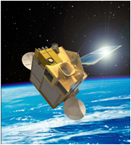
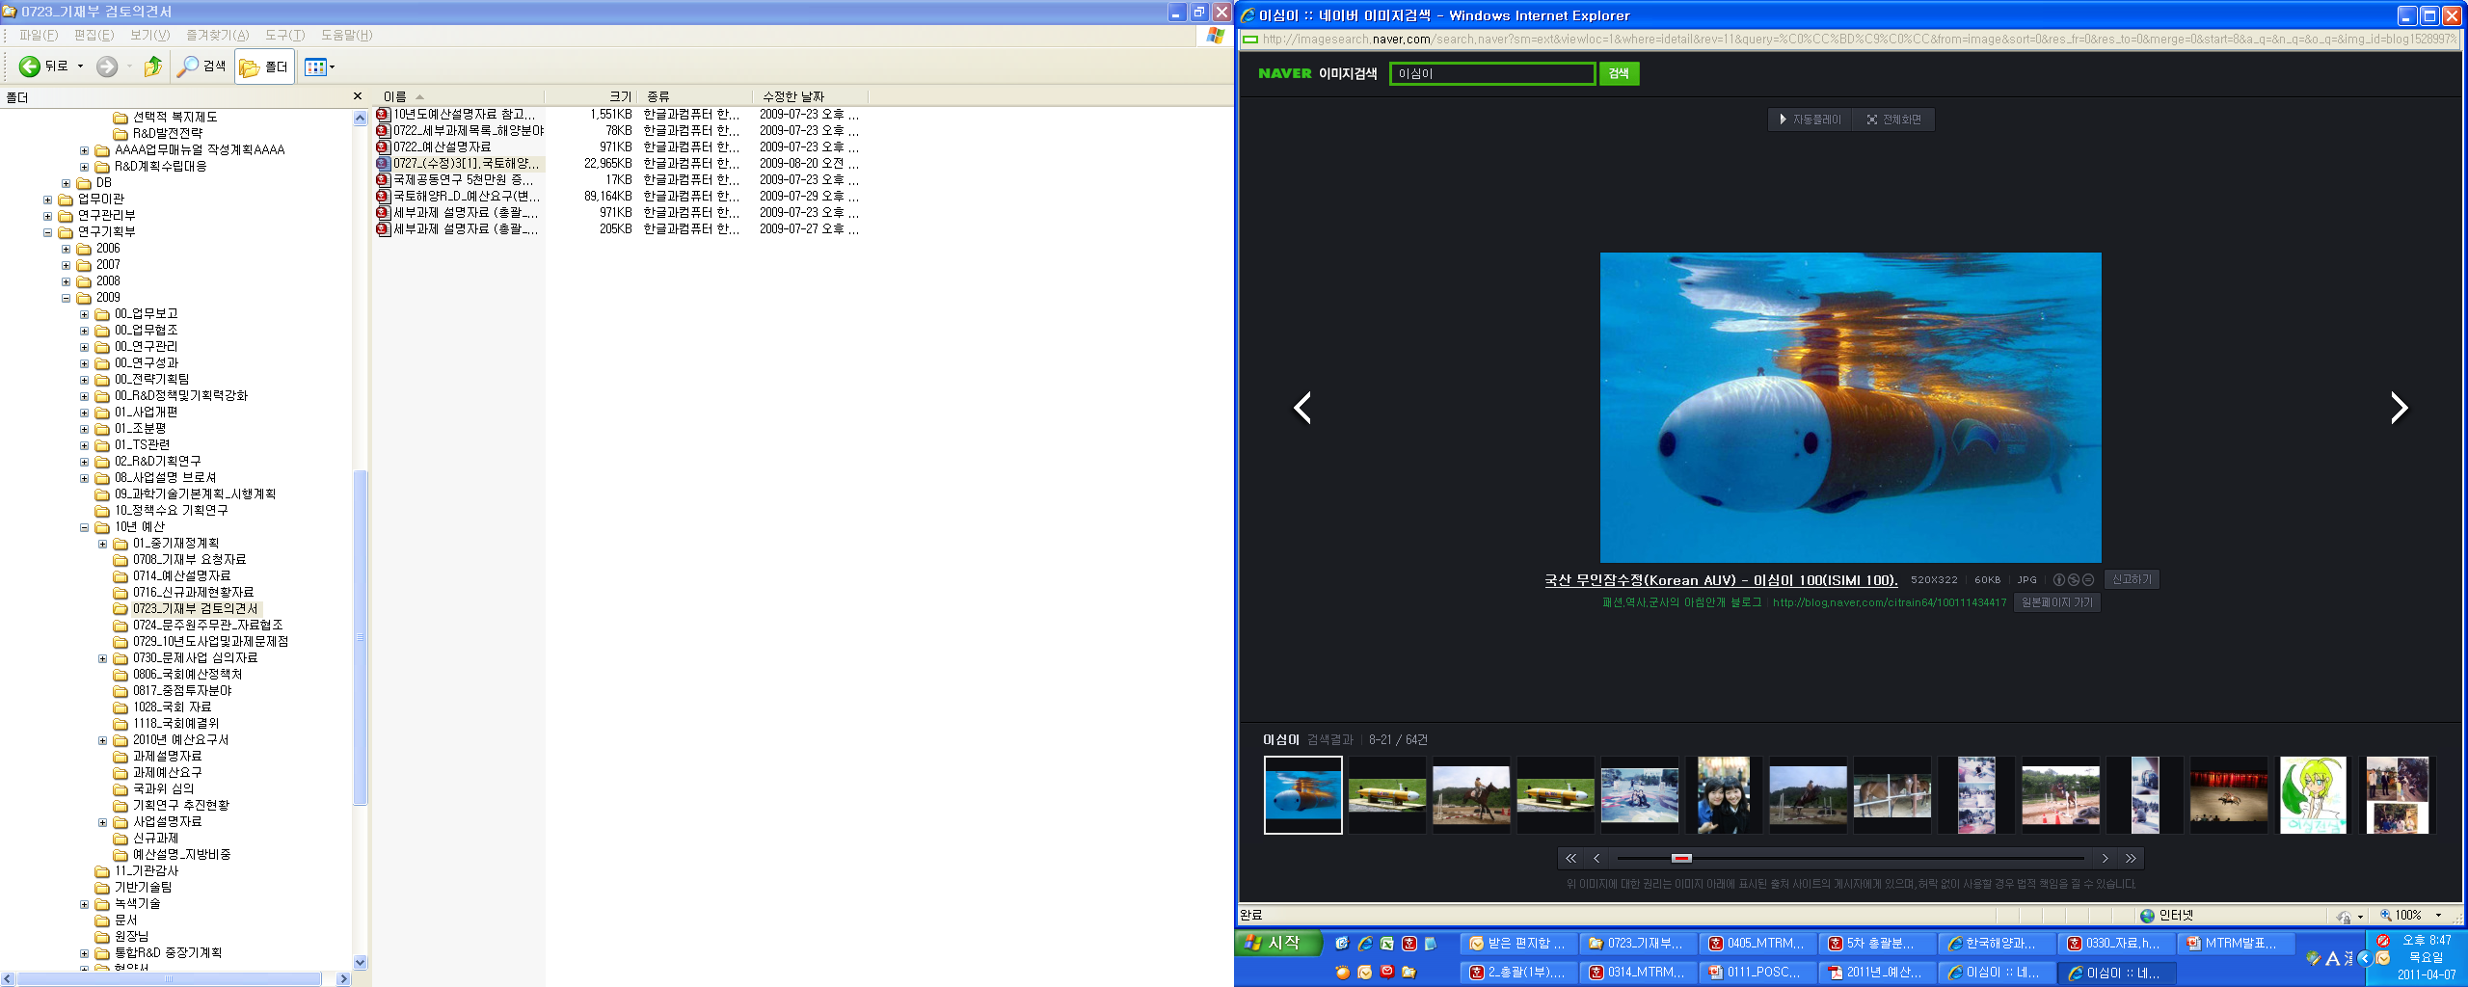
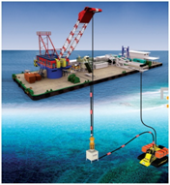
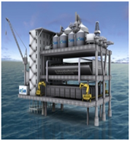
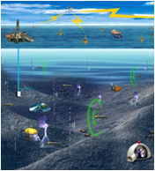
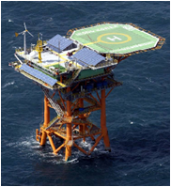
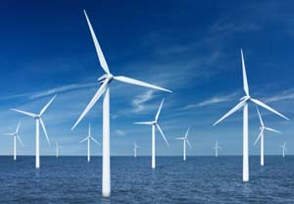
OES in the IEEE
Signal
Communication
And Acoustical Processing
Instruments
Sensors
Vehicles
Information
Processing
Modelling
Understanding, monitoring, predicting
the marine environment
Physical Observations
Ocean Energy
Global
Observation

Slide 3
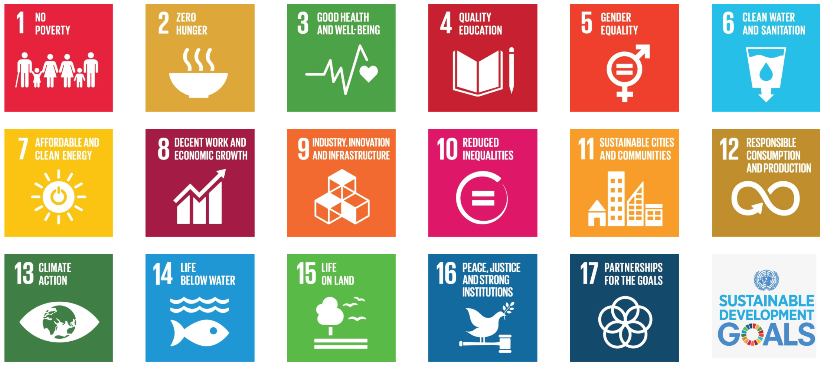
(a)
(b)
Goals
Goals
Targets
Targets
169 targets
230 indicators
Indicators
Indicators
Essential Variables
Observations
Observations

Slide 4
What Is Sustainable Development?
“Sustainable development is development that meets the needs of the present without compromising the ability of future generations to meet their own needs.”
Brundtland Report, http://www.un-documents.net/ocf-02.htm.
Our Common Journey: A Transition Toward Sustainability
William C. Clark Robert Frosch Robert Kates
National Research Council, Policy and Global Affairs, Policy Division, Board on Sustainable Development

Slide 5
Technologies for observing and monitoring plastics in the oceans
Aim
Roadmap / White Paper around the observing/monitoring theme.
Goals
Determine the strategy for monitoring the plastics in the ocean.
Objectives
Assess the means of observation and the methods of detection, according to indicators to define.

Slide 6
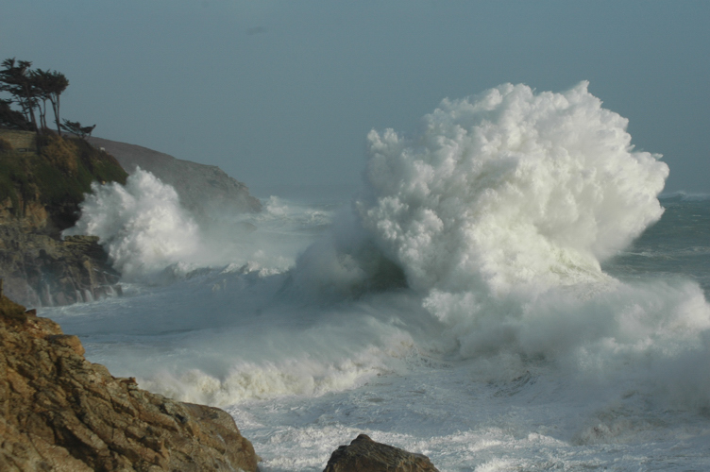
Welcome

