Slide 1
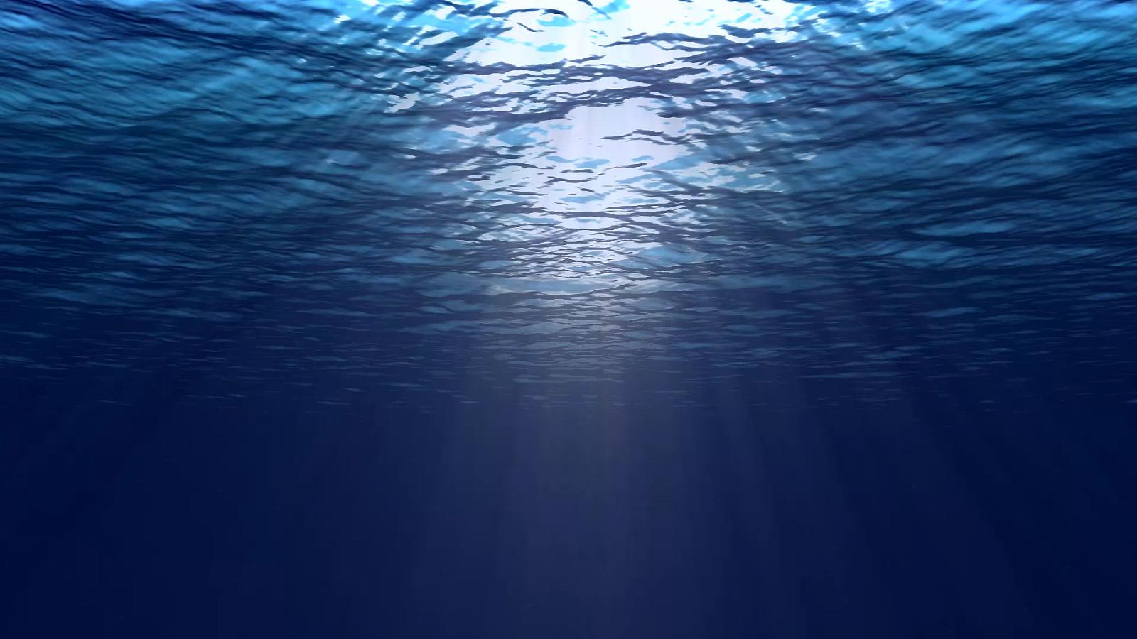


Slide 2
Our Goal :
Collect floating plastics in the coastal area
Efficiently
With the support of all sea users

Slide 3
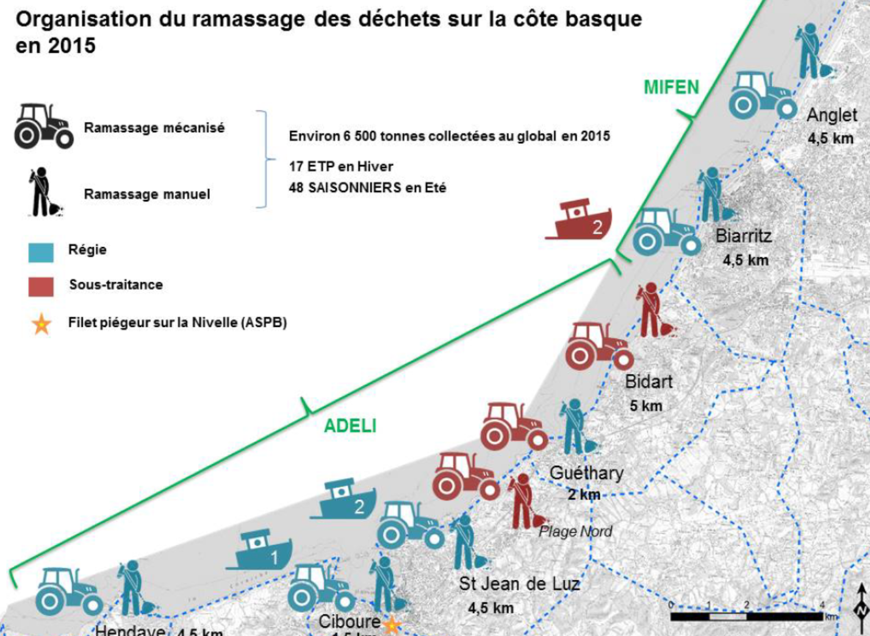
How it all started :
Existing initiatives & experiences on the French coasts
  Basque Country 6 ships
  Mediterranean Coast 2 ships
  … ?
Identified limitations to the existing plans
Technical solutions to enhance efficiency
Global awareness of the plastic problem
Costs of environmental damage attributed to plastic pollution in Europe, is estimated at 22 billion euros by 2030 (europarl.europa.eu)
Economic strategy to set up a pilot project

Slide 4
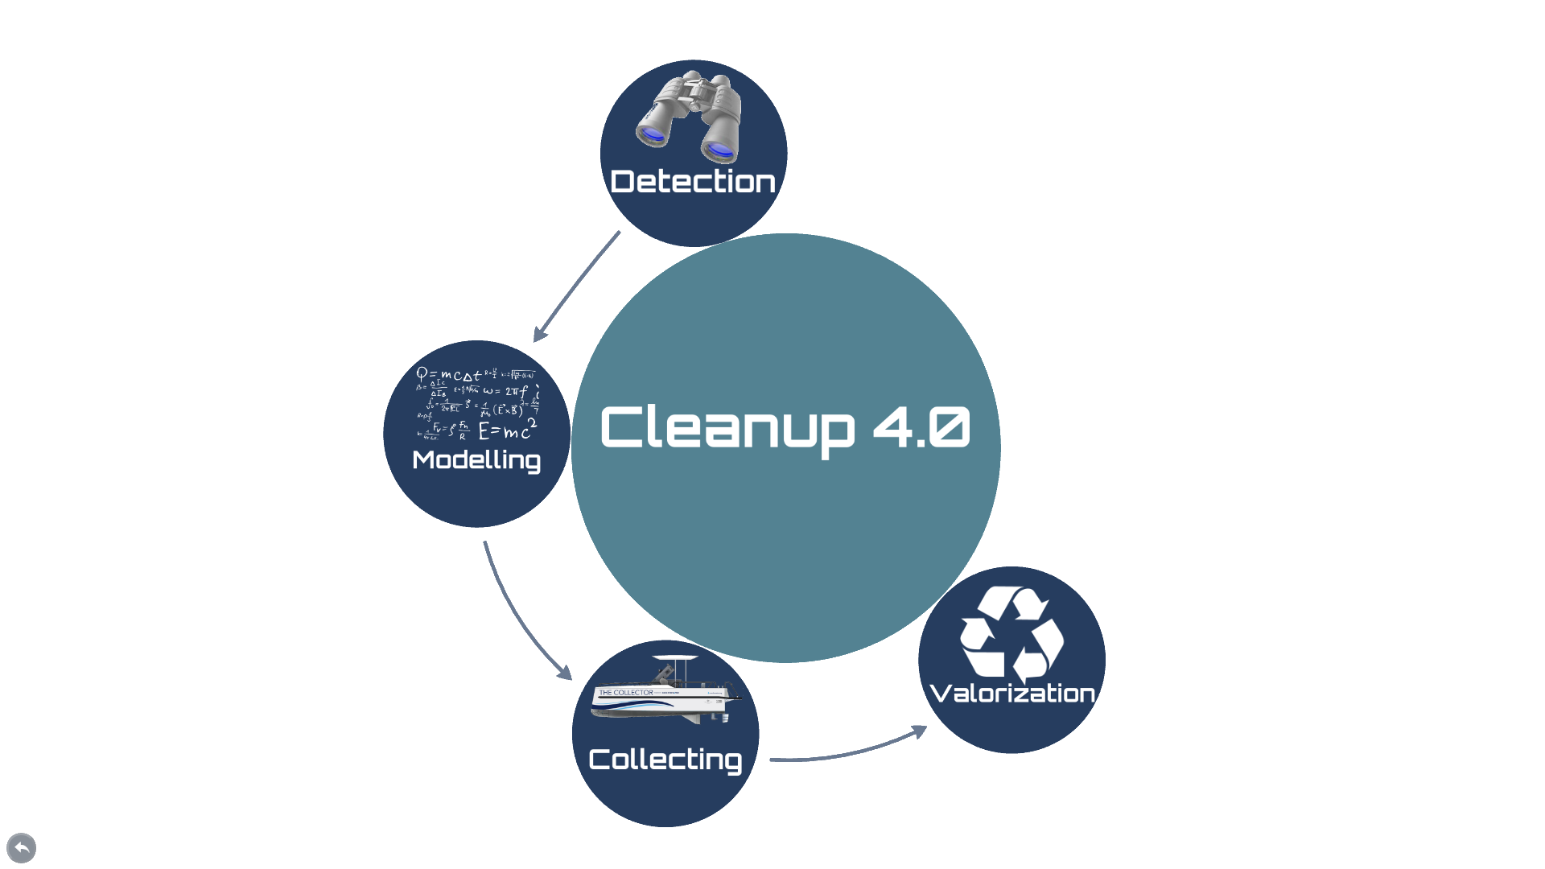
Operational Strategy

Slide 5
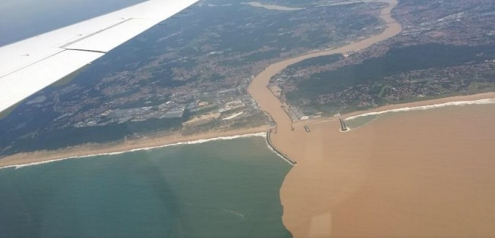
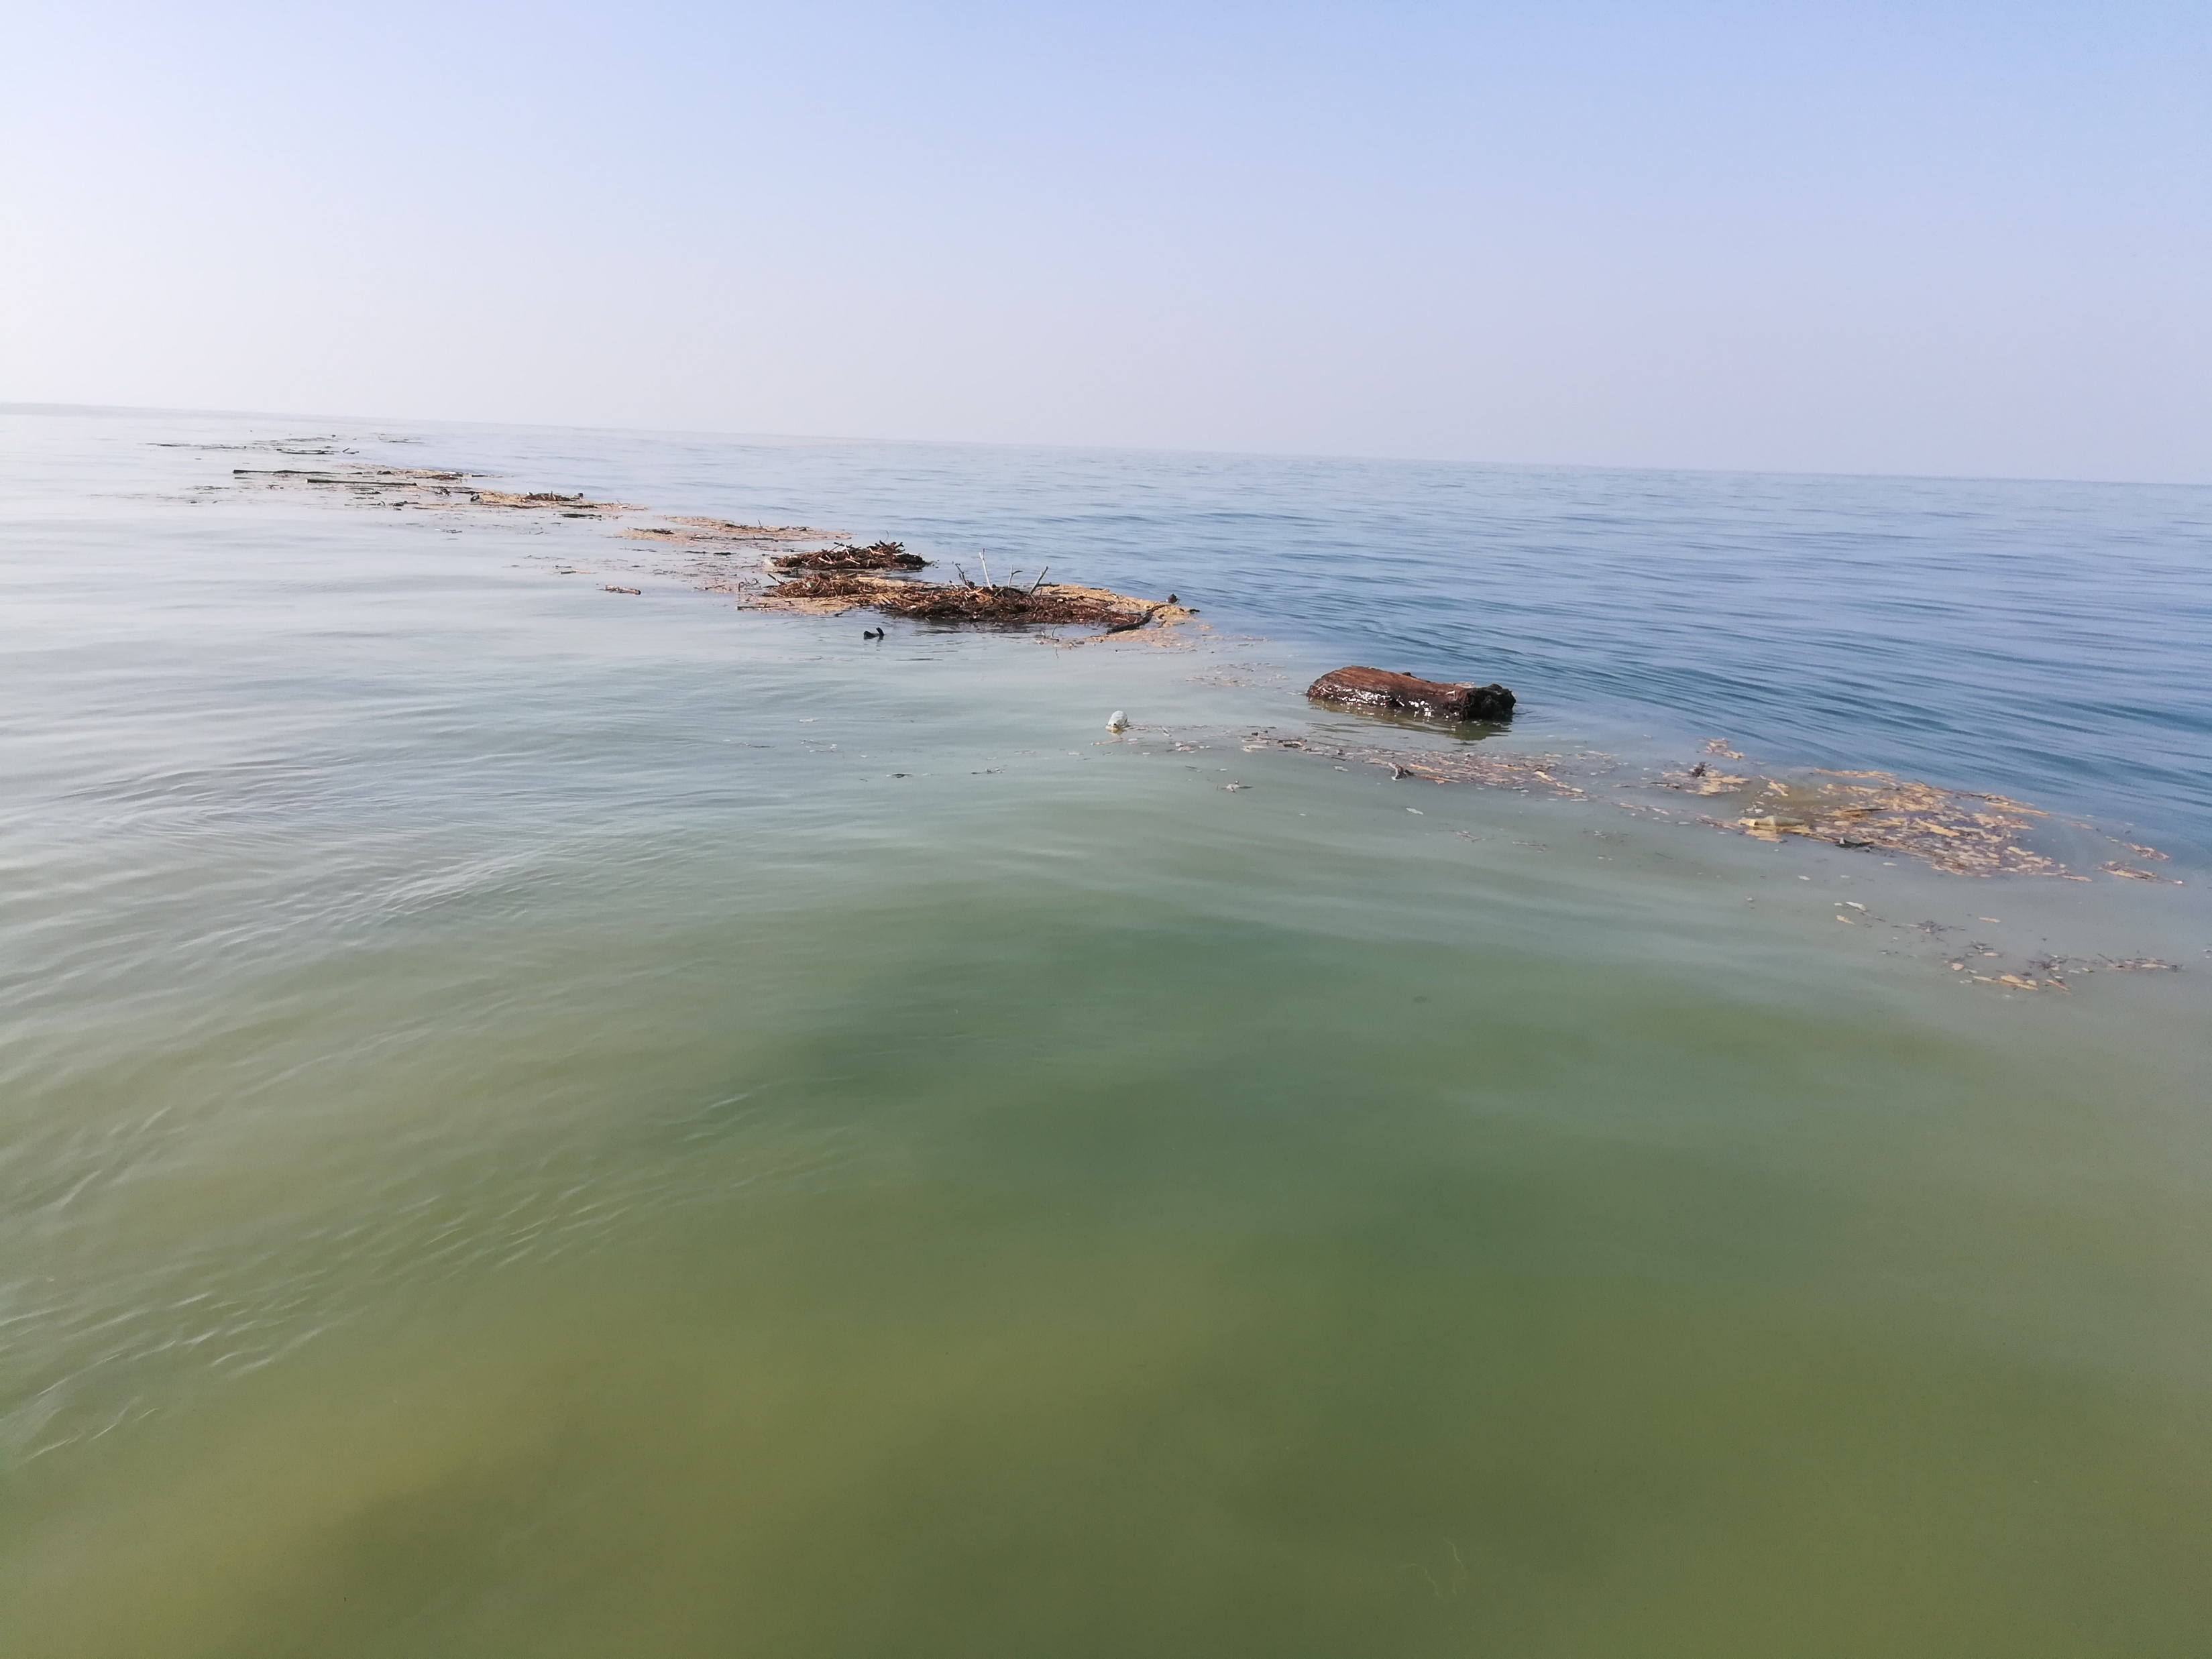
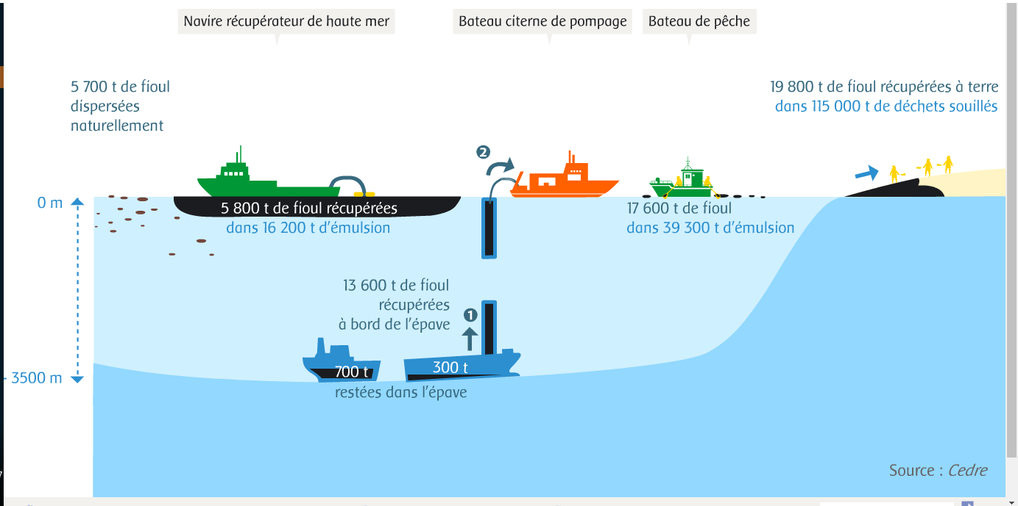

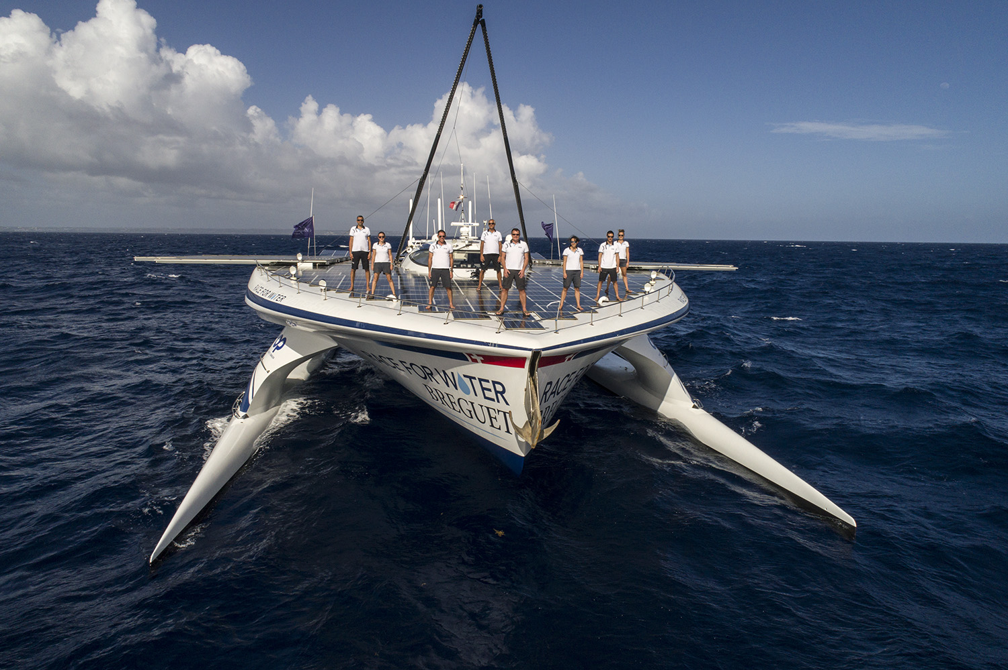

80 % of plastics transit through rivers
Prestige oil spill
Many small units are more efficient than a single large vessel

Slide 6
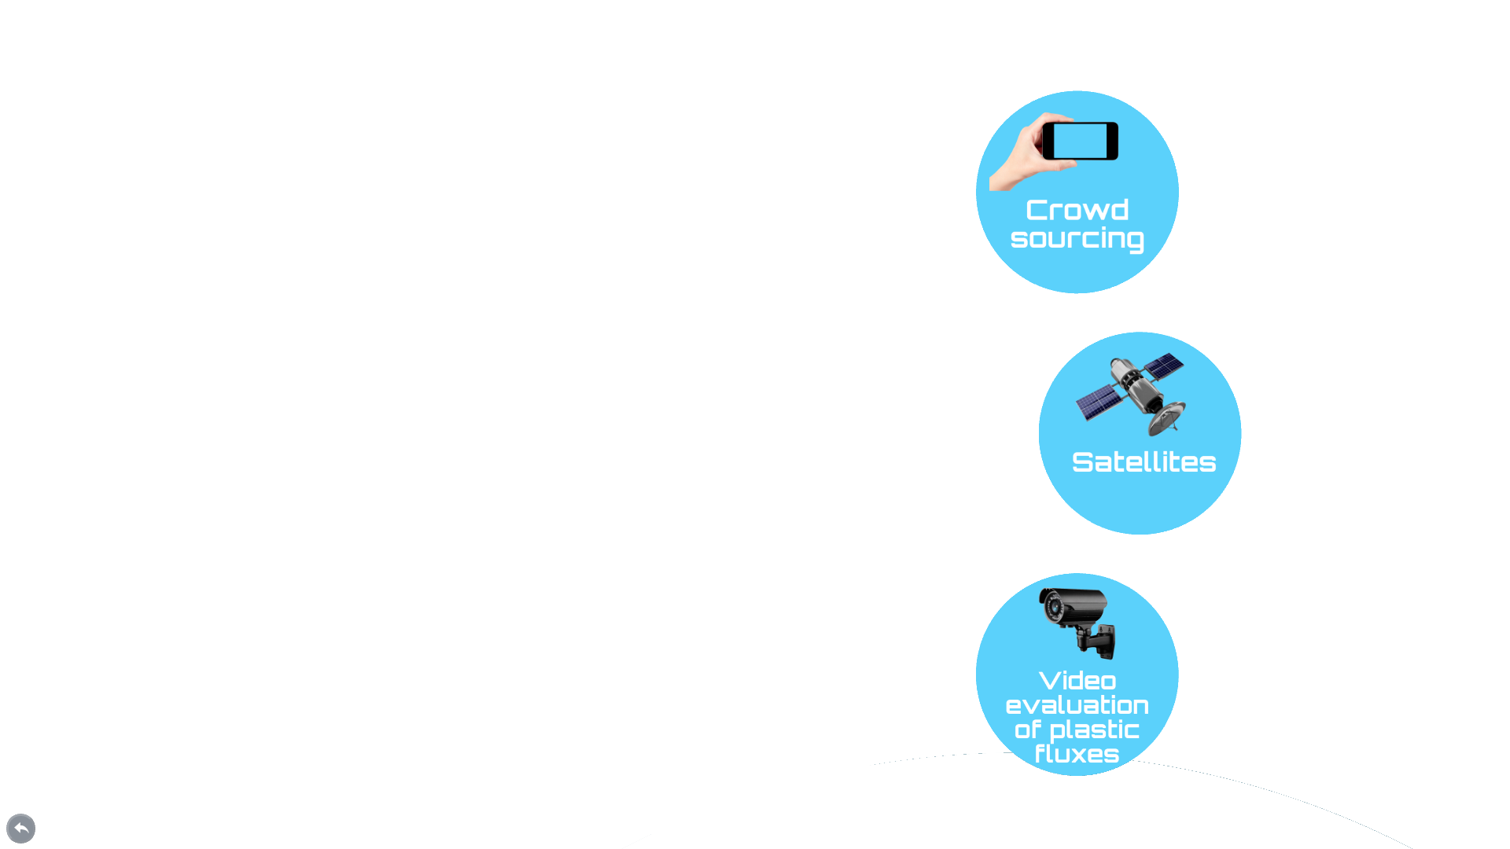
Operational Strategy

Slide 7

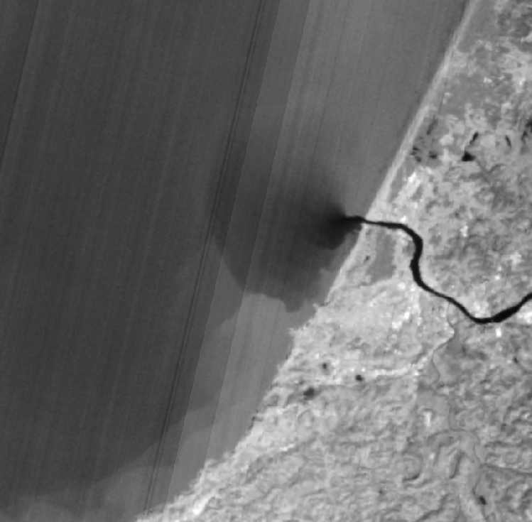
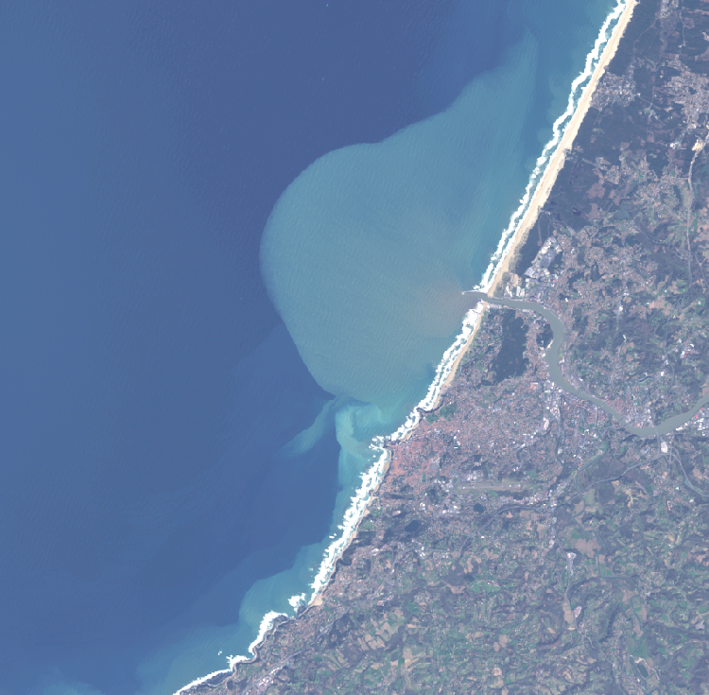
Marine Front Detection
As a proxy to locate potential plastic accumulation areas
High resolution optical satellite data (Landsat-8 / Sentinel-2)
  Landsat-8 thermal bands to detect thermal fronts
  Landsat-8 and Sentinel-2 optical bands (NIR) to detect turbidity fronts
Landsat-8 thermal bands
Sentinel-2 visible bands

Slide 8
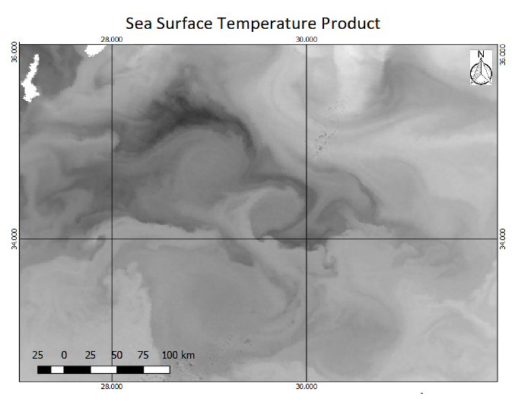
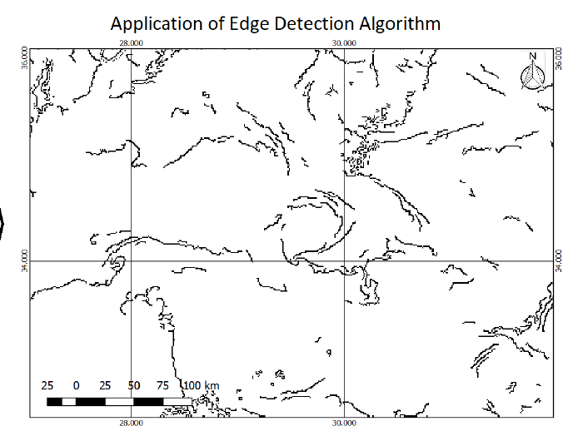
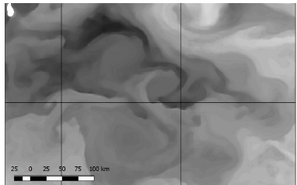
Marine Front Detection
Edge detection algorithms
Fronts detected by their high gradient difference
Laplacian kernel / Canny / Mean-Shift
Sensitivity to noise → Filtering is needed
Detected edge objects → inputs for the drift forecasts
Denoising filters
Miltiadou, M., Papoutsa, C., Karathanassi, V., Kolokoussis, P., Lafon, V., … (2018, August). Detection of marine fronts: a comparison between different approaches applied on the SST product derived from Sentinel-3 data. In Sixth International Conference on Remote Sensing and Geoinformation of the Environment (RSCy2018)

Slide 9
Operational Strategy

Slide 10
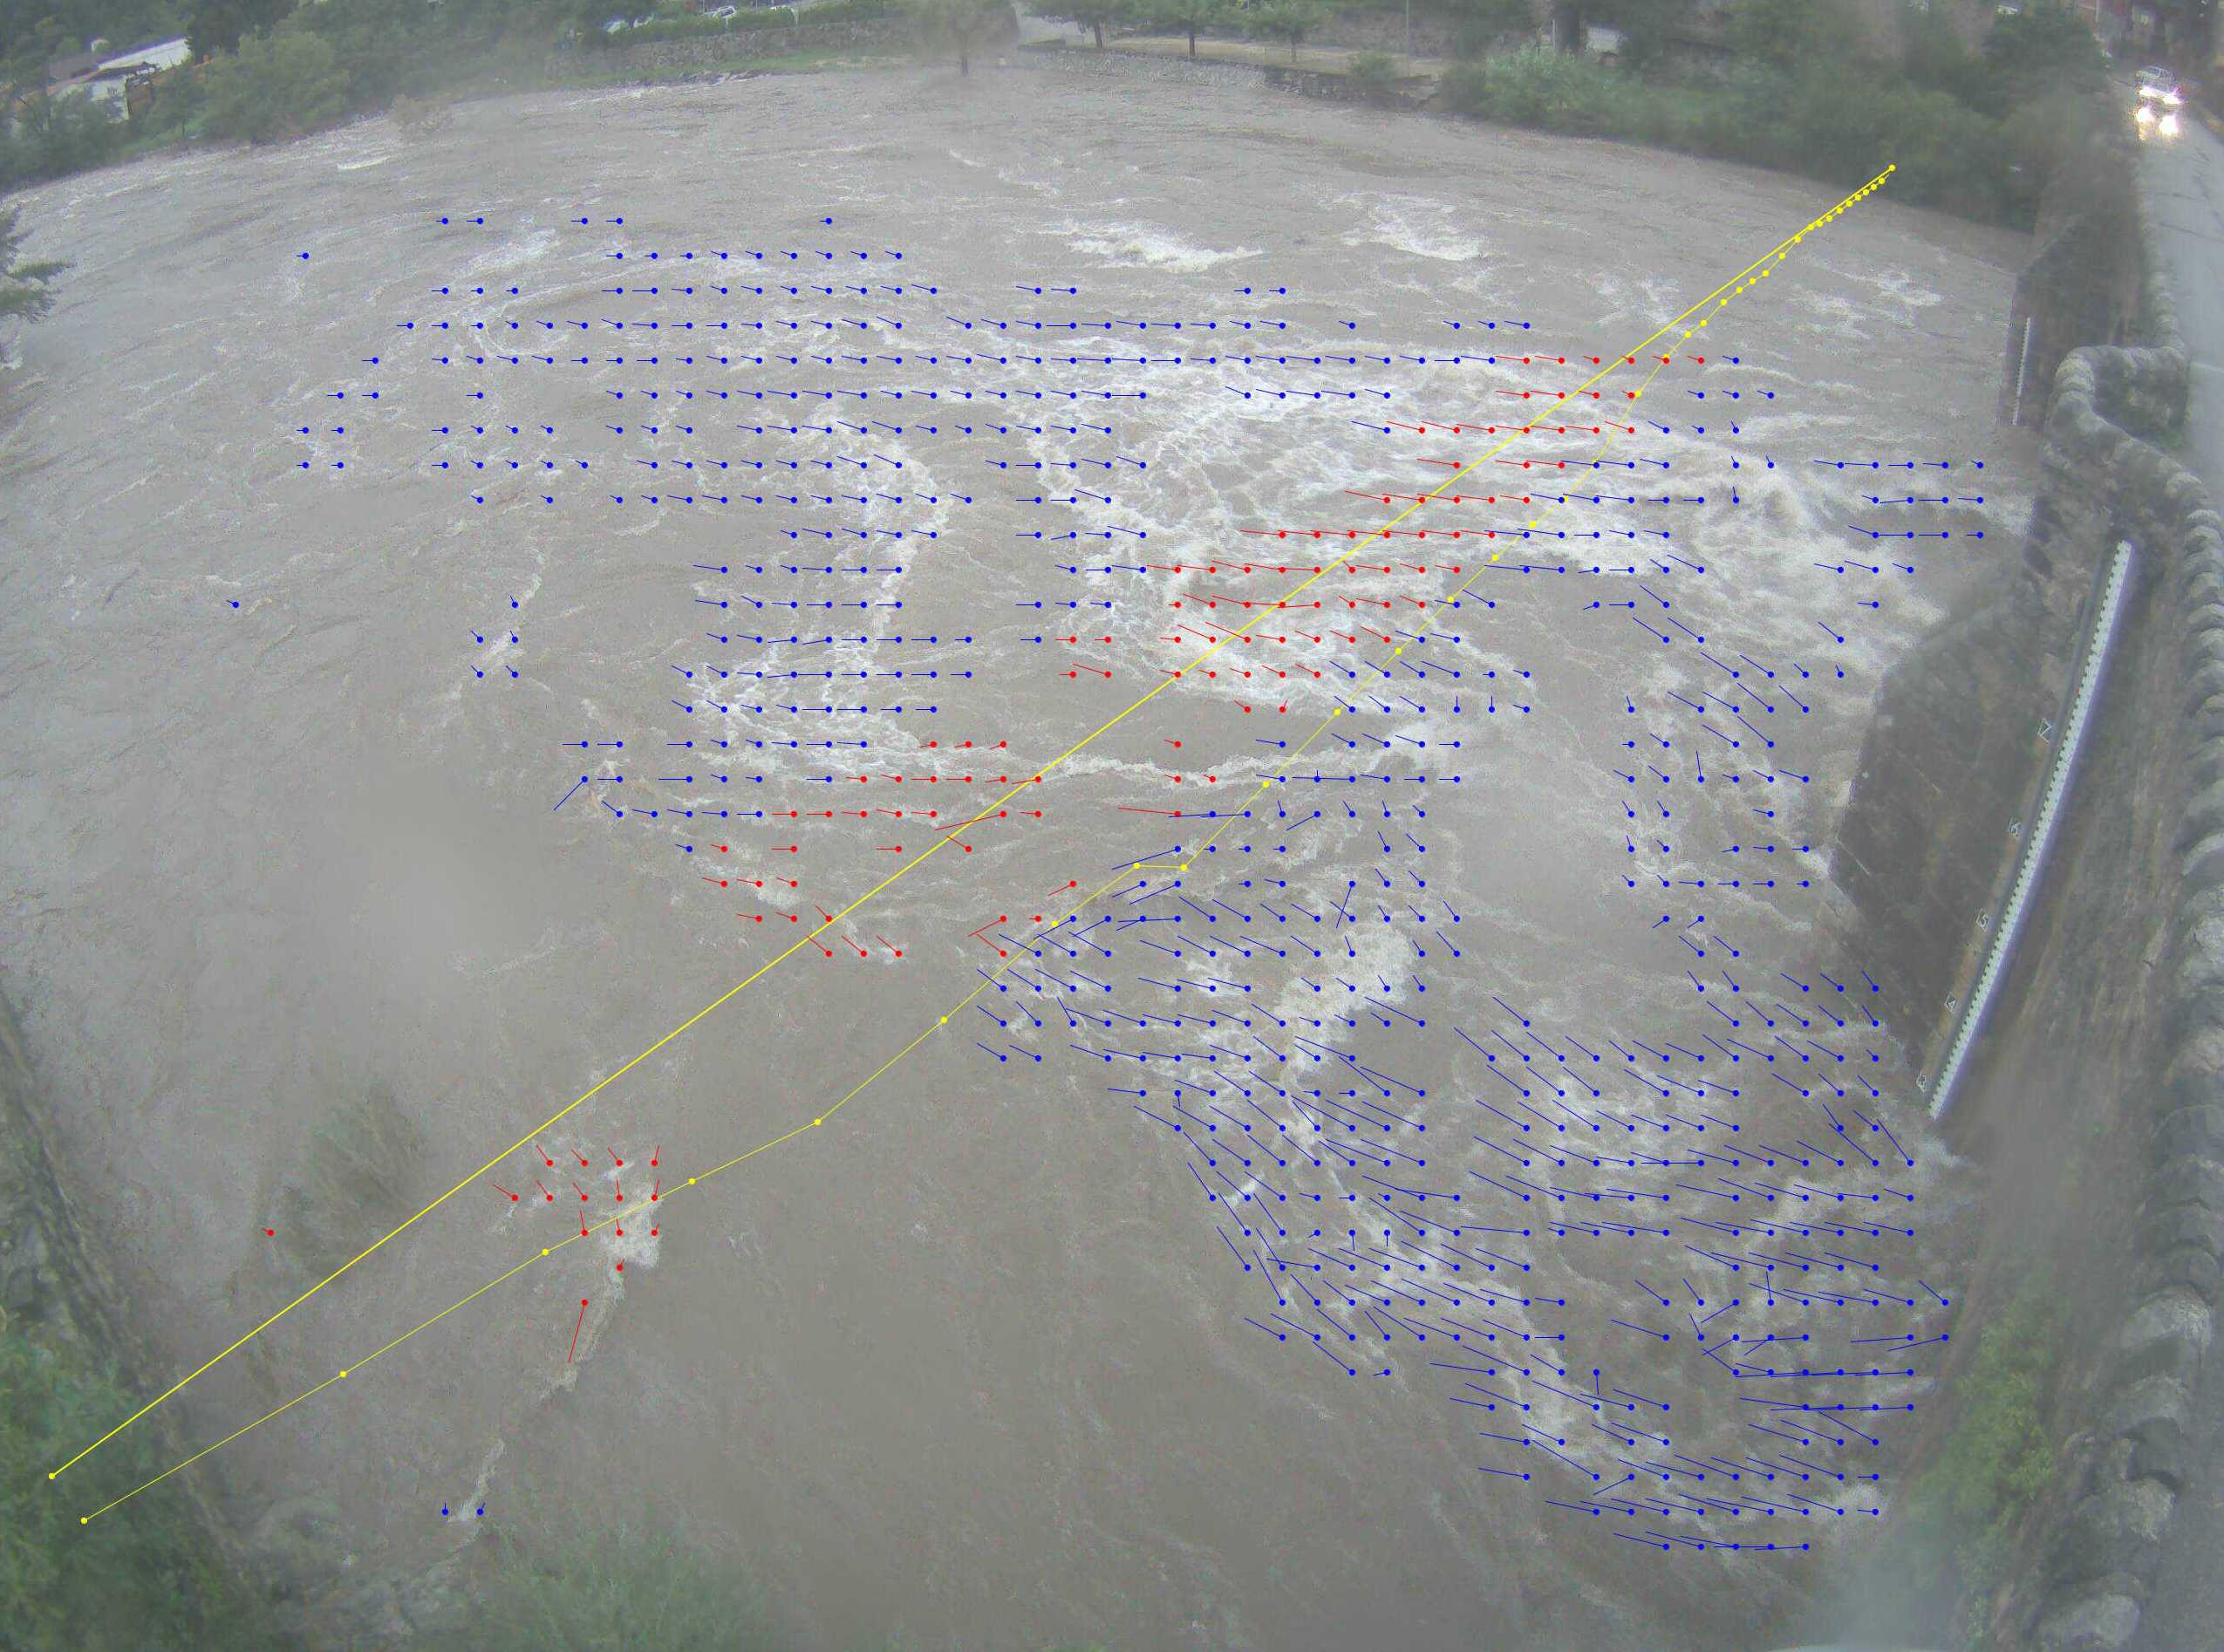

Video Sensing

Slide 11
Operational Strategy

Slide 12

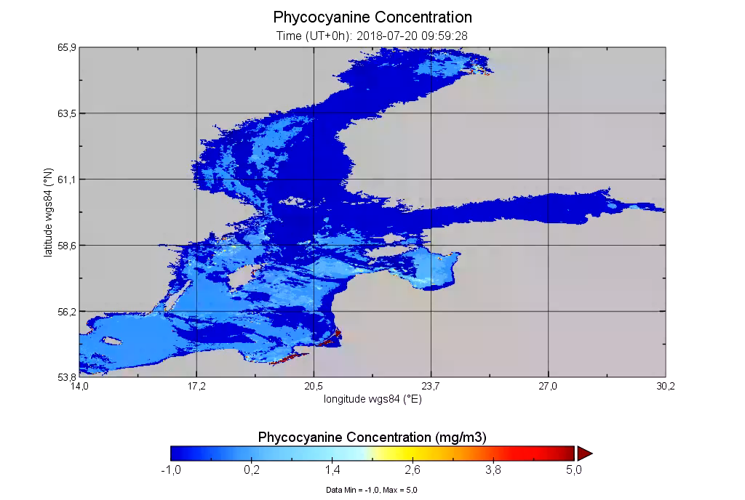
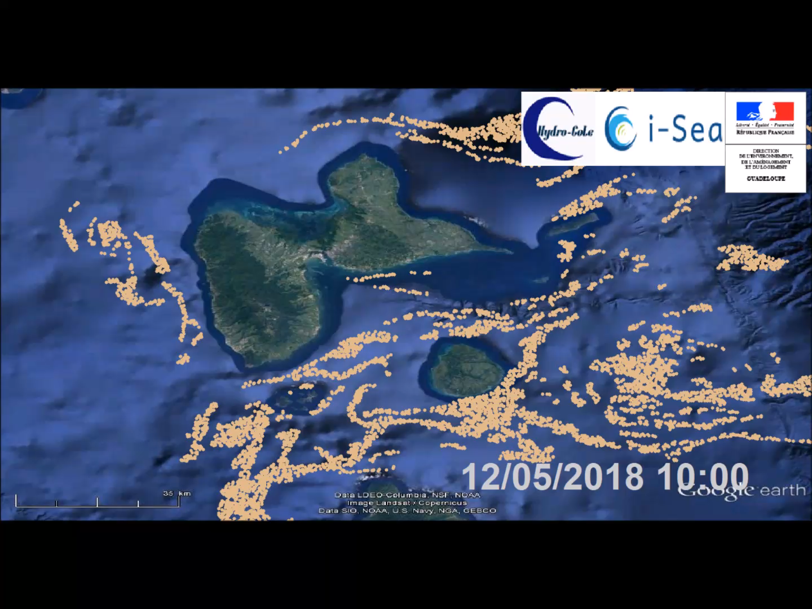
Drift Forecast

Slide 13
Operational Strategy

Slide 14



Partnerships :
Technical
functional
financial

Slide 15



Development Plan :
Development of web marketing tools
Crowd Funding
Grant application (Public)
Fund Raising (investors)
Pilot project setup on the French Basque Coast with support from Regional, National, European funds

Slide 16

Together let’s clean our ocean, join us on :
icleanmysea.com
@icleanmysea
@icleanmysea
icleanmysea
contact@icleanmysea.com

