Slide 1
ODYSSEA project:
Data collection on water column
Sergio Martinez
Javier Martinez
November 2018

Slide 2

About us
Applied research in Europe and South America
240 professionals
Spain
6 locations
>220 R&D Contracts
22 million € revenue
>90% customer loyalty
Chile
2 locations
Applied research
Health & Biomedicine
Circular Economy
Energy + Engineering
Advanced Technological Solutions
Applied Chemistry & Materials
odysseaplatform.eu |@odysseaplatform

Slide 3
Business Units
Energy conversion & storage
Electronics & communication
Robotics
Product development
Energy +
Engineering
Applied Chemistry & Materials
Nanomaterials
Polymers & Coatings
Lubs & Greases
Detergency & cosmetics
INDUSTRIAL
& SOCIETAL
INNOVATION
Circular
Economy
Health &
Biomedicine
Waste valorization
Bioeconomy
Pollutants Control
Sustainability
Water Reuse
Advanced
Technological
Solutions
Preclinical studies
Antibodies
Drug discovery
Diagnosis
Analytical Chemistry
Inverse Engineering
odysseaplatform.eu |@odysseaplatform

Slide 4
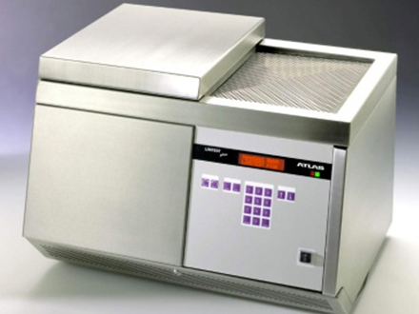

What we are working on
Studies of nanohealthy.
Concentration of some othe pollutants
Impact of nanoparticles on human health
Studies to determine particles on prawn & schrimp
Systems for water filtering on a WWTP
Characterization, separation and recovery
Use and evaluation of diferent techniques and equipment
FTIR
GPC-RI (Gel Permeation Chromotography – Refractive Index
MALDI – ToF / ToF
Mass spectrometry technique that used soft ionization
Allow the analysis of biomolecules: DNA, proteins, peptides
Methods to identify and quantify textile MP released during laundering of synthetic textiles
Influence of detergents
Influence of whashing conditions
Influence os textile topology
Using a Linitest apparatus (URAI S.p.A., Assago, Italy) for lab simulation of real washing machines operating in both domestic and industrial conditions
Design and development of automated systems
odysseaplatform.eu |@odysseaplatform

Slide 5
Automated systems
What they should offer:
In-situ measurements
Real time mapping
Information availability
Decrease analysis time
Integration within existing platforms
  Ferry box / research vessels or boats
  Gliders
  Landers
  Surface platforms
But…
Diversity: Microplastics are not homogeneus, with a lot of inferents (aging, eutrophications, contaminants....)
Spatial range: If we plan to monitor wide areas, use of buffering and concentration tools are required. Otherwise maybe the sample is not significative.
Speed and size: It determines the resolution of system, in terms of computation speed and range of particles that can be identified.
odysseaplatform.eu |@odysseaplatform

Slide 6
To consider previously
This is the most important part. How to perform a representative or a least an effective sample acquisition
1. Sampling
How to diferentiate microplastics from other sources. (sand, algae, fishes…)
2. Detection
3. Quantification
To determine how many of the detected particles are microplastics, and to enumerate them. If feasible provide a number in terms of concentration.
4. Study / conclusions
Provide all the numbers in order to give an idea about general concern of microplastics.
Reproducibility
y repeatability
In other to provide the same conclsuions in the same experiments (validation purposes).
Assays should be not destructive, in other to allow counter-analysis.
odysseaplatform.eu |@odysseaplatform

Slide 7
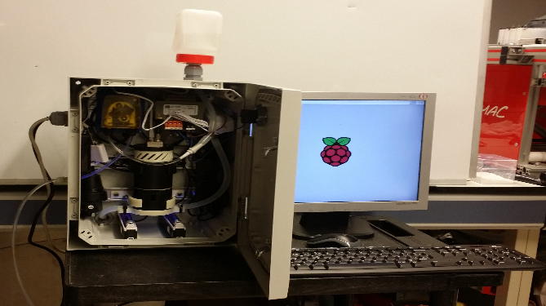
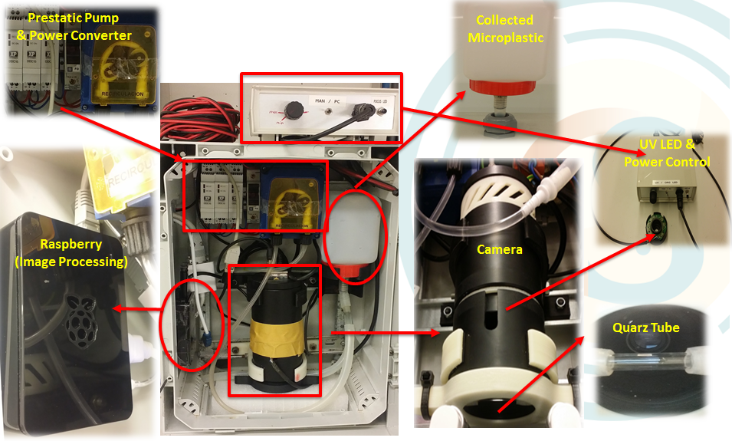
Previous experience
COMMON SENSE was an Oceans of Tomorrow 2013 Project, devoted to provide innovative sensors, in order to meet MSFD
LEITAT developed a first prototype of an automated microplastics sensor for in-situ measurements.

Slide 8
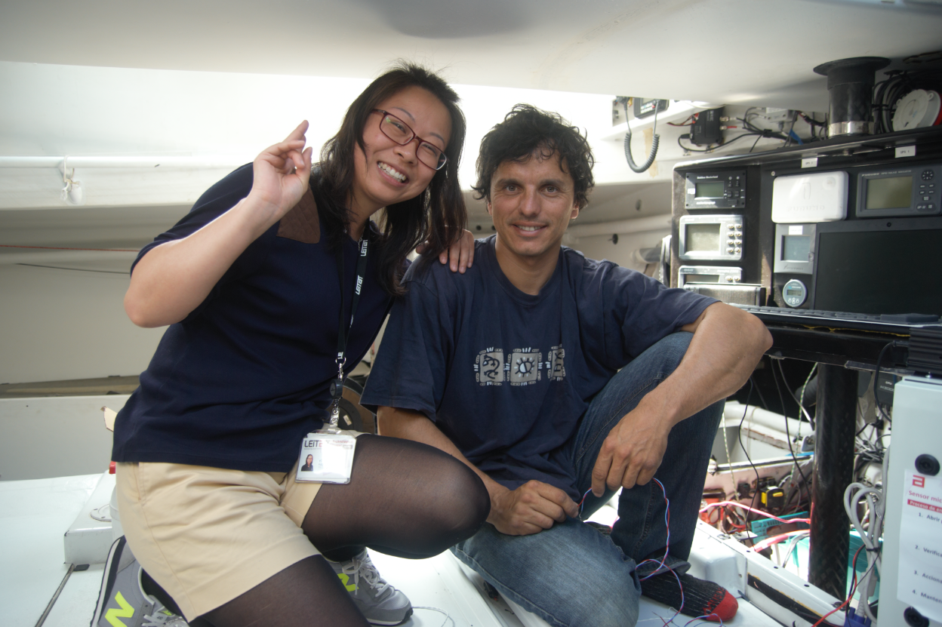
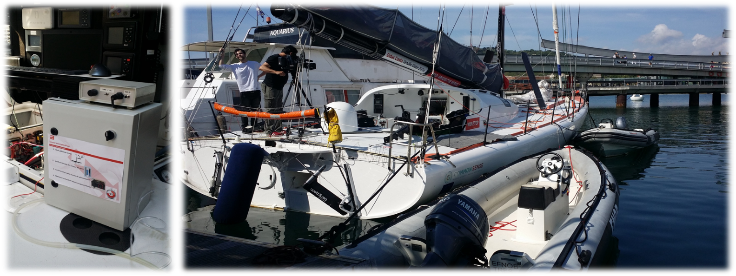
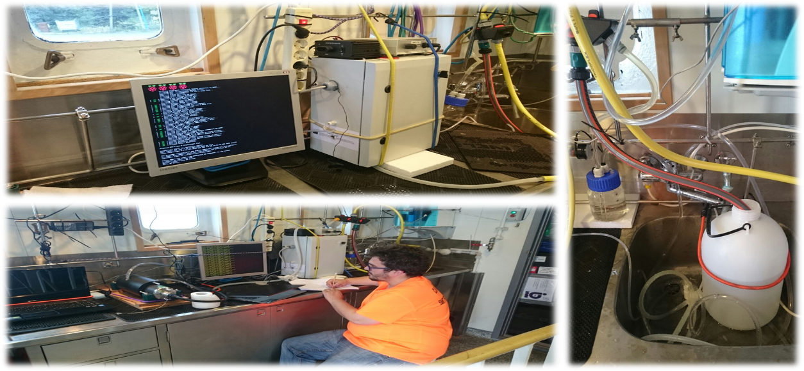
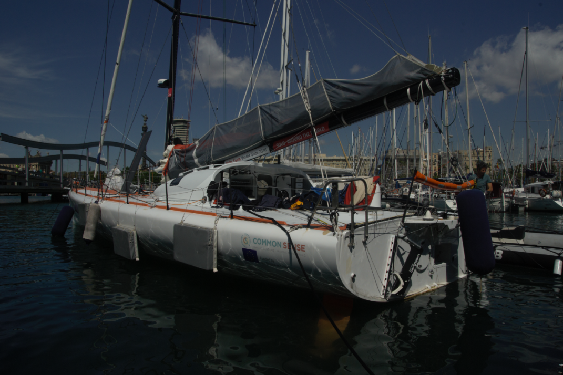
Previous experience

Slide 9
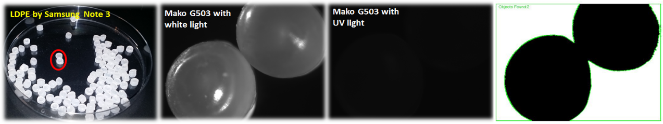
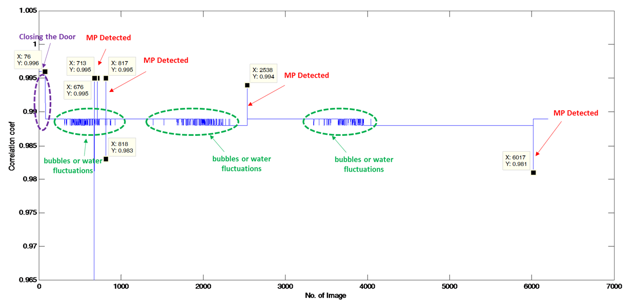
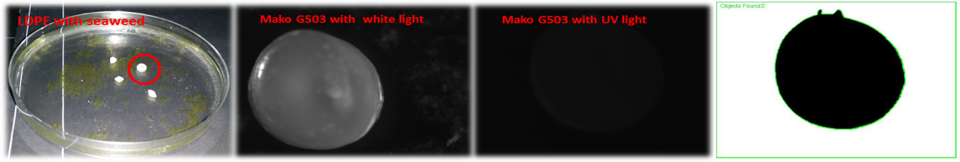
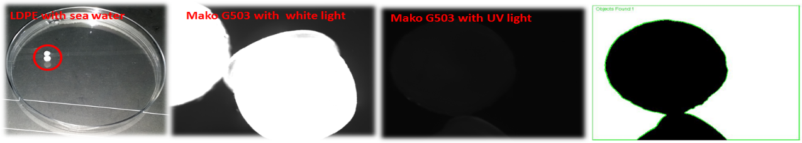
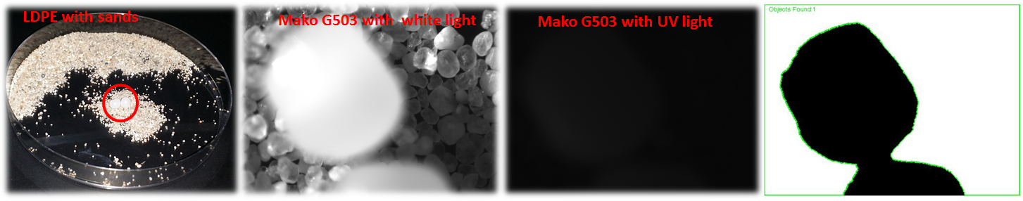
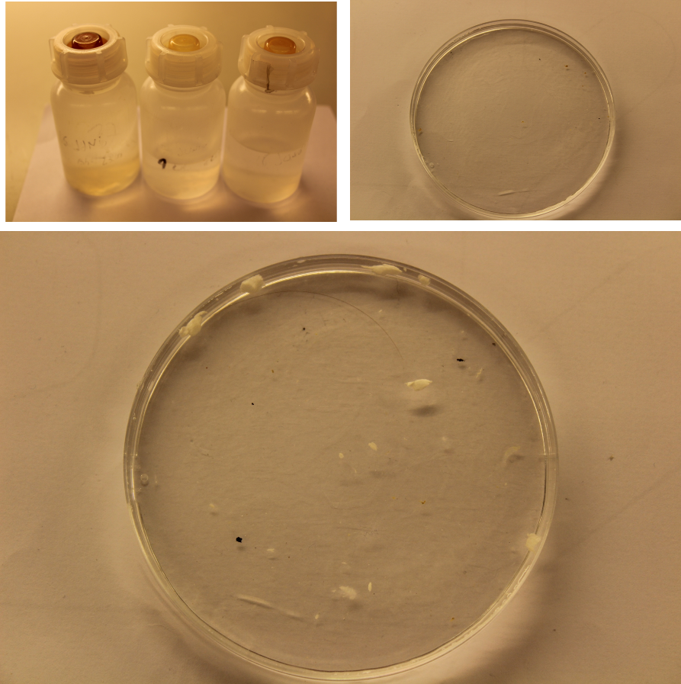
Previous experience COMMON SENSE
odysseaplatform.eu |@odysseaplatform

Slide 10
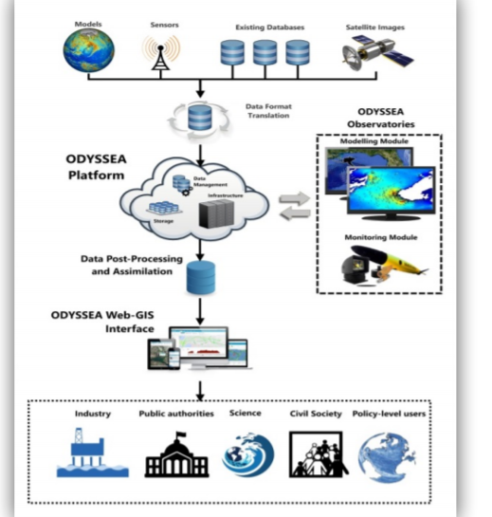
ODYSSEA project
ODYSSEA is a user-centred project aiming to make Mediterranean marine data easily accessible and operational to multiple end-users
ODYSSEA is a system bridging the gap between operational oceanography capacities and the need for information on marine conditions from the community of end-users.
ODYSSEA’s ambition is to develop an interoperable, fully-integrated and
cost-effective multiplatform network of observing and forecasting systems across the Mediterranean basin, addressing both the open sea and the coastal zone.
odysseaplatform.eu |@odysseaplatform

Slide 11
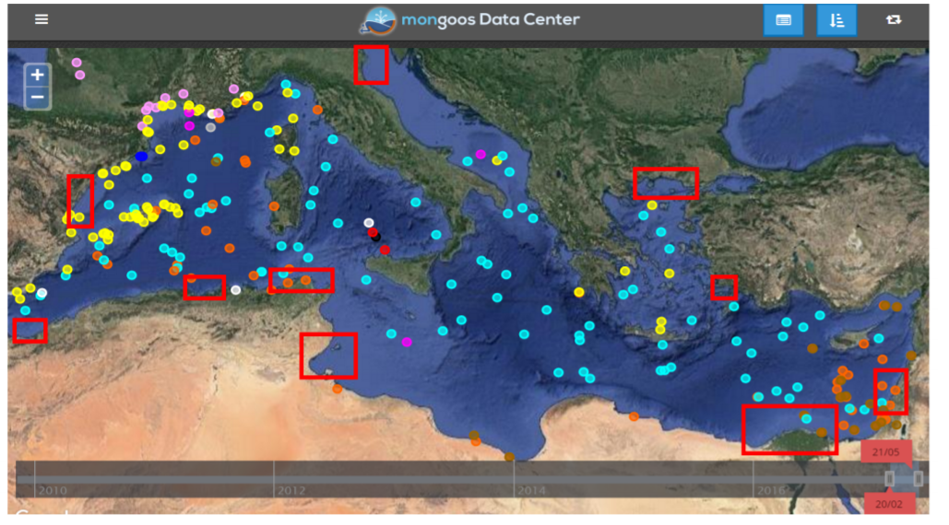
ODYSSEA project
odysseaplatform.eu |@odysseaplatform

Slide 12
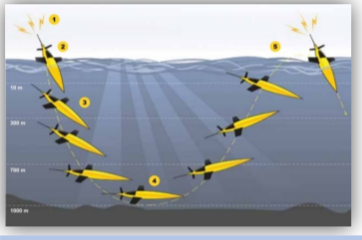
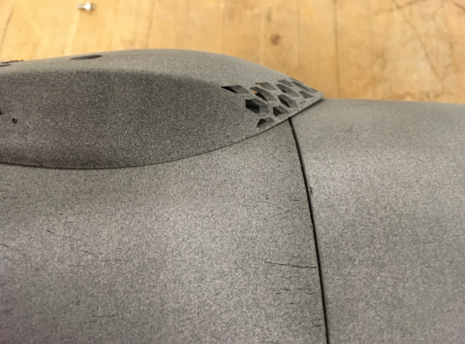
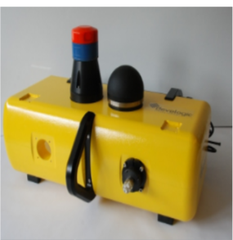
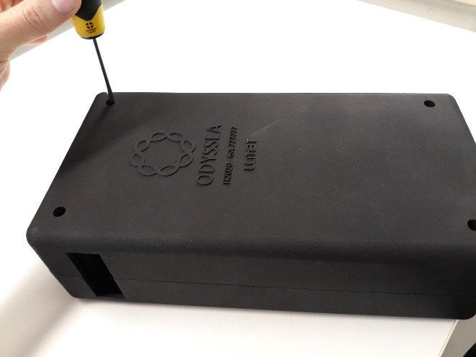
Odyssea sensors: Where
odysseaplatform.eu |@odysseaplatform

Slide 13
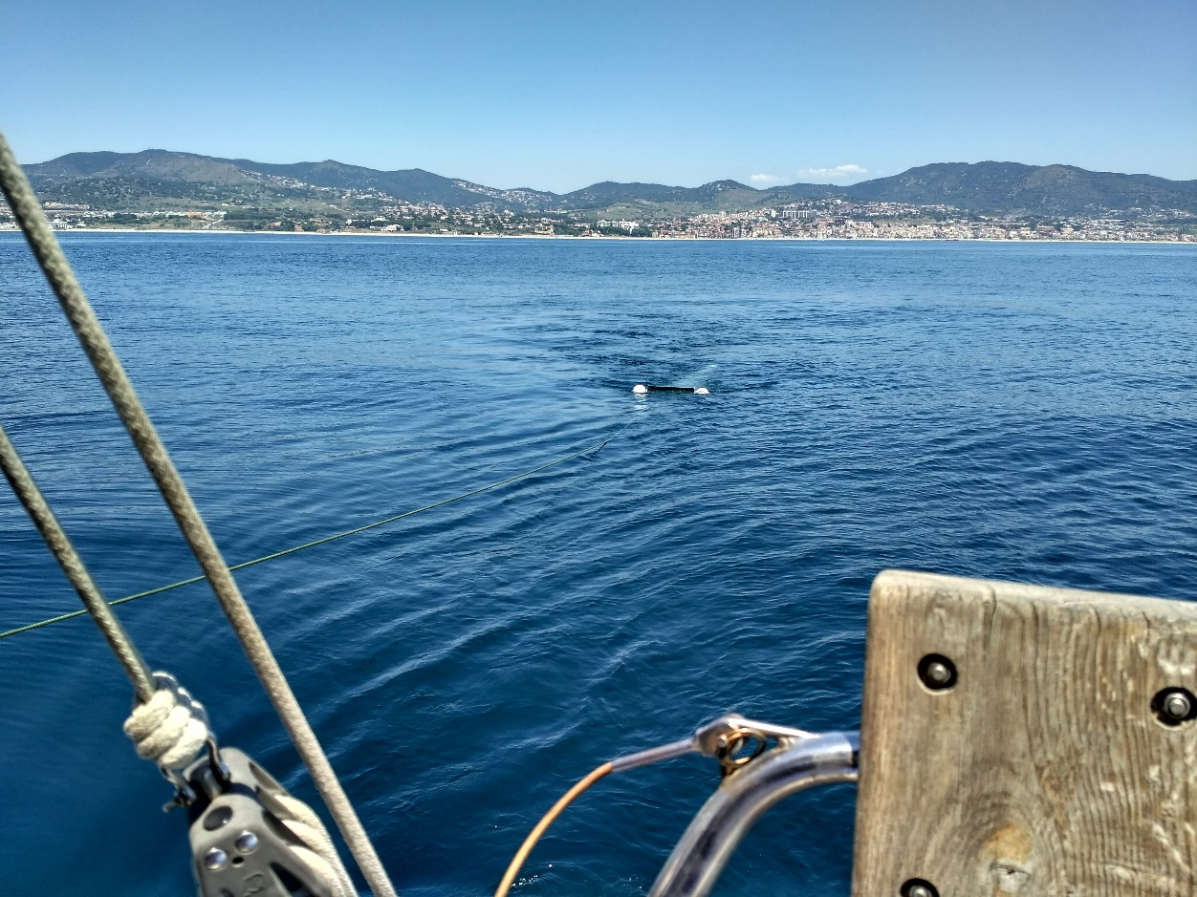
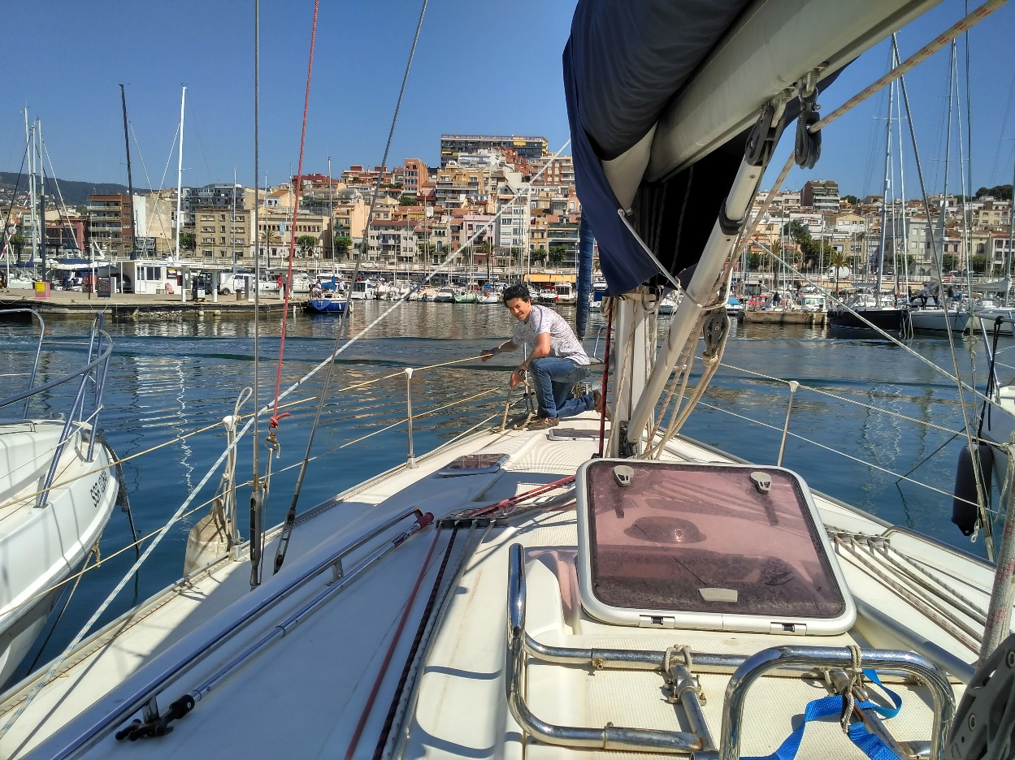
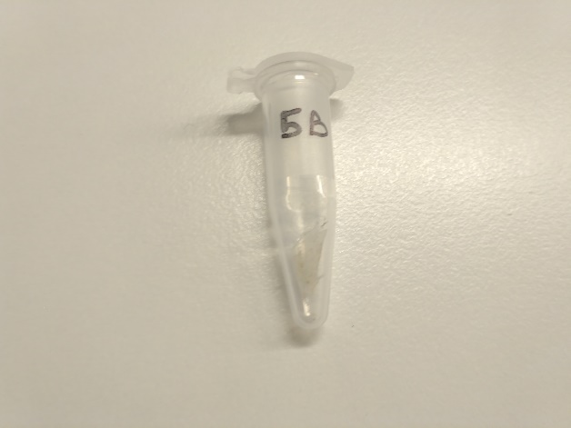
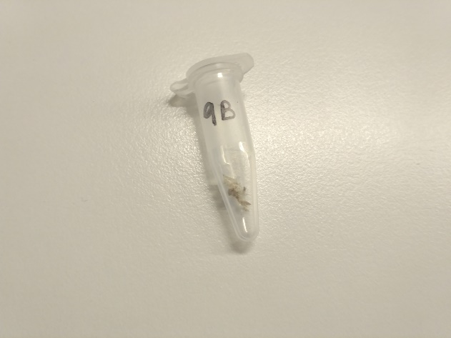
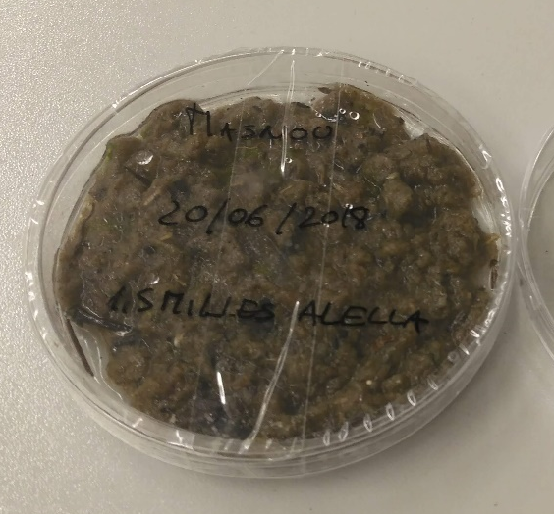
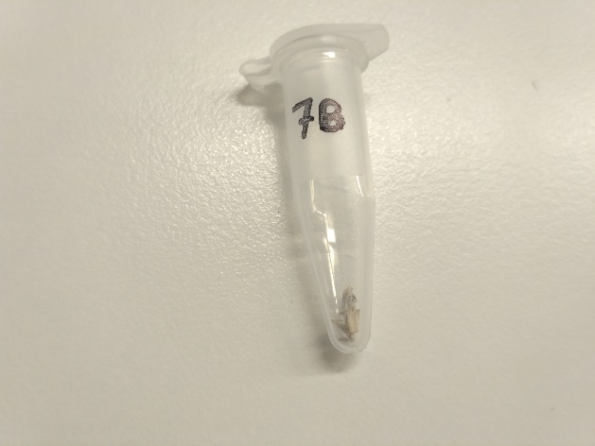
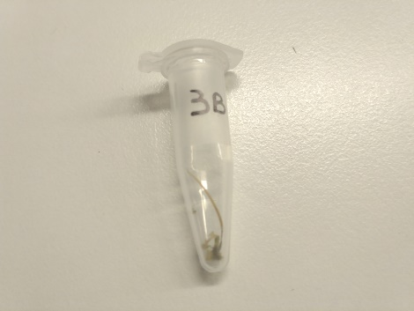
Sampling collection & Validation
odysseaplatform.eu |@odysseaplatform

Slide 14
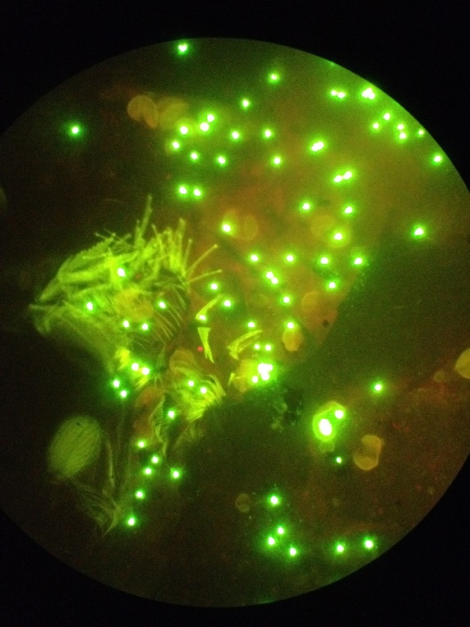
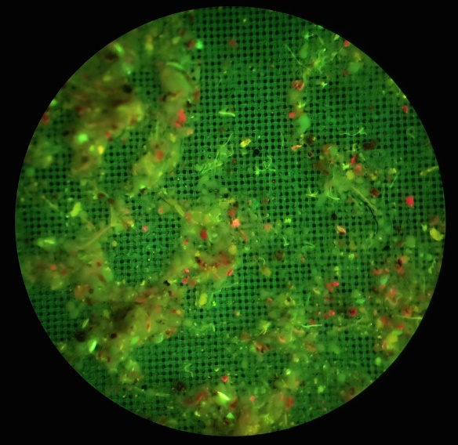
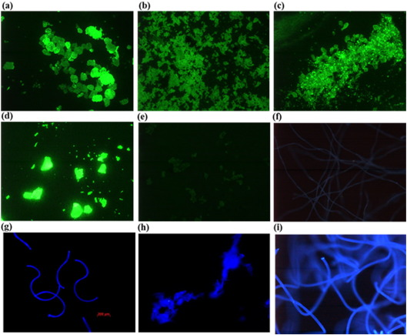
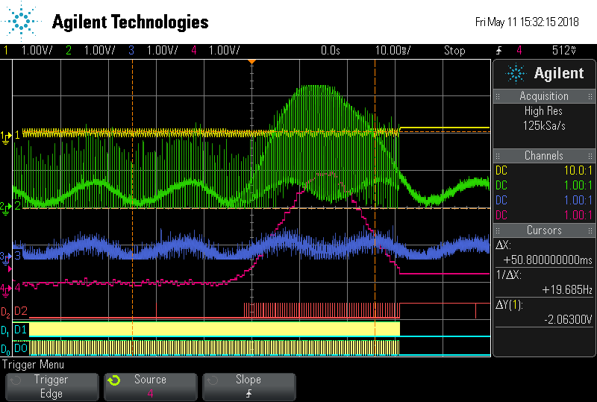
Sensor
Multiband system
odysseaplatform.eu |@odysseaplatform

Slide 15


Sergio Martínez
Javier Martínez
smartineznavas@leitat.org
jmartinez@leitat.org
ODYSSEA
odysseaplatform.eu |@odysseaplatform

