Slide 1

TOWARDS RESPONSIBLE CONSUMPTION & PRODUCTION IN THRIVING & HEALTHY COMMUNITIES: THE LINK TO THE OCEAN
"Implementation and Monitoring of the Sustainable Development Goals in the Caribbean: The Role of the Ocean” Workshop in St Vincent and the Grenadines,
17-19 January, 2018
By: Rose Alabaster
Co-Chair, GEO Global Water Sustainability Initiative
Global Water Sustainability

Slide 2
GEOGLOWS Mission
“To connect the demand for sound and timely environmental information to the supply of data, information and knowledge about the Earth’s water system and to explore the science needed to achieve the goals outlined in the GEOGLOWS initiative…
Advocacy for broad, open data policies & for the realization of the right to access information helps ensure that the data collected through national, regional and global observing systems is made available in the public domain and applied to decision-making.
Policy drivers
  SDGs
  the Addis Ababa Action Agenda,
  the Paris Agreement on climate change,
  the Sendai Framework for Disaster Risk Reduction and
  Aichi Targets of The Convention on Biodiversity”

Slide 3
Why GEOGLOWS?
Water sustainability is a critical issue in sustainable development and for the achievement of the SDGs.
Decision-making in water resources planning and management can be supported with the improved use of earth observation data and associated analytical tools and services.
Poor awareness and use of the available and evolving data (incl. from earth observation) and analytical services especially in the developing world.
Strong need to improve open, public-domain access to critical data and analytical services
Need for improved partnerships to improve quality of supply of services and connect to demand of end-users.
This can lead to modernized management of water resources to improve productivity and better manage climate risks

Slide 4
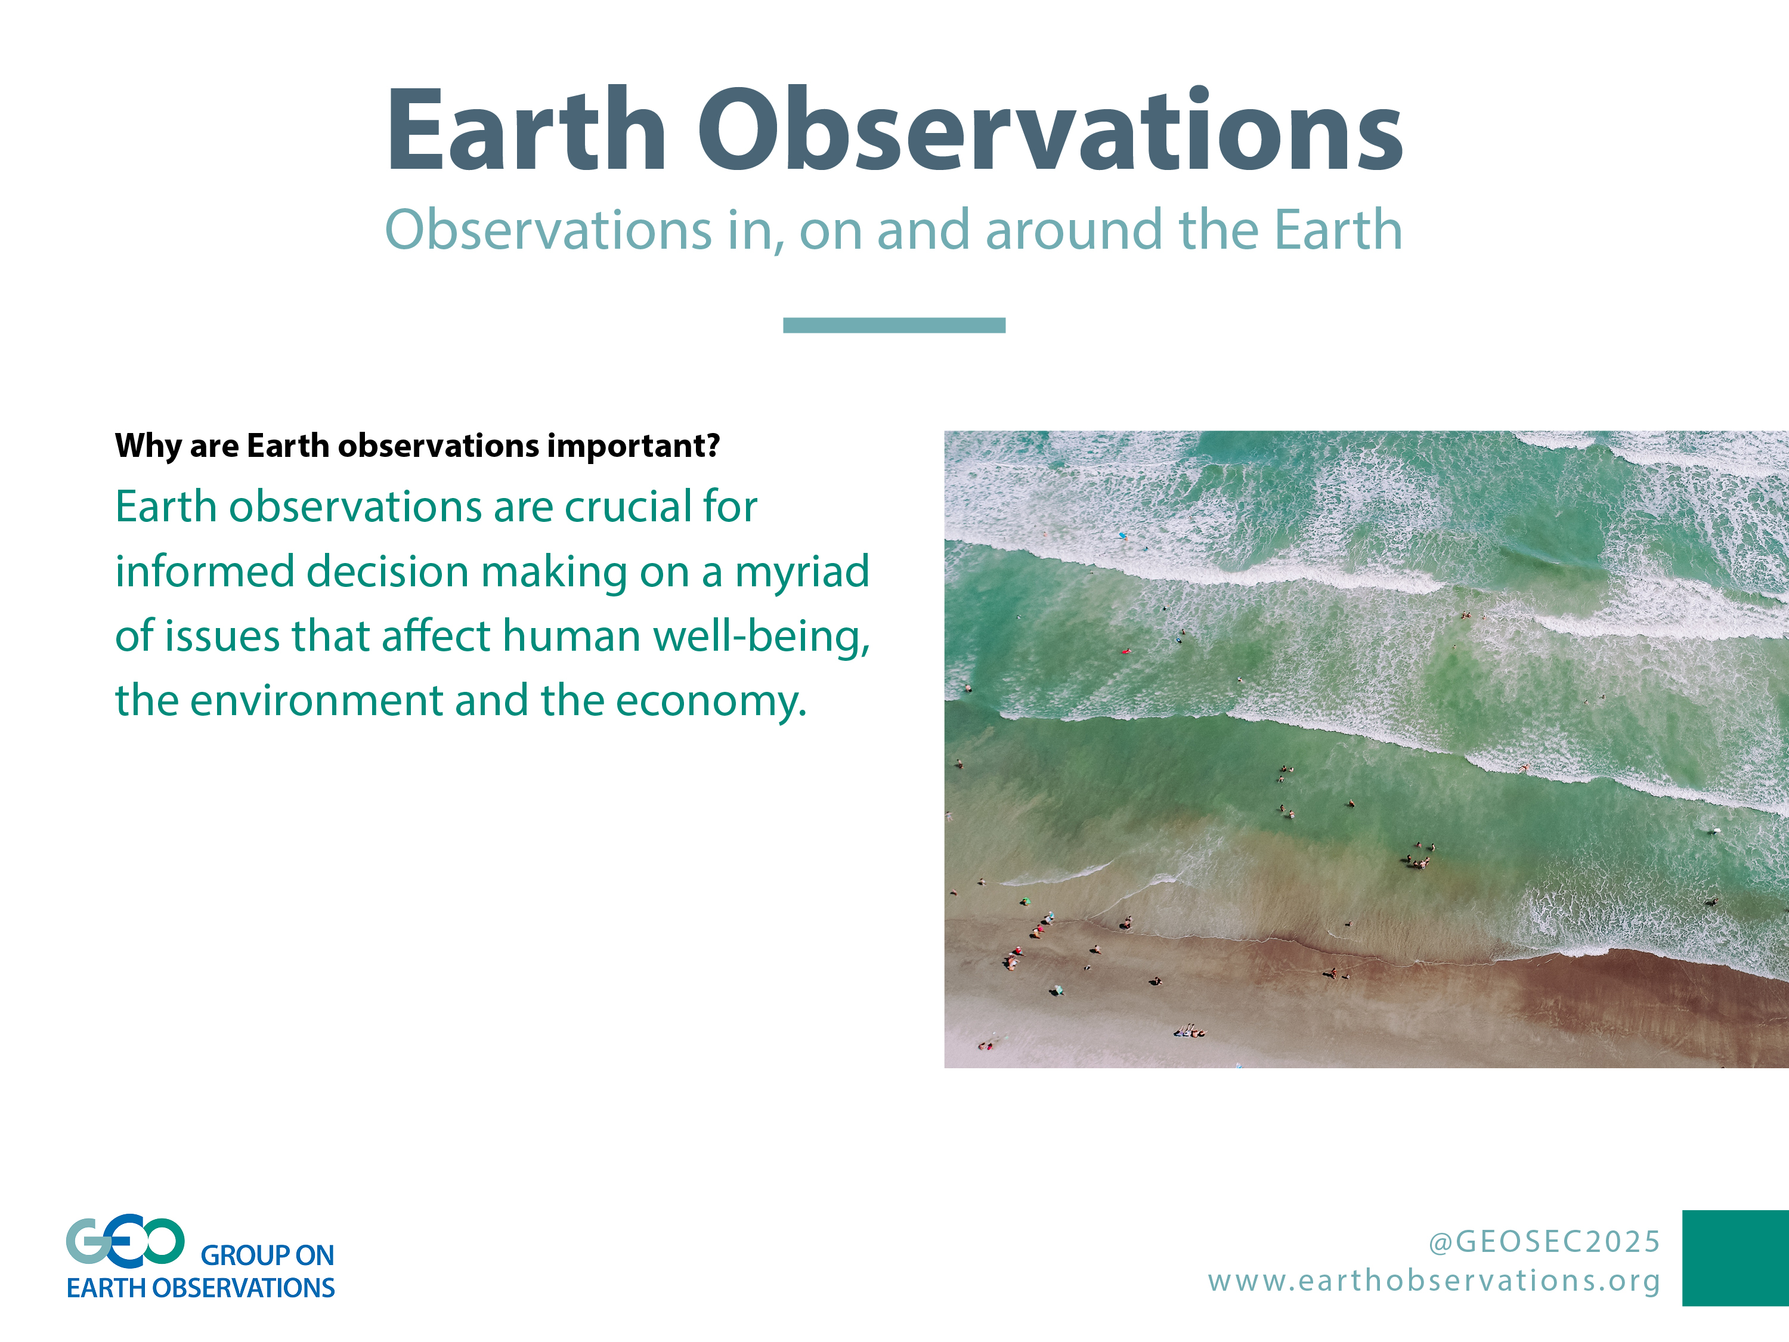
The Ocean`s Interconnectedness
The ocean is largest ecosystem on our planet -main regulator of our climate - provides 50% of our oxygen – absorbing more than 90% of excess heat from human activities
FAO estimates 10-12% of the world pop. rely on fisheries and aquaculture for financial and physical survival – 38m people worldwide are fishers and fish-farmers
The ocean constitutes a conduit for 90% of the world trade - connects people, markets and livelihoods – highlighting.

Slide 5
Ocean as commons
The ocean as commons = implies it’s a shared resource BUT in practice it has no equal and collective responsibility!

Slide 6
Human Rights are interconnected
Water is intrinsically connected to basic human rights such as the right to life, to food, to health and to adequate standard of living.
  Universality, indivisibility and interconnectedness of rights
  National plan of action with time lines
  Progressive realization using maximum available resources
  Key principles of HR - sustainability, accountability, participation, access to information, non-discrimination
  Norms and standards
  STATE OBLIGATION TO RESPECT, PROTECT, FULFIL

Slide 7
Legal framework - Water
The crucial role of water in development processes, as well as in the strategies of international cooperation, has absolutely been expanded and recognized as a key issue for international law.
Water falls not only in the human rights legal framework, but also within the international trade legal framework.
States need strong legal, regulatory and policy frameworks to effectively fight against poverty, conservation and exploitation of ecosystems, or renewable and non-renewable resources

Slide 8
LEGAL FRAMEWORK - WATER
From a Legal perspective, the challenges concerning water (pollution, scarcity, stress, access, increased demand, etc.) are closely related to the enjoyment of other human rights, including safe environment, food, health, labor, and education.
Articulation of rights in national legislative systems is important
- St Vincent and the Grenadines - The law provides for public access to information - 2007 parliament approved the Freedom of Information Act - regulations pertaining to this act have never been adopted

Slide 9
UN GUIDING PRINCIPLES ON BUSINESS AND HUMAN RIGHTS
Based on the UN Guiding Principles on Business & Human Rights, adopted by the UN Human Rights Council in 2011, businesses have the responsibility to respect human rights.
http://www.ohchr.org/Documents/Publications/GuidingPrinciplesBusinessHR_EN.pdf +Provides framework for implementing
  deal explicitly with international trade and investment agreements
  Expect States to consistently fulfil their obligation to protect human rights in this context,
  caution States to reserve and maintain adequate policy and regulatory ability to do so.

Slide 10
Grave concerns re over-exploitation of water resources & the Impact of international trade agreements on national environmental policies.

Slide 11
Legal framework - Oceans
The United Nations Convention on the Law of the Sea, sets out the legal framework within which all activities in the oceans and seas must be carried out.
Strategically important - basis for national, regional and global action and cooperation in the marine sector and as an important contribution to the maintenance of peace, justice and progress for all peoples of the world.
Multi stakeholder partnership and collaboration are key as well as investments for ensuring a healthy ocean!

Slide 12
BINATIONAL-MULTINATIONAL TRADE LIBERALISATION
SDGs have defined a Means of Implementation in which all governments, international organisations and private companies will be called upon to realize universal access.
Challenge is the framework for engaging the private setor in particular has not been provided under the SDG framework.
Governments bind themselves to credit agreements, trade treaties and private investment agreements
BUT, Water should not be commodified…..
Duty of governments to ensure the course of action aligns with norms and principles = compliance - prioritization in planning and resources allocation /mobilization; adequate laws and policies; independent regulation . etc etc

Slide 13
International trade and investment regime is under the spotlight.
Possible to retain the advantages of trade openness while avoiding the negative impacts on peoples’ lives and habitat?
  e.g. human rights impact assessments of trade agreements to inform trade policies - following in the footsteps of economic, environmental and social impact assessments.

Slide 14
SDG 6 - Wastewater monitoring ladder
Monitoring level | Intended policy consequence
Level 0 BASIC : Proportion of all municipal wastewater collected in sewers (and through transfer of septage and FS to STPs) and treated at STPs *(either compliance OR treatment to secondary standard) * | To ensure basic level of health & environmental protection
Level 1 ENHANCED: The above + proportion of compliance * of all premises that discharge wastewater (and sludges) directly to the environment, based on national standards* | An additional safeguard to reduce health & env risks from isolated direct discharges (industries, mining etc)
Level 2 SECURE: All of the above + a further disaggregation showing proportion of industries and other establishments complying with permitted discharge consent to sewers and direct to environment * based on national standards* | An additional safeguard to protect against unauthorized discharges to sewer
Level 3 ADVANCED all of the above + further disaggregation on suitability of all wastewater for reuse | To promote recycling and reuse by assessment of potential
Level 4 OPTIMAL all of the above + the proportion of wastewater safely reused | To indicate which countries currently practise safe reuse

Slide 15
What this means…
Protect scarce water resources from the impact of pollution (faecal and toxic chemicals)
Ladder allows the application of `polluter-pays-principle` in prcatice
Ladder allows starting modestly and then progressively improve
Re-use - offset water scarcity

Slide 16
Speed & scale is needed…
  Improve ocean governance at global, regional, national and local levels
  a) Protection against pollution and ecosystem degradation -
    e.g. Revised legislative proposals on waste - to promote “closing the loop” of product lifecycles. E.g. Circular Economy Package: EU Action Plan for the Circular Economy that establishes a concrete and ambitious programme of action, with set clear targets for reduction of waste and with measures covering the whole cycle: from production and consumption to waste management and the market for secondary raw materials. i.e. adopt a systemic approach
  2. Implementation of commitments/obligations - Standards for protection & compliance
  How many are aware of the global, regional, national commitments and existing reporting?
    UN Oceans Compact: - establishes 3 objectives: protecting people and improving the health of the oceans; protecting, recovering and sustaining the oceans’ environment and natural resources; and strengthening ocean knowledge and the management of oceans.
    - Mapping /establish the baseline
    Link with on-going initiatives/processes
    Resource mobilization – means of impl. of plans and targets
  3. Establishing circular profitable solutions/innovations for businesses – e.g. through peer co-creators – SDG17
  Crucial to review our modes of production and consumption at all levels of society.
  4. Review Legal, Policy , Regulatory frameworks to align with development agenda and needed monitoring actions and capacities -enhance political accountability

Slide 17
Thank You!
Email:rose.alabaster@gmail.com

