Slide 1
Implementing and Monitoring the Sustainable Development Goals in the Caribbean: The Role of the Ocean
Integrating geography and statistics to assist public policies for SDG implementation
Artie Dubrie
Sustainable Development officer
ECLAC Port of Spain office
dubrie@un.org

Slide 2
UN ECLAC Member States
The 33 countries of Latin America and the Caribbean,
together with several Asian, European and North American nations that have historical, economic and cultural ties with the region,
comprise the 46 Member States of ECLAC. Thirteen non-independent territories in the Caribbean are Associate Members of the Commission.
UN ECLAC was Established in 1948, only three years following the establishment of the United Nations
Head office in Santiago Chile
Notes:
Ref: https://www.cepal.org/sites/default/files/events/files/data_gap_in_the_caribbean.pdf

Slide 3
UN ECLAC Member states
Antigua and Barbuda | France | Peru
Argentina | Germany | Portugal
Bahamas | Grenada | Republic of Korea
Barbados | Guatemala | Saint Kitts and Nevis
Belize | Guyana | Saint Lucia
Bolivia (Plurinational State of) | Haiti | Saint Vincent and the Grenadines
Brazil | Honduras | Spain
Canada | Italy | Suriname
Chile | Jamaica | Trinidad and Tobago
Colombia | Japan | Turkey
Costa Rica | Mexico | United Kingdom of Great Britain and Northern Ireland
Cuba | Netherlands | United States of America
Dominica | Nicaragua | Uruguay
Dominican Republic | Norway | Venezuela (Bolivarian Republic of)
Ecuador | Panama
El Salvador | Paraguay

Slide 4
Associate members- Caribbean
Anguilla, Aruba, Bermuda, British Virgin Islands, Cayman Islands, Curaçao, Guadeloupe, Martinique, Montserrat, Puerto Rico,
Saint Maarten, Turks and Caicos Islands,
United States Virgin Islands.

Slide 5

Notes:
https://www.cepal.org/en/events/workshop-accelerate-sdg-implementation-caribbean

Slide 6
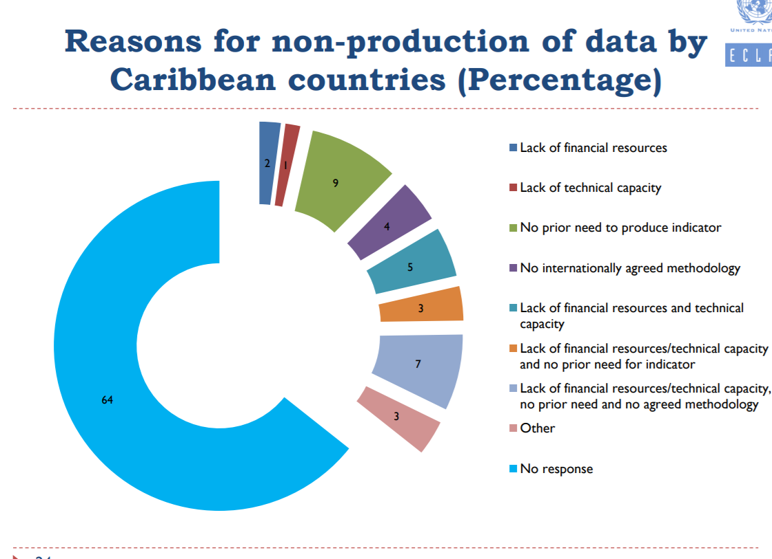
Notes:
Ref: https://www.cepal.org/sites/default/files/events/files/data_gap_in_the_caribbean.pdf

Slide 7
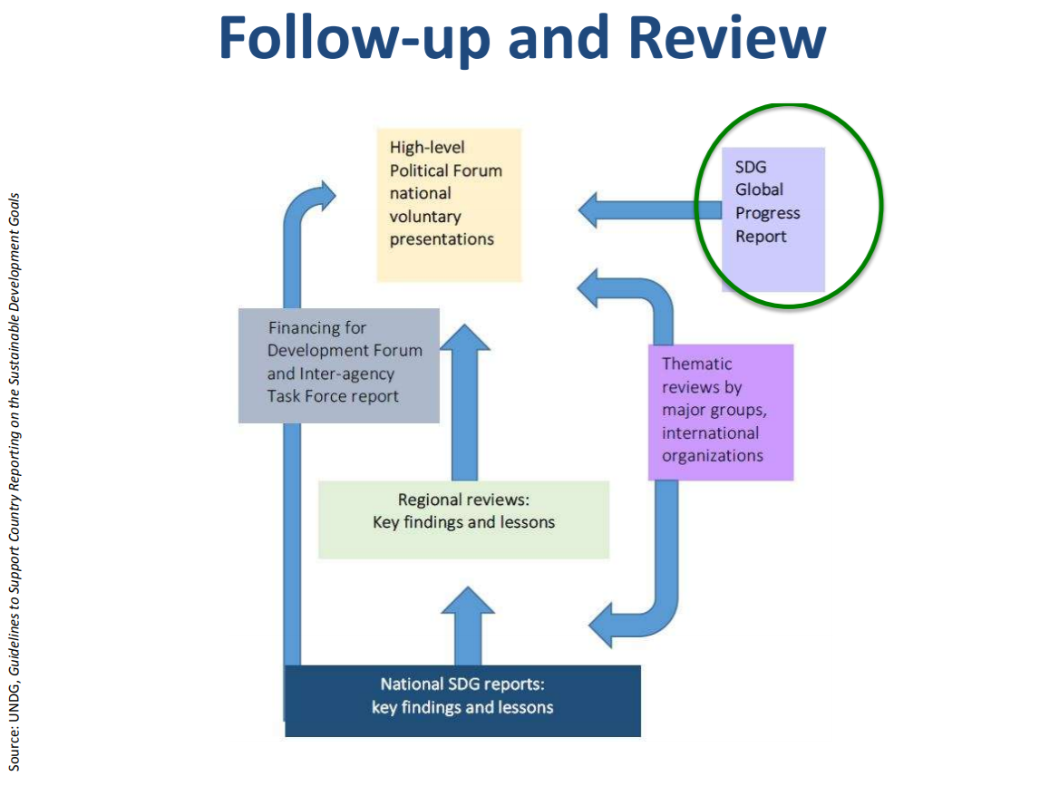
SDG (UN) reporting

Slide 8


INTEGRATING GEOGRAPHY AND STATISTICS TO ASSIST PUBLIC POLICIES FOR SDG IMPLEMENTATION
Session 1: Implementing the SDGs: The relevance of geography and reliable, timely, accessible and disaggregated data
Alicia Bárcena
Executive Secretary of ECLAC
5th High Level Forum on United Nations Global Geospatial Information Management
Mexico City, 28 – 30 November 2017
Notes:
the 5th High Level Forum on Global Geospatial Information Management, with the theme "Implementing the Sustainable Development Goals: The Role of Geospatial Technology and Innovation", was organized by United Nations Statistics Division as the Secretariat for UN-GGIM in collaboration with the Government of Mexico through the National Institute of Statistics and Geography (INEGI), supported by Geospatial Media and Communications in Mexico City.
http://ggim.un.org/meetings/2017-Mexico
https://www.cepal.org/sites/default/files/presentation/files/un-ggim_29nov_final_abi_0.pdf

Slide 9






A new development paradigm with equality and sustainability as drivers of growth
ACTUAL DEVELOPMENT PARADIGM
NEW DEVELOPMENT PARADIGM
, moving toward a sustainable economic model, taking advantage from the environmental big push and the technological revolution, will provide a pathway to preserving the best of globalization and global interconnectedness, enhancing economic and environmental sustainability and empowering individuals and communities to strengthen social inclusion and multilateralism.
Environmental crisis and climate changes
Big environmental push with carbon-free production and consumption
Rising inequalities and exclusion
New social compact: universal access to basic goods and social protection
Extractivism, commoditization of developing countries, jobless growth with low productivity
Schumpeterian efficiency: Innovation- and learning-intensive sectors with jobs
Fragile economic stability
Keynesian efficiency: expansion of aggregate demand and active fiscal policy sustainable economic growth
Notes:
The actual development paradigm is no longer sustainable, moving toward a sustainable economic model, taking advantage from the environmental big push and the technological revolution, will provide a pathway to preserving the best of globalization and global interconnectedness, enhancing economic and environmental sustainability and empowering individuals and communities to strengthen social inclusion and multilateralism.

Slide 10


The 2030 Agenda and the 17 SDGs
It reflects the consensus of the 193 countries on the need to change the prevailing development pattern.
It is universal, indivisible, integrated and civilizing call for reconciling policies to end poverty, achieve equality and ensure environmental stewardship.
Only multilateral cooperation can correct asymmetries and lay the foundations of an open and stable international system that imposes fewer restrictions on national decisions.
169 targets - 231 indicators
“Leaving no one behind with equality front and centre”
Country owned and driven

Slide 11
Six pillars for action and cooperation
  High level:
    National institutional and inter sectorial architecture
  Integration of SDG into national planes, budgets including investments
  Strengthen capacities in statistics
  Implementation: financing, technology, commence, accountability
  Strengthening of regional architecture: for example on SGD of gender, planning, energy etc
  Working medium amongst government, industry (private sectors), citizens other stakeholders etc.
Notes:
rendición de cuentas: accountability
Arquitectura nacional interinstitucional e intersectorial al más alto nivel
Integración de los ODS en los planes de desarrollo y en los presupuestos incluyendo inversión
Fortalecer capacidades estadísticas
Medios de Implementación: financiamiento, tecnología, comercio, rendición de cuentas
Fortalecimiento de la arquitectura regional: observatorios de género, de planificación, energía
Espacios de diálogo entre gobierno, empresas y ciudadanía

Slide 12
Why is territory and geography so relevant?
Geographical averages hide inequalities
Understanding our territory allows the design of indicators of poverty, inequality and welfare with an integrated approach
SDGs require a geographical interpretation at regional, national and sub-national levels
Geographical information fosters productive synergies and natural resources governance
Geospatial information should help public policies to revert concentration of wealth and the lack of basic needs
Notes:
Es indispensable impulsar una noción de desarrollo basado en el valor de los potenciales endógenos de cada territorio,
Urgente planificar los asentamientos humanos en zonas de riesgo natural con herramientas eficientes y legítimas de participación ciudadana
Geografía económica de los recursos naturales puede conducir a la gobernanza
Cambio climático exige una política territorial nacional, regional y global
Existen grandes brechas en las condiciones de vida a las que se accede, el acceso al empleo, a los servicios básicos, ó en los niveles de productividad dependiendo del lugar de nacimiento o residencia.
Si bien en varios países se ha registrado un desempeño económico y social positivo en las últimas dos décadas, resulta evidente que esto no ha permitido superar las distancias entre territorios rezagados y avanzados.
A pesar del creciente interés por el desarrollo de políticas nacionales que apunten a un desarrollo territorial más equilibrado, no se aborda aún con la suficiente fuerza en la agenda supranacional de la región.
La igualdad requiere un cambio de estructuras productivas que requieren de una especificidad territorial.

Slide 13

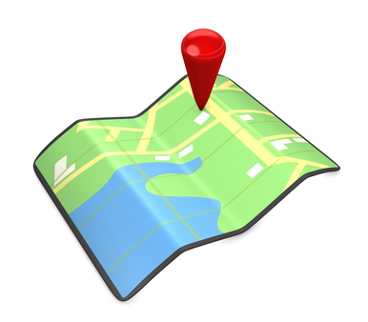
The vision from the territory makes a difference: geography answers fundamental questions: any event happens “somewhere”
ENVIRONMENTAL
MANAGEMENT
URBAN PLANNING
Where can cities be extended
Where to concentrate social programmes
Where to protect the ecosystems
Where are the socio environmental conflicts
Where to locate infrastructure or schools
LAND
ADMINISTRATION
RISK MANAGEMENT
5th High Level Forum on United Nations Global Geospatial Information Management
Mexico City, 28 – 30 November 2017

Slide 14
Towards the integration of statistical and geospatial information in Latin America and the Caribbean

Slide 15
QUESTIONNAIRE APPLIED IN OCTOBER-NOVEMBER 2017
National Statistical
Organizations
National Geographic Institutes
Countries participated
in the consultation
29
Estimate the presence / importance of the geographical component in the production and dissemination of statistics, in its broad spectrum of thematic contents.
Document existence, institutional aspects and basic specifications of geospatial data relevant to the process of integration between these and statistical data.
19
National Statistical
Organizations
26
National Geographic
Institutes or SDI
coordinating agencies
17
Countries with Statistical / Geospatial representation
To know if the process of integration of statistical and geospatial information has already begun in the countries , through an institution or under a structure or mechanism installed at the national level.

Slide 16
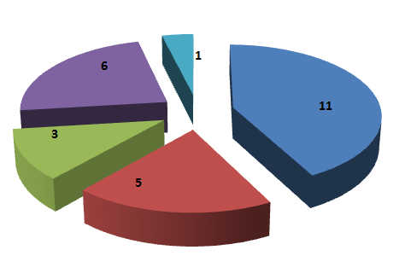
Situation of the integration of statistical and geospatial information in LAC
Response of the National Geographic Institutes or SDI Coordinating Agencies
Response of the National Statistical Offices

Slide 17
Situation of the process of integration of statistical and geospatial information according to the existence of SDIs in the countries
Number of countries

Slide 18
Use of geospatial inputs for the production of statistics
Number of cases-country

Slide 19
Use of geospatial technologies for the dissemination of statistics
Number of cases-country

Slide 20
Road map towards the integration of statistical and geospatial information
Complete the diagnosis on the integration of geography and statistics
Produce an official document with the results and analysis
Prepare a regional strategic plan for the integration of geography and statistics and geospatial information based on the Global Geospatial Statistics Framework, Agenda 2030 and the Census Round 2020.
Promote national plans for the integration of geography and statistics
Establish a data base of best practices and national experiences in the integration of statistical, and geospatial information

Slide 21
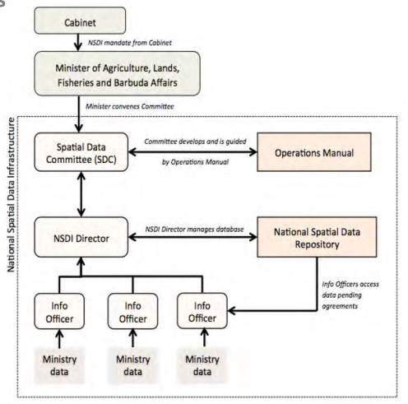
INSTITUTIONAL ARRANGEMENTS AT THE
NATIONAL LEVEL
Seeking support in structures of transversal organization that propitiate the coordination of geospatial information at the national level.

Slide 22

FIVE STEPS TO ENHANCE COOPERATION AND COLLABORATION
Implement the Mega Project based on the guidelines and specifications disseminated by UN- Global Geospatial Information Management for the Americas
Mainstream geospatial approaches into the working groups of the Statistical Conference of the Americas
Establish collaborative relationships with the global and regional community of Earth Observation
Articulate collaboration with regional organizations on geospatial matters
Promoting initiatives of collaborative work between government, academia and civil society.
Notes:
http://ggim.un.org/knowledgebase/KnowledgebaseCategory15.aspx
UN Global Geospatial Information Management for the Americas

Slide 23
Additional for Caribbean SIDS
National work on the implementation of Programme of Action for the Sustainable Development of Small Island Developing States (SIDS)

Slide 24
Thank you

