Slide 1
Implementing & Monitoring the SDGs in the Caribbean: The Role of the Ocean
Interdependencies Between Sustainable Development Goals and Implementation
Dr Julian Roberts
Blue Resources Ltd

Slide 2
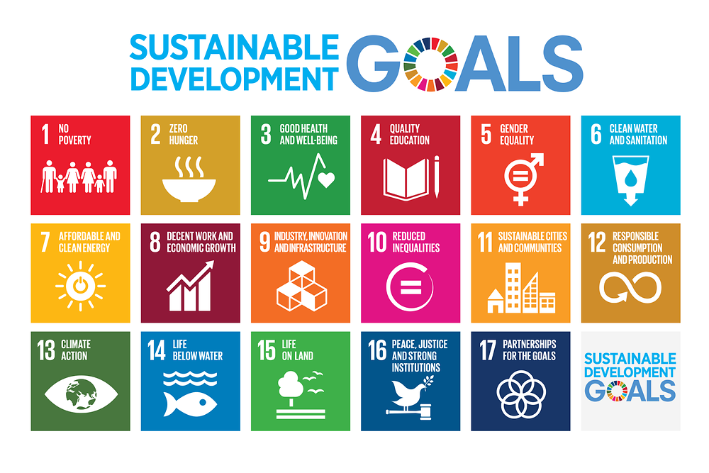
Why Discuss This?
“the SDGs are meant to be integrated, indivisible and collectively support a development agenda balancing the economic, social and environmental dimensions of sustainability”

Slide 3
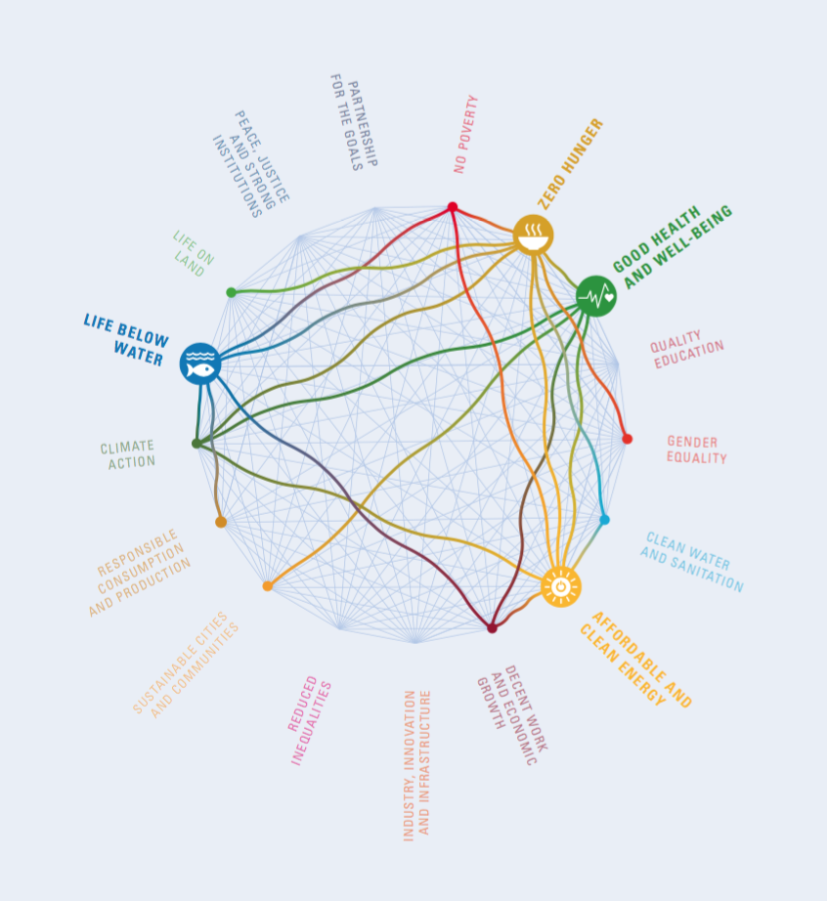
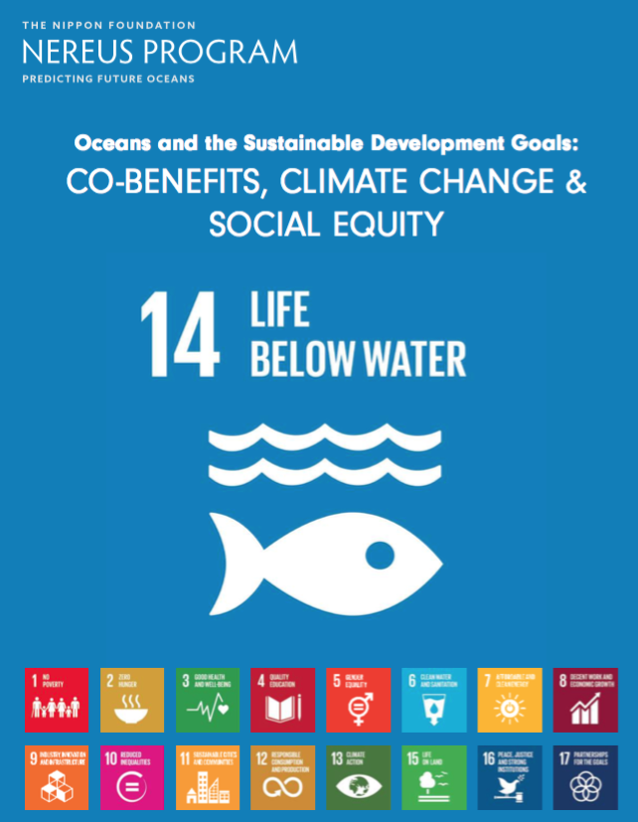
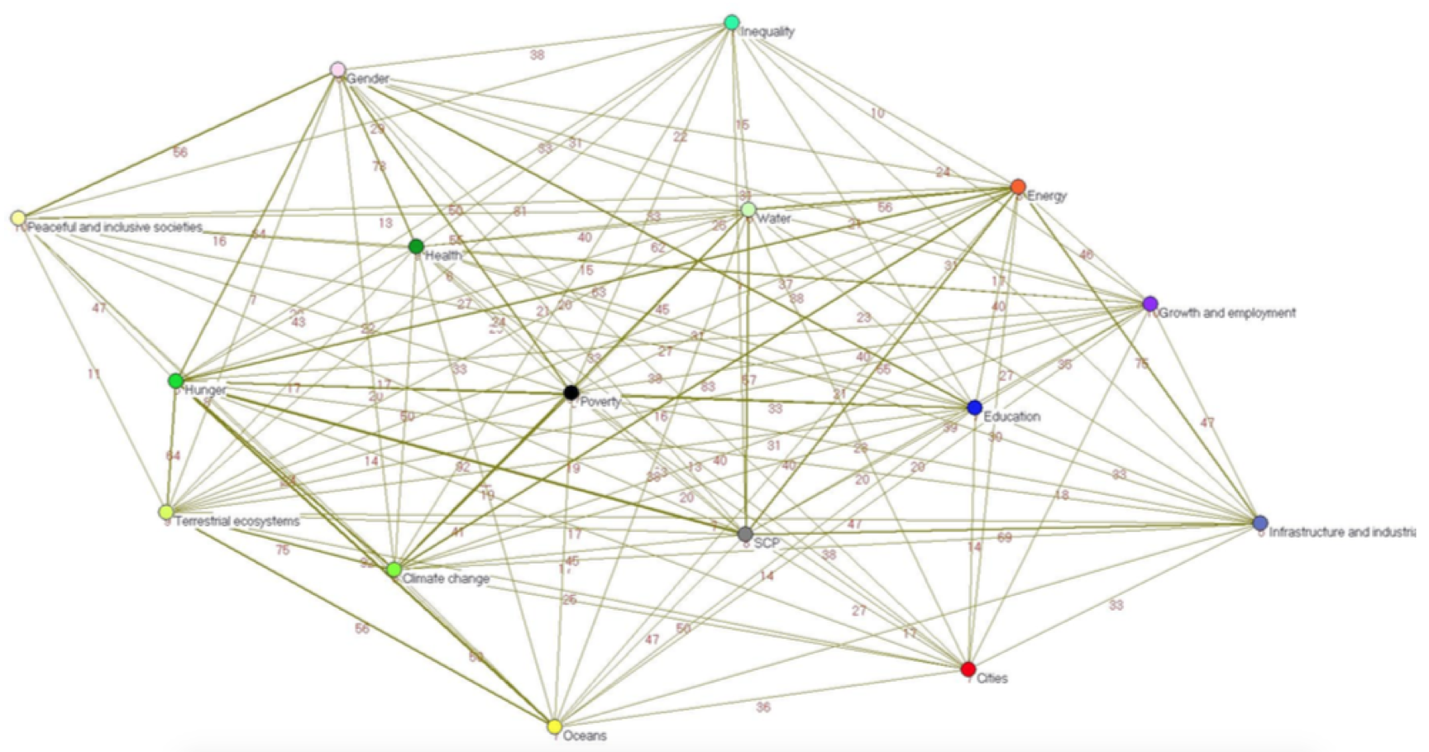
Interdependencies Between SDGs
Source: Nereus Program, 2017
Source: UN DESA, 2015

Slide 4
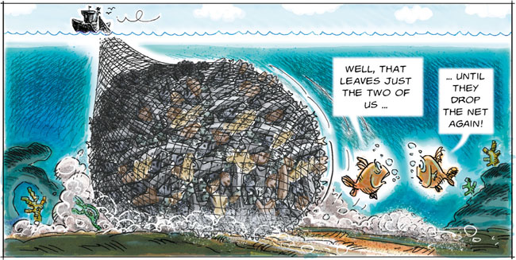
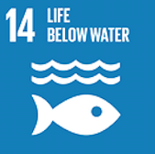
Interdependencies Between SDGs
Unsustainable fishing

Slide 5
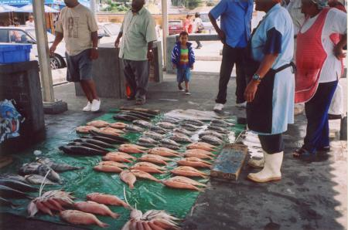


Interdependencies Between SDGs
Unsustainable fishing practices
Less fish available

Slide 6
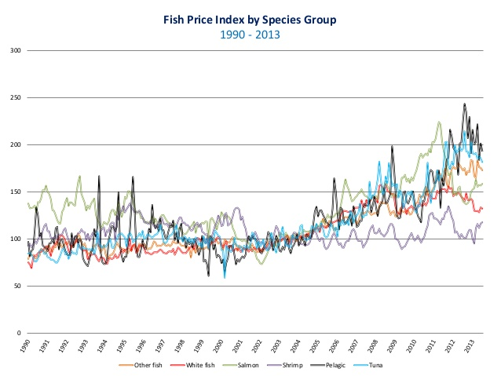


Interdependencies Between SDGs
Unsustainable fishing practices
Cost of fish increases
Less fish available

Slide 7

Interdependencies Between SDGs
Unsustainable fishing practices
Consumers shift diet preference
Less fish available
Cost of fish increases

Slide 8


Interdependencies Between SDGs
Unsustainable fishing practices
Poor diet
Less fish available
Cost of fish increases
Consumers shift diet preference

Slide 9
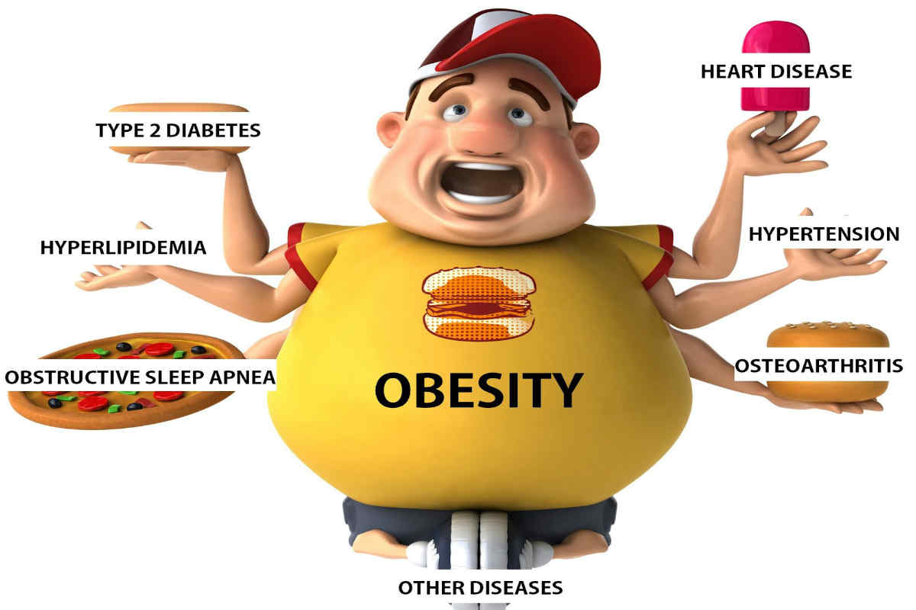
Interdependencies Between SDGs
Unsustainable fishing practices
Obesity-related diseases
Less fish available
Cost of fish increases
Consumers shift diet preference
Poor diet

Slide 10
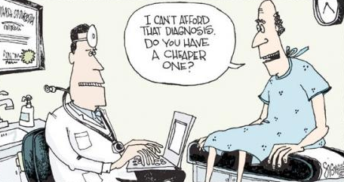
Interdependencies Between SDGs
Unsustainable fishing practices
Increasing social and health costs
Less fish available
Cost of fish increases
Consumers shift diet preference
Obesity-related diseases
Poor diet

Slide 11
Interdependencies Between SDGs
Unsustainable fishing practices
Less fish available
Cost of fish increases
Consumers shift diet preference
Obesity-related diseases
Increasing health and social costs
Poor diet

Slide 12
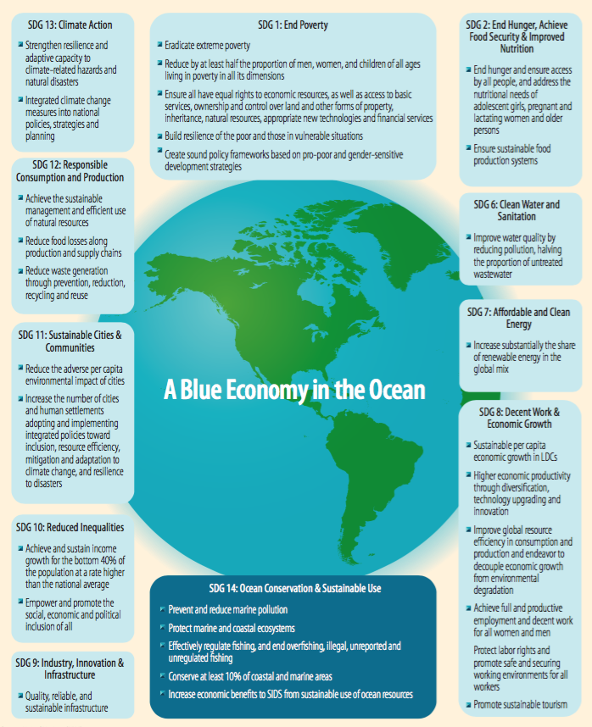
Blue Economy – All About Fish?
How can the ocean support achievement of the 2030 development agenda and the SDGs in particular in the context of island nations?
Food security
Sustainable economic growth
Energy security
Climate change mitigation
Disaster risk reduction
Poverty reduction

Slide 13
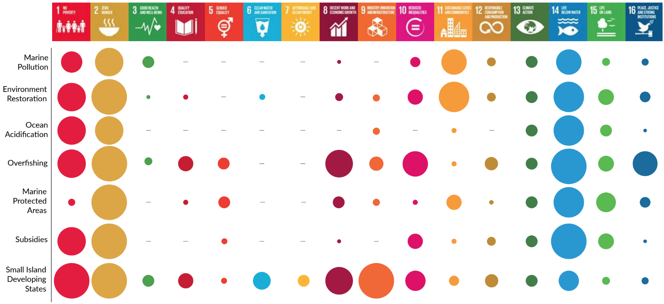
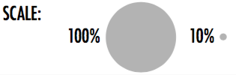
Co-Benefits of Achieving Targets for SDG14
Source: Nereus Program, 2017

Slide 14
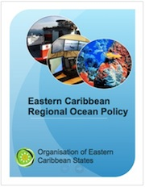
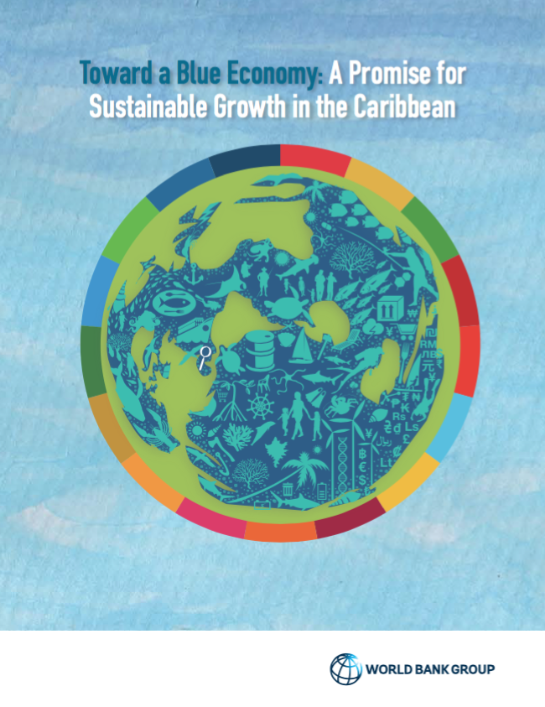
Key Challenges for the Caribbean
Challenges
  small size of the countries
  provision of public services has a high cost
  limiting the institutions and skills available for policy response
  high Government debt-GDP ratio
Lack of economic diversification
  Threats to the marine environment

Slide 15
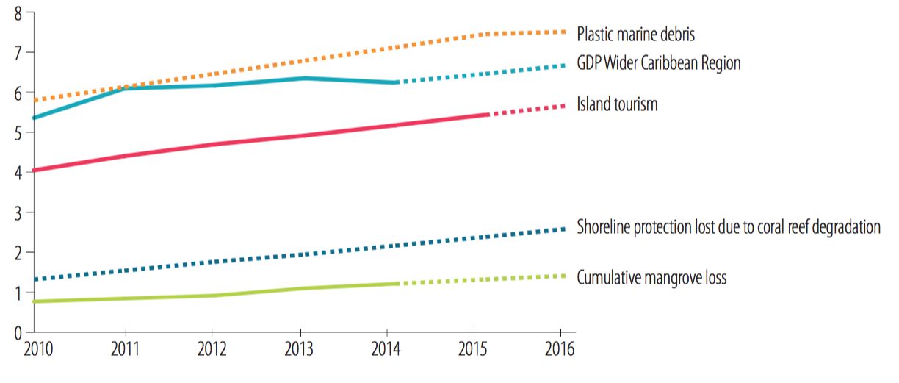
Key Challenges for the Caribbean

Slide 16
Implementation in the Caribbean
Strategies to maintain regional scale processes
Individual goals and targets that can serve as focal points for a wide range of stakeholders
Targets and strategies tailored at regional, national or local levels
Indicators and monitoring capabilities with the capacity to track change and report on progress

Slide 17
Implementation in the Caribbean
Socio-Economic Development Planning
Ocean Policy /
Blue Economy Strategy
SUPPORTING
INFORMING
National Sectoral Policies

Slide 18
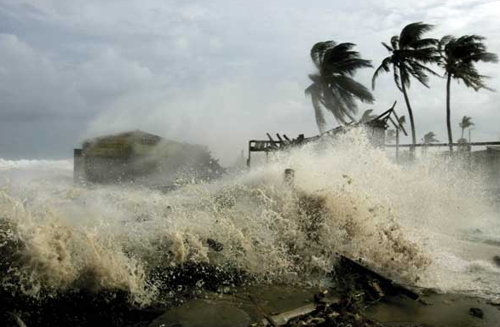
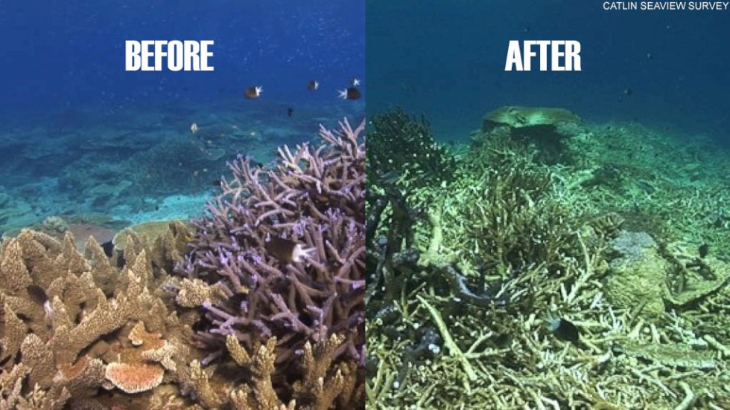
Shocks and Discontinuities
Shocks
  Sudden events that impact on the vulnerability of the system and its components

Slide 19
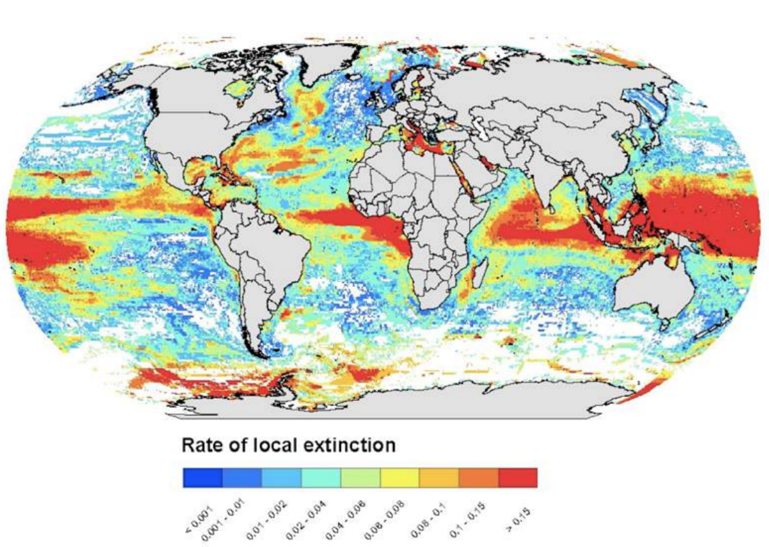
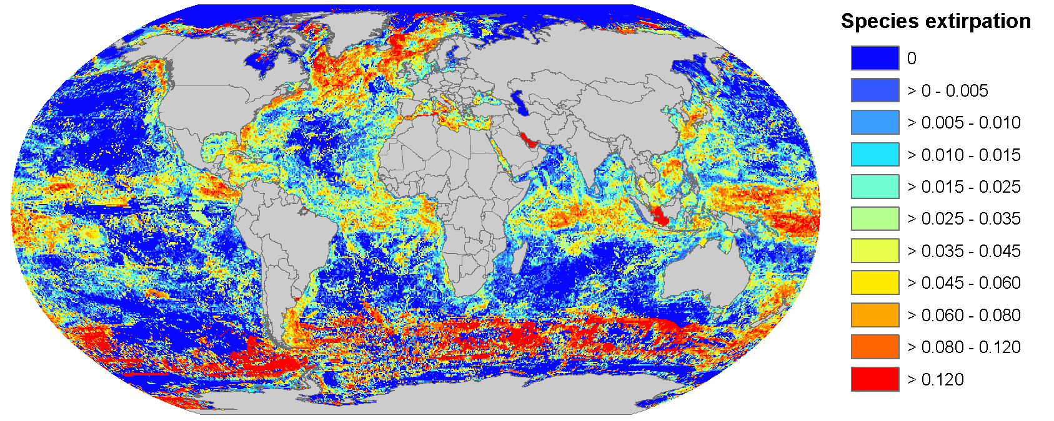
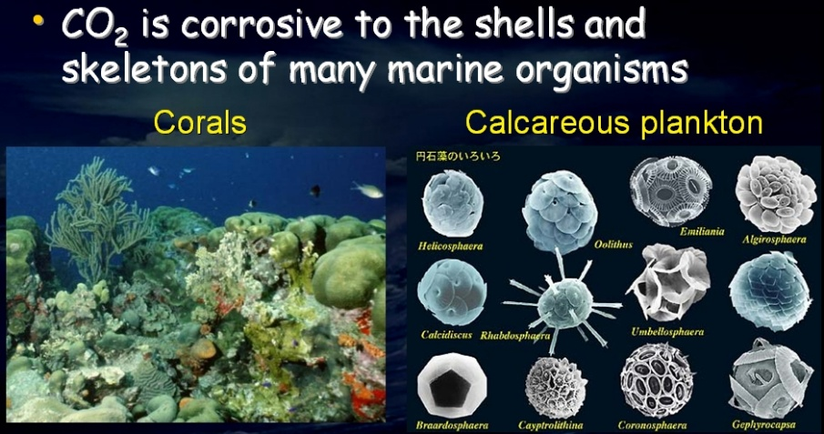
Shocks and Discontinuities
Discontinuities
  Long-term trends that undermine the potential of a given system or process and increase vulnerability

Slide 20
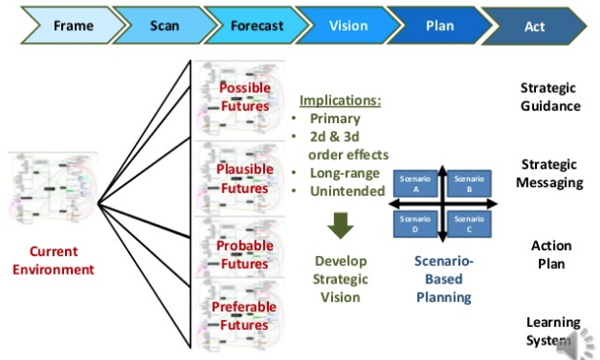
Scenario-Based Planning

Slide 21
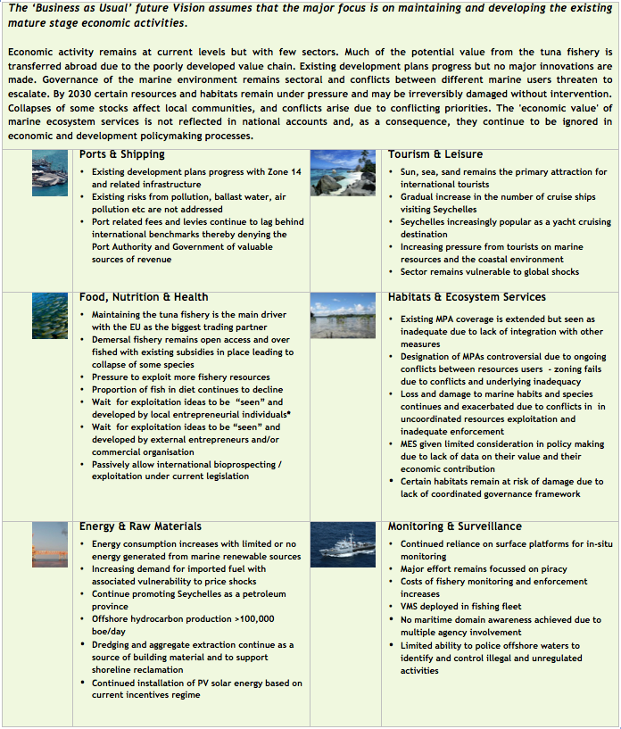
Scenario-Based Planning
Scenarios help decision-making by revealing possible futures
Scenarios show a logical chain of events that demonstrate how future events are linked

Slide 22


THANK YOU FOR LISTENING
Dr Julian Roberts
j.roberts@blueresources.co.uk
With thanks to the CME Programme
for enabling my participation

Slide 23
Implementing & Monitoring the SDGs in the Caribbean: The Role of the Ocean
Beachcombers Hotel, St Vincent and the Grenadines
17th to 19th January 2018

Slide 24
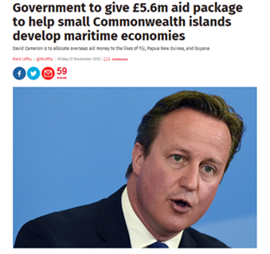
CME Programme
UK Government commitment
to support Commonwealth Small Island Developing States (SIDS)
to alleviate poverty
by preserving their marine environments
and harnessing maritime resources that will support the sustainable growth
3 partners/agencies - expertise from Cefas, UKHO & National Oceanography Centre (NOC)
currently in yr 2 of a 4yr programme
Total funding over 4yrs
likely to exceed £23M

Slide 25
2 regions, 17 countries
Caribbean
Region
Pacific
Region
Pacific
Region

Slide 26
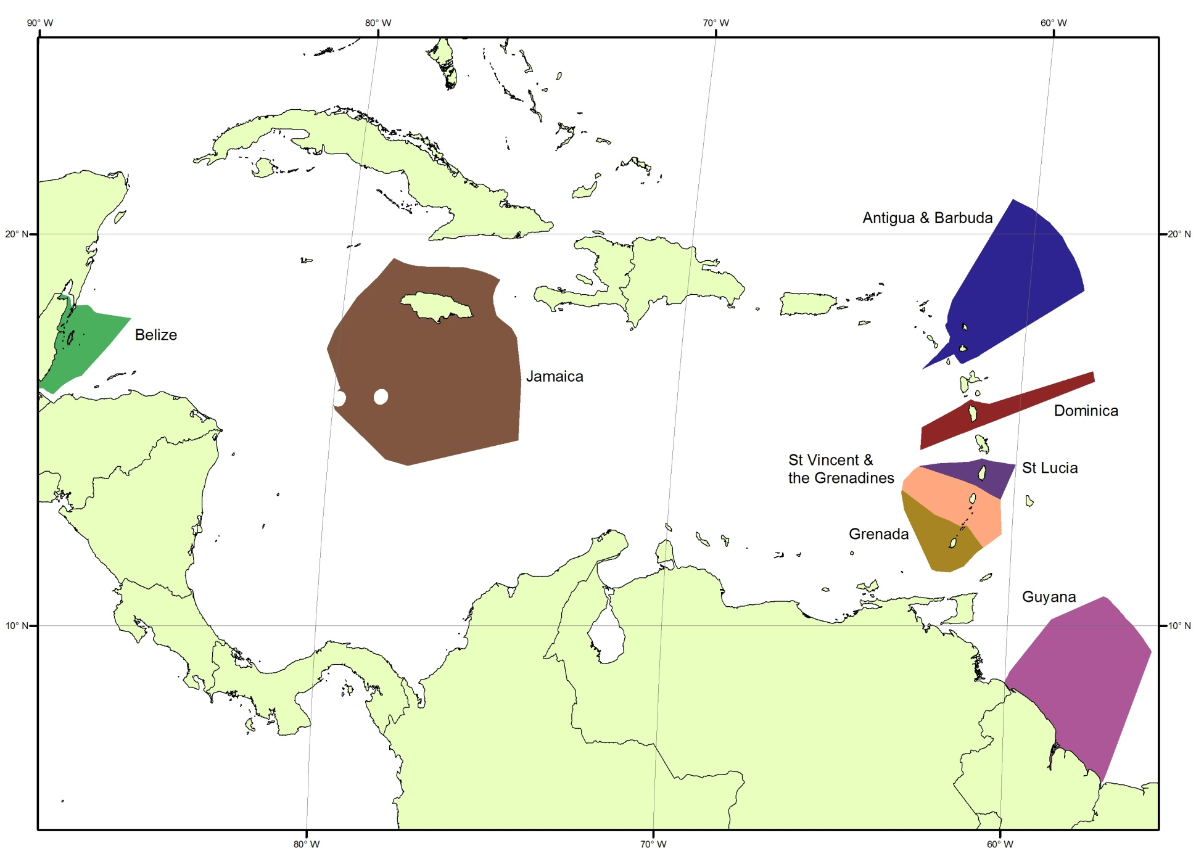
non-Commonwealth countries benefit from agencies’ expertise directly via alternative funding

Slide 27

UK Government fisheries laboratory established in 1902
Fisheries science and management advice
Aquaculture, fish and shellfish hygiene
Pollution and contaminants
Advice on marine protected areas and biodiversity
Statutory monitoring and surveillance
Seabed mapping
Navigational charting
Tidal prediction
Hydrographic Governance
(reviewing government frameworks and legislation)
Data management
Capacity building and provision of equipment
Marine scientific research from coast to deep ocean (short term projects to long term observations)
Adaptation and mitigation to climate change
sustainable use of marine resources
provision of bespoke research
capacity building and transfer of marine technology
Autonomous mapping and monitoring
World Bank/OECS CROP – Commonwealth Secretariat – CME Communique on Blue Economy partnership

Slide 28
Example outcomes of CME (to date) which support SDG14 (Caribbean)
Indicator 14.2.1: Proportion of national exclusive economic zones managed using ecosystem-based approaches
CME deliverable – use of remote sensing data to map and monitor corals in Antigua and Barbuda
Indicator 14.3.1: Average marine acidity (pH) measured at agreed suite of representative sampling stations
CME deliverable - Installation of OA sensors in Dominica
Indicator 14.5.1: Coverage of protected areas in relation to marine areas
CME Deliverable – hydrographic/bathymetry data with associated habitat maps to enable informed decision as to where to protect, St Vincent and the Grenadines and Grenada
Indicator 14.7.1: Sustainable fisheries as a percentage of GDP in small island developing States, least developed countries and all countries
CME deliverable - MSC accreditation for seabob in Guyana and conch and spiny lobster in Jamaica
Indicator 14.a.1: Proportion of total research budget allocated to research in the field of marine technology
CME deliverable – scientific infrastructure e.g. provision of sea level/tide gauges in St Lucia and Belize

Slide 29
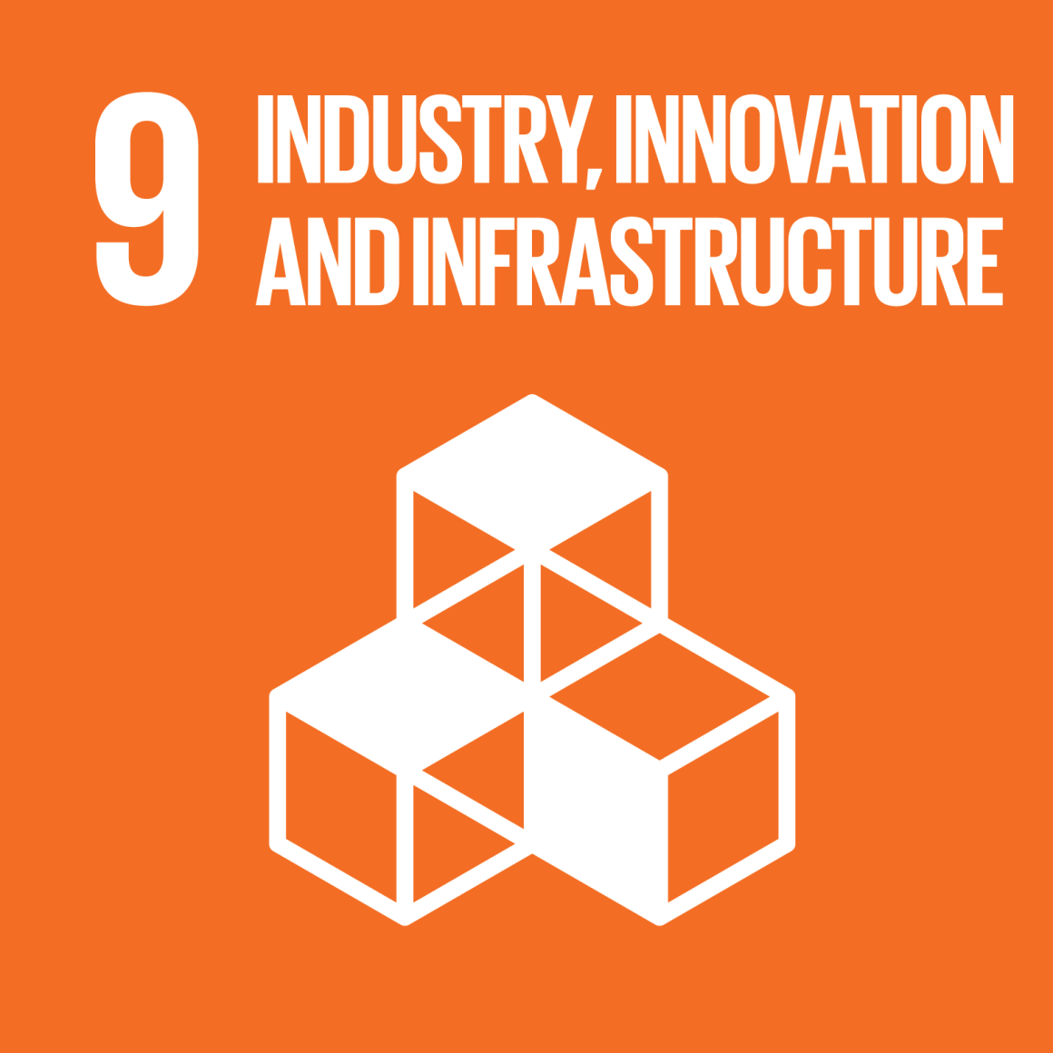
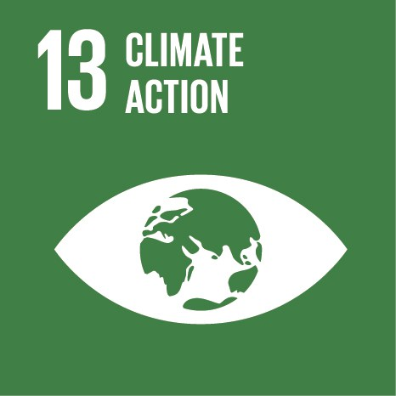
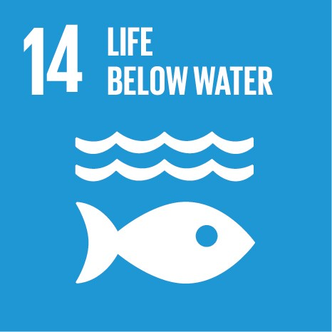
Announcement!
Monitoring and Modelling the Coastal Zone –
A 3-day interactive training course and stakeholder workshop
run by the National Oceanography Centre, UK
funded by the Commonwealth Marine Economies Programme
March 5th to 7th at the NIS Building, Kingstown
Part 1: Observing the Ocean from Space
Satellite Oceanography, winds and waves
Part 2: Modelling Coastal Impacts for St Vincent
modelling, monitoring, managing
Infrastructure, resilience, scientific knowledge

Slide 30
Thank you
Alan Evans
International and Strategic Partnership Office, NOC
Alan.Evans@noc.ac.uk

