Slide 1


Session 4: Observational requirements for ocean-related variables related to fisheries
Milton Haughton
Executive Director

Slide 2
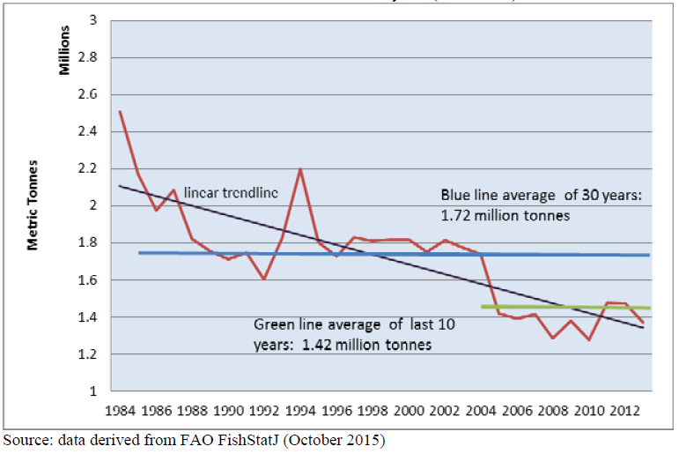

.

Slide 3
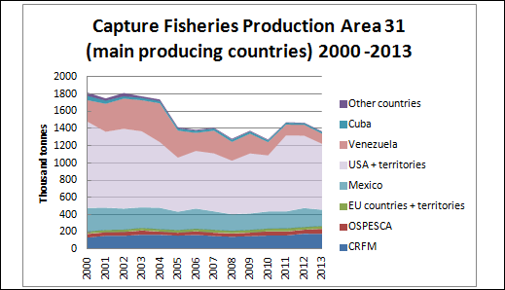

Slide 4
Marine Fish Production CRFM Countries (MT)

Slide 5

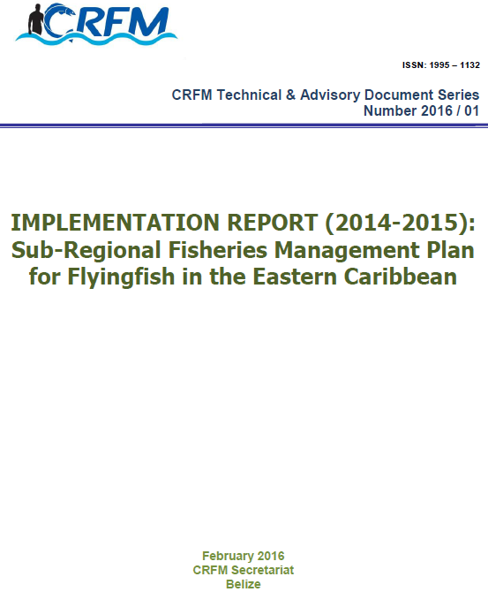
Flyingfish Management Plan
Very Important small pelagic fishery
Stable fisheries – not overfished but many challenges for long-term
7 States (Barbados, Trinidad, St. Lucia, Dominica, Grenada, St. Vincent/ Grenadines, Martinique)
FMP developed over several years
Adopted 2014 by CRFM Council
FMP implemented by States
1st review of implementation (2016)
CLME+ Project funding supporting implementation e.g evidence-base, catch documentation & traceability

Slide 6
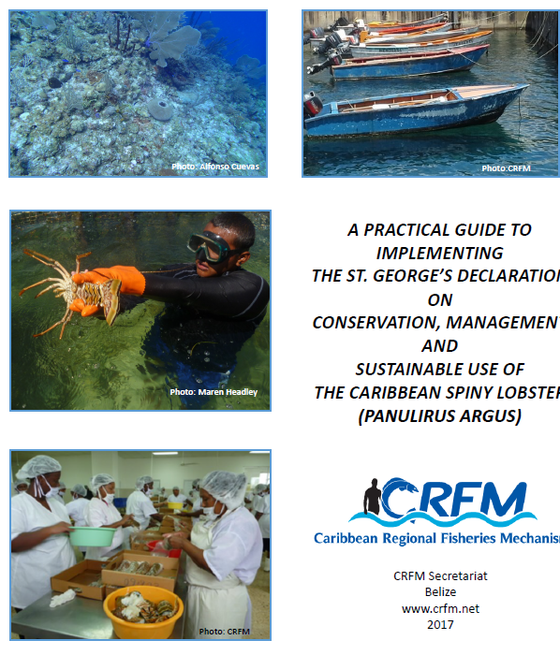
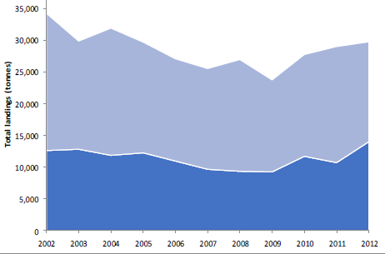
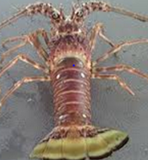
Management of Caribbean Spiny Lobster
Most important commercial species – highly traded, IUU fishing
St. Georges Declaration on Conservation, Management and Sustainable Use of the Caribbean Spiny Lobster (P. argus)
Joint WECAFC/CRFM/OSPESCA Regional Lobster FMP
Joint Lobster Working Group
Other Caribbean States
CRFM States

Slide 7
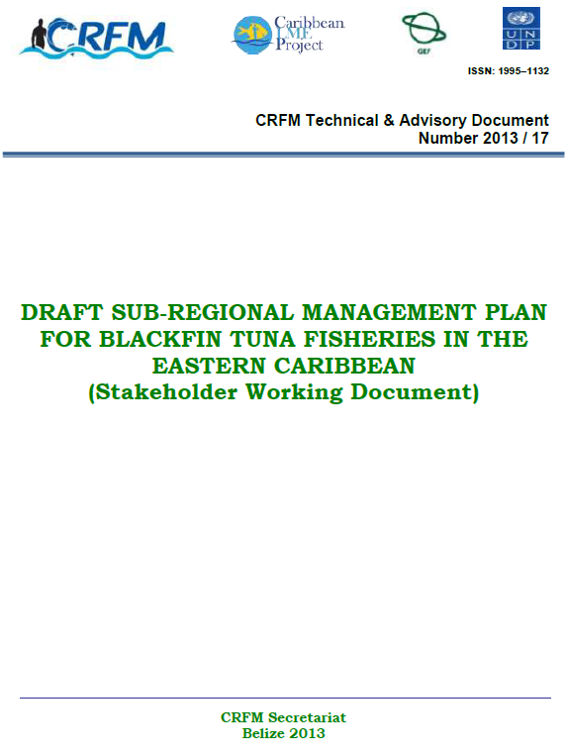
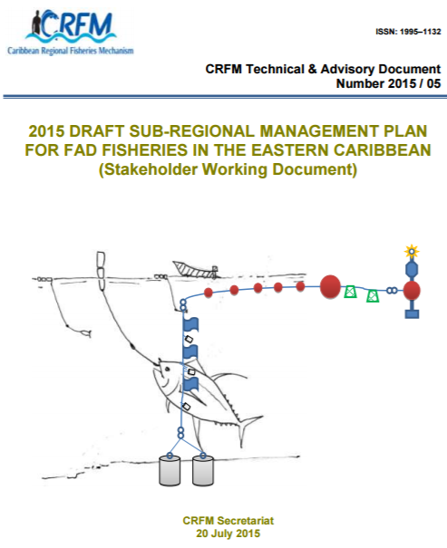
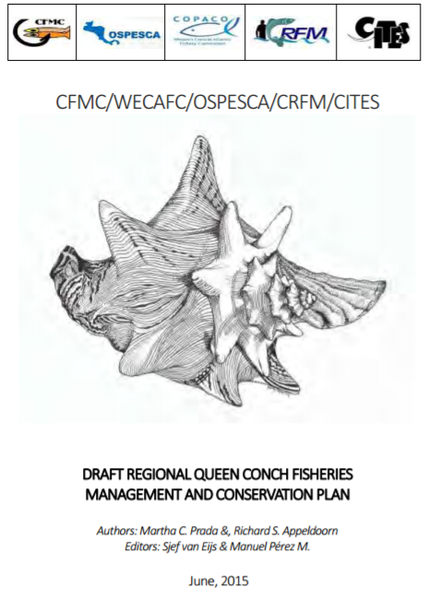
Other Fisheries Management Plans and Instruments
Joint Regional Queen Conch Fisheries Management Plan
FAD Fisheries Management Plan (Draft)
Blackfin Tuna Fisheries
Management Plan (Draft)

Slide 8
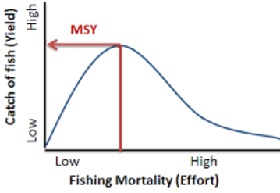
What is the main objective of fisheries Management?
Achieve optimum exploitation level for the stock
UNCLOS, FSA, SDG speak of MSY
What is Maximum Sustainable yield?
The highest theoretical equilibrium yield that can be continuously taken (on average) from a stock under existing (average) environmental conditions without affecting significantly the reproduction process (FAO)
Notes:
SDG 14.4 - Target 14.4 by 2020, effectively regulate harvesting, and end overfishing, illegal, unreported and unregulated (IUU) fishing and destructive fishing practices and implement science-based management plans, to restore fish stocks in the shortest time feasible at least to levels that can produce maximum sustainable yield as determined by their biological characteristics

Slide 9
Fisheries Management & Stock Status
To conduct stock assessment
Scientific analysis of the abundance & composition
Use best information available,
  data from fishery landings,
  independent scientific surveys &
  biological data
Output of Stock assessment:
Determine stock status (overfished, approaching overfishing, under-exploited, rebuilding etc)
Recommend annual catch limits & management or conservation measures that may be required
Assess effects of conservation & management measures
Notes:
Stock assessment determine the current state of the stock, and identify an appropriate target rate for fishing, that will balance short term catches and income and long-term sustainability and income.

Slide 10
What is needed for stock assessment?
  Catch & Effort Data
    amount of fish removed from a stock by fishing
    effort spent to get the catch (nos. traps, boats, hooks used, hours spent fishing etc)
  Data collection programme:
    A network of fishery data collectors that continuously collects catch & effort data for stock assessment
  Sources of catch data include:
    Monitoring at landing site (docks, ports or beaches) - commercial landings and biological samples of the length, sex, and age of fish.
    Logbooks: commercial fishermen - location, gear, and catch.
    Observers: Biologists on fishing boats observe fishing operations & collect data on the amount of catch and discards.
    Recreational sampling: interview surveys and dockside sampling estimate the level of catch by the recreational fishery

Slide 11
What is needed for stock assessment?
  Independent Survey
  Measure abundance or relative index, of the number or weight of fish in the stock
  Data collected by a statistically-designed, fishery-independent survey by research vessel that samples fish throughout the stock’s range. ➔ Dive survey
  Ideally Surveys should be conducted annually at same time
  Biology Data
  Provides information on fish growth rates & natural mortality
  Information on fish size, age, reproductive rates, movement
  Collected at landing site, during survey or academic
  A LOT OF DATA????? = Money & Capacity???
  For classical stock assessment

Slide 12
Indicator 14.2.1-Proportion of national exclusive zones managed using ecosystem-based approaches.
Percentage of stocks with ecosystem based-fisheries management plans
  Oceanographic
    Primary production
    Ocean currents
    Ocean temperatures
    Ocean oxygen
    Salinity
    Acidity (pH)
    Nutrients
    turbidity
  Socioeconomics of fishers
    Education levels of fishers
    Fisher income
    Fixed and operational costs of fishing

Slide 13
Indicator 14.2.1-Proportion of national exclusive zones managed using ecosystem-based approaches.
Percentage of stocks with ecosystem based-fisheries management plans
  Catch and effort data for target species
  By-catch data
  Habitat information- e.g. habitat type, coverage & health – critical fish habitats
  Food webs - Predator prey relationships
  Both the number of species and the distribution of biomass distributed among species

Slide 14
Indicator 14.4.1-Proportion of fish stocks within biologically sustainable levels
Percentage of countries with national data collection systems
Number of stock assessments conducted
Stock statuses known for commercially important species
Proportion of fish stocks within biologically sustainable limits
  Need to understand population dynamics of stocks
  [Entry of young fish, growth, mortality, migration]
    Recruitment
    Size composition - Length-weight
    Maturity (rates and weight at age in stock)
    Growth functions
    Fecundity
    Mortality- fishing and natural
    Biomass at age
    Harvest parameters (gear selectivity, catchability)

Slide 15
What challenges do SIDs face in assessing stocks?
Tropical fisheries – multi-gear, multi-species = complex
Data poor for many stocks – data collection & assessment tend to focus on more commercially important stocks
Conventional stock assessment methods, such as the age-based methods, are data-intensive, single species model: not very suitable for tropical stocks
Length-based methods, which have been developed & promoted for tropical stocks, not very accurate
Limited, therefore, to use of surplus production models, which are usually single-species models, but applied to fisheries that are often multi-gear operations, multiple species
Hence, more sensible for countries with such fisheries to work with simpler markers of stock health, that could cover several species at a time – ecosystems approach.
High cost of data collection & surveys, & limited human & institutional resources

Slide 16
What challenges do SIDS face in assessing stocks?
While having long-term, continuous datasets for each species is ultimate goal, data-poor methods can still provide useful information & reduce risks associated with fishing in ignorance
CRFM states use conventional methods when appropriate and data available
Otherwise, we use trends in catch & size composition & local knowledge to determine stock status
Indirect indicators that suggest overfishing include:
  A reduction in the stock biomass;
  Catches exceed their target reference points;
  Change in the size and age composition, reduction in larger size class and mature individuals
  declining catch or value per unit effort
[Decline may be due to management intervention]

Slide 17
What challenges do SIDS face in assessing stocks & Fisheries Management?
Additional issues
Experience with CRFM Scientific Meetings
Compatibility of data for regional assessments
Sharing of data & information
Capacity challenges – reliance on external experts
Next Steps
Norwegian Research Vessel (RV) Dr. Fridtjof Nansen
Fisheries information technology innovations for resource management and climate change adaptation in the Caribbean (FIT4CC),

Slide 18

THANK YOU
      www.youtube.com/TheCRFM
      www.facebook.com/CarFisheries
      www.twitter.com/CaribFisheries

