Slide 1




Earth Observations and the SDGs
Implementing and Monitoring the Sustainable Development Goals in the Caribbean: The Role of the Ocean
Argyro Kavvada
EO4SDG Initiative &
NASA Earth Science - BAH
Saint Vincent and the Grenadines
Jan. 17-19, 2018

Slide 2


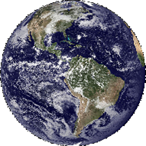


Initiative
National Efforts & Partnerships
SDG 14, Life Below Water, & Conclusions
EO4SDG

Slide 3

“The 2030 Agenda is deliberately ambitious and transformational, with a set of 17 integrated and indivisible Sustainable Development Goals and targets, and a Global Indicator Framework to guide us. This collective journey has at its heart a promise to leave no one behind.
The 2030 Agenda for Sustainable Development aims to improve the lives and future prospects of everyone, everywhere.
Implementation has begun, but the clock is ticking. This report shows that the rate of progress in many areas is far slower than needed to meet the targets by 2030.
This report ..underscores the need for reliable, timely, accessible and disaggregated data to measure progress, inform decision-making and ensure that everyone is counted.”
UN Secretary-General António Guterres

Slide 4
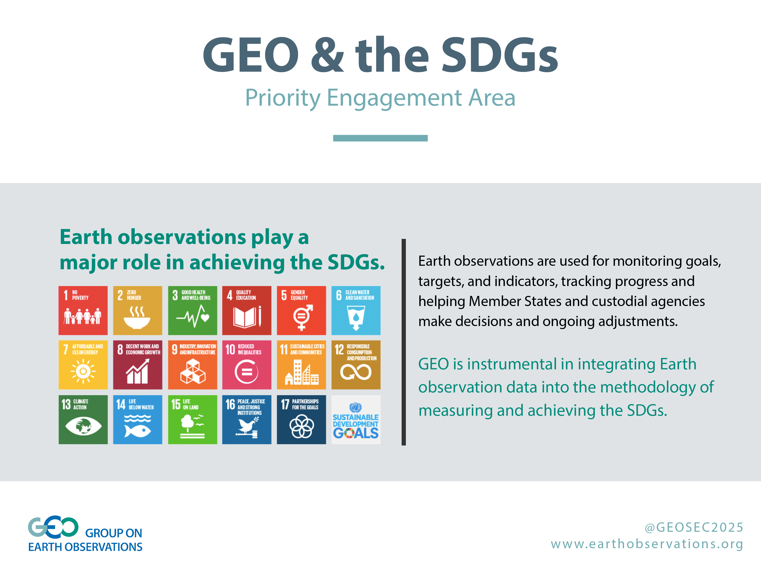

Slide 5
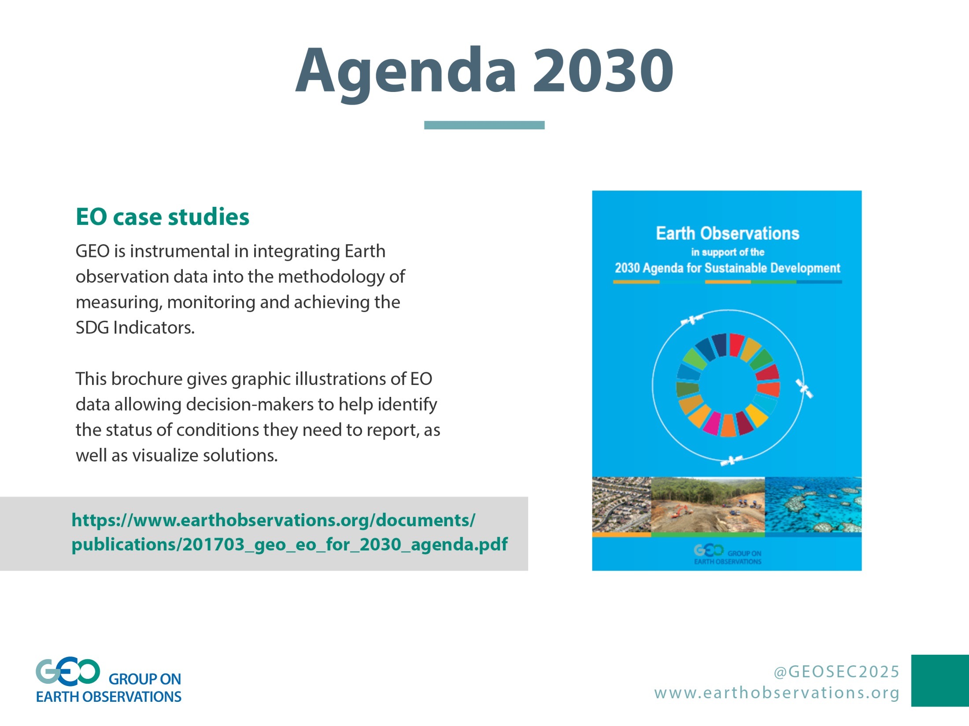

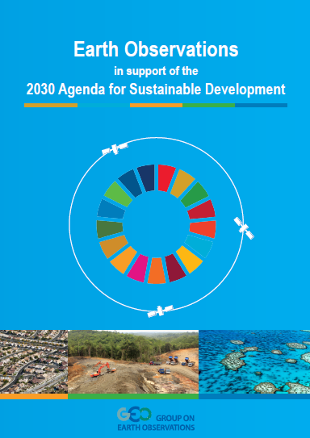
Agenda 2030
EO Case Studies
GEO is instrumental in integrating Earth observation data into the methodology of measuring, monitoring and achieving the SDG Indicators.
Brochure gives graphic illustrations of EO data allowing decision-makers to help identify the status of conditions they need to report, as well as visualize solutions.
https://www.earthobservations.org/documents/publications/201703_geo_eo_for_2030_agenda.pdf
GEO is instrumental in integrating Earth observation data into the methodology of measuring, monitoring and achieving the SDG indicators.
This brochure provides examples of EO applications and potential help decision makers identify the status of conditions they need to report on, and visualize solutions.
Notes:
GEO working on 6.6.1 spatial extent of water. GEO Secretariat, NASA and others are coordinating with UN Environment through the EO4SDG Initiative to measure spatial extent of open water bodies in 8 countries (starting with Peru, Senegal and Jamaica), to generate maps and analysis, and also test the use of very high resolution remote sensing in 3 of 8 countries.
The NASA team will provide maps & estimates of vegetated wetlands extent across a select group of the 8 countries. For water quality, the NASA team will be using Landsat and Sentinel-2 to produce concentrations of Total Suspended Solids (TSS) and Chlorophyll-a (Chl) products. All National EO analysis will be packaged by NASA and provided to countries by UN Environment (around October 2017). Training sessions will follow dissemination of these EO data analyses.
15.3.1 Proportion of degraded land over total land area
GEO representatives have again been extensively involved with UNCCD and FAO in their efforts to develop methodologies for monitoring degraded land through use of EO techniques.
GEO Secretariat has been asked to provide advice and expertise in the UN process of elevating Goal 15 indicators to higher classification based on development and translation of EO techniques into robust methods that can be supported by the global statistical community.

Slide 6

EO4SDG Initiative
www.eo4sdg.org
@EO4SDG
Earth Observations in Service of the 2030 Agenda
Purpose:
Organize and realize the potential of Earth observations and geospatial information within GEO to advance the 2030 Agenda and enable societal benefits through achievement of the SDGs.
Key Emphasis:
Collaborations with the statistical community, NSOs, line ministries, custodian agencies. Also, communication role in a federated approach to GEO community
Projects
Develop, validate and deploy uses of Earth observations to support SDG tracking and reporting
Capacity Building
Build skills for accessing and applying Earth observations data
Data and Information Products
Advance discoverability and accessibility of products
Outreach and Engagement
Promote the consideration and adoption of Earth obs. for the SDGs
Notes:
The GEO Initiative titled “EO4SDG” serves a corporate-knowledge role within GEO both to keep abreast of United Nations developments with the SDGs and to share that information with the GEO community. The EO4SDG Initiative supports pilot projects, organizes capacity building activities, supports the development of data and information products, and pursues outreach and engagement activities to encourage uses of Earth observations for the SDGs. The Initiative also works to expand GEO’s partnerships on the SDGs, such as with the Global Partnership for Sustainable Development Data and the UN Sustainable Development Solutions Network, among others.

Slide 7


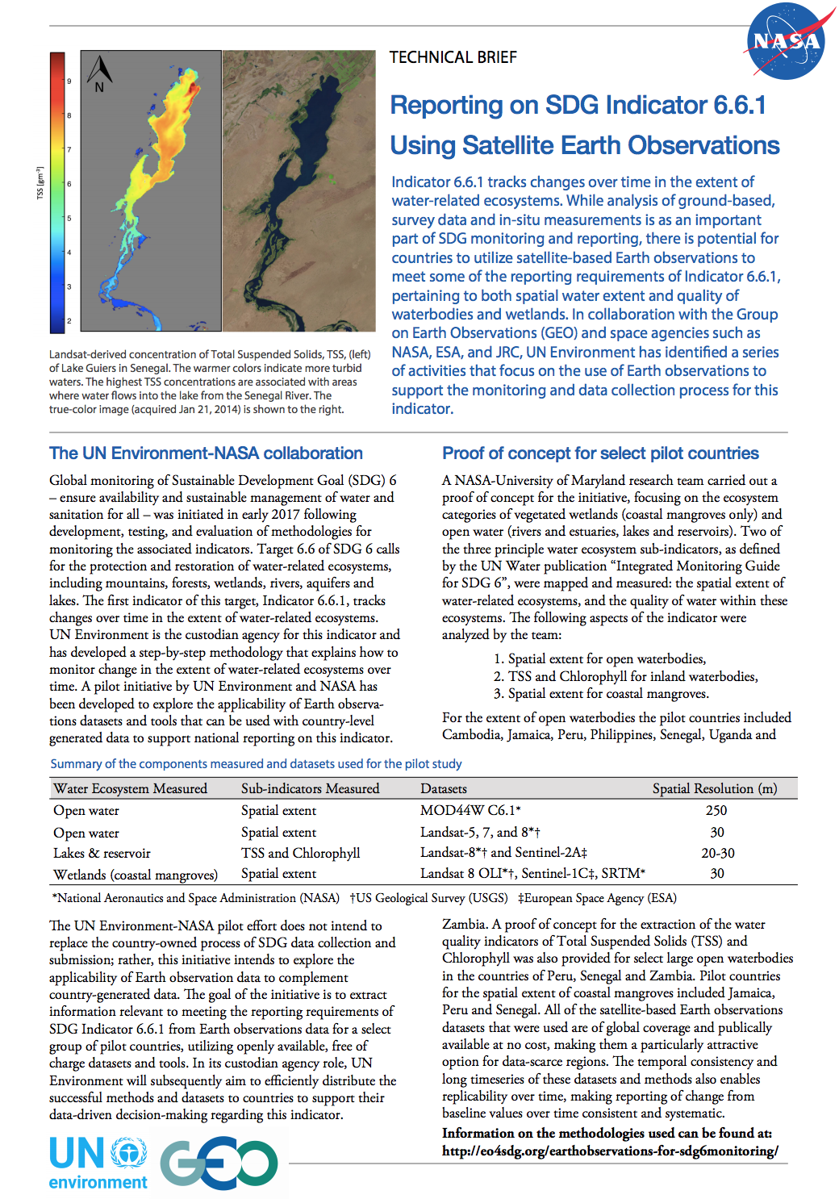
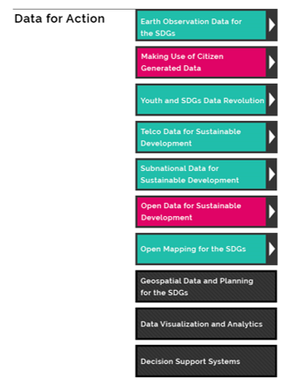



UN Environment-GEO-NASA -UMD
Collaboration on SDG 6
Fourth Expert Meeting of the IAEG-SDGs: Working Group on Geospatial Information
A Primer on SDG 2, Zero Hunger
Toolbox:
Data for Action
Pilot Activities
Outreach & Engagement
Capacity Building
Information Products
EO4SDG-GPSDD-DANE Workshop at DANE HQ, Colombia
  In person trainings & webinars

Slide 8
  Webinar Training
  Remote Sensing of Land Indicators for SDG 15: 15.1.1 & 15.3.1
  June 20-22, 2017; English
  Course Material in English & Spanish
Three-session training:
Satellite observations of land cover; image classification, change detection, and techniques for developing accuracy assessments.
Satellites & sensors: Landsat, MODIS, Sentinel 3, Suomi NPP/VIIRS
  In person Training
  Satellite Observations of Water Quality for SDG 6: 6.3.2
  October 24, 2017; English
  16:30-19:30; Hemisphere B
Three-hour training:
Satellite observations for monitoring of harmful algal blooms, sediments, and other water pollutants.
Hands-on Exercises: Acquiring Satellite-Based Water Quality Data for SDG Indicator 6.3.2
https://arset.gsfc.nasa.gov/
Notes:
The United Nations Sustainable Development Goals (SDG) are a series of 17 goals set to end global poverty
and protect the planet, with the aim of achieving successes by 2030. The SDGs cover topics from global health,
climate change, economic inequality, sustainability, poverty, and more. This training will focus on addressing
SDG 15, whose focus is to “protect, restore and promote sustainable use of terrestrial ecosystems, sustainably
manage forests, combat desertification, and halt and reverse land degradation and halt biodiversity loss.”
In this webinar, participants will learn how to access and apply satellite data relevant to land indicators, such
as estimating total forest area and forest change. The webinar will include an overview of the SDGs, as well as
an introduction to image classification, change detection, and accuracy assessments.

Slide 9
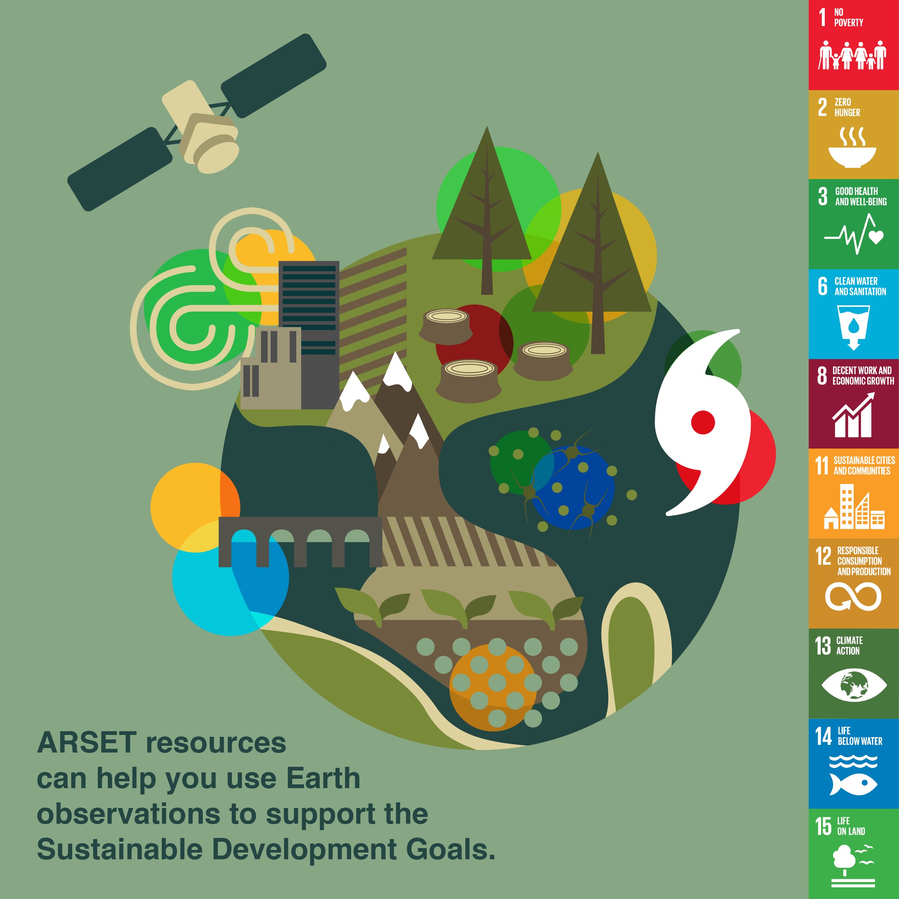

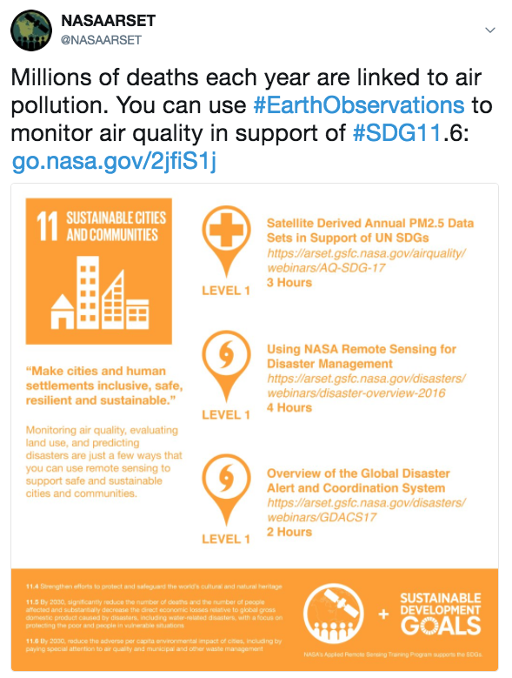
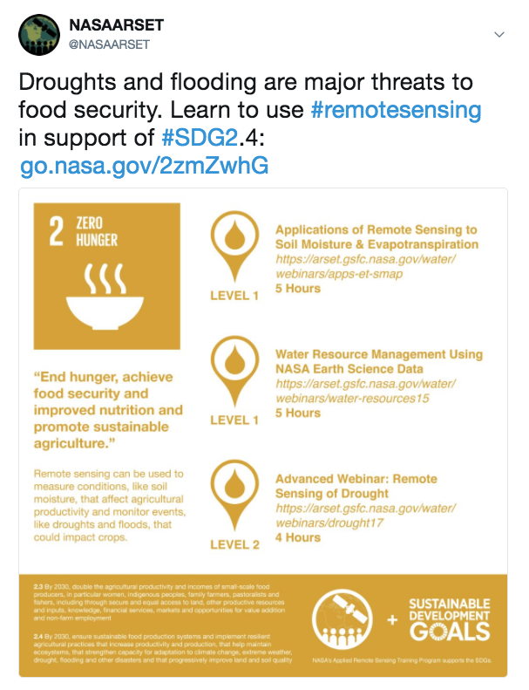
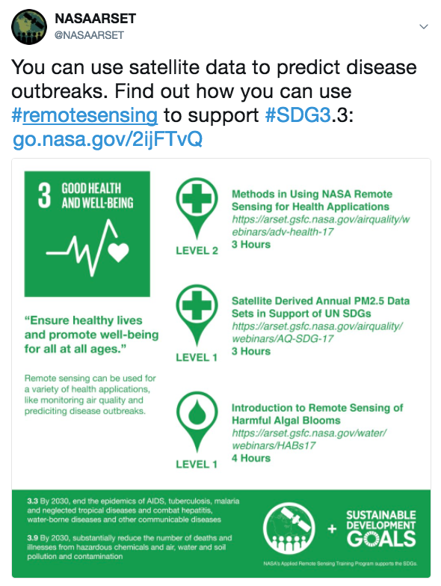
Social Media Campaign: ARSET Trainings in Support of UN SDGs
In November 2017 ARSET launched a social media campaign on Twitter to highlight past ARSET trainings relevant to the UN SDGs
@NASAARSET, 4,630+ followers
96 more followers
38
Tweets
27,040
Total
Impressions
652
Total
Engagements
Most Popular ARSET Tweets
Notes:
Impressions: number of views on tweets (non-unique)
Engagements: Likes, retweets, link clicks, media opens
Circles in above image indicate relevant SDGs
Most Impressions & Engagement (3,097, 57)
2nd Highest Impressions (2,250)
2nd Highest Engagement (45)

Slide 10
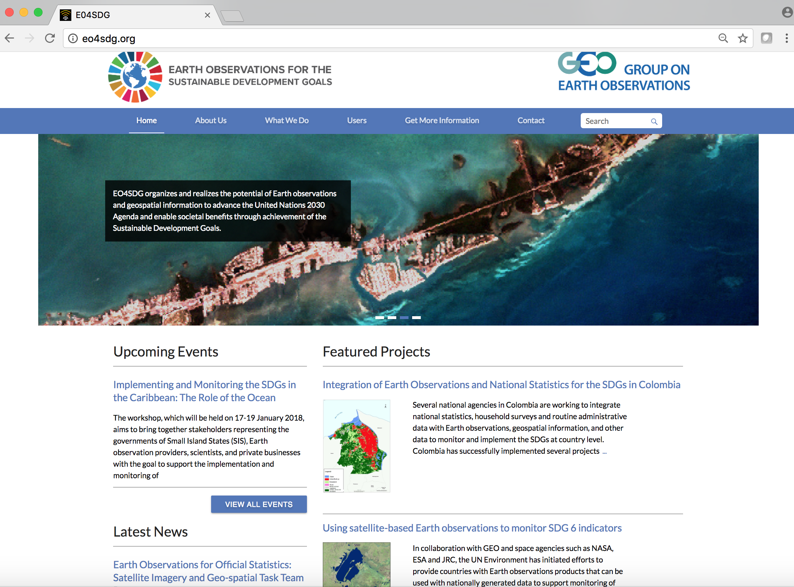
EO4SDG
http://eo4sdg.org
Twitter: @EO4SDG

Slide 11
National Efforts & Partnerships
EO4SDG

Slide 12






Country-level Engagement
Activities through Group on Earth Observations
                Colombia: SDG 6, 11, 15
                Kenya: SDG 2, 15
                Albania & Balkans: SDG 2, 6, 15
                Senegal, Ghana, Tanzania
                Sierra Leonne: SDG 2, 15
»
»
»
»
        Additional country-engagement in collaboration with:
        UN Environment in support of its national level data studies on 6.6.1
        UNCCD by assisting countries to fulfill reporting on 15.3.1

Slide 13


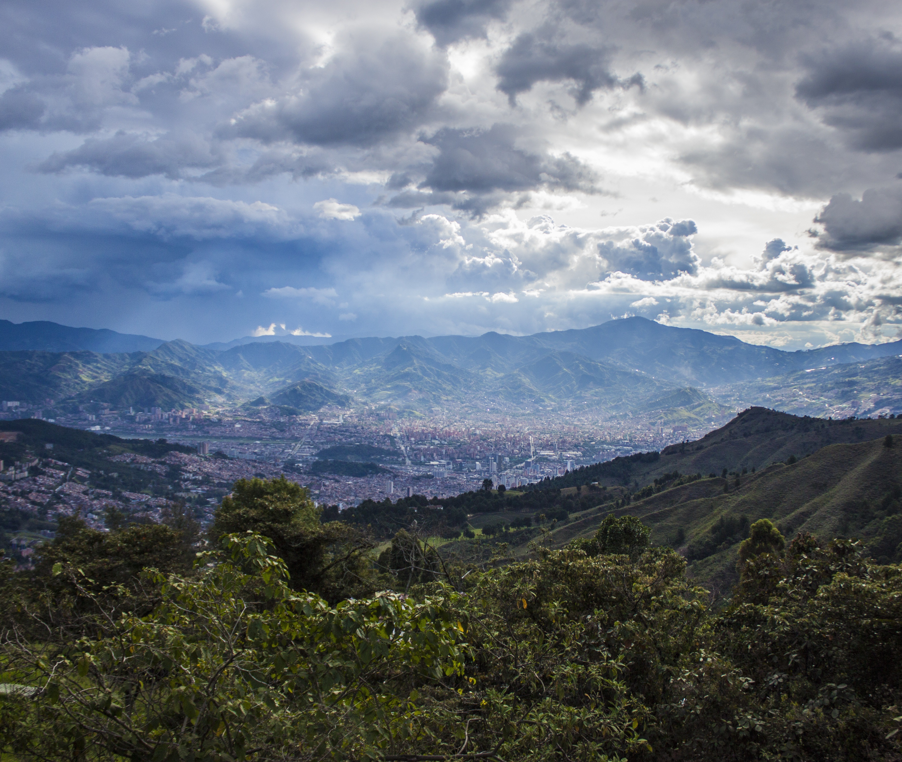
Colombia: DANE Pilot Project
Monitoring Land Consumption and Population Growth
In Colombia, the National Administration Department (DANE) is using Earth observations with population data to examine SDG11, Indicator 11.3.1: Ratio of land consumption to population growth
DANE developed a method that incorporates freely available Landsat images with population projection data to measure 11.3.1 in 138 cities and 4 metropolitan areas.
Software Used: Google Earth Engine, ArcGIS, R
GEO is collaborating with DANE and GPSDD to help scale this method to other countries in the region.

Slide 14
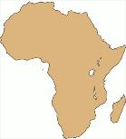

African Regional Data Cube
Coming in May 2018 ... A new satellite data solution providing critical Earth observation information to benefit central Africa
Zero Hunger, Life on Land
Earth observations are crucial for measuring the extent of degraded land and identifying common land classification approaches, as well as for monitoring and forecasting agricultural production.
GEO is working with United Nations Food and Agriculture Organization (FAO) and other partners to integrate Earth observations into the monitoring framework for SDG2.
GEOGLAM, GEO’s agricultural monitoring flagship, is assisting FAO to identify global coverage indicators of food crops, in order to fight food insecurity.
GEO, CEOS, GPSDD, Amazon and Strathmore University are working toward the development and deployment of a regional African Data Cube to support 5 countries in central Africa: Kenya, Senegal, Sierra Leone, Ghana and Tanzania.
Notes:
Planned for release in May 2018, the ARDC will support a number of key users, including Government Ministries, National Statistical Agencies, Geographic Institutes, and Research Scientists.

Slide 15
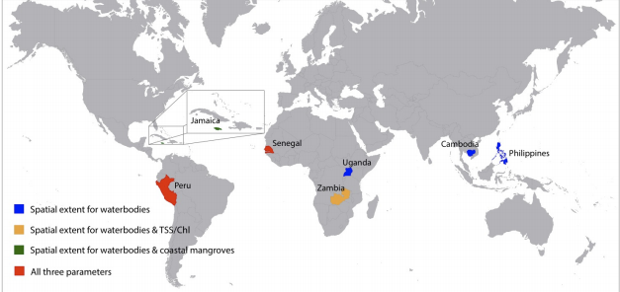
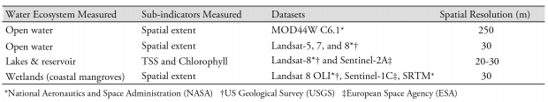
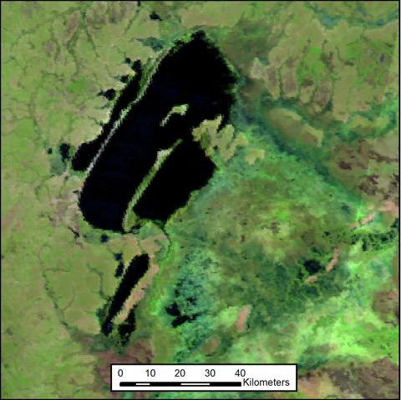
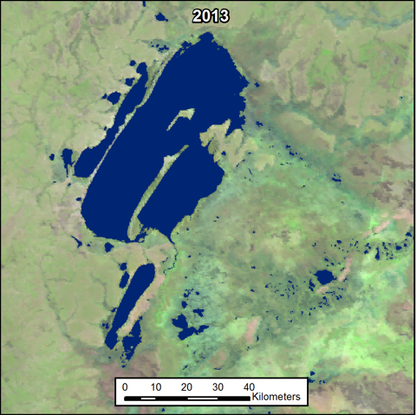
Piloting the Use of Earth Observations for Monitoring Extent of
Water-Related Ecosystems
EO4SDG has an ongoing, productive partnership with UN Environment
Together with NASA, ESA, and JRC, GEO is working with UN Environment to explore the applicability of EO datasets and tools in support of national reporting for changes over time in the extent of water-related ecosystems (indicator 6.6.1 under SDG 6, Water and Sanitation)
Figure 1 Map of countries considered in the NASA-UMD pilot effort, with the parameters/sub-indicators investigated, and summary of the components measured and datasets used for the pilot study.
UN Environment, in its custodian role, is examining ways to distribute developed methods and products to countries, in support of SDG monitoring and reporting.
Example: The NASA –UMD pilot study (Fig. 1 & 2) serves as a proof of concept for similar future applications and provides a means for countries to adapt the EO methods to meet their needs.
Figure 2 (left): False color composite MODIS surface reflectance image of several lakes, the largest of which is Lake Bangweulu, and associated swamps in Zambia. Imagery is an 8-day composite collected from a period beginning on 7/12/13. (right) The annual water dataset, overlain in blue, showing measured spatial extent of open water for the year 2013 (Credit: Vermote E. et al., 2015)
Notes:
In its custodian agency role, UN Environment is now examining ways to efficiently distribute the successful methods and datasets to countries to support their data-driven decision-making regarding this indicator, expanding the use of Earth observations and geo-spatially disaggregated information by countries for monitoring and reporting of SDG 6 indicators. As part of the Fifth High Level Forum on United Nations Global Geospatial Information Management, UN Environment is organizing a side meeting in collaboration with NASA, ESA, and JRC and countries such as Peru and Colombia, among others, titled "Sharing experiences on indicator 6.6.1 on freshwater related ecosystems, and exploring opportunities for better monitoring of the land-water-ocean nexus".
Significance: All of the Earth observation datasets that were used are of global coverage and freely available, making them a particularly attractive option for data-scarce regions. Further, the availability of high-quality, relatively frequent satellite products together with existing algorithm/methodologies and validation using in-situ and ground based data enables reporting on relative changes from baseline values over time in a more systematic manner. The pilot study serves as a proof of concept for similar future applications and provides a means for countries to replicate and adapt the Earth observation methods to meet their needs.

Slide 16


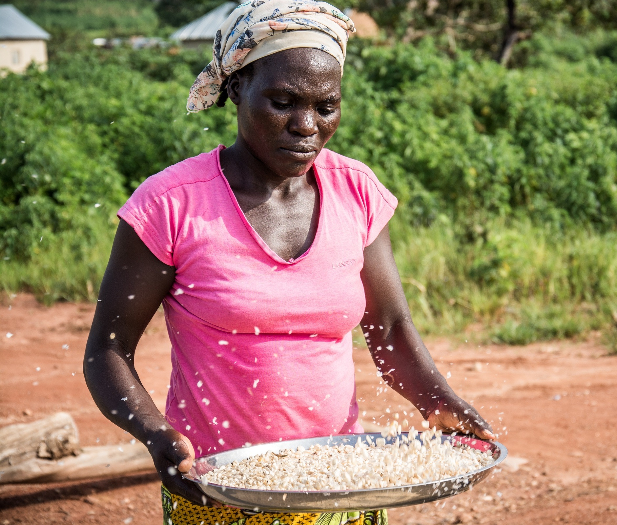




GEO Land Degradation Neutrality
Proposed GEO Work Programme Initiative
Earth Observations
for Land Degradation
GEO is partnering with UNCCD to help countries develop the capacity to monitor and report on SDG 15.3.1: “proportion of land that is degraded over total land area”
The GEO Land Degradation Neutrality Initiative will interact other activities in the GEO Work Programme, including GEOBON (biodiversity), GEOGLAM (agriculture), GFOI (forests), and EO4SDG (SDGs).

Slide 17
SDG 14, Life Below Water, & Conclusions
EO4SDG

Slide 18
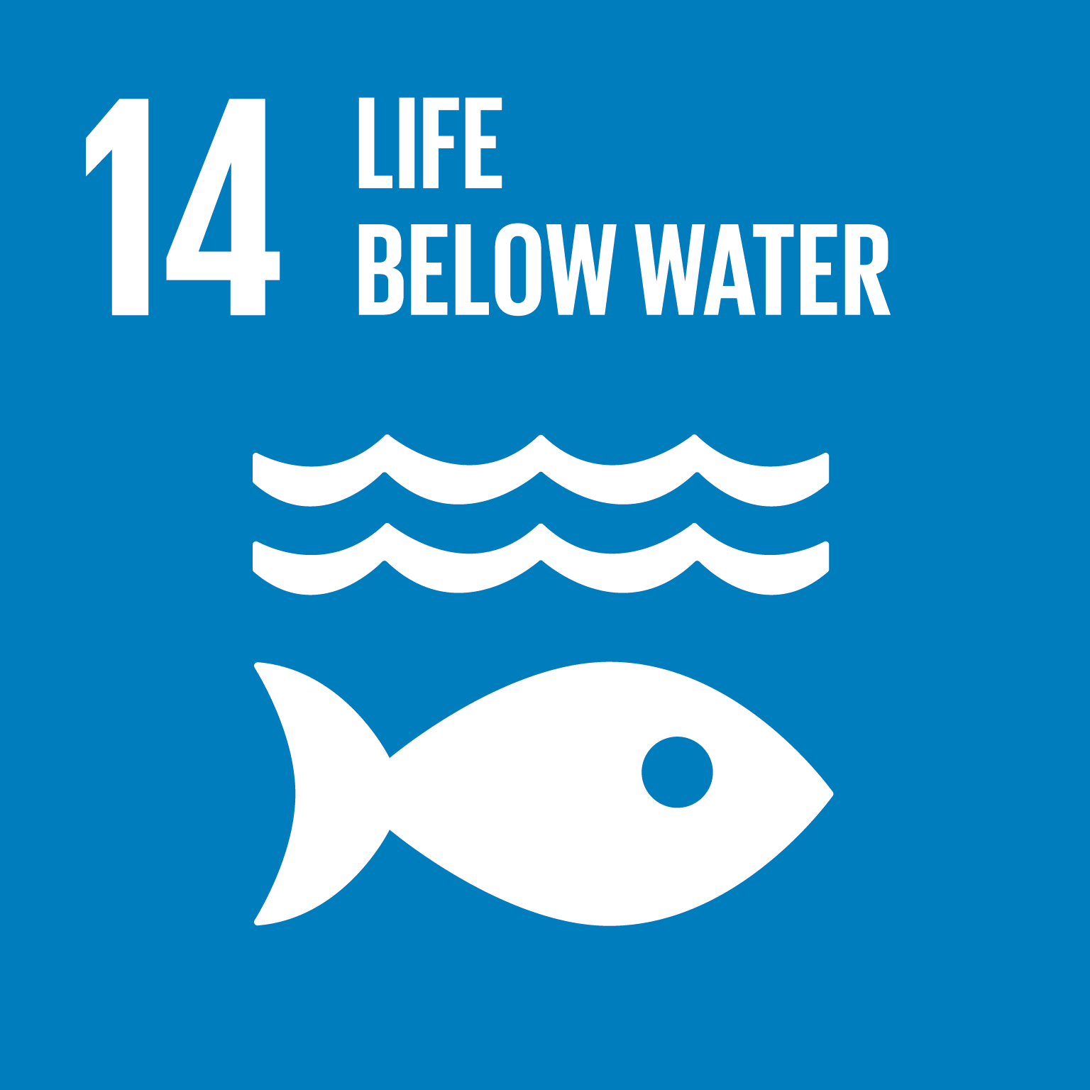
Life below Water
The adverse impacts of climate change, ocean acidification, human activities, overfishing and marine pollution put at risk efforts to protect the world’s oceans and coastal areas.
SDG 14 targets are designed to support efforts to conserve and sustainably use the oceans and marine resources, and protect benefits that humans derive from the variety and abundance of life in the oceans, and from the diverse interactions between these organisms and the marine environment.
Advances in Remote Sensing technology, combined with in-situ Earth observation data, now allow for real-time assessment of ecosystem health and the monitoring of water quality and other associated variables in water systems around the world.

Slide 19
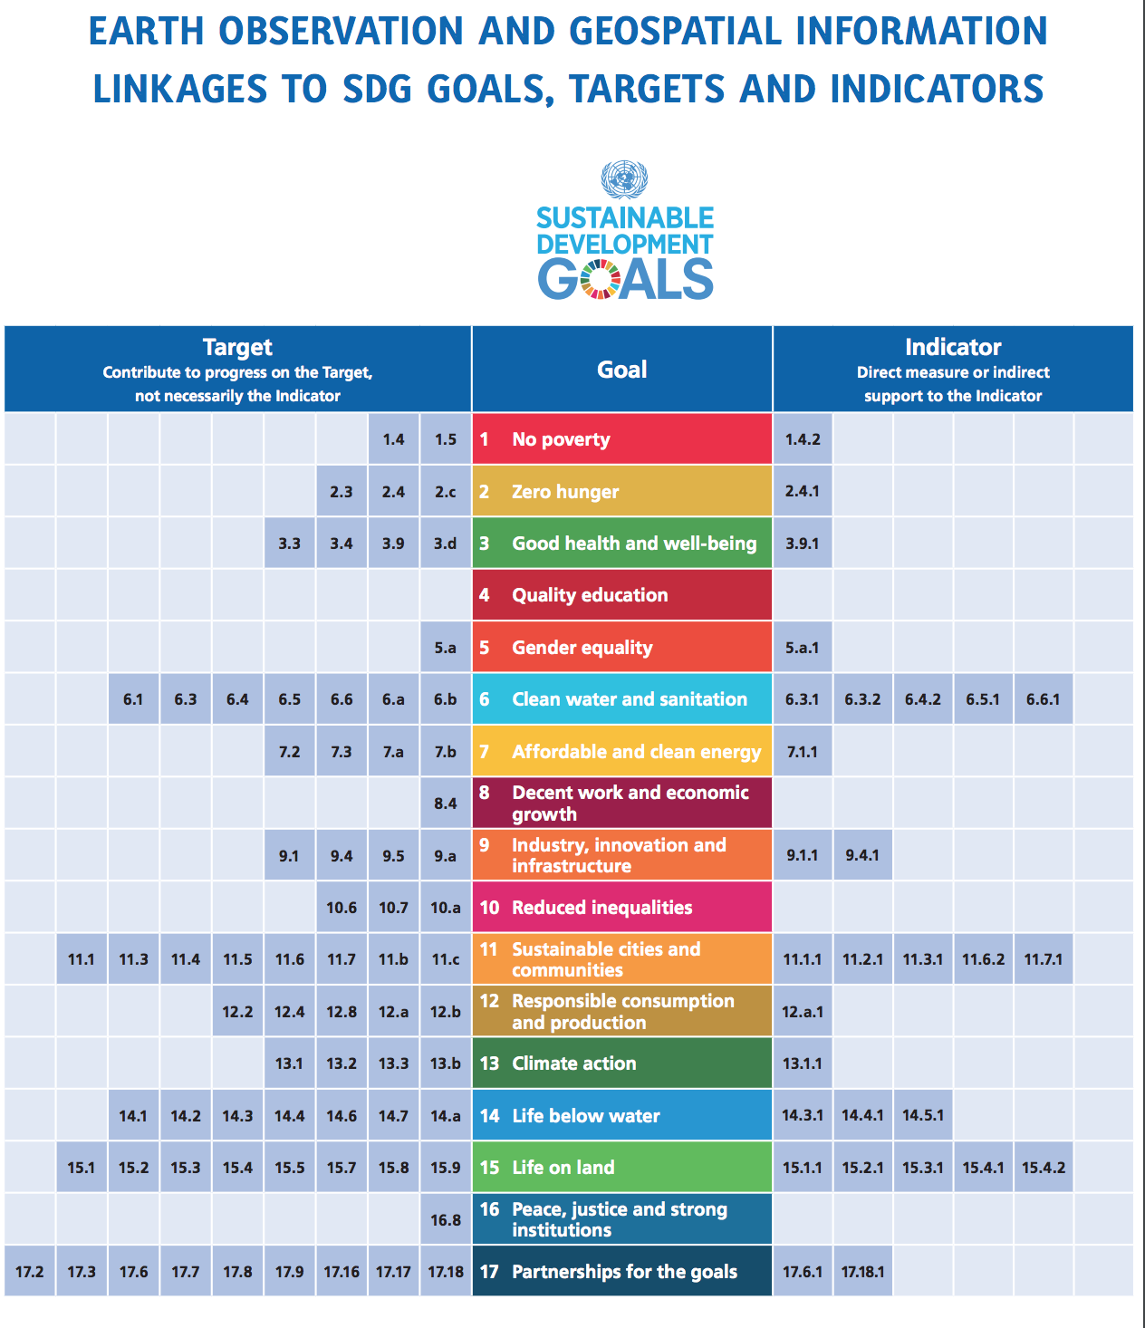

EO4SDG
Alignment of Earth Obs. and GEO to the Goals, Targets, and Indicators
SDG 14
7 Targets; 3 Indicators

Slide 20
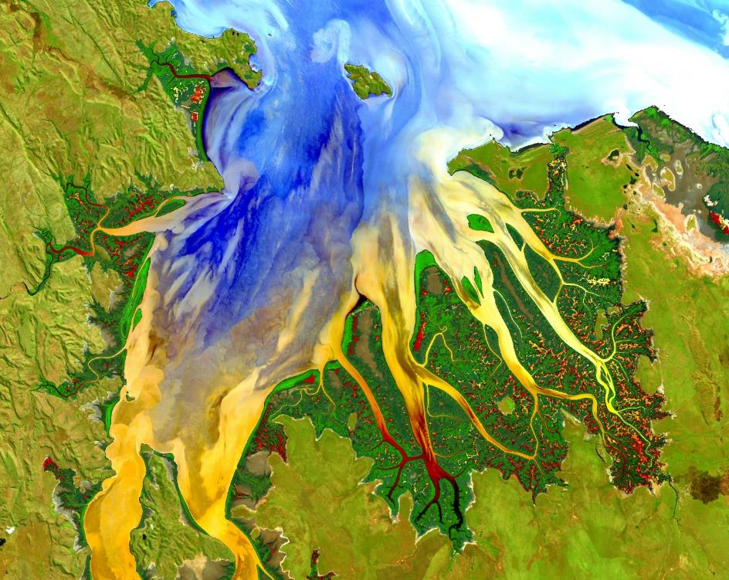

Caribbean Oceans II (2016 Summer DEVELOP California – Ames): Addressing Inundation Events: A Comparative Study of Remote Sensing Techniques Utilizing NASA Earth Observations to Identify Sargassum for Caribbean Nations
Partners: Consorcio de Instituciones de Investigación Marina del Golfo de México y del Caribe (CiiMar-GoMC); Comisión Nacional para el Conocimiento y Uso de la Biodiversidad (CONABIO); University of Puerto Rico, Department of Marine Sciences; Regional Activity Center for Specially Protected Areas and Wildlife (SPAW-RAC); Sea Education Association
Video: https://www.youtube.com/watch?v=0A6YwE0NrtE
SDGs: 6, 14
Related ILAC priority area: Water resources management
DEVELOP National Program
Caribbean Projects
Notes:
Caribbean nations were overwhelmed by an unprecedented quantity of Sargassum that washed ashore. This issue prompted international discussion to better understand the origin, distribution, and movement of Sargassum, a free-floating brown seaweed with ecological, environmental, and economic importance. In the open ocean, Sargassum mats serve a vital ecological function. However, when large quantities appear onshore without warning, Sargassum threatens local tourist industries and near-shore ecosystems. As part of the international response, this project investigated the proliferation of this seaweed using National Aeronautics and Space Administration (NASA) Earth observations for detection of Sargassum and available nutrients across the region. The NASA DEVELOP National Program Caribbean Oceans team at the NASA Ames Research Center compared Landsat 8 Operational Land Imager (OLI) imagery to Aqua Moderate Resolution Imaging Spectroradiometer (MODIS) and Sentinel II MultiSpectral Instrument (MSI) imagery across a number of indices for the identification of Sargassum. The presence of Sargassum was then compared to ground truth data points from Sea Education Association cruises and social media platforms, as well as various oceanic variables, to determine the ideal pelagic environment for Sargassum growth. As part of the international effort to better understand the life cycle of Sargassum in the Caribbean, the results of this project will assist local economies and help promote sustainable management practices.
the years 2011 and 2015, the nations of the Caribbean Sea were overwhelmed by the unprecedented quantity of sargassum that washed ashore. This issue prompted international discussion to better understand the origins, distribution, and movement of Sargassum, a free-floating brown macro alga with ecological, environmental, and commercial importance. In the open ocean, Sargassum mats serve a vital ecological function. However, when large quantities appear onshore without warning, Sargassum threatens local tourist industries and near-shore ecosystems within the Caribbean. As part of the international response, this project investigated the proliferation of this seaweed within the Sargasso and Caribbean Seas from 2003-2015, and used NASA Earth observations to detect and model Sargassum growth across the region. The Caribbean Oceans team derived the Floating Algal Index (FAI) using Terra MODIS data, and compared the FAI to various oceanic variables to determine the ideal pelagic environment for Sargassum growth. The project also examined the annual spread of Sargassum throughout the region by using TerrSet’s Earth Trends Modeler. As part of the international effort to better understand the life cycle of Sargassum in the Caribbean, the results of this project will help local economies thrive and promote sustainable management practices
Goal 6. Ensure availability and sustainable management of water and sanitation for all
Goal 14. Conserve and sustainably use the oceans, seas and marine resources for sustainable development

Slide 21
Disasters (2018 Summer): Assessing and Quantifying Land-use Change to Map At-risk Coastal Habitats in the US Virgin Islands after hurricane Maria and Irma
Potential Partners: US Virgin Islands Department of Planning and National Resources, Coastal Zone Management; University of the Virgin Islands; College of Charleston; Kent State University; other
Relevant SDGs: 11, 14
Related ILAC priority area: Vulnerability, human settlements and sustainable cities
DEVELOP National Program
Caribbean Projects

Slide 22
Conclusions
The 2030 Agenda offers a unique opportunity for convergence between global, regional and national agendas for sustainable development;
Integration of statistics with geospatial information and Earth observations is necessary to enable informed decision-making and an integrated approach to support the development of informed policies and national leadership;
Participation of all stakeholders, including civil society and the private sector, is essential to ensure access to reliable, unbiased, accurate, timely, accessible and disaggregated information to ensure that no one is left behind;
The sharing of knowledge, experiences, and lessons learned across countries is vital to help scale successful methods, share best practices and respond to the 2030 Agenda.

Slide 23
"It is a curious situation that the sea, from which life first arose should now be threatened by the activities of one form of that life. But the sea, though changed in a sinister way, will continue to exist; the threat is rather to life itself.”
- Rachel Carson
THANK YOU!
Argyro.Kavvada@nasa.gov

