Slide 1
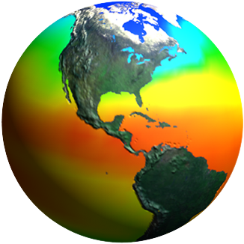
Opportunities for new and improved observations
Session 6: Improving availability of Earth observations in service of SDG implementation in Caribbean Small Island States

Slide 2
NASA resources: tools in our toolkit
Arset
globe
Develop
MBON: explorer & P2P

Slide 3
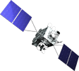
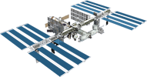
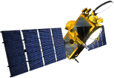
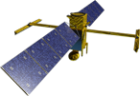
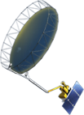
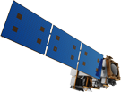
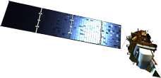
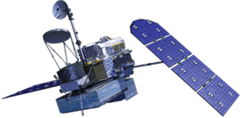
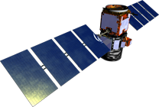
Earth Science Missions
Landsat 9
PACE
ISS Instruments
LIS, SAGE III
TSIS-1, OCO-3, ECOSTRESS, GEDI CLARREO-PF
GeoCARB
TROPICS (12)
MAIA
Sentinel-6A/B
JPSS-2 Instruments
RBI, OMPS-Limb
NI-SAR
SWOT
TEMPO
GRACE-FO (2)
Formulation
ICESat-2
CYGNSS (8)
NISTAR, EPIC
(DSCOVR / NOAA)
Implementation
Primary Ops
Extended Ops
SMAP
Landsat 7
(USGS)
QuikSCAT
SORCE,
TCTE (NOAA)
Suomi NPP (NOAA)
Terra
Landsat 8
(USGS)
Aqua
CloudSat
CALIPSO
GPM
Aura
OSTM/Jason-2 (NOAA)
OCO-2

Slide 4
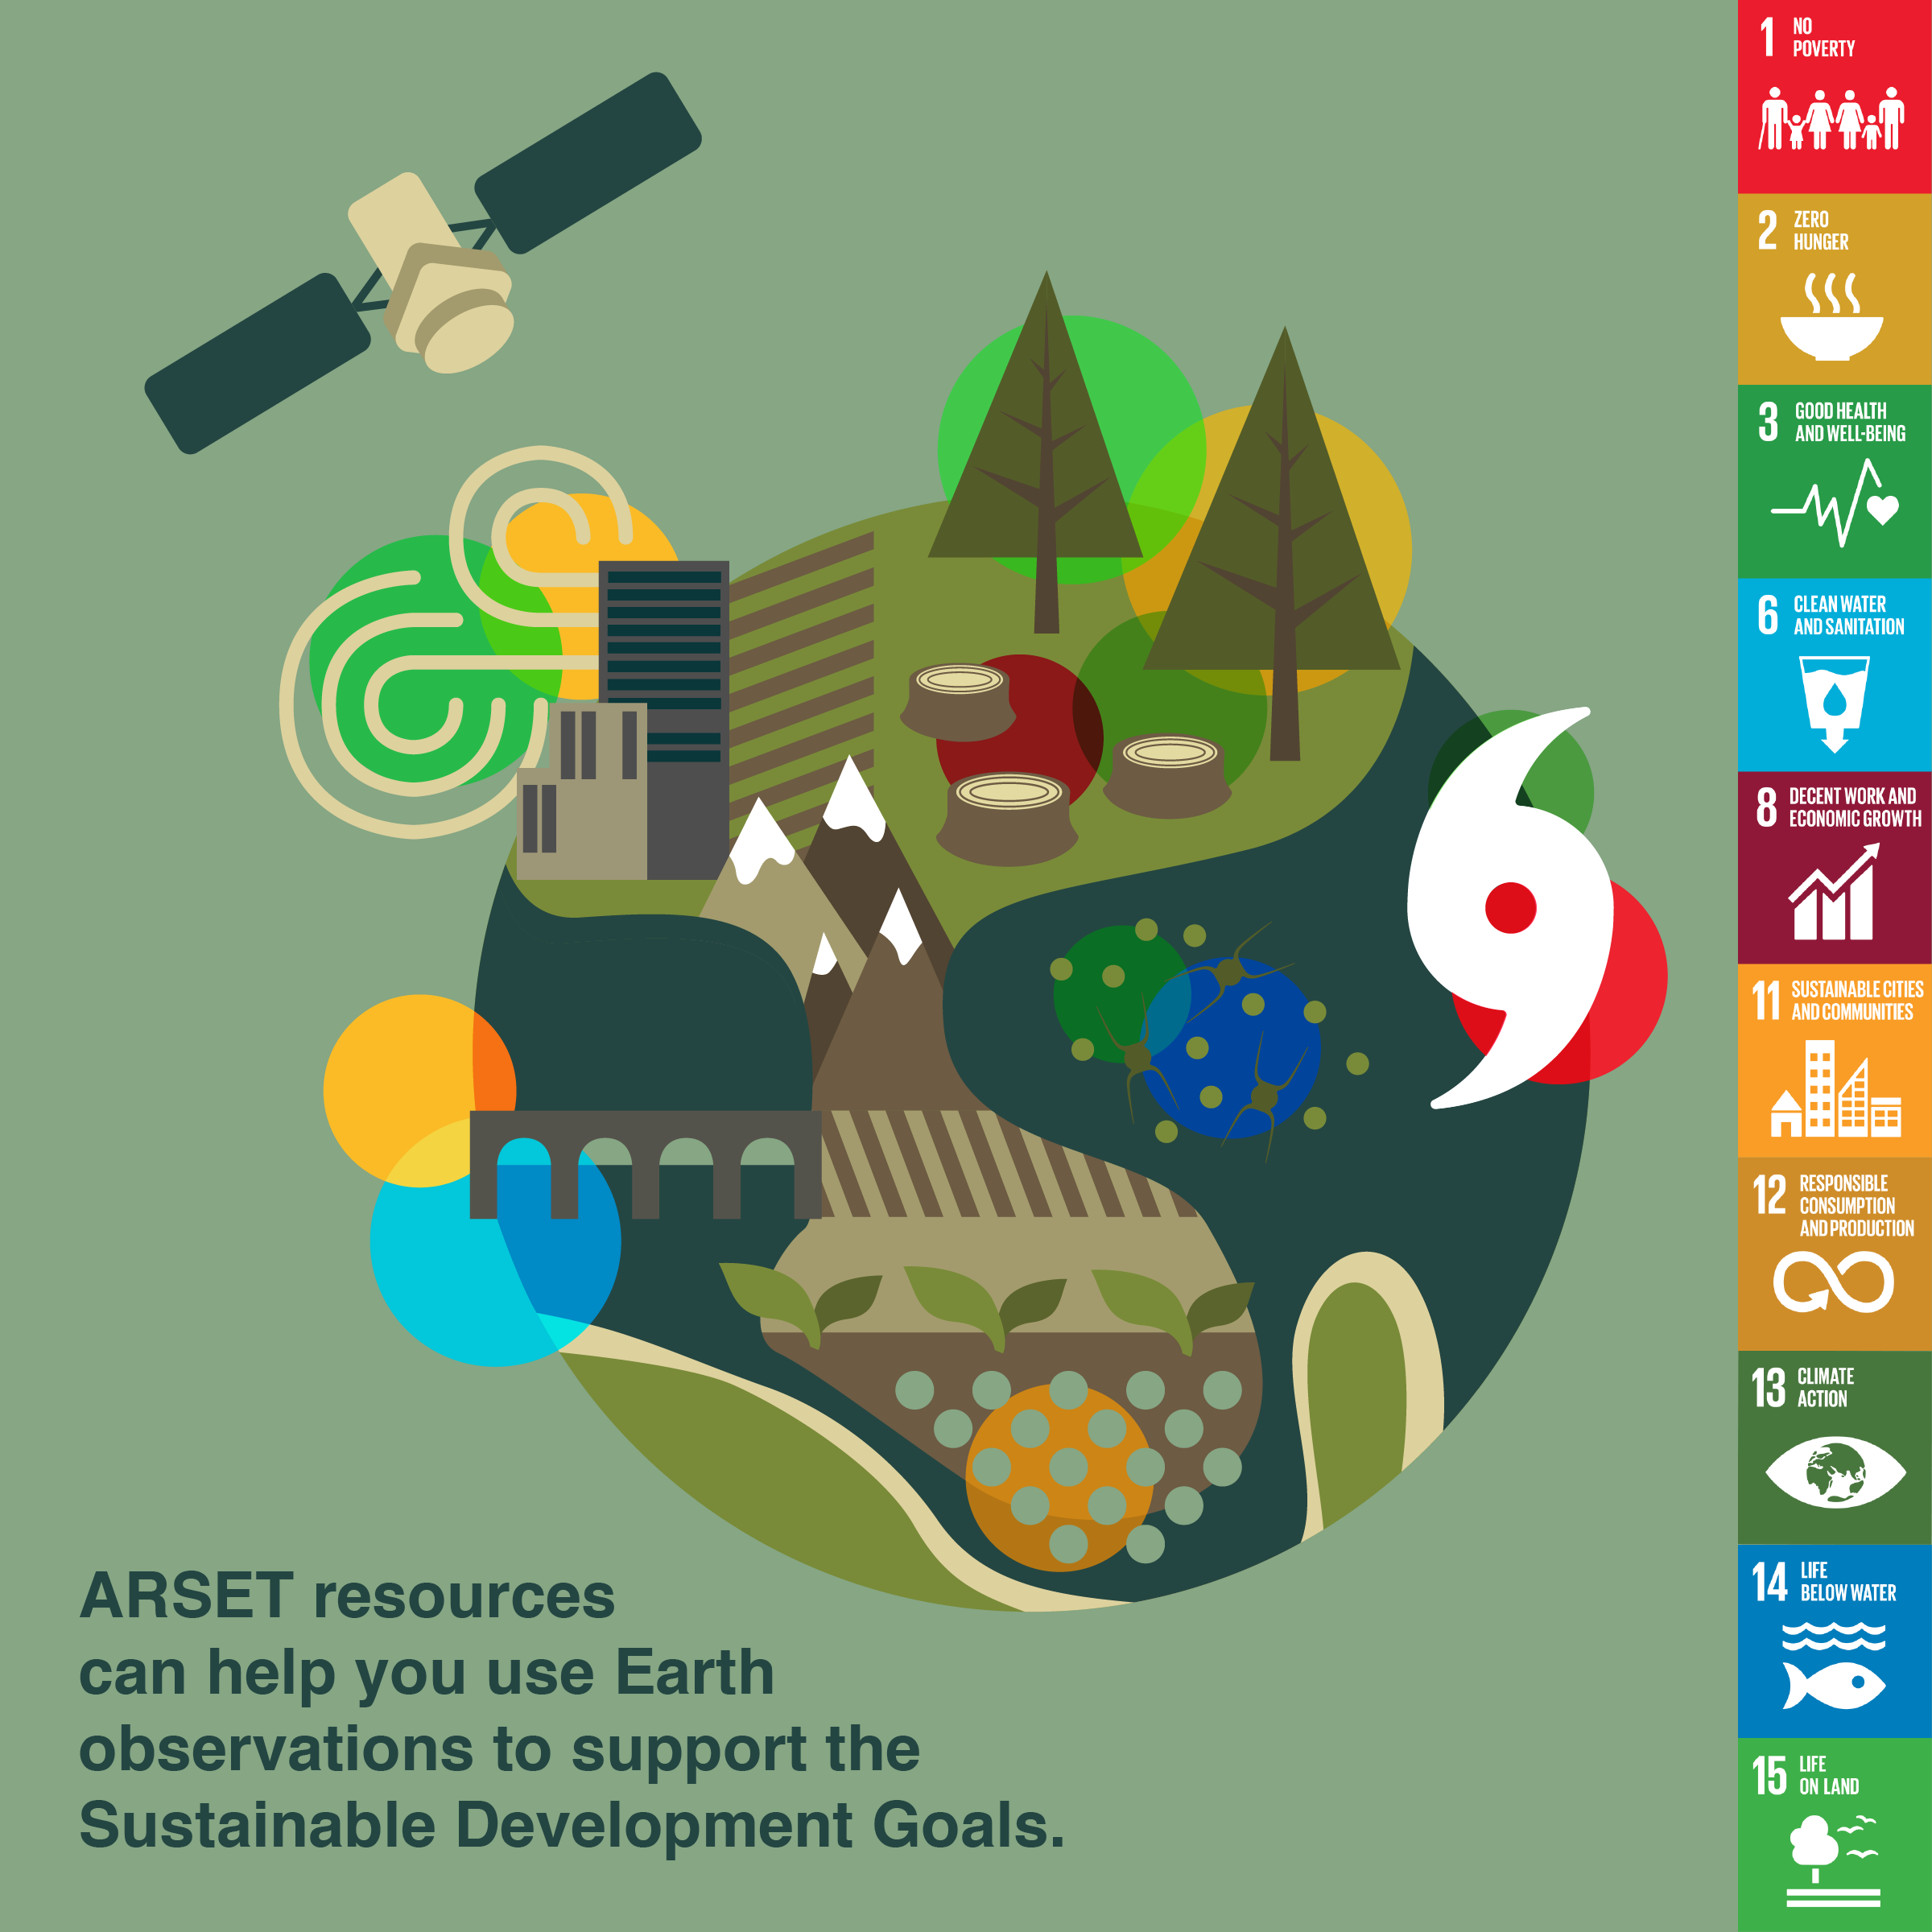
arset: Applied Remote Sensing Training
ARSET Trainings developed specifically in Support of UN SDGs
Training on Satellite observations:
https://arset.gsfc.nasa.gov/water/workshops/geoweek-sdg6
https://arset.gsfc.nasa.gov/webinars/fundamentals-remote-sensing
https://arset.gsfc.nasa.gov/land/webinars/coastal-oceans-2016
Contact Ana Prados: aprados@umbc.edu
Nancy Searby: nancy.d.searby@nasa.gov

Slide 5
GLOBE
GLOBE is an international science and education program that connects a network of students, teachers and scientists from around the world to better understand, sustain and improve Earth’s environment at local, regional and global scales.
Documents that lay out the process for making a certain measurement
To collect data that can be compared across the world.
Contact Lin Chambers: lin.h.chambers@nasa.gov

Slide 6
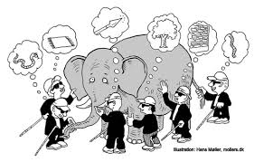
No, really: What IS The GLOBE Program?
A website (https://www.globe.gov)
A document: GLOBE Teacher’s Guide
A resource (Learning Activities, Elementary GLOBE)
A tool: Data Visualization (https://vis.globe.gov/GLOBE/)
A community
Teachers, students
Alumni
GLOBE International STEM Network (GISN)
Partners, Country Coordinators
Working Groups
An activity: Data Collection/Campaigns

Slide 7
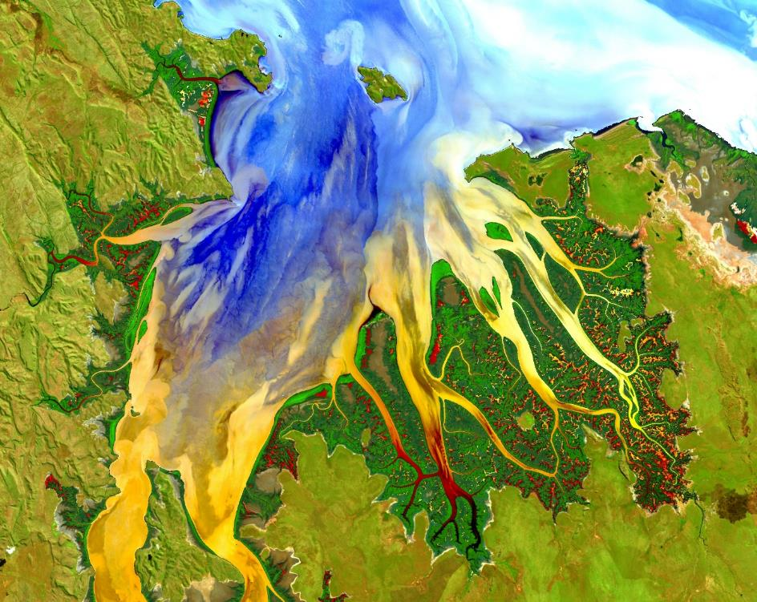
DEVELOP National Program
https://develop.larc.nasa.gov
Notes:
addresses environmental and public policy issues through interdisciplinary research projects that apply the lens of NASA Earth observations to community concerns around the globe. Bridging the gap between NASA Earth Science and society, DEVELOP builds capacity in both participants and partner organizations to better prepare them to address the challenges that face our society and future generations.

Slide 8
Previous Project Examples
US Virgin Islands Ecological Forecasting (2017 Summer DEVELOP California – Ames): Using NASA Earth Observations to Monitor Land-use Change and Map At-risk Coastal Habitats in the US Virgin Islands
Partners: US Virgin Islands, Department of Planning and Natural Resources, Coastal Zone Management; University of the Virgin Islands; College of Charleston; Kent State University
Video: https://www.youtube.com/watch?v=vJIhG-fEn7E
Related SDG: Goal 14, Goal 15
Related ILAC priority area: Protection and restoration of ecosystems and their biological diversity; Water resources management
Notes:
United States Virgin Islands (USVI) are home to an array of diverse and stunning habitats. The beauty of the islands has continued to attract visitors and residents, which overtime has increased human development and impact. The resulting land-use change increases sediment loads and the flow of pollutants into surrounding nearshore environments such as coral reefs, mangroves, and seagrass beds. Coral reefs, the most diverse marine habitats on Earth, are particularly susceptible to these inputs. Compounded with regional climate-related processes such as rising ocean temperatures and acidification, future land-use change poses a formidable threat to the marine environment. Without a healthy environment, the USVI economy also becomes endangered because it is mainly supported by tourism and recreation. In order to assess land-use change in the USVI, we utilized Landsat 5 TM, Landsat 8 OLI and TIRS, and Sentinel-2 MSI data to map land-use and analyze land cover change dating back to 1985. We then extrapolated the models to the year 2025. Our work will provide the USVI Department of Planning and Natural Resources, Division of Coastal Zone Management (CZM) with a tool to better understand land-use trends, identify at-risk coastal habitats, and strengthen existing knowledge of the link between land-use and coastal ecosystem health.
Goal 14. Conserve and sustainably use the oceans, seas and marine resources for sustainable development
Goal 15. Protect, restore and promote sustainable use of terrestrial ecosystems, sustainably manage forests, combat desertification, and halt and reverse land degradation and halt biodiversity loss

Slide 9
Previous Project Examples
Previous Project Examples
Caribbean Oceans (2016 Spring DEVELOP California – Ames): Utilizing NASA Earth Observations to Detect, Monitor, and Respond to Unprecedented Levels of Sargassum in the Caribbean Sea
Partners: Consorcio de Instituciones de Investigación Marina del Golfo de México y del Caribe (CiiMarGoMC); Regional Activity Center for Specially Protected Areas and Wildlife (SPAW-RAC); Comisión Nacional para el Conocimiento y Uso de la Biodiversidad (CONABIO); University of Puerto Rico, Department of Marine Sciences
Video: https://www.youtube.com/watch?v=ROlIpzKCMrc&list=PLL8pCbx5gnDYax2OGc9XjGBIo6SeEUMhN&index=21
Related SDG: Goal 6, Goal 14
Related ILAC priority area: Water resources management
Notes:
2. Caribbean nations were overwhelmed by an unprecedented quantity of Sargassum that washed ashore. This issue prompted international discussion to better understand the origin, distribution, and movement of Sargassum, a free-floating brown seaweed with ecological, environmental, and economic importance. In the open ocean, Sargassum mats serve a vital ecological function. However, when large quantities appear onshore without warning, Sargassum threatens local tourist industries and near-shore ecosystems. As part of the international response, this project investigated the proliferation of this seaweed using National Aeronautics and Space Administration (NASA) Earth observations for detection of Sargassum and available nutrients across the region. The NASA DEVELOP National Program Caribbean Oceans team at the NASA Ames Research Center compared Landsat 8 Operational Land Imager (OLI) imagery to Aqua Moderate Resolution Imaging Spectroradiometer (MODIS) and Sentinel II MultiSpectral Instrument (MSI) imagery across a number of indices for the identification of Sargassum. The presence of Sargassum was then compared to ground truth data points from Sea Education Association cruises and social media platforms, as well as various oceanic variables, to determine the ideal pelagic environment for Sargassum growth. As part of the international effort to better understand the life cycle of Sargassum in the Caribbean, the results of this project will assist local economies and help promote sustainable management practices.
the years 2011 and 2015, the nations of the Caribbean Sea were overwhelmed by the unprecedented quantity of sargassum that washed ashore. This issue prompted international discussion to better understand the origins, distribution, and movement of Sargassum, a free-floating brown macro alga with ecological, environmental, and commercial importance. In the open ocean, Sargassum mats serve a vital ecological function. However, when large quantities appear onshore without warning, Sargassum threatens local tourist industries and near-shore ecosystems within the Caribbean. As part of the international response, this project investigated the proliferation of this seaweed within the Sargasso and Caribbean Seas from 2003-2015, and used NASA Earth observations to detect and model Sargassum growth across the region. The Caribbean Oceans team derived the Floating Algal Index (FAI) using Terra MODIS data, and compared the FAI to various oceanic variables to determine the ideal pelagic environment for Sargassum growth. The project also examined the annual spread of Sargassum throughout the region by using TerrSet’s Earth Trends Modeler. As part of the international effort to better understand the life cycle of Sargassum in the Caribbean, the results of this project will help local economies thrive and promote sustainable management practices
Goal 6. Ensure availability and sustainable management of water and sanitation for all
Goal 14. Conserve and sustainably use the oceans, seas and marine resources for sustainable development

Slide 10
Tentative Upcoming Projects
Previous Project Examples
Tentative upcoming Projects
US Virgin Islands Disasters (2018 Summer): Assessing and Quantifying Land-use Change to Map At-risk Coastal Habitats in the US Virgin Islands after hurricane Maria and Irma
Partners: US Virgin Islands Department of Planning and National Resources, Coastal Zone Management; University of the Virgin Islands; College of Charleston; Kent State University
Opportunity to add or propose new projects: https://develop.larc.nasa.gov/projects.php
Contact Georgina Crepps: georgina.s.crepps@nasa.gov
Related SDG: Goal 11, 14
Related ILAC priority area: Vulnerability, human settlements and sustainable cities
Notes:
Who is Eligible to Apply to DEVELOP?
Individuals interested in furthering their experience in the Earth sciences and remote sensing, including currently enrolled students, recent graduates, early career professionals, and transitioning career professionals.

Slide 11
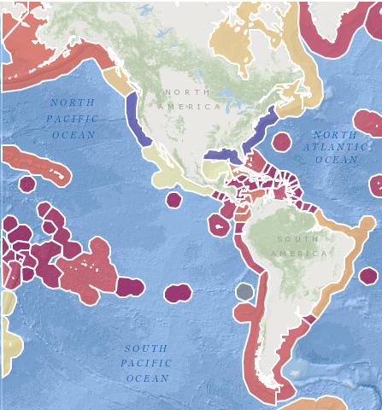
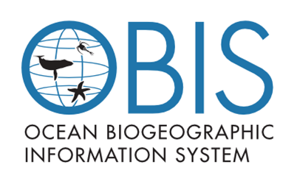
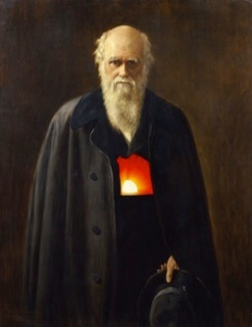
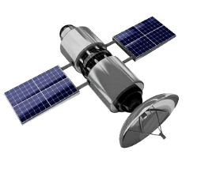
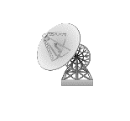
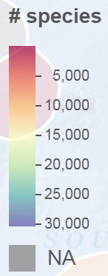
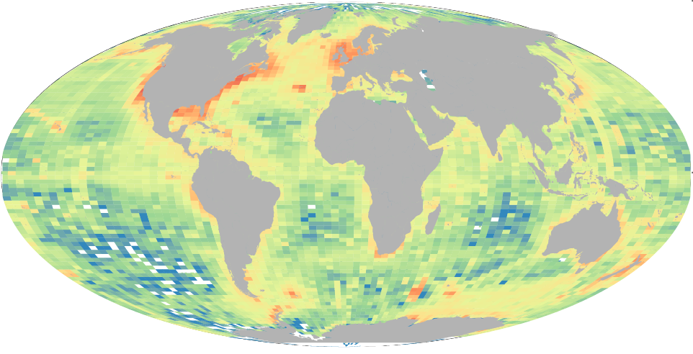
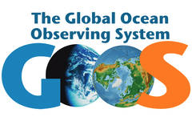
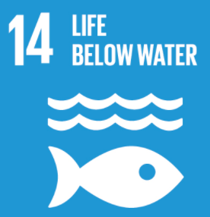
MBON: p2p and explorer
Vision
OBJECTIVES
Distribution of satellite products
Capacity-building
Canada
USA
Belize
Mexico
Costa Rica
Colombia
Data standards
(e.g. Darwin Core; DwC)
Ecuador
Peru
Brazil
Seascape data
Chile
Argentina
Supports
Seascapes
(see Kavanaugh et al.).
Data analysis tools
Notes:
We are working together to define core observational requirements for an MBON, determine what observations are feasible, and address questions about data standards, data management, and products.
The main goal of P2P is to contribute to the implementation of the GEO BON Marine Biodiversity Obs Network by helping to build a community of practice in the Americas.
The vision of the Pole to Pole MBON is to (1) connect existing observing programs, (2) integrate surveys on species distribution, movement, habitat, and genetic material, (3) develop a community of practice and foster collaboration on science and data sharing, and (4) share infrastructure when feasible (e.g. for sample analysis).
The AmeriGEOSS initiative is a framework that seeks to promote collaboration and coordination among the GEO members in the American continent

Slide 12
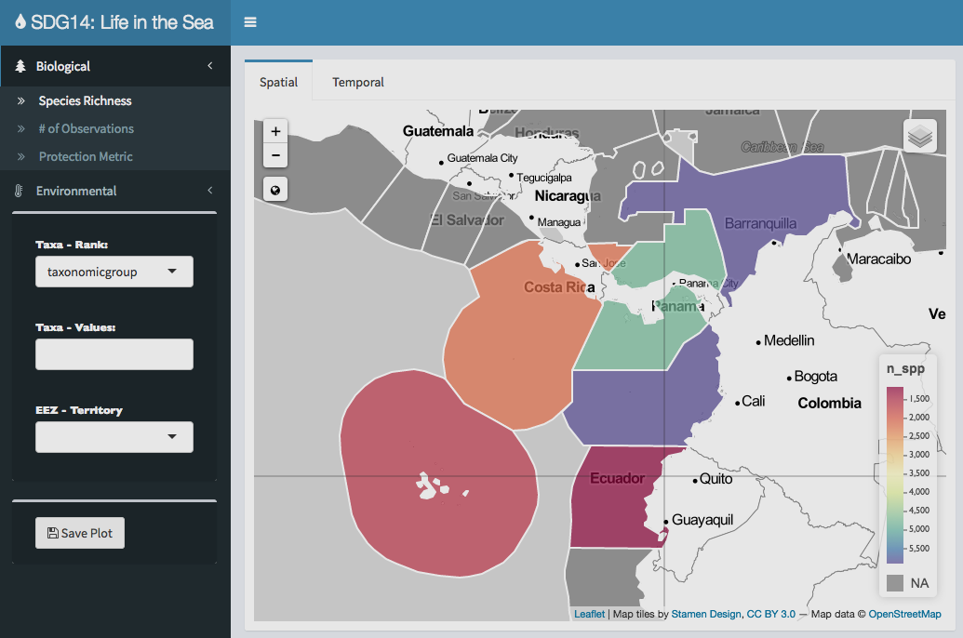
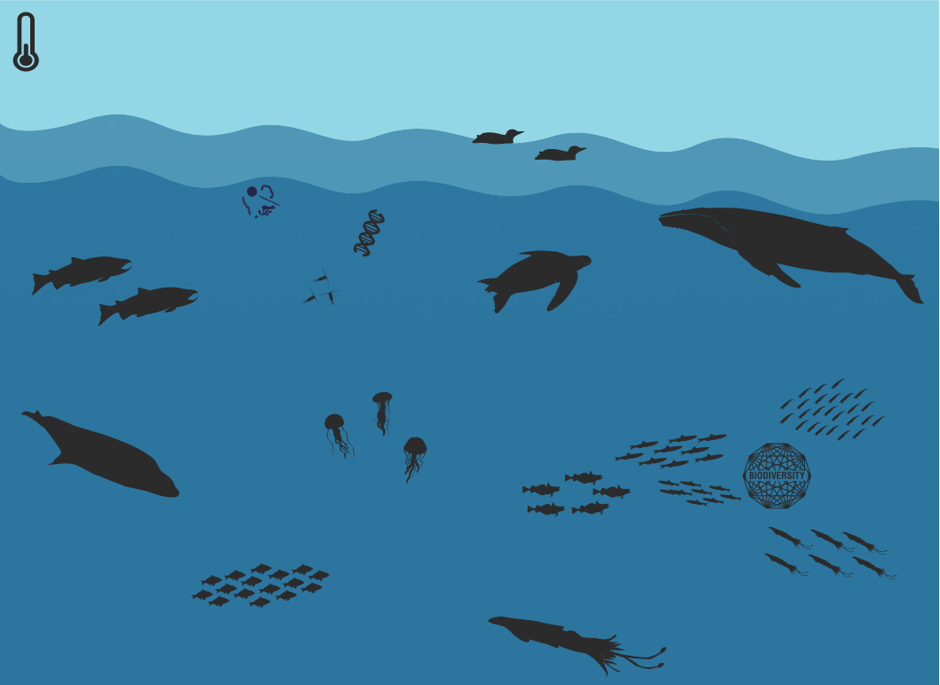
MBON EXPLORER
github.com/marinebon
Explorer
Written in open access code; provides global biological data (OBIS), coupled with environmental data (SST, Chla, seascapes).
Infographic
infographic: package of functions to create interactive infographics linking habitat scenes with interactive plots for serving on any website.
Contact: Frank Muller-Kager: carib@usf.edu
Enrique Montes: emontesh@mail.usf.edu
Notes:
Join the discussion about how to implement standardized marine biodiversity monitoring from local to global scales by joining and actively participating in the MBON email list (this implies responding to requests and sending news of related activities, publications, potential new members, funding opportunities, etc.)
Recommend integration or partnership with existing initiatives active in your country or region, join initiatives such as RLS, CPR, marineGEO, MBON P2P that may be relevant for your organization, and/or form new initiatives that target methods and components of marine biodiversity that existing partners may not yet be addressing.
Support the global effort to advance standardization of biological observing data in partnership with the Ocean Biogeographic Information System, and encourage integration of biological observations into the Global Ocean Observing System, towards ensuring availability of long-term, sustained biological observations.

Slide 13
Species richness from OBIS records
http://www.marinebon.org/
Notes:
The number of species by country is derived from the occurrence records in the Ocean Biogeographic Information System (OBIS) and intersected with the exclusive economic zone (EEZ) from MarineRegions.org.

Slide 14
Extinction risk for species observed inside versus outside marine protected areas
http://www.marinebon.org/
Notes:
The protection metric is the ratio of average extinction risk for species observed inside versus outside marine protected areas. The observations by country are derived from the occurrence records in the Ocean Biogeographic Information System (OBIS) and intersected with the exclusive economic zone (EEZ) from MarineRegions.org. OBIS also provides the IUCN RedList extinction risk status through the robis::checklist function. And the marine protected areas come from the World Database of Protected Areas (WDPA).

Slide 15
Satellite surface chlorophyll
Orinoco plume
Notes:
The chlorophyll a (chl) data come from the MODIS Aqua satellite sensor, September 2002-present. The Level-3 mapped 9-km monthly products were obtained directly from NASA Ocean Color and processed by Dan Otis at USF IMARS. Products are in geographic project at nominally 9km at the equator (4320x2160 columnsxrows).
Note the influence of the Orinoco plume on the islands

Slide 16
Satellite surface temperature (SST)
Notes:
The nighttime sea surface temperature (sst) data come from the MODIS Aqua satellite sensor, September 2002-present. The Level-3 mapped 9-km monthly products were obtained directly from NASA Ocean Color and processed by Dan Otis at USF IMARS. Products are in geographic project at nominally 9km at the equator (4320x2160 columnsxrows).

Slide 17
User-developed platforms
AFAI near real time products: SaWS
(http://optics.marine.usf.edu/projects/SaWS.html)
NOAA Resources (e.g. Coral Reef Watch)
Online teaching resources/Remote Sensing courses
Freely available data from multiple sites
COVERAGE (CEOS initiative; ftp://podaac.jpl.nasa.gov/misc/outgoing/jorge/CEOS/noaapresentation.pdf)
What is the current regional data infrastructure?
What are the data policies?
Notes:
The project seeks to build a Near-Real-Time (~24 hr) co-located gridded (~25km) global data set including Sea Surface Height, Temperature, Salinity, Color, Vector Winds, Salinity, Ocean Currents, Sea Surface Temperature Gradients, and Sea Surface Temperature Anomaly. Additionally it seeks to include Animal Track data that can be overlaid on the satellite data. It’s a way to unite the Ocean Virtual Constellations around a common project for CEOS and Blue Planet Preliminary analysis has shown that is feasibie.

Slide 18
Become part of ongoing efforts ~g7 future of oceans and seas wg ~goos/oceanobs19 ~geo/geobon/amerigeoss Take advantage of existing tools Ask questions
Notes:
The Action 4 plan develops and enhances regional coastal ocean observing systems, building on existing activities, and also working in new partnerships with developing countries to co-design new systems.
OceanObs19: OceanObs’19 will seek to better connect observers with end user communities. Special emphasis on stakeholders.

