Slide 1

“Your Deepest Dive Experience”

Slide 2
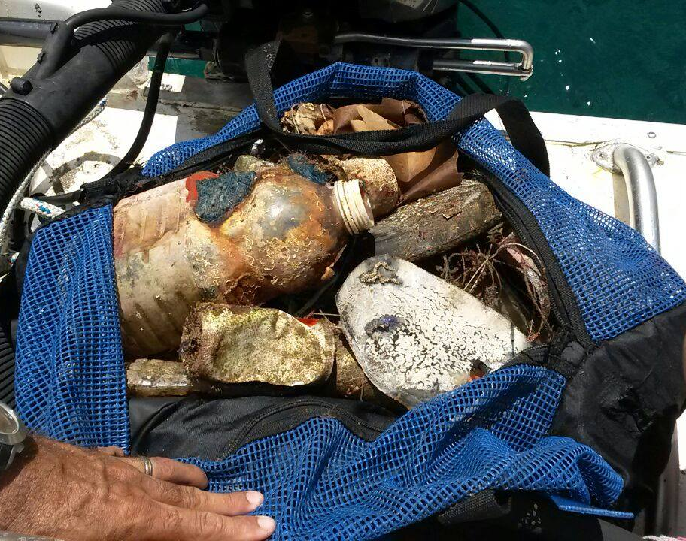
Underwater Beach Cleanup

Slide 3
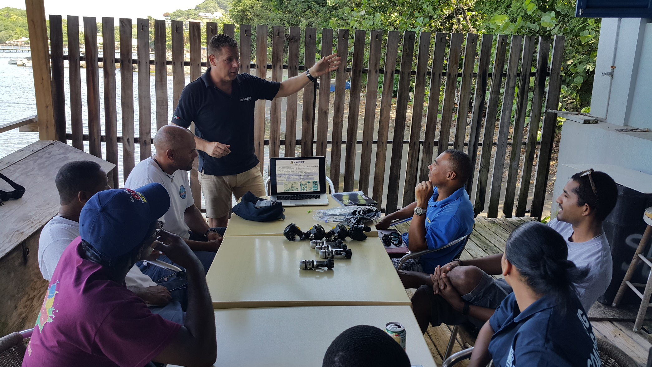
Cressi/Scuba Pro Equipment Workshops

Slide 4
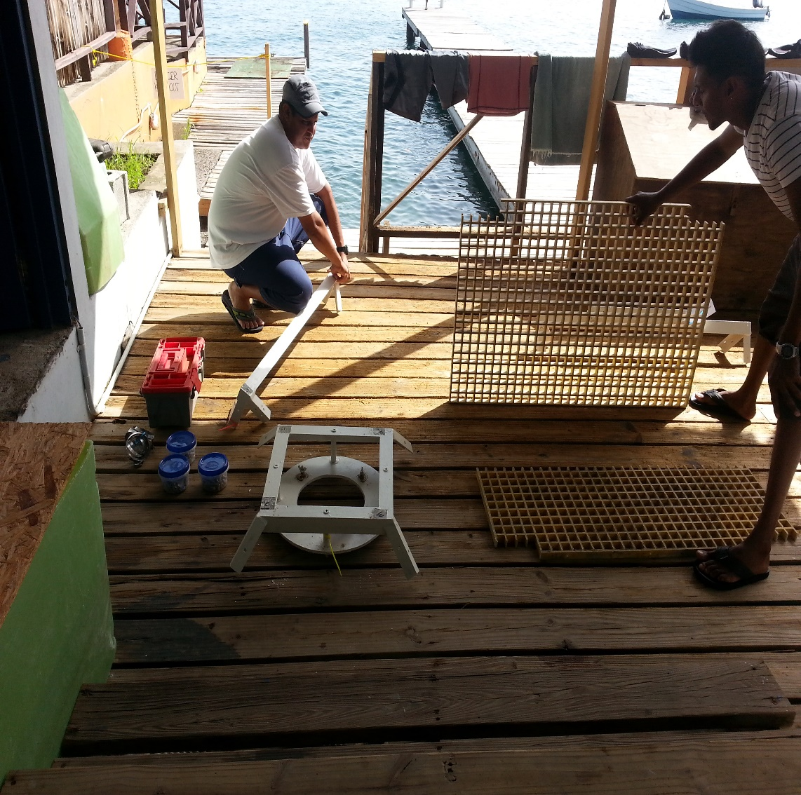
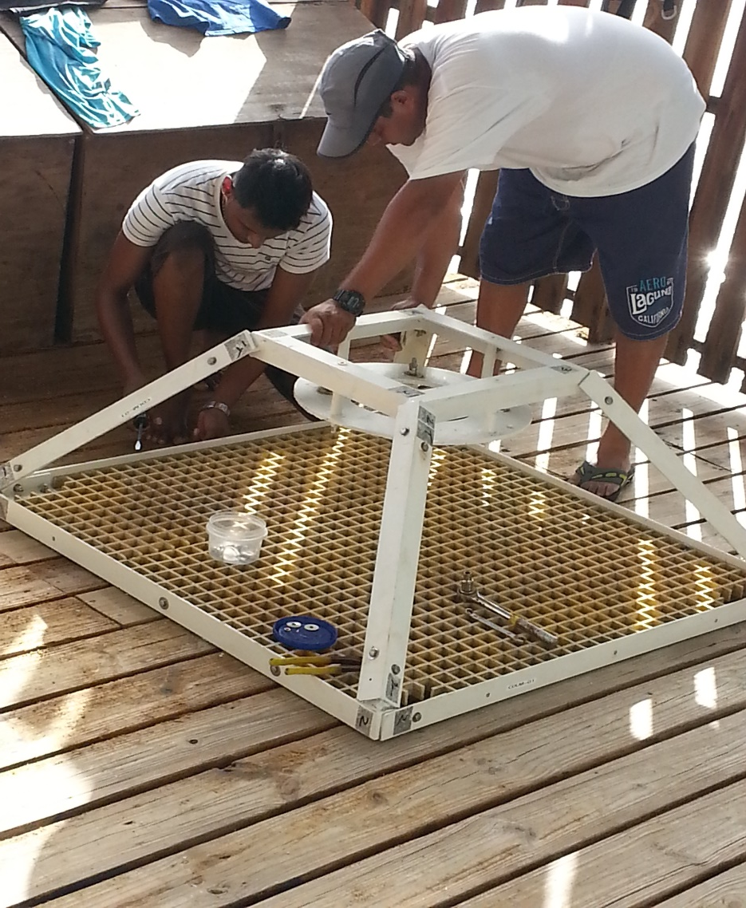
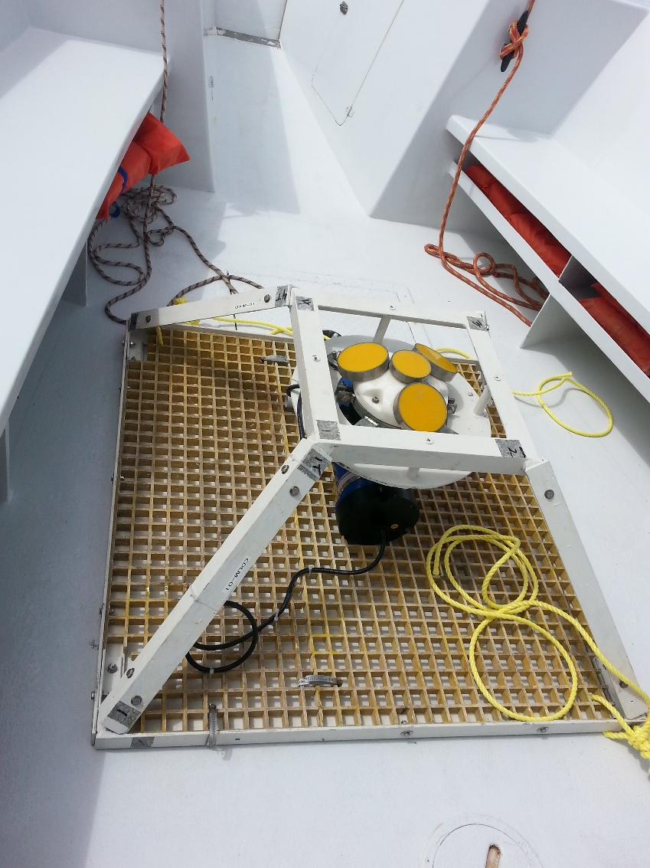
Working along with the Coastal Dynamics Team out of Trinidad on the installation of wave monitoring equipment on our windward coastline

Slide 5
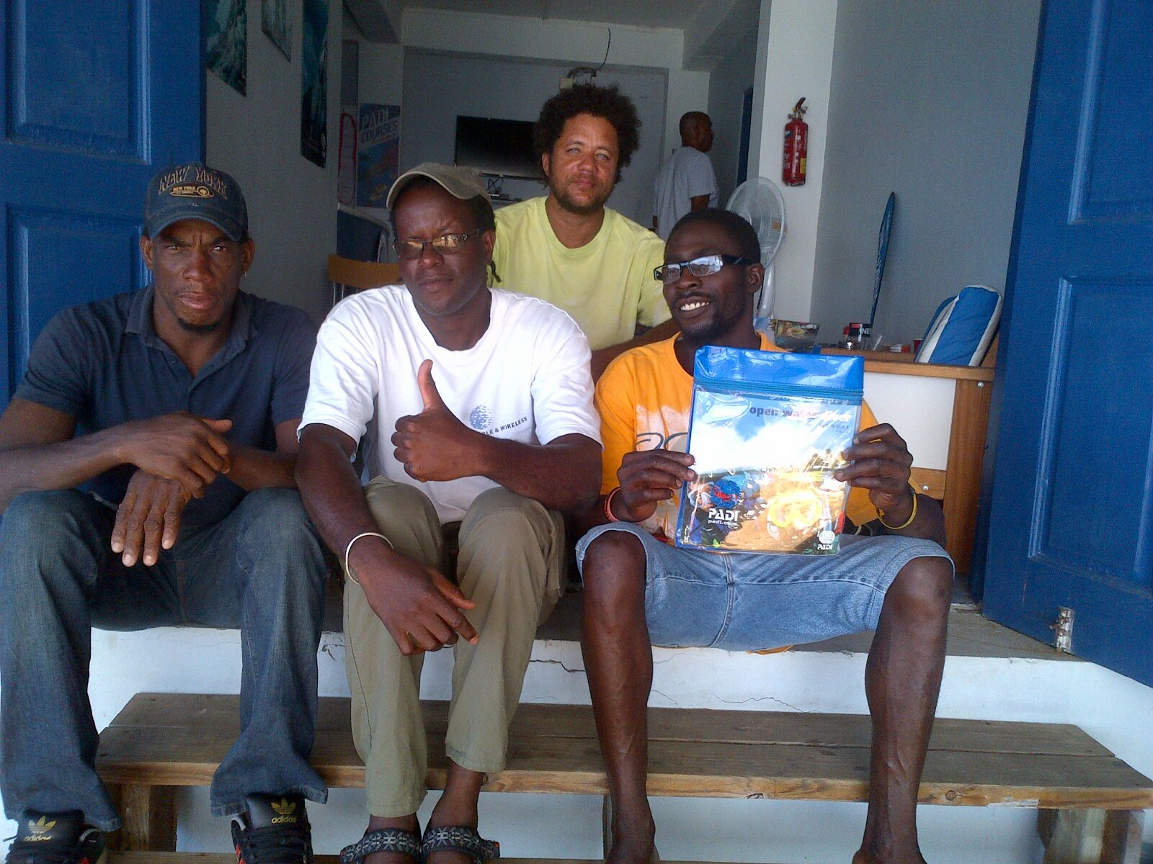
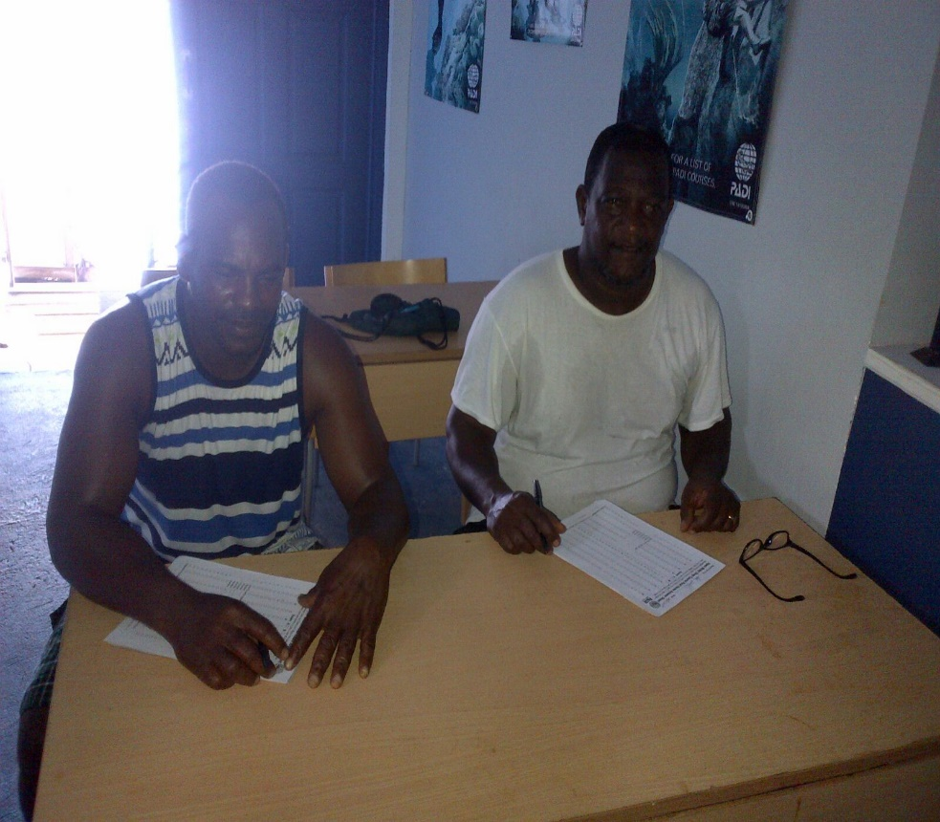
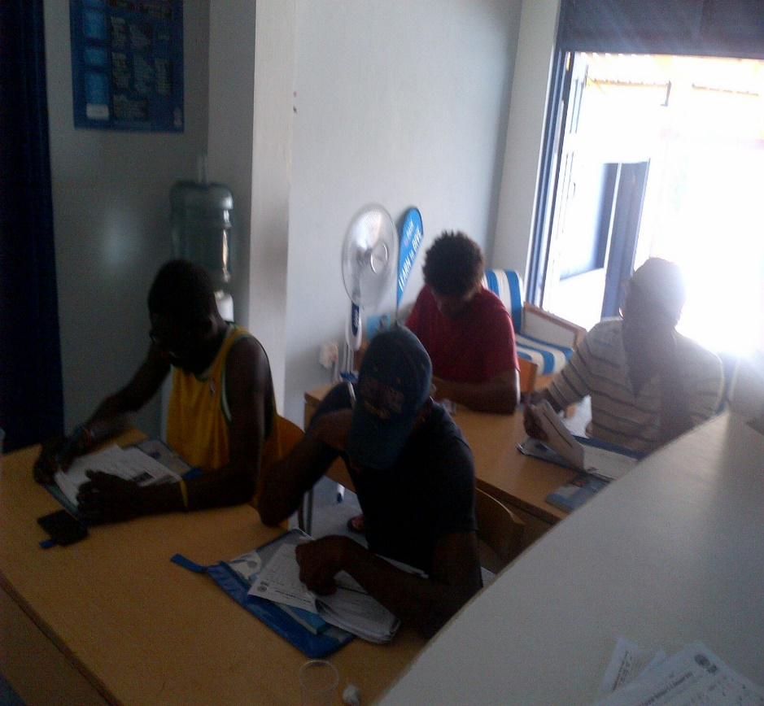
Certification of 25 fisherfolks under the PADI (Professional Association of Dive Instructors) system through a sustainable livelihoods grant awarded to us through the ECMANN Project

Slide 6
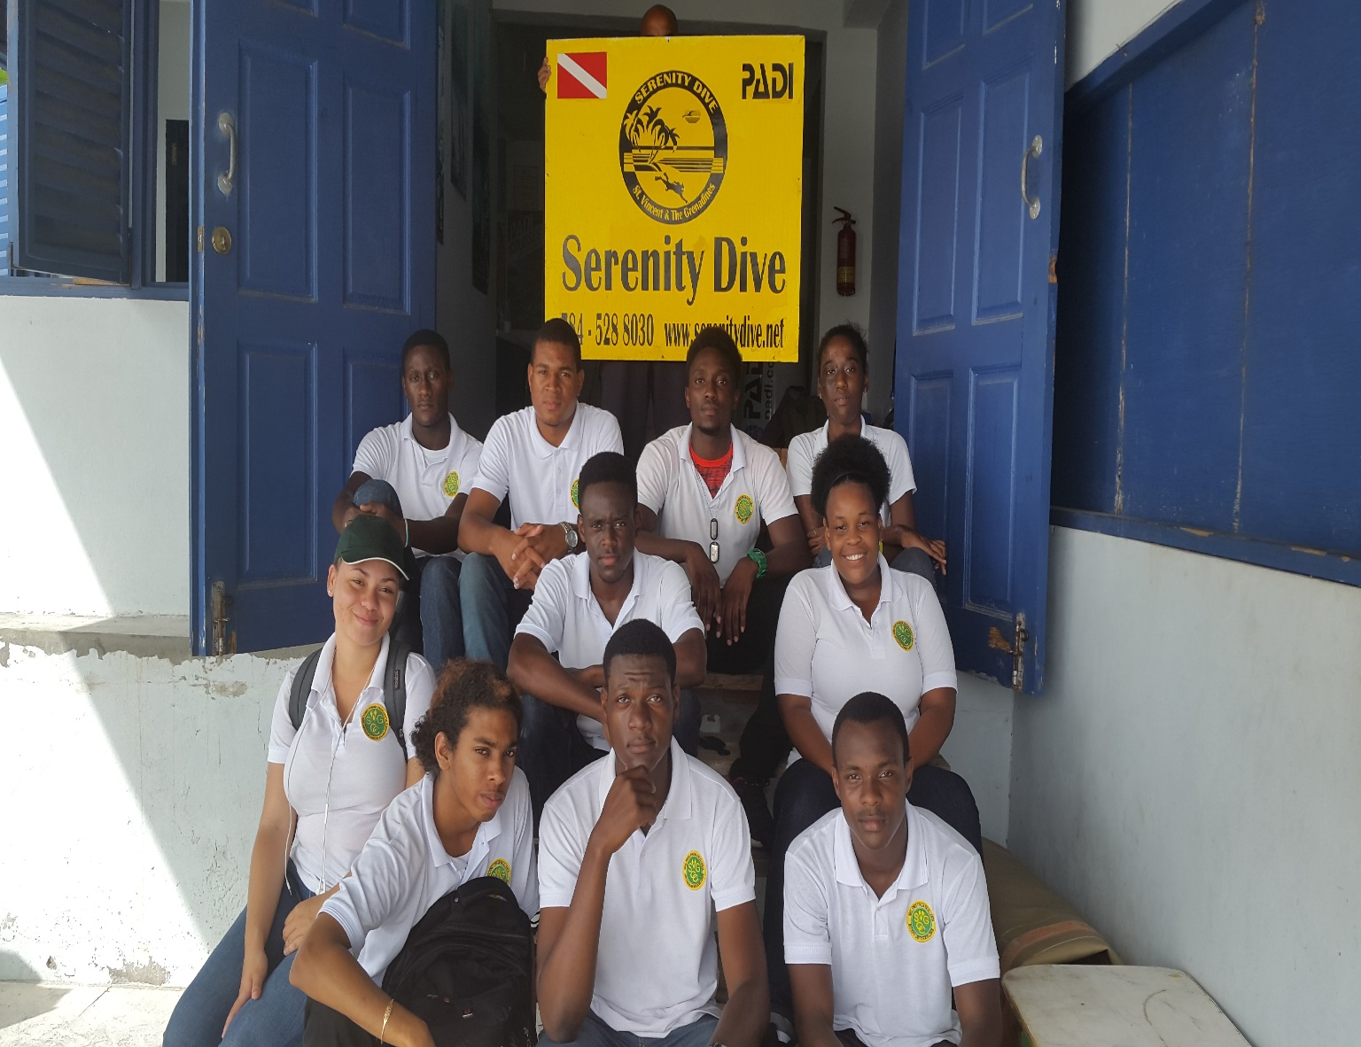
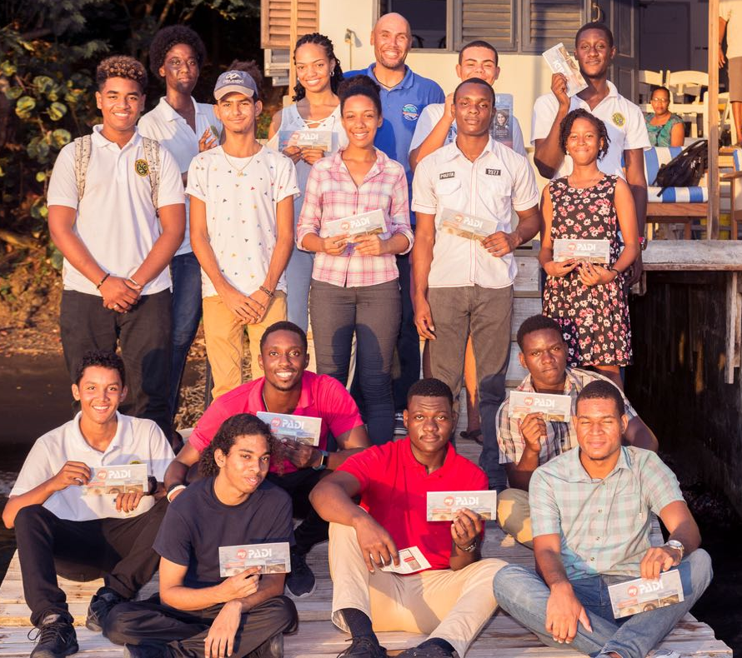
“Diving, another way of life” program
Certification of 15 Community College/ Secondary School Students

Slide 7
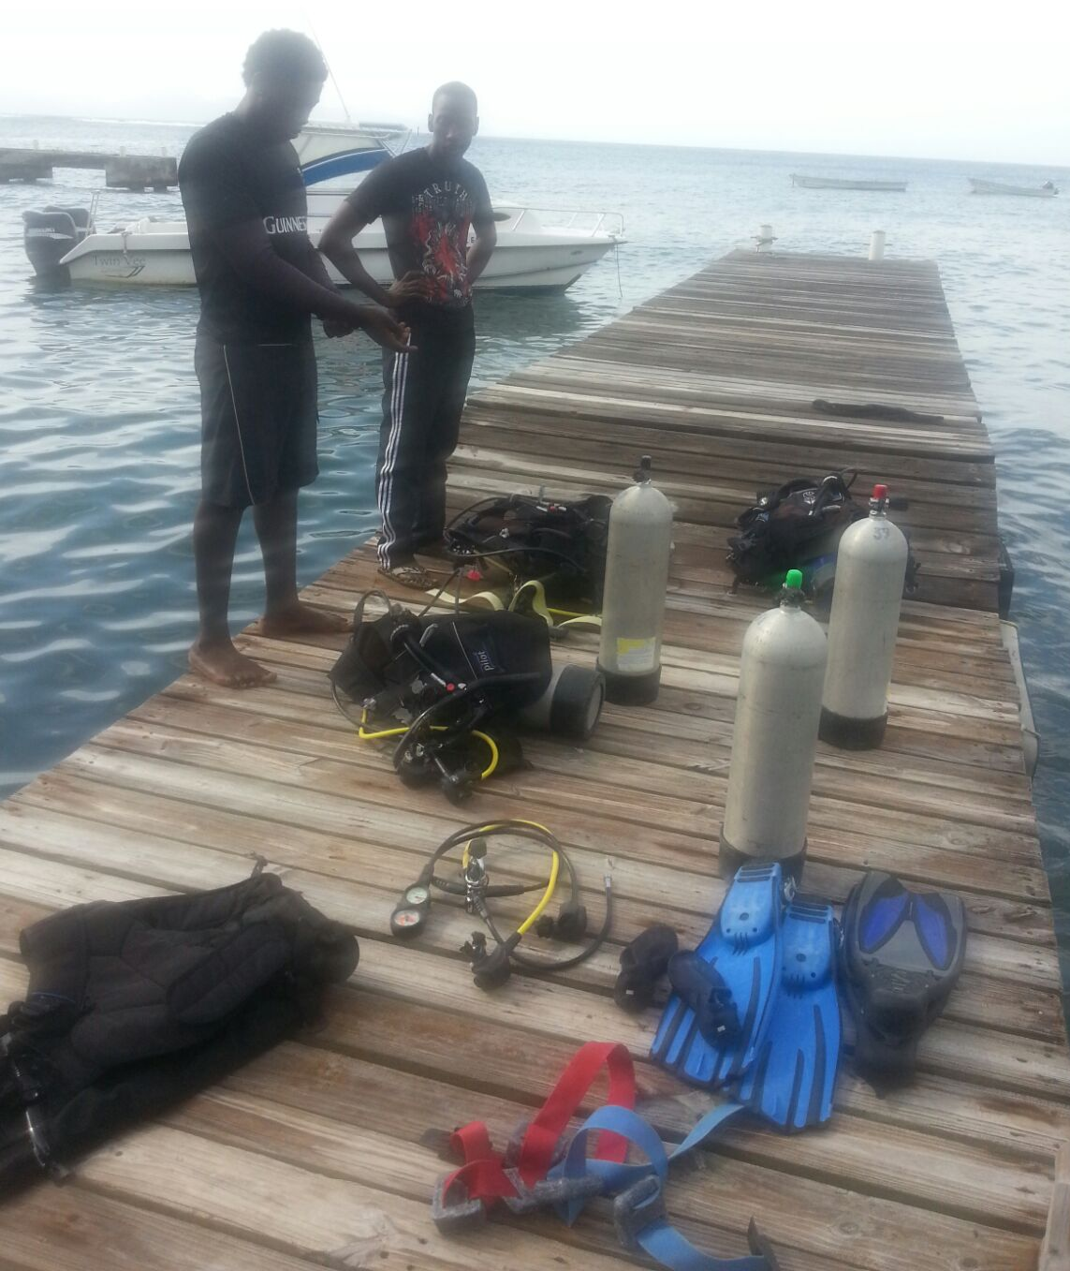
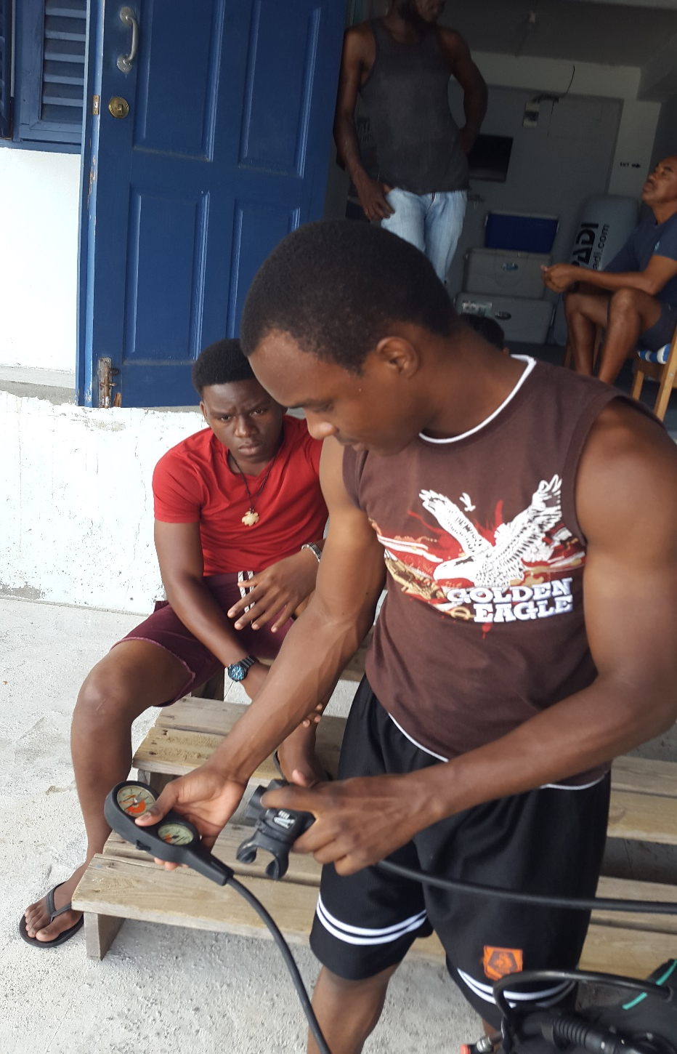
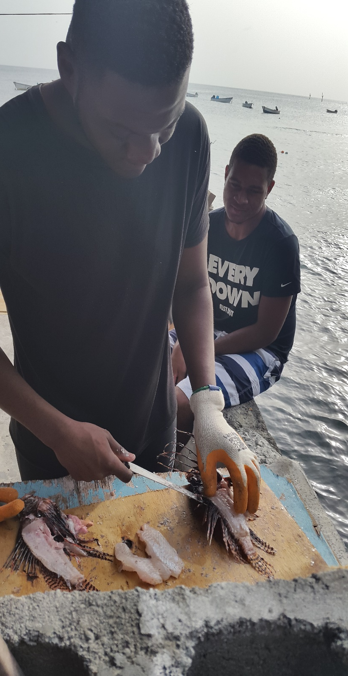
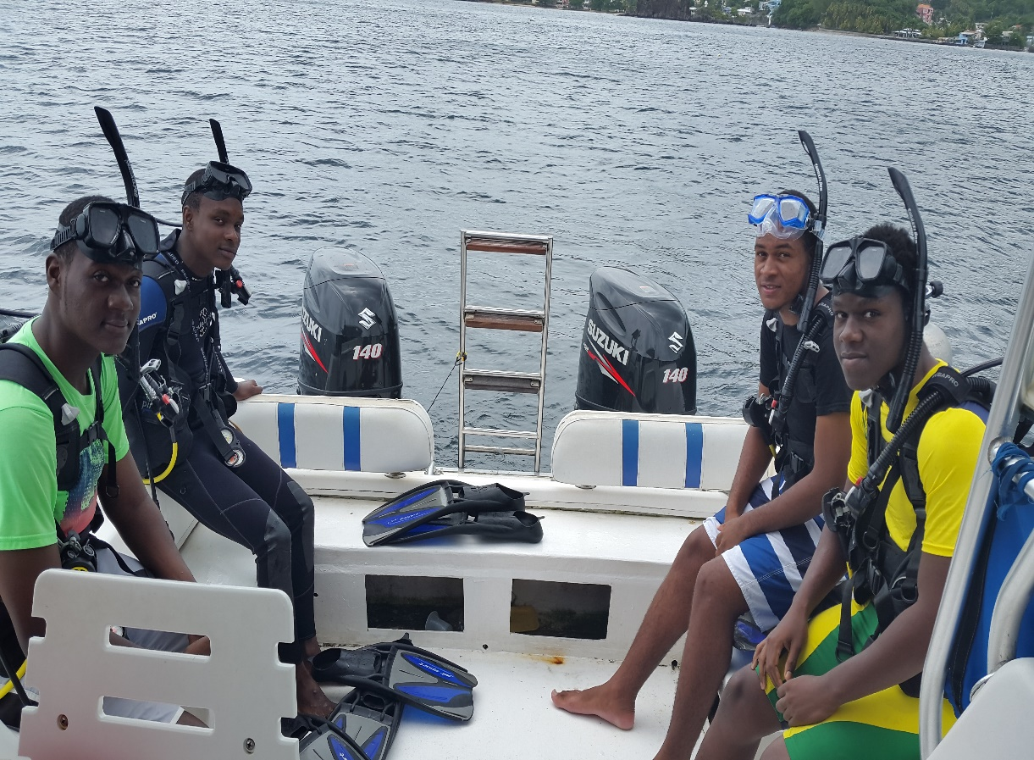

Slide 8
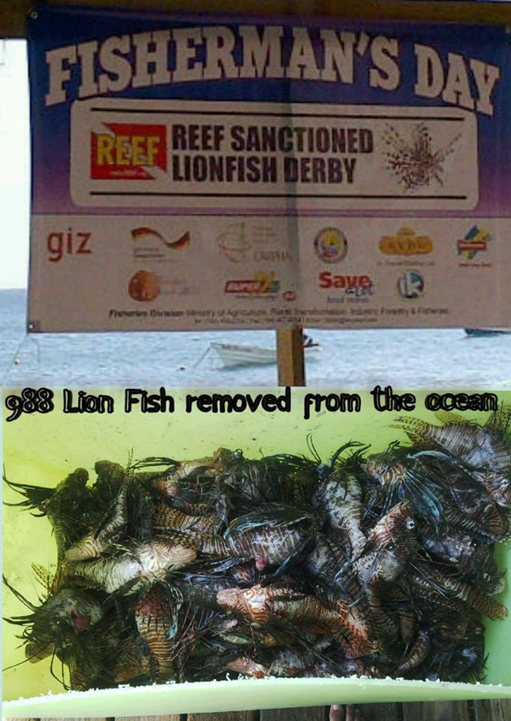
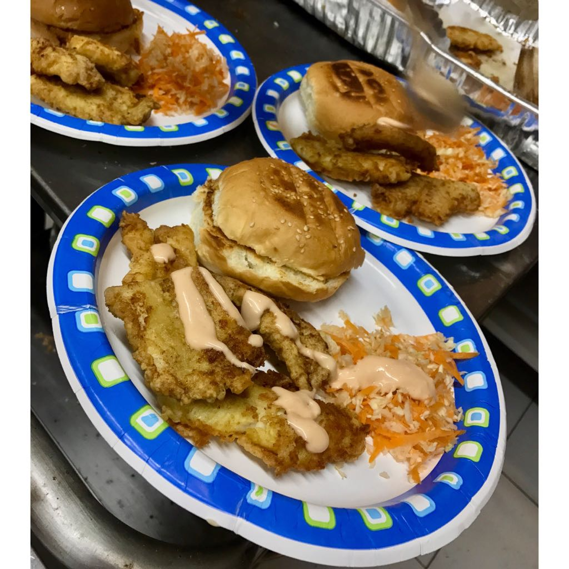
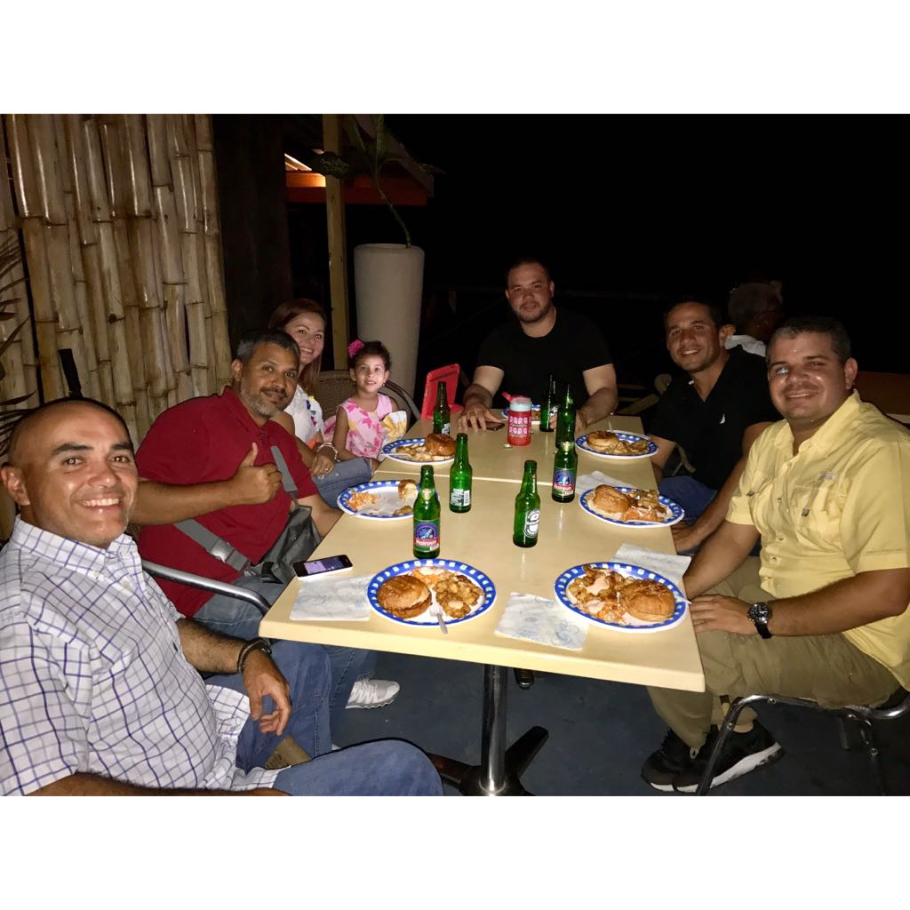
We have to eat them
To defeat them

Slide 9
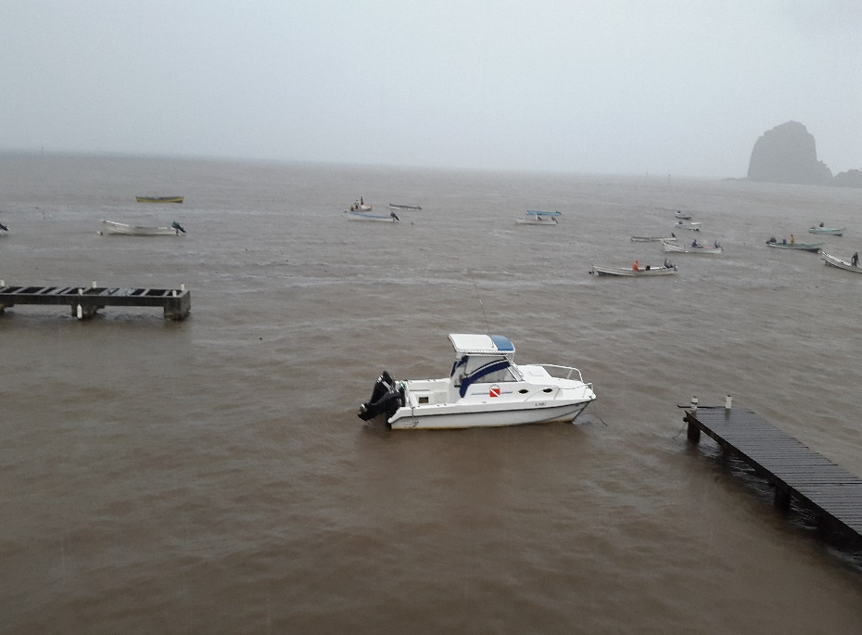
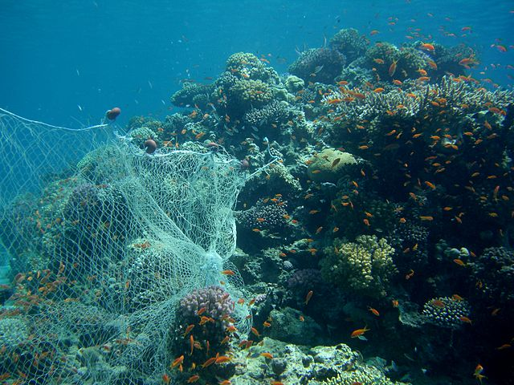
Challenges
Debris flowing into the ocean after heavy rainfall through the river system that exits into the site for the Marine Managed Area.
Getting the fisherfolks more aware of the damages done to the reef by their nets. Not to mention spearfishing of juvenile fishes especially the parrot fish.
Lack of resources to police and implement rules and regulation necessary to ensure the success of theses projects.
More information and collaboration needed between key stake holders and government organisations.

Slide 10
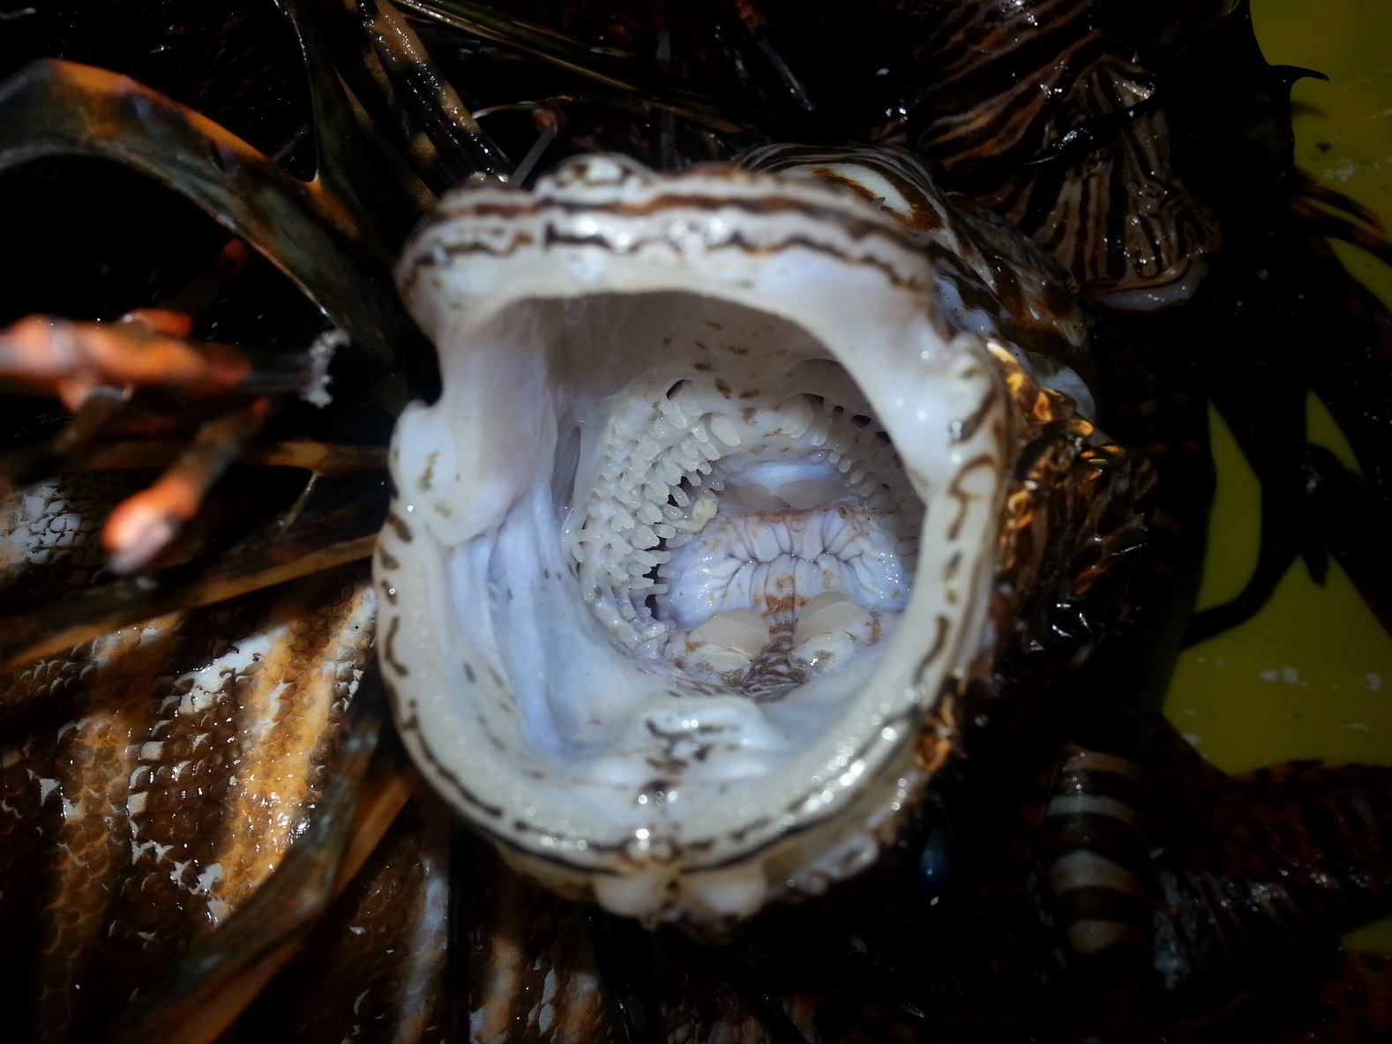
Thank You

