Slide 1


Science Support for Policy Development for the Implementation of the Sustainable Development Goals
Dr. Clare Morrall
Department of Biology, Ecology and Conservation, School of Arts and Sciences, St. George’s University, Grenada, West Indies

Slide 2
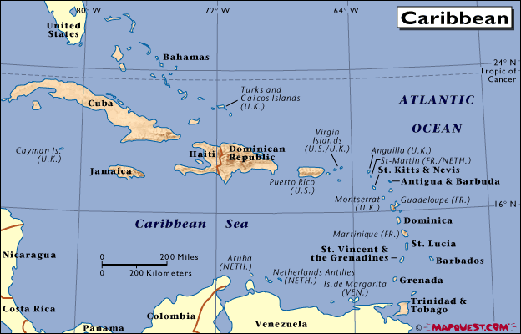

Slide 3
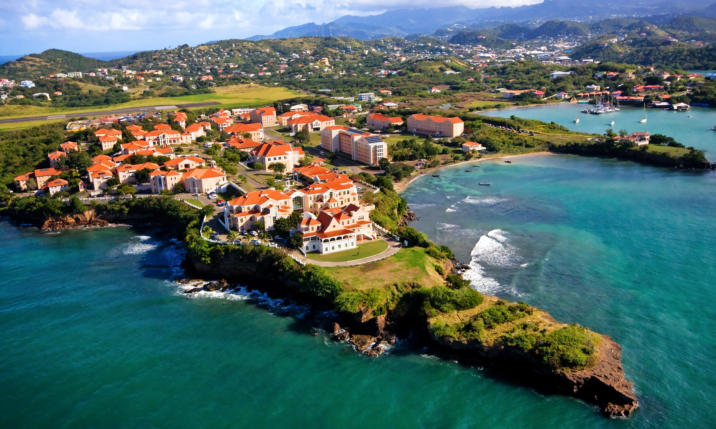

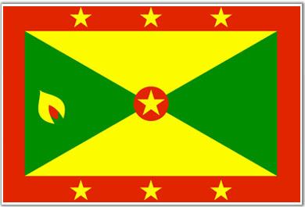


Slide 4
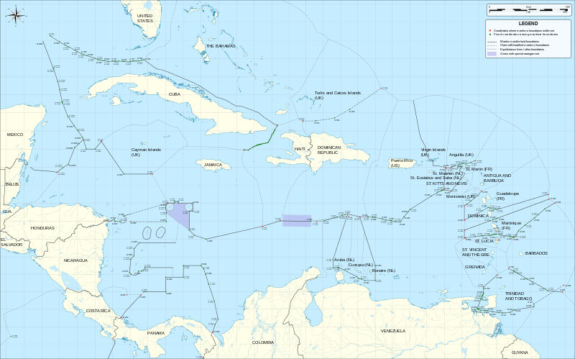
The Caribbean
Ocean space v’s Land space
From: http://commons.wikimedia.org/wiki/File:Caribbean_maritime_boundaries_map.svg

Slide 5
Science in the Caribbean
Who does it?
What is done with what is done? ☺

Slide 6
Science in the Caribbean- Who?
Academic institutions
Government Departments, Divisions and Statutory Bodies
Local, regional and international NGOs
Regional and International agencies
‘Parachute scientists’
And………?

Slide 7
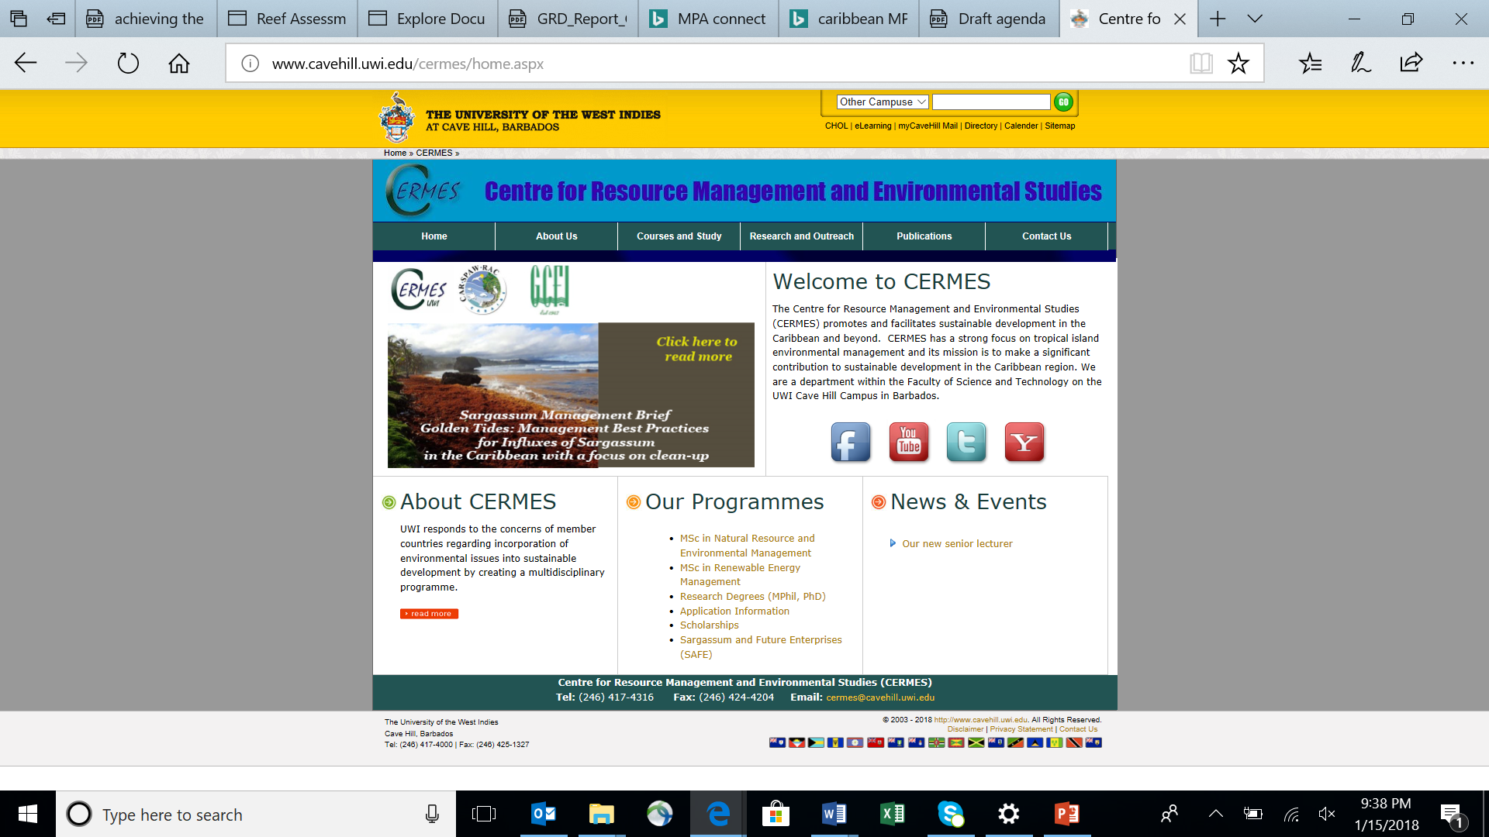

Slide 8
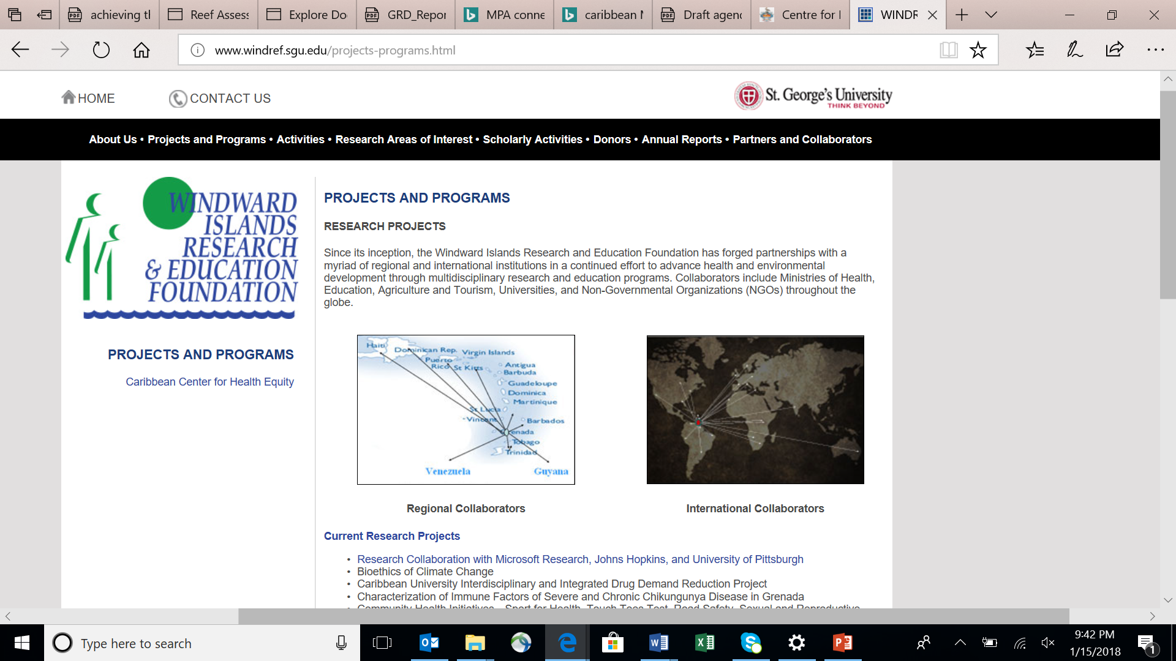

Slide 9
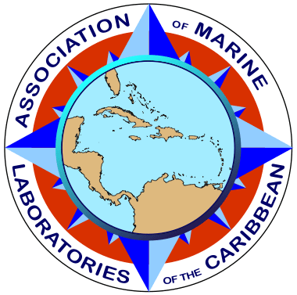

Established 1957
Established 1947
Regional research NGO’s. AMLC and GCFI contribute to research and information sharing. Conferences, searchable databases and student support.

Slide 10
Communication of Science
Caribbean societies- generally poorly informed in relation to science (?). There may even be distrust of science
Scientists- may not understand the policy process (and their role in the process- i.e. how, when, how to contribute)
Knowledge transfer not currently valued in the same way that research is valued

Slide 11
Science and Decision Making
Scientific data may not be available: it may not exist, or decision makers don’t know it exists
Available scientific data may not be used: it may be inaccessible or it may not be in a useable form (or it may be ‘inconvenient truth’)

Slide 12
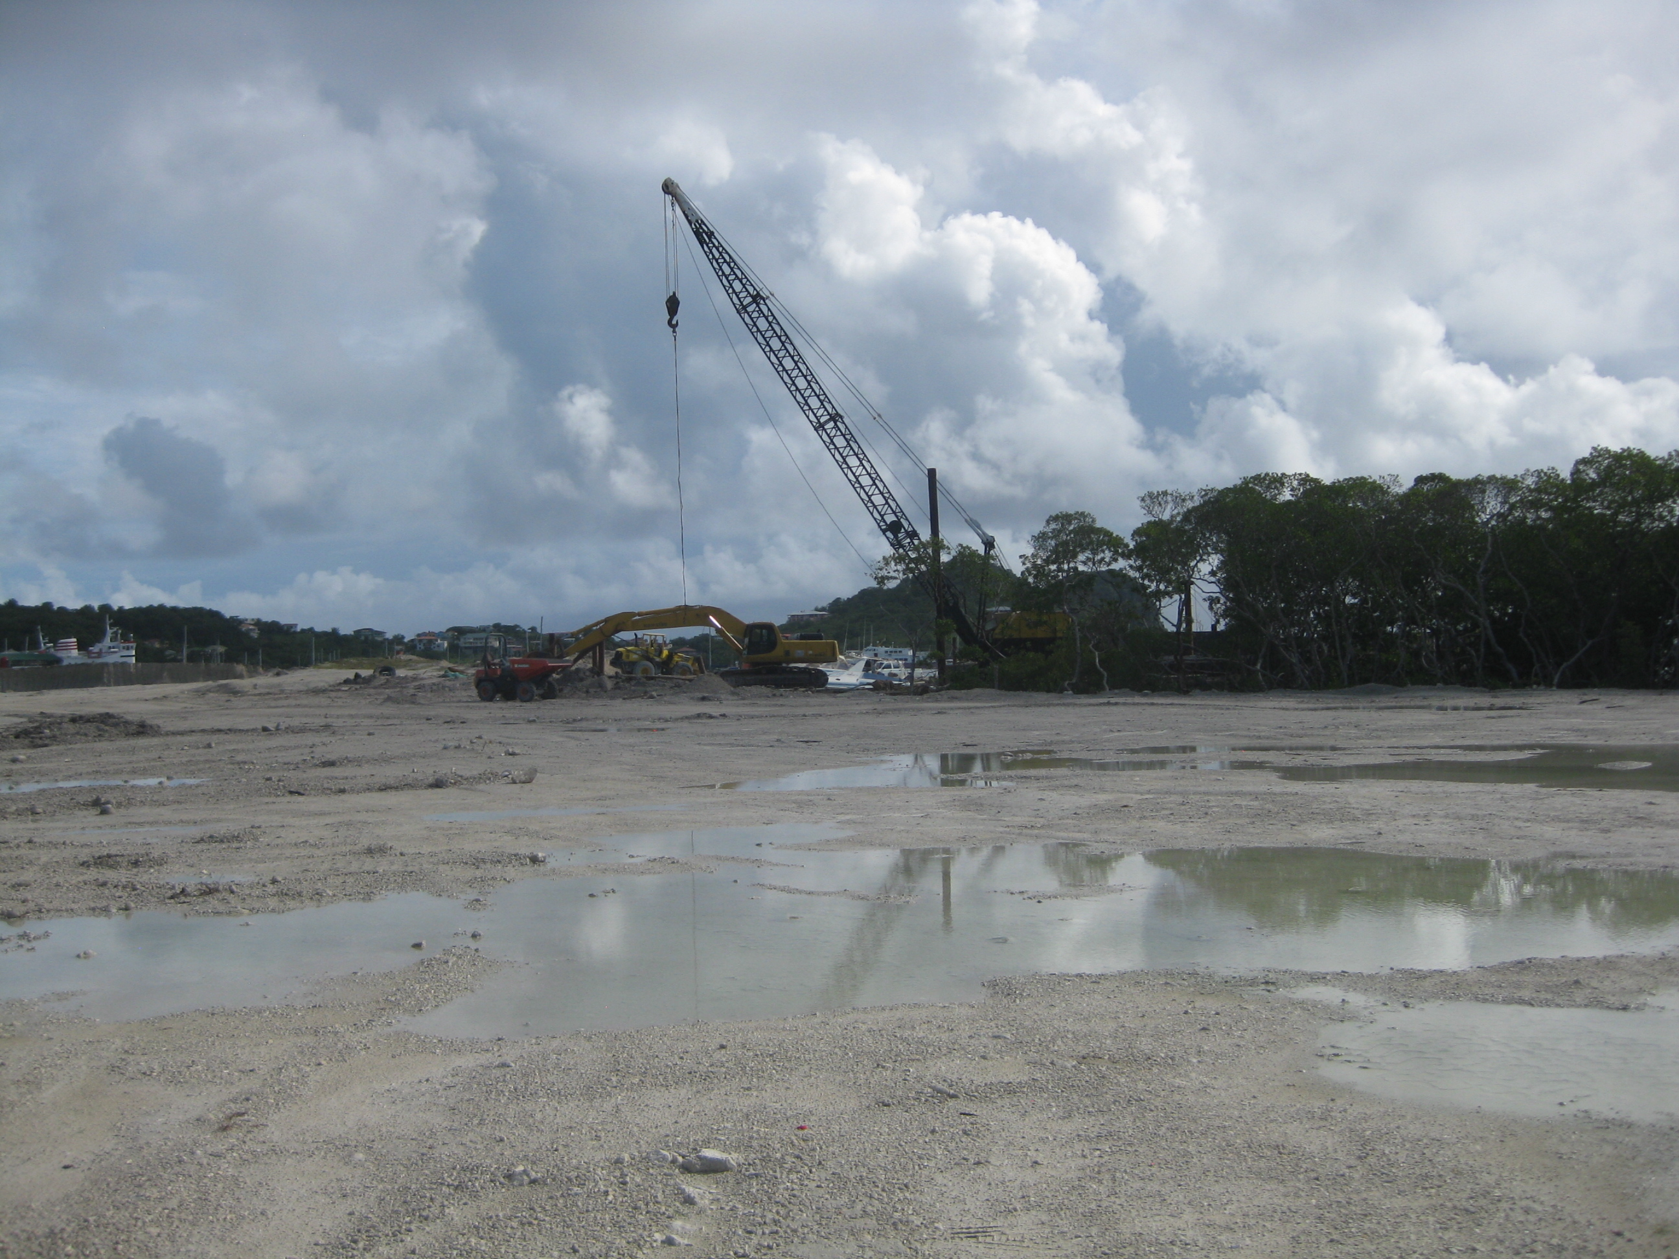

Slide 13
Marine Protected Areas- Network Success

Slide 14
Grenadines Network of Marine Protected Areas
2018- year 8 of the network
Needs assessment and Gap analysis
Annual meeting
Monitoring plans- made with decision makers and based on what MPA managers need to know to inform adaptive management
Information and skill sharing

Slide 15
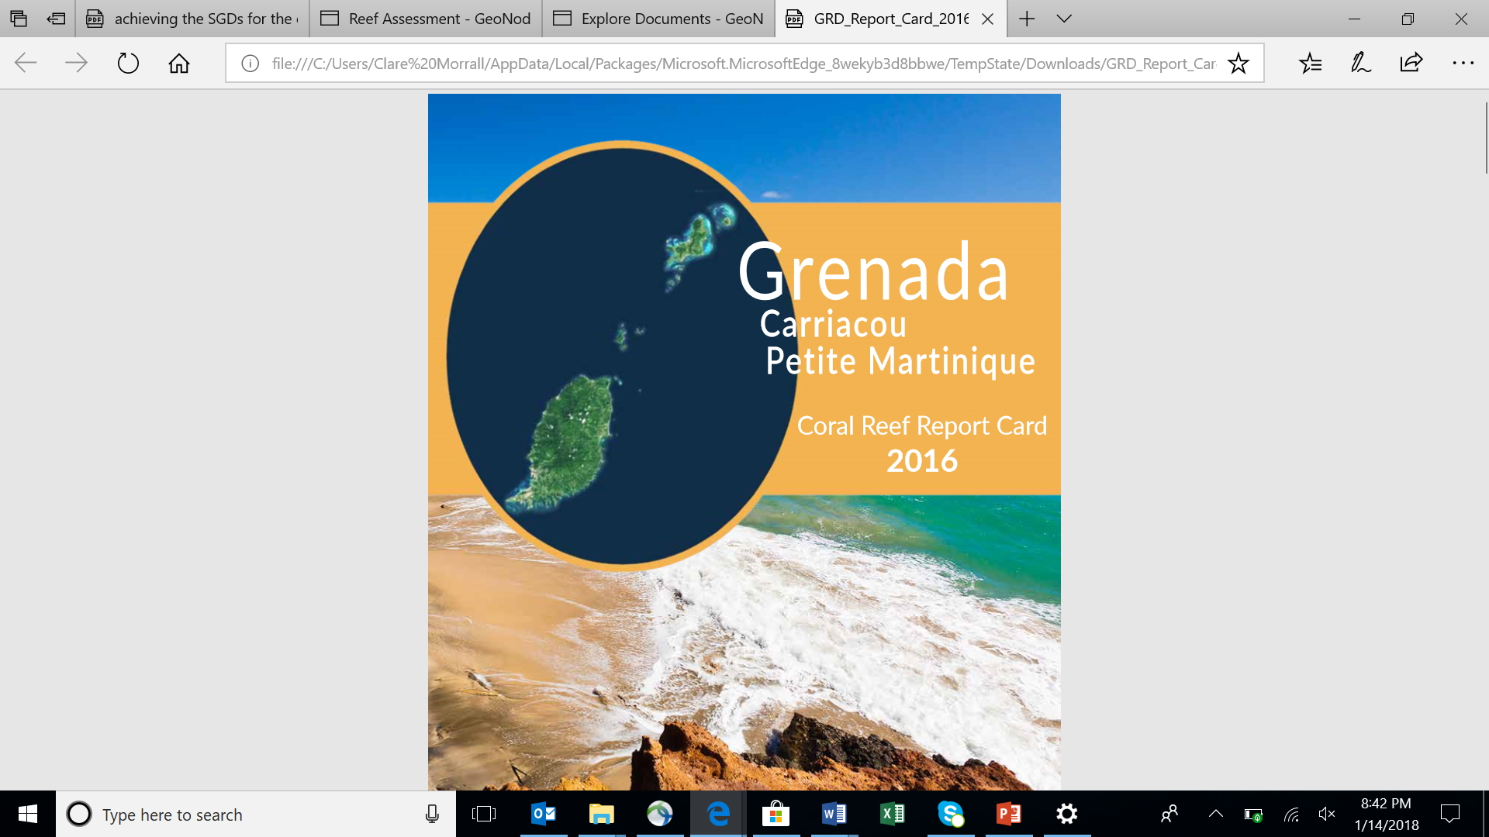

Slide 16
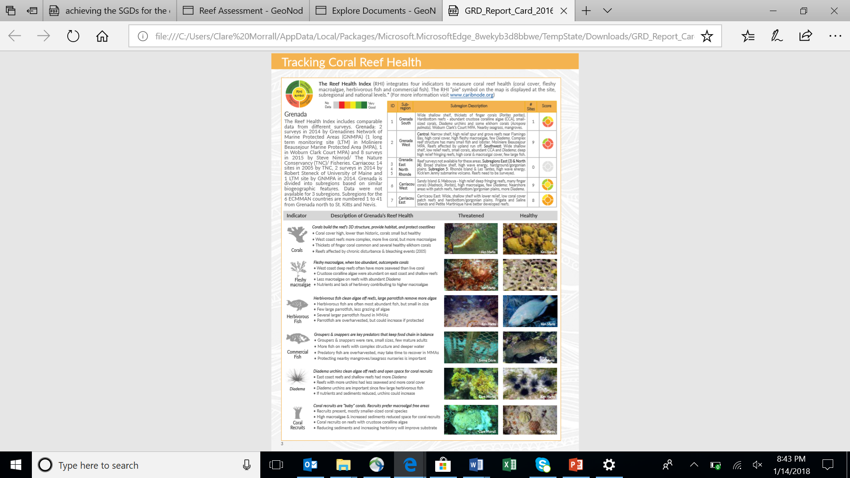

Slide 17
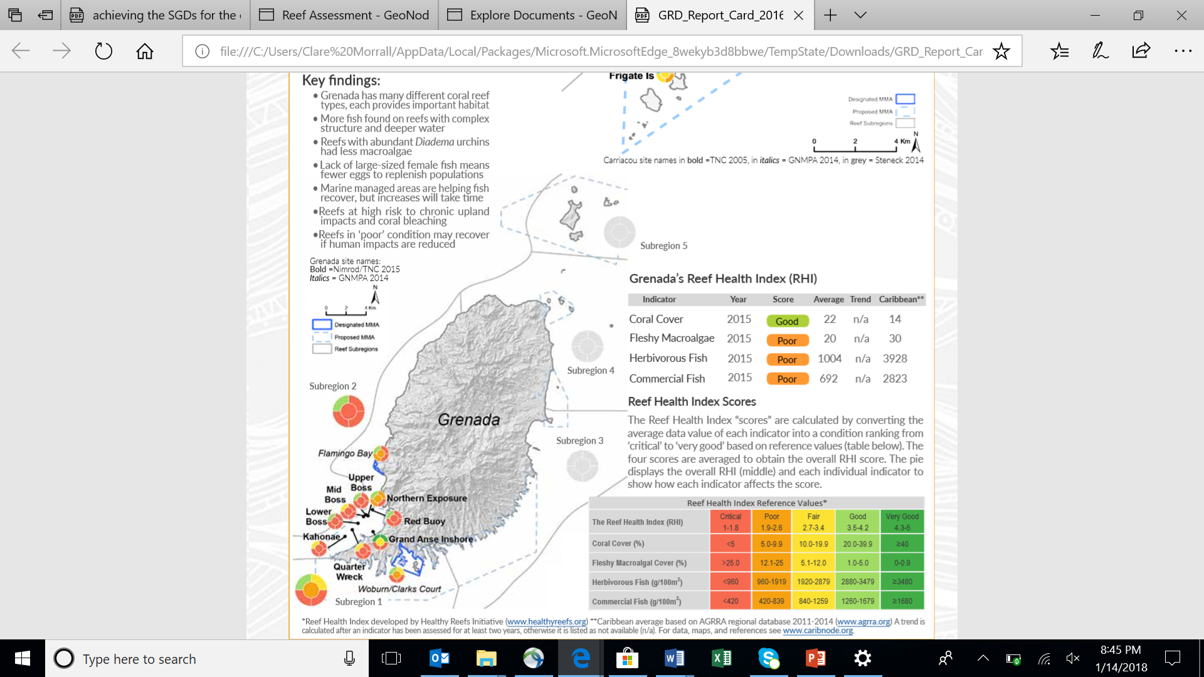

Slide 18
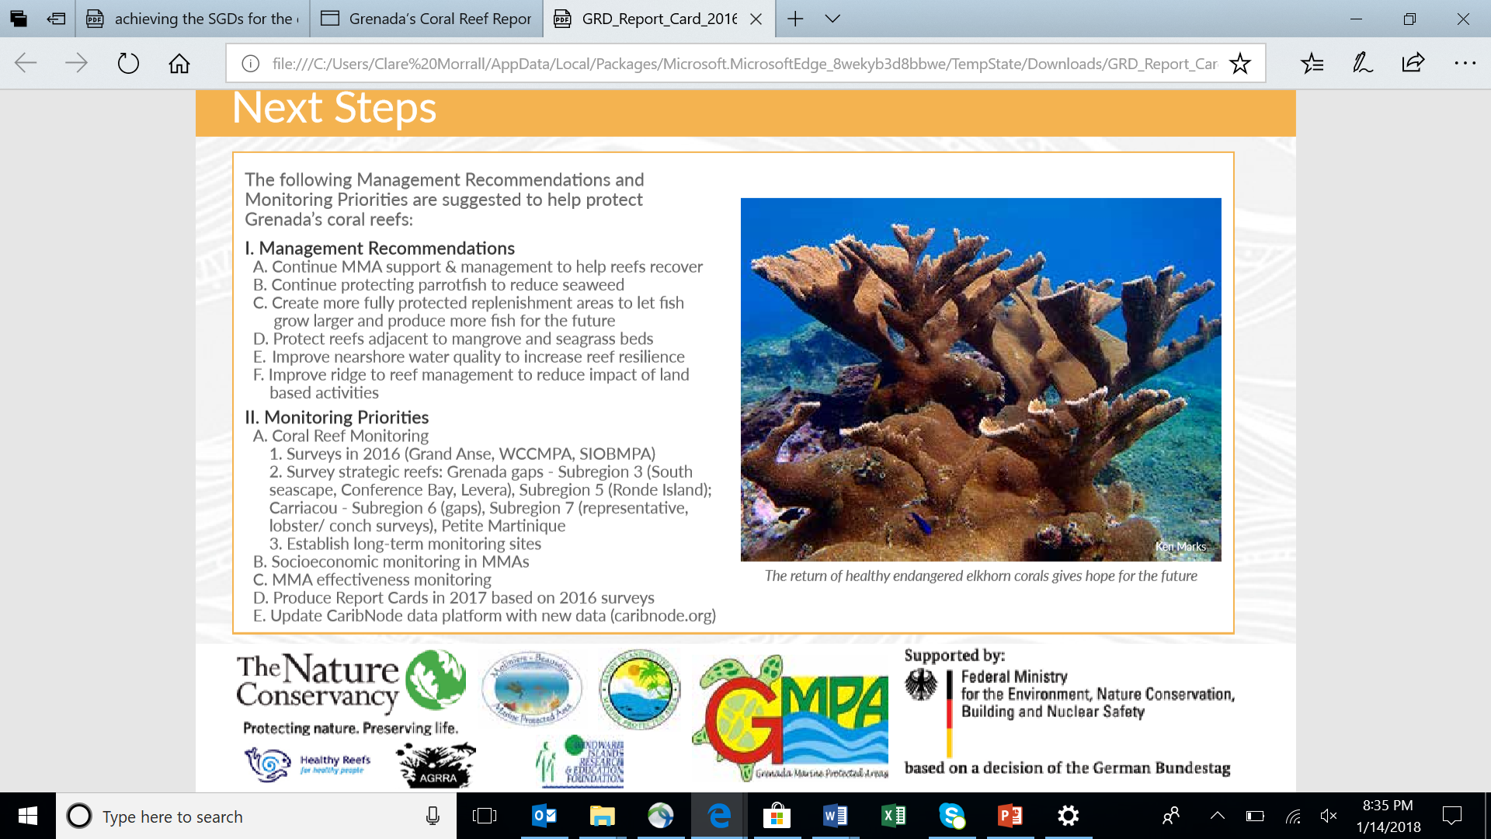

Slide 19
Suggestions
Science needed to forecast possible futures and inform decision makers
‘Nitty gritty’ reality on the ground in Caribbean nations must inform SDG implementation and monitoring plans
Build and/or strengthen networks connecting scientists
Build strong and effective connections between scientists and communities
Build strong and effective connections between scientists and decision makers
Many organizations are already working towards aspects of SDG Goals and Targets- implementation of SDG’s should start here!

Slide 20
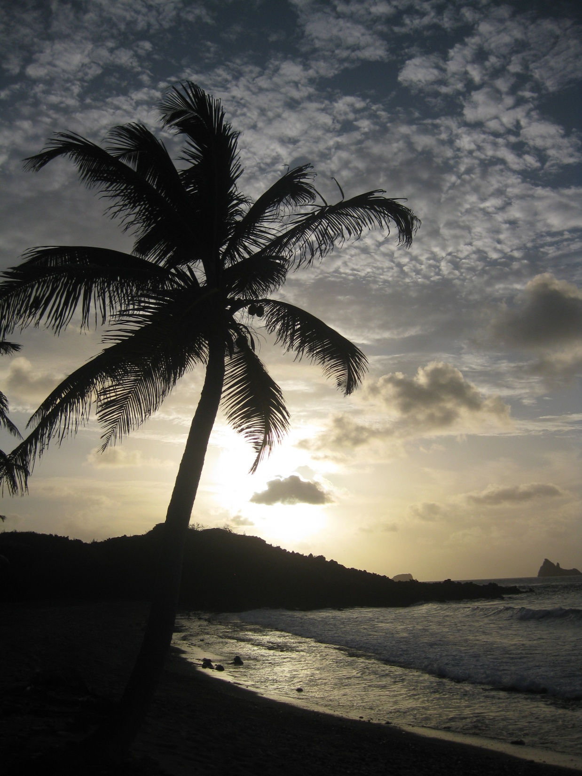
Thank-you!
Dr. Clare Morrall
cmorrall@sgu.edu

