Slide 1
Sustainable Development Goals in the Caribbean
Presented by: Mr. Jai Rampersad IMBA (Distinction) BSc (First Class Honours)

Slide 2
Overview
Photo Review
Caribbean Grouping and Characteristics
Millennium Development Goals review
United Nations Interventions for SIDS
Sustainable Development Goals
Caribbean Review
Caribbean Challenges
Caribbean/ SIDS Requirements
Case Study: St Vincent and the Grenadines

Slide 3
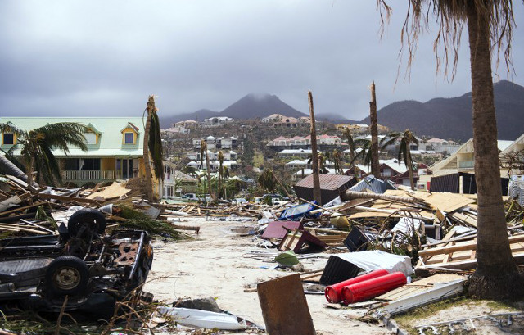
Climate Change:
Hurricane Irma 2017 (St Martin)
Source: www.thelocal.fr

Slide 4
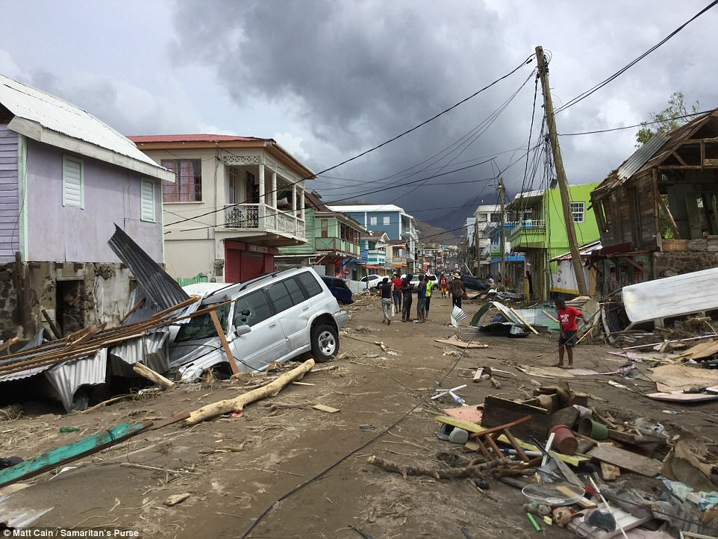
Climate Change:
Hurricane Maria 2017 (Dominica)
Source: http://www.dailymail.co.uk

Slide 5
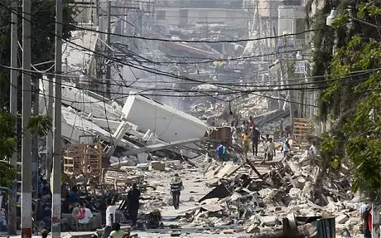
Natural Disasters:
Earthquake 2010 (Haiti)
Source: http://www.telegraph.co.uk

Slide 6
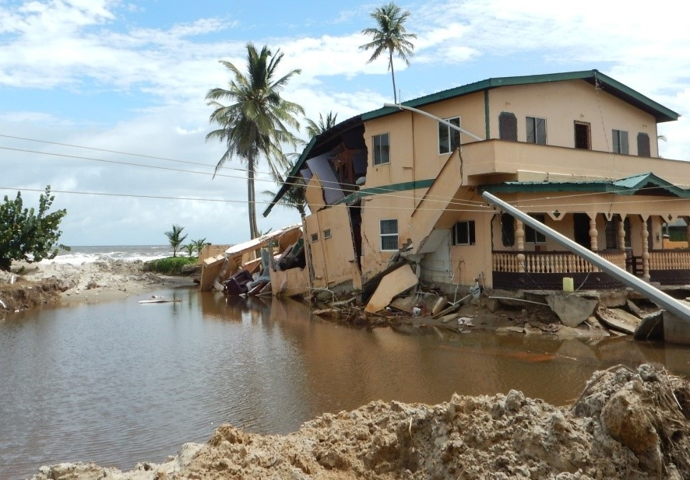
Coastal Erosion:
(Trinidad and Tobago)
Source: http://www.latinamerica.undp.org

Slide 7
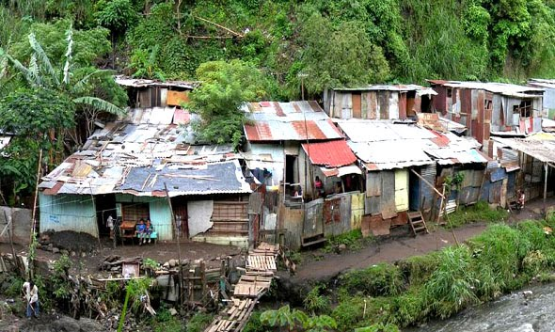
Poverty
World Bank notes that from 2000 to 2014, extreme poverty (people living under US$2.50 a day) in Latin America and the Caribbean , decreased to 10.8 per cent from 25.5 per cent
Source: https://www.stlucianewsonline.com

Slide 8
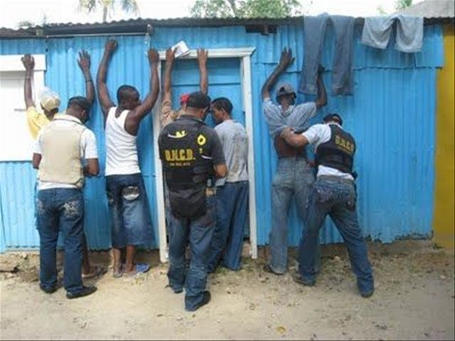
Increase in Crime
Source: https://dominicantoday.com

Slide 9
Caribbean Review: Groupings
Latin America and the Caribbean
Caribbean Community (CARICOM)
Small Island Developing States (57 countries): There are 57 countries classified by the United Nations (UN) as SIDS (Caribbean, Pacific regions and also the Atlantic and Indian Oceans, in the Mediterranean and in the South China Sea.

Slide 10
Small Island Developing States Characteristics
Limited geographic size
Extensive coastal areas
Remote locations
Fragile economies that are often dependent on narrow sectors
Limited natural resources and access to fresh water and energy
Small populations
Weak institutional capacity
Their small size in terms of geography, economy, and population, and their limited capacities render them vulnerable to external shocks.
Article Source: Evaluating Sustainable Development in SIDS - Lessons from the Pacific and the Caribbean
Juha I. Uitto, Jeremy Kohlitz, and David Todd

Slide 11
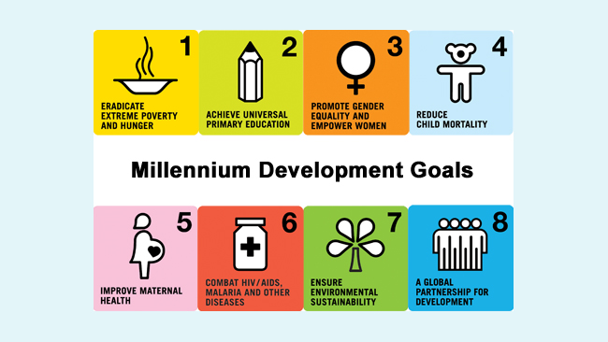
Millennium Development Goals (2015): Highlights

Slide 12
Millennium Development Goals (2015): Highlights
Goal 1: Eradicate Extreme Poverty and Hunger
  Global number of people living in extreme poverty reduced from 1.9 billion in 1990 to 836 million in 2015
Goal 2: Achieve Universal Primary Education
  Sub-Saharan Africa primary school enrolment rate increased from 52% in 1990 to 80% in 2015
Goal 3: Promote Gender Equality and Empower Women
  90% of countries have more women in parliament from 1995 to 2015
Goal 4: Reduce Child Mortality
  Global under 5 mortality rate has declined from 90 to 43 deaths per 1,000 live births between 1990 and 2015
Source: The Millennium Development Goals Report 2015 – United Nations

Slide 13
Millennium Development Goals (2015): Highlights
Goal 5: Improve Maternal Health
  Maternal Mortality rate has declined by 45% globally between 1990 and 2015
Goal 6: Combat HIV/AIDS, Malaria and Other Diseases
  New HIV infections fell by 40% between 2000 and 2013
Goal 7: Ensure Environmental Sustainability
  1.9 billion people have gained access to piped drinking water between 1990 and 2015
Goal 8: Develop a Global Partnership for Development
  Internet penetration has increased globally from 6% in 1990 to 43% in 2015
Source: The Millennium Development Goals Report 2015 – United Nations

Slide 14
Millennium Development Goals Review: Ongoing Issues
Gender Inequality
Huge wage gaps
Climatic Change and Environmental degradation continues
Conflicts hamper human development
Millions still live in poverty and hunger, without access to basic services
Source: The Millennium Development Goals Report 2015 – United Nations

Slide 15
United Nations Interventions for SIDS
The Barbados Programme of Action (BPOA) : The Global Conference on the Sustainable Development of Small Island Developing States (UN 1994).
The Mauritius Strategy of Implementation (MSI) 2005
The SIDS Accelerated Modalities of Action (SAMOA) Pathways 2014: The Third International Conference on SIDS was held in Apia, Samoa, and the was adopted.
The UN report on “The Future We Want” dedicated a section to SIDS: “small island developing States have made less progress than most other groupings, or even regressed, in economic terms especially in terms of poverty reduction and debt sustainability,” with member states reaffirming their commitment to providing assistance to implementing BPOA and MSI (UN 2012).
The 2030 Agenda for Sustainable Development, adopted by the UN member states in 2015
Source: United Nations MultiCountry Sustainable Development Framework in the Caribbean June 2016

Slide 16
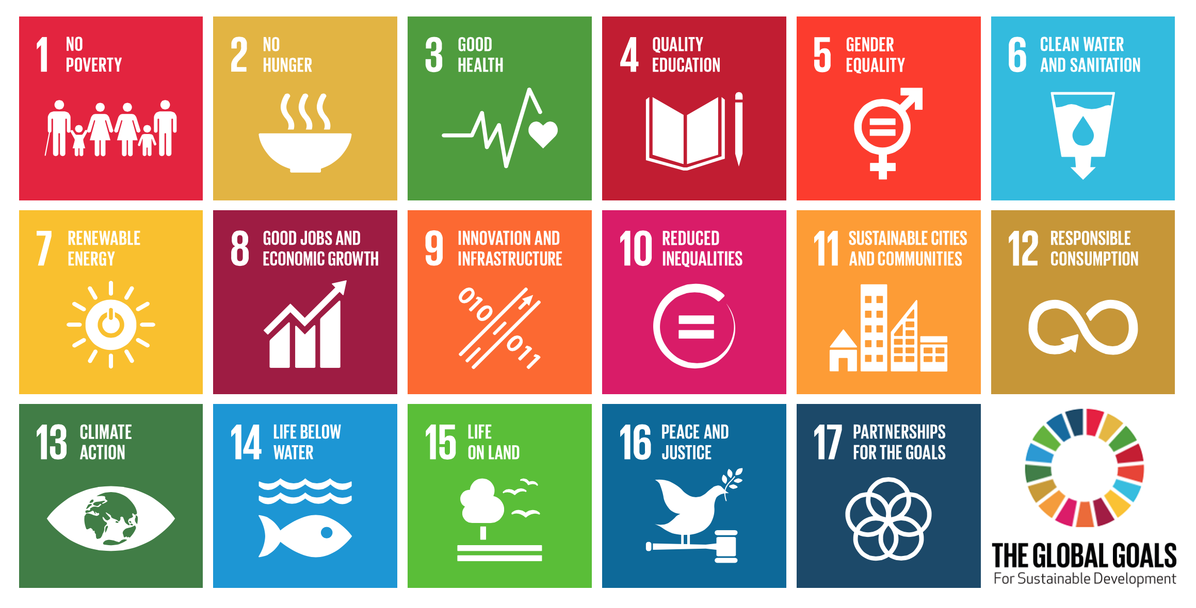
Sustainable Development Goals
(2030)
Source: United Nations

Slide 17

Caribbean Review

Slide 18
Caribbean Review: Vulnerability
The Caribbean is characterized as a vulnerable region.
  Hurricanes
  Earthquakes
  Volcanic activity
  Climate change effects on coastal communities, fisheries, fresh water and marine life
  losses in human lives and livelihood sources
  Losses in infrastructure, productivity and economic output in key sectors such as tourism and agriculture.
The Caribbean is also very vulnerable to external economic shocks
  The relatively small size of its domestic markets
  High dependency on both imports of food and industrial inputs and export concentration
  High sovereign debt
  Source: CARIBBEAN HUMAN DEVELOPMENT REPORT MULTIDIMENSIONAL PROGRESS: HUMAN RESILIENCE BEYOND INCOME
  Source: (UNDP, 2016, Bourne, 2015)

Slide 19
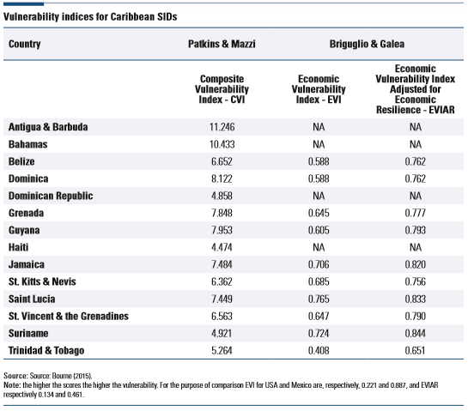
Caribbean Review: Vulnerability
  Vulnerability indexes have been elaborated, combining exposure to both natural hazards and external economic shocks.
  Antigua and Barbuda, The Bahamas, Saint Lucia and Suriname show the highest vulnerability depending on the index.

Slide 20
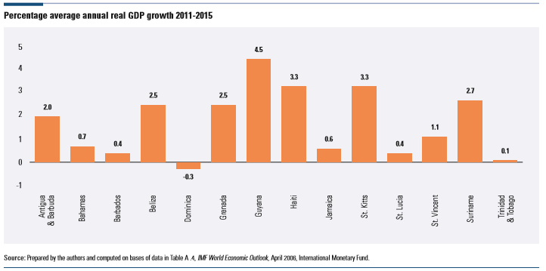
Caribbean Review: Vulnerability

Slide 21
Caribbean Review: Women in the Workplace
Gender differences are still large: in 2013, the percentage of women in the labour force was 59.3 percent versus 78.7 percent for men (World Bank Gender Statistics).
  Between 2000 and 2013, the labour force participation rate of women aged 15-64 increased in Caribbean Small Islands by 2.2 percent whilst that of men decreased by 2.5 percent.
Employment to population rate by gender: The gender gap is still significant, as in 2013 the figures were respectively 45.5 percent for women and 67.3 percent for men (ibid.)
  In 2000 and 2013 it increased by 3 percent for women and decreased by 2.1 percent for men.
Caribbean women´s participation is concentrated in middle- and low-level jobs and in sectors that are characterized by lower salaries and in lower levels in the employment hierarchy (ECLAC, 2010).
A large number of women in the Caribbean work in community, social and personal services, whereas men tend to dominate better paid jobs in the construction sector, craft, plant and machine operation ECLAC (2009)

Slide 22
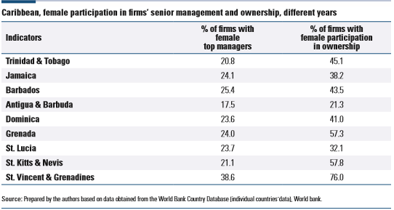
Caribbean Review: Women in the Workplace

Slide 23
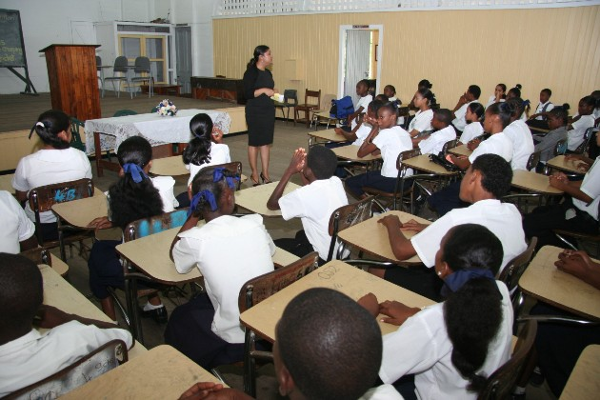
Caribbean Review: Education
Inequality in access to education also grows with age: whilst enrolment of the richest and the poorest quintiles starts at the same level, by the ages of 15 and 16 the difference is 20 percentage points, and at 17 and 18 it grows to 50 percentage points
Source: http://caricom.org

Slide 24
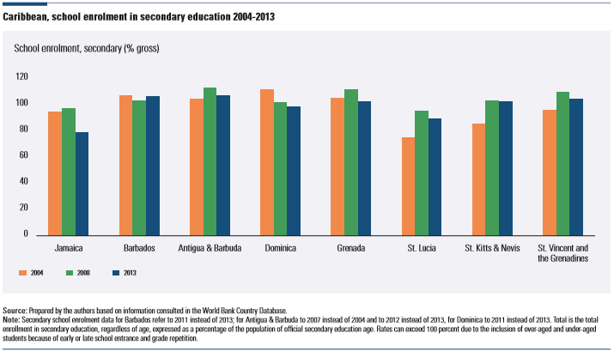
Caribbean Review: Education

Slide 25
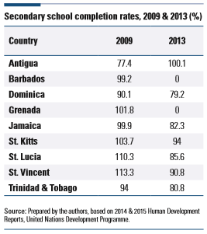
Caribbean Review: Education

Slide 26
Caribbean Review: Health Care
There has been progression in health Care in the Caribbean. WHO World Heath Statistics 2015 showed the rate of achievement in relation to some of the targets set in the MDGs 1990–2015.
  In terms of maternal mortality, some Caribbean countries achieved reductions of 32-57 between 1990 and 2013 (MDG two-thirds reduction), while others were well below these rates and in the case of Guyana deteriorated.
  With respect to child mortality, some Caribbean achievement rates ranged between 24-58 percent (MDG two-thirds reduction), except in Antigua and Barbuda (65 percent) and St. Kitts and Nevis (66 percent).
  Adult mortality rates were lower in 2013 than in 2009 for both males and females, except in Guyana where rates have increased and for males in Antigua and Barbuda
  Infant mortality rates diminished between 2010 and 2014 in all countries
  The loss of life to communicable diseases in the Caribbean exceeds mortality rates in upper middle income countries, sometimes by a large margin. In Guyana and Haiti, the mortality rates are as high as 177 and 405, respectively.
While progress is noted, there is still room for improvement

Slide 27
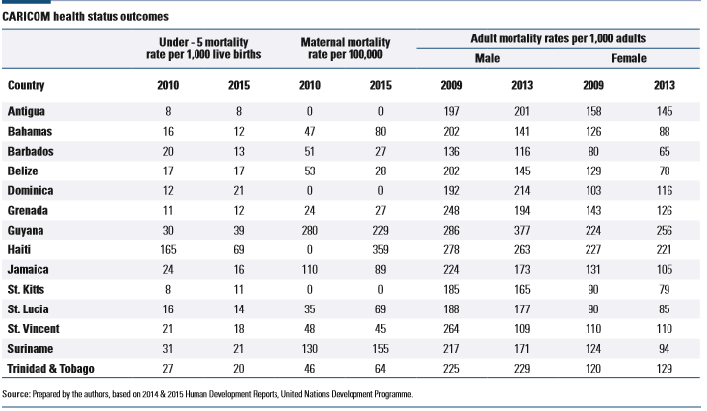
Caribbean Review: Health Care

Slide 28

Caribbean Review: Crime
We have seen an increase in crime in the region. It is estimated that the direct costs of fighting crime and indirect costs from lost economic outcomes from youth imprisonment and decline in revenues from tourism are estimated at between 2.8 percent and 4 percent of GDP of CARICOM countries annually (UNDP, 2012)

Slide 29
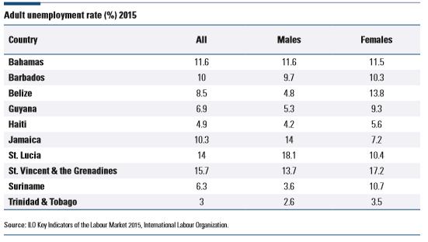
Caribbean Review: Unemployment Rate
Generally high Unemployment rate especially in St. Vincent and the Grenadines, Bahamas and Jamaica
It should be noted that the unemployment rates of women are generally higher than men

Slide 30
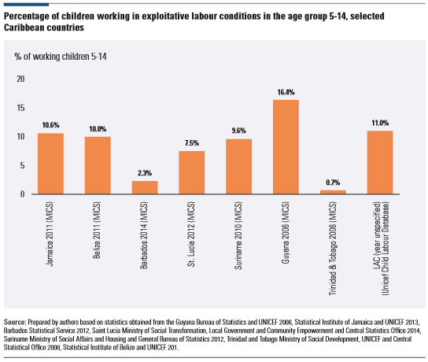
Caribbean Review: Child Labour
Generally high child labour percentages for Guyana, Jamaica, Belize and Suriname

Slide 31
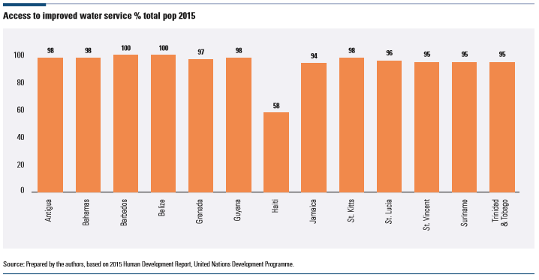
Caribbean Review: Water Access
Generally good water access, with the exception of Haiti

Slide 32
Caribbean Review: Climate Change
The SIDS of the Caribbean are among the world’s most vulnerable countries when it comes to the effects of climate change (Todd 2011, 2013; UNFCCC 2005)
Hurricane IRMA and MARIA (2017): Path of Destruction
  Dominica: 27 Fatalities
  Cuba: 10 Fatalities
  St. Martin: 12 Fatalities
  Thousands Displaced: Puerto Rico, US Virgin Islands and British Virgin Islands
  First time in 300 years no one lives in Barbuda
Global Warming effects

Slide 33
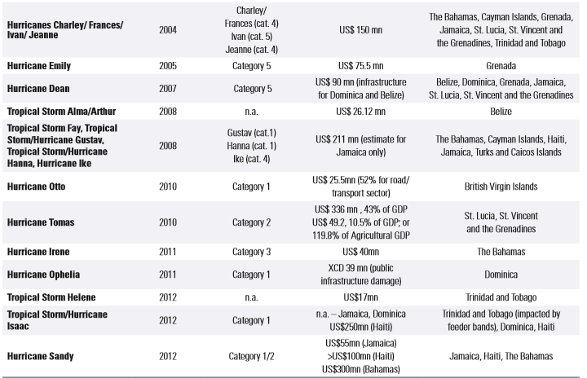
Caribbean Review: Climate Change

Slide 34
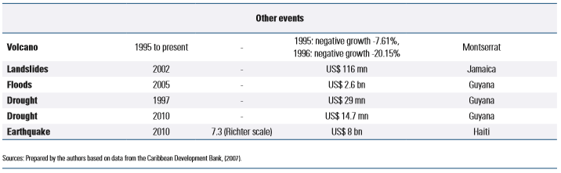
Caribbean Review: Climate Change

Slide 35
Caribbean Review: Climate Change
An economic analysis of the costs of a changing climate in just three categories: increased hurricane damages, loss of tourism revenue and infrastructure damages – projected that the Caribbean’s annual cost of inaction could total:
  US$10.7 billion annually by 2025
  US$22 billion by 2050
  US$46 billion by 2100
  These costs represent 5, 10 and 22 percent, respectively, of Caribbean economy (at 2004 prices).
The World Bank has estimated that about 11 percent of the total GDP of all 20 CARICOM countries could be adversely impacted annually by climate change (Toba 2009; see also IDB 2014; World Bank 1997)

Slide 36
Caribbean Challenges
The global economic crisis
Declining foreign direct investment
trade imbalances
Increased indebtedness
Lack of adequate transport, energy and ICT infrastructure networks
Limited human and institutional capacity
Inability to integrate effectively into the global economy
Climate change
Natural disasters
The degradation of coastal and marine ecosystems and sea-level rise
Source: Samoa Pathway

Slide 37
Caribbean Challenges
‘One Size Fits All’ Policies that does not cater to the needs of the SIDS
Data collection and analysis issues
  Public sector driven
  Lack of technical support
  Lack of Infrastructure
  Financing
  Problems: Inconsistencies, planning, lack of accountability, monitoring issues and delays
Little to no ICT support
Lack of Political directive

Slide 38
Small Island Developing States (SIDS) Requirements
Enhance international cooperation, exchanges and investments
Increased public and private investment in infrastructure
Foster entrepreneurship and innovation and sustainable industrial development
Development of the financial services industry
Job Creation/ Technical support
Improve working conditions
Greater ICT integration
Promote and enhance gender equality
Set national regulatory and policy frameworks to improve transparency, accountability, and corporate social responsibility.
  Source: Samoa Pathway (2014 Outcomes)

Slide 39
Small Island Developing States (SIDS) Requirements
Decision making: Integrate regional bodies (Caribbean/SIDS) in the domestic policy development.
Better assessment of each sovereign country requirements with respect to the SDGs
“No Country Left Behind”

Slide 40
Case Study:
Saint Vincent and the Grenadines
In 2014/15 SVG set up the Ministry of Sustainable Development
  Oversee and monitor the implementation of the SDG’s
Creation of a Parliamentary Front: This is a motion supported by both the Political party in power and the Opposition. All activities would be free from political bias.
Notes:
FAO / UN Representatives convinced the Opposition

Slide 41
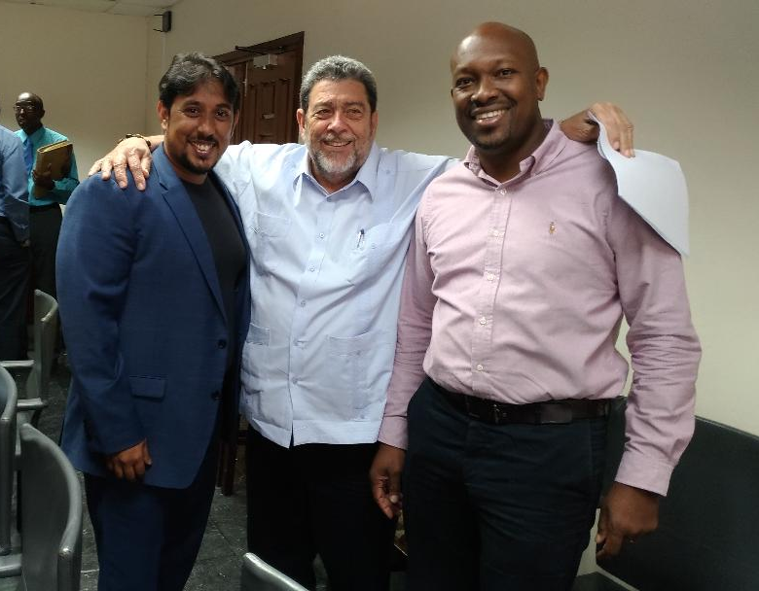
Case Study:
Saint Vincent and the Grenadines
‘Zero Hunger’ Trust Fund: 2% of every dollar spent on phone calls (incoming and outgoing) is placed in this fund.
  School Feeding Program and Physically Challenged Individuals
Reduction in Pollution: Bans on the use of Styrofoam
Notes:
FAO / UN Representatives convinced the Opposition

Slide 42
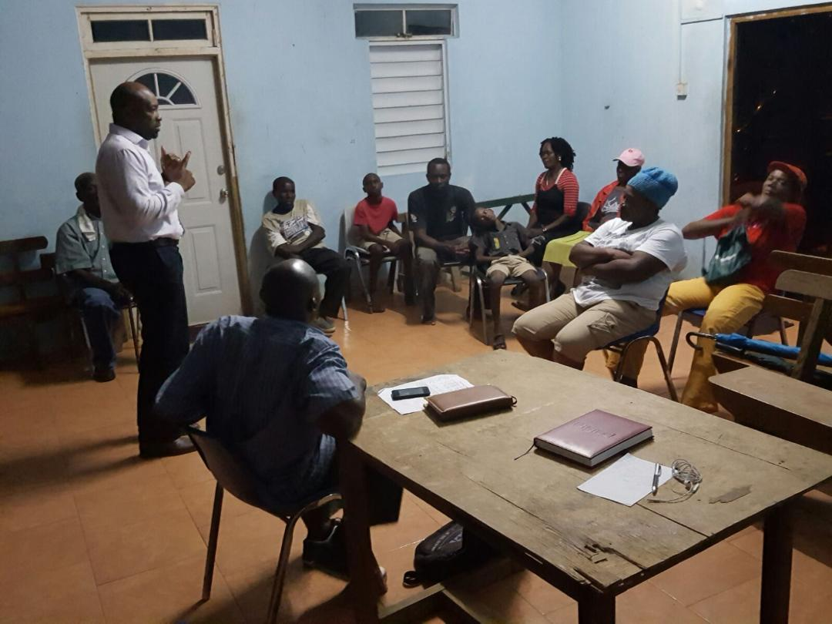
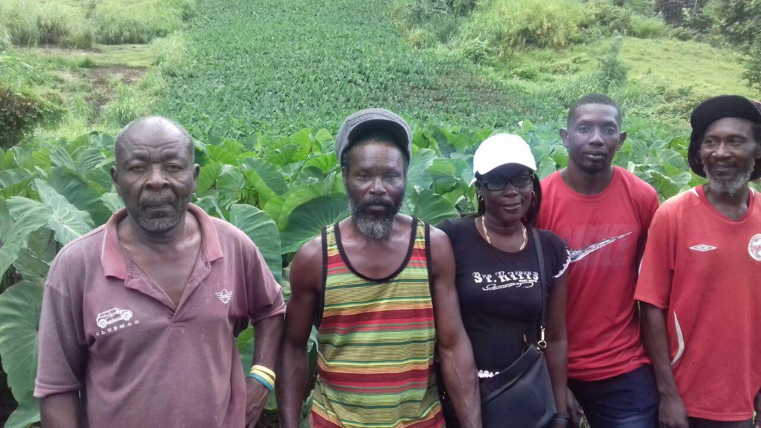
Case Study:
Saint Vincent and the Grenadines
Cooperatives formed: These small groups would work together to aid the implementation and development process.
Notes:
FAO / UN Representatives convinced the Opposition

Slide 43

Case Study:
Saint Vincent and the Grenadines
Ban on the consumption of ‘Turtle Meat’
Notes:
FAO / UN Representatives convinced the Opposition

Slide 44
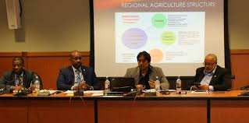
Case Study:
Saint Vincent and the Grenadines
Regional Agriculture Revitalisation
  People - Support - Market (PSM) model for small island development states (SIDS)
  Production Planning
  Infrastructure enhancement: Physical and ICT
  Quality: Certification (International)
  Consistency (Supply and Income)
  Reduction in wage gap
  Reduction in gender inequality
  Regional controlled (OECS) NGO to oversee implementation
  SDG goals targeted: 1, 2, 3, 5,8, 9, 10, 12 and 17
Notes:
PSM Presented at the Regional Meeting of the Ministers of Agriculture and Caribbean Week of Agriculture

Slide 45
Case Study:
Saint Vincent and the Grenadines
Geo-Space: A designated area that is selected with an intensified and organised effort to achieve the sustainable development goals
  7,000 acres
  Parish, Town and or Constituency
  Cooperatives
  Surveys and Interviews conducted (Government Institutions)
  All applicable SDG’s ranked (Scale 1 -10) based on current status vs 2030 expected outcomes
  Performance monitored on an annual basis
  Metrics are kept in line with achieving the SDGs outcomes by 2030

Slide 46
Case Study:
Saint Vincent and the Grenadines
Some examples of Metrics being utilised:
Identified Percentage of Participants earning less than USD 1.25 a day
  Target: Reduced to Zero by 2030
Wage rates for men and women in similar job portfolios
  Target: Equal wages based on tasks performed by 2030
Increase the Agriculture productivity and incomes of small scale producers
  Target: Double the output and income of small scale producers
End all forms of malnutrition with a special target towards stunting and malnutrition in children under 5 years old
  Target: End all forms of malnutrition by 2030
  Source: UN Indicator framework
Notes:
School feeding program

Slide 47
Case Study:
Saint Vincent and the Grenadines
Expected Outcomes
Improve data management: Collection and Analysis
Monitoring and Accountability
Ease of Implementation
Targeted goals
Expandable based on successes
Maximum utilisation of limited resources
Accelerated reaction time
Notes:
Can you move a mountain? This is what 17 huge goals may seem, but in smaller pieces it can be achieved. That mountain can move piece by piece.

Slide 48

Contact Information
Mr. Jai Rampersad IMBA (Distinction) BSc (First Class Honours) jairampersad@yahoo.com

