Slide 1
Oceans and Sustainability Related Variables
Implementing and Monitoring the Sustainable Development Goals in the Caribbean:
The Role of the Ocean
January 18, 2018
St. Vincent
Emily Smail, Ph.D.
Scientific Coordinator
GEO Blue Planet Initiative

Slide 2
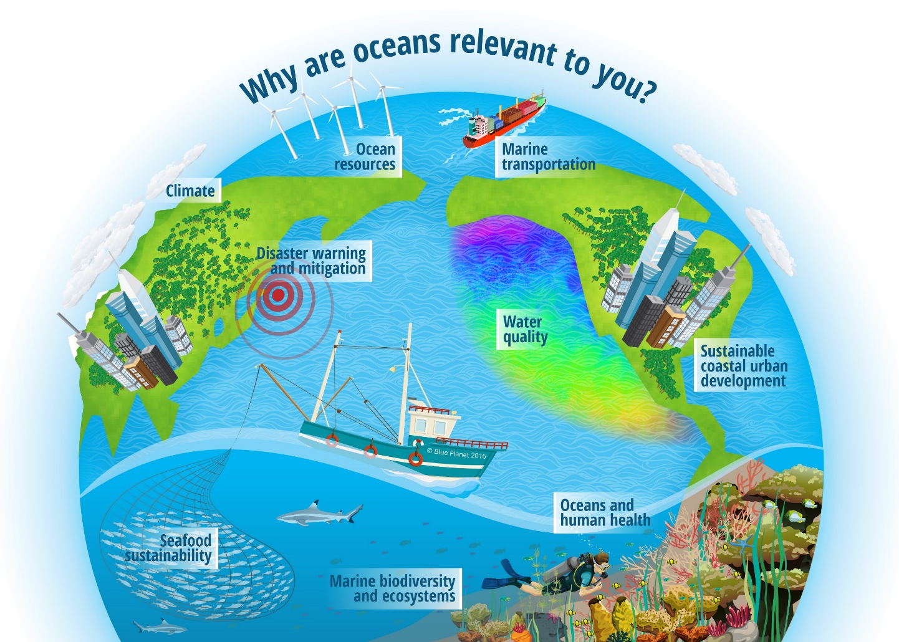
Oceans and Society: Blue Planet
Oceans and Society: Blue Planet is an Initiative within GEO that focuses on coastal and ocean observations for societal benefit

Slide 3

GEO Blue Planet Goal
The overall goal of Blue Planet Initiative is to ensure the sustained development and use of ocean and coastal observations for the benefit of society
User needs
Observations
Data
Products
Information
Knowledge
Notes:
Blue Planet sees the value chain as a feedback loop rather than a straight value chain

Slide 4
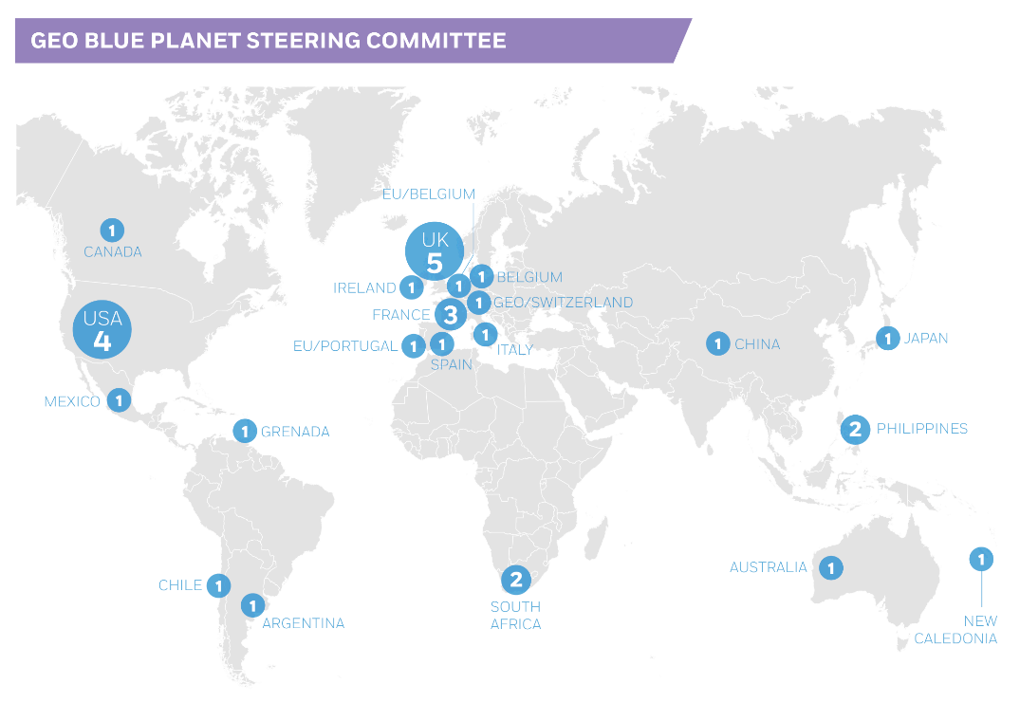
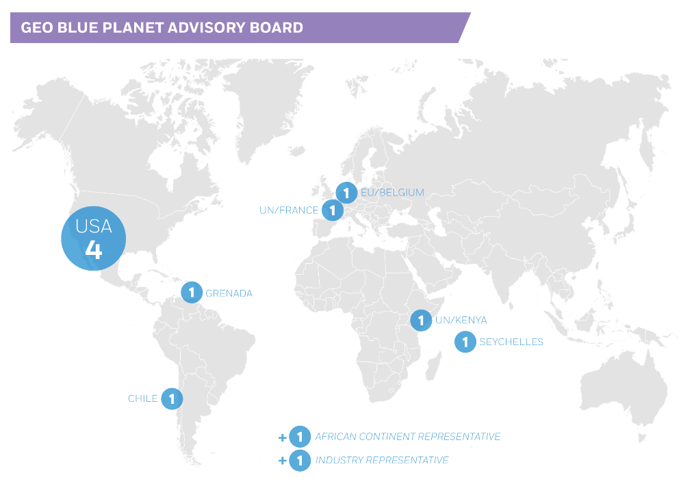
Who is GEO Blue Planet
GEO Blue Planet is a network of ocean and coastal-observers, social scientists and end-user representatives from a variety of stakeholder groups, including international and regional organizations, NGOs, national institutes, universities and government agencies.

Slide 5
Session 4: Observational requirements for ocean-related variables and indicators
Joaquin Trinanes – NOAA CoastWatch Caribbean and Gulf of Mexico Node
Cesar Toro – IOC/UNESCO Rep to IOCARIBE
Milton Haughton – CRFM
Nazeer Gopaul – Coastal Dynamics, Ltd.
Vaughn Martin – Serenity Dive

Slide 6
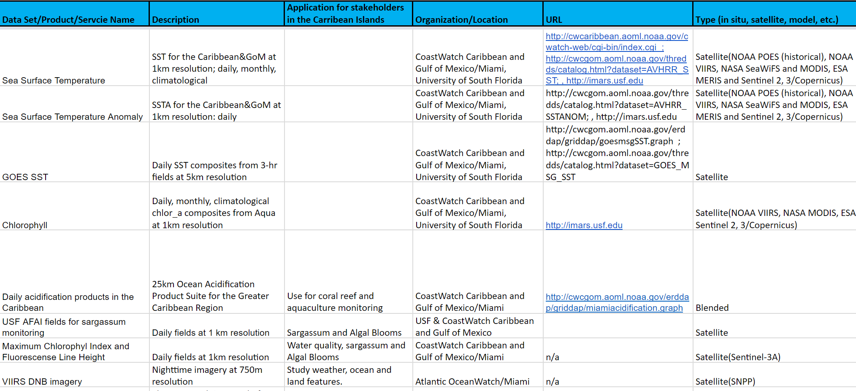
Data & Product Inventory

Slide 7
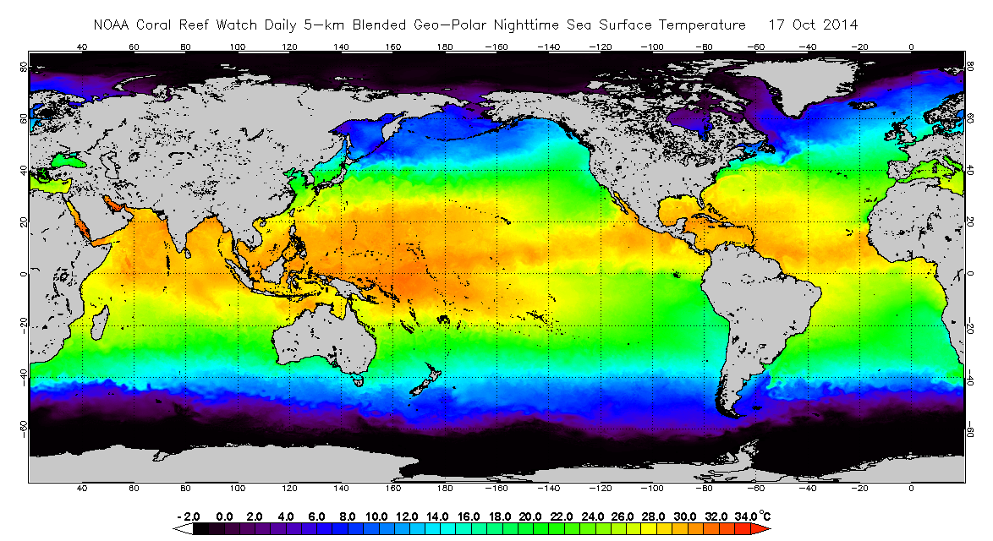
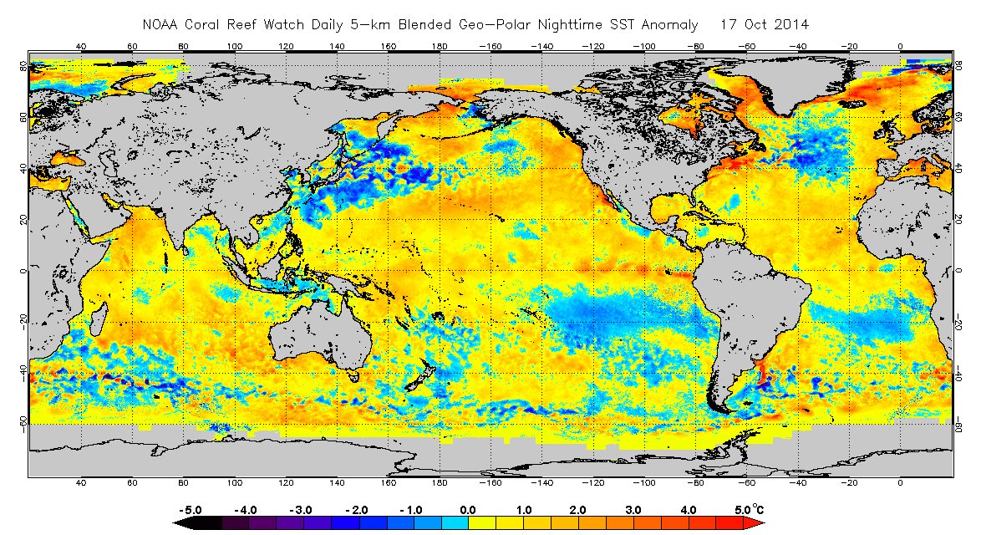
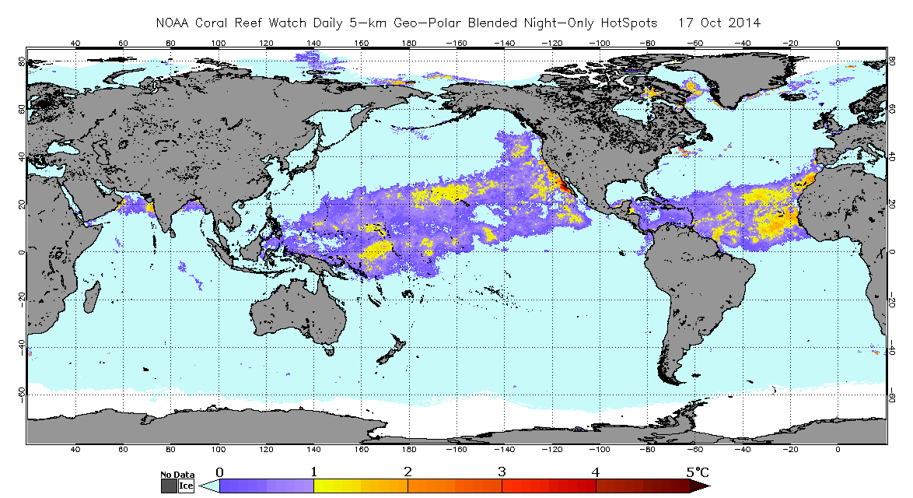
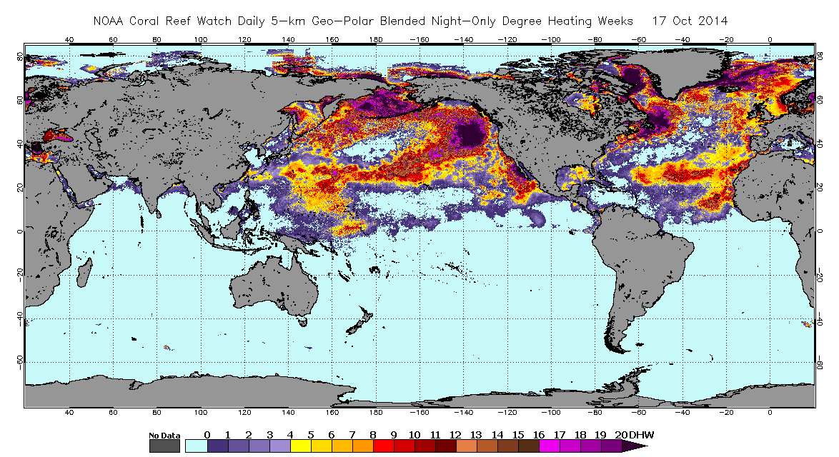
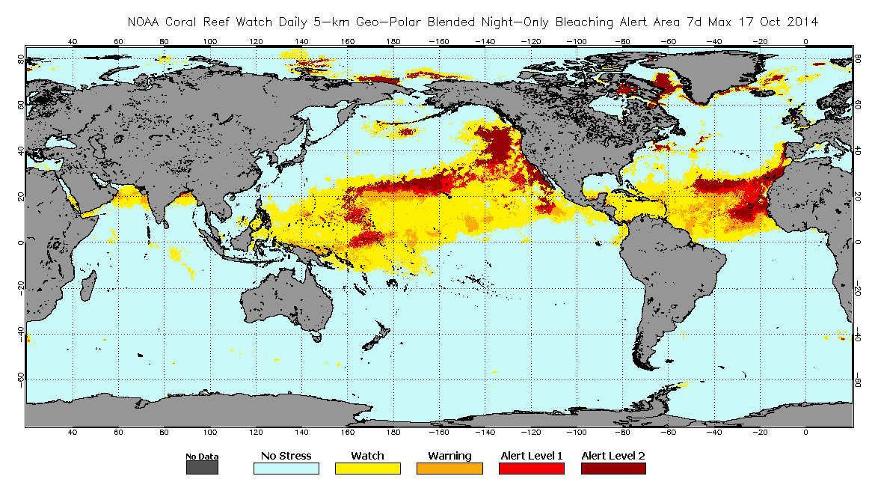
Example: Coral Reef Watch
NOAA Coral Reef Watch Bleaching Alerts
Sea Surface Temperature
Bleaching Alert Area
SST Anomaly
HotSpot
Degree Heating Week

Slide 8
Example: USGS Lionfish distribution
USGS Lionfish Map
https://nas.er.usgs.gov/queries/SpeciesAnimatedMap.aspx?speciesID=963

Slide 9
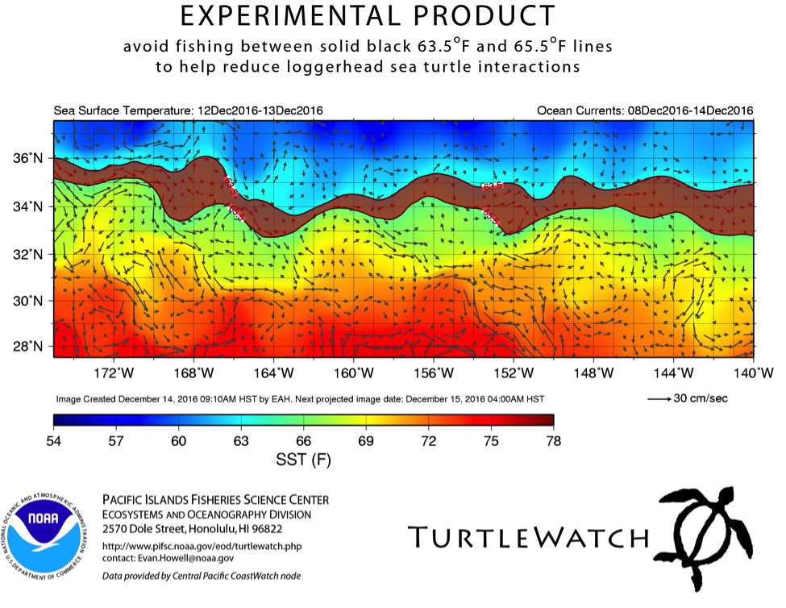
Example: Turtle Watch

Slide 10
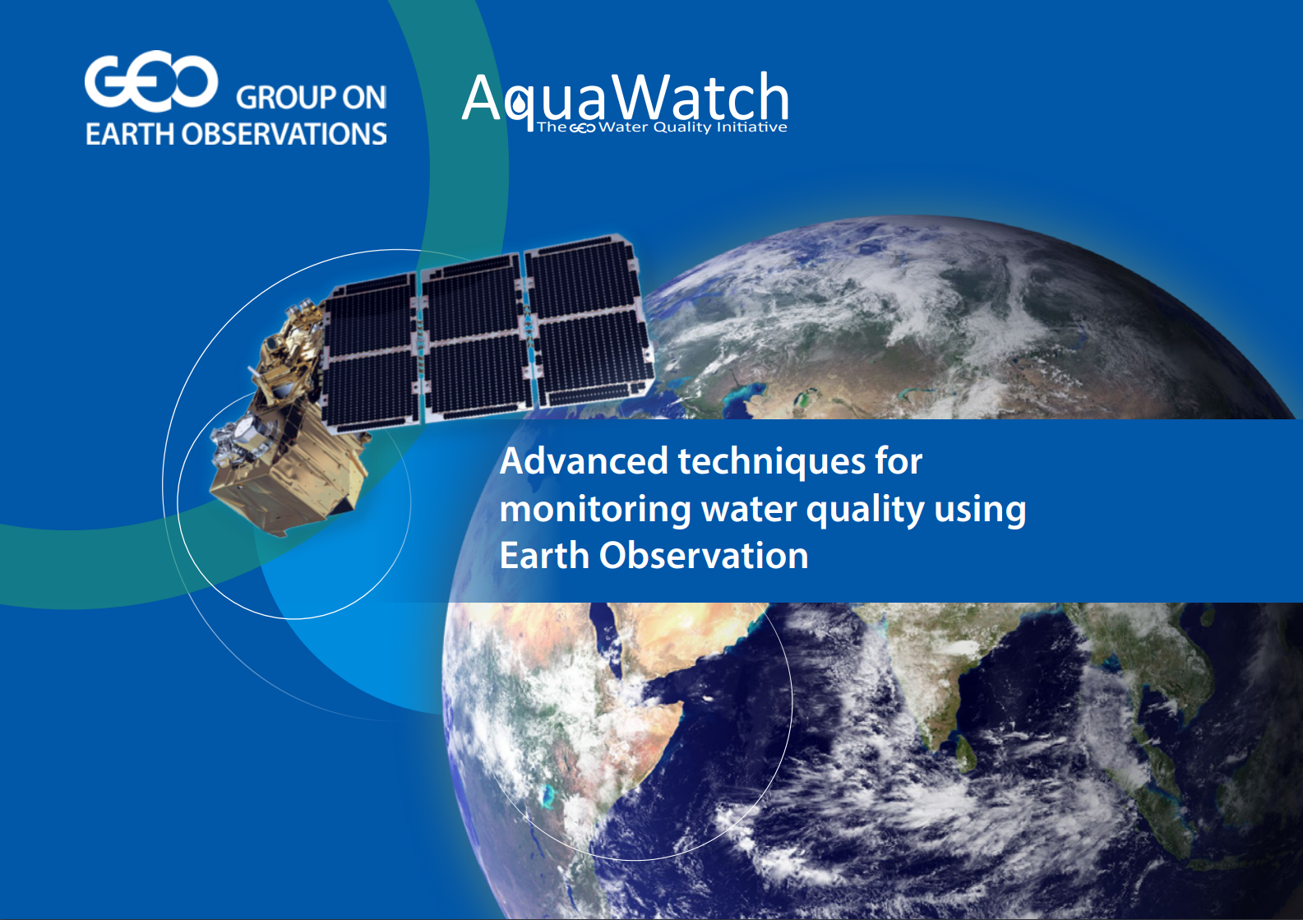
Example: Water Quality
https://www.geoaquawatch.org/documents/

Slide 11
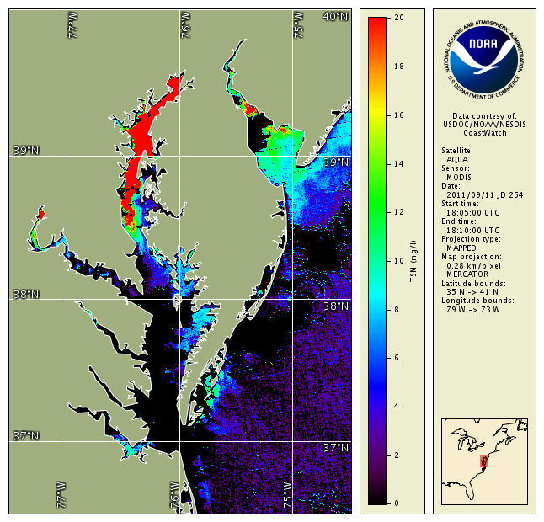
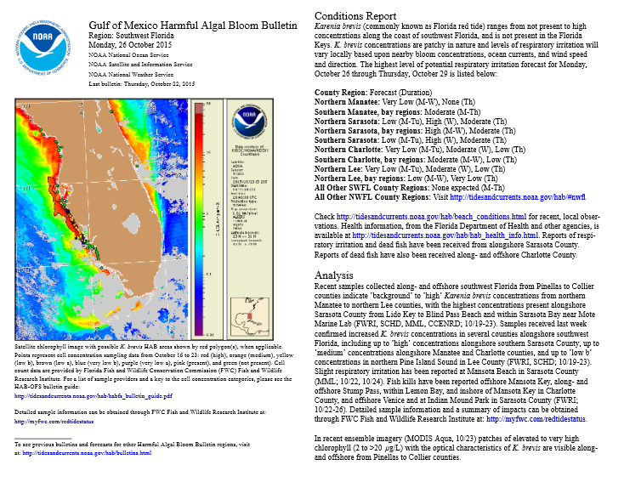
Examples: Turbidity and harmful algal bloom forecasts
https://www.geoaquawatch.org/documents/

Slide 12
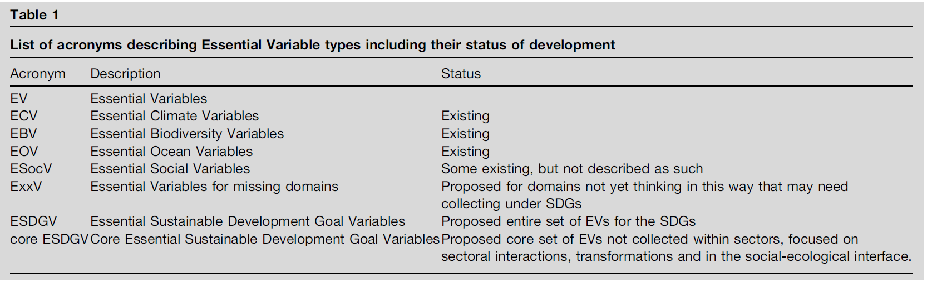
Ocean & Sustainability Variables
Essential Variables help to focus Sustainable Development Goals monitoring. Current Opinion in Environmental Sustainability 2017, 26–27:97–105.
Notes:
Search results for keyword “mangrove” in the red bounding box area.

Slide 13



Additional Information
www.geoblueplanet.org
@GeoBluePlanet
info@geoblueplanet.org

Slide 14
Questions?

